Slide 1
Network Psychometrics: Using network analysis to model personality
Sam McManagan

Slide 2
Traditional Personality Models
Employ factor analysis techniques to derive unseen ’latent’ variables from these personality questionnaires
Two main personality models currently use are the Big Five and the HEXACO model
The Big Five model is composed of five latent personality factors; openness (to new experiences, artistic), conscientousness (orderliness and industriousness), extraversion (sociability and outgoingness), agreeableness (compassion) and neuroticism (negative emotions), each measured by a separate scale
The HEXACO model is a newer version which comprises of these five factors too, as well as an honesty-humility factor
Some of the most empirically supported and reliable constructs in psychology, but also quite rigid in their depiction of personality

Slide 3
Network Psychometrics: A New Approach
These traditional models are encased within classical test theory, and have not been updated with the introduction of new methodologies and theories (Christensen et al., 2020)
Dispute over the existence of these latent variables existing (Borsboom et al., 2003). Even if latent variables only represent shared variance between questions, doesn’t allow for intricate relationships between factors to be taken into account.
Is it accurate to say an individual’s whole personality is encompassed within these five/six latent factors?
Network analysis offers a new approach to traditional psychometric methods.

Slide 4
Why Model Personality as a Network?
Provides a much more nuanced view of personality compared to traditiional methods
Relationship between everything is taken into account within the model
Likely more accruately reflects the true nature of personality, as an interconnected network of thoughts, behaviours and emotions. Some of these aspects may cluster together, but still remain interconnected with other areas of a complete personality network
Model can be hierarchical (global and local structures can be assessed)
Can take into account more adjacent and less central pieces of an individual’s personality, to expand the model past five or six vaiables

Slide 5
Current Analysis: The Data
Data was from the Analog to Multiple Broadband Inventories collected online in 2019 with an interactive personality test.
Dataset consisted of 2,017 responses to 181 7-point likert scale questions relating to aspects of an individual’s personality (e.g, “I rarely worry”).
Not based specifically off of a previous personality model, so results would not be baked into analysis
Thus, the dataset was desgined for exploratory purposes in personality research

Slide 6
Current Analysis: Building the Model
Spearman partial correlations between questions computed. This leaves us with a random markov field where each node is conditionally independent from any node it is not connected to.
LASSO regularization applied to remove trivial correlations (LASSO alpha the main tunable parameter of the model, controlling model sparsity). Thus, no single solution is gained from this method, but instead a range of solutions.
How to pick best alpha value? Minimizing the extended bayesian information criterion (EBIC) is a common method (Epskamp, 2017). EBIC is an extension of BIC that adds an extra parameter (gamma) to penalize model complexity. EBIC gamma set to 0.5 for preference of parsimonious models as recommended by Foygel and Drton (2010).
EBIC model selection only requires an estimate of the covariance matrix and not the raw data, meaning correlation matrices with ordinal data can be used, covariance matrix estimated as recommended by Croux and Ollerer (2015).

Slide 7
Current Analysis: Assessing the Model
Model with optimal regularization will be assessed as main model. However, models with other alpha values will also be assessed to see how the structure of the model is affected the more regularization is allowed, and to see which clusters are the first to breakdown.
If regularization results in network disconnectedness, the largest fully connected part of the network will be taken as the personality model
Centrality measures (degree and betweenness) computed to determine most influential nodes in the network
Clustering using the Leiden algorithm to see if results are comparable to existing models. Louvain algorithm pairs well with GLASSO (Christensen et al., 2024), Leiden to address issues with Louvain method disconnected clusters.
Modularity scores will be calculated for each cluster solution of each alpha value to assess clustering quality.

Slide 8
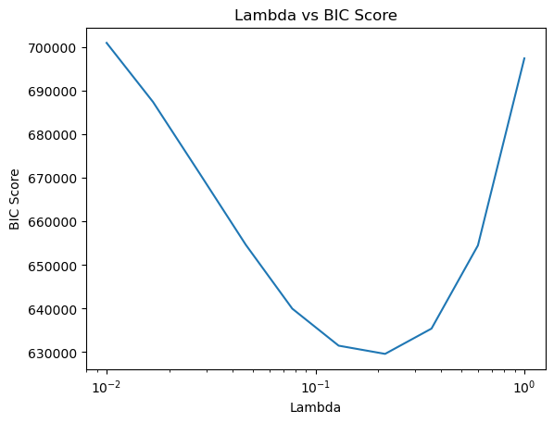
Thre Results: The Model
EBIC scores resulted in picking the model with a regularization alpha value of .36.
In this model, all 181 of the questions remain connected to the main network
16,177 of the 16,290 edges are retained, network is almost fully connected, not much regularization taken place

Slide 9
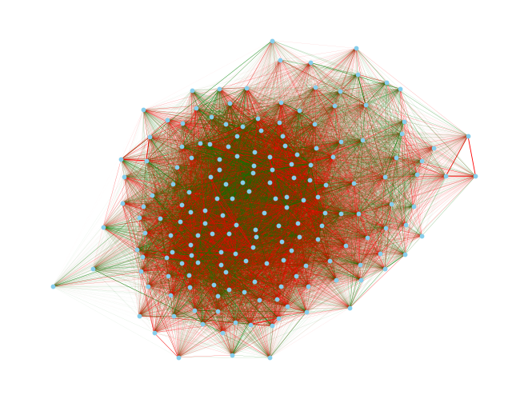
Visualizing the Network
Red edges represent negative partial correlations, green lines represent positive ones
181 nodes represent the questions
Graph is almost fully connected

Slide 10
Questions with Highest Degree
I am very shy in social situations. Degree: 24.23
I am the life of the party. Degree: 23.09
I am skilled in handling social situations. Degree: 22.81
I talk to a lot of different people at parties. Degree: 22.71
I feel a sense of worthlessness or hopelessness. Degree: 22.65
I see myself as a good leader. Degree: 22.02
I take charge. Degree: 21.28
I love to be the center of attention. Degree: 21.18
I seem to derive less enjoyment from interacting with people than others do. Degree: 21.02
I am often in a bad mood. Degree: 20.99
8 questions associated with extraversion, 2 with neuroticism

Slide 11
Questions with Highest Betweenness
I feel emotions with extreme intensity. Betweenness: 0.065
I have frequent mood swings. Betweenness: 0.059
I like to solve complex problems. Betweenness: 0.058
I feel a sense of worthlessness or hopelessness. Betweenness: 0.053
I have a colorful and dramatic way of talking about things. Betweenness: 0.049
I am very shy in social situations. Betweenness: 0.046
I see myself as a good leader. Betweenness: 0.044
I am easily intimidated. Betweenness: 0.036
I panic easily. Betweenness: 0.034
I feel that life has no meaning. Betweenness: 0.032
6 questions associated with neuroticism, 3 with extraversion and 1 with openness

Slide 12
The Results: Influential nodes
Nearly all nodes with highest degree and betweenness came from questions that would be associated with extraversion and neuroticism latent factors
Suggests that these factors are central aspects of an individual’s personality
Large part of this may have to do with the fact that these latent variables are the most represented in the network

Slide 13
The Resulting Network: Clusters
Alpha = 1.5: 82 questions remain in main personality network, 63 questions with no correlations. Clusters resembling extraversion, neuroticism and agreeableness part of main model. Also clusters resembling humility-honesty, sprituality and revenge-seeking thoughts and behaviours. However, questions relating to openness all disconnected with no correlations, and conscientiousness remains disconnected from main personality network (10 connected questions all relating to conscientiousness). A disconnected impulsivity subcomponent also present. Too much excluded. Modularity .60.
Alpha = .95. Lowest alpha value where all Big Five Factors are represented as a cluster in a single network. Model contains 162 of the 181 questions. Extra clusters resembling spirtuality, introspection, spending habits also found. Questions relating to impulsivity, Machiavellianism and the honesty-humility factor from the HEXACO model found in agreeableness cluster. Modularity: .40.
Alpha = .36 The final model. Only five clusters, each loosely related to the Big Five Factors. Agreeableness includes the Machiavellianism and spirituality factors, and impulsivity merges with conscientiousness. Openness merges with verbal and reasoning aptitudes. Modularity: .21

Slide 14
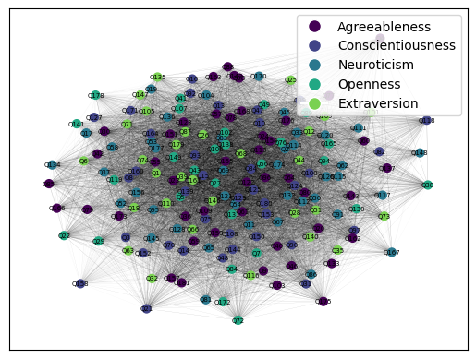
Visualizing Clusters

Slide 15
Some Takeaways from the Resulting Model
Openness and conscientiousness the first two clusters to break away from the main personality network. This is unusual, as traditionally the two highest correlating pairs of factors are agreeableness and openness, and agreeableness and conscientiousness
Extraversion and neuroticism questions seem to play central roles in the personality network. However, this may also be due to these factors being the best represented factors within the network
Viewing personality as just five or six factors may not give a complete picture, other adjacent personality facets arise in our network, and may be considered in future models
Changing which correlations are included and excluded through the lasso lambda parameter brings about significant changes in the model.
Modularity score of the chosen model is quite poor (.20)

Slide 16
Commenting on Reliability & Validity,
Replicability a big topic of discussion in network psychometrics.
Partial correlations between so many variables brings about issues with replicability- due to high sampling variance and not directly related to reliability (Williams, 2022)
The fact that each node is only measured by one item/question is likely resulting in poor reliability (Herrera-Bennett & Rhemtulla, 2021).
Convergent and discriminant validity usually a key desire in traditional psychometric techniques. As displayed by modularity scores, these forms of validity were not maximized here.
Biggest issue with model is where to draw the line. Countless questions that can be viewed as relating to one’s personality- which to include?
For these reasons, although network analysis allows for a model of personality probably more suitable to its structure, it comes with its own issues of reliability and validity.

Slide 17
Expanding on This Research: Future Possibilities
Use questionnaires with a much wider range of questions, and see if more novel clusters arise that have not been taken into account in traditional clusters. This can be used in an exploratory manner before reliable and valid network models are built
Incorporate some degree of convergent and discriminant validity into the model- possible subfacets of factors as nodes instead of individual nodes. This will both improve the reliability of the model, and deal with the issue of limitless (Costatini & Perugini, 2012).
This would represent a middle ground between the model in the current analysis and traditional models, and would address issues with both
Temporal studies assessing personality networks of different ages. to see how one’s personality develops overtime

Slide 18
References
Borsboom D, Mellenbergh GJ, van Heerden J. The theoretical status of latent variables. Psychol Rev. 2003 Apr;110(2):203-219. doi: 10.1037/0033-295X.110.2.203. PMID: 12747522.
Christensen AP, Garrido LE, Guerra-Peña K, Golino H. Comparing community detection algorithms in psychometric networks: A Monte Carlo simulation. Behavior Research Methods. 2024 Mar;56(3):1485-1505. DOI: 10.3758/s13428-023-02106-4. PMID: 37326769.
Christensen, A. P., Golino, H., & Silvia, P. J. (2020). A Psychometric Network Perspective on the Validity and Validation of Personality Trait Questionnaires. European Journal of Personality, 34(6), 1095-1108.
Costantini, G., & Perugini, M. (2012). The Definition of Components and the Use of Formal Indexes are Key Steps for a Successful Application of Network Analysis in Personality Psychology. European Journal of Personality, 26(4), 434-435. https://doi.org/10.1002/per.1869
Croux, Christophe and Oellerer, Viktoria, Robust and Sparse Estimation of the Inverse Covariance Matrix Using Rank Correlation Measures (June 2015).
Epskamp, S. (2017). Network psychometrics. [Thesis, fully internal, Universiteit van Amsterdam].
Foygel, R., & Drton, M. (2010). Extended Bayesian information criteria for Gaussian graphical models. Advances in Neural Information Processing Systems, 23, 2020–2028
Herrera-Bennett, A. C., & Rhemtulla, M. (2021, July 12). Network Replicability & Generalizability: Exploring the Effects of Sampling Variability, Scale Variability, and Node Reliability. https://doi.org/10.31234/osf.io/7vkm8
Williams DR. Learning to live with sampling variability: Expected replicability in partial correlation networks. Psychol Methods. 2022 Aug;27(4):606-621. doi: 10.1037/met0000417. Epub 2022 Jan 31. PMID: 35099239.

