Slide 1
Introduction to HTML
HTML (HyperText Markup Language) is the fundamental language used to create and structure web pages. It provides the basic framework upon which websites are built, using a system of elements and tags to define content and layout.

Slide 2
What is HTML?
HTML is a markup language, not a programming language, which means it is used to structure content rather than create dynamic functionality. It consists of a series of elements that tell a web browser how to display content, including text, images, links, and multimedia.

Slide 3
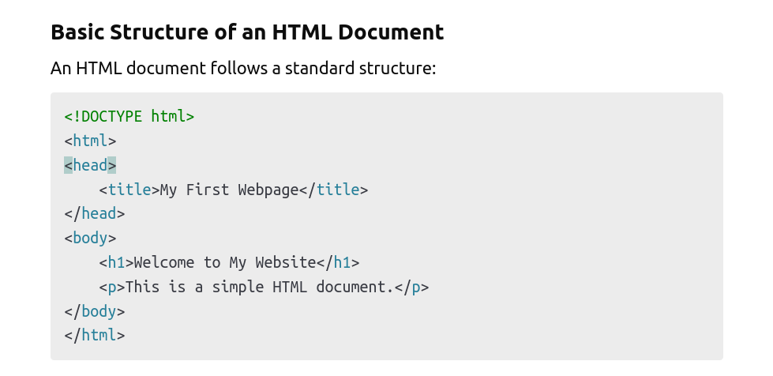

Slide 4
Key HTML Elements
HTML Element | Description
<!DOCTYPE html> | Declares the document type and version of HTML.
<html> | The root element that contains all other HTML elements.
<head> | Contains metadata such as the title and links to stylesheets.
<title> | Specifies the title of the webpage displayed in the browser tab.

Slide 5
<body> | Contains the visible content of the webpage.
<h1> to <h6> | Headings used to define sections of content.
<p> | Defines a paragraph.
<a> | Creates hyperlinks.
<img> | Embeds images.
<ul>, <ol>, <li> | Create lists.

Slide 6
Exercise
<!DOCTYPE html>
<html lang="en">
<head>
<meta charset="UTF-8" />
<meta name="viewport" content="width=device-width, initial-scale=1.0" />
<title>My Simple Web Page</title>
</head>
<body>
<h1>Welcome to My Web Page</h1>
<p>This is a simple HTML page with basic elements.</p>
</body>
</html>

Slide 7
Ordered List
An ordered list (<ol>) in HTML is a list where items are displayed in a specific order, usually numbered or labeled sequentially. Each item in the list is wrapped in a <li> (list item) tag.
We can style ordered lists using the type attribute in the <ol> tag.
Different type Attribute Values for Ordered Lists are as follows
1 (default) – Numbers (1, 2, 3...)
A – Uppercase letters (A, B, C...)
a – Lowercase letters (a, b, c...)
I – Uppercase Roman numerals (I, II, III...)
i – Lowercase Roman numerals (i, ii, iii...)

Slide 8
Exercise
Write a HTML page to create a ordered list of fruits of the following
Apple, Banana,Orange,PineApple and Blue Berries

Slide 9
Ordered List Cont...
1. Start Attribute
<ol start="5">
<li>Item One</li>
<li>Item Two</li>
<li>Item Three</li>
</ol>
2. Nested List
<ol>
<li>Topic 1</li>
<li>Topic 2
<ol type="a">
<li>Subtopic 1</li>
<li>Subtopic 2</li>
</ol>
</li>
<li>Topic 3</li>
</ol>

Slide 10
Un-Ordered List
An unordered list in HTML is used to display a list of items without a specific order. Each item is marked with a bullet point (•) by default. The list is created using the <ul> (unordered list) tag, and each item is placed inside <li> (list item) tags.

Slide 11
Exercise
Organise the Nature HTML Page
Understand about div and span tags

Slide 12
Anchor Tag
The <a> (anchor) tag is used to create hyperlinks in HTML. It allows users to navigate to different pages, sections, or external websites.
Attributes of anchor tag
Href
Target
Title
href=mailto
href=tel

Slide 13
Exercise
Courses WebPage with anchor pointing to different page or Section

Slide 14
Input Form & Label Element
1. Text-Based Inputs
2. Number & Range
3. Date & Time Inputs
4. Selection Inputs
5. File Upload & Hidden Inputs

Slide 15
Text-Based Inputs
1. text
2.password
3.email
4.search

Slide 16
Exercise
Student Registration Form

Slide 17
Number & Range Inputs
1. number
2. range
Date & Time Inputs
1. date
2. time
3. datetime-local

Slide 18
Selection Inputs
1. checkbox
<input type="checkbox" name="skills" value="HTML" /> HTML
<input type="checkbox" name="skills" value="CSS" /> CSS
<input type="checkbox" name="skills" value="JavaScript" /> JavaScript
2.radio
<input type="radio" name="gender" value="Male" required /> Male
<input type="radio" name="gender" value="Female" required /> Female

Slide 19
Multi-line Text Input & Dropdown List
1.textarea
<textarea rows="4" cols="30">Enter your message...</textarea>
2.select
Syntax
<select id="courses" name="course">
<option value="Web Development">Web Development</option>
<option value="Data Science">Data Science</option>
<option value="Cyber Security">Cyber Security</option>
</select>

Slide 20
Exercise
Enhance Student Registration Form

Slide 21
CSS – Cascading Style Sheet
Selectors
1. Element Selectors
2. Class Selectors
3. Id Selectors
4. Attribute Selector

Slide 22
Property | Description | Example
color | Sets the text color | color: red;
font-family | Specifies the font(s) to be used | font-family: Arial, sans-serif;
font-size | Sets the size of the text | font-size: 16px;
font-style | Defines the text style (normal, italic, oblique) | font-style: italic;
font-variant | Enables small-caps text | font-variant: small-caps;
font-weight | Sets the text thickness (normal, bold, lighter, bolder, 100-900) | font-weight: bold;

Slide 23
Box Model
1. Content-Box
2. Padding
3.Border
4.Margin

Slide 24
Padding
The padding property in CSS is used to create space inside an element, between the element's content and its border. It helps in controlling spacing and improving layout design.
Syntax:
selector {
padding: <top> <right> <bottom> <left>;
}

Slide 25
Padding and Box Model
div {
width: 200px;
padding: 20px;
border: 2px solid black;
}
Padding does not have any color but we can include color to padding area via background color
div {
background-color: lightblue;
padding: 20px;
}
background-clip : content-box or border-box

Slide 26
Border Property
The border property in CSS is used to set the border around an element. It allows you to customize the width, style, and color of the border.
Syntax:
selector {
border: <width> <style> <color>;
}
Border Width can be applied to the individual sides as well with the following attributes
Border-top, border-right,border-bottom and border-left

Slide 27
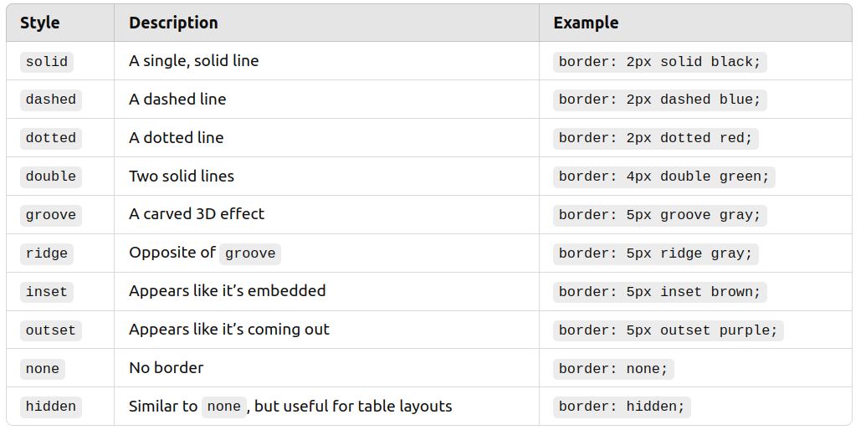
Border-radius: Makes rounded corners

Slide 28
Margin Property
The margin property in CSS is used to create space outside an element, separating it from other elements. It does not affect the element's size but controls the distance between elements.
Syntax:
selector {
margin: <top> <right> <bottom> <left>;
}

Slide 29
Assignment
Explore about the following
1. Text Alignment
text-align, text-align-last, direction, unicode-bidi
2. Decoration
text-decoration, text-decoration-color, text-decoration-line, text-decoration-style, text-shadow
3.Transformation
text-transform
4. Spacing & Indentation and Text Wrapping & Overflow
  letter-spacing, word-spacing, line-height, text-indent, white-space word-break, overflow-wrap, text-overflow

Slide 30
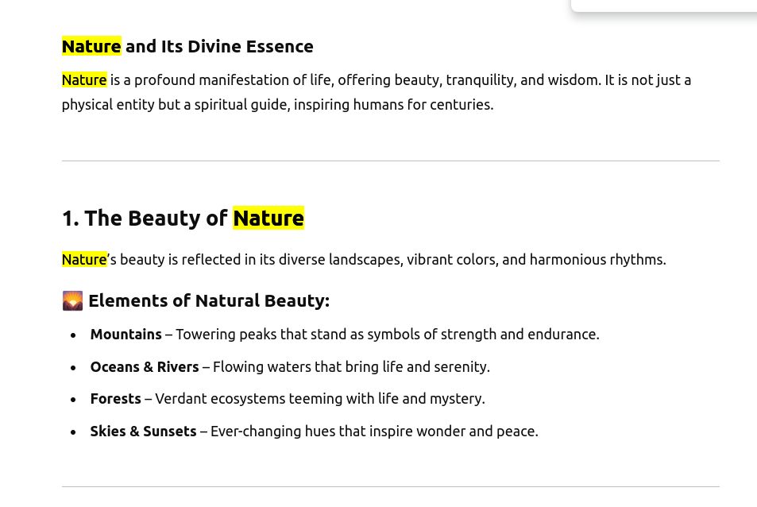

Slide 31
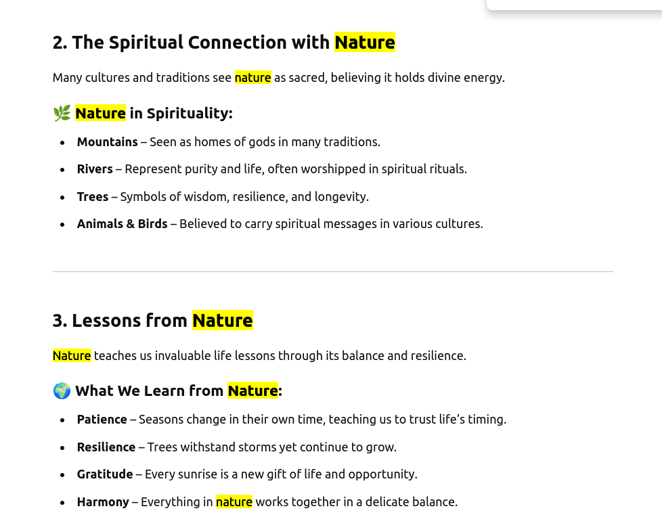

Slide 32
