Slide 1
Introduction to Java Script
JavaScript (JS) is a lightweight, interpreted programming language that allows developers to create dynamic and interactive content for websites. It is widely used for web development, enabling functionalities like interactive forms, animations, and real-time updates.

Slide 2
Java Script Variables
A variable in JavaScript is a container for storing data values. It allows developers to assign, store, and manipulate data dynamically within a program.
Declaring Variables in JavaScript
JavaScript provides three ways to declare variables:
.
1.var – Oldest way, function-scoped.
2. let – block-scoped variable .
3.const – block-scope andcannot be reassigned.

Slide 3
Rules for Naming Variables
1. Must start with a letter, _, or $
2. Cannot be a JavaScript reserved keyword
3.Case-sensitive (age and Age are different)

Slide 4
Data Types in JavaScript
JavaScript provides different data types to store and manipulate values. These data types are classified into primitive and non-primitive (reference) types.

Slide 5
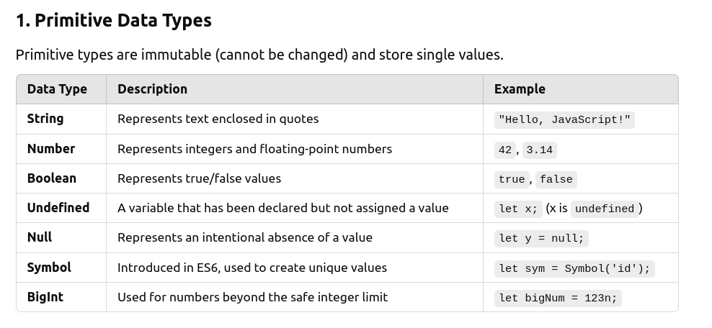

Slide 6
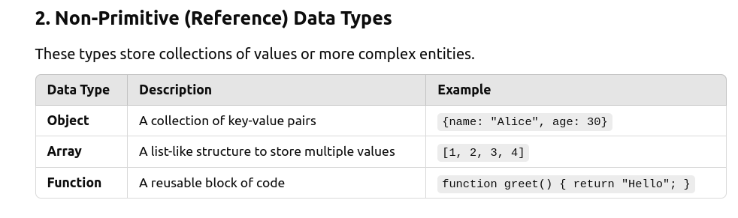

Slide 7
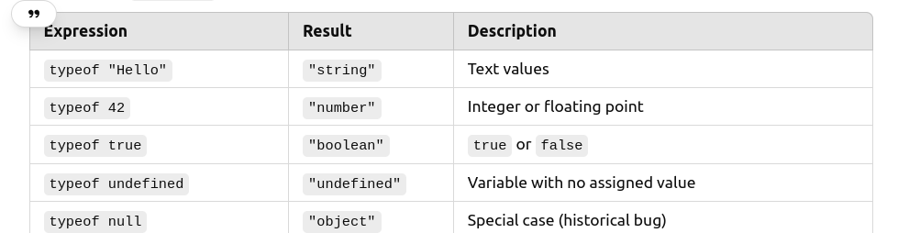
Typeof operator
The typeof operator in JavaScript is used to determine the data type of a given variable or value. It returns a string indicating the type of the operand.

Slide 8
Demo For Primitive Data Types

Slide 9
Array Data Type
A JavaScript array is a special type of object that stores ordered collections of values. Arrays allow you to store multiple values in a single variable and provide built-in methods to manipulate the data efficiently.
Declaring an Array
1. Array literal
Syntax : let fruits = ["Apple", "Banana", "Cherry"];
2. Using the new Array() constructor
Syntax: let numbers = new Array(1, 2, 3, 4);

Slide 10
Accessing Elements
Array elements are accessed using zero-based indexing.
let colors = ["Red", "Green", "Blue"];
console.log(colors[0]); // "Red"
console.log(colors[1]); // "Green"
Array Properties
length – Returns the number of elements in an array
Arrays in JavaScript are dynamic – They can grow or shrink in size.

Slide 11
Array Iteration
1. Using for Loop
The for loop iterates through an array using an index.
Syntax
let numbers = [10, 20, 30, 40];
for (let i = 0; i < numbers.length; i++) {
console.log(numbers[i]); // 10, 20, 30, 40
}
2. Using forEach()
The forEach() method executes a function for each element in the array.
Syntax
numbers.forEach(num => console.log(num));
3. Using for...of Loop
Syntax
for (let num of numbers) {
console.log(num); // 10, 20, 30, 40
}

Slide 12
Function
A JavaScript function is a reusable block of code designed to perform a specific task. Functions help in structuring and reusing code efficiently.
Declaring a Function
We can define a function in multiple ways:
1. Function Declaration (Named Function)
function greet(name) {
return "Hello, " + name;
}
console.log(greet("Alice")); // "Hello, Alice"
2. Function Expression
let greet = function(name) {
return "Hello, " + name;
};
console.log(greet("Bob")); // "Hello, Bob"

Slide 13
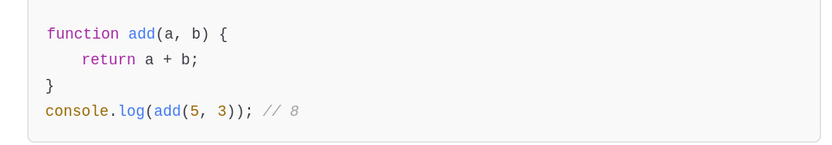
Function Parameters & Arguments
Functions can take parameters (inputs) and return values.

Slide 14
Push, Pop, Shift and unshift
Push(‘element’) – Adds elements at the end of an array
pop() – Removes the element at the end of an array
shift(‘element’) – Adds elements at the start of an array
Unshift(‘element’) – Removes an element at the start of an array

Slide 15
Functional Methods
1. ForEach
2.map
3.filter
4. reduce

Slide 16
ForEach Method
The forEach method in JavaScript is used to iterate over an array and execute a provided function once for each element.
Syntax:
array.forEach(callbackFunction(currentValue, index, array), thisArg);
Parameters:
1. callbackFunction - The function to execute for each element. It takes three arguments:
currentValue: The current element being processed.
index (optional): The index of the current element.
array (optional): The array that forEach was called on.
2.thisArg (optional) - The value to use as this inside the callback function.
Demo for For Each Method

Slide 17
Map Method
The map method in JavaScript is used to create a new array by applying a function to each element of an existing array. It does not modify the original array.
Syntax:
let newArray = array.map(callbackFunction(currentValue, index, array), thisArg);
Applications of Map Method
It helps in the transformation of the elements.

Slide 18
Exercise
1. Double the Numbers
Input
const numbers = [1, 2, 3, 4];
Output
[1,4,9,16];
2. Tranform text into Upper Case
Input
Const fruits = [‘Apple’,’Banana’,’Mango’];
Output
[‘APPLE’,’BANANA’,’MANGO’];

Slide 19
Filter Method
The filter() method in JavaScript is used to create a new array with only the elements that pass a certain condition (test). It does not modify the original array.
Syntax
let newArray = array.filter(callbackFunction(currentValue, index, array), thisArg);

Slide 20
Exercise
1. Filter Even Numbers javascript
Input
const numbers = [1, 2, 3, 4, 5, 6];
Output: Expected = [2,4,6]
2. Filter Words with More Than 5 Letters
Input
const words = ["apple", "banana", "cherry", "fig", "grape"];
Output
["banana", "cherry"]
3. Remove Negative Numbers
Input
const numbers = [-10, 5, -3, 8, -1, 12];
4. Filter Words Starting with ‘A’
const words = ["Apple", "Banana", "Avocado", "cherry", "Apricot"];

Slide 21
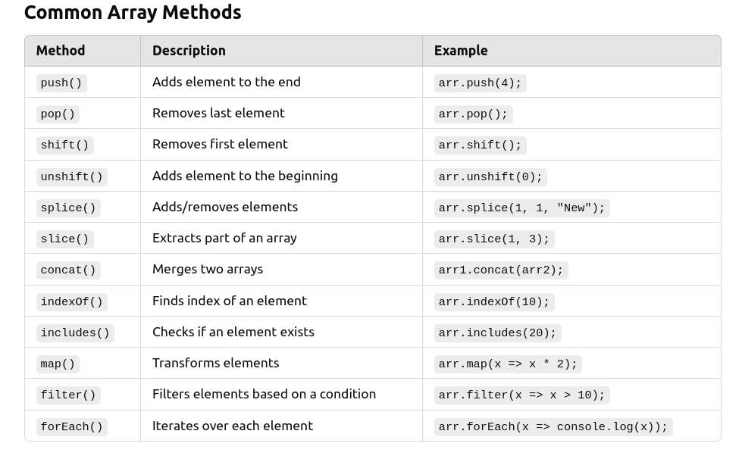

Slide 22
Object Data Type
A JavaScript object is a collection of key-value pairs, where each key (or property) maps to a value. Objects allow you to store and organize related data efficiently.
Declaring an Object
1. Using Object Literal
Syntax:
let person = {
name: "John",
age: 30,
isStudent: false
};
2. Using Object Constructor
let person = new Object();
person.name = "John";
person.age = 30;
person.isStudent = false;

Slide 23
Access a Property in Object
We can access object properties using dot notation or bracket notation.
Syntax
console.log(person.name); // "John"
console.log(person["age"]); // 30
Object’s properties can be dynamically updated or we can add a new property to an existing object dynamically
Syntax
person.age = 31; // Update property
person.city = "New York"; // Add new property
Deleting Properties
Syntax
delete person.isStudent;
Checking Property Existence
Use the in operator or hasOwnProperty().
Syntax
console.log("age" in person); // true
console.log(person.hasOwnProperty("city")); // true

Slide 24
Iterating Over an Object
Use a for...in loop.
for (let key in person) {
console.log(key + ": " + person[key]);
}
Object Methods (Functions in Objects)
Objects can contain functions, called methods.
let car = {
brand: "Toyota",
start: function() {
console.log("Car is starting...");
}
};
car.start(); // "Car is starting..."

Slide 25
Object Methods
1. keys
2.values
3.assign
4.entries

Slide 26
Exercise
I. Iterate over Product Object
Product = {name: "Laptop", price: 1200}
2. Filter Expensive Products . Products that are more than 500 rupees
const products = [
{ name: "Laptop", price: 1200 },
{ name: "Phone", price: 800 },
{ name: "Tablet", price: 300 },
{ name: "Headphones", price: 150 }
];

Slide 27
Exercise
1. Filter Students Who Passed
const students = [
{ name: "John", marks: 45 },
{ name: "Alice", marks: 80 },
{ name: "Bob", marks: 60 },
{ name: "David", marks: 30 }
];
2. Extract Product Names
const products = [
{ name: "Laptop", price: 1000 },
{ name: "Phone", price: 500 },
{ name: "Tablet", price: 300 }
];

Slide 28
Wrappers for Primitive Data Types in JavaScript
In JavaScript, primitive data types (string, number, boolean, bigint, symbol, undefined, and null) do not have methods. However, JavaScript automatically wraps them with object equivalents when accessing properties or methods, allowing primitives to behave like objects.
JavaScript provides three wrapper objects for primitive data types:
1. String
2. Boolean
3. Number

Slide 29
Implicit Conversion of Primitives to Wrapper Objects in JavaScript
JavaScript automatically converts primitive values into temporary wrapper objects when accessing properties or calling methods on them. This is known as autoboxing or implicit conversion.
How Implicit Conversion Works
When you use a method or access a property on a primitive type (string, number, or boolean), JavaScript:
1. Wraps the primitive value with its corresponding object type (String, Number, or Boolean).
2. Executes the method on the temporary object.
3. Discards the object, keeping only the result.

Slide 30
Scope
Scope in JavaScript defines the accessibility and lifetime of variables. It determines where variables and functions can be accessed and used in a program.
Types of Scope in JavaScript
1. Global Scope
Variables declared outside any function are in the global scope.
Accessible anywhere in the script.
Syntax
let globalVar = "I am global";
function test() {
console.log(globalVar); // Accessible
}
console.log(globalVar); // Accessible

Slide 31
2. Function (Local) Scope
Variables declared inside a function are only accessible within that function.
Syntax
function greet() {
let message = "Hello";
console.log(message); // Accessible inside function
}
console.log(message); // ❌ Error: message is not defined

Slide 32
Block Scope
let and const have block scope, meaning they exist only inside {} (if statements, loops, etc.).
var does NOT have block scope, meaning it can be accessed outside a block.

Slide 33
Document Object Model (DOM)
The DOM is a programming interface that allows JavaScript to interact with and manipulate the elements of a webpage.
Document → The entire webpage.
Object → Every HTML element (like <h1>, <p>, <div>) is treated as an object.
Model → The structure is represented as a tree of objects.
When a webpage loads, the browser converts the HTML into a DOM tree, which JavaScript can manipulate.

Slide 34
Demo on Document Object Model (DOM)

Slide 35
DOM Events in JavaScript
A DOM Event is an action that happens in the browser, like a click, keypress, hover, or form submission. JavaScript can listen for these events and execute code in response.

