Slide 1
Final project ideas round table
By Sam

Slide 2


Text-based Game

Slide 3
Animation

Slide 4

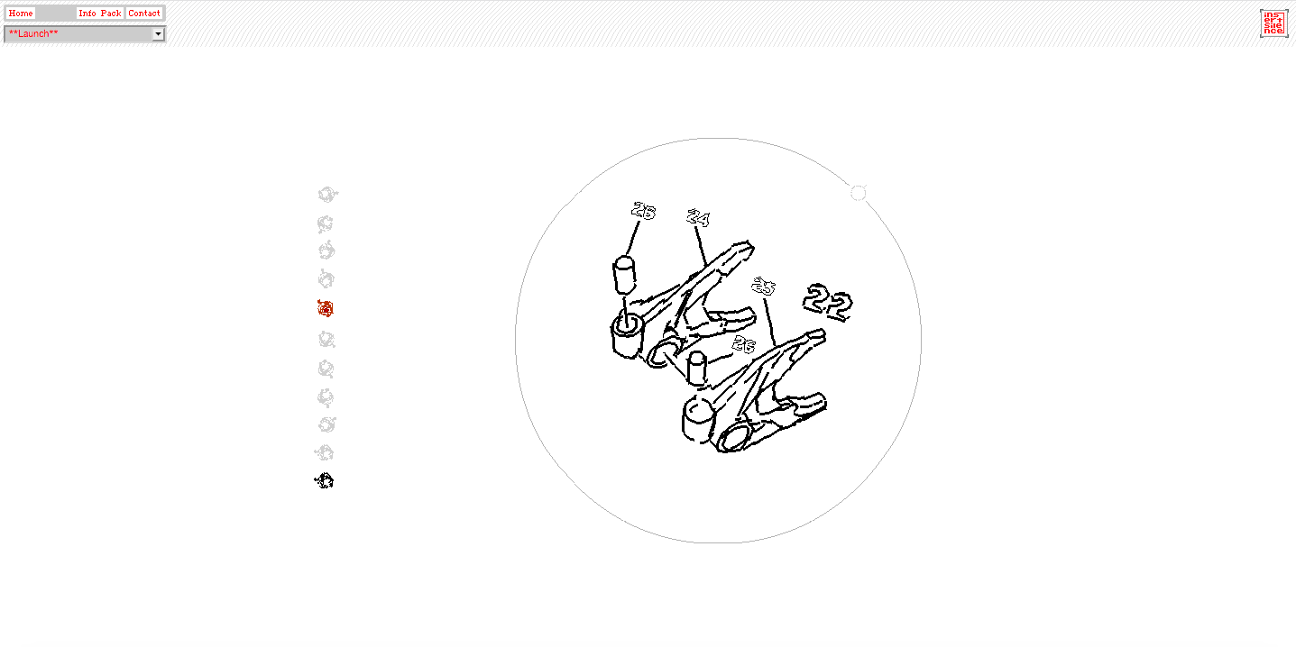
Inspirations

Slide 5
Thank you ☺

