Slide 1

INTERNET COMPUTER
Dapps built 100% On-chain

Slide 2
Overview
What is the Internet Computer?
The blockchain trilemma?
Key features and benefits?
Potential use cases for the Internet Computer?
Programming languages are supported?

Slide 3
Smart Contracts
Canisters.
ICP token.
Network Nervous System (NNS)
Recent Innovation in the ecosystem

Slide 4
Opportunities
Grants
- Community
- Developers
- Content Creation
Jobs

Slide 5
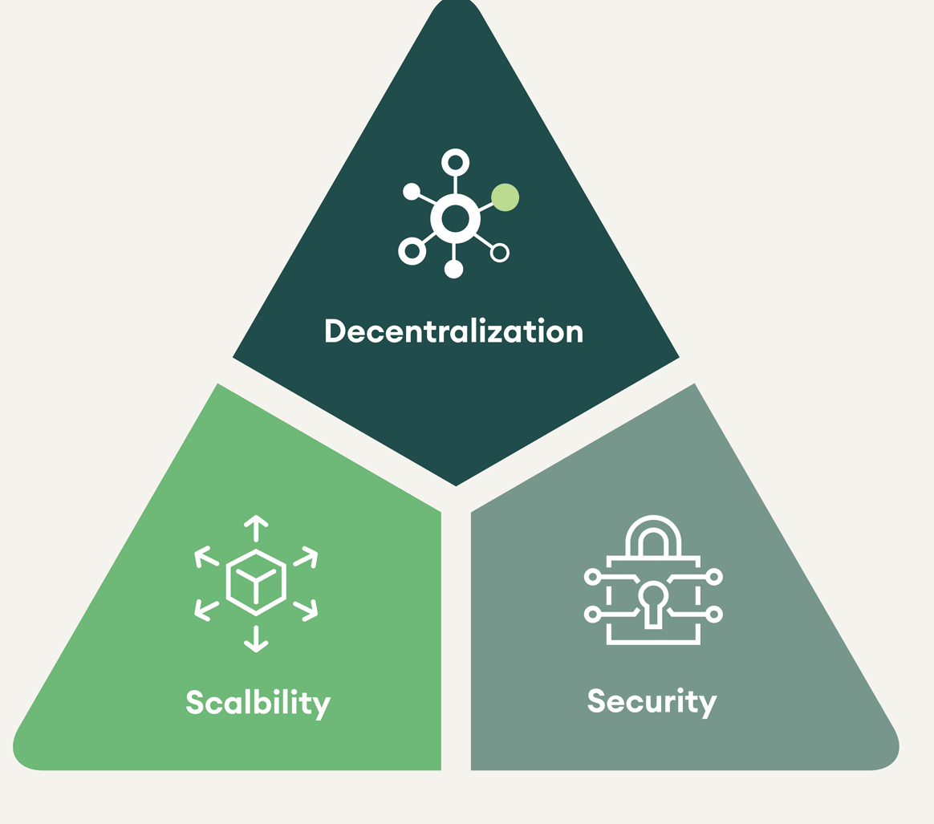
Blockchain Trilemma?
Scalability
Decentralization
Security

Slide 6
What is Internet Computer?
Layer 1 network
Custom architecture

Slide 7
Key features of Dapps on IC
100% on chain
Governance
Decentralization
Interoperability

Slide 8
Use cases of the Internet Computer
DEFI
Decentralized Cloud Computing:
Decentralized Social Networks
Gaming and Non-Fungible Tokens (NFTs)
Supply Chain Management

Slide 9
Languages Supported
Rust
Python
Javascript,Typescript
Motoko
Solidity(to be supported later)

Slide 10
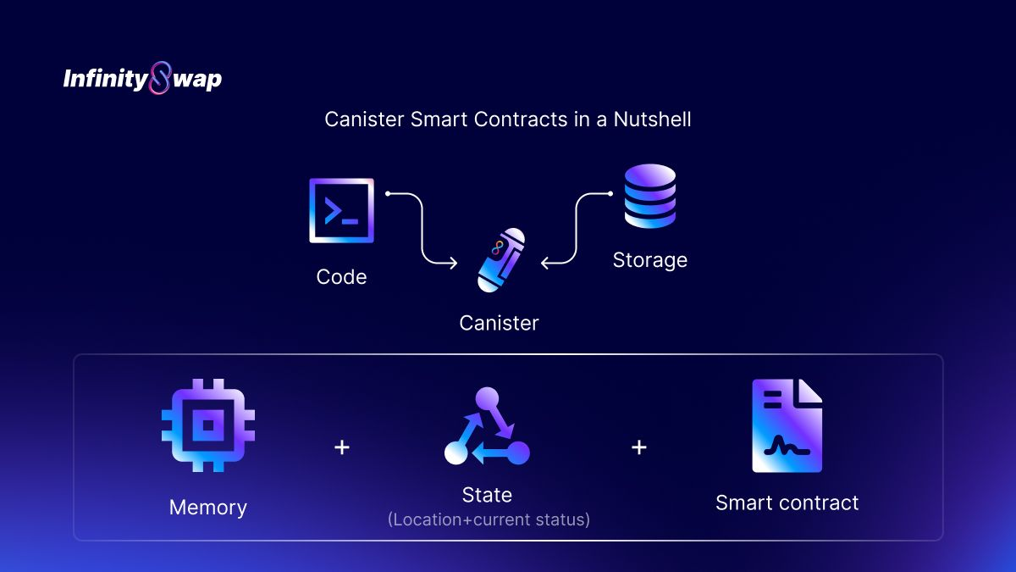
Canisters

Slide 11

ICP Token
Native token for IC
Payments for computational power and resources(cycles)
Governance

Slide 12
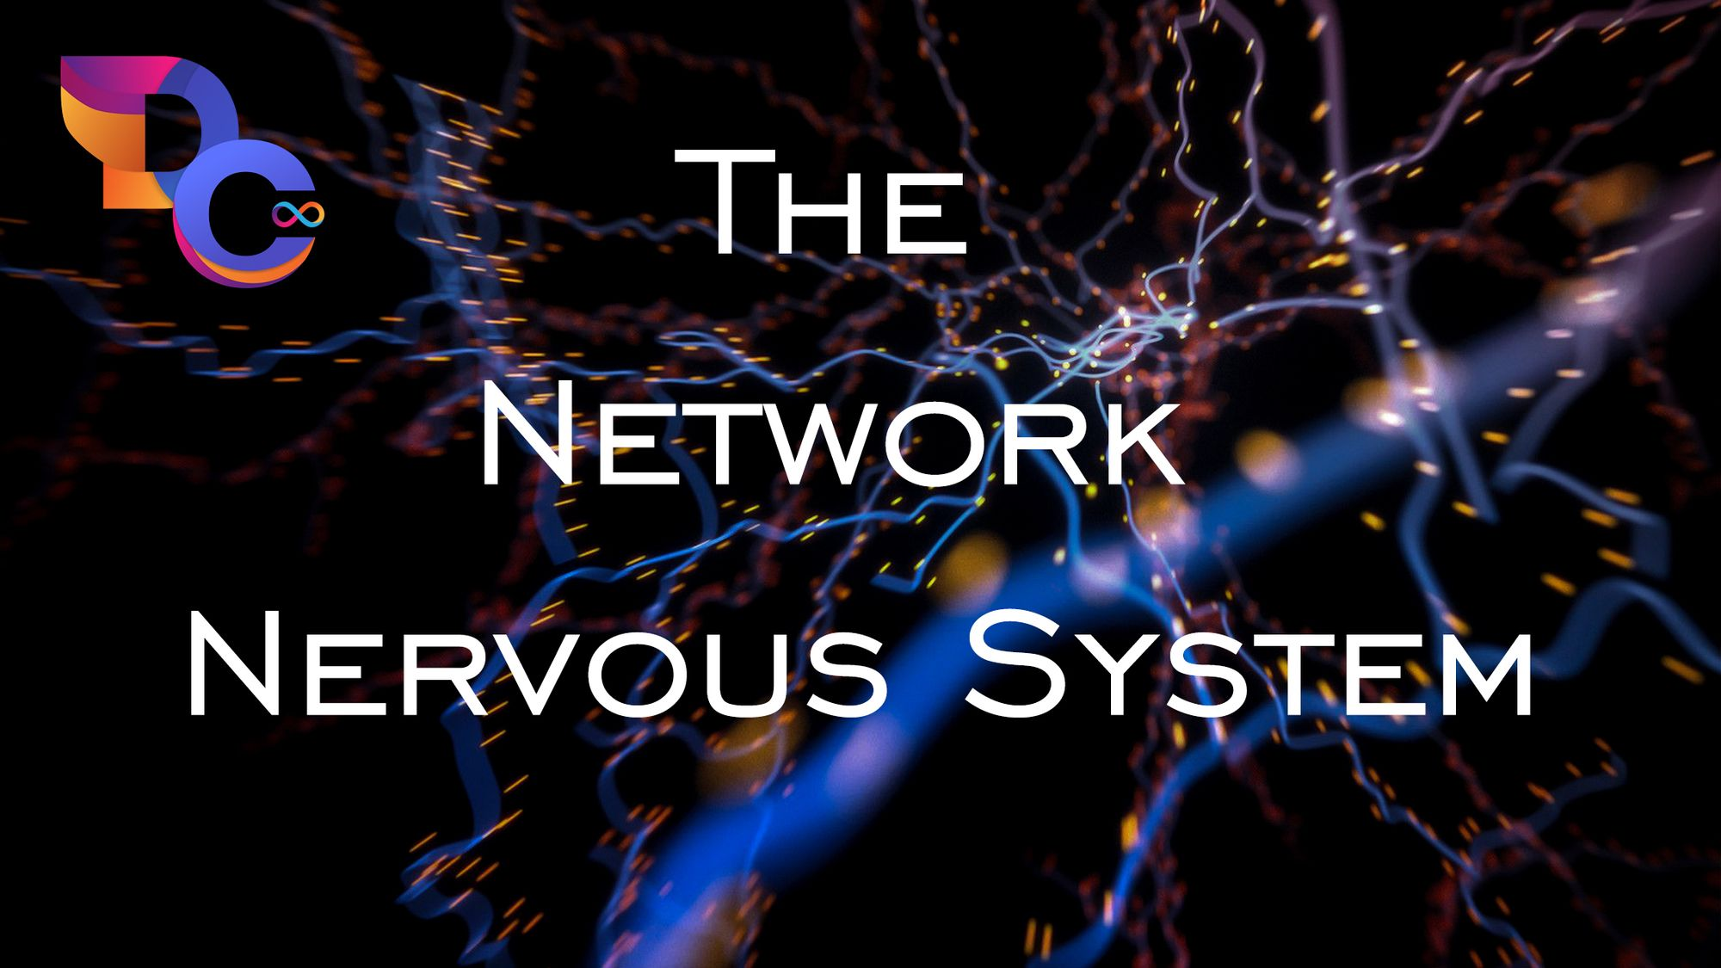
Network Nervous System
Decentralized governance system
- Canisters
- Nodes
- Proposals
- Voting
- Economics

Slide 13

Recent Innovations
ckBTC

Slide 14
The End
Thank you for listening

