Slide 1



Manipal Socials
An app that connects you!

Slide 2

What is it?
An app that helps the introvert in you to find people you might wanna hang around with in the campus

Slide 3
Why?
Stronger Campus Community
Personal and Professional Growth
Address Mental Health and Well-being
Leverage Technology for Positive Impact
Enhance campus spirit and belonging
A more inclusive environment for all students.
Facilitate networking and career development.
Increase collaborations among students
A supportive platform for social interaction and emotional connection.
Help combat loneliness and isolation
Utilize innovative features to enhance user experience and engagement.

Slide 4


01
Objectives and Problem Solving

Slide 5

Objectives
01
Facilitate communication among students
02
Build Communities based on interests
03
Provide a user-friendly platform for event managing and socialising

Slide 6
02
Design and Innovation

Slide 7
How it works?
Profile Creation
Matchmaking
01
02
Chat
03
The app identifies potential matches based on shared interests, such as movies, hobbies, songs, memes, and other preferences.
personalized profile to showcase their interests, hobbies, and preferences.
communicate directly with other members through private messaging.

Slide 8
Technical Innovation
Backend
Algorithm
App Dev
A scalable database that would help in managing user profiles
Real-time messaging and recommendation algorithm for interests.
Flutter

Slide 9
03
Development Methodology

Slide 10
TechStack
Flutter | Ensuring a visually appealing, high-performing, and engaging app experience for students.
Dart | Enables us to write efficient, maintainable, and high-quality code.
Post Grate SQL | Provides a reliable and scalable database for storing and managing user data, interactions, and content.

Slide 11


Why Flutter
Cross Platform: Develop a single codebase that could be deployed to both iOS and Android devices, saving time and effort.
Rapid development: Flutter's hot reload feature enabled quick iterations and real-time updates, accelerating the development process.
Community and support :Flutter's growing community and extensive documentation provided valuable resources and support throughout the development process.
State management: Flutter's state management solutions, such as Provider or Riverpod, helped manage the app's data and UI state efficiently.

Slide 12
Why Dart?
Object-Oriented: Dart is an object-oriented language, which means it follows the principles of encapsulation, inheritance, and polymorphism. This makes it easier to structure and maintain large codebases.
Garbage-Collected: Dart has automatic garbage collection, automatically manage memory allocation and deallocation. This can help prevent memory leaks and improve performance.

Slide 13
Why PostGre
Proven track record: PostgreSQL has been used in production environments for decades, demonstrating its reliability and stability.
Advanced data types: PostgreSQL supports a wide range of data types, including JSON, XML, arrays, and geographic data. This flexibility is crucial for handling diverse data in a social networking app
Foreign data wrappers: PostgreSQL can integrate with external data sources, allowing you to access data from other databases or systems

Slide 14
04
Key features Overview

Slide 15
Key Features
Outlook Login Integration
Interest-Based Group Discovery
Easy login using outlook that ensures that only students with a learners id get access to the app.
Automatically suggest groups to students based on their profile and activity.
Real-Time Messaging
In-app messaging system for group chats, event updates, and interest-specific discussions.

Slide 16
Key Features
One-to-One Matching:
Direct Communication:
Instead of general group discovery, the platform matches two users based on shared interests or activities.
Matched students can chat directly through the platform, allowing them to plan meet-ups, discuss mutual interests, or collaborate on activities.
Messages sync in real-time, ensuring smooth communication.

Slide 17
05
Dataflow

Slide 18
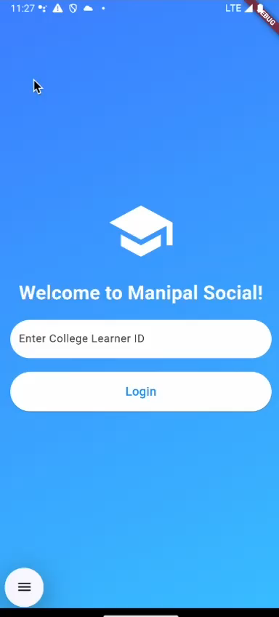
Dataflow
Login
Interest Matching
User enters their college learner ID -> Requests authentication via Firebase Authentication or gmail API -> If verified, the session is created.
User provides interests during profile creation -> Profile information is stored in database-> Matching algorithm queries the database to find users with similar interests -> Two users are paired and notified.

Slide 19
Dataflow
Real time messaging
User sends a message -> Database stores the message -> Message is synced with the matched user’s app in real-time -> Push notifications are sent if the recipient is not actively using the app.

Slide 20
06
Matching Algorithm Design

Slide 21
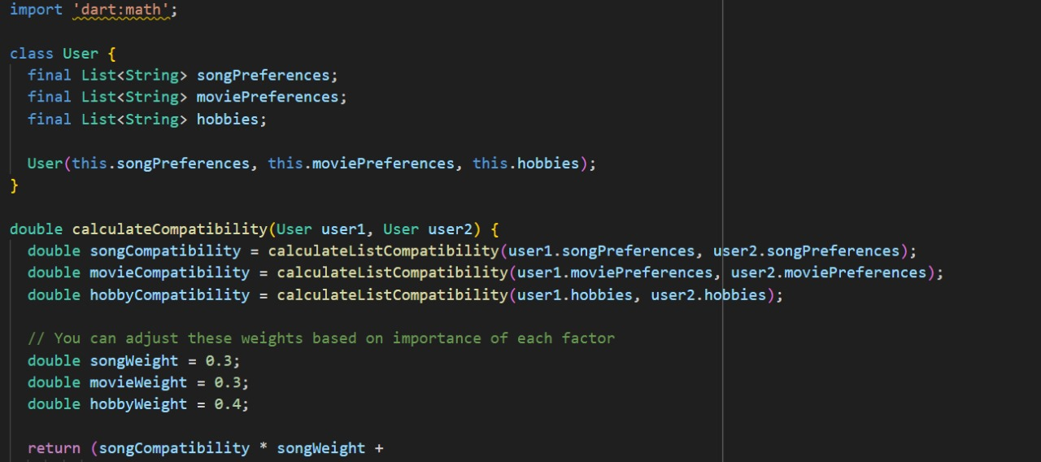

Slide 22
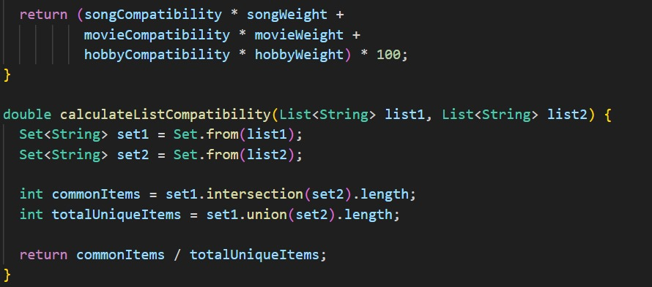

Slide 23
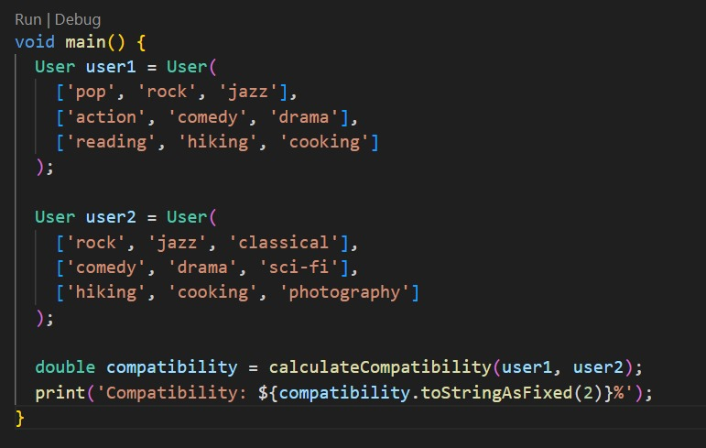
Sample input

Slide 24

Sample output: Please look at the board

Slide 25
Trying to implement

Slide 26
Thanks

