Slide 1

Machine Learning in Networks
Samuel Thomas

Slide 2
Contents
Background
Defining the problem
Finding a dataset
Analysing the data
Data processing
Classification algorithms
Results and discussion
Working example – Networks specific

Slide 3
Background

Slide 4
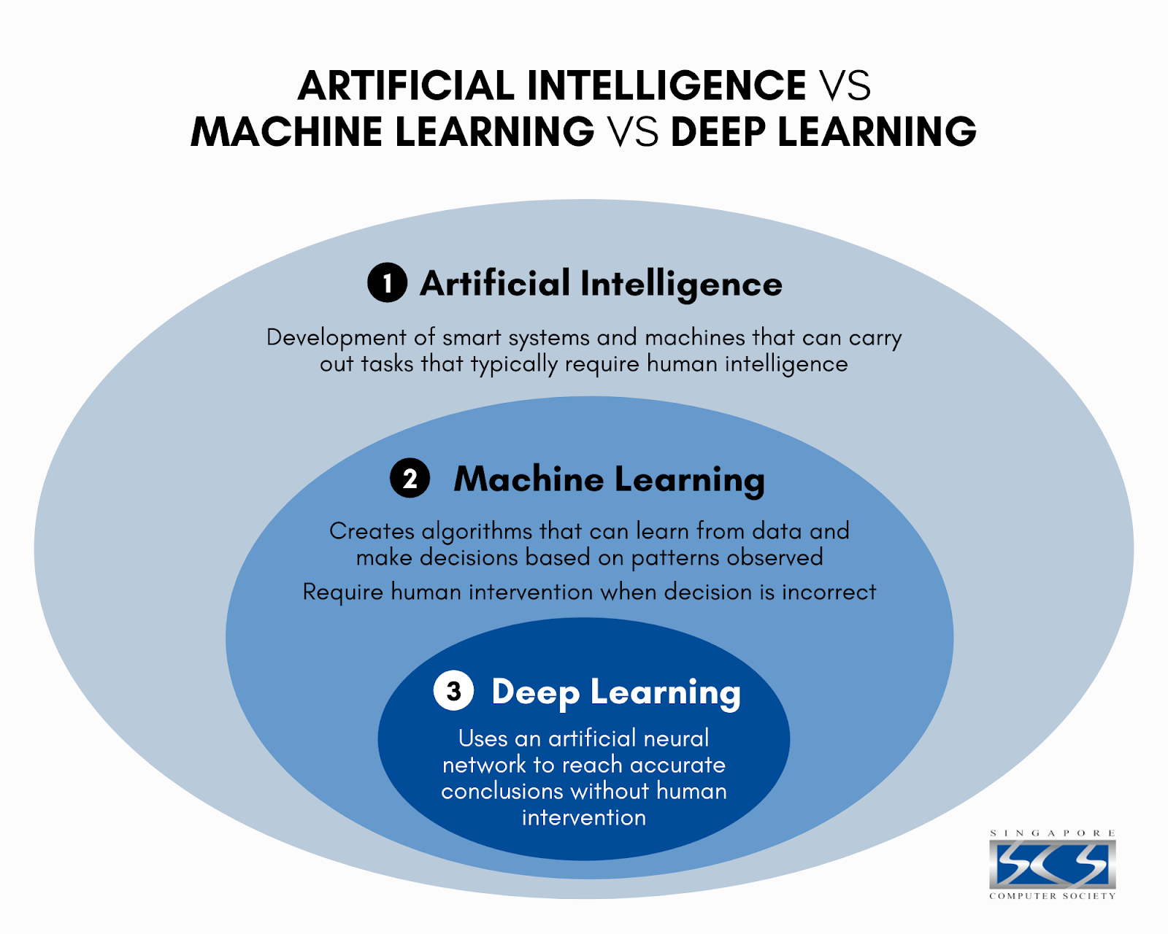
Artificial Intelligence with a focus on data

Slide 5
Industry
Palo Alto “The world’s first ML-Powered NGFW”
Broadcom on-chip neutral network
Nokia SRLinux – ChatGPT integration
Juniper Mist AI – 100% growth in a year
Academia
A machine learning approach to improve congestion control over wireless computer networks
Machine Learning Network Security

Slide 6
The Technical Bits

Slide 7
Types of Machine Learning
Supervised
Labels are fed into the algorithm
We tell the algorithm what want it to produce
Unsupervised
No labels
Helps us understand data
Reinforcement

Slide 8
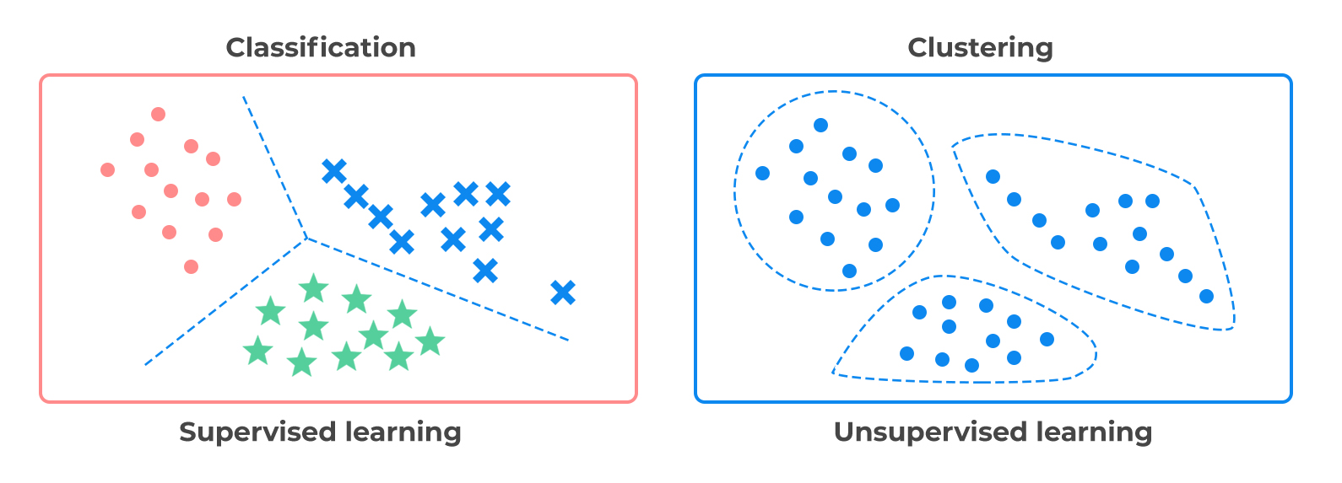
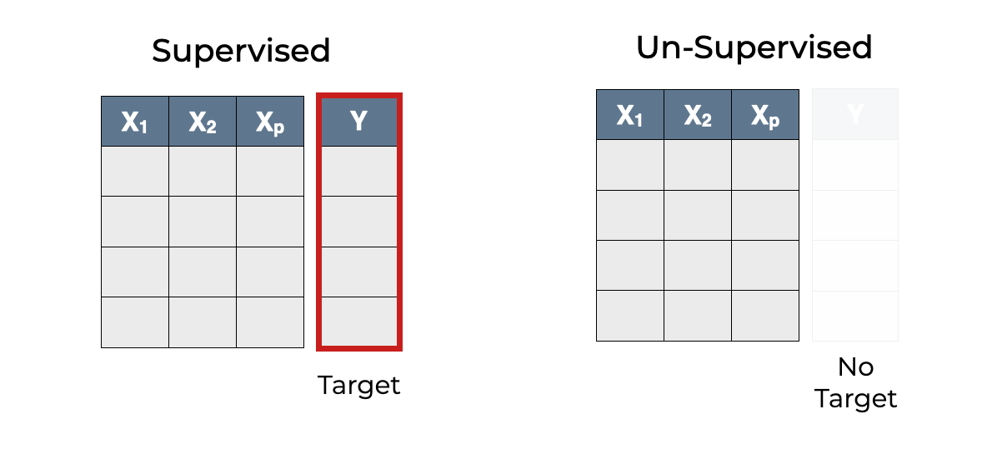

Slide 9
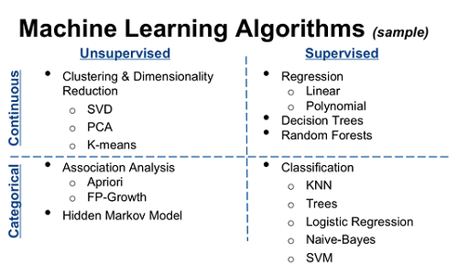
Continuous – on a scale, e.g. a float
Categorical / Discrete – a label

Slide 10
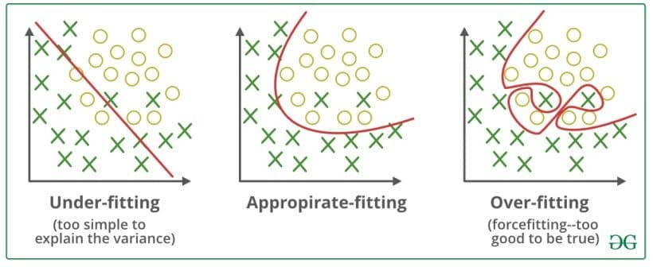
Underfitting | Overfitting
Model is not specific enough Model is not complex enough | Model is trained too specific on the test set Model too complex
Example solution:
Add more training data
How do we solve this?

Slide 11
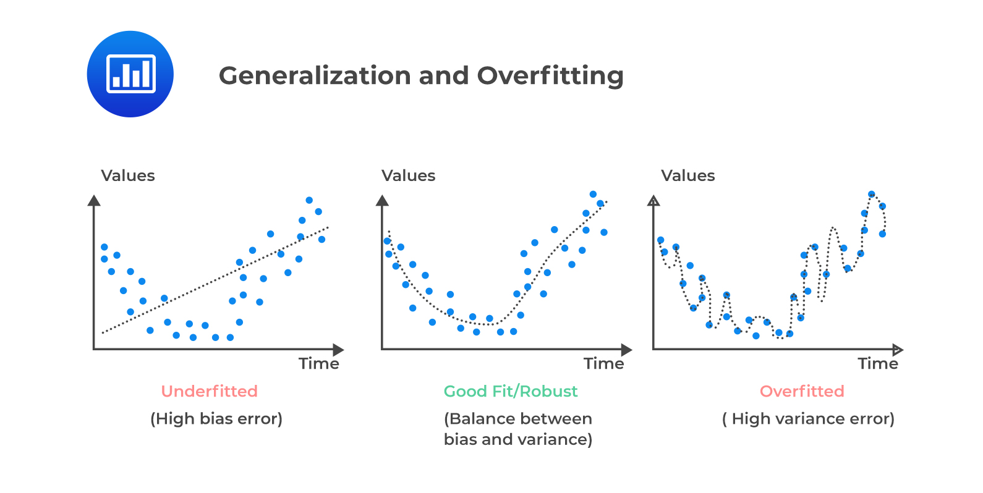

Slide 12
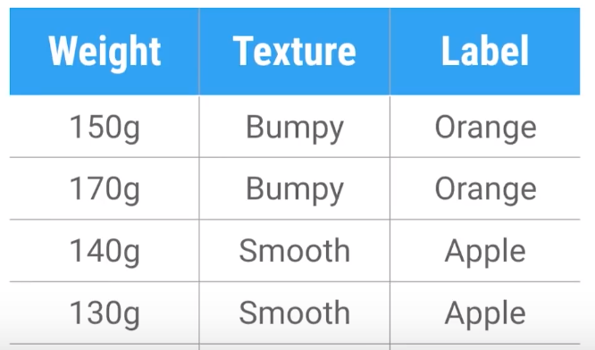
What is a feature?
“an individual measurable property or characteristic of a phenomenon” – Wikipedia
Examples – People: Name, Age, Gender, BMI etc
Examples - Apples: Colour, Age, Type, Label, Discolouration

Slide 13
Palo Alto – Conditions for Machine Learning
Conditions for Machine Learning
The relevant data must be consolidated and accessible. Data includes text, images, computer clicks and social media postings.
An algorithm must be developed to analyze the large amounts of data for similarities and patterns. Enough computational processing power must also be available for the program to comb through vast amounts of data.
A basic set of rules must be provided to the machine to serve as guidelines. https://www.paloaltonetworks.co.uk/cyberpedia/what-is-machine-learning

Slide 14
Simplified – Conditions for Machine Learning
Processing – sufficient power to crunch sufficient data
Good data - sufficient number of features
Narrow application

Slide 15
Networking Example

Slide 16



Setting up the environment
Jupyter Notebook
Python Modules
Sci-kit learn – delivers all ML algorithms
Numpy – efficient mathematical operations
Pandas – data tables
Seaborn – data visualisation
Matplotlib – data visulisation

Slide 17
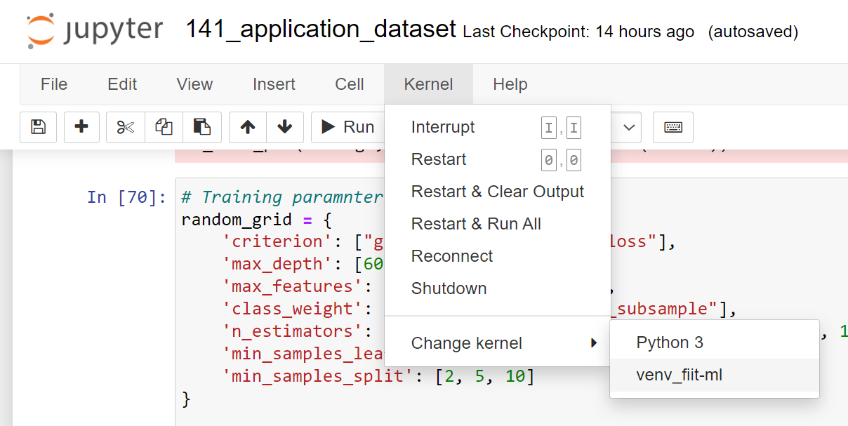
pip install jupyerlab
jupyter notebook
pip install scikit-learn
pip install numpy
pip install pandas
pip install seaborn
Note: Virtual Environmen - install Kernel with ipykernel and select in jupyter notebook
<within current environment>
python -m ipykernel install --user --name <NAME>

Slide 18
Defining the problem

Slide 19

“Real network data is challenging to obtain due to security and privacy issues. Also, production networks do not generate labelled flows, which is necessary for following a supervised ML learning method. “
“However, as these feature sets are unique and often completely different than each other, researchers have been unable to evaluate their proposed learning models on multiple datasets using a specific set of features.”
NetFlow Datasets for Machine Learning-based Network Intrusion Detection Systems, Mohanad Sarhan et al, 2020

Slide 20
Separate VPN traffic from non VPN traffic (HTTPS) – and identify the traffic within the VPN
Ideas
Application recognition
Device failure conditions
Malicious traffic recognition

Slide 21
Finding a dataset

Slide 22
Relatively clean
Consistent features
Narrow application
Large
https://www.kaggle.com/datasets/jsrojas/labeled-network-traffic-flows-114-applications

Slide 23
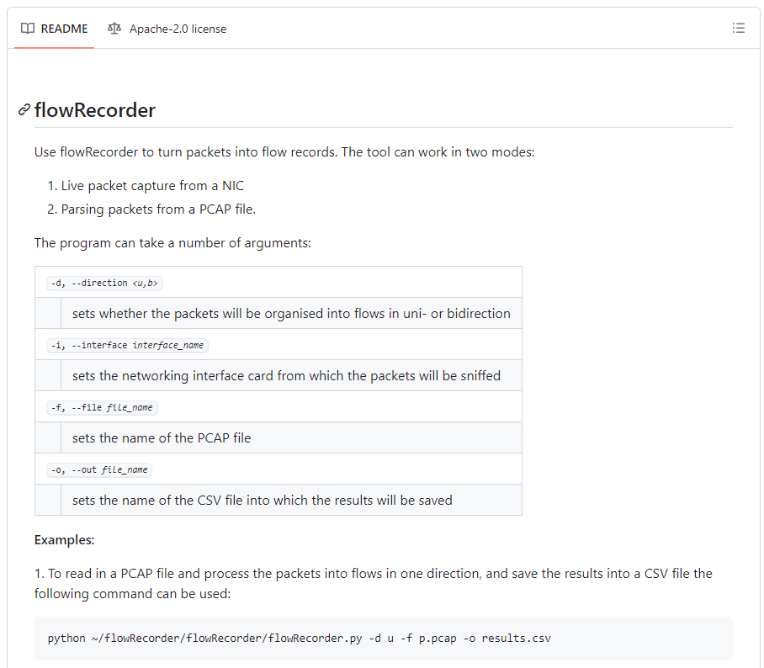
Dataset Source
GitHub Repo: https://github.com/drnpkr/flowRecorder
Simple, but also enough options to be useful

Slide 24
Analysing the data
Understand data significance and anticipate processing requirements

Slide 25
Techniques
Class Balance
Missing values
Duplicates
Data Factsheet
Noise
Correlation Analysis
Feature Analysis and Importance

Slide 26
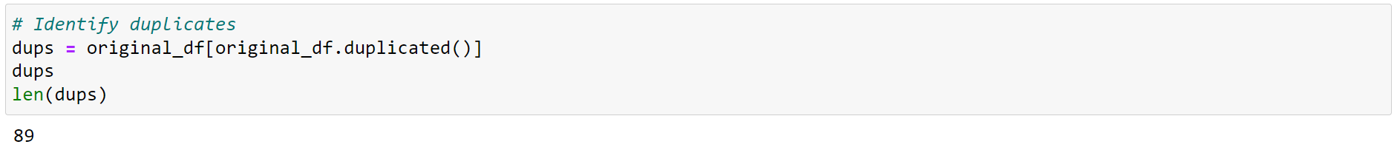
Missing & Error Values
original_df.drop_duplicates()

Slide 27
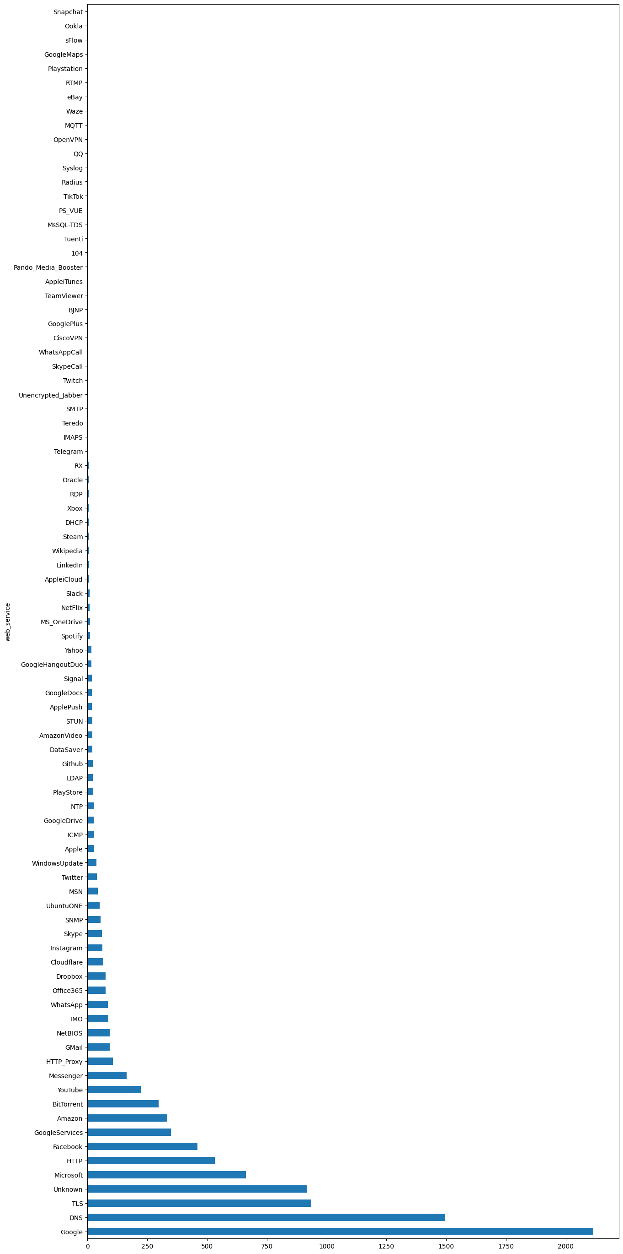
Class Balance

Slide 28
Feature | Column Type | Mean | Variance Coefficient | Range | Interquartile Range | Skew | Anomalies
src_port
dst_port
proto
pktTotalCount | int64 | 5.120046e+04 | 556 | 2.548000e+03 | 14 | .. | ..
octetTotalCount | int64 | 6.870713e+04 | 898 | 3.270412e+06 | 4297 | .. | ..
min_ps | int64 | 5.822900e+01 | 84 | 1.349000e+03 | 25 | .. | ..
max_ps | int64 | 1.296609e+03 | 217 | 2.614700e+04 | 1307 | .. | ..
avg_ps | float64 | 2.335809e+02 | 130 | 2.960067e+03 | 165 | .. | ..
.. | .. | .. | .. | .. | .. | .. | ..

Slide 29
Data Processing
Preparing our dataset for classification algorithms

Slide 30
Class Balancing
Feature Selection
Normalisation
Removing Noise
Removing Anomalies

Slide 31
Classification Algorithms
Deploying different classification algorithms on our dataset z

Slide 32
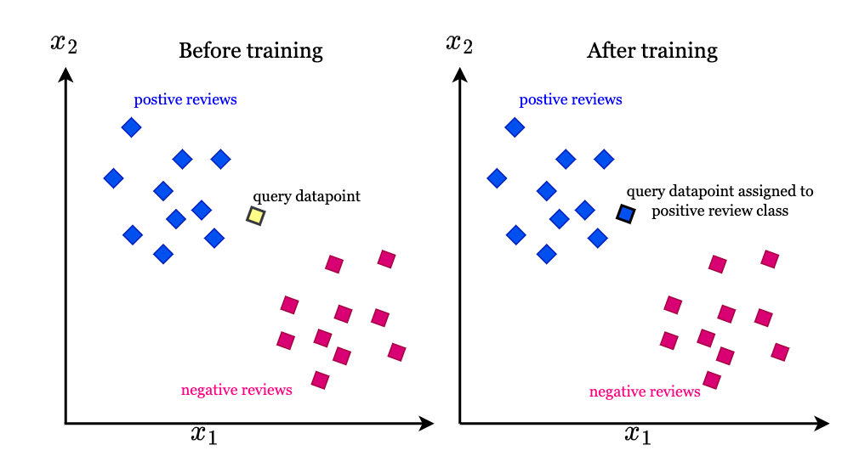
KNN
K-Nearest Neighbors
Uses proximity to other (known) classes
All the computation occurs when a classification or prediction is being made

Slide 33

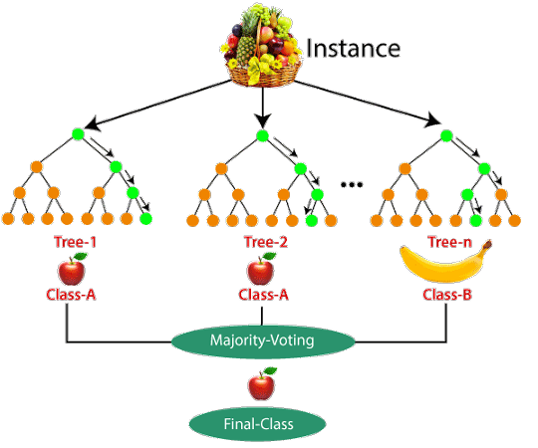
RandomForest
Lots of decision trees
If feature x is y, goto next decision tree
Prone to problems, such as bias and overfitting (IBM)
Combine different types of decision trees
Ensemble

Slide 34
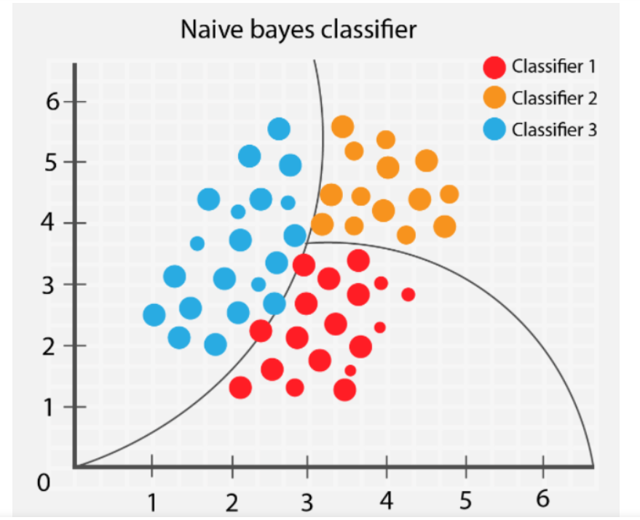
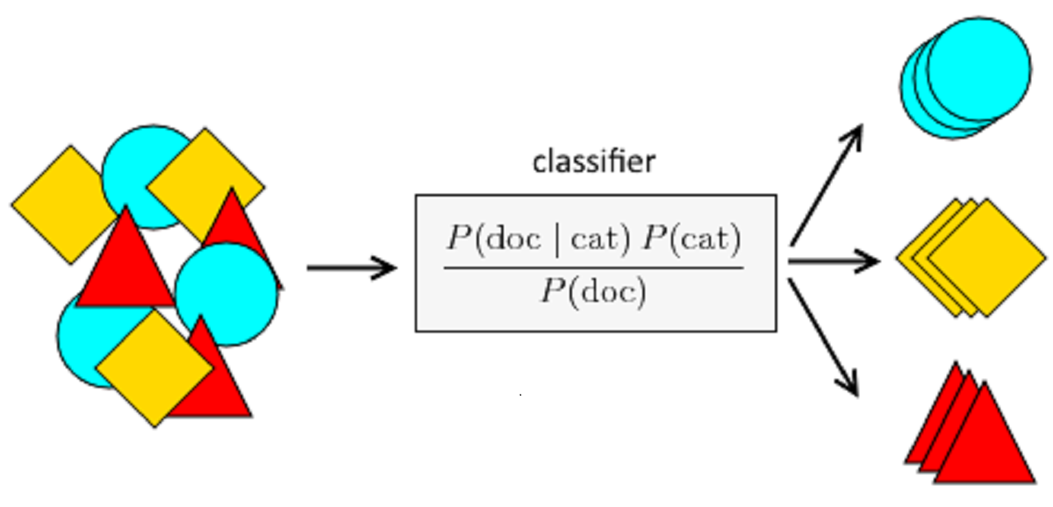
Naïve Bayes
Based on Baynes Theorem
Lots of maths
Models probabilities

Slide 35
Hyperparameter Tunning

Slide 36
https://scikit-learn.org/stable/modules/generated/sklearn.ensemble.RandomForestClassifier.html

Slide 37

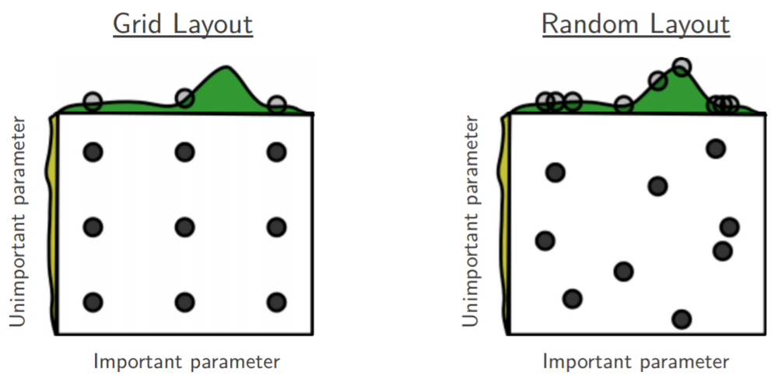

Slide 38
Results and Discussion
Using different techniques to understand if our results are useful

Slide 39
Techniques
Accuracy
Precision
Recall
F1
Confusion Matrix

Slide 40
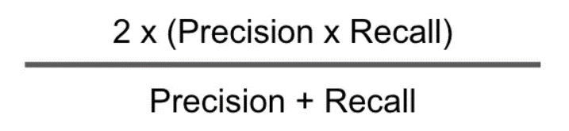
Accuracy – What proportion of identifications were actually correct?
Precision - What proportion of positive identifications was actually correct?
Recall - What proportion of actual positives was identified correctly?
F1 Score -

Slide 41
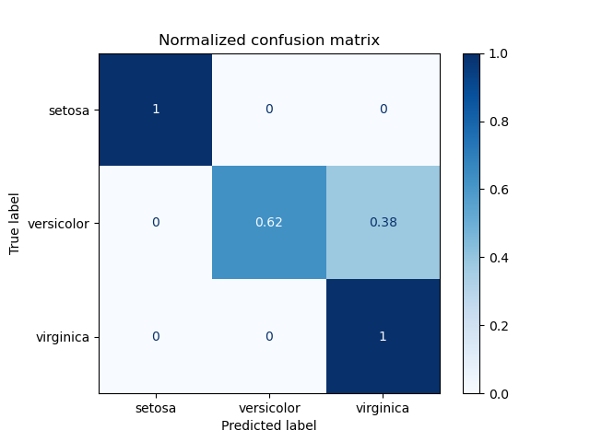
Confusion Matrix

Slide 42
Key Takeaways
Data can help generate insights / value through minimal efforts
Application must be focussed
No knowledge of maths required – does help
Give it a go
A few areas to start
Don’t need labelled data (unsupervised)
Network Security – detecting suspicious traffic flows, anything anomalous
Network Monitoring – detecting outliners in SNMP monitoring

Slide 43
Thank you
Any questions?

