Slide 1
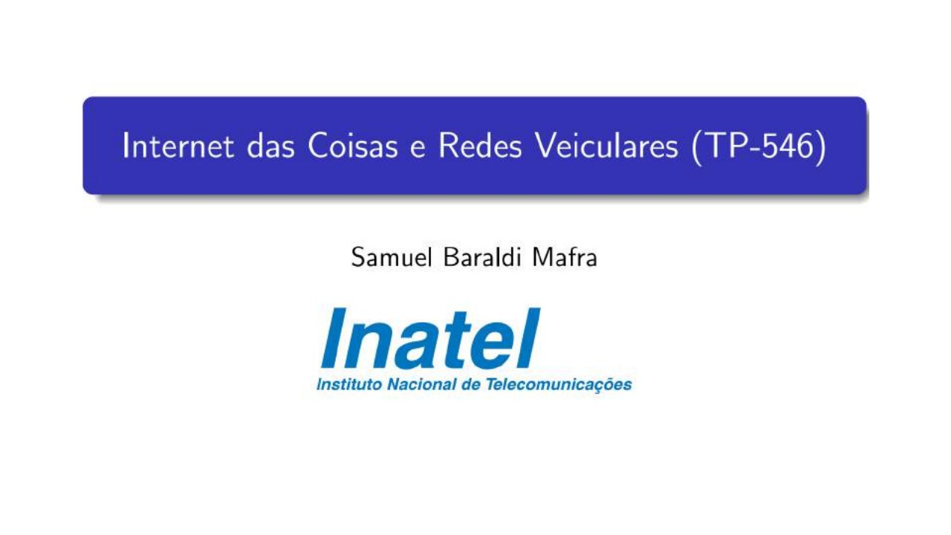
Internet of Things and Vehicular Networks (TP-546)
Notes:
[Sources]
- User-provided source: aula09tp546.pdf, page 1. English translation prepared from the original Portuguese content.

Slide 2
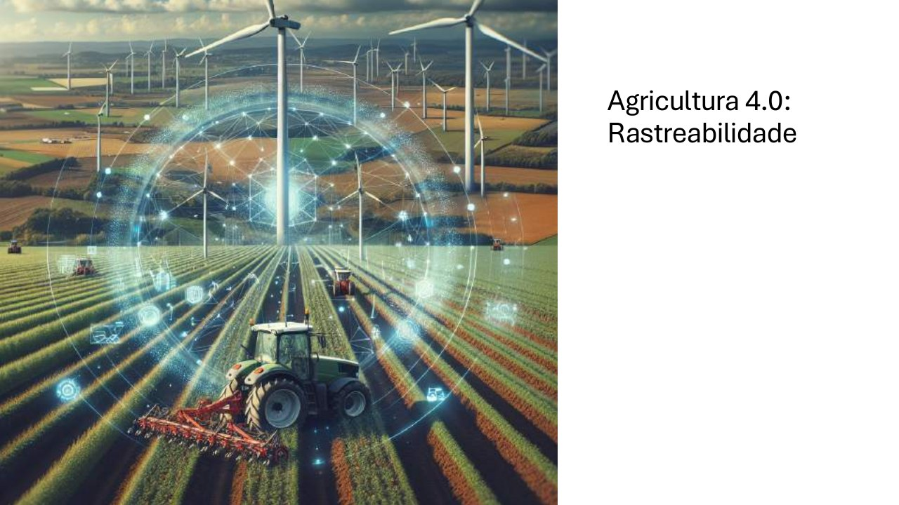
Agriculture 4.0: Traceability
Notes:
[Sources]
- User-provided source: aula09tp546.pdf, page 2. English translation prepared from the original Portuguese content.

Slide 3
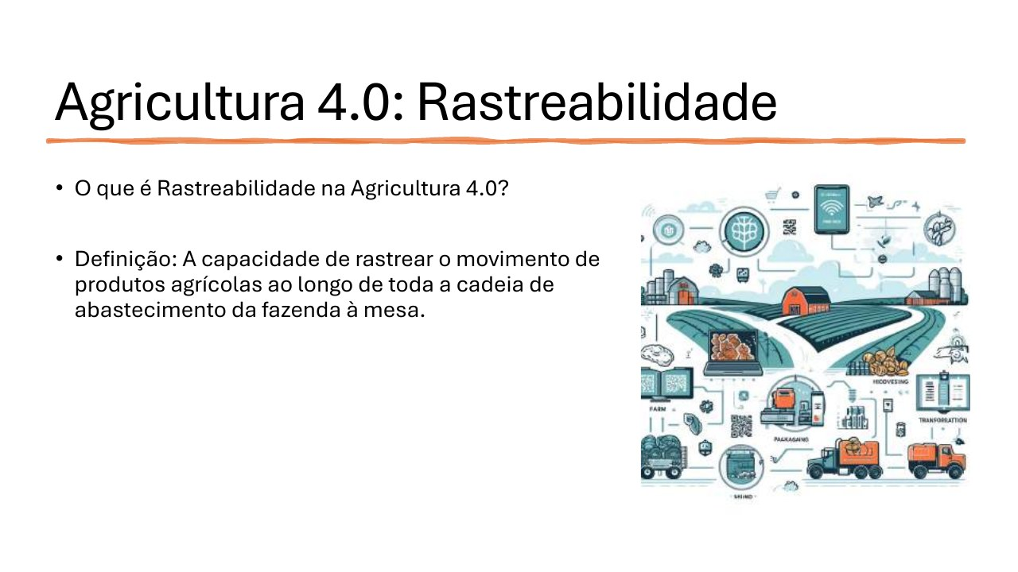
Agriculture 4.0: Traceability
• What is traceability in Agriculture 4.0?
• Definition: the ability to track the movement of agricultural products throughout the supply chain, from farm to table.
Notes:
[Sources]
- User-provided source: aula09tp546.pdf, page 3. English translation prepared from the original Portuguese content.

Slide 4
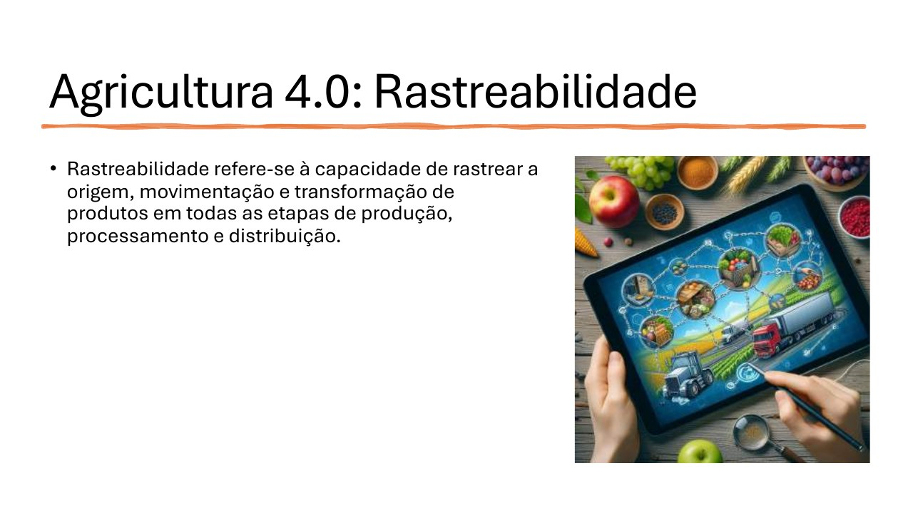
Agriculture 4.0: Traceability
• Traceability is the ability to track the origin, movement, and transformation of products across every stage of production, processing, and distribution.
Notes:
[Sources]
- User-provided source: aula09tp546.pdf, page 4. English translation prepared from the original Portuguese content.

Slide 5
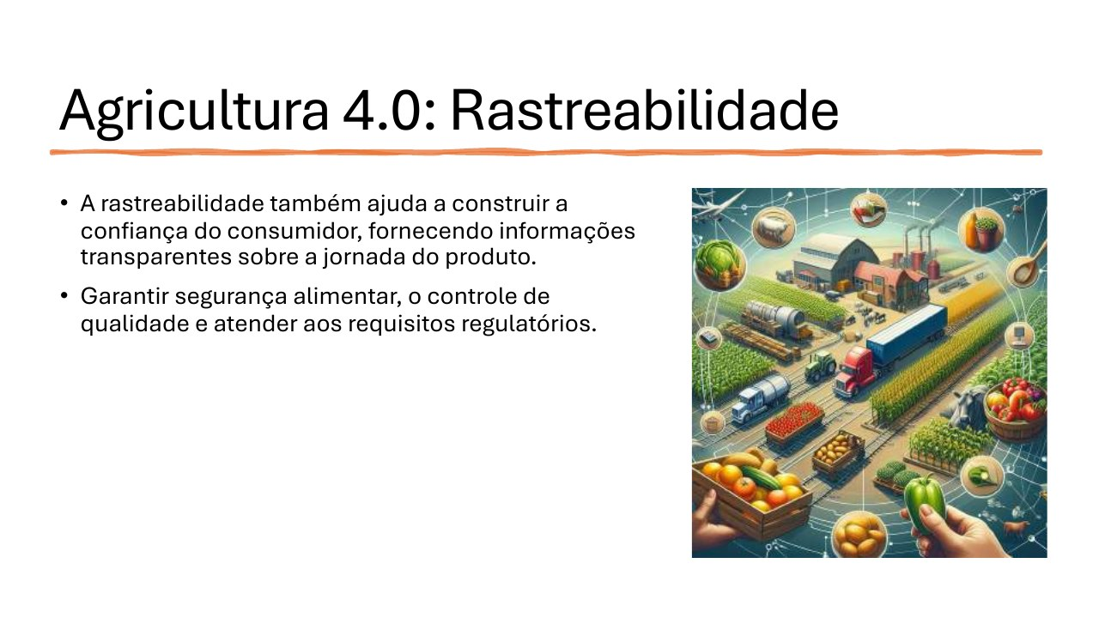
Agriculture 4.0: Traceability
• Traceability builds consumer trust by providing transparent information about a product's journey.
• It supports food safety, quality control, and compliance with regulatory requirements.
Notes:
[Sources]
- User-provided source: aula09tp546.pdf, page 5. English translation prepared from the original Portuguese content.

Slide 6
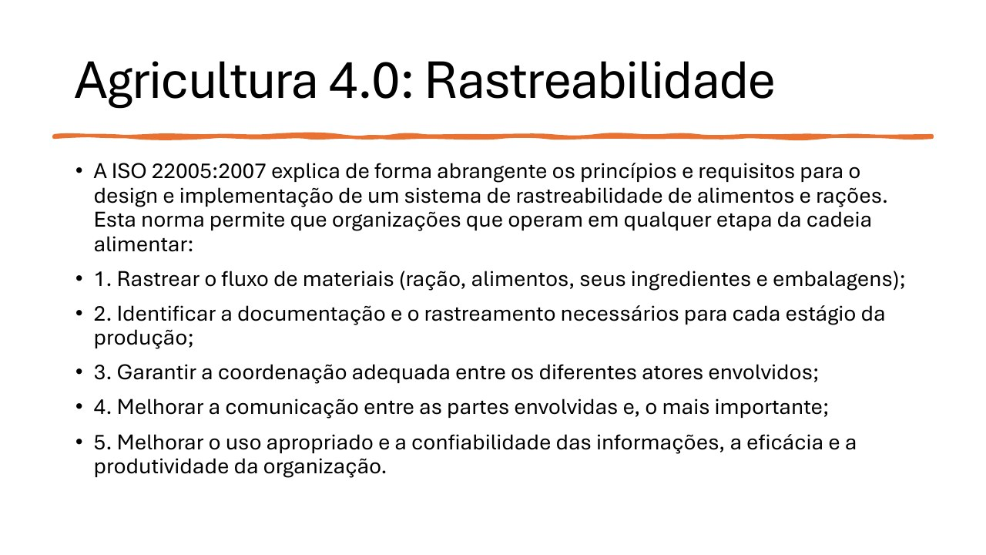
Agriculture 4.0: Traceability
• ISO 22005:2007 defines principles and requirements for food and feed traceability systems. It helps organizations:
1. Track materials, ingredients, food, feed, and packaging;
2. Identify the documentation required at each production stage;
3. Coordinate actors across the chain;
4. Improve communication among stakeholders;
5. Improve information reliability, effectiveness, and productivity.
Notes:
[Sources]
- User-provided source: aula09tp546.pdf, page 6. English translation prepared from the original Portuguese content.

Slide 7
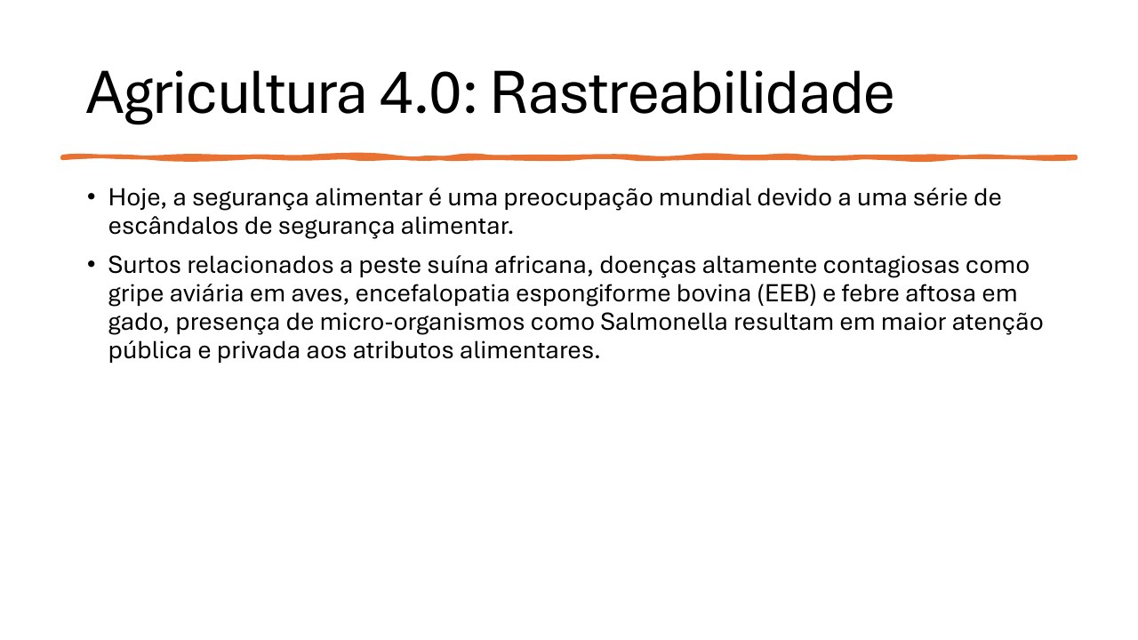
Agriculture 4.0: Traceability
• Food safety is a global concern because of recurring safety incidents.
• African swine fever, avian influenza, bovine spongiform encephalopathy, foot-and-mouth disease, and microorganisms such as Salmonella have increased public and private attention to food attributes.
Notes:
[Sources]
- User-provided source: aula09tp546.pdf, page 7. English translation prepared from the original Portuguese content.

Slide 8
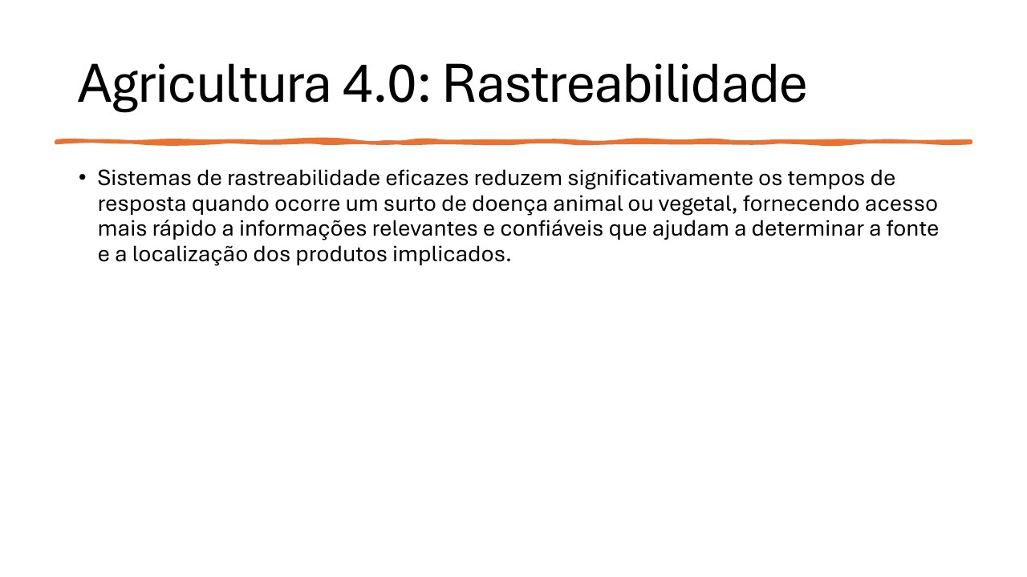
Agriculture 4.0: Traceability
• Effective traceability systems significantly reduce response time during animal- or plant-disease outbreaks by providing rapid access to reliable information about the source and location of affected products.
Notes:
[Sources]
- User-provided source: aula09tp546.pdf, page 8. English translation prepared from the original Portuguese content.

Slide 9
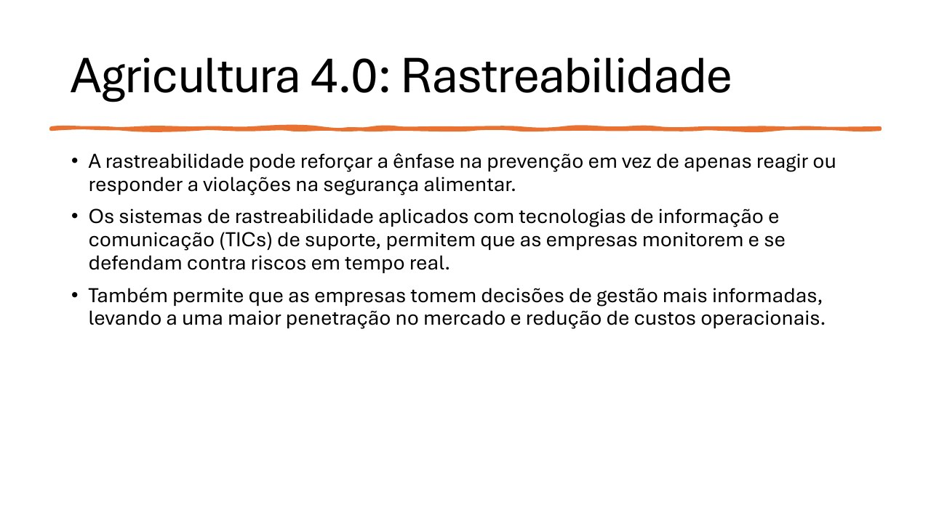
Agriculture 4.0: Traceability
• Traceability strengthens prevention instead of relying only on reaction to food-safety violations.
• Supported by ICT, traceability systems help companies monitor and manage risks in real time.
• Better information also supports management decisions, market access, and lower operating costs.
Notes:
[Sources]
- User-provided source: aula09tp546.pdf, page 9. English translation prepared from the original Portuguese content.

Slide 10
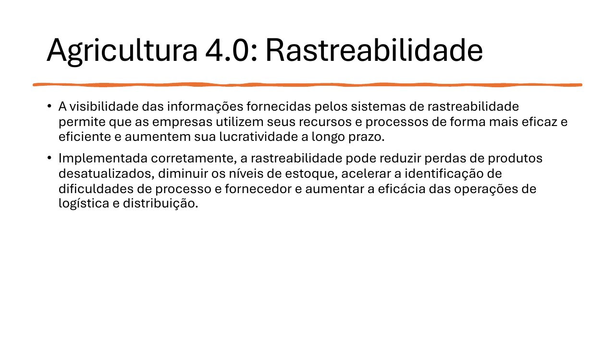
Agriculture 4.0: Traceability
• Traceability visibility helps companies use resources and processes more effectively, improving long-term profitability.
• Proper implementation can reduce obsolete-product losses and inventory levels, accelerate the identification of supplier or process problems, and improve logistics and distribution.
Notes:
[Sources]
- User-provided source: aula09tp546.pdf, page 10. English translation prepared from the original Portuguese content.

Slide 11
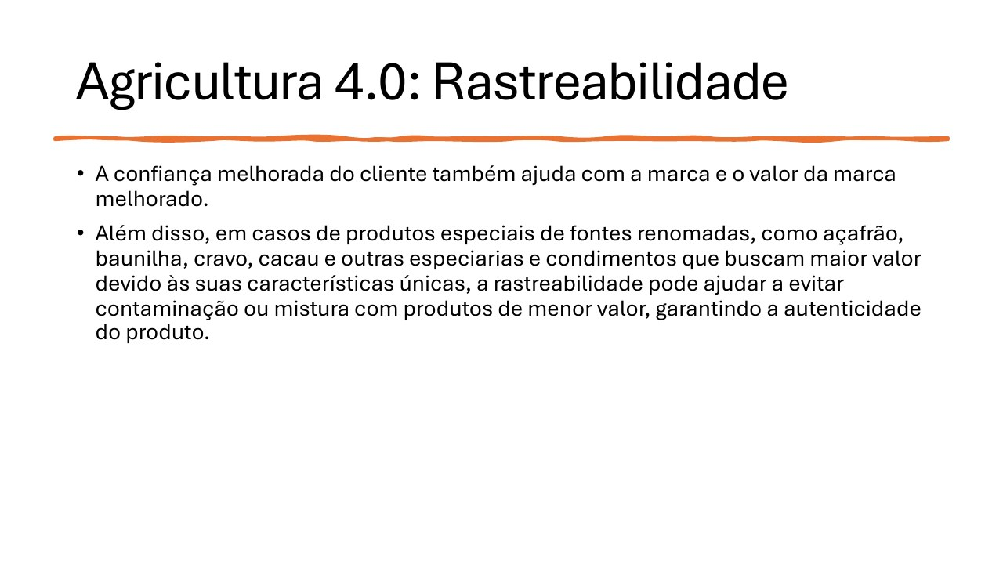
Agriculture 4.0: Traceability
• Greater customer confidence strengthens brands and brand value.
• For premium products such as saffron, vanilla, cloves, cocoa, and other spices, traceability prevents contamination or mixing with lower-value goods and helps guarantee authenticity.
Notes:
[Sources]
- User-provided source: aula09tp546.pdf, page 11. English translation prepared from the original Portuguese content.

Slide 12
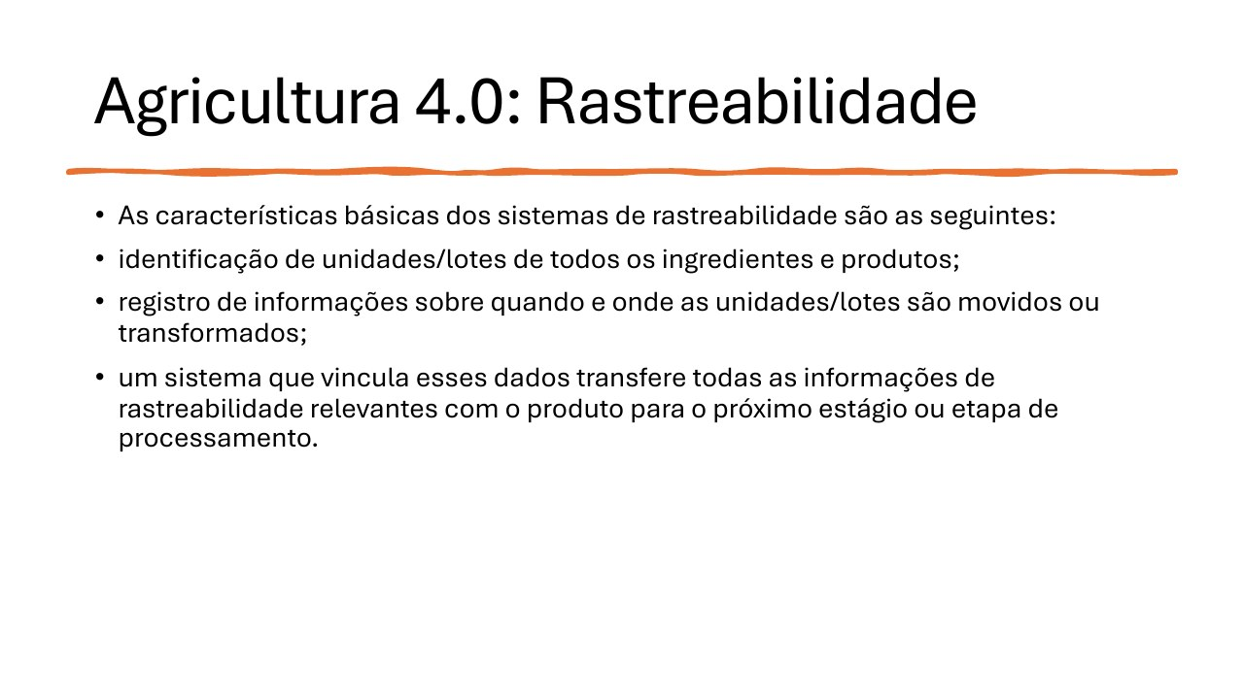
Agriculture 4.0: Traceability
• Basic characteristics of traceability systems:
• Identification of units and batches for every ingredient and product;
• Records of when and where units or batches move or are transformed;
• A system that links these records and transfers relevant traceability data with the product to the next processing stage.
Notes:
[Sources]
- User-provided source: aula09tp546.pdf, page 12. English translation prepared from the original Portuguese content.

Slide 13
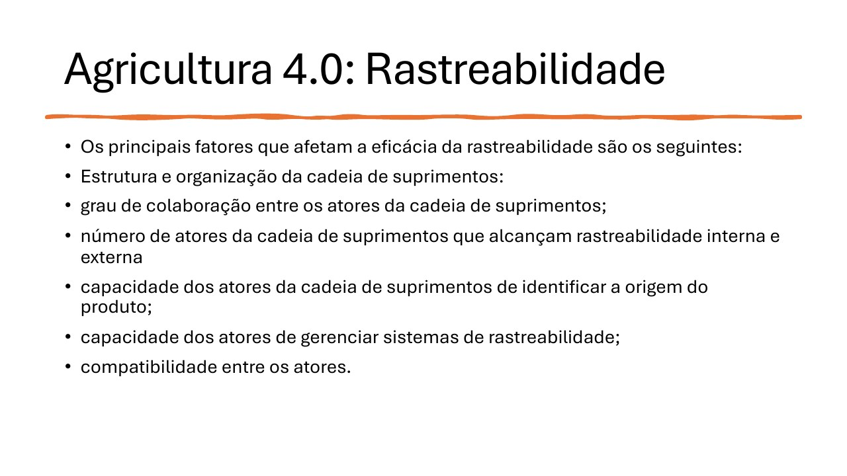
Agriculture 4.0: Traceability
• Main factors affecting traceability effectiveness:
• Supply-chain structure and organization;
• Collaboration among supply-chain actors;
• Number of actors with internal and external traceability;
• Ability to identify product origin;
• Ability to manage traceability systems;
• Compatibility among participants.
Notes:
[Sources]
- User-provided source: aula09tp546.pdf, page 13. English translation prepared from the original Portuguese content.

Slide 14
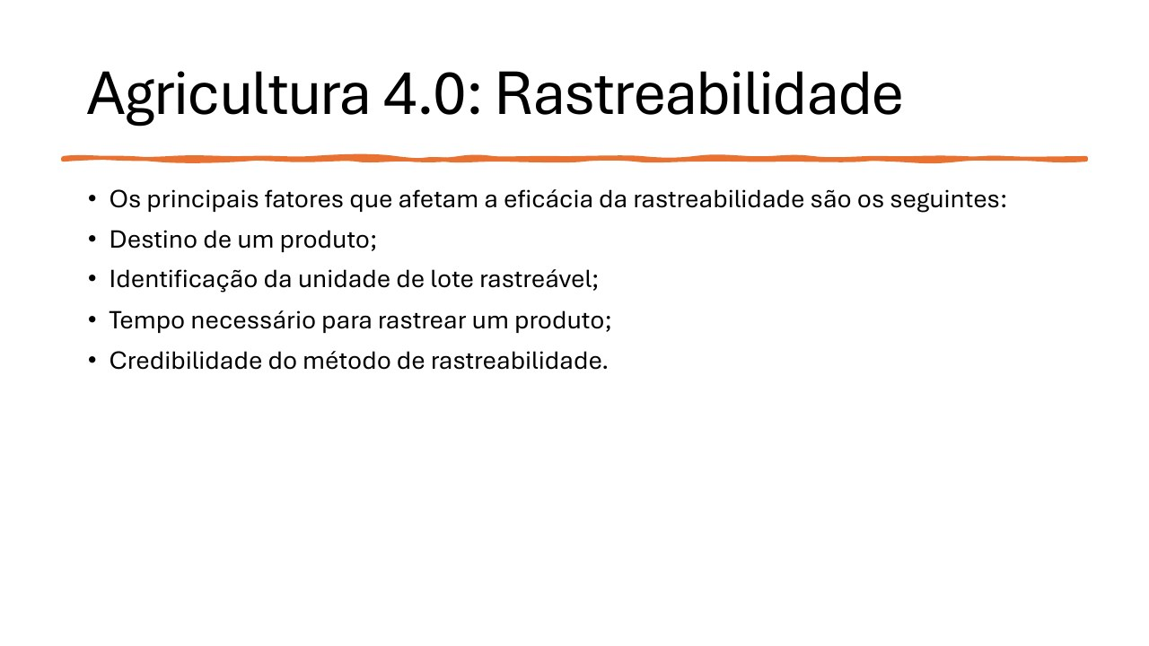
Agriculture 4.0: Traceability
• Main factors affecting traceability effectiveness:
• Product destination;
• Identification of the traceable batch unit;
• Time required to trace a product;
• Credibility of the traceability method.
Notes:
[Sources]
- User-provided source: aula09tp546.pdf, page 14. English translation prepared from the original Portuguese content.

Slide 15
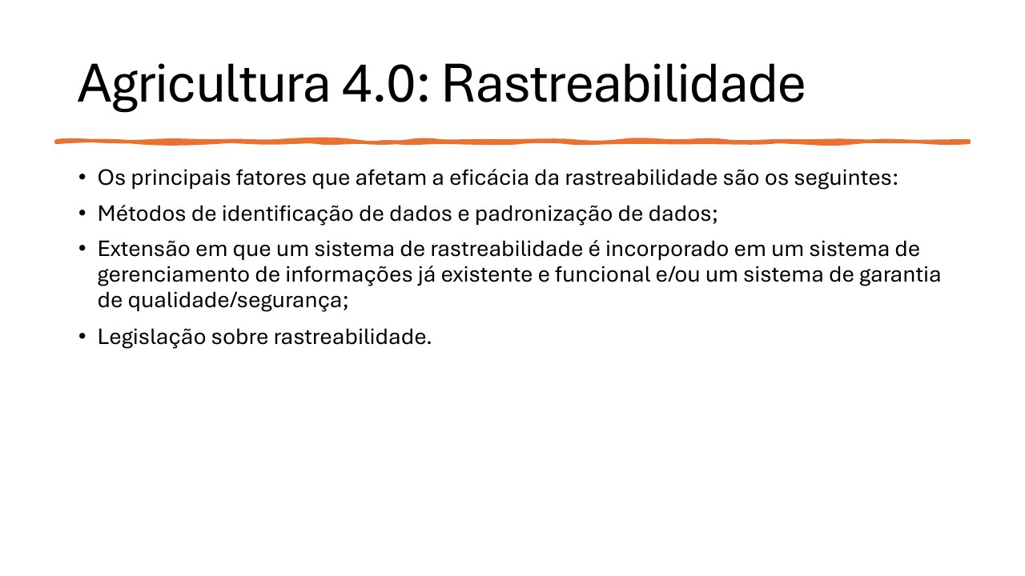
Agriculture 4.0: Traceability
• Main factors affecting traceability effectiveness:
• Data-identification methods and data standards;
• Integration with existing information-management and quality- or safety-assurance systems;
• Traceability legislation.
Notes:
[Sources]
- User-provided source: aula09tp546.pdf, page 15. English translation prepared from the original Portuguese content.

Slide 16
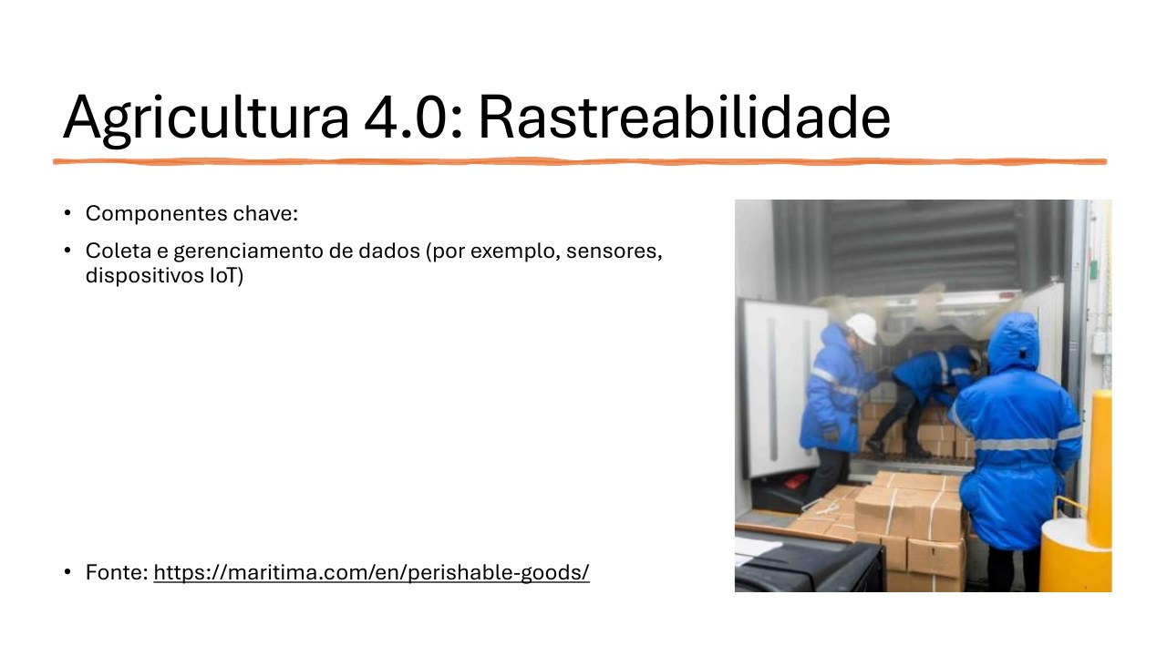
Agriculture 4.0: Traceability
• Key components:
• Data collection and management using sensors and IoT devices.
• Source: https://maritima.com/en/perishable-goods/
Notes:
[Sources]
- User-provided source: aula09tp546.pdf, page 16. English translation prepared from the original Portuguese content.

Slide 17
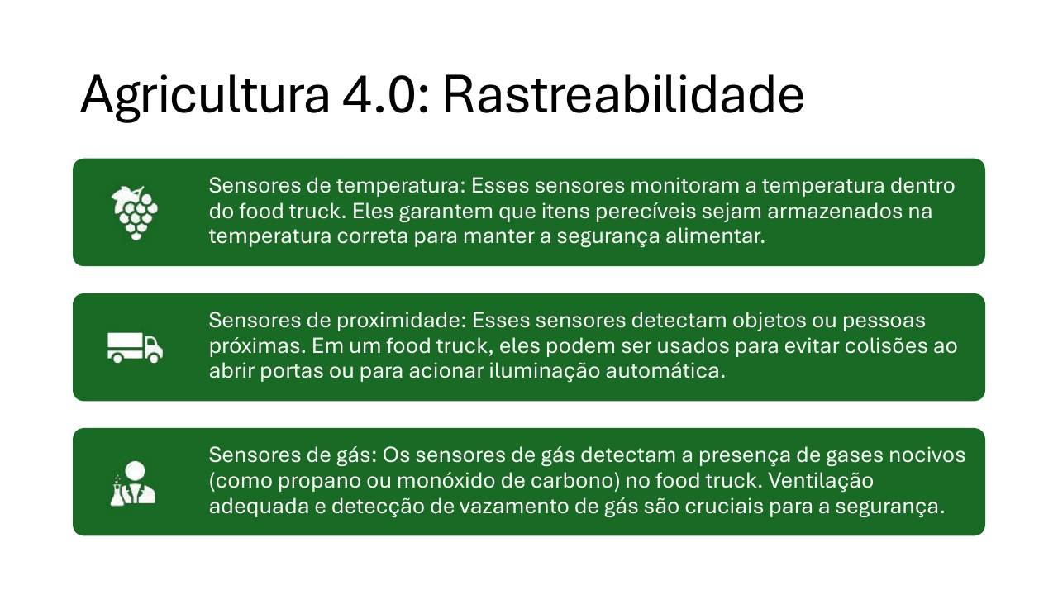
Agriculture 4.0: Traceability
Temperature sensors monitor conditions inside the food truck and ensure perishable items remain at safe temperatures.
Proximity sensors detect nearby objects or people and can prevent door collisions or activate lighting.
Gas sensors detect hazardous gases such as propane or carbon monoxide; ventilation and leak detection are essential for safety.
Notes:
[Sources]
- User-provided source: aula09tp546.pdf, page 17. English translation prepared from the original Portuguese content.

Slide 18
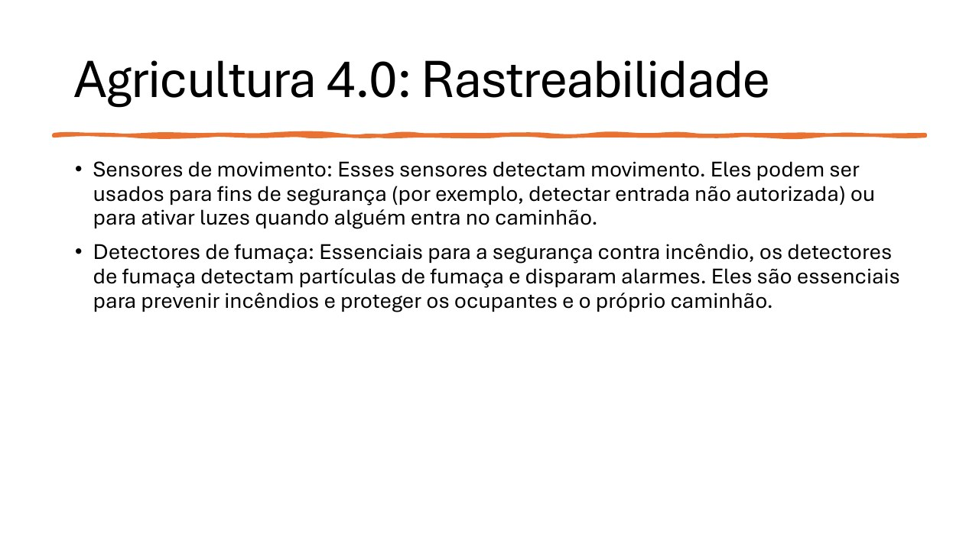
Agriculture 4.0: Traceability
• Motion sensors detect movement for security, such as unauthorized entry, or to activate lights when someone enters the truck.
• Smoke detectors identify smoke particles and trigger alarms, helping prevent fires and protect occupants and the vehicle.
Notes:
[Sources]
- User-provided source: aula09tp546.pdf, page 18. English translation prepared from the original Portuguese content.

Slide 19
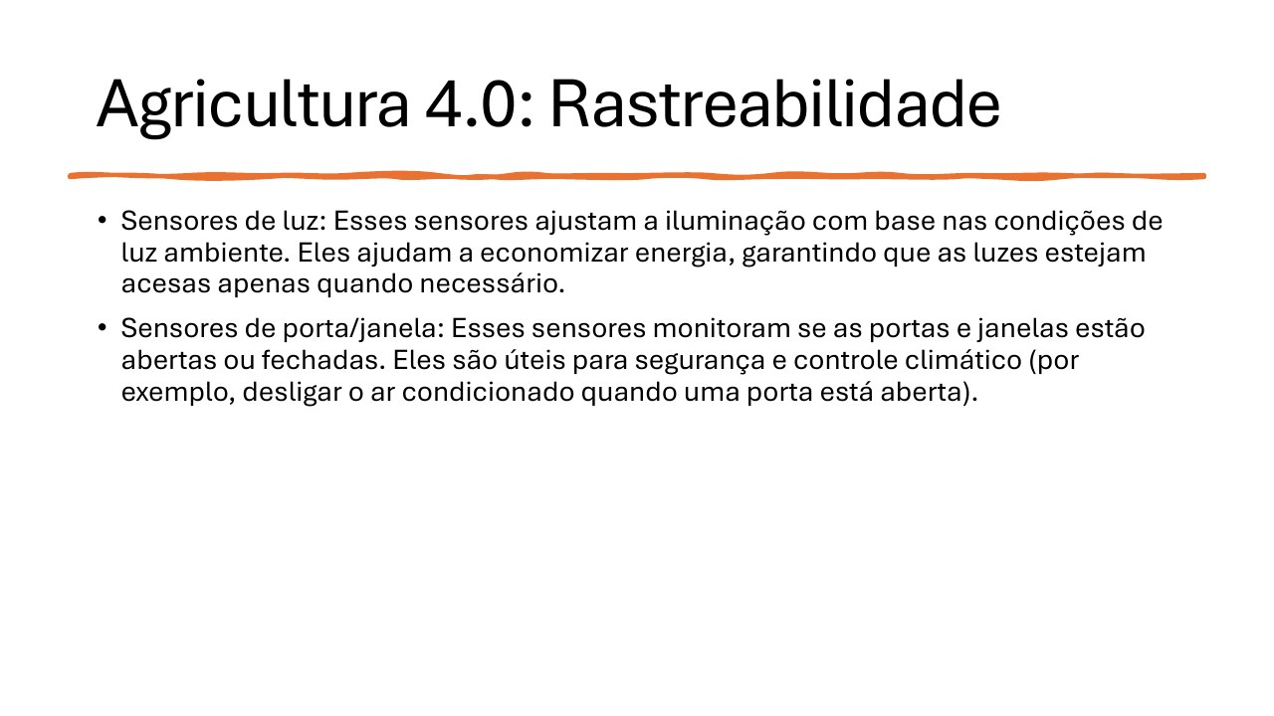
Agriculture 4.0: Traceability
• Light sensors adjust illumination according to ambient conditions, saving energy by activating lights only when needed.
• Door and window sensors report whether openings are closed. They support security and climate control, such as switching off air conditioning when a door is open.
Notes:
[Sources]
- User-provided source: aula09tp546.pdf, page 19. English translation prepared from the original Portuguese content.

Slide 20
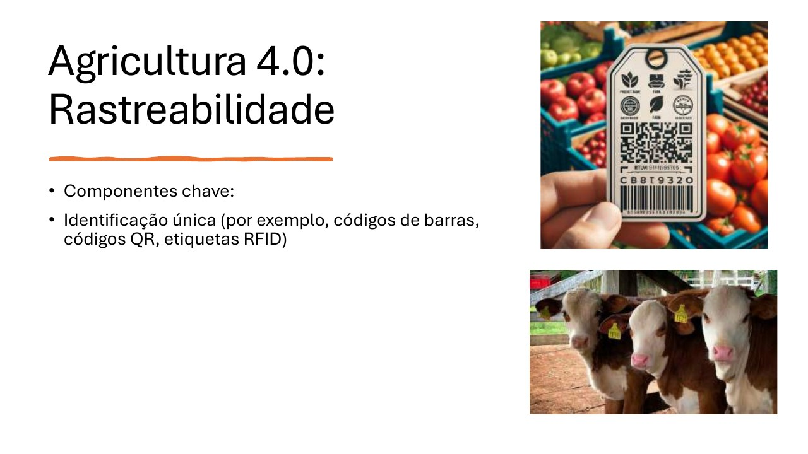
Agriculture 4.0: Traceability
• Key components:
• Unique identification using barcodes, QR codes, and RFID tags.
Notes:
[Sources]
- User-provided source: aula09tp546.pdf, page 20. English translation prepared from the original Portuguese content.

Slide 21
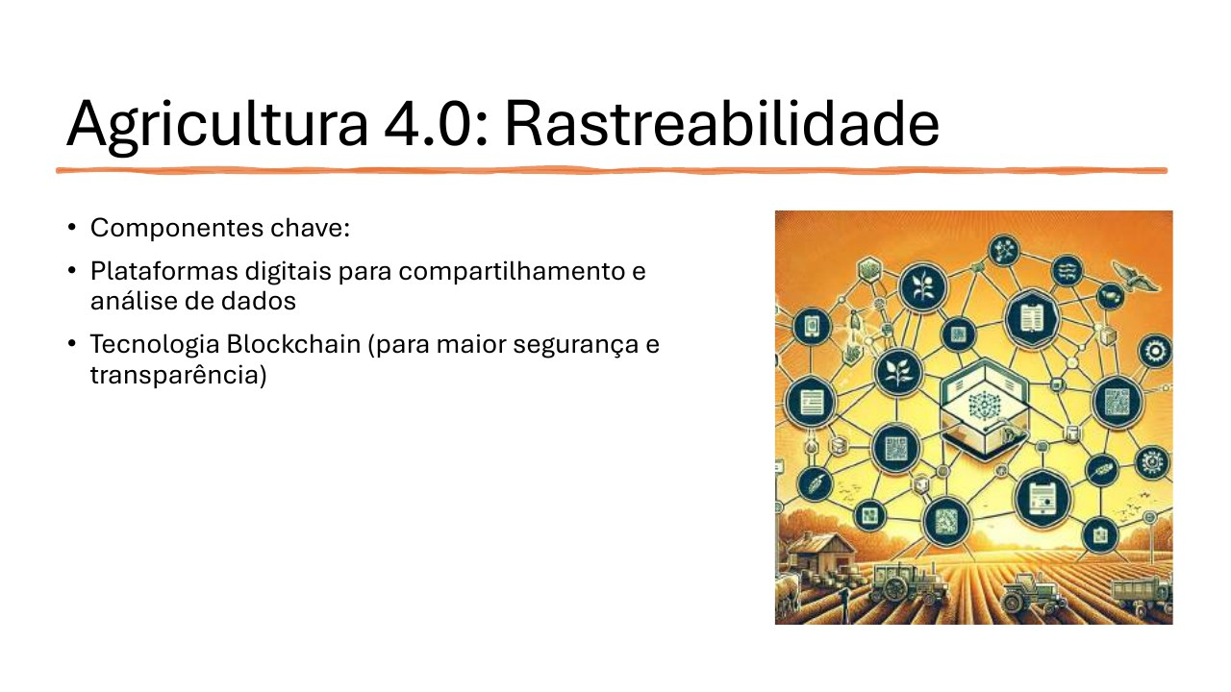
Agriculture 4.0: Traceability
• Key components:
• Digital platforms for data sharing and analysis;
• Blockchain technology for stronger security and transparency.
Notes:
[Sources]
- User-provided source: aula09tp546.pdf, page 21. English translation prepared from the original Portuguese content.

Slide 22
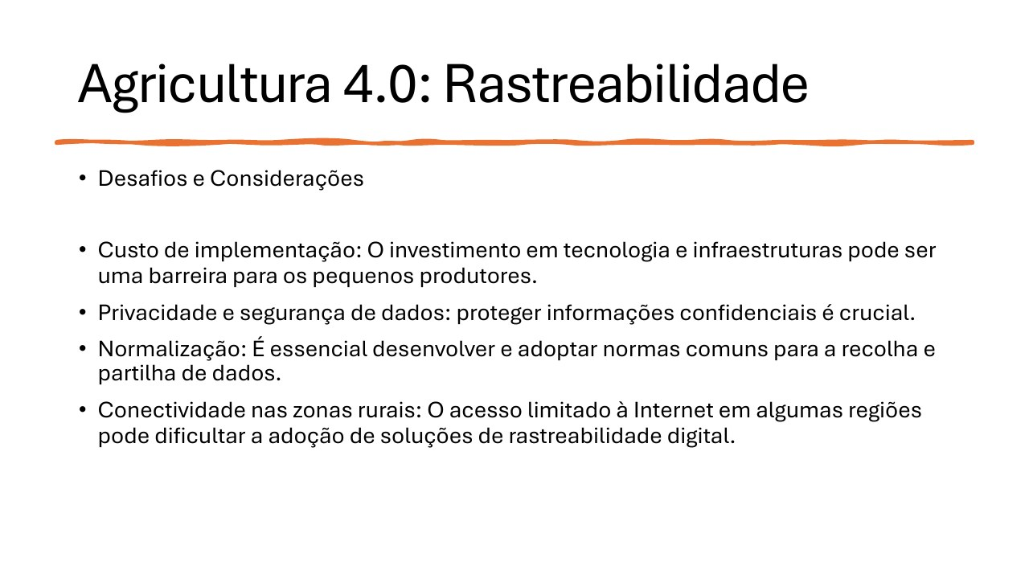
Agriculture 4.0: Traceability
• Challenges and considerations:
• Implementation cost may be a barrier for small producers;
• Data privacy and security are critical;
• Common standards are needed for data collection and sharing;
• Limited rural connectivity can hinder digital traceability solutions.
Notes:
[Sources]
- User-provided source: aula09tp546.pdf, page 22. English translation prepared from the original Portuguese content.

Slide 23
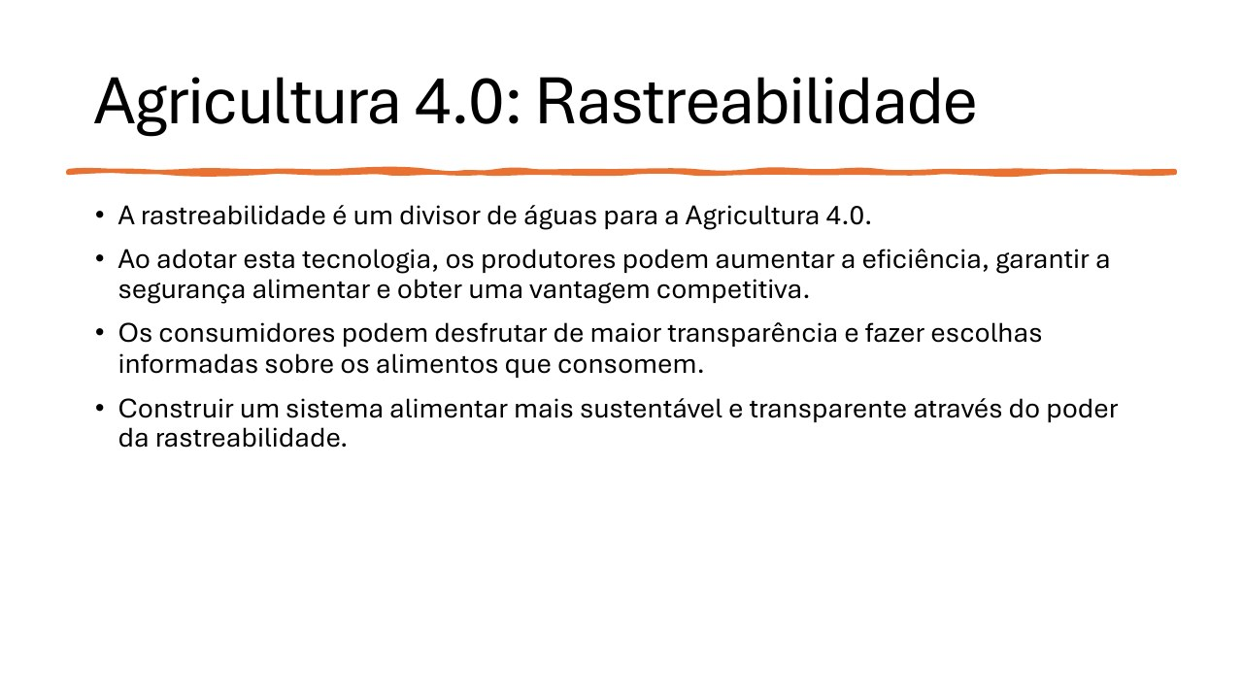
Agriculture 4.0: Traceability
• Traceability is a major enabler of Agriculture 4.0.
• Producers can increase efficiency, ensure food safety, and gain a competitive advantage.
• Consumers gain transparency and can make informed food choices.
• Traceability supports a more sustainable and transparent food system.
Notes:
[Sources]
- User-provided source: aula09tp546.pdf, page 23. English translation prepared from the original Portuguese content.

Slide 24
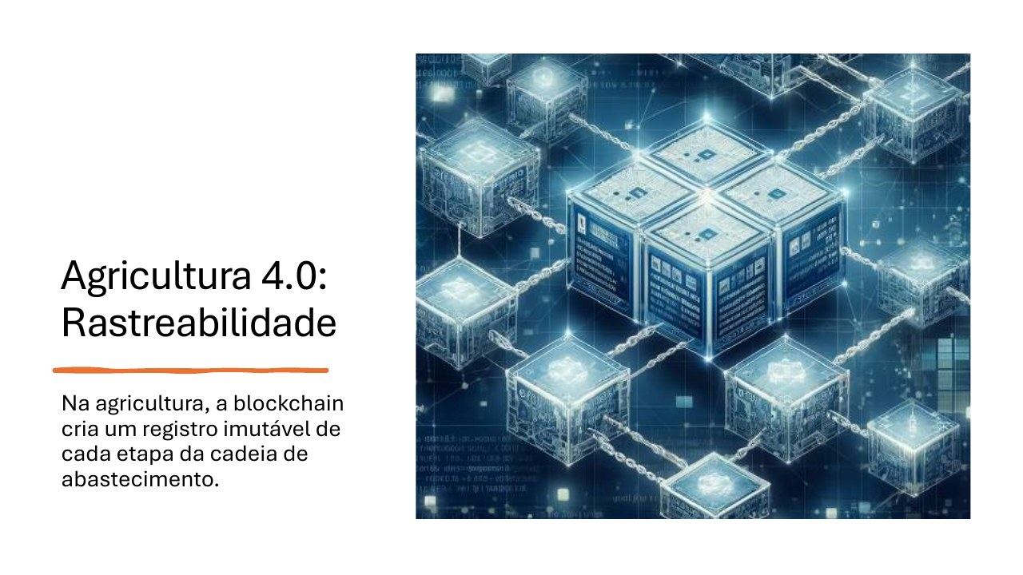
Agriculture 4.0: Traceability
In agriculture, blockchain creates an immutable record of every stage in the supply chain.
Notes:
[Sources]
- User-provided source: aula09tp546.pdf, page 24. English translation prepared from the original Portuguese content.

Slide 25
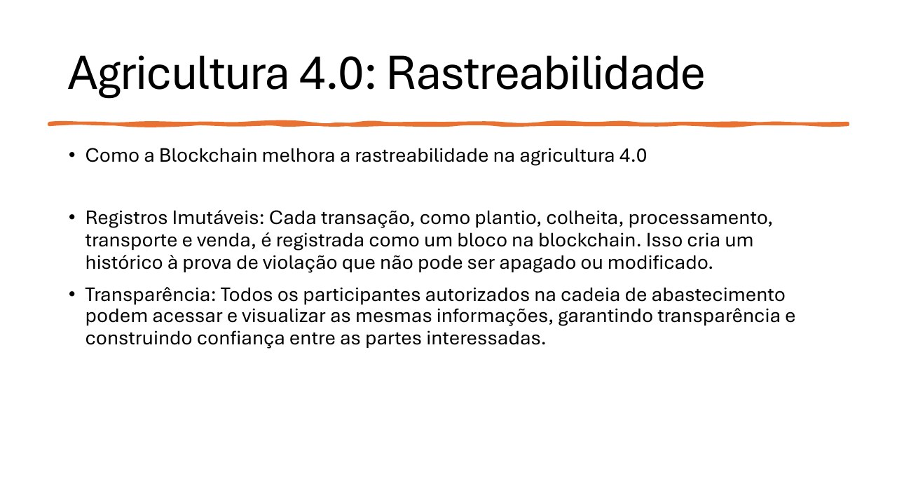
Agriculture 4.0: Traceability
• How blockchain improves traceability in Agriculture 4.0:
• Immutable records: planting, harvesting, processing, transportation, and sales are recorded as tamper-resistant blocks that cannot be erased or changed.
• Transparency: authorized participants access the same information, increasing visibility and trust.
Notes:
[Sources]
- User-provided source: aula09tp546.pdf, page 25. English translation prepared from the original Portuguese content.

Slide 26
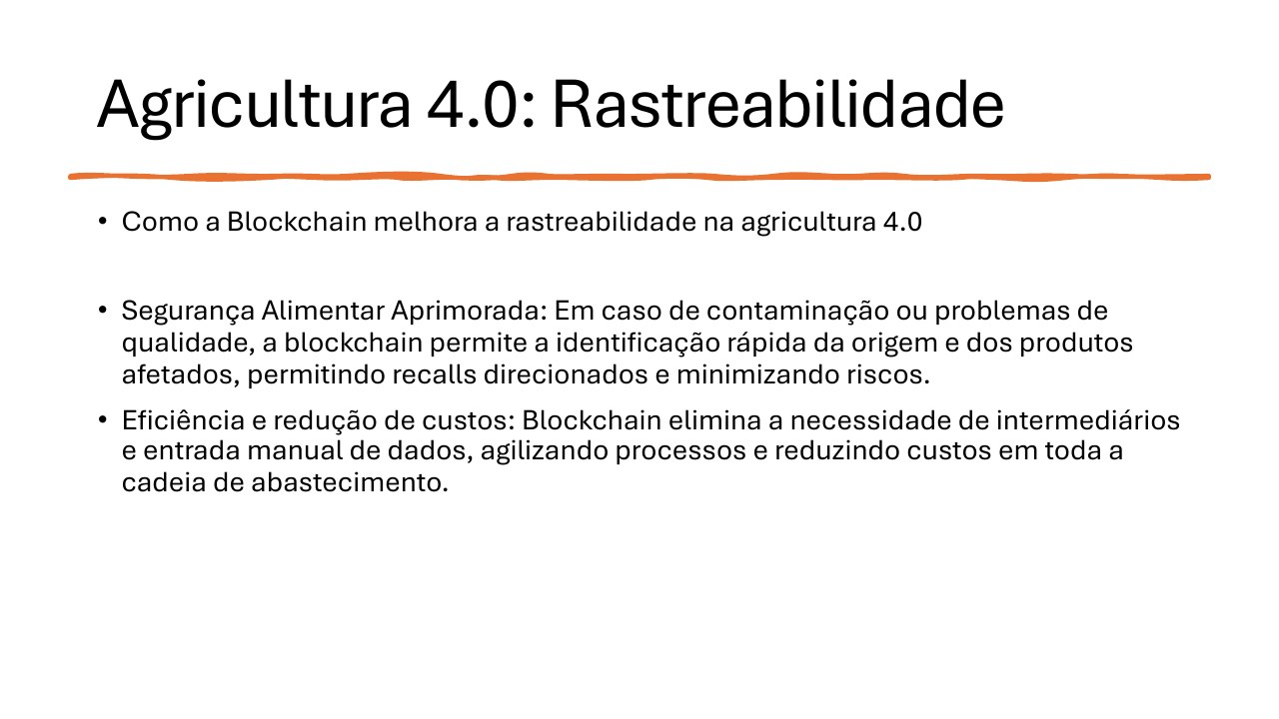
Agriculture 4.0: Traceability
• How blockchain improves traceability in Agriculture 4.0:
• Improved food safety: contamination or quality issues can be traced rapidly, enabling targeted recalls and lower risk.
• Efficiency and cost reduction: blockchain reduces intermediaries and manual data entry, streamlining processes across the supply chain.
Notes:
[Sources]
- User-provided source: aula09tp546.pdf, page 26. English translation prepared from the original Portuguese content.

Slide 27
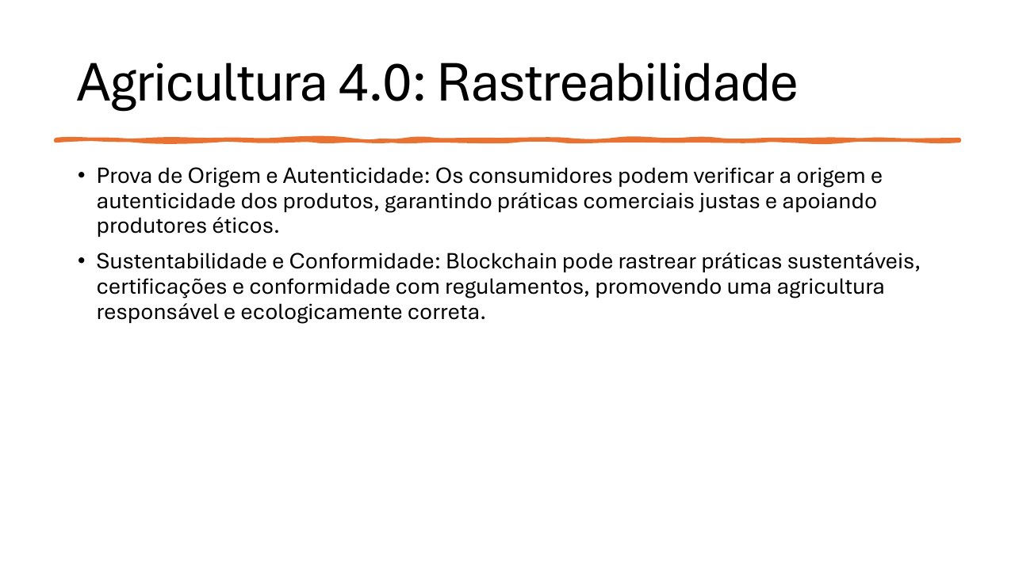
Agriculture 4.0: Traceability
• Proof of origin and authenticity: consumers can verify where products came from, supporting fair trade and ethical producers.
• Sustainability and compliance: blockchain can track sustainable practices, certifications, and regulatory compliance, promoting responsible agriculture.
Notes:
[Sources]
- User-provided source: aula09tp546.pdf, page 27. English translation prepared from the original Portuguese content.

Slide 28
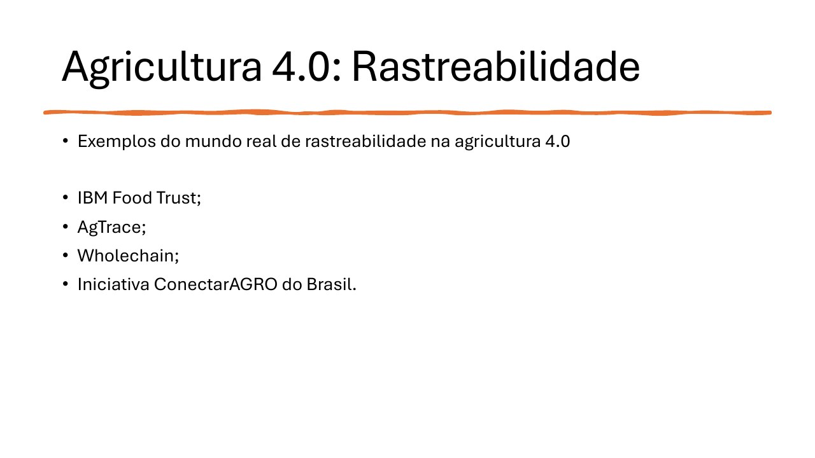
Agriculture 4.0: Traceability
• Real-world examples of Agriculture 4.0 traceability:
• IBM Food Trust;
• AgTrace;
• Wholechain;
• Brazil's ConectarAGRO initiative.
Notes:
[Sources]
- User-provided source: aula09tp546.pdf, page 28. English translation prepared from the original Portuguese content.

Slide 29
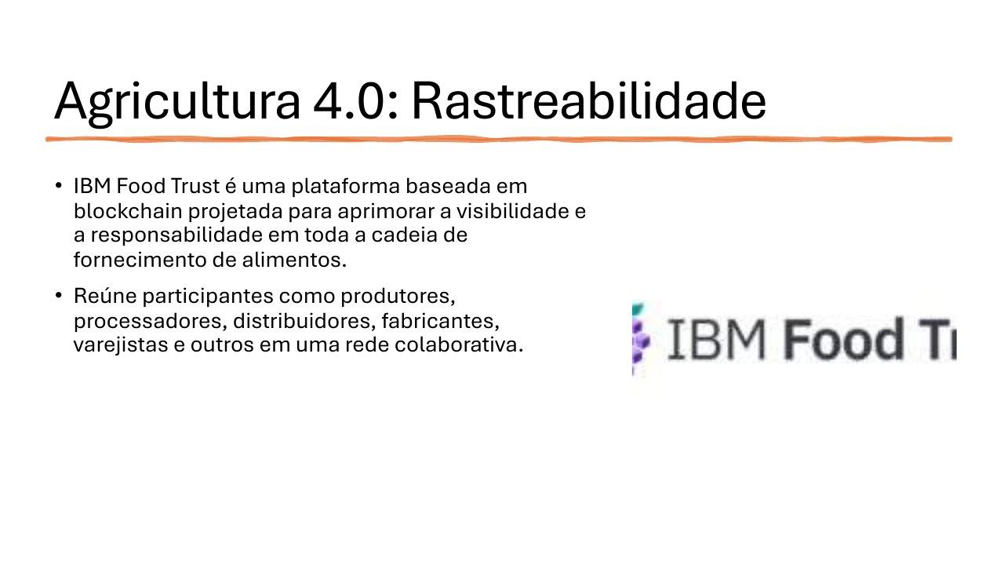
Agriculture 4.0: Traceability
• IBM Food Trust is a blockchain-based platform designed to improve visibility and accountability throughout the food supply chain.
• It connects producers, processors, distributors, manufacturers, retailers, and other participants in a collaborative network.
Notes:
[Sources]
- User-provided source: aula09tp546.pdf, page 29. English translation prepared from the original Portuguese content.

Slide 30
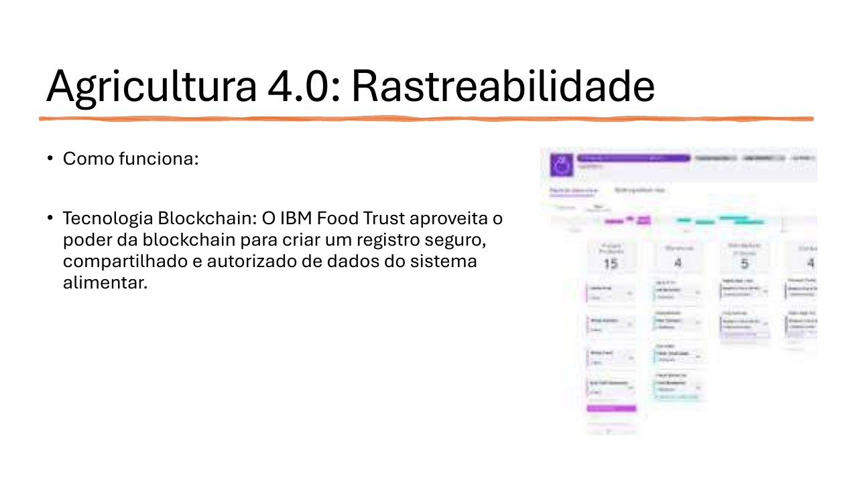
Agriculture 4.0: Traceability
• How it works:
• Blockchain technology: IBM Food Trust creates a secure, shared, permissioned record of food-system data.
Notes:
[Sources]
- User-provided source: aula09tp546.pdf, page 30. English translation prepared from the original Portuguese content.

Slide 31
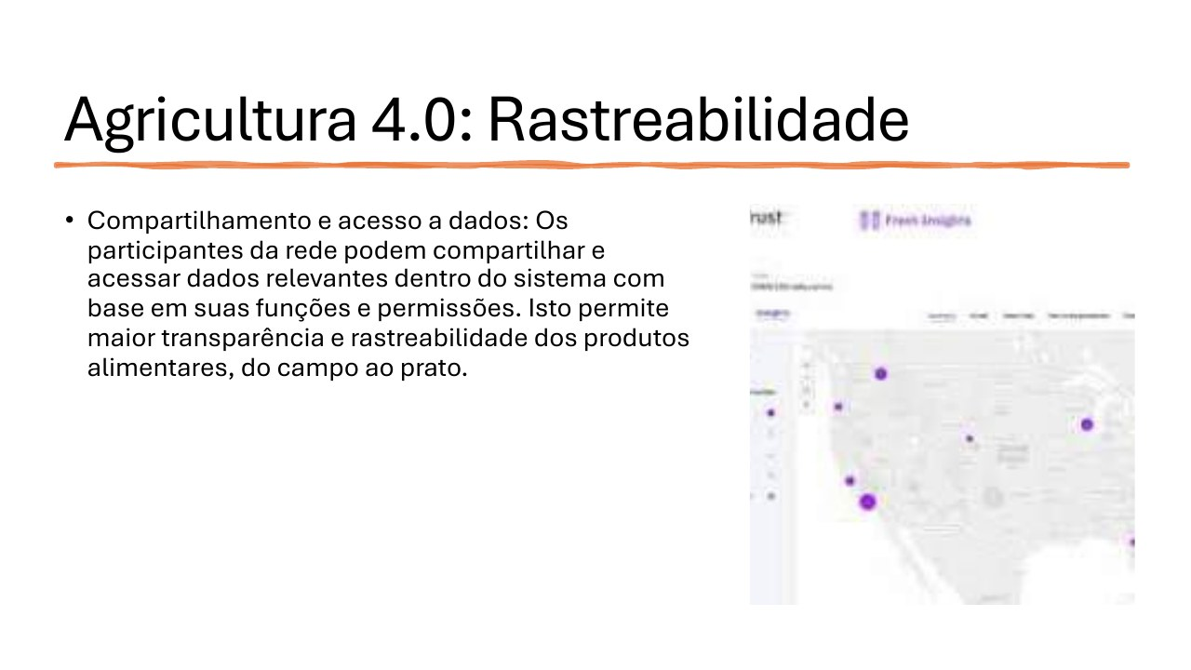
Agriculture 4.0: Traceability
• Data sharing and access: network participants share and access relevant data according to their roles and permissions.
• This improves transparency and traceability from farm to plate.
Notes:
[Sources]
- User-provided source: aula09tp546.pdf, page 31. English translation prepared from the original Portuguese content.

Slide 32
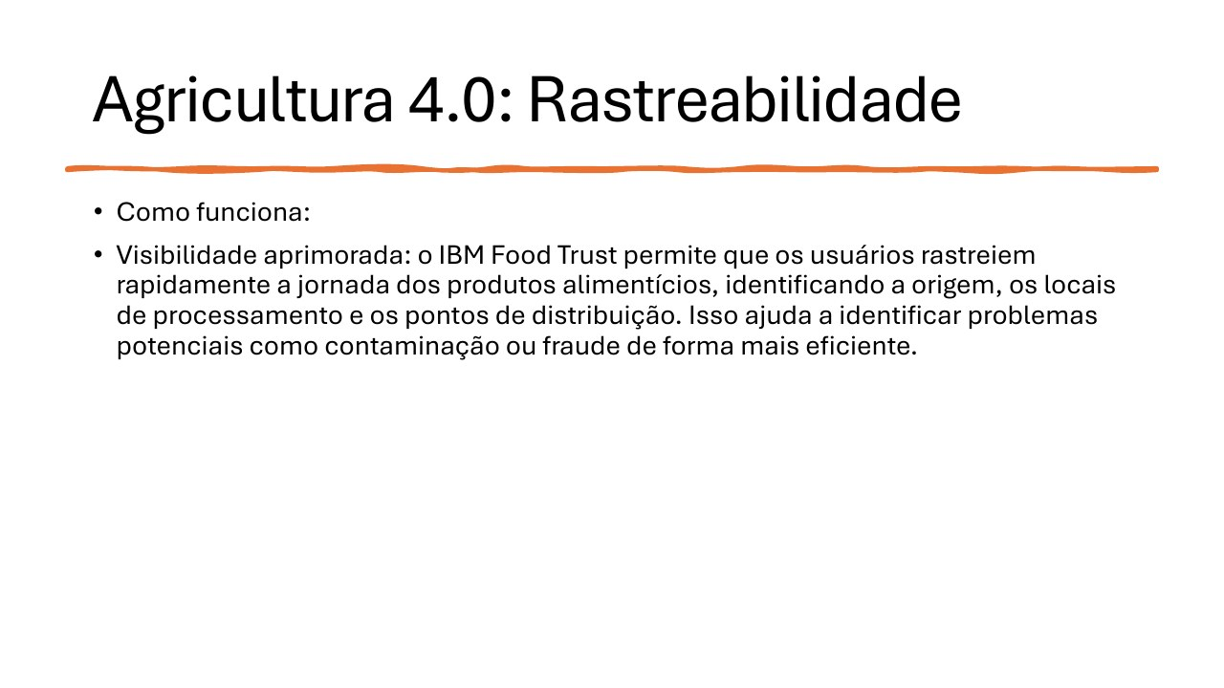
Agriculture 4.0: Traceability
• How it works:
• Improved visibility: IBM Food Trust allows users to trace food journeys rapidly, identifying origins, processing sites, and distribution points. Potential contamination or fraud can therefore be investigated more efficiently.
Notes:
[Sources]
- User-provided source: aula09tp546.pdf, page 32. English translation prepared from the original Portuguese content.

Slide 33
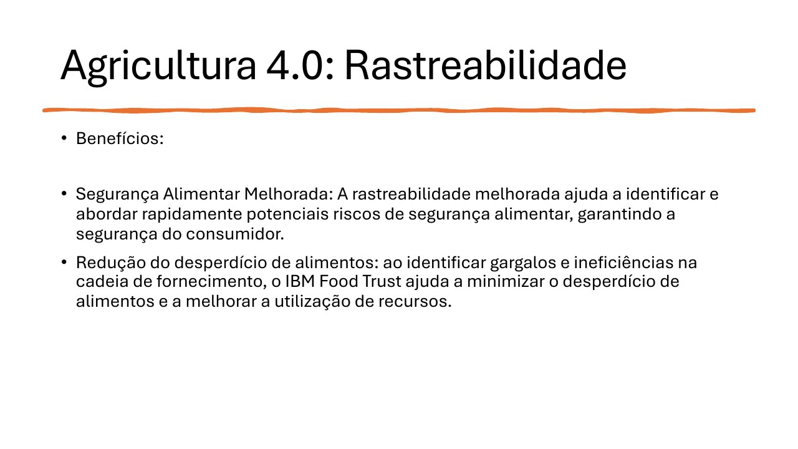
Agriculture 4.0: Traceability
• Benefits:
• Improved food safety: stronger traceability helps identify and address safety risks rapidly.
• Reduced food waste: identifying bottlenecks and inefficiencies minimizes waste and improves resource use.
Notes:
[Sources]
- User-provided source: aula09tp546.pdf, page 33. English translation prepared from the original Portuguese content.

Slide 34
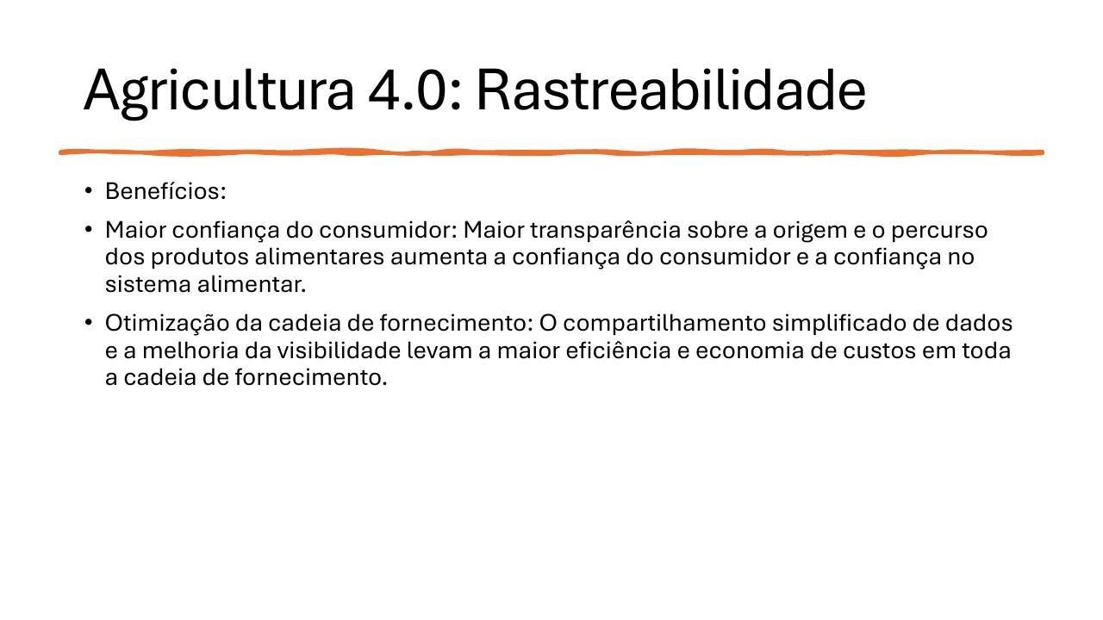
Agriculture 4.0: Traceability
• Benefits:
• Greater consumer confidence: transparency about origin and product journeys strengthens trust in the food system.
• Supply-chain optimization: simplified data sharing and better visibility improve efficiency and reduce costs.
Notes:
[Sources]
- User-provided source: aula09tp546.pdf, page 34. English translation prepared from the original Portuguese content.

Slide 35
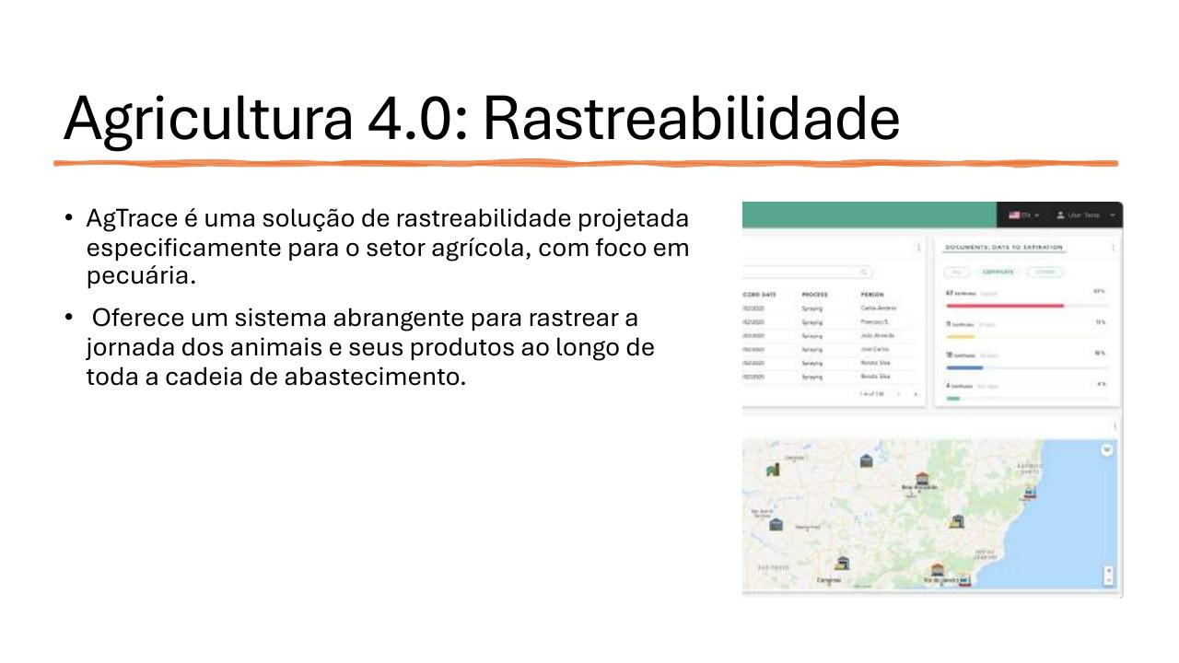
Agriculture 4.0: Traceability
• AgTrace is a traceability solution designed specifically for agriculture, with a focus on livestock.
• It provides a comprehensive system for tracking animals and animal products throughout the supply chain.
Notes:
[Sources]
- User-provided source: aula09tp546.pdf, page 35. English translation prepared from the original Portuguese content.

Slide 36
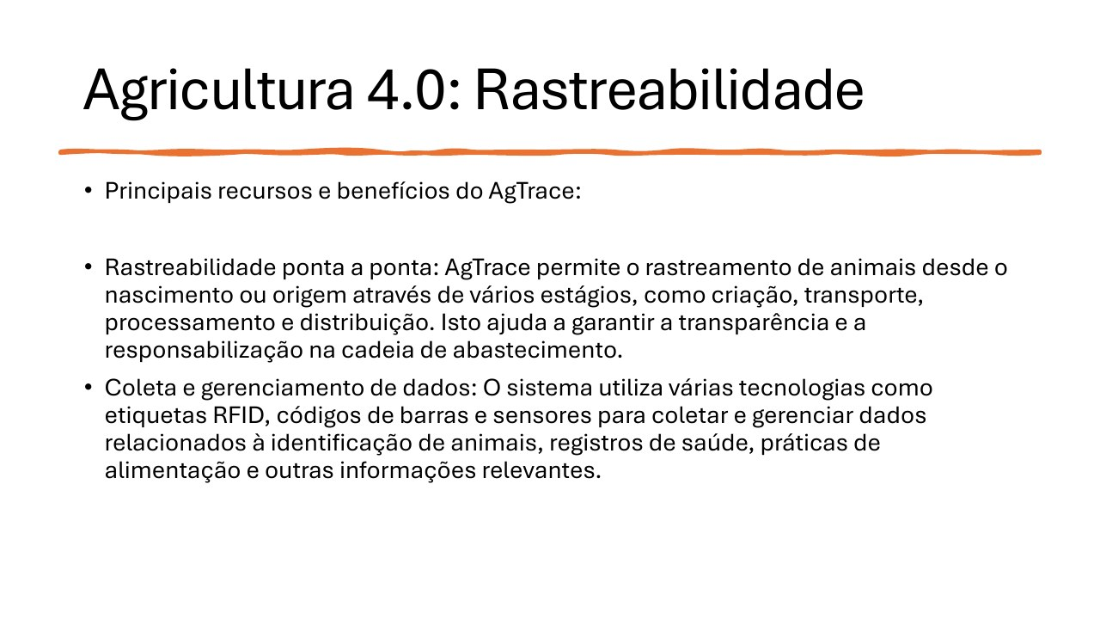
Agriculture 4.0: Traceability
• AgTrace features and benefits:
• End-to-end traceability tracks animals from birth through breeding, transport, processing, and distribution.
• RFID tags, barcodes, and sensors collect and manage identification, health, feeding, and other relevant data.
Notes:
[Sources]
- User-provided source: aula09tp546.pdf, page 36. English translation prepared from the original Portuguese content.

Slide 37
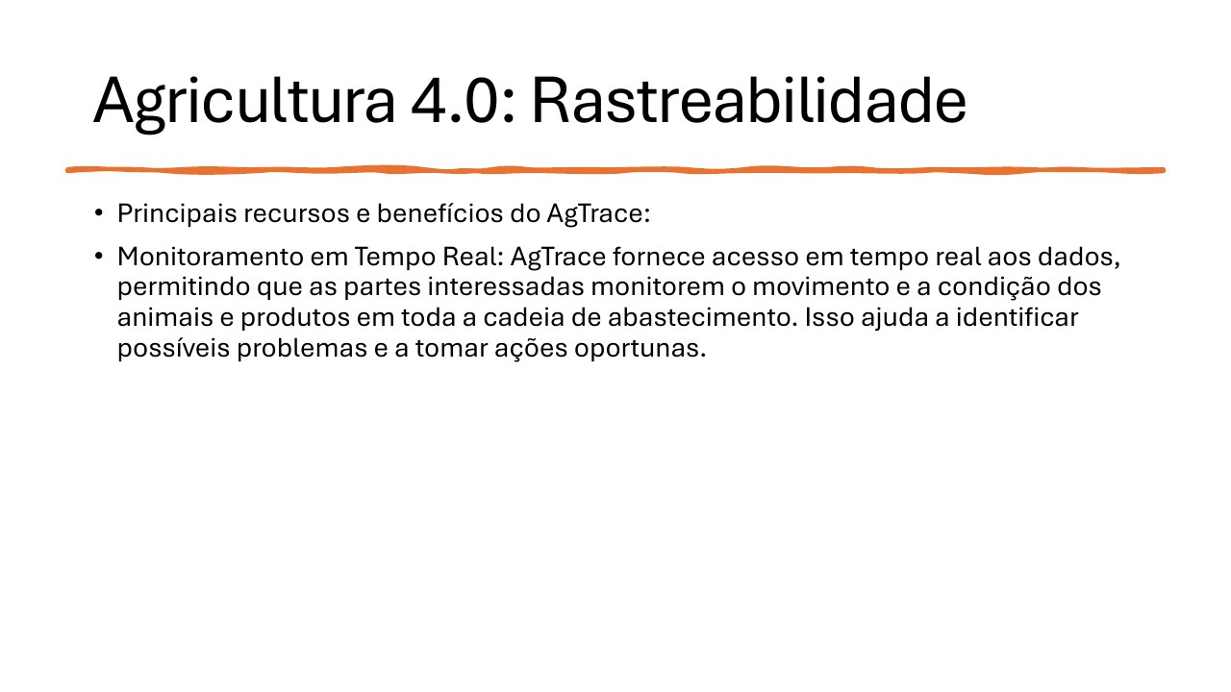
Agriculture 4.0: Traceability
• AgTrace features and benefits:
• Real-time monitoring gives stakeholders immediate access to the movement and condition of animals and products across the supply chain, supporting early problem detection and timely action.
Notes:
[Sources]
- User-provided source: aula09tp546.pdf, page 37. English translation prepared from the original Portuguese content.

Slide 38
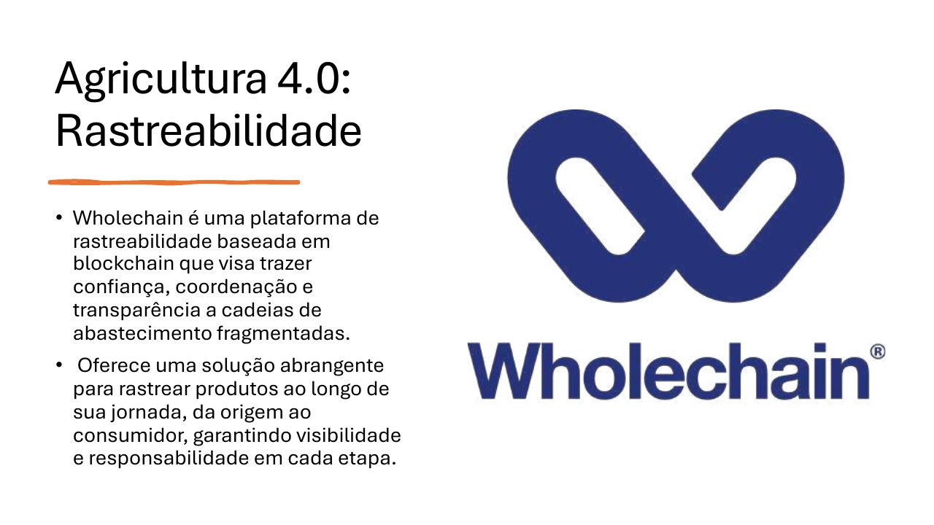
Agriculture 4.0: Traceability
• Wholechain is a blockchain-based traceability platform designed to bring trust, coordination, and transparency to fragmented supply chains.
• It tracks products from origin to consumer, supporting visibility and accountability at every stage.
Notes:
[Sources]
- User-provided source: aula09tp546.pdf, page 38. English translation prepared from the original Portuguese content.

Slide 39
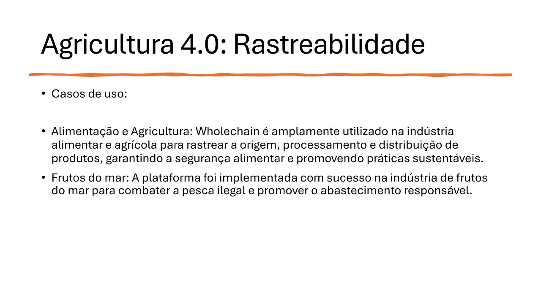
Agriculture 4.0: Traceability
• Use cases:
• Food and agriculture: Wholechain tracks origin, processing, and distribution to support safety and sustainable practices.
• Seafood: the platform has been used to fight illegal fishing and promote responsible sourcing.
Notes:
[Sources]
- User-provided source: aula09tp546.pdf, page 39. English translation prepared from the original Portuguese content.

Slide 40
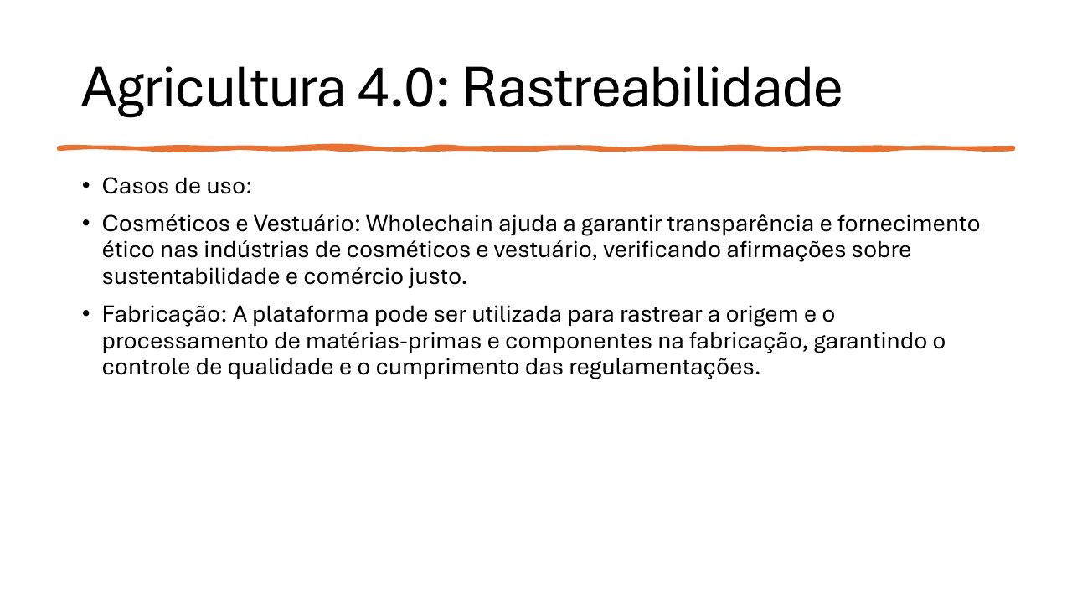
Agriculture 4.0: Traceability
• Use cases:
• Cosmetics and apparel: Wholechain verifies sustainability and fair-trade claims, supporting ethical sourcing.
• Manufacturing: the platform tracks raw materials and components, supporting quality control and regulatory compliance.
Notes:
[Sources]
- User-provided source: aula09tp546.pdf, page 40. English translation prepared from the original Portuguese content.

Slide 41
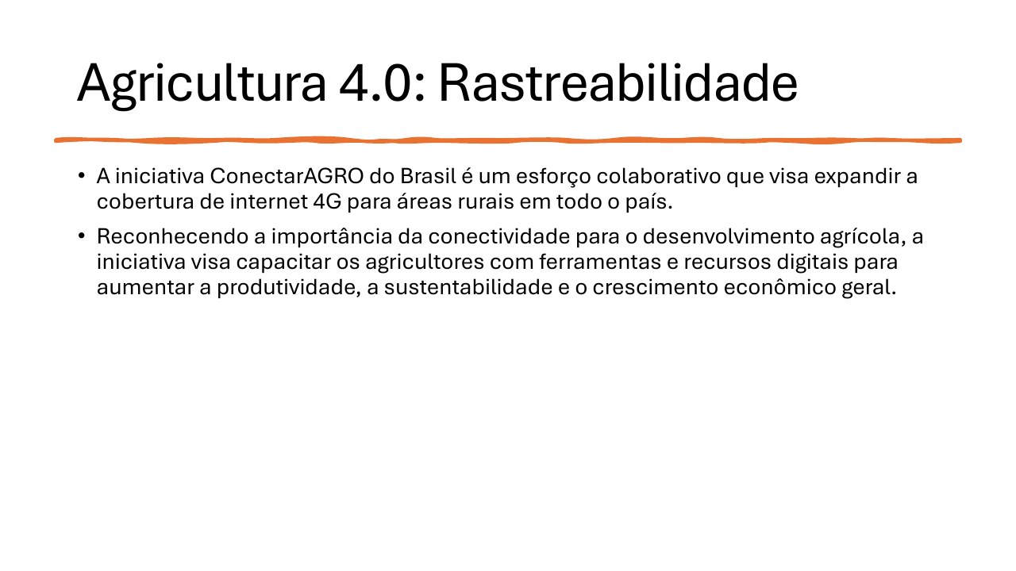
Agriculture 4.0: Traceability
• Brazil's ConectarAGRO initiative is a collaborative effort to expand 4G internet coverage in rural areas.
• Recognizing that connectivity drives agricultural development, it gives farmers digital tools and resources to improve productivity, sustainability, and economic growth.
Notes:
[Sources]
- User-provided source: aula09tp546.pdf, page 41. English translation prepared from the original Portuguese content.

Slide 42
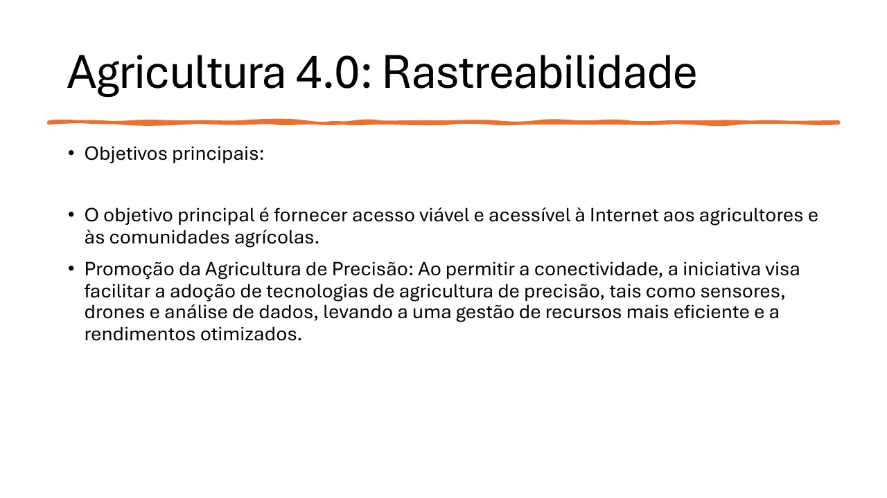
Agriculture 4.0: Traceability
• Main objectives:
• Provide affordable and practical internet access to farmers and agricultural communities.
• Promote precision agriculture by enabling sensors, drones, and data analytics for more efficient resource management and optimized yields.
Notes:
[Sources]
- User-provided source: aula09tp546.pdf, page 42. English translation prepared from the original Portuguese content.

Slide 43
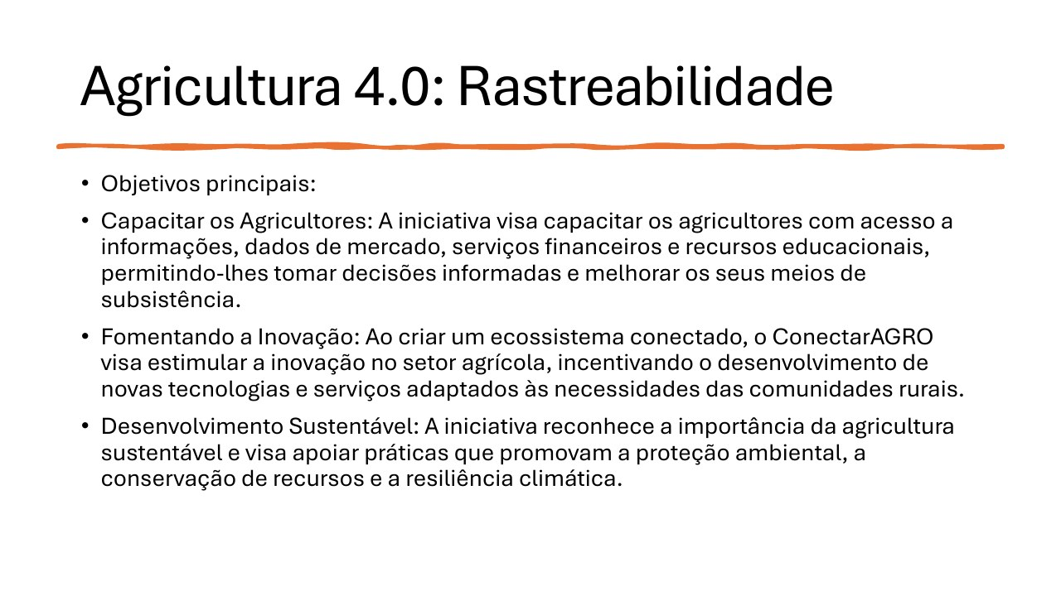
Agriculture 4.0: Traceability
• Main objectives:
• Empower farmers with information, market data, financial services, and educational resources;
• Encourage innovation through technologies and services tailored to rural communities;
• Support sustainable practices, environmental protection, resource conservation, and climate resilience.
Notes:
[Sources]
- User-provided source: aula09tp546.pdf, page 43. English translation prepared from the original Portuguese content.

Slide 44
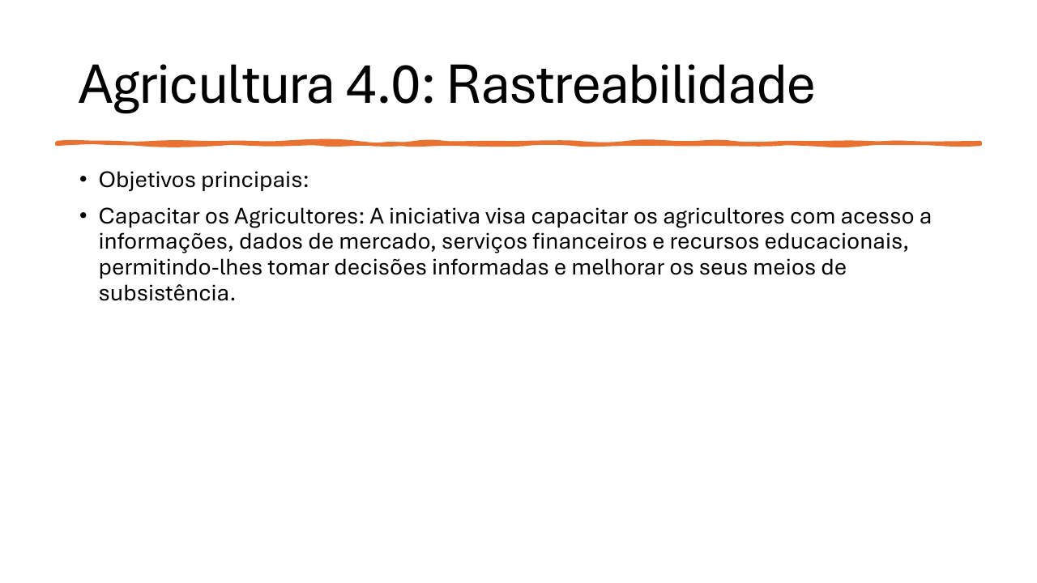
Agriculture 4.0: Traceability
• Main objectives:
• Empower farmers by providing access to information, market data, financial services, and educational resources, enabling informed decisions and improved livelihoods.
Notes:
[Sources]
- User-provided source: aula09tp546.pdf, page 44. English translation prepared from the original Portuguese content.

Slide 45
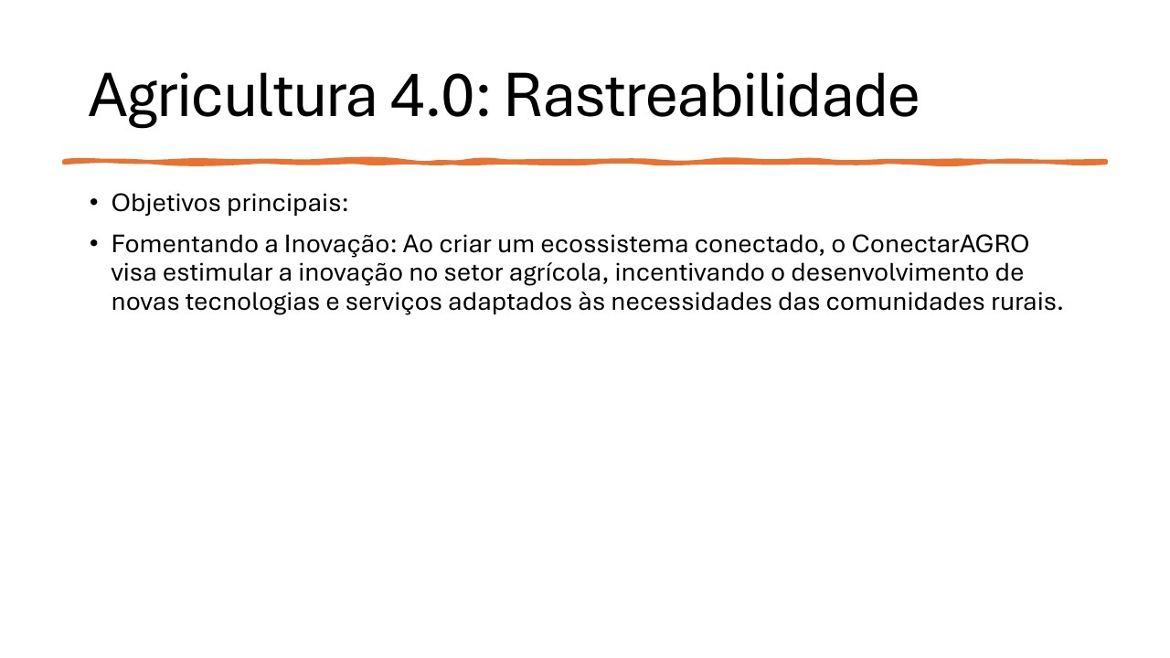
Agriculture 4.0: Traceability
• Main objectives:
• Foster innovation: by creating a connected ecosystem, ConectarAGRO encourages technologies and services tailored to rural communities.
Notes:
[Sources]
- User-provided source: aula09tp546.pdf, page 45. English translation prepared from the original Portuguese content.

Slide 46
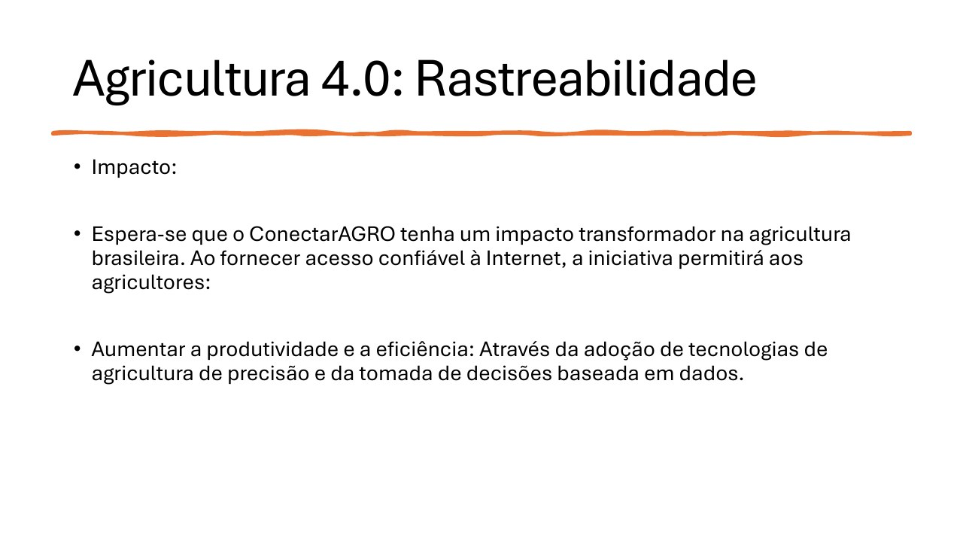
Agriculture 4.0: Traceability
• Expected impact:
• Reliable internet access can transform Brazilian agriculture by enabling precision technologies and data-driven decisions that increase productivity and efficiency.
Notes:
[Sources]
- User-provided source: aula09tp546.pdf, page 46. English translation prepared from the original Portuguese content.

Slide 47
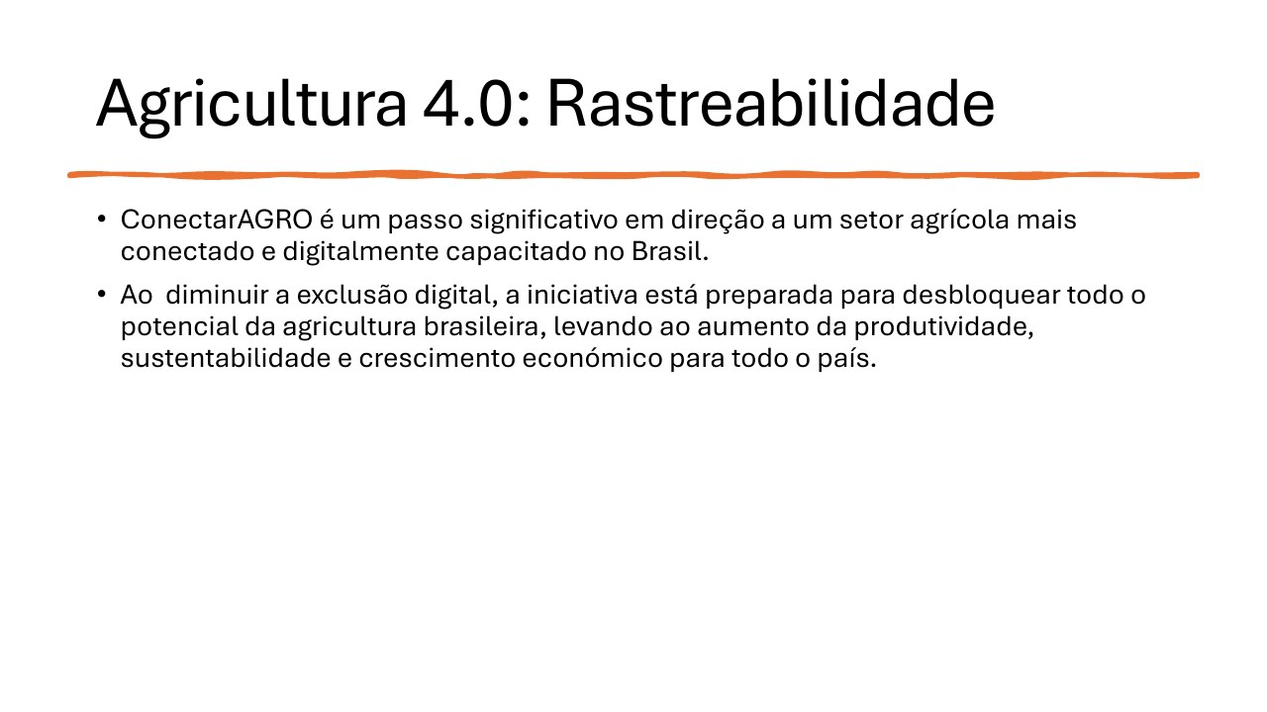
Agriculture 4.0: Traceability
• ConectarAGRO is a significant step toward a connected and digitally enabled Brazilian agricultural sector.
• By narrowing the digital divide, it can unlock greater productivity, sustainability, and economic growth nationwide.
Notes:
[Sources]
- User-provided source: aula09tp546.pdf, page 47. English translation prepared from the original Portuguese content.

Slide 48
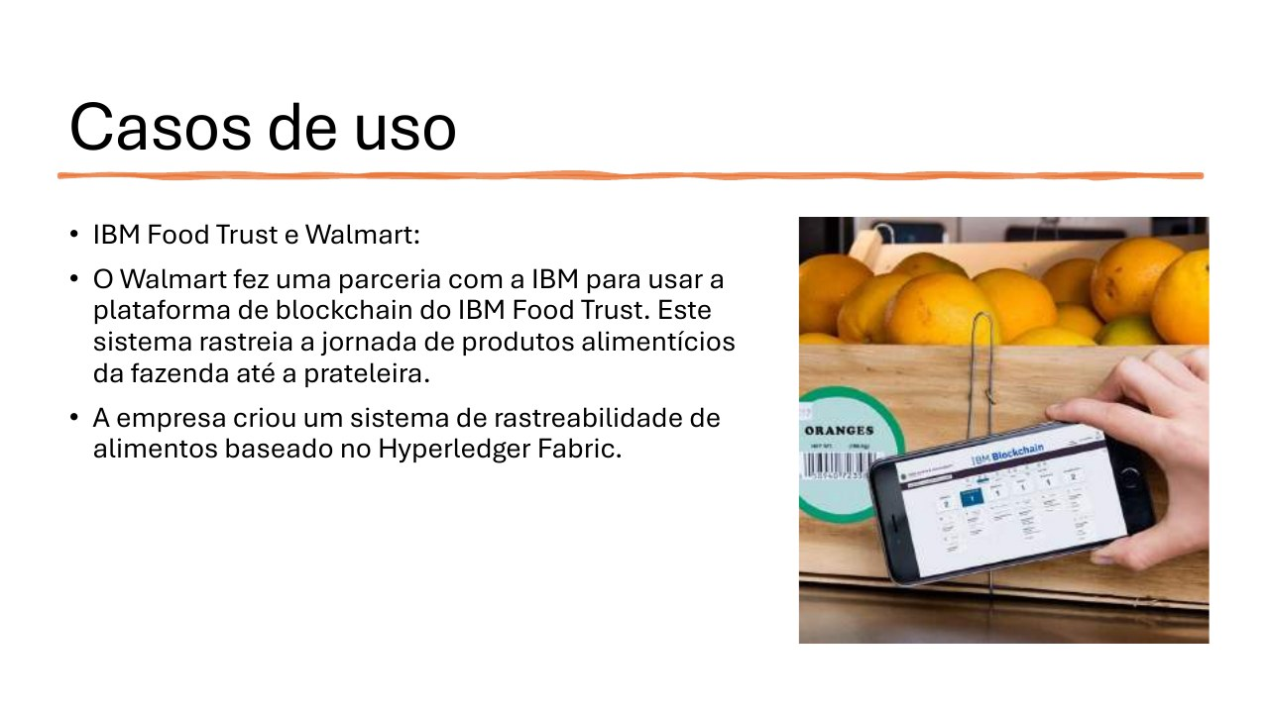
Use Cases
• IBM Food Trust and Walmart:
• Walmart partnered with IBM to use the IBM Food Trust blockchain platform to track food from farm to shelf.
• The traceability system is based on Hyperledger Fabric.
Notes:
[Sources]
- User-provided source: aula09tp546.pdf, page 48. English translation prepared from the original Portuguese content.

Slide 49
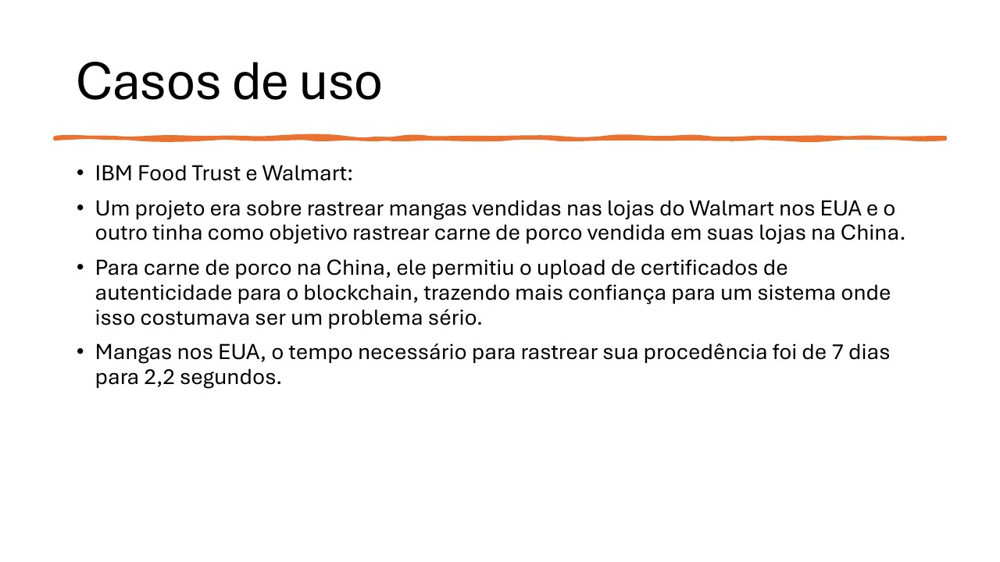
Use Cases
• IBM Food Trust and Walmart:
• One pilot traced mangoes sold in U.S. stores; another traced pork sold in China.
• For Chinese pork, authenticity certificates were uploaded to the blockchain.
• For U.S. mangoes, origin-tracing time fell from seven days to 2.2 seconds.
Notes:
[Sources]
- User-provided source: aula09tp546.pdf, page 49. English translation prepared from the original Portuguese content.

Slide 50
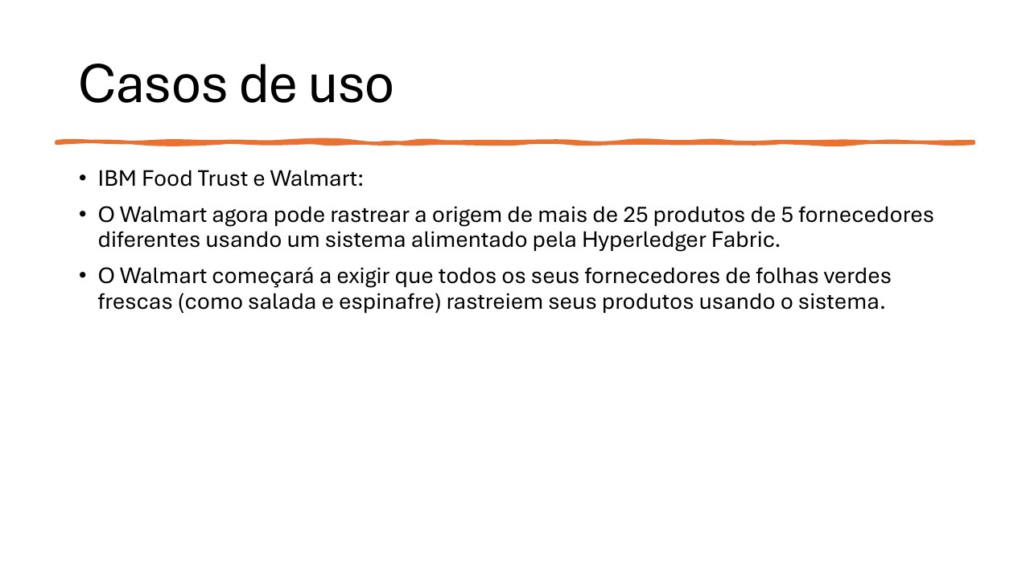
Use Cases
• IBM Food Trust and Walmart:
• Walmart can track the origin of more than 25 products from five suppliers using Hyperledger Fabric.
• Fresh leafy-green suppliers are required to trace products such as lettuce and spinach through the system.
Notes:
[Sources]
- User-provided source: aula09tp546.pdf, page 50. English translation prepared from the original Portuguese content.

Slide 51

Use Cases
• Provenance:
• Provenance uses blockchain to track the origin and journey of food products.
• Indonesia is the world's largest tuna-producing country, and tuna fishing is an important source of employment and foreign income.
Notes:
[Sources]
- User-provided source: aula09tp546.pdf, page 51. English translation prepared from the original Portuguese content.

Slide 52

Use Cases
• The tuna industry faces overfishing, human-rights abuses, fraud, and illegal, unreported, and unregulated fishing.
• Provenance tracks tuna from Indonesian waters to the final consumer, helping confirm sustainable harvesting and processing.
Notes:
[Sources]
- User-provided source: aula09tp546.pdf, page 52. English translation prepared from the original Portuguese content.

Slide 53

Use Cases
• Source: https://www.provenance.org/news-insights/tracking-tuna-catch-customer
Notes:
[Sources]
- User-provided source: aula09tp546.pdf, page 53. English translation prepared from the original Portuguese content.

Slide 54

Use Cases
• Phase 1 - the first mile:
• Local fishers receive blockchain keys linked to verified phone and catch data. Simple SMS messages record daily catches and create blockchain assets. When fish are sold, ownership transfers to the supplier, creating a permanent digital history.
Notes:
[Sources]
- User-provided source: aula09tp546.pdf, page 54. English translation prepared from the original Portuguese content.

Slide 55

Use Cases
• Phase 2 - along the chain:
• Data flow into ERP and supply-chain systems to verify factory inputs and outputs. Smart contracts manage conversion from raw fish to finished products. Blockchain prevents duplicate sustainability claims and allows certifications to be accounted for without exposing every participant's complete dataset.
Notes:
[Sources]
- User-provided source: aula09tp546.pdf, page 55. English translation prepared from the original Portuguese content.

Slide 56

Use Cases
• Phase 3 - consumer environments:
• Information collected at origin and throughout the supply chain becomes available to downstream buyers. Brands and retailers can replace dense printed communication with mobile-accessible information about producers, suppliers, and processing procedures.
Notes:
[Sources]
- User-provided source: aula09tp546.pdf, page 56. English translation prepared from the original Portuguese content.

Slide 57

Use Cases
• Zebra Technologies and McCormick & Company:
• McCormick uses Zebra barcode and RFID solutions to trace spices, herbs, and seasonings.
• Ingredients can be tracked from origin to final product, supporting quality and food-safety compliance.
Notes:
[Sources]
- User-provided source: aula09tp546.pdf, page 57. English translation prepared from the original Portuguese content.

Slide 58

Use Cases
• Fairfood:
• Fairfood is a nonprofit that uses blockchain to provide supply-chain transparency.
• The initiative helps ensure fair compensation for producers and lets consumers trace food to its source.
Notes:
[Sources]
- User-provided source: aula09tp546.pdf, page 58. English translation prepared from the original Portuguese content.

Slide 59

Use Cases
• Fairfood and coffee producers:
• In collaboration with Koffielust and coffee supplier MAAS, Pure Africa developed an exclusive coffee label called De Idealist.
Notes:
[Sources]
- User-provided source: aula09tp546.pdf, page 59. English translation prepared from the original Portuguese content.

Slide 60

Use Cases
• Fairfood and coffee producers:
• Pure Africa uses the Trace platform to gain deeper insight into the production chains behind this coffee.
Notes:
[Sources]
- User-provided source: aula09tp546.pdf, page 60. English translation prepared from the original Portuguese content.

Slide 61

Use Cases
• Fairfood and coffee producers:
• Trabocca is a coffee-bean importer that works with growers, cooperatives, and exporters to supply roasters with traceable green specialty coffees.
Notes:
[Sources]
- User-provided source: aula09tp546.pdf, page 61. English translation prepared from the original Portuguese content.

Slide 62

Use Cases
• In partnership with Fairfood, Trabocca traced every transaction behind its Ethiopian coffee.
• The data indicated that participating farmers earned 63% more than farmers elsewhere.
Notes:
[Sources]
- User-provided source: aula09tp546.pdf, page 62. English translation prepared from the original Portuguese content.

Slide 63

Use Cases
• TE-FOOD is a blockchain-based farm-to-table food traceability solution.
• It has been deployed in several countries to track livestock and fresh products.
• In Vietnam, TE-FOOD traces the pork supply chain from breeding to retail, supporting transparency and safety.
Notes:
[Sources]
- User-provided source: aula09tp546.pdf, page 63. English translation prepared from the original Portuguese content.

Slide 64

Use Cases
• Nestlé and OpenSC:
• Nestlé partnered with blockchain platform OpenSC to trace product supply chains.
• The initiative provides transparency and helps guarantee authenticity and quality.
Notes:
[Sources]
- User-provided source: aula09tp546.pdf, page 64. English translation prepared from the original Portuguese content.

Slide 65

Use Cases
• Nestlé and OpenSC:
• A traceability tool follows Congo's KAHAWA coffee used in Nespresso capsules.
• https://nestle-nespresso.com/news/new-levels-transparency-coffee-supply-chain
• https://nespresso.opensc.org/product/46155847884615538540/journey
Notes:
[Sources]
- User-provided source: aula09tp546.pdf, page 65. English translation prepared from the original Portuguese content.

Slide 66

Use Cases
• Nestlé and OpenSC:
• Traceability for Congo's KAHAWA coffee used in Nespresso capsules.
Notes:
[Sources]
- User-provided source: aula09tp546.pdf, page 66. English translation prepared from the original Portuguese content.

Slide 67

Use Cases
• Nestlé and OpenSC:
• Traceability for Congo's KAHAWA coffee used in Nespresso capsules.
Notes:
[Sources]
- User-provided source: aula09tp546.pdf, page 67. English translation prepared from the original Portuguese content.

Slide 68

Use Cases
• Carrefour and Hyperledger:
• Carrefour uses Hyperledger Fabric to trace products including meat, milk, and fruit.
• Customers scan a QR code on the package to view the product's journey from farm to shelf.
Notes:
[Sources]
- User-provided source: aula09tp546.pdf, page 68. English translation prepared from the original Portuguese content.

Slide 69

Use Cases
• Carrefour and BRF:
• BRF and Carrefour partnered with IBM Brazil on the Food Tracking project.
• The goal is blockchain-based product traceability.
Notes:
[Sources]
- User-provided source: aula09tp546.pdf, page 69. English translation prepared from the original Portuguese content.

Slide 70

Use Cases
• Italian olive oil:
• The Italian government implemented blockchain traceability for olive oil.
• Consumers can trace oil to a specific farm and production batch, helping guarantee authenticity and quality.
Notes:
[Sources]
- User-provided source: aula09tp546.pdf, page 70. English translation prepared from the original Portuguese content.

Slide 71

Use Cases
• IBM Food Trust and Coricelli:
• A three-year supply-chain contract covers 2 million kg of Italian olive oil from three organizations in Apulia.
• Coricelli is present in 110 countries; exports represent 54% of sales.
• Four million kg of oil are traced by blockchain.
• The product carries the 100% Italian label 'Signed by Italian Farmers.'
Notes:
[Sources]
- User-provided source: aula09tp546.pdf, page 71. English translation prepared from the original Portuguese content.

Slide 72

Agriculture 4.0: Big Data
Notes:
[Sources]
- User-provided source: aula09tp546.pdf, page 72. English translation prepared from the original Portuguese content.

Slide 73

Agriculture 4.0: Big Data
• In Agriculture 4.0, big data refers to the vast and diverse datasets generated by sensors, drones, satellites, weather stations, and agricultural machinery.
Notes:
[Sources]
- User-provided source: aula09tp546.pdf, page 73. English translation prepared from the original Portuguese content.

Slide 74

Agriculture 4.0: Big Data
• Big-data analytics processes this information to uncover patterns, trends, and correlations, helping farmers make informed decisions.
Notes:
[Sources]
- User-provided source: aula09tp546.pdf, page 74. English translation prepared from the original Portuguese content.

Slide 75

Agriculture 4.0: Big Data
The five Vs of Big Data:
• Volume: the massive amount of data generated;
• Velocity: how quickly data are collected and processed;
• Variety: multiple data types, including images, text, and numbers;
• Veracity: data quality and reliability;
• Value: the insights and decisions derived from data.
Notes:
[Sources]
- User-provided source: aula09tp546.pdf, page 75. English translation prepared from the original Portuguese content.

Slide 76

Agriculture 4.0: Cloud Computing
Cloud computing provides on-demand computing resources over the internet. It removes the need to manage physical infrastructure directly and lets users pay only for what they consume.
• Infrastructure as a Service: computing and storage;
• Platform as a Service: development and deployment environments;
• Software as a Service: complete applications delivered as services.
Notes:
[Sources]
- User-provided source: aula09tp546.pdf, page 76. English translation prepared from the original Portuguese content.

Slide 77

Agriculture 4.0: Cloud Computing
• Cloud computing provides the infrastructure and services needed to store, process, and analyze the large volumes of data generated by agricultural technologies.
Notes:
[Sources]
- User-provided source: aula09tp546.pdf, page 77. English translation prepared from the original Portuguese content.

Slide 78

Agriculture 4.0: Cloud Computing
• Data storage and management:
• Cloud platforms offer scalable and cost-effective storage for data from sensors, drones, satellites, and agricultural equipment.
• Datasets may describe soil conditions, crop health, weather patterns, and livestock health.
Notes:
[Sources]
- User-provided source: aula09tp546.pdf, page 78. English translation prepared from the original Portuguese content.

Slide 79

Agriculture 4.0: Cloud Computing
• Data processing and analytics:
• Cloud computing supplies the processing power needed to extract decision-support insights.
• Machine-learning algorithms can identify patterns, forecast yields, detect crop diseases, and optimize resource allocation.
Notes:
[Sources]
- User-provided source: aula09tp546.pdf, page 79. English translation prepared from the original Portuguese content.

Slide 80

Agriculture 4.0: Cloud Computing
• Accessibility and collaboration:
• Cloud platforms make agricultural data available to farmers, agronomists, researchers, and other stakeholders wherever internet access exists.
• This supports collaboration, knowledge sharing, faster decisions, and problem solving.
Notes:
[Sources]
- User-provided source: aula09tp546.pdf, page 80. English translation prepared from the original Portuguese content.

Slide 81

Agriculture 4.0: Cloud Computing
• Scalability and flexibility:
• Agricultural organizations can scale IT resources up or down and pay only for what they use.
• This is especially useful for seasonal operations and unexpected events such as weather changes or pest outbreaks.
Notes:
[Sources]
- User-provided source: aula09tp546.pdf, page 81. English translation prepared from the original Portuguese content.

Slide 82

Agriculture 4.0: Cloud Computing
• Cost efficiency:
• By reducing the need for expensive local infrastructure and dedicated IT staff, cloud computing can significantly lower agricultural data-storage and processing costs.
Notes:
[Sources]
- User-provided source: aula09tp546.pdf, page 82. English translation prepared from the original Portuguese content.

Slide 83

Agriculture 4.0: Cloud Computing
• Cloud-computing applications in Agriculture 4.0:
• Farm-management software provides tools for crop planning, field mapping, inventory management, and financial tracking.
Notes:
[Sources]
- User-provided source: aula09tp546.pdf, page 83. English translation prepared from the original Portuguese content.

Slide 84

Agriculture 4.0: Cloud Computing
• Trimble Ag Software:
• Crop planning;
• Operations monitoring;
• Input tracking;
• Financial reporting.
Notes:
[Sources]
- User-provided source: aula09tp546.pdf, page 84. English translation prepared from the original Portuguese content.

Slide 85

Agriculture 4.0: Cloud Computing
• Agroptima:
• Agricultural activity records;
• Inventory control;
• Machinery management;
• Reporting and analytics.
Notes:
[Sources]
- User-provided source: aula09tp546.pdf, page 85. English translation prepared from the original Portuguese content.

Slide 86

Agriculture 4.0: Cloud Computing
• Granular:
• An agricultural management and analytics platform designed to improve efficiency and profitability.
• Features include crop planning, operations tracking, financial reporting, and team management.
Notes:
[Sources]
- User-provided source: aula09tp546.pdf, page 86. English translation prepared from the original Portuguese content.

Slide 87

Agriculture 4.0: Cloud Computing
• Aegro is a farm-management platform that supports complete crop planning, from planting-cost budgets to business productivity targets.
Notes:
[Sources]
- User-provided source: aula09tp546.pdf, page 87. English translation prepared from the original Portuguese content.

Slide 88

Agriculture 4.0: Cloud Computing
• Precision-agriculture platforms use cloud computing to process sensor data and other sources, giving farmers real-time information to optimize irrigation, fertilization, and pest control.
Notes:
[Sources]
- User-provided source: aula09tp546.pdf, page 88. English translation prepared from the original Portuguese content.

Slide 89

Agriculture 4.0: Cloud Computing
• John Deere Operations Center:
• Machinery monitoring;
• Planting, harvesting, and spraying management;
• Yield mapping.
Notes:
[Sources]
- User-provided source: aula09tp546.pdf, page 89. English translation prepared from the original Portuguese content.

Slide 90

Agriculture 4.0: Cloud Computing
• Climate FieldView:
• A Climate Corporation solution that integrates weather, soil, and crop data to provide real-time insights.
Notes:
[Sources]
- User-provided source: aula09tp546.pdf, page 90. English translation prepared from the original Portuguese content.

Slide 91

Agriculture 4.0: Cloud Computing
• Topcon Agriculture:
• Precision solutions designed to optimize agricultural operations.
Notes:
[Sources]
- User-provided source: aula09tp546.pdf, page 91. English translation prepared from the original Portuguese content.

Slide 92

Agriculture 4.0: Cloud Computing
• Livestock-management systems:
• Cloud-based systems monitor animal health, track feeding patterns, and optimize breeding programs.
Notes:
[Sources]
- User-provided source: aula09tp546.pdf, page 92. English translation prepared from the original Portuguese content.

Slide 93

Agriculture 4.0: Cloud Computing
• CattleMax:
• Livestock-management software that helps organize and analyze herd data.
Notes:
[Sources]
- User-provided source: aula09tp546.pdf, page 93. English translation prepared from the original Portuguese content.

Slide 94

Agriculture 4.0: Cloud Computing
• AgriWebb:
• Livestock tracking;
• Pasture planning;
• Treatment records;
• Performance reporting.
Notes:
[Sources]
- User-provided source: aula09tp546.pdf, page 94. English translation prepared from the original Portuguese content.

Slide 95

Agriculture 4.0: Cloud Computing
• MooMonitor+:
• A sensor-based system that tracks cattle health and behavior.
• Functions include activity monitoring, heat detection, rumination tracking, and health alerts.
Notes:
[Sources]
- User-provided source: aula09tp546.pdf, page 95. English translation prepared from the original Portuguese content.

Slide 96

Agriculture 4.0: Cloud Computing
• CowMed:
• A sensor-based monitoring system for dairy-herd management.
Notes:
[Sources]
- User-provided source: aula09tp546.pdf, page 96. English translation prepared from the original Portuguese content.

Slide 97

Agriculture 4.0: Edge Computing
• Edge computing complements the cloud by moving processing closer to where data are generated - at the network edge, within the farm or field.
Notes:
[Sources]
- User-provided source: aula09tp546.pdf, page 97. English translation prepared from the original Portuguese content.

Slide 98

Agriculture 4.0: Edge Computing
• Edge computing supports Agriculture 4.0 through real-time decisions.
• Processing data at the source reduces latency and enables immediate action.
• Examples include adjusting irrigation from live soil-moisture data or detecting pest infestations early.
Notes:
[Sources]
- User-provided source: aula09tp546.pdf, page 98. English translation prepared from the original Portuguese content.

Slide 99

Agriculture 4.0: Edge Computing
• Bandwidth optimization:
• Local processing reduces the amount of data transmitted to the cloud, saving bandwidth and cost.
• Only the most relevant processed information needs to be sent for further analysis and storage.
Notes:
[Sources]
- User-provided source: aula09tp546.pdf, page 99. English translation prepared from the original Portuguese content.

Slide 100

Agriculture 4.0: Edge Computing
• Offline functionality:
• In remote areas with limited or unreliable internet, edge devices can collect data and perform basic analytics autonomously.
• Critical operations can therefore continue without constant connectivity.
Notes:
[Sources]
- User-provided source: aula09tp546.pdf, page 100. English translation prepared from the original Portuguese content.

Slide 101

Agriculture 4.0: Edge Computing
• Improved security:
• Edge computing can keep sensitive agricultural data inside the farm network, reducing exposure during transmission to the cloud.
Notes:
[Sources]
- User-provided source: aula09tp546.pdf, page 101. English translation prepared from the original Portuguese content.

Slide 102

Agriculture 4.0: Edge Computing
• Scalability and adaptability:
• Edge devices can be deployed and scaled according to the needs of a specific farm or field, providing a flexible solution for many agricultural applications.
Notes:
[Sources]
- User-provided source: aula09tp546.pdf, page 102. English translation prepared from the original Portuguese content.

Slide 103

Agriculture 4.0: Edge Computing
• Edge-computing applications in Agriculture 4.0 - smart irrigation:
• Edge devices collect soil-moisture and weather-station data, process them locally, and adjust irrigation schedules automatically in real time.
Notes:
[Sources]
- User-provided source: aula09tp546.pdf, page 103. English translation prepared from the original Portuguese content.

Slide 104

Agriculture 4.0: Edge Computing
• Autonomous agricultural robots:
• Robots with edge-computing capabilities perform weeding, harvesting, and spraying with minimal human intervention, increasing efficiency and precision.
Notes:
[Sources]
- User-provided source: aula09tp546.pdf, page 104. English translation prepared from the original Portuguese content.

Slide 105

Agriculture 4.0: Edge Computing
• Livestock monitoring:
• Edge devices monitor animal health and behavior, provide early warnings of potential problems, and support timely intervention.
Notes:
[Sources]
- User-provided source: aula09tp546.pdf, page 105. English translation prepared from the original Portuguese content.

Slide 106

Agriculture 4.0: Edge Computing
• Crop-disease detection:
• Edge-enabled cameras and sensors analyze plant images for early signs of disease or stress, allowing immediate treatment and helping prevent crop loss.
Notes:
[Sources]
- User-provided source: aula09tp546.pdf, page 106. English translation prepared from the original Portuguese content.

Slide 107

Big Data Platforms
• Several commercial big-data platforms can support Agriculture 4.0 applications:
• Amazon Web Services (AWS);
• Microsoft Azure.
• Services may be usage-based, with free tiers available for limited periods or workloads.
Notes:
[Sources]
- User-provided source: aula09tp546.pdf, page 107. English translation prepared from the original Portuguese content.

Slide 108

Big Data Platforms
• Data collection - Amazon Web Services:
• AWS IoT Core enables connected devices to interact securely and easily with cloud applications.
Notes:
[Sources]
- User-provided source: aula09tp546.pdf, page 108. English translation prepared from the original Portuguese content.

Slide 109

Big Data Platforms
• Data collection:
• AWS IoT Core supports the following protocols:
• MQTT;
• HTTPS;
• LoRaWAN.
Notes:
[Sources]
- User-provided source: aula09tp546.pdf, page 109. English translation prepared from the original Portuguese content.

Slide 110

Big Data Platforms
• Data processing - Amazon Web Services:
• AWS Lambda executes code in response to events and automatically manages computing resources.
Notes:
[Sources]
- User-provided source: aula09tp546.pdf, page 110. English translation prepared from the original Portuguese content.

Slide 111

Big Data Platforms
• Data storage - Amazon Web Services:
• Amazon S3 provides scalable storage for large datasets such as drone imagery and sensor readings.
• Amazon RDS is a managed relational-database service for structured data.
Notes:
[Sources]
- User-provided source: aula09tp546.pdf, page 111. English translation prepared from the original Portuguese content.

Slide 112

Big Data Platforms
• Data analytics - Amazon Web Services:
• Amazon SageMaker is a fully managed service that lets developers and data scientists build, train, and deploy machine-learning models.
Notes:
[Sources]
- User-provided source: aula09tp546.pdf, page 112. English translation prepared from the original Portuguese content.

Slide 113

Big Data Platforms
• Data analytics:
• Support for major machine-learning frameworks, toolkits, and programming languages.
Notes:
[Sources]
- User-provided source: aula09tp546.pdf, page 113. English translation prepared from the original Portuguese content.

Slide 114

Big Data Platforms
• Data analytics - Amazon Web Services:
• Amazon Rekognition provides machine-learning-based image and video analysis.
Notes:
[Sources]
- User-provided source: aula09tp546.pdf, page 114. English translation prepared from the original Portuguese content.

Slide 115

Big Data Platforms: Use Cases
• Amazon Web Services - The Climate Corporation:
• The Climate Corporation uses AWS to collect, process, and analyze large agricultural datasets, including weather and soil information.
Notes:
[Sources]
- User-provided source: aula09tp546.pdf, page 115. English translation prepared from the original Portuguese content.

Slide 116

Big Data Platforms: Use Cases
• Amazon Web Services:
• AWS IoT Core connects field sensors for real-time monitoring.
• Data are stored in Amazon S3 and analyzed with Amazon Redshift to produce forecasts and recommendations for farmers.
Notes:
[Sources]
- User-provided source: aula09tp546.pdf, page 116. English translation prepared from the original Portuguese content.

Slide 117

Big Data Platforms: Use Cases
• Amazon Web Services - John Deere:
• John Deere uses AWS to deliver precision-agriculture solutions.
Notes:
[Sources]
- User-provided source: aula09tp546.pdf, page 117. English translation prepared from the original Portuguese content.

Slide 118

Big Data Platforms: Use Cases
• John Deere equipment uses IoT sensors to collect machine-performance and soil-condition data.
• AWS IoT transmits the data, AWS Lambda and Amazon DynamoDB process them, and Amazon SageMaker builds machine-learning models that optimize operations and improve crop yields.
Notes:
[Sources]
- User-provided source: aula09tp546.pdf, page 118. English translation prepared from the original Portuguese content.

Slide 119

Big Data Platforms: Use Cases
• Bayer Crop Science:
• Bayer uses AWS to support agricultural research and development.
• Large genomic datasets are stored in Amazon S3.
Notes:
[Sources]
- User-provided source: aula09tp546.pdf, page 119. English translation prepared from the original Portuguese content.

Slide 120

Big Data Platforms: Use Cases
• Bayer Crop Science:
• Amazon SageMaker builds machine-learning models that identify genetic traits associated with higher yields and disease resistance.
• Amazon Redshift supports rapid data analysis and the development of new crop varieties.
Notes:
[Sources]
- User-provided source: aula09tp546.pdf, page 120. English translation prepared from the original Portuguese content.

Slide 121

Big Data Platforms: Use Cases
• Farmers Edge:
• Farmers Edge is a digital-agriculture company that uses AWS to provide real-time monitoring and analytics.
• AWS IoT Core connects field sensors and transmits collected data to the cloud.
Notes:
[Sources]
- User-provided source: aula09tp546.pdf, page 121. English translation prepared from the original Portuguese content.

Slide 122

Big Data Platforms: Use Cases
• Farmers Edge:
• Data are stored in Amazon S3 and processed on Amazon EC2.
• SageMaker predictive models help farmers make irrigation, fertilization, and crop-protection decisions.
Notes:
[Sources]
- User-provided source: aula09tp546.pdf, page 122. English translation prepared from the original Portuguese content.

Slide 123

Big Data Platforms: Use Cases
• Indigo Agriculture:
• Indigo uses AWS to collect real-time IoT sensor data and optimize plant health and crop yields.
Notes:
[Sources]
- User-provided source: aula09tp546.pdf, page 123. English translation prepared from the original Portuguese content.

Slide 124

Big Data Platforms: Use Cases
• Indigo Agriculture:
• Amazon Kinesis processes real-time data streams, while Amazon S3 stores the data.
• SageMaker models provide personalized crop-management recommendations.
Notes:
[Sources]
- User-provided source: aula09tp546.pdf, page 124. English translation prepared from the original Portuguese content.

Slide 125

Big Data Platforms
• Data collection - Azure IoT Hub:
• A managed service for connecting, monitoring, and managing billions of IoT devices.
Notes:
[Sources]
- User-provided source: aula09tp546.pdf, page 125. English translation prepared from the original Portuguese content.

Slide 126

Big Data Platforms
• Data storage:
• Azure Data Lake Storage;
• Azure SQL Database;
• Azure Cosmos DB.
Notes:
[Sources]
- User-provided source: aula09tp546.pdf, page 126. English translation prepared from the original Portuguese content.

Slide 127

Big Data Platforms
• Data analytics - Azure Machine Learning:
• A platform for building, training, and deploying machine-learning models.
Notes:
[Sources]
- User-provided source: aula09tp546.pdf, page 127. English translation prepared from the original Portuguese content.

Slide 128

Big Data Platforms
• Azure Data Manager for Agriculture:
• An agriculture-specific platform that integrates data from sensors, drones, satellite imagery, and third-party sources.
Notes:
[Sources]
- User-provided source: aula09tp546.pdf, page 128. English translation prepared from the original Portuguese content.

Slide 129

Big Data Platforms
• Agricultural use:
• Collecting and analyzing data from multiple sources to provide detailed insights into farm conditions and support decision-making.
Notes:
[Sources]
- User-provided source: aula09tp546.pdf, page 129. English translation prepared from the original Portuguese content.

Slide 130

Big Data Platforms
• Azure Time Series Insights:
• A service for time-series analysis and visualization.
• It can monitor farm operations and analyze sensor data over time to identify patterns and anomalies.
Notes:
[Sources]
- User-provided source: aula09tp546.pdf, page 130. English translation prepared from the original Portuguese content.

Slide 131

Big Data Platforms
• Azure Cognitive Services:
• APIs that add AI capabilities such as image and video analysis.
• Applications include detecting pests, diseases, and water stress through drone and satellite imagery.
Notes:
[Sources]
- User-provided source: aula09tp546.pdf, page 131. English translation prepared from the original Portuguese content.

Slide 132

Big Data Platforms
• Azure Maps:
• A mapping and geolocation service.
• Applications include agricultural-machinery route planning, field mapping, and product-transport monitoring.
Notes:
[Sources]
- User-provided source: aula09tp546.pdf, page 132. English translation prepared from the original Portuguese content.

Slide 133

Big Data Platforms
• Azure Synapse Analytics:
• A data-analytics platform that integrates big data and data warehousing.
• It combines multiple agricultural data sources to produce actionable insights.
Notes:
[Sources]
- User-provided source: aula09tp546.pdf, page 133. English translation prepared from the original Portuguese content.

Slide 134

Big Data Platforms: Use Cases
• Land O'Lakes:
• Uses technology to increase agricultural productivity, optimize resources, and promote sustainability.
Notes:
[Sources]
- User-provided source: aula09tp546.pdf, page 134. English translation prepared from the original Portuguese content.

Slide 135

Big Data Platforms: Use Cases
• Land O'Lakes:
• Azure Machine Learning forecasts crop yields from historical data and current conditions, enabling more accurate harvest planning and resource management.
Notes:
[Sources]
- User-provided source: aula09tp546.pdf, page 135. English translation prepared from the original Portuguese content.

Slide 136

Big Data Platforms: Use Cases
• Saturas:
• Improves irrigation efficiency and crop productivity by monitoring plant water needs in real time.
Notes:
[Sources]
- User-provided source: aula09tp546.pdf, page 136. English translation prepared from the original Portuguese content.

Slide 137

Big Data Platforms: Use Cases
• Saturas:
• In apple orchards, stem-water-potential sensors continuously monitor tree water status.
• Azure IoT Hub and Synapse Analytics provide precise irrigation recommendations, delivering water savings of up to 20% and significant yield improvements.
Notes:
[Sources]
- User-provided source: aula09tp546.pdf, page 137. English translation prepared from the original Portuguese content.

Slide 138

Recommended Videos
• Land O'Lakes Uses Azure Data Manager for Agriculture to Support Efficient Farming
• https://www.youtube.com/watch?v=kLKB6Zf4jRE
• Building a Unified Agriculture Technology Ecosystem - Amazon Web Services
• https://www.youtube.com/watch?v=NX9pPrD105Y
• All in the Field: AWS Agriculture Live
• https://www.youtube.com/watch?v=S7VLSJgdKCE
Notes:
[Sources]
- User-provided source: aula09tp546.pdf, page 138. English translation prepared from the original Portuguese content.

Slide 139

References
• Sadiku, M. N. O., Chukwu, U. C. & Sadiku, J. O. (2023). Cloud Computing in Agriculture. World Journal of Agriculture and Urbanization, 2(11), 26-31. https://doi.org/10.51699/wjau.v2i11.11
• Ampatzidis, Y., Partel, V. & Costa, L. Agroview: Cloud-based UAV data analysis for precision agriculture using AI. Computers and Electronics in Agriculture 174, 105457 (2020).
• Punjani, K. K. et al. Cloud computing in agriculture: a bibliometric and network visualization analysis. Quality & Quantity 57, 3849-3883 (2023). https://doi.org/10.1007/s11135-022-01535-1
Notes:
[Sources]
- User-provided source: aula09tp546.pdf, page 139. English translation prepared from the original Portuguese content.

Slide 140

References
• Amazon Web Services
• https://aws.amazon.com/
• Microsoft Azure
• https://azure.microsoft.com/
• https://azure.microsoft.com/en-us/products/data-manager-for-agriculture
Notes:
[Sources]
- User-provided source: aula09tp546.pdf, page 140. English translation prepared from the original Portuguese content.

