Slide 1
Tab-tracker
Vue frontend app

Slide 2
GIT repo
Download git from git repo
Git has copy of the repository on each developers system

Slide 3
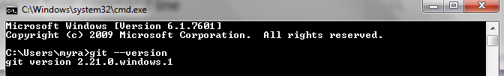
First Setup
Install Git from website and open cmd prompt
git –version

Slide 4
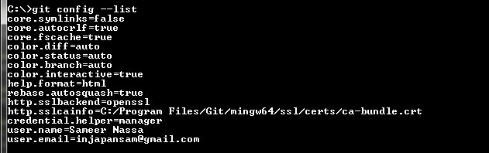
Set config (users)
Global variables to be setup for users
git config –global user.name “Sameer Nassa”
git config –global user.name “injapansam@gmail.com”
To list config values
git cofig –list

Slide 5
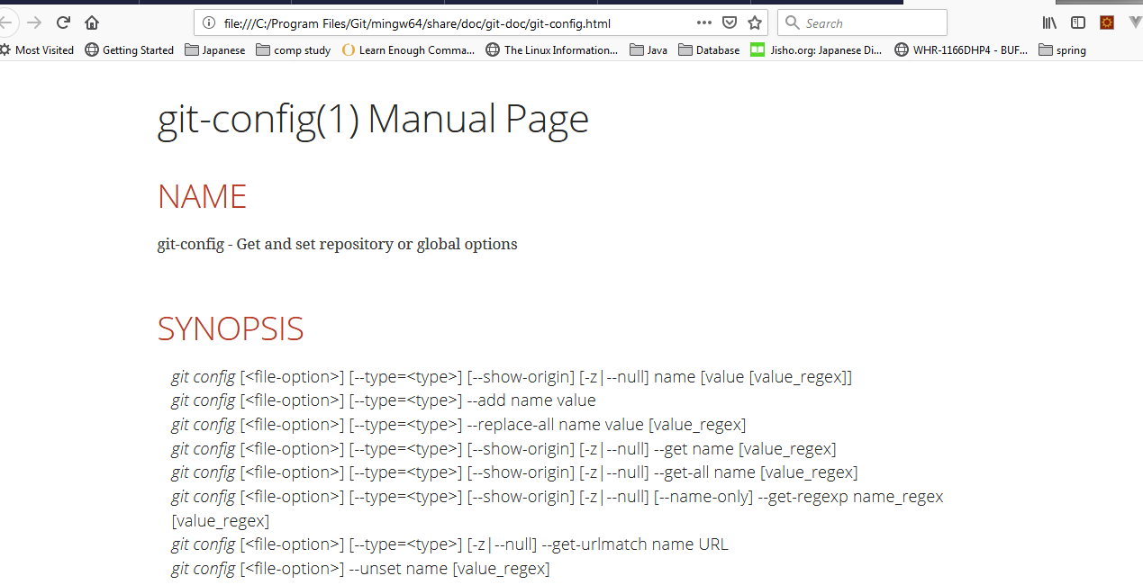
Help
git help <verb>
Git <verb> --help

Slide 6
Using GIT
Local code base to track using git
Remote code base to track using git

Slide 7
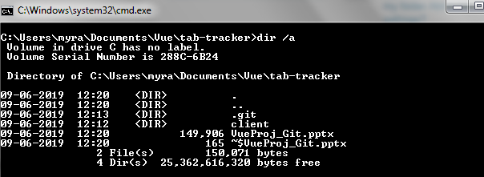
Local Code to track
Run git init in the project folder to be tracked.
Folder .git will be created

Slide 8
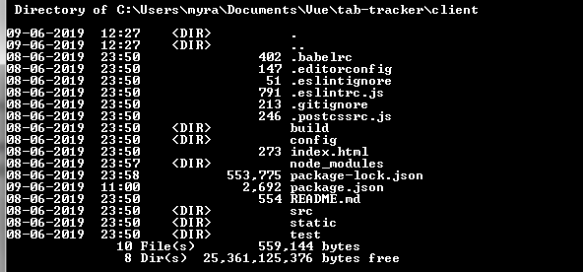
stop tracking project
rd /s git
.git folder will be removed

Slide 9
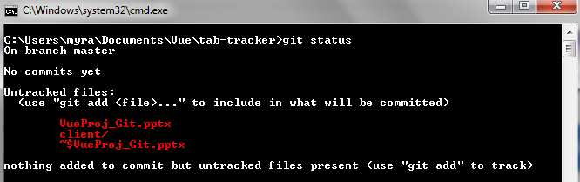
git status
This command will show the tracked and untracked files.

Slide 10
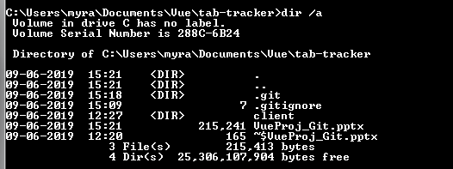
git ignore
Create .gitingnore file
Add extension of file not to be added to git

Slide 11
git add .gitignore
Add the .gitignore file
git add .gitignore

Slide 12
git add -A
Add everthing to statging area
git config core.autocrlf false
To suppress warning [LF will be converted to CRLF]

Slide 13
git add -A
Add everthing to statging area
git config core.autocrlf false
To suppress warning [LF will be converted to CRLF]

Slide 14
Dev Server
Cloned up git repo
Vue cli to create project
Vue Cli to build up a boilerplate project using $ vue init webpack my-project
Command npm run dev (used to run the project)

