Slide 1
Tab-tracker
Vue frontend app

Slide 2
GIT repo
Download git from git repo
Git has copy of the repository on each developers system

Slide 3
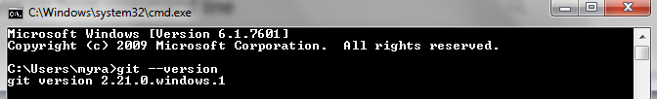
First Setup
Install Git from website and open cmd prompt
git –version

Slide 4
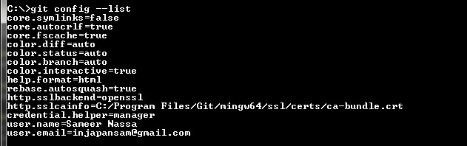
Set config (users)
Global variables to be setup for users
git config –global user.name “Sameer Nassa”
git config –global user.name “injapansam@gmail.com”
To list config values
git cofig –list

Slide 5
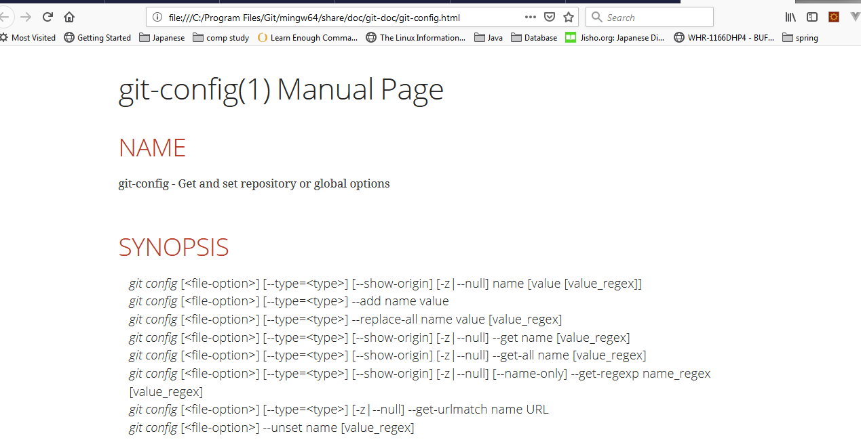
Help
git help <verb>
Git <verb> --help

Slide 6
Using GIT
Local code base to track using git
Remote code base to track using git

Slide 7
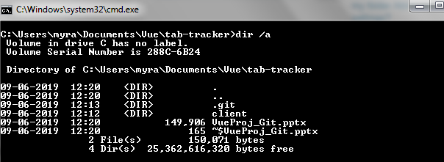
Local Code to track
Run git init in the project folder to be tracked.
Folder .git will be created

Slide 8
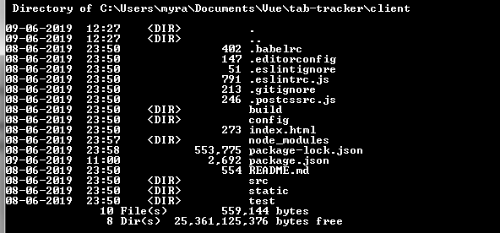
stop tracking project
rd /s git
.git folder will be removed

Slide 9
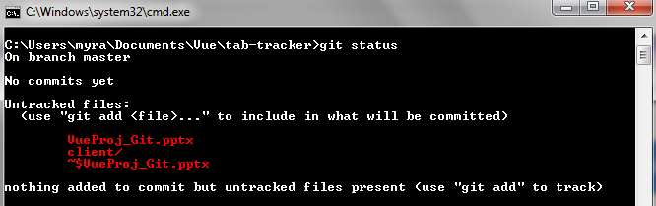
git status
This command will show the tracked and untracked files.

Slide 10
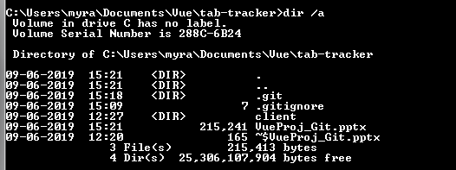
git ignore
Create .gitingnore file
Add extension of file not to be added to git

Slide 11
git add .gitignore
Add the .gitignore file
git add .gitignore

Slide 12
git add -A
Add everthing to statging area
git config core.autocrlf false
To suppress warning [LF will be converted to CRLF]

Slide 13
git add -A
Add everthing to statging area

Slide 14
git config core.autocrlf false
To suppress warning [LF will be converted to CRLF]

Slide 15
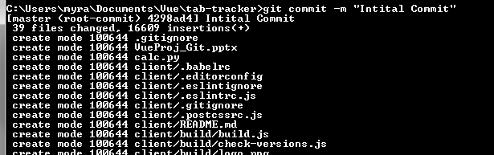
git commit –m “Initial Commit”
To commit the files added to STAGING AREA.
-m is used to add the message to commit which is important

Slide 16
git status
Status shows that there is now nothing to commit as all is commited

Slide 17

git status
Status shows that there is now nothing to commit as all is commited
git log
Hashcode displayed will be unique and name of the user who committed will be displayed.

Slide 18
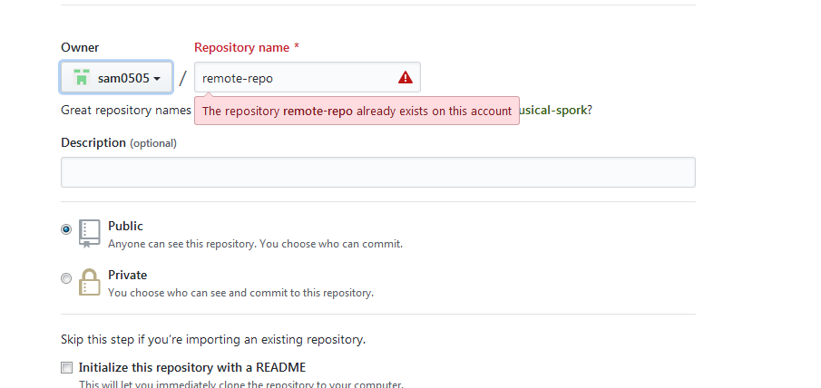
git clone <url> .
Create a repo on git hub
git clone <url> .
. will clone all files from the remote repo
This will create directory in the path

Slide 19

git remote -v
This will show details of remote repository

Slide 20
git branch -a

Slide 21
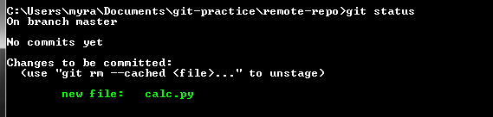
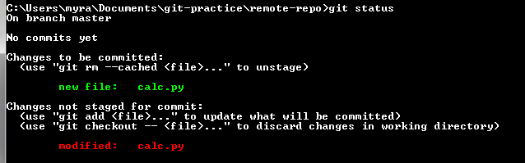
push changes to repo
git add calc.py

Slide 22
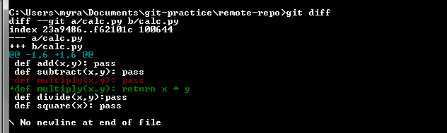

git diff
This will show the diff between the remote repo
Commit the diff with following

Slide 23
git pull & git push
git pull origin master
git push
(will push all the files to the git repo)
Commit the diff with following

Slide 24
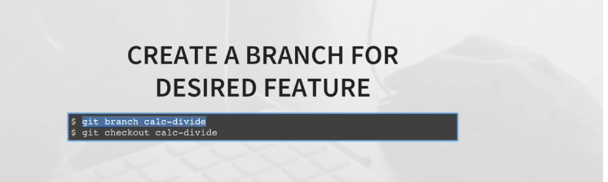
git branch
Creates a branch

Slide 25
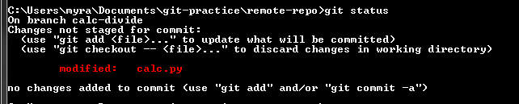
git checkout
To work with the branch it needs to be checkout
git status

Slide 26
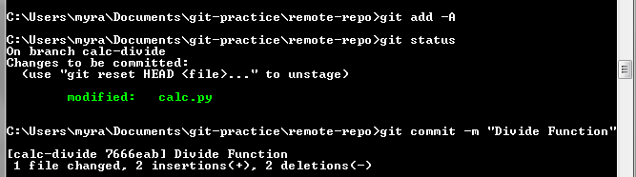
Committing the changes
git add –A (to add changes to stage area)
git status
git commit

Slide 27
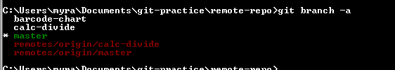
2. git branch -a

Slide 28
MERGE a branch
git checkout master
git pull origin master
git branch –merged
git merge calc-divide
git push origin master

Slide 29


git merge calc-divide
Merge the calc-divide branch to master
Check the branch merged
Delete the branch from local

Slide 30
Because we push the calc-divide to remote repo we need to delete it
Check the branch merged
Delete the branch from local

Slide 31
Dev Server
Cloned up git repo
Vue cli to create project
Vue Cli to build up a boilerplate project using $ vue init webpack my-project
Command npm run dev (used to run the project)

