Slide 1

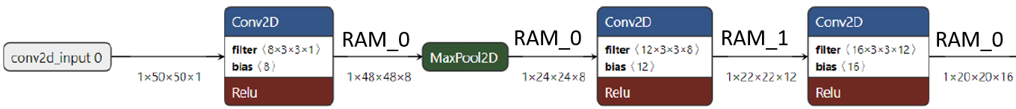
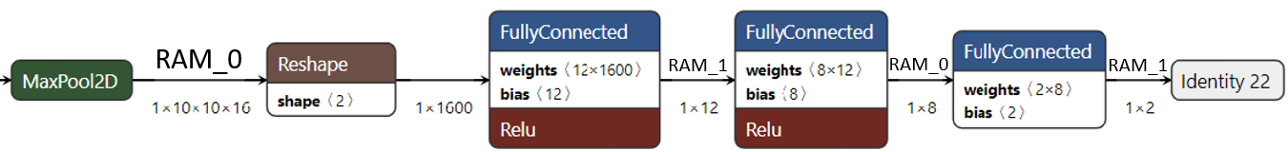
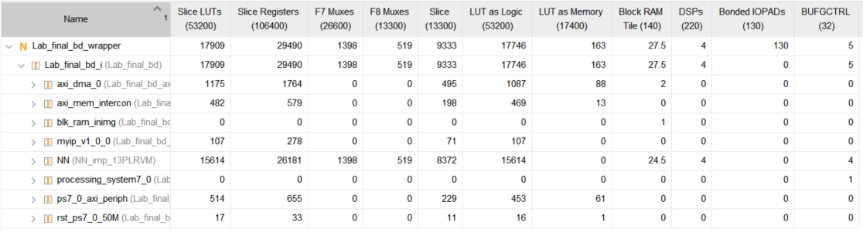
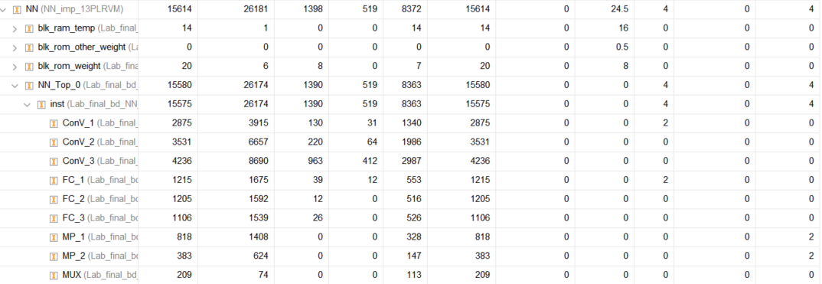
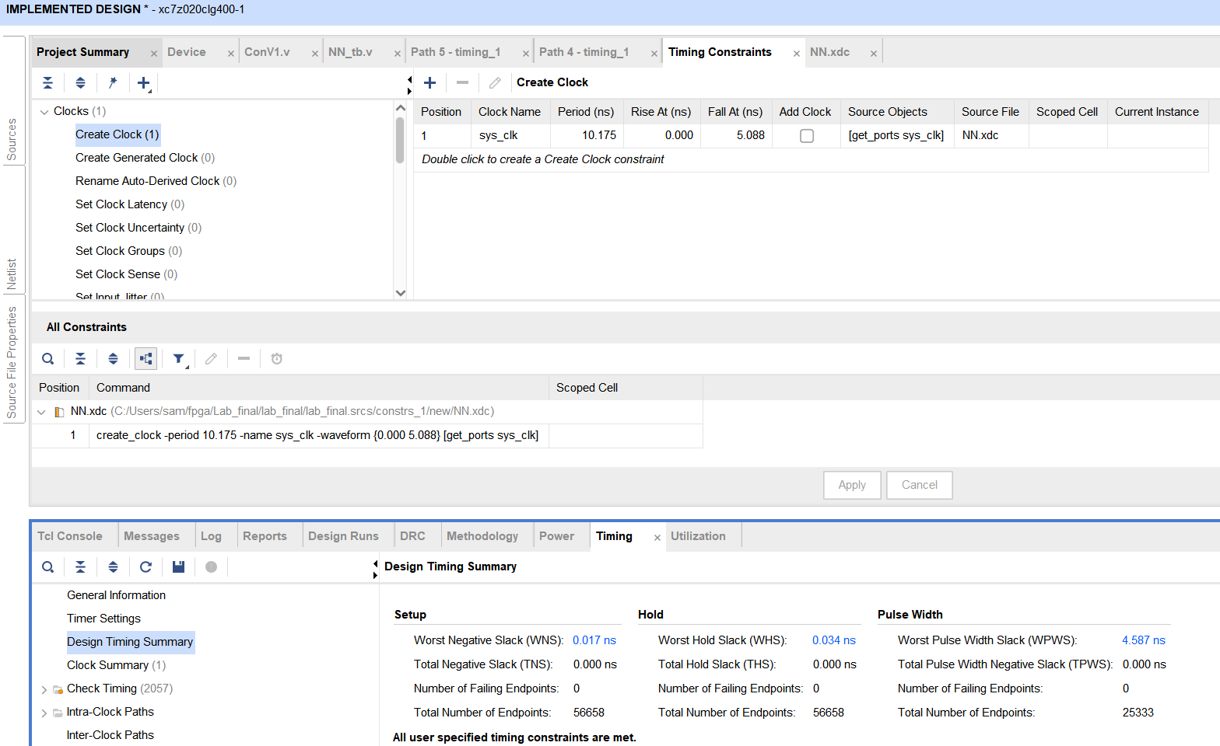
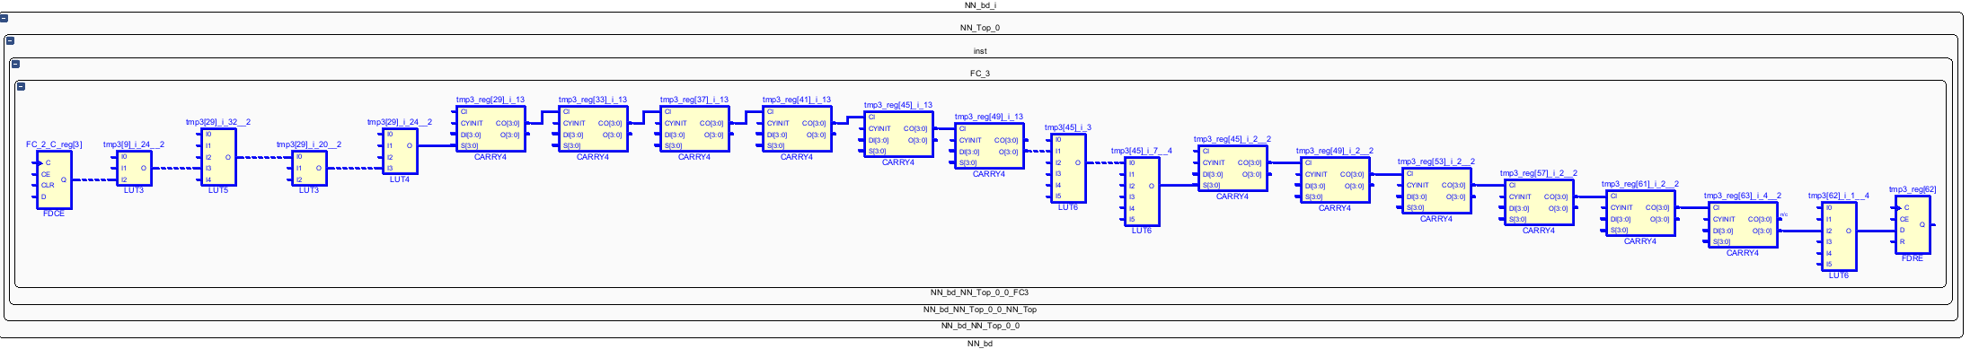
嵌入式深度神經網路
M11102142 張祈安 M11102270 黎姿伶
嵌入式深度神經網路處理 Embedded Deep Neural Network Processing
一、設計理念
本研究在PYNQ板上對PS端進行Verilog編寫，並完成CNN模型在Vivado中的設計，以確保所設計的硬體模塊能夠正確且有效地被PYNQ板上的可程式邏輯（PL）部分使用。
(七) Fully Connected1架構:
This block will achieve the reshaping through the order of reads.
repeat 12 times
repeat 100 times
Inputs multiplied by weights and added to the previous result.
二、架構
(一)本研究的CNN model架構如下:
其中不同model讀取與寫入標示RAM_0、RAM_1，並非代表多使用一個RAM，而是將原本RAM拆成兩半使用，目的在於不讓還未處理的值被覆蓋掉，RAM示意圖於圖一，0~32767代表RAM_0， 32767~65535代表RAM_1。
(二) Convolution1架構:
Start
Read 16 inputs
Read 16 weights
FC1
FC2
other operate
Output to RAM_0
End FC1
(八) Fully Connected2架構:
repeat 8 times
Inputs multiply weights
Start
Read 12 inputs
Read 12 weights
FC1
FC2
other operate
Output to RAM_0
End FC2
(九) Fully Connected3架構:
repeat 2 times
Inputs multiply weights
圖一、
RAM_0
RAM_1
Start
Read 8 inputs
Read 8 weights
FC1
FC2
other operate
Output to RAM_0
End FC3
0
32,767
65535=2¹⁶-1
repeat 8 filters.
when finished, stride to next row
三、資源利用率和時序分析
模擬時的總clock cycles數:12,426,164.5
Start
Read all filter
Read image
(50*3)
Conv_1
(3*3 conv) Sum result
Conv_2
Other operate
Output to RAM_0
End CV1
(一) Utilization:
(三) Convolution2架構:
when this column finished, stride to next column
when this column finished, stride to next column
repeat 12 filters.
Read new weight
Conv_1
(3*3 conv)
Sum result
stride next row, use same filter
Start
Read input
(24*3*8)
Read weight
(3*3*8)
Conv_2
other operate
Output to RAM_1
End CV2
(四) Convolution3架構:
(二) Timing Summary:
when this column finished, stride to next column
repeat 16 filters.
Read new weight
Conv_1
(3*3 conv)
Sum result
stride next row, use same filter
Start
Read input
(22*3*12)
Read weight
(3*3*12)
Conv_2
other operate
Output to RAM_0
End CV3
(五) Maxpooling1架構:
Compare with right one
Start
Read input
(48*2)
MP_1
(24*2)
Order of writings:
+48 to next Register
Output to RAM_0
End MP1
MP_2
(24*1)
Order of writings:
+24 to next Register
(三) Critical Path:
Compare with down one
(六) Maxpooling2架構:
Compare with right one
四、結論
在PYNQ板上對PS端進行Verilog編寫，需要仔細執行合成、實現和生成位流等步驟，以確保設計能夠在FPGA上正確運行，同時滿足時序和面積的要求。
Start
Read input
(20*2)
MP_1
(10*2)
Order of writings:
+20 to next Register
Output to RAM_0
End MP2
MP_2
(10*1)
Order of writings:
+10 to next Register
Compare with down one
Color transformation is a plain image enhancement technique that modifies pixel values in the spatial domain. Few studies have proposed some subtractive equations, which can be quantitatively constrained using image quality metrics such as PSNR [1] and SSIM [2].

