Slide 1
Chapter two Web page Development using HTML
Prepared by: Marta G. (MSc)

Slide 2
HTML (Hyper Text Markup Language)
Is not a programming language, it is a markup language.
Is a language for describing web pages.
A markup language is a set of markup tags.
A tag added around content are referred to as the markup
Is a set of logical codes (markup) that constitute the appearance of a web document and the information it contains

Slide 3
HTML cont…
html codes are not case-sensitive.

Slide 4
HTML element
The first word or character that appears inside the “<”
opening bracket is Called the element.
An element is a command that tells the browser to do something.
e.g. <b> , <input type=textfiled>
Most elements have an opening element (tag) and a closing element (tag) Distinguished by the “/” inside the “<”
opening bracket.
E.g. <p>this text is paragraph</p>

Slide 5
Cont…
Block-level, inline and empty element
Block element: Each block-level element begins on new line and space is also usually add above and below the entire element by default.
E.g. heading tags <h1> to <h6>, paragraph<p>,<li>
Inline element: Do not start new line, they just go with flow.
Only takes up as much width as necessary.
Eg. <div> the following span is an <span class=“highlight”> inline element </span>; its background has been colored to display….</div>
Eg. <img>, <input>

Slide 6
Cont…
Empty element: Empty elements do not have text content b/c they are used to provide a simple instruction.
All elements don't require the end tag or closing tag to be present. These are referred as empty elements, self-closing elements or void elements.
E.g. image element <img>
Line break <br>

Slide 7
HTML Attribute
Attributes are another way of describing the element’s
properties.
Attribute are instruction that clarify or modify an element.
Attributes appear to the right of an element, separated by a Space, and followed by an equal sign. The value of the attribute is contained in quotes

Slide 8
Cont…
The syntax for attribute:
<element attribute name=”value”> content </element>
e.g. <p align=“left”>this is paragraph</p>
Or for empty <element attribute name=”value”/>
Example: <img src=“bird.jpg” alt=“photo of bird”>

Slide 9
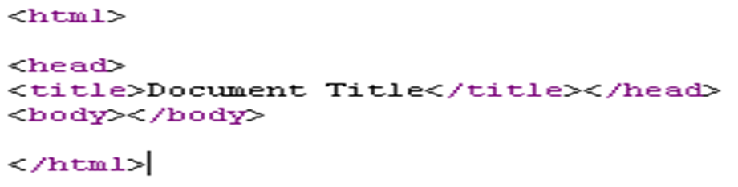
Basic HTML Document structure
An element called HTML surrounds the whole document. This element contains two sub-elements, HEAD and BODY. These elements are required to form any HTML document.
9

Slide 10
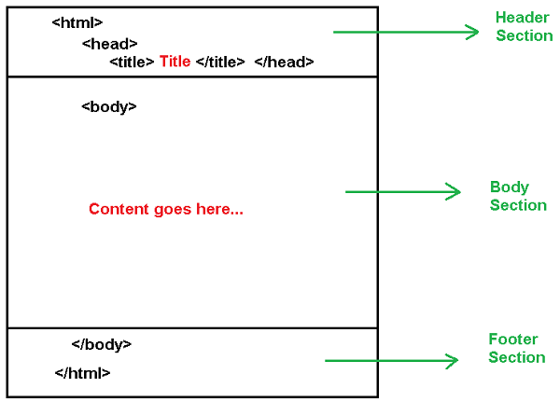
Basic HTML Document structure cont..

Slide 11
Document explanation
<HTML>The first tag in your HTML document tells your browser that this is the start of HTML document.
<HEAD>has sub-elements that define header information; header information is not display in the browser window.
<TITLE>tag defines document title. The title of your document is what appears in a web browser’s Bookmark list. Your document’s title should be as descriptive as possible. Search engines on the Internet use the document’s title for indexing purposes. </TITLE>
11

Slide 12
Cont’d…
<LINK>indicates a relationship between this document and some other object on the Web. </LINK>
<META>provides information such as the page’s keywords and description that appears in HTTP headers. </META>
<SCRIPT>contains either JAVA Script or VB Script </SCRIPT>
<STYLE>contains information used by cascading style sheets </STYLE>
</HEAD>
<BODY>the remaining HTML elements are contained within these tags. The text between <body>tag is displayed in your browser window.</BODY>
</HTML> this tag tells your browser that this is the end of the HTML document.
12

Slide 13
Describe HTML layout structure.
Every web page has different components to display the intended content and a specific UI. But still, there are few things which are templated and are globally accepted way to structure the web page, such as:
<header>: Stores the starting information about the web page.
<footer>: Represents the last section of the page.
<nav>: The navigation menu of the HTML page.
<article>: It is a set of information.
<section>: It is used inside the article block to define the basic structure of a page.
<aside>: Sidebar content of the page

Slide 14
HTML Headings
Heading are defined with the <h1> to <h6> tags.
Inside the BODY element, heading elements H1 through H6 are generally used for major divisions of the document.
H1: should be used as the highest level of heading, H2 as the next highest, and so forth.
The size of the text surrounded by a heading element varies from very large in an <H1> tag to very small in an <H6> tag.
14

Slide 15
Cont’d
<HTML>
<HEAD>
<TITLE>Heading Example</TITLE>
</HEAD>
<BODY>
<H1>Heading 1</H1>
<H2>Heading 2</H2>
<H3>Heading 3</H3>
<H4>Heading 4</H4>
<H5>Heading 5</H5>
<H6>Heading 6</H6>
</BODY>
</HTML>
15

Slide 16
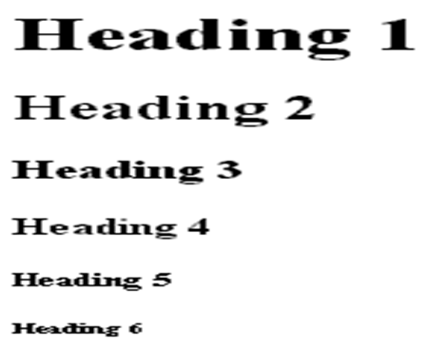
Cont’d…
This will produce:
16

Slide 17
Paragraphs, <P></P>
The <p> tag defines a paragraph.
Paragraphs allow you to add text to a document
E.g. <p>When creating a web page, Block-level elements make up the main components of content structure.</p>
<p> block level elements always start on a new line and usually have some space added above and below, stacking up like blocks in the normal flow of the document. </p>

Slide 18
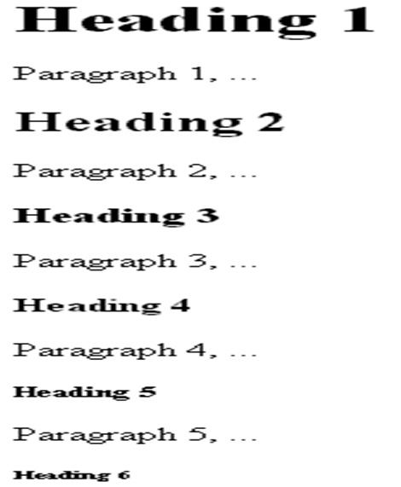
Cont’d…
<HTML>
<HEAD>
<TITLE>Example Page</TITLE>
</HEAD>
<BODY>
<H1>Heading 1</H1>
<P>Paragraph 1, ...</P>
<H2>Heading 2</H2>
<P>Paragraph 2, ...</P>
<H3>Heading 3</H3>
<P>Paragraph 3, ...</P>
<H4>Heading 4</H4>
<P>Paragraph 4, ...</P>
<H5>Heading 5</H5>
<P>Paragraph 5, ...</P>
<H6>Heading 6</H6>
</BODY>
</HTML>
18

Slide 19
Preformatted text
It is a unique element in that it is displayed exactly as it is typed—including all the carriage returns and multiple character spaces
By default, preformatted text is also displayed in a constant-width font
E.g.
<pre> This is an example of
Text with a lot of
Curious
White space.
</pre>
<p> This is an example of
Text with a lot of
Curious
White space.
</p>

Slide 20
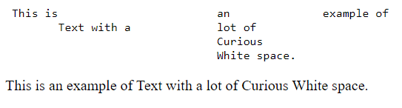
Cont…
This will result:

Slide 21
Horizontal Rule, <HR>
The <HR> element causes the browser to display a horizontal line (rule) in your document.
This element does not use a closing tag, </HR>.
Simply type <HR> to insert a horizontal line (rule) element into your document.
21

Slide 22
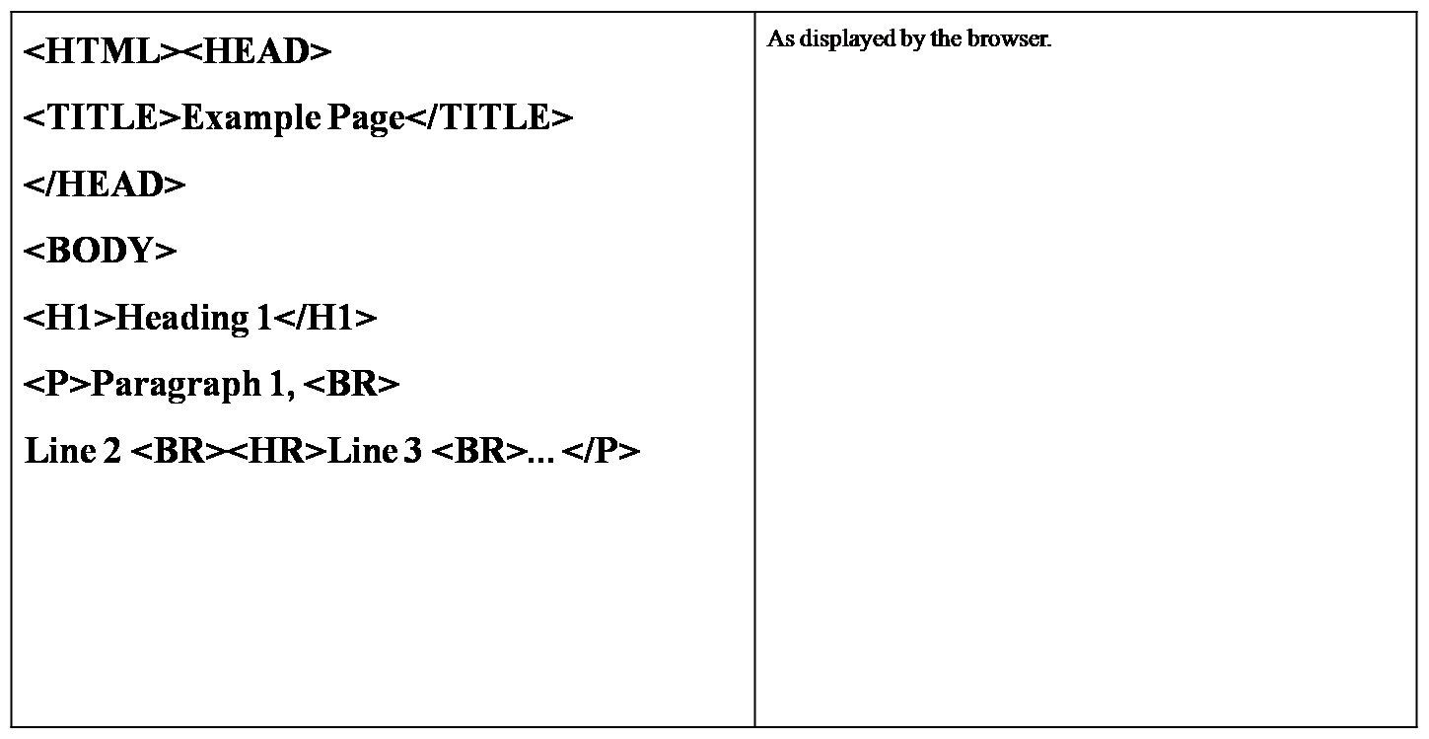
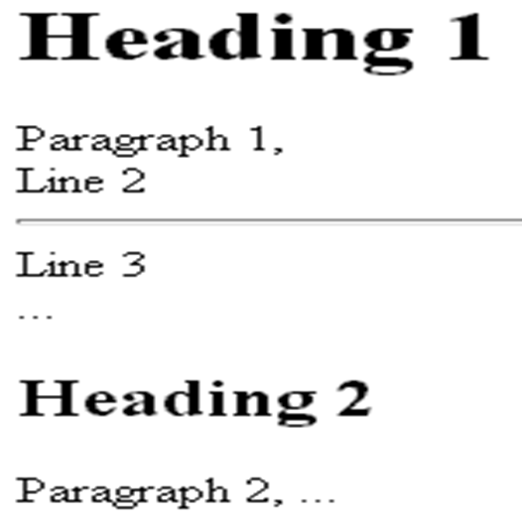
Cont’d…
22

Slide 23
Break, <BR>
Line breaks allow you to decide where the text will break on a line
A <BR> is an Empty Element
The <BR> element does not have a closing tag.
The closing tag, </BR>, is not required as this element marks a position and does not contain content
23

Slide 24
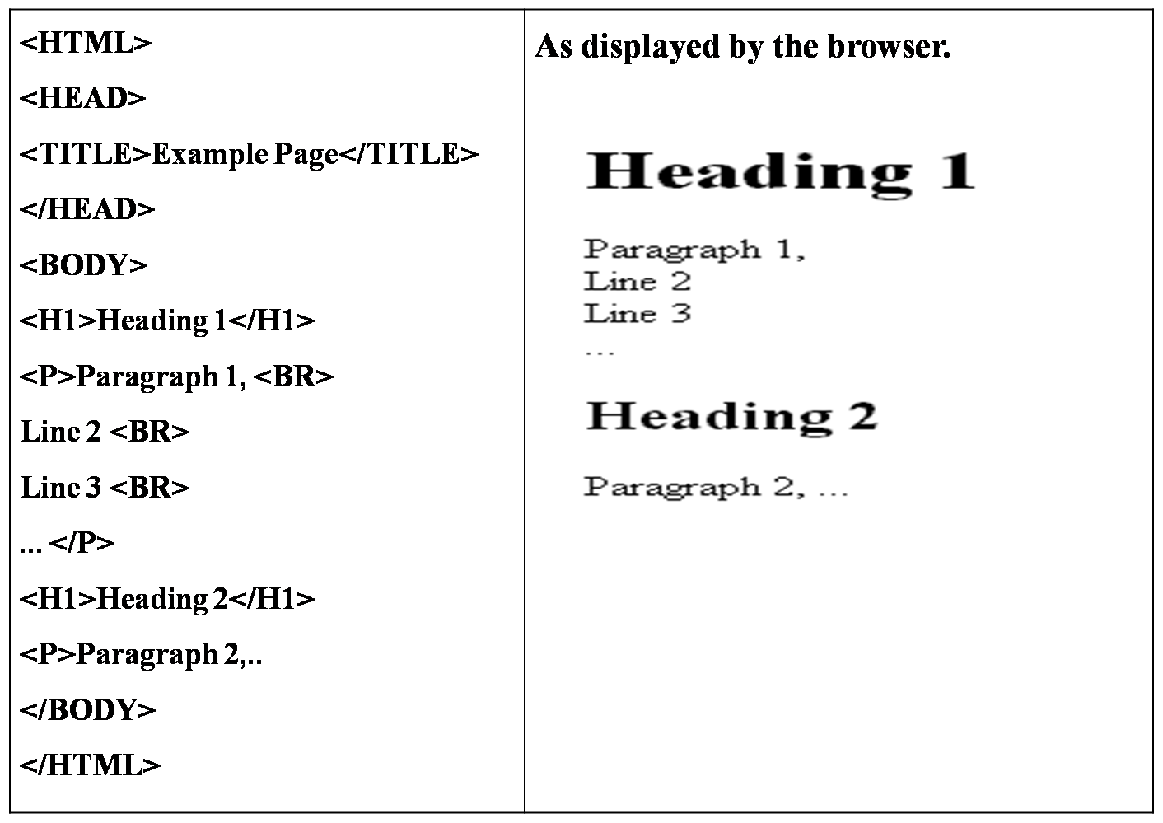
Cont’d…
24

Slide 25
Addresses
The address element that is used to provide contact information for the author or maintainer of the document.
It is generally placed at the beginning or end of a document or a large section of a document.

Slide 26
Cont…
E.g. <address> <a href="../authors/robbins/">Jennifer Robbins</a>, <a href="http://www.ebc.com/">EBC Media</a> </address>
<address>+251910102080</address>

Slide 27
HTML <a> tag
The <a> tag defines a hyperlink, which is used to link from one page to another.
Anchors(a tag) are inline elements, they may only contain text and other inline elements.
The most important attribute of the <a> element is the href attribute, which indicates the link’s destination.
Download attribute specifies that the target will be downloaded when a user clicks on the hyperlink.
Target attribute specifies the context in which the linked resource will open.
Eg.: <a href=https://www.w3schools.com> visit w3schools.com!</a>

Slide 28
Character Formatting Elements
HTML defines a lot of elements for formatting output.
Font element
Used to modify the text size using size attribute
The size attribute can be set as absolute value from 1 to 7 or as a relative value using the “+” or “-“sign.
E.g.<FONT SIZE=“5">Five sizes bigger</FONT>
Normal text is size 3.
Used to modify the text color using color attribute
E.g. <FONT COLOR=”#RRGGBB”>this text has color</FONT>
28

Slide 29
Cont’d…
Center text- the <CENTER> element
<CENTER>…</CENTER> element Will center elements.
Bold Text - The <b> Element:
Anything that appears in a <b>...</b> element is displayed in bold, like the word bold here:
e.g.<p>The following word uses a <b>bold</b> typeface.</p>
This will produce following result:
The following word uses a bold typeface.
Another element that used to make the text bold is <STRONG> element. <STRONG> STRONG </STRONG> browsers display this as BOLD.
29

Slide 30
Cont’d…
Italic Text - The <i> Element:
Anything that appears in a <i>...</i> element is displayed in italicized, like the word italicized here:
E.g.<p>The following word uses an <i>italicized</i>typeface.</p>
This will produce following result:
The following word uses an italicized typeface
30

Slide 31
Cont’d…
Underlined Text - The <u> Element:
Anything that appears in a <u>...</u> element is displayed with underline, like the word underlined here:
E.g. <p>The following word uses a <u>underlined</u>typeface.</p>
This will produce following result:
The following word uses an underlined typeface.
31

Slide 32
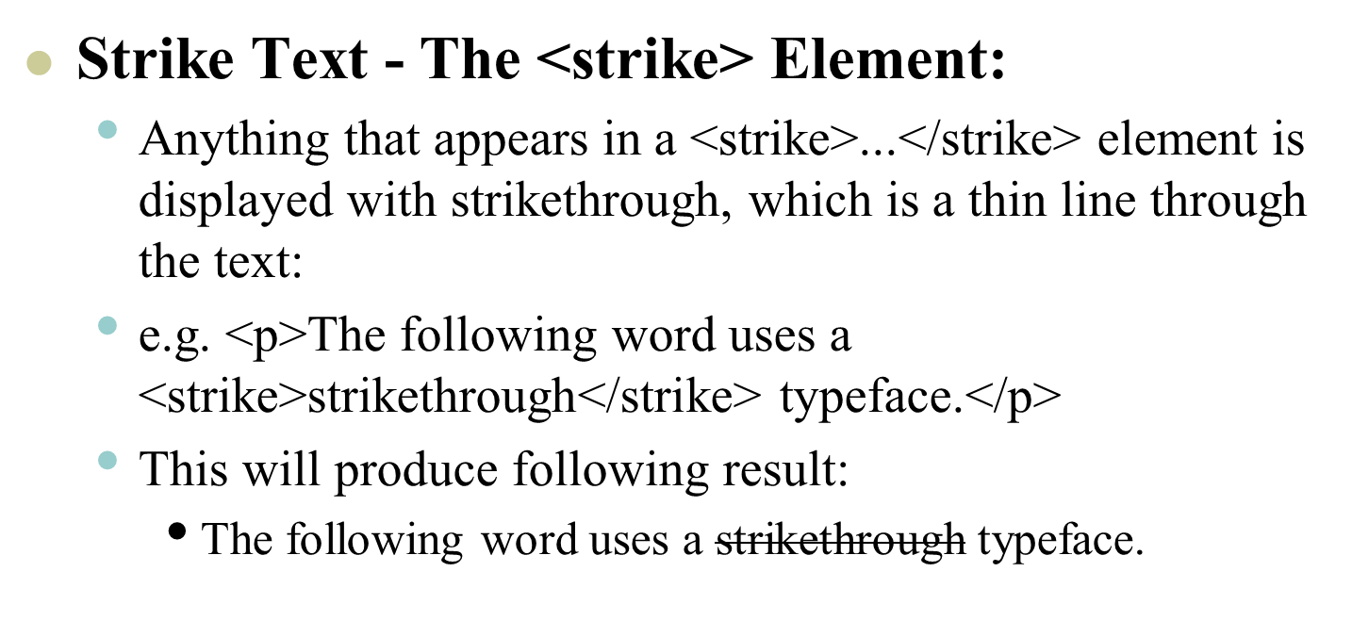
Cont’d…
32

Slide 33
Cont’d…
Superscript Text - The <sup> Element:
The content of a <sup> element is written in superscript.
E.g.<p>ax<sup>2</sup> + bx + c=0</p>
This will produce the following result
ax²+bx+c=0
33

Slide 34
Cont…
Subscript Text - The <sub> Element:
The content of a <sub> element is written in subscript;
E.g.<p>H<sub>2</sub>O</p>
This produces the following result
H₂O
34

Slide 35
Cont…
The div element
The <div> element is often use as a container for other HTML elements.
div used to break a page into sections for context, structure, and lay out purposes
The div (short for division) is used to indicate a generic block-level element
With the div tag, you can group large sections of HTML elements together and for setup them with CSS.
E.g a heading and several paragraph are enclose in a div and identified as the “news” section.
35

Slide 36
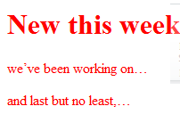
Cont’d…
<html> <head> <title>Moby-Dick</title> </head> <body> <div id=”news”> <font color=”#ff0000”> <h1>New this week</h1> <p>we’ve been working on…</p> <p>and last but no least,…</p> </font> </div> </body> </html>
This produce the following result
36

Slide 37
Character entity
Some characters have a special meaning in HTML, like the less than sign (<) that defines the start of an HTML tag .
If we want the browser to actually display these characters we must insert character entities in the HTML source.
A character entity has three parts: an &, an entity name or a # and an entity number and finally a semicolon (;)
37

Slide 38
Cont…
The most common character entity
Result | Description | Entity name | Entity number
 | Non-braking space | &nbsp; | &#160;
< | Less than | &lt; | &#60;
> | Greater than | &gt; | &#62;
“ | Quotation mark | &quot; | &#34;
‘ | Apostrophe | &apos; | &#39;
 | Cent | &cent; | &#162
38

Slide 39
Cont…
 | Pound | &pound; | &#163;
 | Yen | &yen; | &#165;
 | Copyright | &copy; | &#169;
 | Registerd trademark | &reg; | &#174;
 | Multiplacation | &times; | &#215;
 | Division | &divide; | &#245;
39

Slide 40
Comment in HTML
Comments are usually added with the purpose of making the source code easier to understand.
Html comment begins with <!–- and ends with -->
Example:
<!-- This is an HTML comment -->
<!-- This is a multi-line HTML comment that spans across more than one line -->
<p>This is a normal piece of text.</p>

Slide 41
Meta tag
Meta tags always go inside the <head> element, and are typically used to specify charater set, page description, keywords, author of the document, and viewport settings.
Meta data will not be displayed on the page, but is machine parsable.
It is used by browsers(how to display content or reload page), search engines(keywords), and other web services.

Slide 42
Cont…
The meta element represents various kinds of metadata that cannot be expressed using the title, base, link, style, and script element.
Meta tag is a self closing tag
We have to place meta tag on the head section
To display an HTML page correctly, a web browser must know the character set used in the page.

Slide 43
Cont…
<meta charset="UTF-8">
<meta name="description" content="web programming materials for CS">
<meta name=“authors" content=“cs students">
<meta name="keyword" content="web, programming, CS">
<meta name="viewport" content="width=device-width, initial-scale=1.0">
<meta http-equiv="refresh" content="30">

Slide 44
Various list elements
Unordered list
To identify an unordered list, mark it up as ul element.
The opening <ul> tag goes before the first list item and the closing tag </ul> goes after the last item.
Then, each item in the list gets marked up as a list item <li> by enclosing it in opening and closing </li> tags

Slide 45
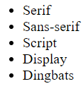
Cont…
E.g.
<ul>
<li>Serif</li> This will result:
<li>Sans-serif</li>
<li>Script</li>
<li>Display</li>
<li>Dingbats</li>
</ul>

Slide 46
Ordered list
Ordered lists are for items that occur in a particular order, such as step-by-step instructions or driving directions.
E.g.
<ol>
<li>Gutenburg develops moveable type (1450s)</li>
<li>Linotype is introduced (1890s)</li>
<li>Photocomposition catches on (1950s)</li>
<li>Type goes digital (1980s)</li>
</ol>

Slide 47
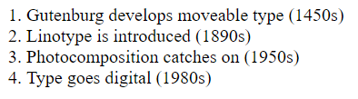
Cont…
This will produce:

Slide 48
Cont…
If you want a numbered list to start at a number other than “1,” you can use the start attribute in the ol element to specify another starting number, as shown here:
<ol start=“10">
<li>Highlight the text with the text tool.</li>
<li>Select the Character tab.</li>
<li>Choose a typeface from the pop-up menu.</li>
</ol>
The resulting list items would be numbered 10, 11, and 12, consecutively.

Slide 49
Nesting Lists
You can nest lists by inserting a UL, OL, etc…
Example:

Slide 50
Table

Slide 51
Table
Tables are defined with the <table> tag.
A table is divided into rows with the <tr> tag (table row) and each row is divided into data cells with the <td> tag (table data).
td holds the content of a data cell.
A <td> tag can contain text, links, images, lists, forms, other tables, etc.
51

Slide 52

Cont’d…
<table border=”1”> <tr> <td>row 1, cell 1</td> <td>row 1, cell 2</td> </tr> <tr> <td>row 2,cell 1</td> <td>row 2,cell 2</td> </tr> </table> | It looks like:-
52

Slide 53

Cont…
Table and the border attribute
If you do not specify a border attribute the table will displayed without any borders.
To display a table with borders, you will have to use the border attribute.
53

Slide 54
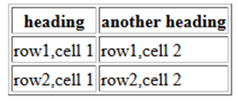
Cont’d…
Heading in a table
Heading in a table are defined with the <th> tag.
<table border="1"> <tr> <th>heading</th> <th>another heading</th> <tr> <td>row1,cell 1</td> <td>row1,cell 2</td </tr> <tr> <td>row2,cell 1</td> <td>row2,cell 2</td </tr> </table> | It looks like this:
54

Slide 55
Cont’d…
Table Caption
A Table caption allows you to specify a line of text that will appear centered above or below the table.
This can act like a title for the table.
The caption element has one attribute ALIGN that can be either TOP or BOTTOM
You can use standard character formatting codes inside the CAPTION element.
55

Slide 56
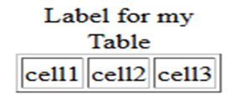
Cont’d…
<TABLE BORDER="1"> <CAPTION ALIGN="Top">Label for my Table</CAPTION> <tr> <td>cell1</td><td>cell2</td><td>cell3</td> </tr> </table> | This will result:-
56

Slide 57
Cont…
Table cell padding and cell spacing
Cell spacing- the distance b/n the adjacent cells
Syntax : <table cellspacing=“pixels”>
Cell padding- the distance b/n the inserted row data and the cell boundaries.
Syntax: <table cellpadding=“pixels”>

Slide 58
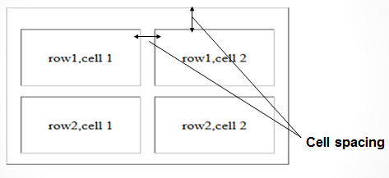
Cont…

Slide 59
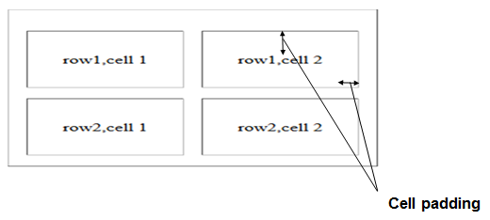
Cont…

Slide 60
Change the background color of the table
The BGCOLOR attribute used to specify the background color of the whole table.
Syntax : <table BGCOLOR=”#RRGGBB” >

Slide 61
Cont…
Controlling individual cells
This includes
Column and row spanning
Cell dimension
Alignment of cell contents
Background color of cell

Slide 62
Cont…
Spanning cell
Spanning: is the stretching of a cell to cover several rows or columns.
Column spans: used to merge two or more columns. Use colspan attribute in the td or th element.
Row spans: used to merge two or more rows. Use rowspan attribute in the td or th element.

Slide 63
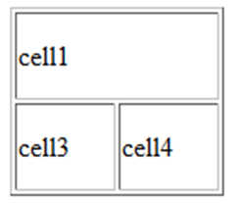
Cont…
<table border="1" WIDTH=130 HEIGHT=110> <tr><td COLSPAN="2">cell1</td></tr> <tr><td>cell3</td><td>cell4</td></tr> </table> | Will produce:
63

Slide 64
Cont…
Controls the alignment of elements within cells
Use align attribute to Controls the alignment of elements within cells.
<TD ALIGN=left|right|center VALIGN=top|middle|bottom>
By default the text (or any elements) placed in a cell will be positioned left & center vertically.
ALIGN: horizontal
VALIGN: vertical
64

Slide 65
Frames

Slide 66
Frames
With frames, you can display more than one html document in the same browser window. each html document is called a frame, and each frames is independent of the other.
66

Slide 67
Cont…
Elements for creating frames
Frameset element:
The <frameset> tag define how to divide the window into frames
This allows you to define the divisions as either rows or columns.
The primary function of the FRAMESET document is to set up a structure for the page.
<Frameset> tag is placed in the html document before the <BODY> element.
67

Slide 68
Cont…
Frameset attribute
ROWS: Determines the size and number of rectangular rows within a <FRAMESET>. They are set from top of the display area to the bottom.
COLS: Determines the size and number of rectangular columns within a <FRAMESET>. They are set from left to right of the display area.
68

Slide 69
Cont…
Frame element:
The frame tag defines what HTML document to put into each frame.
69

Slide 70
<FRAME> tag attributes
SRC: Required, as it provides the URL for the page that will be displayed in the frame.
NAME: Required for frames that will allow targeting by other HTML documents. All names must begin with an alphanumeric value and not the underscore character.
MARGINWIDTH: Determines horizontal space between the <FRAME> contents and the frame's borders.
MARGINHEIGHT: Determines vertical space between the <FRAME> contents and the frame's borders.
SCROLLING: Displays a scroll bar(s) in the frame. Possible values are: yes, no, auto.
NORESIZE: Optional - prevents viewers from resizing the frame.

Slide 71
Cont…
<html>
<head>
<title>framed page</title>
</head>
<frameset cols="25%,75%">
<body>
<frame src="doc1.html" scrolling="no">
<frame src="doc2.html" scrolling="yes">
</body>
</frameset>
</html>
Note: We can remove the body element
71

Slide 72
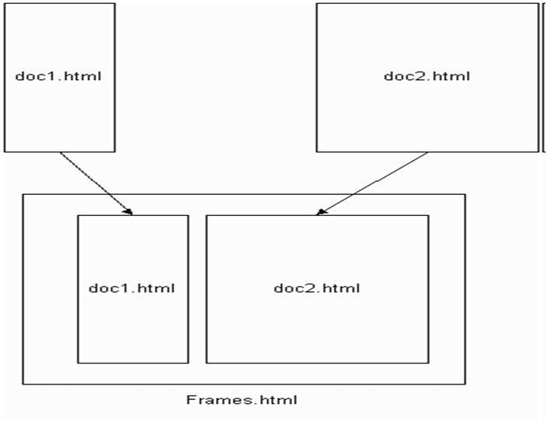
Cont…
72

Slide 73
Inserting image
You can insert any image in your web page by using <img> tag. Following is the simple syntax to use this tag.
<img src="image URL" attr_name="attr_value"...more attributes />
73

Slide 74
Cont…
Image Attributes:
Following are most frequently used attributes for <img> tag.
width: sets width of the image.
height: sets height of the image.
border: sets a border around the image.
src: specifies URL of the image file.
74

Slide 75
Cont…
alt: this is an alternate text which will be displayed if image is missing.
align: this sets horizontal alignment of the image and takes value either left, right or center.
name: name of the image with in the document.
id: id of the image with in the document.
title: specifies a text title. The browser, perhaps flashing the title when the mouse passes over the link.
75

Slide 76
Inserting video and audio
You can add music or video into your web page.
The easiest way to add video or audio to your web site is using HTML tag called <video> and <audio> respectively.
E.g <video width="320" height="240" controls>
<source src=“GOT_ep1.mp4" type="video/mp4">
</video>
76

Slide 77
Cont…
Attributes:
align - Determines how to align the object. It takes either center, left or right.
autostart - Indicates if the media should start automatically start. Netscape default is true, Internet Explorer is false.
loop - Specifies if the sound should be played continuously (set loop to true), a certain number of times (a positive value) or not at all (false). This is supported by Netscape only.
playcount - Specifies the number of times to play the sound. This is alternate option for loop if you are using IE.
77

Slide 78
Cont…
height - Height of the object in pixels or in.
width - Width of the object in pixels or in.
src - URL of the object to be embedded. This can be any recognizable by the user's browser. It could be .mid, .wav, .mp3, .avi and so on).
volume - Controls volume of the sound. Can be from 0 (off) to 100 (full volume). This attribute is supported by Netscape only.
78

Slide 79
Form

Slide 80
HTML Form
HTML forms are used to select different kinds of user input.
HTML forms are used to pass data to a server.
There are two parts of working form
The first part is the form that you see on the page itself.
The second component of a web form is an application or script on the server.

Slide 81
Form Element
The <form> tag is used to create an HTML form
Most frequently used form attributes are:
Name: This is the name of the form.
Action:
The action attribute provides the location (URL) of the application or script (sometimes called the action page) that will be used to process the form (which will receive uploaded data).
For example the action attribute sends the data to a script called register.php
.php suffix indicates that this form is processed by a php script.

Slide 82
Cont…
Method: Here you will specify method to be used to upload data (The method attribute specifies how the information should be sent to the server). It can take various values but most frequently used are GET and POST.
Target: It specifies the target page where the result of the script will be displayed. It takes values like _blank, _self, _parent etc.

Slide 83
Cont…
Example:-
<html>
…
…
<body>
<h1>Mailing List Signup</h1>
<form action=“register.php" method="post">
</form>
</body>
</html>

Slide 84
Form controls
There are different types of form controls that you can use to collect data from a visitor to your site.
Text input controls
Buttons
Checkboxes and radio buttons
Select boxes
File select boxes
Hidden controls
Submit and reset button

Slide 85
Text Input Controls
There are actually three types of text input used on forms:
Single-line text input controls: Used for items that require only one line of user input, such as search boxes or names. They are created using the <input> element.
Password input controls: Single-line text input that mask the characters a user enters.
Multi-line text input controls: Used when the user is required to give details that may be longer than a single sentence. Multi-line input controls are created with the <textarea> element.

Slide 86

Single-line text input controls:
<form action="abc.php" method="get"> First name: <input type="text" name="first_name"/><br> Last name: <input type="text" name="last_name"/><br> <input type=’’submit’’ value="submit"/> </form> | Will result

Slide 87
Cont’d…
Following is the list of attributes for <input> tag.
Type: Indicates the type of input control you want to create. This element is also used to create other form controls such as radio buttons and checkboxes.
Name: Used to give the name part of the name/value pair that is sent to the server, representing each form control and the value the user entered.

Slide 88
Cont’d…
Value: Provides an initial value for the text input control that the user will see when the form loads.
maxlength: Allows you to specify the maximum number of characters a user can enter into the text box.

Slide 89

Password input controls
<form action="abc.php" method="get"> User name<input type="text" name="user_name"/><br> Password <input type="password" name="password"/><br> <input type="submit" value="submit" /> </form> | Will result

Slide 90
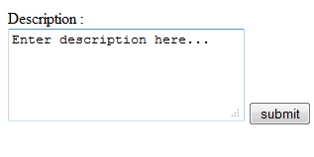
Multiple-Line Text Input Controls
<form > Description : <br /> <textarea rows="5" cols="50" name="abc"> Enter description here... </textarea> <input type="submit" value="submit" /> </form> | Will result:-

Slide 91
Cont’d…
Following is the detail of above used attributes for <textarea> tag
Name: The name of the control. This is used in the name/value pair that is sent to the server.
Rows: Indicates the number of rows of text area box.
Cols: Indicates the number of columns of text area box.

Slide 92
Creating Button
There are various ways in HTML to create clickable buttons. You can create clickable button using<input> tag.
When you use the <input> element to create a button, the type of button you create is specified using the type attribute.

Slide 93
Cont’d…
The type attribute can take the following values:
Submit: This creates a button that automatically submits a form.
Reset: This creates a button that automatically resets form controls to their initial values.

Slide 94

Cont’d…
<form > <input type="submit" name="Submit" value="Submit" /> <br/> <input type="reset" value="Reset" /><br/> </form>

Slide 95

Checkboxes Control
Checkboxes are used when more than one option is required to be selected.
<form> <input type="checkbox" name="maths" value="on"> Maths<br> <input type="checkbox" name="physics" value="on"> Physics<br> <input type="submit" value="Select Subject"/> </form> | Will result

Slide 96
Cont…
List of important checkbox attributes:
Type: Indicates that you want to create a checkbox.
Name: Name of the control.
Value: The value that will be used if the checkbox is selected. More than one checkbox should share the same name only if you want to allow users to select several items from the same list.
Checked: Indicates that when the page loads, the checkbox should be selected.

Slide 97

Raidobox Control
Radio Buttons are used when only one option is required to be selected. They are created using input> tag as shown below:
<form action="abc.php" method="post"> <input type="radio" name="subject" value="maths" />Maths<br> <input type="radio" name="subject" value="physics" /> Physics<br> <input type="submit" value="Select Subject" /> </form> | Will result

Slide 98
Cont…
List of important radio box attributes:
Type: Indicates that you want to create a radio box.
Name: Name of the control.
Value: Used to indicate the value that will be sent to the server if this option is selected.
Checked: Indicates that this option should be selected by default when the page loads.

Slide 99

Select box Control
Drop down Box is used when we have many options available to be selected but only one or two will be selected.
<form> <select name="dropdown"> <option value="Maths" selected>Maths</option> <option value="Physics">Physics</option> </select> <input type="submit" value="Submit" /> </form> | Will result:-

Slide 100
Cont’d…
Following is the list of important attributes of <select>:
Name: This is the name for the control.
Size: This can be used to present a scrolling list box.
Multiple: If set to "multiple" then allows a user to select multiple items from the menu.

Slide 101
Cont…
Following is the list of important attributes of <option>:
Value: The value that is sent to the server if this option is selected.
selected: Specifies that this option should be the initially selected value when the page loads.
label: An alternative way of labeling options.

Slide 102
File Select Boxes
Also known as file upload box
If you want to allow a user to upload a file to your web site from his/her computer, you will need to use file select box.
This is also created using the <input> element.

Slide 103

Cont…
<form name="fileupload" enctype="multipart/form-data"> <input type="file" name="fileupload" accept="image/*" /> </form> | will result

Slide 104
Adding links
It is normal for HTML documents to contain links to other documents, which can be located anywhere on the Web.
There is one element that makes linking possible: the anchor
(<a>…</a>)
Syntax : <a href=”url”>content</a>
E.g. <a href=“www.dbu.edu.et”>DBU</a>
To make an image a link,
E.g <a href="http://www.oreilly.com"><img src="ora.gif" /></a>
104

Slide 105
Cont…
There are two ways to specify the URL:
Absolute URLs: provide the full URL for the document
Eg. <a href= “https://www.w3schools.com/html/html5_canvas.asp”> javascript canvas</a>
Relative URLs: describe the pathname to the linked file relative to the current document.
Eg. <a href= “recipes/index.html”> home</a>

Slide 106
Cont…
NOTE: Remember that the colours of the links to be displayed in the browser are controlled by attributes of the body element i.e. LINK, VLINK, ALINK
E.g.: <BODY LINK="yellow" VLINK="red" ALINK="green">

Slide 107
Link Types
Internal Links (linking within a page ):
Links within a document.
They help in the navigation of large documents.
Linking to a specific point in the page referred to as linking to a document fragment.
107

Slide 108
cont…
It has two steps:
Step1: identify the destination
E.g. <h1 id="startH">H</h1>
Step 2: create a link
E.g. <p><a href="#startH">H</a></p>

Slide 109
Link Types cont..
Local Links: are links to documents on the local web server.
Local links can be the full URL (Complete) or partial (Relative to your current directory).
E.g. http://www.yourdomain.com/sales/report.htm or
/sales/report.htm

Slide 110
Cont…
External Links: links to pages on other web servers. External links are always the full URL.
110

Slide 111
HTML <marquee> Tag
The HTML <marquee> tag is used for scrolling piece of text or image displayed either horizontally across or vertically down your web site page depending on the settings.
111

Slide 112
Cont…
<html> <head> <title>HTML marquee Tag</title>
</head>
<body> <marquee height="25%" bgcolor=“aqua”> <h1>This is basic example of marquee </h1></marquee>
<marquee height="25%" direction="up">The direction of text will be from bottom to top.</marquee>
</body>
</html>
112

Slide 113
Thank you!

