Slide 1

Java Programming
Introduction to Graphical User Interface
Abdella N.
DEBRE BERHAN UNIVERSITY
DEBRE BERHAN

Slide 2
AWT (Abstract Window Toolkit)
An API to develop GUI or window-based application.
Present in all Java implementations
Adequate for many applications
Uses the controls defined by the OS (platform dependent)
Difficult to build an attractive GUI
The java.awt package provides classes for AWT api such as:
TextField, Label, TextArea, RadioButton, CheckBox etc.

Slide 3
Swing
Same concepts as AWT
Doesn’t work in early Java implementations (Java 1.1 and earlier)
Many more controls, and they are more flexible
Some controls, but not all, are a lot more complicated
Gives a choice of “look and feel” packages (platform independent)
Much easier to build an attractive GUI
The javax.swing package provides classes for Swing api such as:
JTextField, JLabel, JTextArea, etc.

Slide 4
Swing vs. AWT
Swing is bigger, slower, and more complicated
Swing is platform independent but not AWT
Swing supports pluggable look and feel but not AWT
Swing is a lightweight process but AWT is a heavyweight
Swing have more components than AWT
Swing follows MVC but not AWT
Swing is more flexible and better looking
Many of the most common controls are just renamed
AWT: Button b = new Button ("OK"); Swing: JButton b = new JButton("OK");

Slide 5
AWT class Hierarchy
Component
Container
Window
Frame
Button
Panel
List
Checkbox
Choice
Label
TextComponent
TextField
TextArea

Slide 6
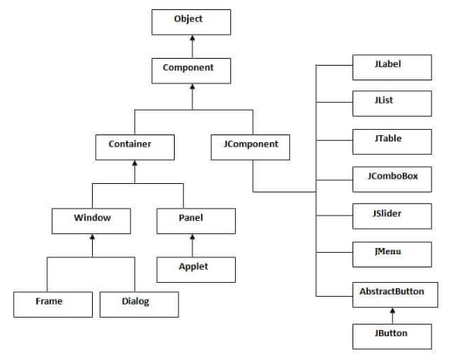
SWING class Hierarchy

Slide 7
To build a GUI...
Make somewhere to display things—usually a Frame or Dialog (for an application), or an Applet
Create some Components, such as buttons, text areas, panels, etc.
Add your Components to your display area
Arrange, or lay out, your Components
Attach Listeners to your Components
Interacting with a Component causes an Event to occur
A Listener gets a message when an interesting event occurs, and executes some code to deal with it

Slide 8
Containers and Components
Purpose of the Container is to hold and display Components
Some common subclasses of Component are Button, Checkbox, Label, Scrollbar, TextField, and TextArea
A Container is also a Component
This allows Containers to be nested
Some Container subclasses are Panel (and Applet), Window, and Frame

Slide 9
Creating components
Label lab = new Label (“Enter your name");
Button but = new Button (“Logging");
Checkbox toggle = new Checkbox (“Allow");
TextField txt = new TextField ("Initial text.", 20);

Slide 10
Creating a Frame
Frame frame = new Frame();
frame.setTitle("My Frame");
frame.setSize(300, 200); // width, height
... add components ...
frame.setVisible(true);
Or:
class MyClass extends Frame {
... setTitle("My Frame"); // in some instance method

Slide 11
Arranging components
Every Container has a layout manager
The default layout for a Panel is FlowLayout
You could set it explicitly with setLayout (new FlowLayout( ));
You could change it to some other layout manager

Slide 12
FlowLayout
Use add(component); to add to a component when using a FlowLayout
Components are added left-to-right
If no room, a new row is started
Exact layout depends on size of Panel
Components are made as small as possible
FlowLayout is convenient but often ugly

Slide 13
Complete example: FlowLayot
import java.awt.*;
public class FlowLayoutExample extends Frame {
public FlowLayoutExample(String title){
super(title);
setLayout (new FlowLayout ()); // default add (new Button ("One")); add (new Button ("Two")); add (new Button ("Three")); add (new Button ("Four")); add (new Button ("Five")); add (new Button ("Six")); }
}

Slide 14
BorderLayout
At most five components can be added
If you want more components, add a Panel, then add components to it.
setLayout (new BorderLayout());
add (new Button("NORTH"), BorderLayout.NORTH);

Slide 15
Complete example: BorderLayout
import java.awt.*;
public class FlowLayoutExample extends Frame {
public FlowLayoutExample(String title){
super(title);
setLayout (new BorderLayout());
add(new Button("One"), BorderLayout.NORTH);
add(new Button("Two"), BorderLayout.WEST);
add(new Button("Three"), BorderLayout.CENTER);
add(new Button("Four"), BorderLayout.EAST);
add(new Button("Five"), BorderLayout.SOUTH);
}
}

Slide 16
Using a Panel
Panel p = new Panel();
add (p, BorderLayout.SOUTH);
p.add (new Button ("Button 1"));
p.add (new Button ("Button 2"));

Slide 17
Making components active
Most components already appear to do something--buttons click, text appears
To associate an action with a component, attach a listener to it
Components send events, listeners listen for events
Different components may send different events, and require different listeners

Slide 18
Listeners
Listeners are interfaces, not classes
class MyButtonListener implements ActionListener {
An interface is a group of methods that must be supplied
When you say implements, you are promising to supply those methods

Slide 19
Writing a Listener
For a Button, you need an ActionListener
b1.addActionListener (new MyButtonListener ( ));
An ActionListener must have an actionPerformed(ActionEvent) method
public void actionPerformed(ActionEvent e) { … }

Slide 20
MyButtonListener
import java.awt.*;
Import java.event.*;
public class FlowLayoutExample extends Frame {
public FlowLayoutExample(String title){
super(title);
Button b1 = new Button(“Show");
b1.addActionListener (new MyButtonListener ());
add(b1);
}
}
class MyButtonListener implements ActionListener {
public void actionPerformed (ActionEvent e) {
…
}
}

Slide 21
Introduction to JavaFX
JavaFX is a Java library used to develop Desktop applications as well as Rich Internet Applications (RIA).
The applications built in JavaFX, can run on multiple platforms including Web, Mobile and Desktops.
JavaFX is intended to replace swing in Java applications as a GUI framework.
However, It provides more functionalities than swing.
Like Swing, JavaFX also provides its own components and doesn't depend upon the operating system.
It is lightweight and hardware accelerated

Slide 22
JAVAFX for GUI - Public JavaFX API
Javafx.stage
Javafx.util
Javafx.application
javafx.collections
javafx.concurrent
javafx.event
javafx.geometry
javafx.animation
javafx.embed.swing
………….
javafx.scene – scene graph API
javafx.scene.control
javafx.scene.input
javafx.scene.layout
javafx.scene.paint
javafx.scene.media
javafx.scene.text
javafx.scene.web
javafx.scene.shape
…………..

Slide 23
JAVAFX for GUI - architecture
Scene graph - It is the starting point of constructing a JavaFX application.
Graphics Engine - provides the graphics support to the scene graph.
Prism can be seen as High Performance hardware-accelerated graphics pipeline.
Quantum Tool Kit is used to bind prism and glass windowing tool kit together and makes them available for the above layers in stack.
Glass Windowing tool kit - It is present on the lowest level of JavaFX graphics stack. It basically can be seen as a platform dependent layer which works as an interface between JavaFX platform and native operating system.
Web View - embed the HTML content to a JavaFX scene graph.
Media engine - the JavaFX application can support the playback of audio and video media files.

Slide 24
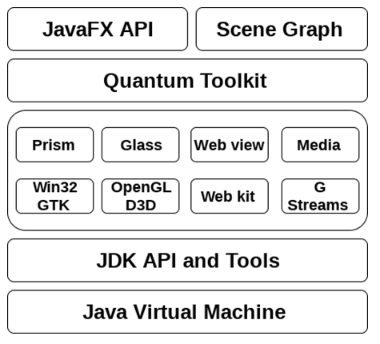
JAVAFX for GUI
JavaFX architecture

Slide 25
JAVAFX for GUI
JavaFX program structure
JavaFX application is divided hierarchically into three main components known as Stage, Scene and nodes.
import javafx.application.Application class in every JavaFX application.
This provides the following life cycle methods for JavaFX application.
public void init()
public abstract void start(Stage primaryStage)
public void stop()
In order to create a basic JavaFX application, we need to:
Import javafx.application.Application into our code.
Inherit Application into our class.
Override start() method of Application class.

Slide 26
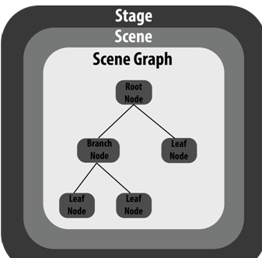
JAVAFX for GUI
JavaFX program structure…
Stage in a JavaFX application is similar to the Frame in a Swing Application.
Scene actually holds all the physical contents (nodes) of a JavaFX application. Javafx.scene.Scene class provides all the methods to deal with a scene object.
Scene Graph exists at the lowest level of the hierarchy.
It can be seen as the collection of various nodes.
A node is the element which is visualized on the stage.
It can be any button, text box, layout, image, radio
button, check box, etc.

Slide 27
JAVAFX for GUI
JavaFX apprlication
Step 1: Extend javafx.application.Application and override start()
package application;
import javafx.application.Application;
import javafx.stage.Stage;
public class Hello_World extends Application{
@Override
public void start(Stage primaryStage) throws Exception {
// TODO Auto-generated method stub
}
}

Slide 28
JAVAFX for GUI
JavaFX apprlication
Step 2: Create a Button
package application;
import javafx.application.Application;
importjavafx.scene.control.Button;
import javafx.stage.Stage;
public class Hello_World extends Application{
@Override
public void start(Stage primaryStage) throws Exception {
// TODO Auto-generated method stub
Buttonbtn1=newButton("Say, Hello World");
}
}

Slide 29
JAVAFX for GUI
JavaFX apprlication
Step 3: Create a layout and add button to it
package application;
import javafx.application.Application;
import javafx.scene.control.Button;
import javafx.stage.Stage;
import javafx.scene.layout.StackPane;
public class Hello_World extends Application{
@Override
public void start(Stage primaryStage) throws Exception {
// TODO Auto-generated method stub
Button btn1=new Button("Say, Hello World");
StackPane root=new StackPane();
root.getChildren().add(btn1);
}
}

Slide 30
JAVAFX for GUI
JavaFX apprlication
Step 4: Create a scene
package application;
import javafx.application.Application;
import javafx.scene.Scene;
import javafx.scene.control.Button;
import javafx.stage.Stage;
import javafx.scene.layout.StackPane;
public class Hello_World extends Application{
@Override
public void start(Stage primaryStage) throws Exception {
// TODO Auto-generated method stub
Button btn1=new Button("Say, Hello World");
StackPane root=new StackPane();
root.getChildren().add(btn1);
Scene scene=new Scene(root);
}
}

Slide 31
JAVAFX for GUI
JavaFX apprlication
Step 4: Create a Stage
package application;
import javafx.application.Application;
import javafx.scene.Scene;
import javafx.scene.control.Button;
import javafx.stage.Stage;
import javafx.scene.layout.StackPane;
public class Hello_World extends Application{
@Override
public void start(Stage primaryStage) throws Exception {
// TODO Auto-generated method stub
Button btn1=new Button("Say, Hello World");
StackPane root=new StackPane();
root.getChildren().add(btn1);
Scene scene=new Scene(root);
primaryStage.setScene(scene);
primaryStage.setTitle("First JavaFX Application");
primaryStage.show();
}
}

Slide 32
JAVAFX for GUI
JavaFX apprlication
Step 5: Create a Main method
package application;
import javafx.application.Application;
import javafx.scene.Scene;
import javafx.scene.control.Button;
import javafx.stage.Stage;
import javafx.scene.layout.StackPane;
public class Hello_World extends Application{
@Override
public void start(Stage primaryStage) throws Exception {
// TODO Auto-generated method stub
Button btn1=new Button("Say, Hello World");
StackPane root=new StackPane();
root.getChildren().add(btn1);
Scene scene=new Scene(root);
primaryStage.setScene(scene);
primaryStage.setTitle("First JavaFX Application");
primaryStage.show();
}
public static void main (String[] args)
{
launch(args);
}
}

Slide 33
JAVAFX for GUI
JavaFX UI controls
The package javafx.scene.control provides all the necessary classes for the UI components like Button, Label, Menu, ScrolBar, Hyperlink, ProgressBar, TextField, Password, etc.
Example
Label my_label=new Label("This is an example of Label");
Button btn = new Button("My Button");
RadioButton button1 = new RadioButton("option 1");

Slide 34
JAVAFX for GUI
JavaFX UI Layouts
Layouts are the top level container classes that define the UI styles for scene graph objects.
built-in layout panes in JavaFX that are HBox, VBox, StackPane, FlowBox, AnchorPane, etc.
Are belong to javafx.scene.layout package. javafx.scene.layout.Pane class is the base class for all the built-in layout classes in JavaFX.
BorderPane | Organizes nodes in top, left, right, centre and the bottom of the screen.
FlowPane | Organizes the nodes in the horizontal rows according to the available horizontal spaces. Wraps the nodes to the next line if the horizontal space is less than the total width of the nodes
GridPane | Organizes the nodes in the form of rows and columns.
HBox | Organizes the nodes in a single row.
Pane | It is the base class for all the layout classes.
StackPane | Organizes nodes in the form of a stack i.e. one onto another
VBox | Organizes nodes in a vertical column.

Slide 35
JAVAFX for GUI
JavaFX UI Layouts
Steps to create layout
Instantiate the respective layout class, for example, HBox root = new HBox();
Setting the properties for the layout, for example, root.setSpacing(20);
Adding nodes to the layout object, for example, root.getChildren().addAll(<NodeObjects>);
JavaFX Event Handlers
Foreground events are mainly occurred due to the direct interaction of the user with the GUI of the application. Such as clicking the button, pressing a key, selecting an item from the list, scrolling the page, etc.
Background events doesn't require the user's interaction with the application. These events are mainly occurred to the operating system interrupts, failure, operation completion, etc.

Slide 36
JAVAFX for GUI
JavaFX UI Layouts
Steps to create layout
Instantiate the respective layout class, for example, HBox root = new HBox();
Setting the properties for the layout, for example, root.setSpacing(20);
Adding nodes to the layout object, for example, root.getChildren().addAll(<NodeObjects>);
JavaFX Event Handlers
Foreground events are mainly occurred due to the direct interaction of the user with the GUI of the application. Such as clicking the button, pressing a key, selecting an item from the list, scrolling the page, etc.
Background events doesn't require the user's interaction with the application. These events are mainly occurred to the operating system interrupts, failure, operation completion, etc.

Slide 37
JAVAFX for GUI
JavaFX Event Handlers
JavaFX provides the class javafx.event.Event
example MouseEvent, KeyEvent, ScrollEvent, DragEvent, etc.
Setter method example
setOnDragDetected(EventHandler value )
setOnDragDone(EventHandler value )
setOnInputMethodTextChanged(EventHandler value )
setOnKeyPressed(EventHandler value )
setOnKeyReleased(EventHandler value )
setOnMouseClicked(EventHandler value )
……

Slide 38
JAVAFX for GUI
Thank You

