Slide 1
Chapter Five
Server-Side Scripting (PHP )
Prepared by: Marta G. (MSc. )

Slide 2
What is PHP (Hypertext Preprocessor) ?
PHP is a server side scripting language.
PHP is simple and easy to learn language.
PHP is an interpreted language, i.e. there is no need for compilation.
Php is a loosely typed language
In PHP, a variable does not need to be declared before adding a value to it.
You do not need to tell PHP which data type the variable is.
PHP automatically converts the variable to the correct data type, depending on its value.
PHP supports many databases (MySQL, Informix, Oracle, Sybase, Solid, PostgreSQL, Generic ODBC, etc.)
Notes:
The code that on the server and responds to the HTTP requests.
PHP is one of the most popular scripting languages on the web and it stands for Hypertext Preprocessor.
PHP is an HTML-embedded scripting language
With PHP you can create user name, passwords, login pages, check details from a form, create forms, picture galleries, surveys and much more
PHP works well with MySQL which is a relational database management system. MySQL is a very fast and secure data base management system
PHP is an interpreted language, i.e. there is no need for compilation.
Php is a loosely typed language
In PHP, a variable does not need to be declared before adding a value to it.
you do not need to tell PHP which data type the variable is.
PHP automatically converts the variable to the correct data type, depending on its value.
In a strongly typed programming language, you have to declare (define) the type and name of the variable before using it.
In PHP, the variable is declared automatically when you use it.

Slide 3
PHP Features cont…
Platform Independent:
PHP are available for WINDOWS, MAC, LINUX & UNIX operating system. A PHP application developed in one OS can be easily executed
in other OS also.
Compatibility:
PHP is compatible with almost all local servers used today like Apache, IIS etc.
Embedded:
PHP code can be easily embedded within HTML tags and script.
Notes:
PHP is a cross platform language and runs on different platforms such as, linux/unix, macintosh or windows.
Internet information services

Slide 4


Slide 5
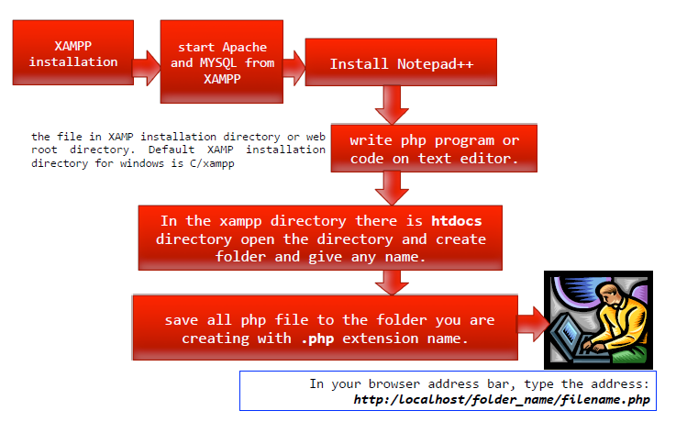
How to run php file on XAMPP server?
Notes:
XAMPP:
X: acronym for X (any Operating System)
A:Apache (Web server),
M: MySQL Database,
P: PHP Language and
P: PERL.
Perl is a family of two high-level, general-purpose, interpreted, dynamic programming languages. Orignally it was developed for text manipulation and now used for a wide range of tasks including system administration, web development, network programming, GUI development and more.

Slide 6
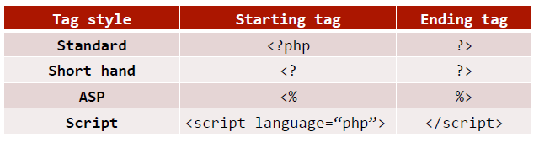
Basic Syntax of PHP
Php file must be saved in .php file extension.
Notes:
There are actually four different styles of PHP tags we can use
A PHP scripting block starts with <?php and ends with ?>.
A PHP scripting block can be placed anywhere in the document.
For maximum compatibility, it is recommended to use the standard form rather than others.

Slide 7
Basic Syntax cont…
PHP code is executed on the server, and the plain HTML result is sent to the browser
create a file and write HTML tags + PHP code and save this file with .php extension.
Each code line in PHP must end with a semicolon (;)
<?php //your code here ?> or
<!DOCTYPE>
<html>
<body>
<?php
echo "<h2>Hello World!</h2>”;
?>
</body>
</html>
Notes:
Each statement must be terminated with a semicolon

Slide 8
PHP echo
Printing variable value:
<?php
$msg="Hello world";
echo "Message is: $msg";
?>
Output: Message is: Hello world

Slide 9
PHP Comments
There are two ways:
Single line comments
// (C++ style single line comment)
# (Unix Shell style single line comment)
Multiple line comments
Enclose all lines within /* */

Slide 10

Example: PHP comments
<?php
#single line comment
echo “ hello world!”;
/* Multiple line
Comment */
?>

Slide 11
Data Types
Data types specify what kind of data, such as numbers and characters, can be stored and manipulated within a program.
PHP supports four core scalar data types:
Integer
Float (also called double)
String
Boolean
PHP supports composite data types:
Arrays
Objects
PHP also supports two special data types
Resource: reference to a third party resource such as a data base.
Null: an uninitialized variables.
Notes:
PHP supports both integers and floating-point numbers.
Integers are whole numbers and can be expressed in decimal (base 10), octal (base 8), and hexadecimal (base 16), and it can also be either positive or negative values.
PHP supports a number of fundamental basic data types, such as integers, floats, and strings. Basic data types are the simplest building blocks of a program. They are called scalars and can be assigned a single literal value such as a number, 5.7, or a string of characters, such as "hello", a date and time, or a Boolean (true/false).
Composite data types represent a collection of data, rather than a single value.

Slide 12
PHP String Functions
1) strtolower()
Returns string in lowercase letter.
Syntax
strtolower ( string $string )
Example
<?php
$str=”Hello STUDENT";
$str=strtolower($str);
echo $str;
?>
Output: hello student

Slide 13
PHP String Functions cont…
2) strtoupper()
returns string in uppercase letter.
Syntax
strtoupper ( string $string )
Example
<?php
$str="Hello STUDENT";
$str=strtoupper($str);
echo $str;
?>
Output: HELLO STUDENT

Slide 14

PHP String Functions cont…
3) ucfirst()
Returns string converting first character into uppercase.
It doesn't change the case of other characters
Syntax
ucfirst ( string $str )
Example
<?php
$str=“hello STUDENT";
$str=ucfirst($str);
echo $str; ?>

Slide 15

PHP String Functions cont…
4) lcfirst()
Returns string by converting first character into lowercase.
It doesn't change the case of other
Syntax
lcfirst ( string $str )
Example
<?php
$str=“Hello Student";
$str=lcfirst ($str);
echo $str; ?>

Slide 16

PHP String Functions cont…
5) ucwords()
Returns string converting first character of each word into uppercase.
Syntax
string ucwords ( string $str )
Example
<?php
$str=”hello student";
$str=ucwords($str);
echo $str;
?>

Slide 17

PHP String Functions cont…
6) strrev()
Returns reversed string.
Syntax
strrev ( string $string )
Example
<?php
$str=”hello student";
$str=strrev($str);
echo $str;
?>

Slide 18

PHP String Functions cont…
7) strlen()
Returns length of the string.
Syntax :
strlen( string $string )
Example :
<?php
$str=”hello student";
$str=strlen($str);
echo $str;
?>

Slide 19
PHP String Functions cont…
8. strpos() :The PHP strpos() function searches for a specific text within a string.
If a match is found, the function returns the character position of the first match.
If no match is found, it will return NULL.
The example below searches for the text "world“ in the string "Hello world!":
<?php
echo strpos("Hello world!", "world");
? >
Output: 6
Tip: The first character position in a string is 0 (not 1).

Slide 20
PHP String Functions cont…
9.str_replace() :The PHP str_replace() function replaces some characters with some other characters in a string.
The example below replaces the text "world“ with ”abeba":
Example
<?php
echo str_replace("world", ”Abeba", "Hello world!");
?>
// outputs Hello Abeba!

Slide 21
Form variables
How PHP collects and stores the form information in variables?
For each HTML form parameter, PHP creates a global variable by the same name and makes it available to your script.
For example:
<input type="text" name="your_name"> // $your_name
<input type="text" name ="your_phone"> // $your_phone
Notes:
Now we are starting to get into what makes PHP so popular.
PHP was designed as a Web-based programming language to create dynamic Web content, to gather and manipulate information submitted by HTML forms.
we are talking about variables, so lets examine a simple form and how PHP collects and stores the form information in variables.
Here we have two text fields. The first text field is named as your_name so php creates a variable called $your_name likewise the second text field…
The values assigned to the PHP variables are the same values the user entered in the HTML text fields when filling out the form.

Slide 22
Cont…
The form starts with the opening <form> tag.
The ACTION attribute of the form tag is assigned the name of the PHP script that will handle the form input.
<form ACTION="php script">
The method attribute specifies how to send the form data to the server. Most popular methods are GET method (default) and the POST method.
<form action="php script“ method= “method”>
Notes:
There are two popular HTTP methods used to send the form information to the server the GET method (default) and the POST method.

Slide 23
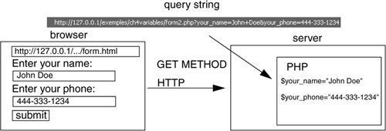
Cont…
GET method
It is simple and fast type of method
The GET method sends form input in the URL
Not suitable for passing sensitive information
Less data can be passed since the length of the URL is limited
Notes:
The GET method is the simplest type of method and is used mainly for the simple retrieval of static HTML documents, images, or results of a database query as shown in the URL of Google’s search engine.
The data is sent as URL parameters that are usually string of name and value pairs separated by ampersands (&)
It is possible to bookmark the page

Slide 24
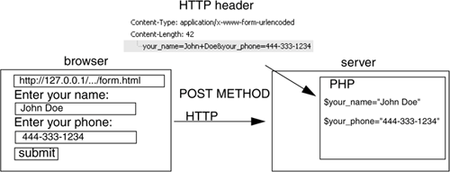
Cont…
Post method
The browser sends an encoded message body in the HTTP header to the server.
In post method the data is sent to the server as a package in a separate communication with the processing script.
Data sent through POST method will not visible in the URL
Notes:
the browser sends an encoded message body in the HTTP header to the server so that it doesn’t appear in the URL.
It is more secure than GET
It is possible to pass large amount of data
Since the data sent by the POST method is not visible in the URL, so it is not possible to bookmark the page with specific query
It is not possible to bookmark the page with specific query
Eg run studF_get and studF_post

Slide 25
Cont…
When using GET method, script pages can access each form field using the predefined super global variable $_GET.
Format: $_GET [“variable name”];
Example : $_GET["stu_name"] or $name= $_GET["stu_name"]
When using the POST method, script pages can access each form field using the predefined super global variable, $_POST.
Format: $_POST [“variable name”];
$_POST["username"]
$HTTP_POST_VARS[‘username’] (long style)
Notes:
When PHP gets the form input from the server, it takes care of decoding the query string or message body and assigning the respective input values to PHP variables.
where variable name takes the name of the form fields.
Eg $_GET["stu_name"]
$_POST["username"]
$stu_name, $username
medium styl $_GET["stu_name"] , $_POST[“username”].
long style,$HTTP_GET_VARS['stu_name'], $HTTP_POST_VARS[‘username'].

Slide 26
Cont…
$_REQUEST is a special global array that contains all of the input data for both GET and POST methods
<html>
<head>
<title>First HTML Form</title>
</head>
<body bgcolor="lightblue"><font size="+1">
<form action="/phpforms/form1.php" method="POST">
Please enter your name: <br />
<input type="text“ size=50 name="your_name">
Please enter your phone: <br />
<input type="text" size=50 name="your_phone">
Please enter your email address:<br />
<input type="text" size=50 name="your_email_addr">
<input type=submit value="submit">
<input type=reset value="clear">
</form>
<hr></body> </html>

Slide 27
PHP Arithmetic Operators
$x=5; $y=2;
Operator | Description | Example | Result
+ | Addition | $x+$y | 7
- | Subtraction | $x-$y | 3
* | Multiplication | $x* $y | 10
/ | Division | $x/$y | 2.5
% | Modulus | $x%$y | 1
** | Exponentiation | $x**$y | 25
Notes:
The php arithmetic operators are used with numeric values to perform common arithmetical operations, such as addition subtraction ….
** result of raising $x to the $yth power
Sum of $x n $y difference .. Product of $x n $y .. Quotient of …reminder of …

Slide 28
PHP assignment operators
Operator | Example | Is The Same As
= | $x=$y | $x=$y
+= | $x+=$y | $x=$x+$y
-= | $x-=$y | $x=$x-$y
*= | $x*=$y | $x=$x*$y
/= | $x/=$y | $x=$x/$y
%= | $x%=$y | $x=$x%$y
Notes:
The php assignment operators are used with numeric values to write a value to a variable.
The left operand gets set to the value of the expression on the right
Addition.. Subtraction… multiplication… division .. Modulus

Slide 29
PHP assignment operators Cont…
Example:
<html>
<head><title>Assignment Operators</title></head>
<body>
<?php
//Using shortcuts
$num=10;
print "10 is assigned to \$num.<br />";
$num += 2;
echo "\$num += 2; \$num is $num. <br />";
$num -= 1;
echo "\$num -= 1; \$num is $num. <br />";
$num *= 3;
echo "\$num *= 3; \$num is $num. <br />";
$num %= 5;
echo "\$num %= 5; \$num is $num.<br />";
?>
</body></html>

Slide 30
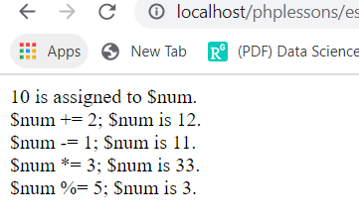
PHP assignment operators Cont…

Slide 31
PHP comparison operators
$x=8; $y=6; $z=“8”
Operator | Name | Example | Result
== | Equal | $x==$z | True
=== | Identical | $x===$z | False
!= | Not equal | $x!=$y | True
<> | Not equal | $x<>$y | True
!== | Not identical | $x!==$z | True
> | Greater than | $x>$y | True
< | Less than | $x<$y | False
>= | Greater than or equal to | $x>=$y | True
<= | Less than or equal to | $x<=$y | False
<=> | Spaceship | $y<=> $x | -1
Notes:
The php comparison operators are used to compare two values (number or string)
Returns true if x is equal to z
Returns true if x is equal to y and they are of the same type
$y⬄ $x returns an integer less than, equal to, or greater than zero, depending on if $x is less than, equal to, or greater than $y.

Slide 32
PHP Increment/ decrement operators
Operator | Name | Example | Result
++$y | Pre-increment | $y=10; echo ++$y; | 11
$y++ | Post-increment | $y=10; echo $y++; | 10
--$y | Pre-decrement | $y=10; echo --$y; | 9
$y-- | Post-decrement | $y=10; echo $y--; | 10
Notes:
The php auto increment operators are used to increment a variable’s value
The php auto decrement operators are used to decrease variable’s value
The operator has two forms: prefix and postfix
Increments $y by one, then returns $y
Returns $x then increments $x by one
Decrements $y by one then returns $y

Slide 33
PHP logical operators
$x=50; $y=30;
Operator | Name | Example | Result
and | And | ($x==50 and $y==30) | True
or | Or | ($x==500 or $y==30) | True
xor | Xor | ($x==50 Xor $y==30) | False
&& | And | ($x<=100 && $y>= 10) | True
|| | Or | ($x==30 || $y==50) | False
! | not | !($x==$y) | True
Notes:
Php logical operators are used to combine conditional statements
Logical operators let you test combinations of expressions resulting in boolean value, true and false.
Xor returns false if both conditions are true or false

Slide 34
PHP string operators
Example
<?php <?php
$str1=“hello”; $str1=“hello”;
$str2= “world!” $str2= “world!”
Echo $str1. $str2; $str1 . =$str2;
?> Echo $str1;
// returns hello world! ?>
// returns hello world!
Operator | Name | Example | Result
. | Concatenation | $str1 . $str2; | Concatenation of $str1 and $str2
.= | Concatenation assignment | $str1 .= $str2; | Appends $str2 to $str1
Notes:
Php has two operators that are specially designed for strings

Slide 35
PHP conditional assignment operators
Operator | Name | Example
?: | Ternary | $y=expr1?expr2:expr3;
?? | Null coalescing | $y=expr1??expr2;
Notes:
Returns the value of $y. the value of y is exp2 if expression one = to true. The value of $x is exp3 if exp1 =false
Returns the value of $y. The value of $y is exp1 if exp1 exists and is not null. Otherwise

Slide 36
PHP Looping - While Loops
Loops execute a block of code for a specified number of times, or while a specified condition is true.
In PHP, we have the following looping statements:
while - loops through a block of code while a specified condition is true
do...while - loops through a block of code once, and then repeats the loop as long as a specified condition is true
for - loops through a block of code a specified number of times
foreach - loops through a block of code for each element in an array
Notes:
While is a control flow statement that allows code to be excuted repeatedly based on a given boolean condition.
The while loop executes the statement when the expression is evaluated to true.

Slide 37
The while Loop
The while loop executes a block of code while a condition is true.
Syntax
while (condition)
{
code to be executed;
}
Example:
<?php
$i=1;
while($i<=5)
{
echo "The number is " . $i . "<br />";
$i++;
}
?>
Notes:
The example below defines a loop that starts with i=1. The loop will continue to run as long as i is less than, or equal to 5. i will increase by 1 each time the loop runs:

Slide 38
Example: while loop
Output:
The number is 1
The number is 2
The number is 3
The number is 4
The number is 5

Slide 39
The do...while Statement
The do...while statement will always execute the block of code at least once, it will then check the condition, and repeat the loop while the condition is true.
Syntax
do
{
code to be executed;
}
while (condition);

Slide 40
Example: do…while
<?php
$i=8;
do
{
$i--;
echo "The number is " . $i . "<br />";
}
while ($i>=5);
?>
Notes:
The example below defines a loop that starts with i=1. It will then increment i with 1, and write some output. Then the condition is checked, and the loop will continue to run as long as i is less than, or equal to 5:

Slide 41
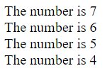

Slide 42
The foreach Loop
The foreach loop is used to loop through arrays.
For each pass the value of the current array element is assigned to $value and the array pointer is moved by one and in the next pass next element will be processed.
Syntax
foreach ($array as $value)
{
code to be executed;
}
For every loop iteration, the value of the current array element is assigned to $value (and the array pointer is moved by one) - so on the next loop iteration, you'll be looking at the next array value.
Notes:
The foreach statement is used to loop through arrays. For each pass the value of the current array element is assigned to $value and the array pointer is moved by one and in the next pass next element will be processed. The array pointer moves from left to right

Slide 43
Foreach loop cont…
Example
The following example demonstrates a loop that will print the values of the given array:
<?php $array = array( 1, 2, 3, 4, 5); foreach( $array as $value ) { echo "Value is $value <br />"; } ?>

Slide 44
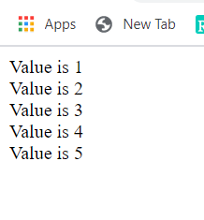

Slide 45
Types of Arrays in PHP
There are three types of arrays that you can create. These are:
Indexed array
Associative array
Multidimensional array

Slide 46
Indexed Arrays
An indexed or numeric array stores each array element with a numeric index.
By default, the array index starts from zero and Values are stored and accessed in linear fashion
Note: In an indexed or numeric array, the indexes are automatically assigned and start with 0, and the values can be any data type.
Notes:
An array with a numeric key.
By default, the array index starts from zero and Values are stored and accessed in linear fashion

Slide 47
Indexed array cont…
<?php
// Define an indexed array
$colors = array("Red”,"Green”,"Blue");
$colors[0] = "Red";
$colors[1] = "Green";
$colors[2] = "Blue";
?>

Slide 48
Associative Arrays
In an associative array, the keys assigned to values can be arbitrary and user defined strings.
Associative array will have their index as string so that you can establish a strong association between key and values.
Notes:
Associative array will have their index as string so that you can establish a strong association between key and values. Arrays indexed by strings
Example to store salarys of an employee : we can take employees name as a key and the value would be their associative salary

Slide 49
<?php
/* First method to create associate array. */
$salary = array( "mohammad" => 2000,
"qadir" => 1000,
"zara" => 500);
echo "salary is $salary.<br />\n";
echo "Salary of mohammad is ". $salary['mohammad'] . "<br />";
echo "Salary of qadir is ". $salary['qadir']. "<br />";
echo "Salary of zara is ". $salary['zara']. "<br />";
/* Second method */
$salary['mohammad'] = "high";
$salary['qadir'] = "medium";
$salary['zara'] = "low";
echo "Salary of mohammad is ". $salary['mohammad'] . "<br />";
echo "Salary of qadir is ". $salary['qadir']. "<br />";
echo "Salary of zara is ". $salary['zara']. "<br />";
?>

Slide 50
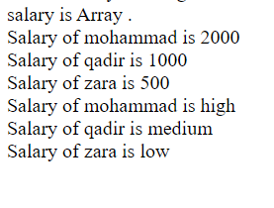
Output:

Slide 51
Multidimensional Arrays
Is an array in which each element can also be an array and each element in the sub-array can be an array or further contain array within itself and so on.
Notes:
An array containing one or more arrays within itself.

Slide 52
cont…
Example 1:
<?php
$marks = array( "mohammad" => array ( "physics" => 35,"maths" => 30, "chemistry" => 39 ),
"abebe" => array ("physics" => 30,"maths" => 32, "chemistry" => 29 ),
"zara" => array ( "physics" => 31, "maths" => 22, "chemistry" => 39 ) );
// Accessing multi-dimensional array values
echo "Marks for mohammad in physics : " ; echo $marks['mohammad']['physics'] . "<br />";
echo "Marks for abebe in maths : ” ;echo $marks['abebe']['maths'] . "<br />";
echo "Marks for zara in chemistry : " ;echo $marks['zara']['chemistry'] . "<br />";
?>

Slide 53
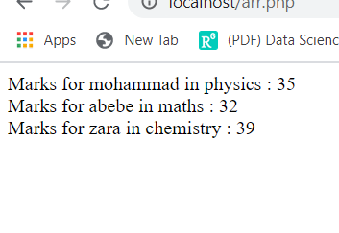
Output:

Slide 54
Example 2:
<html> <head><title>Array of Arrays</title></head>
<body> <font face="arial">
<?php
$numbers=array(array(10,12,14,16),
array(15,18,21,24), array(20,25,30,35),);
echo "<table border='1'><caption><font size=‘-2'>Rows and Columns</font></caption>";
for($i=0; $i < 3; $i++){
echo "<tr bgcolor='999FFF'>";
for($j=0; $j<4; $j++){
echo "<td><b>".$numbers[$i][$j];}
echo "</td></tr>";}
echo "</table>";?> </body> </html>

Slide 55
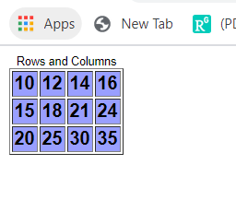
Output:

Slide 56
Function parameters
Information can be passed to functions through arguments. An argument is just like a variable.
Function may accept one or more parameters. There are two ways to pass parameters to a function: passing parameter by value and passing parameter by reference.
Parameter is what's given in the function declaration/definition.
Argument is what's passed when calling the function.

Slide 57
Passing parameters by value
<?php
function increase($x){
$x = $x + 1;
echo ‘Inside function x = ' . $x .'<br />';
}
$x = 10;
increase($x);
echo ‘Outside function x = ' . $x .'<br />'; ?>
Output:

Slide 58

Output

Slide 59
Passing parameters by reference
<?php
function increase(&$x){
$x = $x + 1;
echo ‘Inside function x = ' . $x .'<br />';
}
$x = 10;
increase($x);
echo ‘Outside function x = ' . $x .'<br />'; ?>
Output:

Slide 60

output

