Slide 2
Chapter six DATABASE MANIPULATION using php

Slide 3
What is Database?
A database is a separate application that stores a collection of data which is accessed from a computer system
Other kinds of data stores can be used, such as files on the file system
Data fetching and writing would not be so fast and easy with this type of system
Database: is a collection of tables, with related data
Table: is a matrix of data [column x row]
A table in a database looks like a simple spreadsheet
Column: one column (data element) contains data of one and the same kind, for example the column postcode
Row: A row (= tuple, entry or record) is a group of related data, for example the data of one subscription

Slide 4
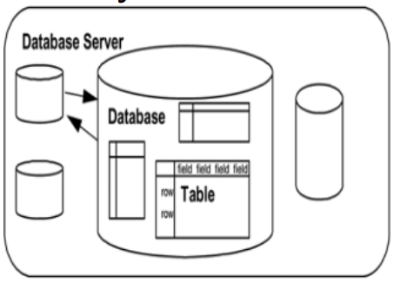
Cont…
Primary Key: a key which uniquely identifies a table
A key value can not occur twice in one table
With a key you can find at most one row
Foreign Key: is the linking pin between two tables
Anatomy of a relational database

Slide 5
Cont…
What makes up a database?
The main components of a RDBMS are:
The database server: is the actual server process running the databases
It controls the storage of the data, grants access to users, updates and deletes records, and communicates with other servers
The database: is a collection of related data elements, usually corresponding to a specific application
Tables: Each database consists of two-dimensional tables
In fact, a relational database stores all of its data in tables, and nothing more
Records and fields: A table has a name and consists of a set of rows and columns
It resembles a spreadsheet where each row, also called a record, is comprised of vertical columns, also called fields
Primary key

Slide 6
Connecting PHP to MySQL Database
To communicate with the MySQL server, you will need a language
SQL (Structured Query Language) is the language of choice for most modern multiuser, relational databases
MySQL:
Easy to use
Large community of developers
Open source license
Commercial license
Scalability

Slide 7
SQL Language
The standard language for communicating with relational databases is SQL
The standard basic commands for querying a database such as SELECT, INSERT, DELETE, UPDATE, CREATE, and DROP will handle most of the essential tasks you will need to perform database operations.

Slide 8
SQL Language Cont…
Data Manipulation Language (DML)
The following commands form the Data Manipulation Language (DML) part of SQL
SELECT: extracts data from a database table
Syntax: SELECT column name(s) FROM table name
UPDATE: updates data in a database table
Syntax: UPDATE table name SET column name = new value WHERE column name = some value
DELETE: deletes data from a database table
Syntax: DELETE FROM table name WHERE column name = some value
INSERT INTO: inserts new data into a database table
Syntax: INSERT INTO table name VALUES (value1, value2,....)

Slide 9
SQL Language Cont…
Data Definition Language (DDL)
The Data Definition Language (DDL) part of SQL permits database objects to be created or destroyed
The most important data definition statements in SQL are:
CREATE TABLE: creates a new database table
ALTER TABLE: alters (changes) a database table
DROP TABLE: deletes a database table
CREATE INDEX: creates an index (search key)
DROP INDEX: deletes an index

Slide 10
Connecting PHP to MySQL Database
PHP provides various functions to access the MySQL database and to manipulate the data records inside MySQL database
You would require to call the PHP functions in the same way you call any other PHP function
The PHP functions for use with MySQL have the following general format:
Mysqli_function(value,value,...)
The second parameter of the function is specific to the function, usually a word that describes what the function does
Example:
Mysqli_connect($connect);
Mysqli_query($connect, "SQL statement");

Slide 11
Connecting PHP to MySQL Database cont…
Open a Connection to MySQL
Before we access data in the MySQL database, we need to be able to connect to the server
To establish a connection to MySQL database server from your PHP script, use the PHP mysqli connect() function
Syntax: mysqli_connect (server,username,password)
Example: $link = mysqli_connect("localhost", "root", "password")
The first argument is the host server where the MySQL server will be running
The second argument is the username, the default value for the name of the owner of the server process
The next argument is the password, if there is one

Slide 12
Connecting PHP to MySQL Database cont…
Close the Connection
If you want to close the database before the program ends, PHP provides
mysqli close() function
The mysqli close() function closes the connection to the MySQL server referenced by the link
Syntax: mysqli close([resource link identifier]);
Example: mysqli close($link);
Choosing the Database
Once connected to the database server, the next step is to set the database that you will be using
The mysqli select db() function is used to select MySQL database
Syntax: mysqli_select_db(MySQL connection, database name)
Example:
$link=mysqli_connect(‘localhost’,‘root’,‘ ’);
$db selected =mysqli_select_db($link, ‘db name’);

Slide 13
Connecting PHP to MySQL Database cont…
Executing SQL Statements (INSERT, UPDATE, DELETE)
Once connected to the database server, and having selected a database, it is time to start executing SQL commands
PHP provides the mysqli_query() function to perform database queries
Syntax: mysqli_query($conn, $query);
Example: $result=mysqli_query($conn, "SELECT Id, Name FROM Employees");

Slide 14
Connecting PHP to MySQL Database cont…
Retrieving the Query Results
SQL commands such as INSERT, UPDATE, and DELETE do not return any data
SELECT statement normally returns a set of data records, called the result set
To display the result set, PHP has provided a number of functions including:
mysqli fetch array(): fetches a result row as an associative, a numeric array, or both
mysqli fetch assoc(): fetches a result row as an associative array
It is very similar to mysqli fetch row() except that the result returned is an associative array
mysqli fetch rows(): returns the number of rows in a result set
mysqli fetch row(): extracts one record of the data from the result set
Example: $result set=mysqli query($conn, $query string);
$record=mysqli fetch row($result set);
Reading assignment
what is the difference between mysqli fetch array(), mysqli fetch assoc(), and mysqli fetch row().

Slide 15
Connecting PHP to MySQL Database cont…
Retrieving the Query Results
To display the result set, PHP has provided a number of functions including:
mysqli num rows(): returns the number of rows in the result-set
$number of rows = mysqli num rows($result set)
mysqli num fields(): returns the number of fields in a table
$number of fields = mysqli num fields($result set)
mysqli field name(): returns the name of a specific field
$field name = mysqli field name($result set, $index)
mysqli error(): returns the text of the error message generated by MySQL server

Slide 16
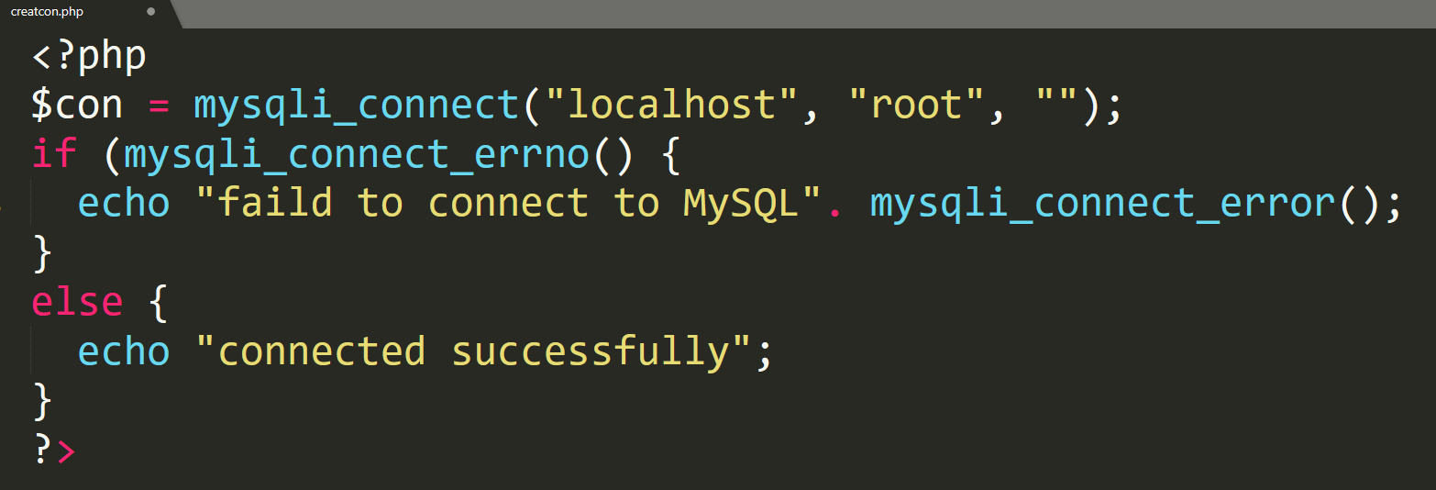

Creating a Connection
Example
output

Slide 17
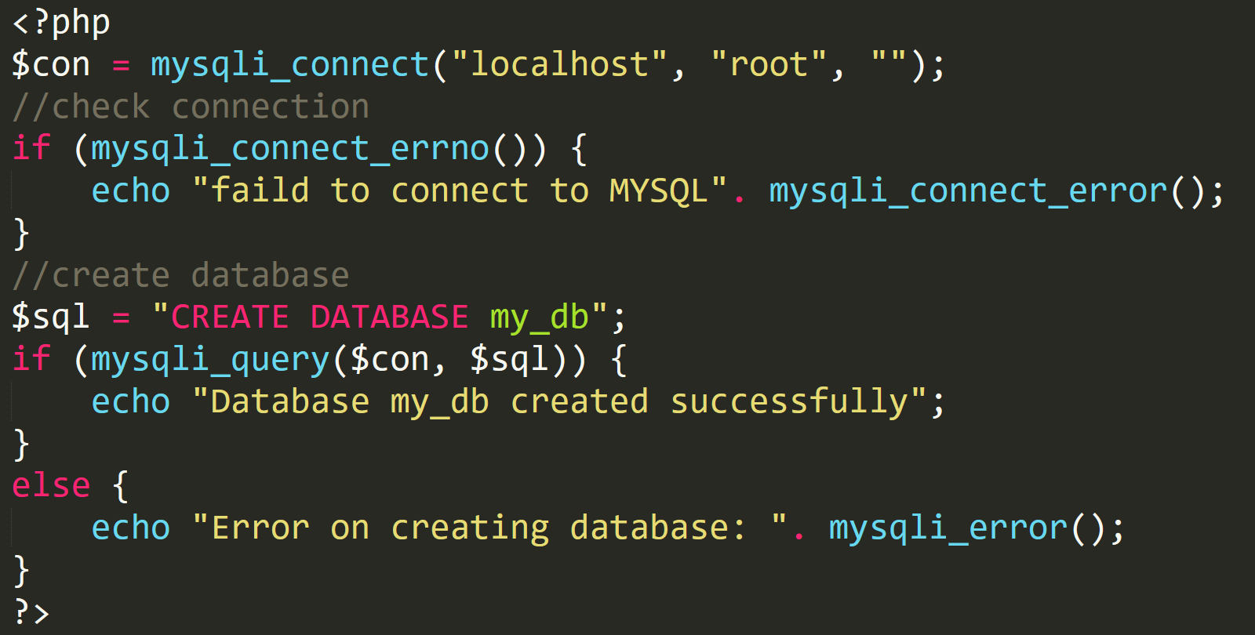
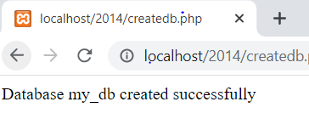
Creating a Database
Example:
Output:

Slide 18
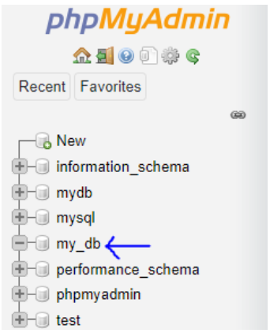
You can check on phpMyAdmin

Slide 19
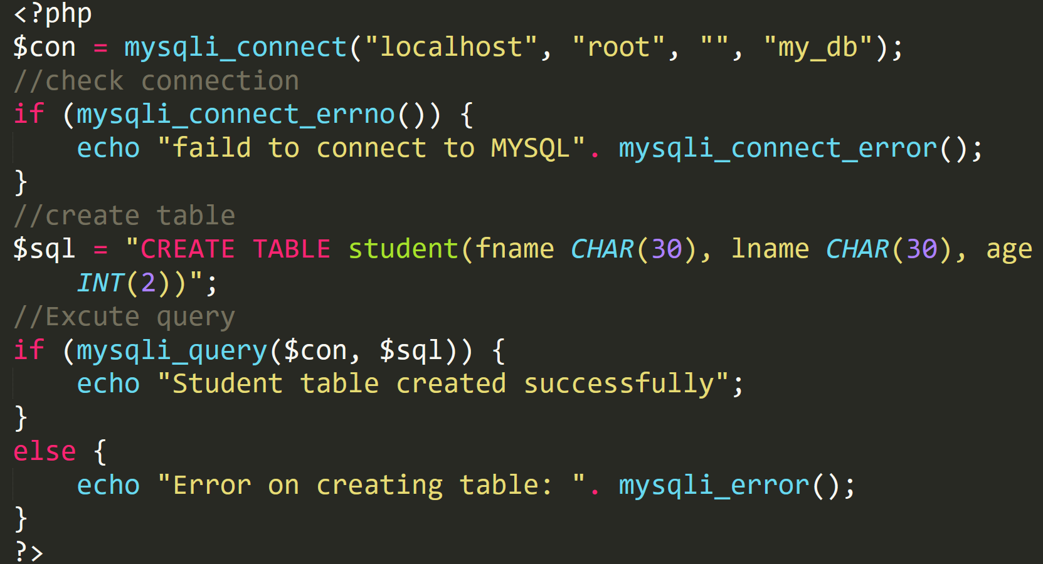
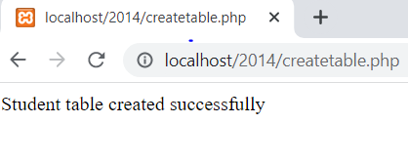
Creating table
Example:
Output:

Slide 20
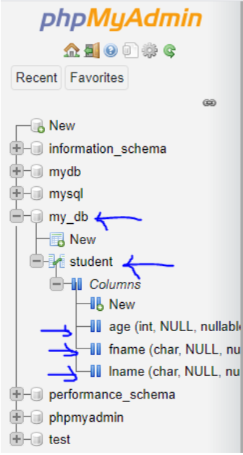

Slide 21
For primary keys and autoincrement feilds
$sql = "CREATE TABLE student ( studID int NOT NULL AUTO_INCREMENT, PRIMARY KEY(studID), fname char(30), lname char(30), age int(2))";

Slide 22
Creating Database and Table Manually
To create database, follow the following step:
1 Write localhost/phpmyadmin on web address of the browser
2 Click on database
3 Set the database name and click on create
To create table, follow the following step:
1 Open the database that you have created previously
2 After opening the database, fill the name of the table and number of columns and click on GO

Slide 23
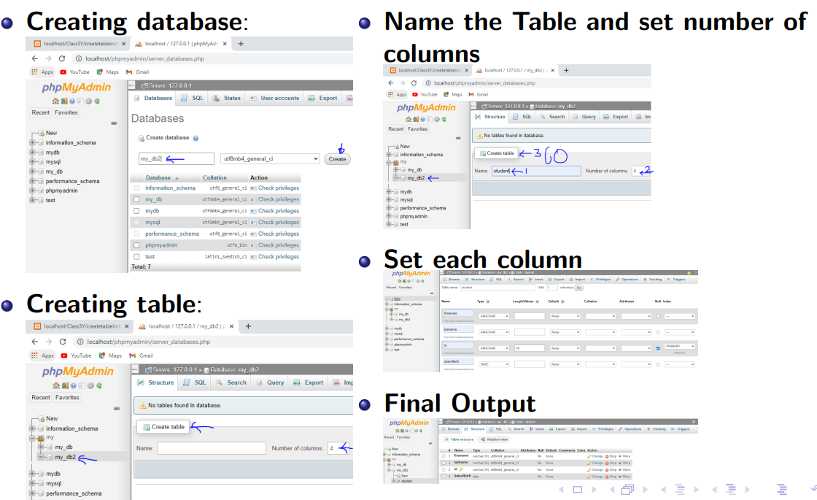

Slide 24
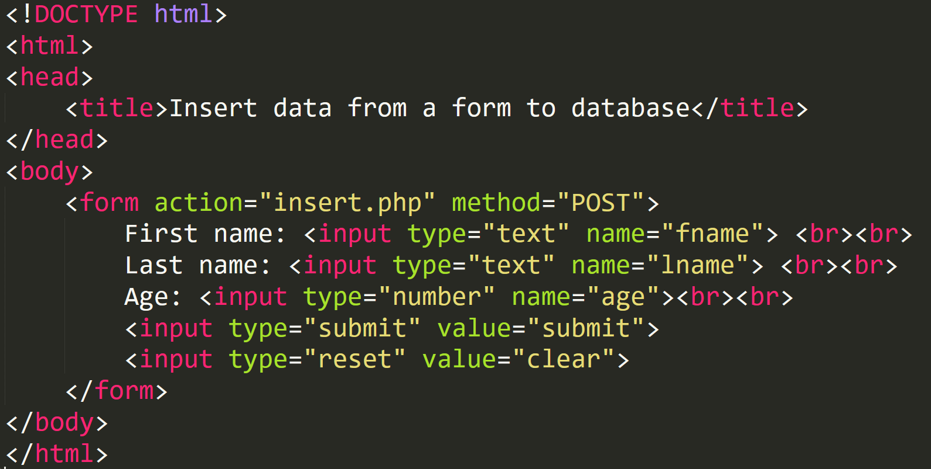
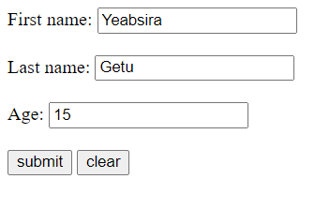
Inserting Data from a Form into a Database
Example

Slide 25
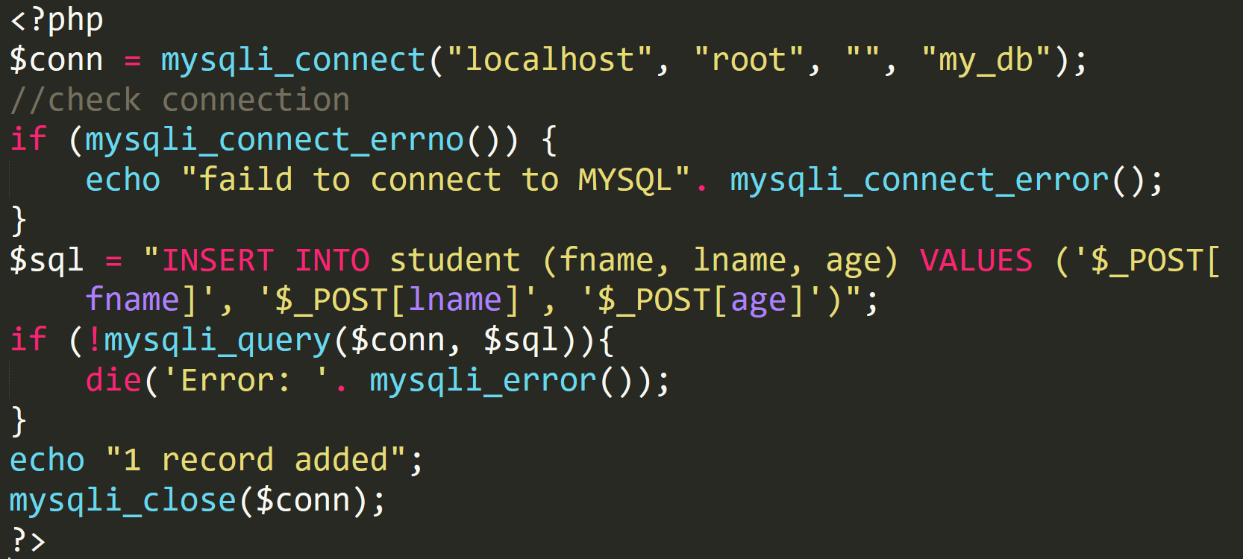
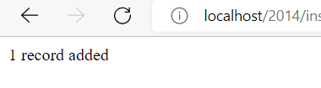
Inserting Data from a Form into a Database cont..
insert.php
Output

Slide 26
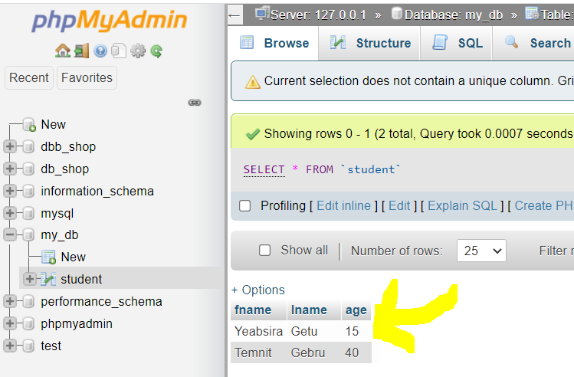
Inserting Data from a Form into a Database cont..
Output or Records seen form localhost/phpmyadmin

Slide 27
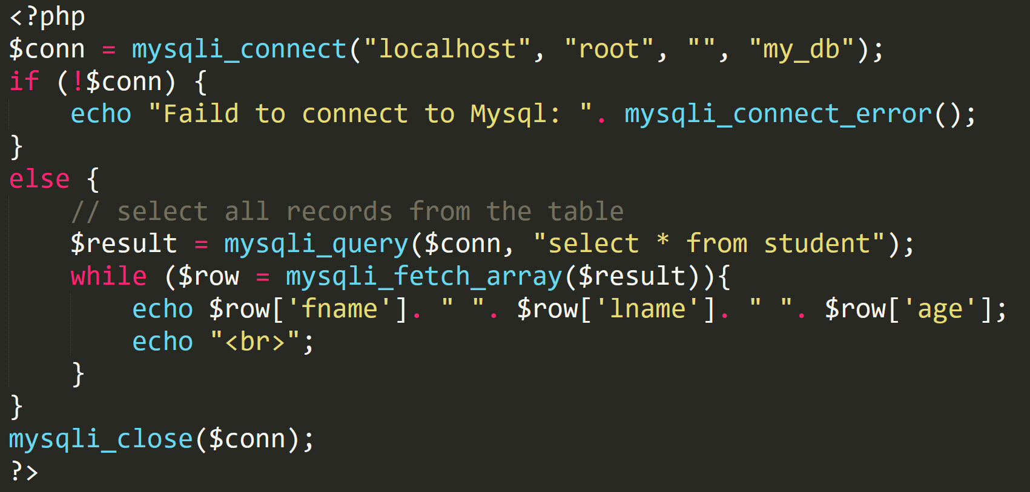
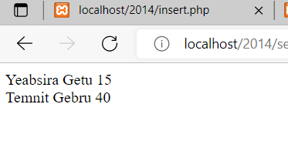
Select All Data Stored from a Table in the Database
select.php
Output

Slide 28
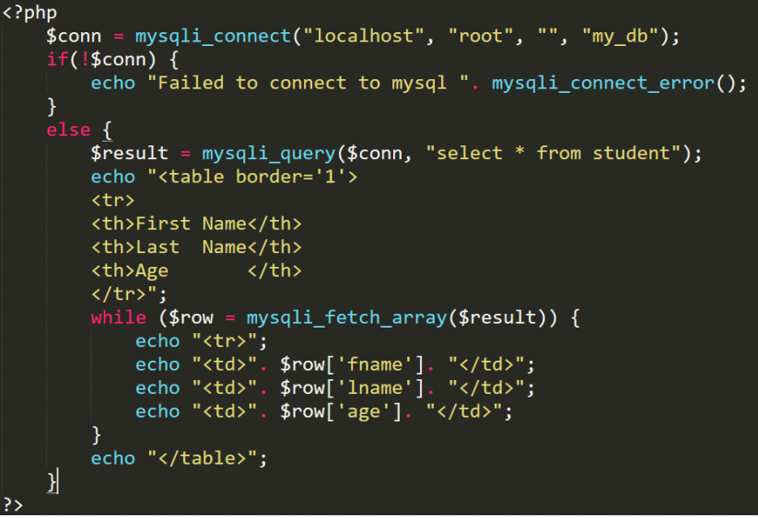
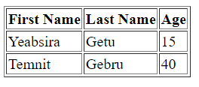
Displaying the Result in an HTML Table
display.php
Output

Slide 29
PHP MySQL Update Query
The UPDATE statement is used to update the records in a MySQL database table
Updating Database Table Data:
The UPDATE statement is used to change or modify the existing records in a database table
It is typically used in conjugation with the WHERE clause to apply the changes to only those records that matches specific criteria
The basic syntax of the UPDATE statement can be given with:
UPDATE table name SET column1=value, column2=value2,...
WHERE column name = some value

Slide 30
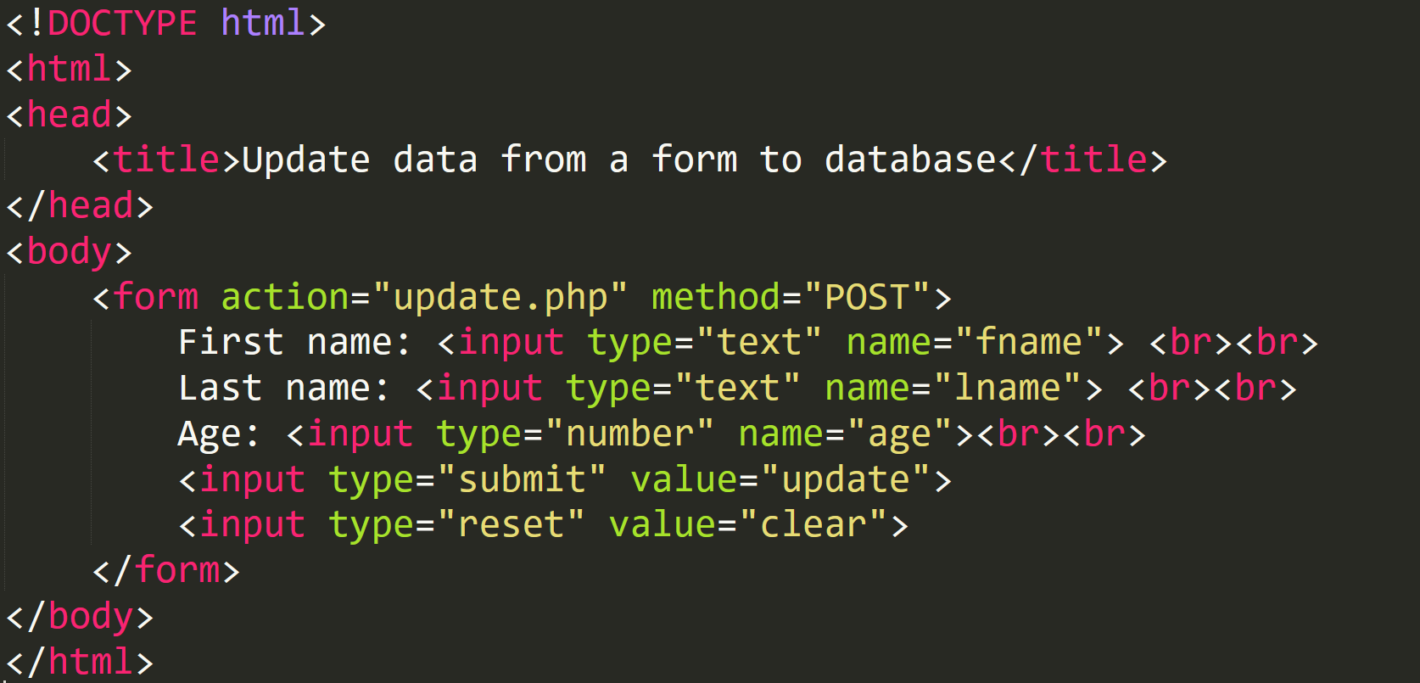
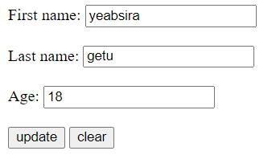
PHP MySQL Update Query
update.html

Slide 31
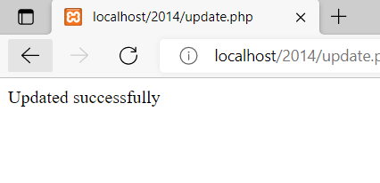
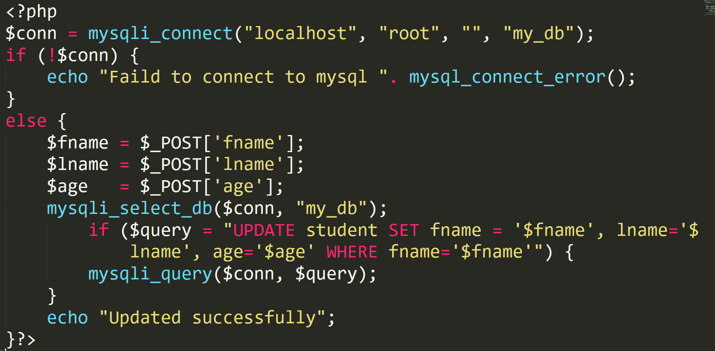
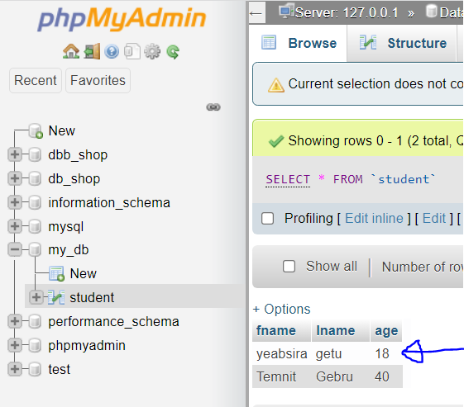
PHP MySQL Update Query
PHP code output
localhost/phpmydmin

Slide 32
PHP MySQL Delete Query
The DELETE statement is used to delete the records from MySQL database table
Deleting Database Table Data:
Just as you insert records into tables, you can delete records from table using the DELETE statement
It is typically used in conjugation with the WHERE clause to delete only those records that matches specific criteria
The basic syntax of the DELETE statement can be given with:
DELETE FROM table name WHERE column name=some value

Slide 33
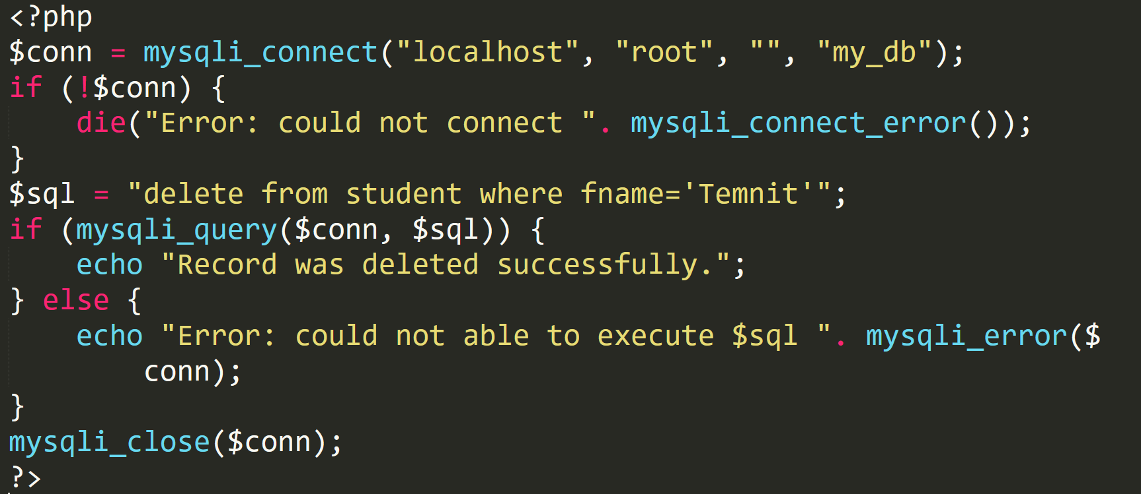
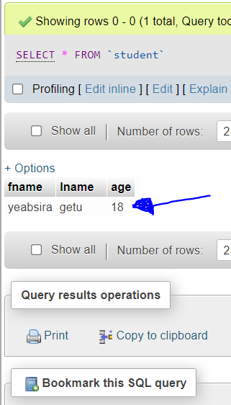
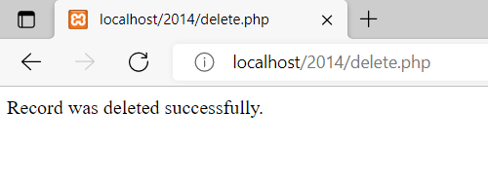
PHP MySQL Delete Query
PHP code without using a form Output seen form localh localhost/phpmyadmin
Output

Slide 34
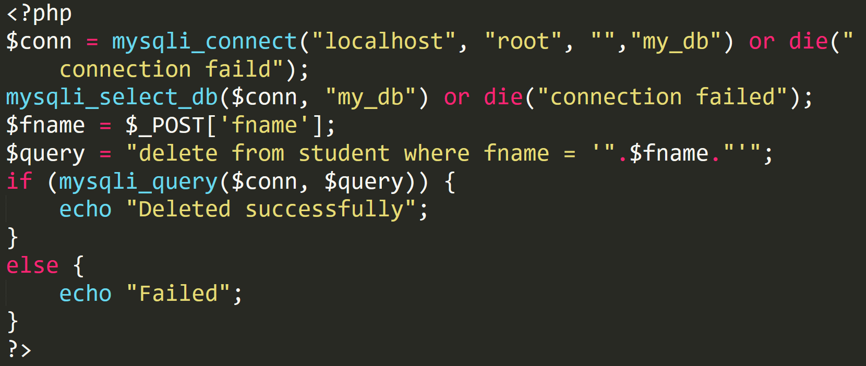
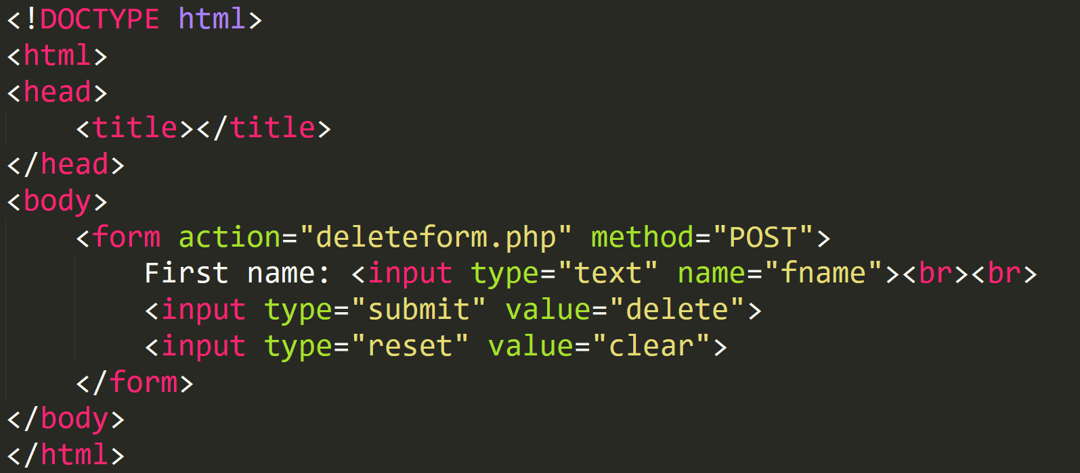
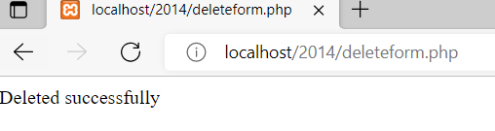
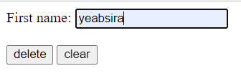
PHP MySQL Delete Query using a Form
HTML CODE deleteform.php
Output

Slide 35
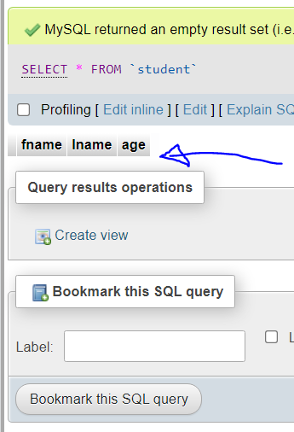
PHP MySQL Delete Query using a Form
Output seen form localhost/phpmyadmin (Empty Table)

Slide 36
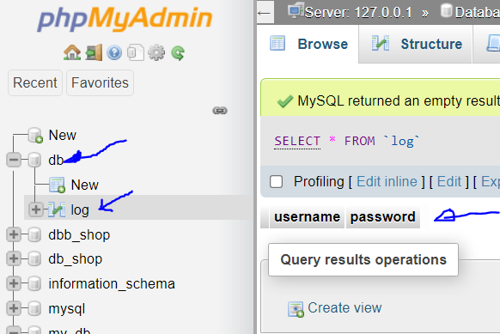
Designing a Login Page
Create database ‘db’, and table ‘log’ with column ‘username’ and ‘password’ manually on localhost/phpMyAdmin

Slide 37
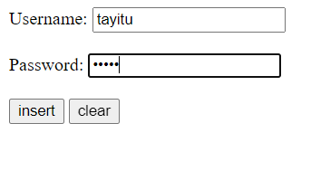
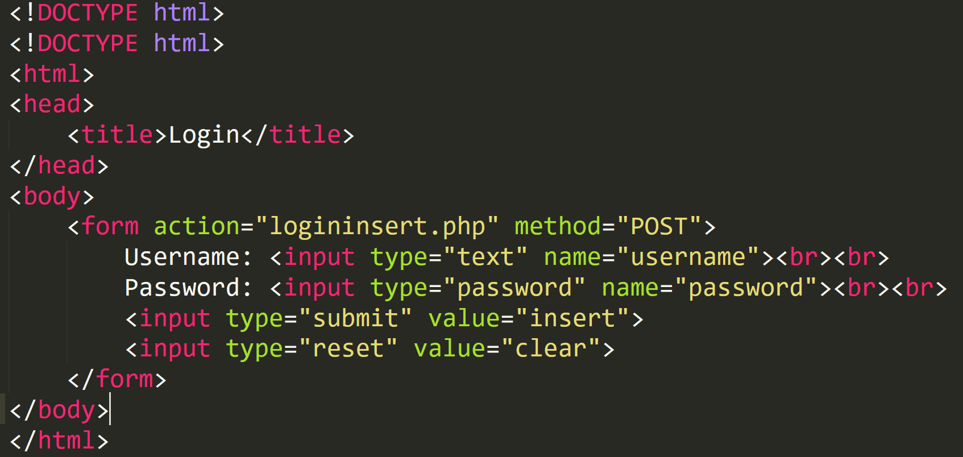
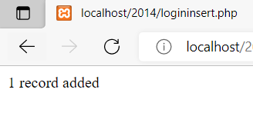
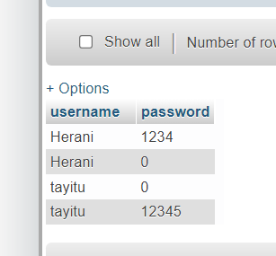
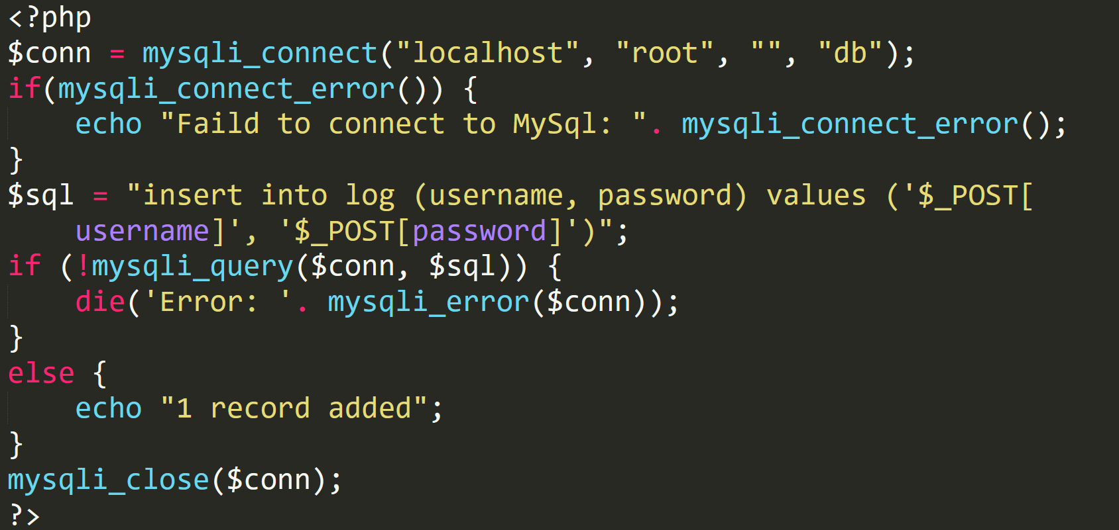
HTML form accepting username and password
logininsert.php

Slide 38
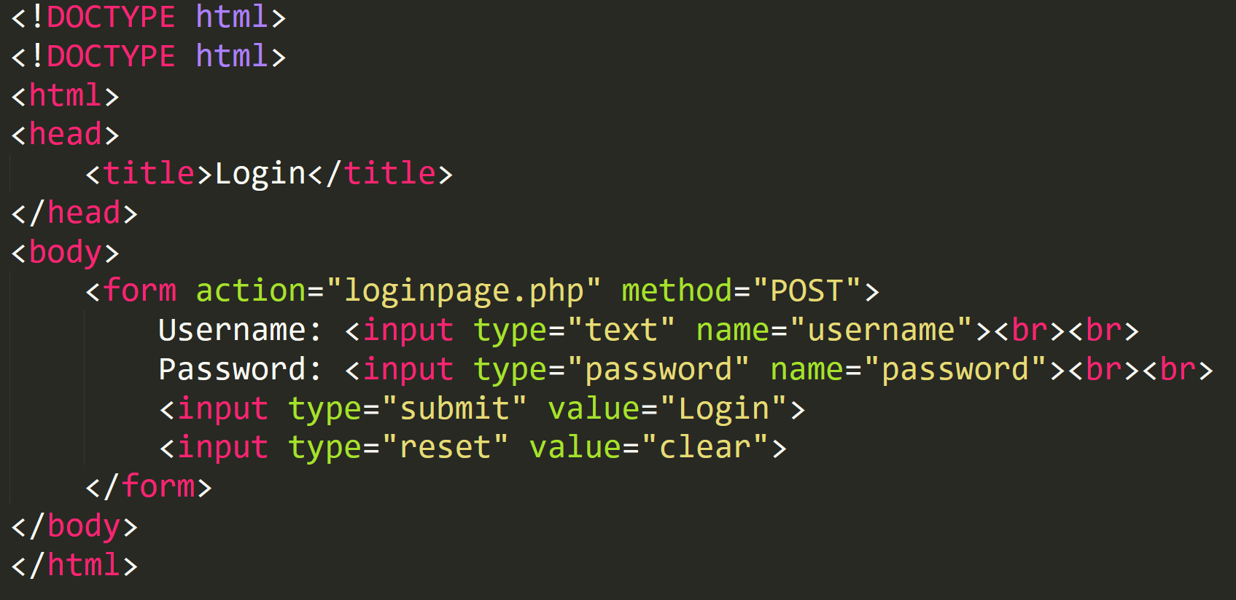
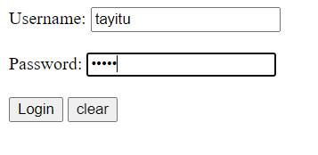
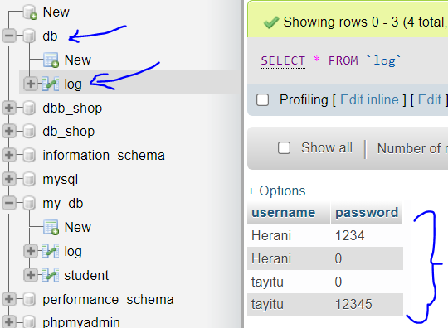
Designing a Login Page cont…
Login.html

Slide 39
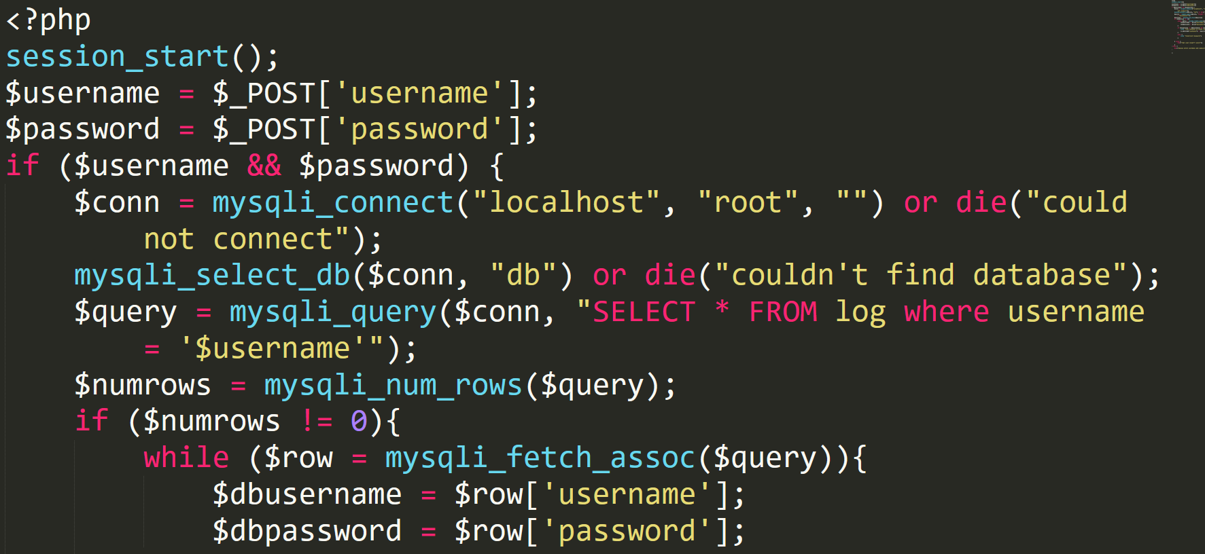
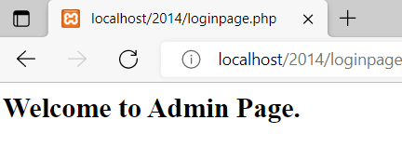
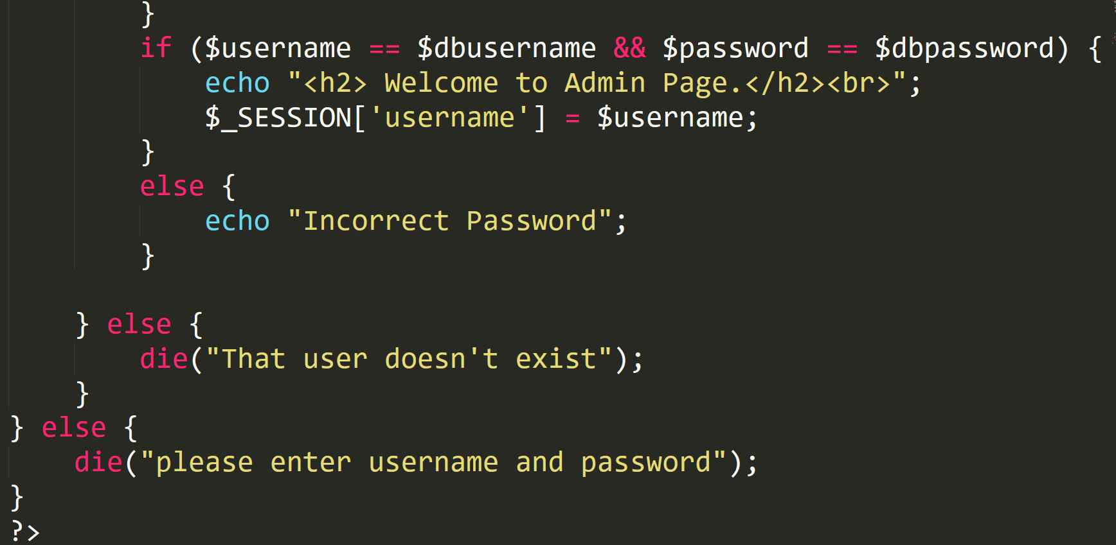
Designing a Login Page
Loginpage.php

Slide 40
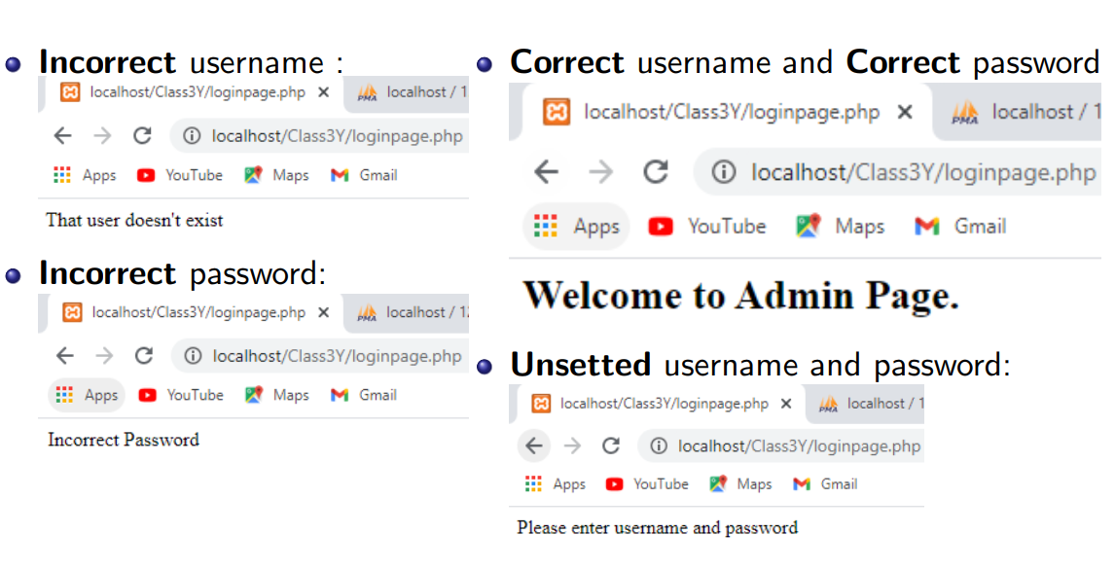

Slide 41
Echo “ Thank you!”

