Slide 1
Chapter One The World Wide Web
Prepared by: Marta G. (MSc.)

Slide 2
Outline
Overview of internet
Services of internet
Static and dynamic web page
Client-server Architecture
How the web works?
Web Hosting and Domain Name Registration

Slide 3
Overview of the internet
Network is an interconnection of computers and other communication equipment's
Internet is network of networks
No company owns the internet

Slide 4
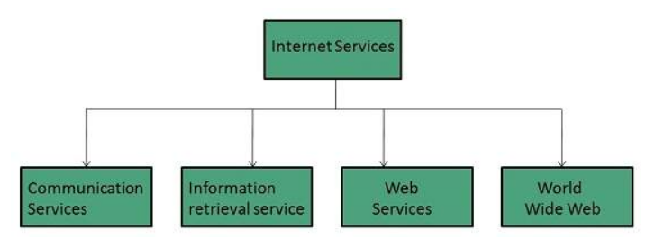
Internet services

Slide 5
Communication Services
There are various Communication Services available that offer exchange of information with individuals or groups.
E-mail: allows user to send a message for one user or group of users
Usenet/ News groups: Allows exchange of news comments, and questions on a specific topic/issue.
Telnet/Remote login: Is away that enables a user to logon to a remote computer and interactively access its resources.
Instant Messaging: Offers real time chat between individuals and group of people. Eg: WhatsApp, Skype, viber….

Slide 6
Information Retrieval Services
There exist several Information retrieval services offering easy access to information present on the internet. Eg:
File Transfer Protocol (FTP): Enable the users to transfer files.
Archie: It’s updated database of public FTP sites and their content. It helps to search a file by its name.
Gopher: used to search, retrieve, and display documents on remote sites.

Slide 7
Web Services
Web services allow exchange of information between applications on the web. Using web services, applications can easily interact with each other.

Slide 8
World Wide Web(WWW)
It consists of a worldwide collection of electronic documents.
An electronic document on the Web is called a Web page, which can contain text, graphics, hyperlink, animation, audio, and video.
A Web site is a collection of related Web pages stored on the same web server.
A Web Server is a computer program that delivers requested Web pages to your computer.
Web pages could be static (fixed) or dynamic (changing).

Slide 9
World Wide Web(WWW) cont…
World Wide Web is combination of four ideas
Hypertext: to move from one part of a document to another or from one page to another through internal connections among these documents (called "hyperlinks");
Resource identifiers: to locate a particular resource (computer, document or other resource) on the network through a unique identifier called IP address.

Slide 10
Cont…
The client-server model: of computing, in which client software or a client computer makes requests of server software or a server computer that provides the client with resources or services, such as data or files;
Markup language: is a computer language that uses tags to define elements within a document. Example: HTML, XML

Slide 11
Static & Dynamic web site
Static (fixed) web site
Is a web site that is written entirely using HTML code.
Each web page is a separate document and there is no database or external file that are drawn upon.
The only way to edit this type of website is to go into each page and edit the HTML.
Difficult to manage and handle the web page
Visitors to a static Web page see the same content (unchanged).
Pre build document and not sufficient

Slide 12
Dynamic Web Sites
A dynamic Web site is one with content that is regenerated every time a user visits or reloads the site.
In most cases it requires the use of a database, which contains the site’s information, and a scripting language that can retrieve the information from the database.
This type of scripting languages are allowed to be embedded in right of the server
Eg: current date and time, ticket availability for flights

Slide 13
Web Application
Architecture : client-server architecture
Client : web browser
It presents an interface to the user
It retrieves information from the Web.
Examples of client-side scripting technologies are:-
HTML5 (Structure), DHTML, CSS (designing), javaScript, jQuery , AJAX , Java applets etc.

Slide 14
web application cont….
Client side scripting
The script that is in the browser and responds to some user input.
It enables web pages to be scripted
It enables to have different changing content depending on user input, environmental conditions(such as time of day) or other variables.
Advantages of client-side scripting are:-
It can be used to validate user input
To interact with the browser
To enhance web pages
Add client/server communication between a browser and a web server.
Limitations of client-side scripting are:-
Browser dependency
Cannot connect to a back-end server, such as a data base or file handling systems.

Slide 15
web application cont….
Server :
Almost all of the work of Web applications takes place on the server.
It is responsible for data storage and management
Specific application, called a Web server, will be responsible for communicating with the browser.(apache or Internet information server)
A relational database server stores whatever information the application requires.

Slide 16
web application cont….
Finally, you need a language to broker requests between the Web server and the database server;
It will also be used to perform programmatic tasks on the information that comes to and from the Web server.

Slide 17
Server-side scripting language
The code that on the server and responds to the HTTP requests.
It is usually used to provide interactive web sites that interface to databases or other data stores.
It has the ability to highly customize the response based on the user’s requirements, access rights or queries into data stores.
Advantages of server-side scripting are:
Session management which helps to maintain user identity
Program flexibility
Browser independent
Security
Limitations of server-side scripting are:
They can be slow due to server programs
Reduce web page appearance, compared to client side scripting.

Slide 18
Cont…
Examples of server-side scripting technologies are:-
PHP (hypertext preprocessor)
ASP (active server page)
JSP (java server page)
Cold Fusion, etc.

Slide 19
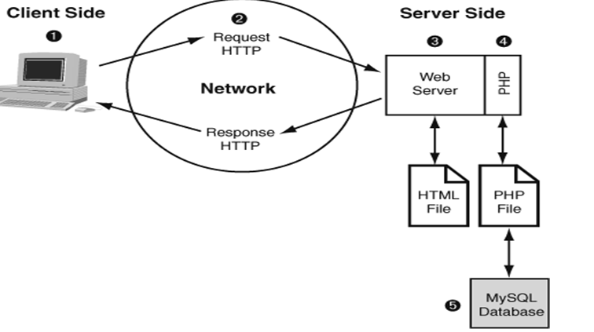
The Life Cycle of a Web Page

Slide 20
How the Web Work?
You request a web page by either typing its URL(for e.g http://www.dbu.edu.et) directly in the browser or by clicking on a link on the page. The URL contains all the information needed to target a specific document on a specific web server on the internet.
your browser send an HTTP request on the server named in the URL and asks for a specific file
The server looks for the request file and sends an either of the following HTTP response:
If the page cannot be found. The server return an error message .the message typical says “404” not found.
If the document is found. The server retrieves the requested file and returns it to the browser.

Slide 21
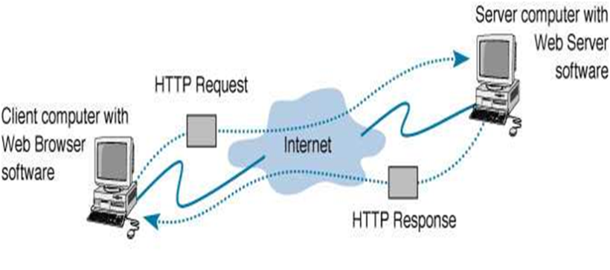
How the Web Work? Cont’d…
4. The browser parses the HTML document. If the page contains images (indicated by the HTML img tag), the browser contacts the server again to request each image files specified in the markup
5. The browser inserts each image in the document flow where indicated by the img. Then, the assembled web page is displayed for your viewing pleasure.

Slide 22
Domain name registration
When you first thought about starting an online business, you purchased a domain name. A domain name is your company’s address on the internet.
If you are renting space on the internet, you give customers your domain name.
Whenever someone types in your domain name, it is converted into an IP address. The hosting company then locates all the files connected to your IP address and returns all of the pictures, videos, and words that make up your website.

Slide 23
Web Hosting
Web hosting is a service that allows organizations and individuals to post a website or web page onto the Internet.
A web host, or web hosting service provider, is a business that provides the technologies and services needed for the website or webpage to be viewed in the Internet.
Websites are hosted, or stored, on special computers called servers. When Internet users want to view your website, all they need to do is type your website address or domain into their browser.
Their computer will then connect to your server and your webpages will be delivered to them through the browser.

Slide 24
Types of Web Hosting Services
There are various types of web hosting services available to host your website.
Before signing up for web hosting services, it is important to understand what kind of service your website needs, the kind of server you or your business needs, your budget, and what type of services the web host offers. Hosting options available are:
Website Builders
Shared Hosting
Dedicated Hosting
Collocated Hosting
VPS Hosting
Cloud Hosting

Slide 25
Web site providers in Ethiopia
Hahu Cloud
Yegara
Ethio telecom
Techno bros
Ahaduweb
Adey Host
Sheger Tech
Hosthabesha
E.t.c

Slide 26
Generally
Web programming refers to the writing, markup and coding involved in Web development, which includes Web content, Web client and server scripting and network security.
The most common languages used for Web programming are XML, HTML, JavaScript, Perl 5 and PHP.
Web programming is different from just programming, which requires interdisciplinary knowledge on the application area, client and server scripting, and database technology.

Slide 27
Thank You!

