Slide 1
Chapter Three CSS
Prepared by: Marta G. (MSc)
2015 E.c.

Slide 2
Content
CSS basics
Attaching CSS with HTML
Style sheet rules
Style properties
CSS measuring units

Slide 3
CSS (cascading style sheets)
A style sheet is a set of instructions that controls the appearance of a web page.
CSS is a simple design language intended to simplify the process of making web pages presentable.
CSS is a simple design language for describing the presentation of a web page.
CSS works with HTML, but it’s not HTML.
It uses rules to say how a document should appear

Slide 4
Cont…
While HTML provides structure to a document by organizing information into headers, paragraphs, bulleted lists, and so on, CSS works hand-in-hand with the web browser to make HTML look good

Slide 5
The Benefits of CSS
Better type and layout controls
Less work - change the appearance of an entire site by editing one style sheet
Potentially smaller documents and faster downloads
More accessible sites: making it more accessible for mobile devices
Reliable browser support

Slide 6
How the style sheet work
Start with a document that has been marked up in HTML.
Write style sheet rules for how you’d like certain element to look.
Attach the style rules to the document.

Slide 7
Style Sheet Rules
Style sheets are made up of one or more style instructions (called rules) for how a page element should be displayed.
A rule says how a particular page element (whether it is heading, a paragraph, or block quote) should be displayed.

Slide 8
Cont…
There are two main sections of a rule those are:
The selector: which identifies the element to be affected (rule applies)
The declaration:
The declaration is made up of a property and a value.
There could be more than one declaration in a single rule
Each declaration must end by semicolons.
Declarations are very similar to attribute names and their values

Slide 9
Style Sheet Rules(cont…)
Syntax
Selector {property : value;}
or
Selector {property1 : value1;
property2: value2;
Property3:value3 ;
}
Example
selector declaration
p { color : red }
value
Css rule property

Slide 10
Attaching the styles to the document
There are three way’s that style information can be applied to an HTML document.
Inline style sheet
Embedded style sheet
External style sheet

Slide 11
Inline style sheet
Style information can be added to an individual element by adding the STYLE attribute within the HTML tag for that element.
Inline style sheet has higher precedence
Example1:
<H1 STYLE ="color : red"> this heading will be red</H1>
Will result : this heading will be red

Slide 12
Embedded style sheet
A more compact method for adding a style sheet is to embed a style block at the top of the HTML document using the <STYLE> tag and this rules apply only to that document.

Slide 13
Con…
Example:
<HTML>
<HEAD>
<STYLE TYPE="text/css">
H1 {color:red;}
P {font-size:12pt;
font-family:sans-serif;
}
</STYLE>
<TITLE>title</TITLE>
<h1>red heading </h1>
<p>paragraph 1</p>
</HEAD>
</HTML>

Slide 14

Cont…
Will result
Make sure that the <STYLE> tag contains the TYPE="text/css" attribute and it is placed within the <HEAD> of the document.

Slide 15
External Style Sheets
An external style sheet is a separate, text-only document that contains a number of style rules. It must be named with .css suffix.
If you are applying one set of style instructions to a number of pages in a site, an external style sheet is the best method.
It is a powerful because you can change the appearance of an entire site by making one change in the external style sheet document.
Steps
First, put your style sheet rules in a separate document and save with .css suffix.
Next, create a link to the style sheet document from your web page (or pages) using a <LINK> tag.

Slide 16
External Style Sheets
Example:
<HEAD>
< LINK REL="STYLESHEET“ HREF="pathname/style.css" TYPE="text/css">
</HEAD>
The REL attribute defines the linked document's relation to the document, that is a "Style sheet"

Slide 17
Conflicting style
Style information is passed down until it is overridden by style command with more weight
The closer the style sheet is the content the more Weight it is given
To prevent a specific rule from being overridden you can assign it “important” with the !important indicator
Example: p {color : blue !important}

Slide 18
CSS Selectors

Slide 19
CSS Selectors
Selector type
Element selector
Grouped selectors
Descendant selectors
Id selectors
Class selectors

Slide 20
Element selector
Single Element selector
Most basic type of selectors is element type selector.
P {color: blue;}
Grouped element selectors
p, ul, td, th {color :cyan;}
The disadvantage of selecting element this way of course, is that the property will apply to every paragraph and other listed elements in the document.

Slide 21
Cont…
Descendant selectors
The CSS descendant selector allows you to target an element that is a descendant of an element type.
The element does not have to be a direct child, but rather any descendant down the line.
Descendant selectors are indicated in a list separated by a character space
element1 element2 { style_properties }
E.g. 1:
ol li {color: red}
This example target list elements that appear in ordered list item (li)

Slide 22
Cont…
E.g. 2:
H1 b,h2 b,h3 b (color : red)
This rule target bold element that only appear in h1 h2 and h3 heading
It is also possible to nest descendant selector to nest several layer deep.
E.g 3
ol a i {color : red}

Slide 23
ID selector
The CSS ID selector matches an element based on the value of the element's id attribute.
In order for the element to be selected, its id attribute must match exactly the value given in the selector.
The symbol that identifies ID selector is the # (hash) symbol
#id_value { style properties }

Slide 24

Cont…
Lets say you create 2 files Doc.html and style.css
Doc.html
<div id="identified">This div has a special ID on it!</div>
<div>This is just a regular div.</div>
Style.css
#identified {
background-color: skyblue;
}
Result

Slide 25
Cont…
E.g.
<li id=“list1”>computer science</li>
CSS rule
#list1 {color : red}
Or
Li# list1 {color : red}

Slide 26
Class selector
The .class selector selects elements with a specific class attribute.
To select elements with a specific class, write a period (.) character, followed by the name of the class.
HTML elements can also refer to more than one class
Syntax
.class {
css declarations;
}

Slide 27
Cont…
Class name are indicated with a period (.)
Example: p.special {color : orange}
To Apply a property to all elements of the same class, omit the element name in the selector
.special{color:red}

Slide 28
Style Properties

Slide 29
1. Setting Backgrounds using CSS
The background-color property is used to set the background color of an element.
The background-image property is used to set the background image of an element.
The background-repeat property is used to control the repetition of an image in the background.

Slide 30
Cont…
The background-position property is used to control the position of an image in the background.
The background-attachment property is used to control the scrolling of an image in the background.
The background property is used as shorthand to specify a number of other background properties.

Slide 31

Set background color:
<p style="background-color:yellow;"> This text has a yellow background color. </p>

Slide 32
Set the background image:
<table style="background-image: url(/images/pattern1.gif);">
<tr><td> This table has background image set. </td></tr> </table>

Slide 33
Repeat the background image:
You can use no-repeat value for background-repeat property if you don't want to repeat an image, in this case image will display only once.
By default background-repeat property will have repeat value.
<table style="background-image:url(/images/pattern1.gif); background-repeat: repeat;"> <tr><td> This table has background image which repeats multiple times. </td></tr> </table>

Slide 34
Set the background image position:
<table style="background-image:url(/images/pattern1.gif); background-position:100px;"> <tr><td> Background image positioned 100 pixels away from the left. </td></tr> </table>
background-position:100px 200px;

Slide 35
Set the background attachment:
Background attachment determines whether a background image is fixed or scrolls with the rest of the page.
Following is the example which demonstrates how to set the fixed background image.
<p style="background-image:url(/images/pattern1.gif); background-attachment:fixed;"> This parapgraph has fixed background image. </p>

Slide 36
Shorthand property :
You can use the background property to set all the background properties at once. For example:
<p style="background: url(/images/pattern1.gif) repeat fixed;"> This parapgraph has fixed repeated background image. </p>

Slide 37
Other Properties
The backdrop-filter Property
Animation of background-color
The background-blend-mode Property
E.t.c.

Slide 38
2. Setting Fonts using CSS
The font-family property is used to change the face of a font.
The font-style property is used to make a font italic or oblique.
The font-variant property is used to create a small-caps effect.

Slide 39
Cont…
The font-weight property is used to increase or decrease how bold or light a font appears.
The font-size property is used to increase or decrease the size of a font.
The font property is used as shorthand to specify a number of other font properties.

Slide 40
Set the font family:
<p style="font-family:georgia,garamond,serif;"> This text is rendered in either georgia, garamond, or the default serif font depending on which font you have at your system. </p>

Slide 41
Cont…
<p style="font-style:italic;"> This text will be rendered in italic style </p>
<p style="font-style:oblique;">
This text will be rendered in oblique style
</p>

Slide 42
Set the font variant:
Possible values are normal, inherit, initial small-caps.
<p style="font-variant:small-caps;"> This text will be rendered as small caps </p>

Slide 43
Set the font weight:
The font-weight property provides the functionality to specify how bold a font is? Possible values could be normal, bold, bolder, lighter, 100 - 900.
<p style="font-weight:bold;"> This font is bold. </p>
<p style="font-weight:bolder;"> This font is bolder. </p>
<p style="font-weight:900;"> This font is 900 weight. </p>

Slide 44
Set the font size:
The font-size property is used to control the size of fonts. Possible values could be xx-small, x-small, small, medium, large, x-large, xx-large, smaller, larger, size in pixels or in %.
<p style="font-size:20px;"> This font size is 20 pixels </p>
<p style="font-size:small;"> This font size is small </p>
<p style="font-size:large;"> This font size is large </p>

Slide 45
Shorthand property :
<p style="font:italic small-caps bold 15px georgia;"> Applying all the properties on the text at once. </p>

Slide 46
3. Manipulating Text using CSS
The color property is used to set the color of a text.
The direction property is used to set the text direction.
The letter-spacing property is used to add or subtract space between the letters that make up a word.
The word-spacing property is used to add or subtract space between the words of a sentence.
The text-indent property is used to indent the text of a paragraph.

Slide 47
Cont…
The text-align property is used to align the text of a document.
The text-decoration property is used to underline, overline, and strikethrough text.
The text-transform property is used to capitalize text or convert text to uppercase or lowercase letters.
The white-space property is used to control the flow and formatting of text.
The text-shadow property is used to set the text shadow around a text.

Slide 48
Set the text color:
<p style="color:red;"> This text will be written in red. </p>

Slide 49
Set the text direction :
Possible values are ltr or rtl.
<p style="direction:rtl;"> This text will be renedered from right to left </p>

Slide 50
Set the space between characters:
Possible values are normal or a number specifying space.
<p style="letter-spacing:5px;"> This text is having space between letters. </p>

Slide 51
Set the space between words:
Possible values are normal or a number specifying space..
<p style="word-spacing:5px;"> This text is having space between words. </p>

Slide 52
Set the text indent:
How to indent the first line of a paragraph. Possible values are % or a number specifying indent space..
<p style="text-indent:1cm;"> This text will have first line indented by 1cm and this line will remain at its actual position this is done by CSS text-indent property. </p>

Slide 53
Set the text alignment:
How to align a text. Possible values are left, right, center, justify..
<p style="text-align:right;"> This will be right aligned. </p>
<p style="text-align:center;"> This will be center aligned. </p>
<p style="text-align:left;"> This will be left aligned. </p>

Slide 54
Decorating the text:
Possible values are none, underline, overline, line-through.
<p style="text-decoration:underline;"> This will be underlined </p>
<p style="text-decoration:line-through;"> This will be striked through. </p> <p style="text-decoration:overline;"> This will have a over line. </p>

Slide 55
Set the text cases:
Possible values are none, capitalize, uppercase, lowercase.
<p style="text-transform:capitalize;">This will be capitalized </p>
<p style="text-transform:uppercase;"> This will be in uppercase </p>
<p style="text-transform:lowercase;"> This will be in lowercase </p>

Slide 56
Set the text shadow:
How to set the shadow around a text. This may not be supported by all the browsers.
<p style="text-shadow:4px 4px 8px blue;"> If your browser supports the CSS text-shadow property, this text will have a blue shadow.</p>

Slide 57
4. CSS - Images
Images are very important part of any Web Page. Though it is not recommended to include lot of images but it is still important to use good images wherever it is required.

Slide 58
Cont…
CSS plays a good role to control image display. You can set following image properties using CSS.
The border property is used to set the width of an image border.
The height property is used to set the height of an image.
The width property is used to set the width of an image.
The -moz-opacity property is used to set the opacity of an image.

Slide 59
Image border Property:
The border property of an image is used to set the width of an image border. This property can have a value in length or in %.
A width of zero pixels means no border.
<img style="border:0px;" src="/images/css.gif" />
<br />
<img style="border:3px dashed red;“ src="/images/css.gif" />

Slide 60
The image height Property:
The height property of an image is used to set the height of an image. This property can have a value in length or in %. While giving value in %, it applies it in respect of the box in which an image is available.
<img style="border:1px solid red; height:100px;" src="/images/css.gif" />
<br />
<img style="border:1px solid red; height:50%;" src="/images/css.gif" />

Slide 61
The image width Property:
The width property of an image is used to set the width of an image. This property can have a value in length or in %. While giving value in %, it applies it in respect of the box in which an image is available.
<img style="border:1px solid red; width:100px;" src="/images/css.gif" />
<br />
<img style="border:1px solid red; width:100%;" src="/images/css.gif" />

Slide 62
The -moz-opacity Property:
The -moz-opacity property of an image is used to set the opacity of an image. This property is used to create a transparent image in Mozilla. IE uses filter:alpha(opacity=x) to create transparent images.
In Mozilla (-moz-opacity:x) x can be a value from 0.0 - 1.0. A lower value makes the element more transparent (The same things goes for the CSS3-valid syntax opacity:x).

Slide 63
Cont…
In IE (filter:alpha(opacity=x)) x can be a value from 0 - 100. A lower value makes the element more transparent.
<img style="border:1px solid red;-moz-opacity:0.4;filter:alpha(opacity=40);" src="/images/css.gif" />

Slide 64


border-radius property
img { border-radius: 8px; }
img { border-radius: 50%; }

Slide 65

Image reflection
img {
-webkit-box-reflect: right;
}
The term 'webkit' is used in the CSS
syntax for rendering content in Safari
and Chrome browsers.
Webkit code may need to be added in
CSS to ensure it renders correctly on
Chrome and Safari due to the lack of
cross-compatibility.

Slide 66


Masking image
.mask1 {
-webkit-mask-image: url(w3logo.png);
mask-image: url(w3logo.png);
-webkit-mask-repeat: no-repeat;
mask-repeat: no-repeat;
}

Slide 67
5.CSS - Links
The :link Signifies unvisited hyperlinks.
The :visited Signifies visited hyperlinks.
The :hover Signifies an element that currently has the user's mouse pointer hovering over it.
The :active Signifies an element on which the user is currently clicking.

Slide 68
Cont…
<style type="text/css">
a:link {color: #000000}
a:visited {color: #006600}
a:hover {color: #FFCC00}
a:active {color: #FF00CC}
</style>

Slide 69
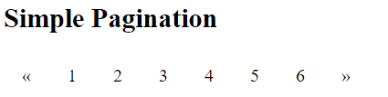
CSS pagination
<html>
<head>
<style>
.pagination {
display: inline-block;
}
.pagination a {
color: black;
float: left;
padding: 8px 16px;
text-decoration: none;
}
</style>
</head>
&laquo is an HTML entity that represents the symbol "<<"
Result
<body>
<h2>Simple Pagination</h2>
<div class="pagination">
<a href="#">&laquo;</a>
<a href="#">1</a>
<a href="#">2</a>
<a href="#">3</a>
<a href="#">4</a>
<a href="#">5</a>
<a href="#">6</a>
<a href="#">&raquo;</a>
</div>
</body>
</html>

Slide 70
6.CSS - Margins
The margin property defines the space around an HTML element. It is possible to use negative values to overlap content.
The values of the margin property are not inherited by child elements. Remember that the adjacent vertical margins (top and bottom margins) will collapse into each other so that the distance between the blocks is not the sum of the margins, but only the greater of the two margins or the same size as one margin if both are equal.

Slide 71
Cont…
There are following four properties to set an element margin.
The margin A shorthand property for setting the margin properties in one declaration.
The margin-bottom Specifies the bottom margin of an element.
The margin-top Specifies the top margin of an element.
The margin-left Specifies the left margin of an element.
The margin-right Specifies the right margin of an element.

Slide 72
Cont…
All the margin properties can have the following values: auto, length, % and inherit.
Eg.
p{
margin-top : 100px;
margin-bottom : 100px;
margin-right : 150px;
margin-left : 80px;
}
Or
P{ margin: 25px 50px 75px;
}

Slide 73
7.CSS - Paddings
The padding property allows you to specify how much space should appear between the content of an element and its border:
The value of this attribute should be either a length, a percentage, or the word inherit. If the value is inherit it will have the same padding as its parent element. If a percentage is used, the percentage is of the containing box.

Slide 74
Cont…
The padding-bottom Specifies the bottom padding of an element.
The padding-top Specifies the top padding of an element.
The padding-left Specifies the left padding of an element.
The padding-right Specifies the right padding of an element.
The padding Serves as shorthand for the preceding properties.

Slide 75
8.CSS - Cursors
The cursor property of CSS allows you to specify the type of cursor that should be displayed to the user.
One good usage of this property is in using images for submit buttons on forms. By default, when a cursor hovers over a link, the cursor changed from a pointer to a hand. For a submit button on a form this does not happen. Therefore, using the cursor property to change the cursor to a hand whenever someone hovers over an image that is a submit button. This provides a visual clue that they can click it.

Slide 76
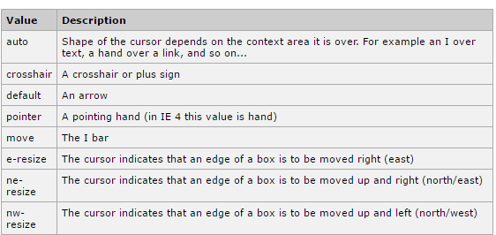
Cont…

Slide 77
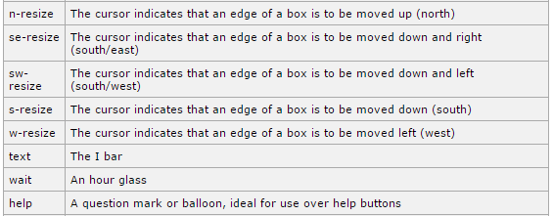
Cont…

Slide 78
Cont…
<div style="cursor:auto">Auto</div>
<div style="cursor:crosshair">Crosshair</div>
<div style="cursor:default">Default</div>
<div style="cursor:pointer">Pointer</div>
<div style="cursor:move">Move</div>
<div style="cursor:e-resize">e-resize</div>
<div style="cursor:ne-resize">ne-resize</div>
<div style="cursor:nw-resize">nw-resize</div>
<div style="cursor:n-resize">n-resize</div>
<div style="cursor:se-resize">se-resize</div>
<div style="cursor:sw-resize">sw-resize</div>
<div style="cursor:s-resize">s-resize</div>
<div style="cursor:w-resize">w-resize</div>
<div style="cursor:text">text</div>
<div style="cursor:wait">wait</div>
<div style="cursor:help">help</div>

Slide 79
CSS measuring units
CSS supports a number of measurements including absolute units such as inches, centimeters, points, and so on, as well as relative measures such as percentages and em units.
You need these values while specifying various measurements in your Style rules e.g. border = "1px solid red".

Slide 80
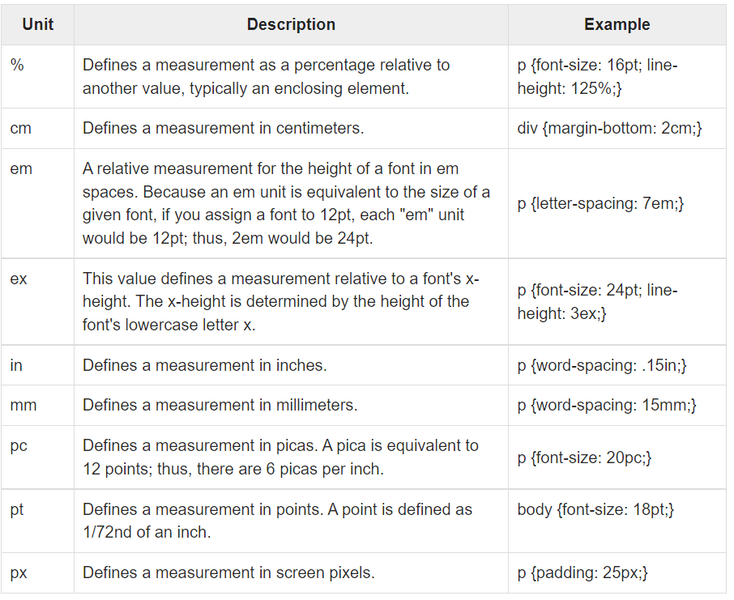

Slide 81
Thank you!

