Slide 1
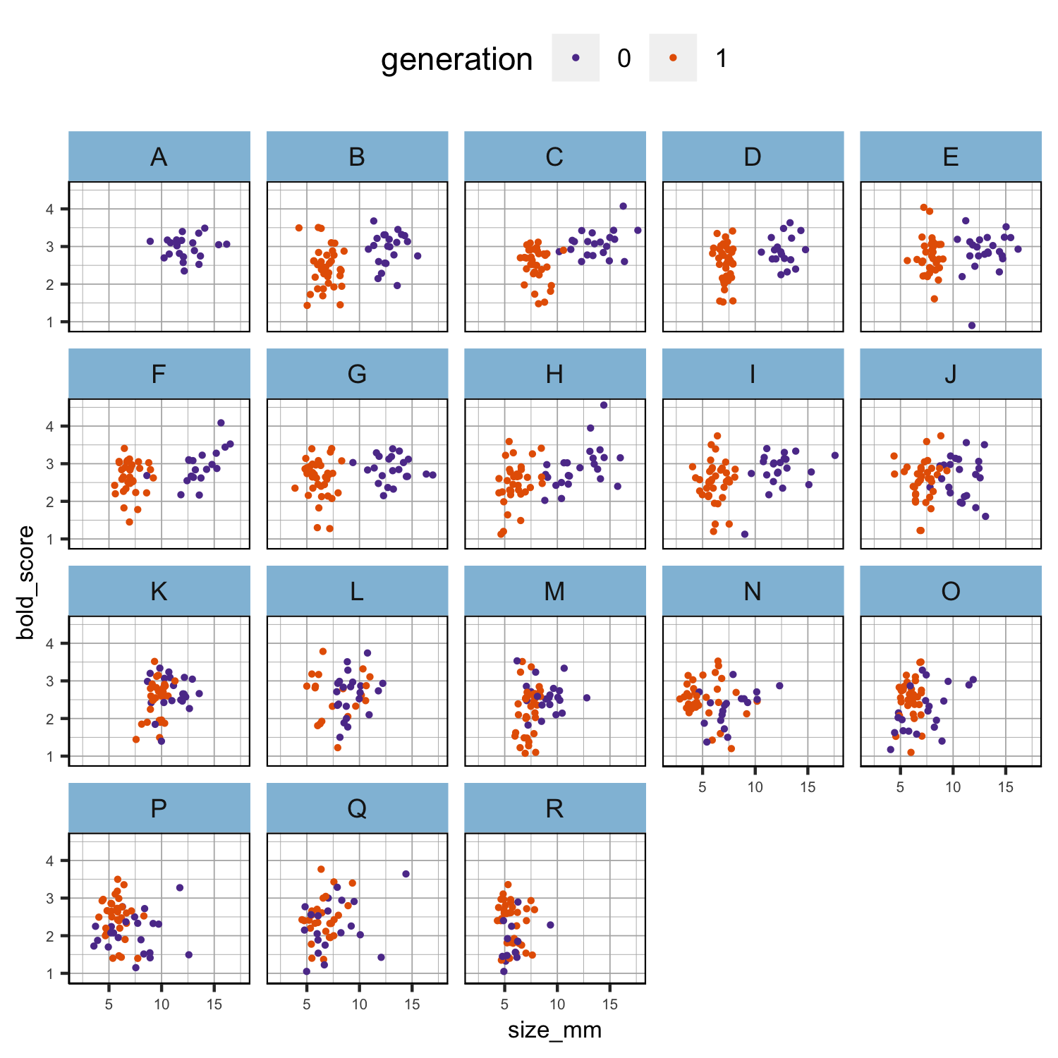
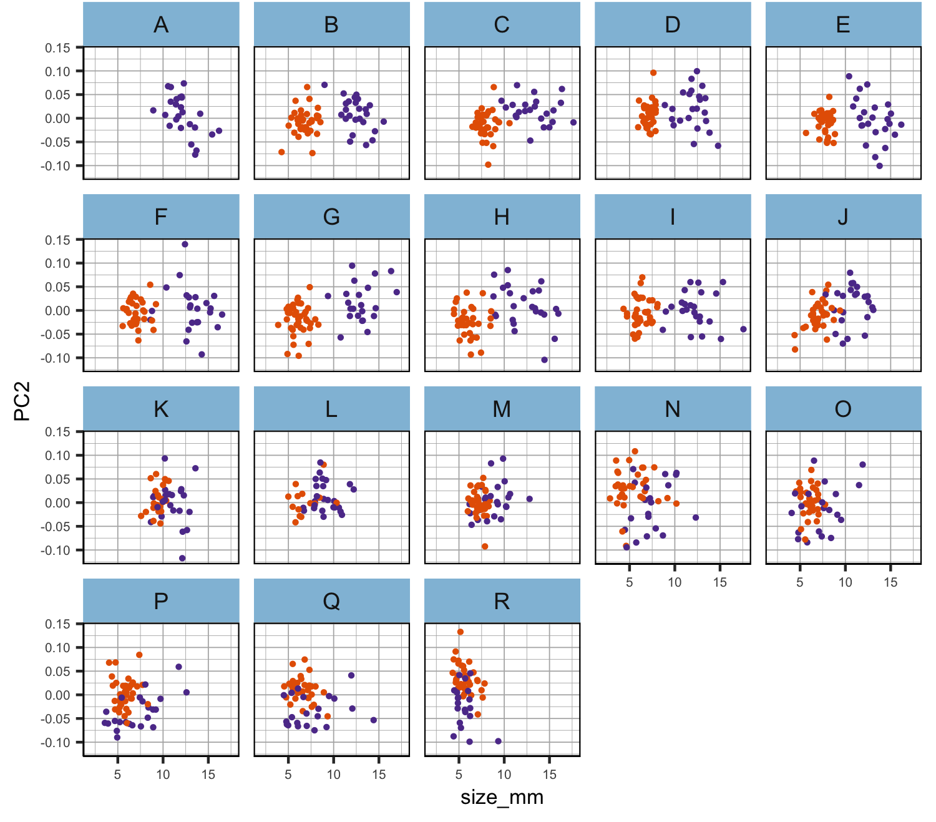
bold and PC2 seem to be size-independent
Figure 1ab. Scatter plots of the relationship between size and the other phenotypes per population in each generation separately. Phenotypic values have not been scaled.

Slide 2
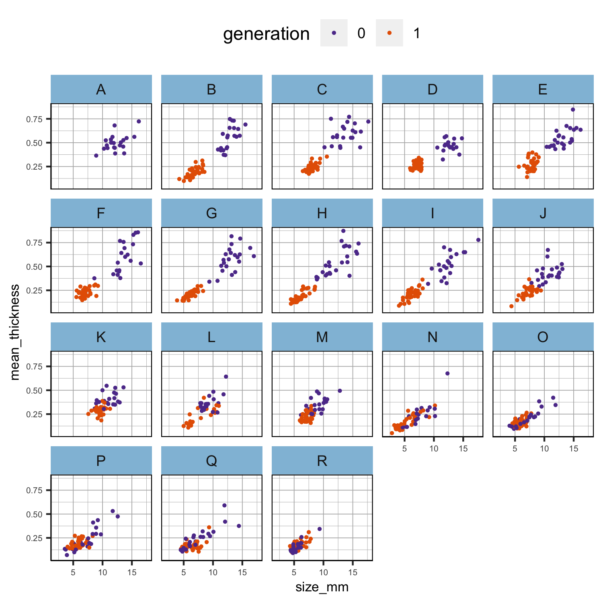
thickness is clearly size-dependent. There is some scatter, which might mean that there is some interesting size-independent thickness variation but it might also just mean that the thickness measurements are noisy!
Figure 1c. Scatter plots of the relationship between size and the other phenotypes per population in each generation separately. Phenotypic values have not been scaled.

Slide 3
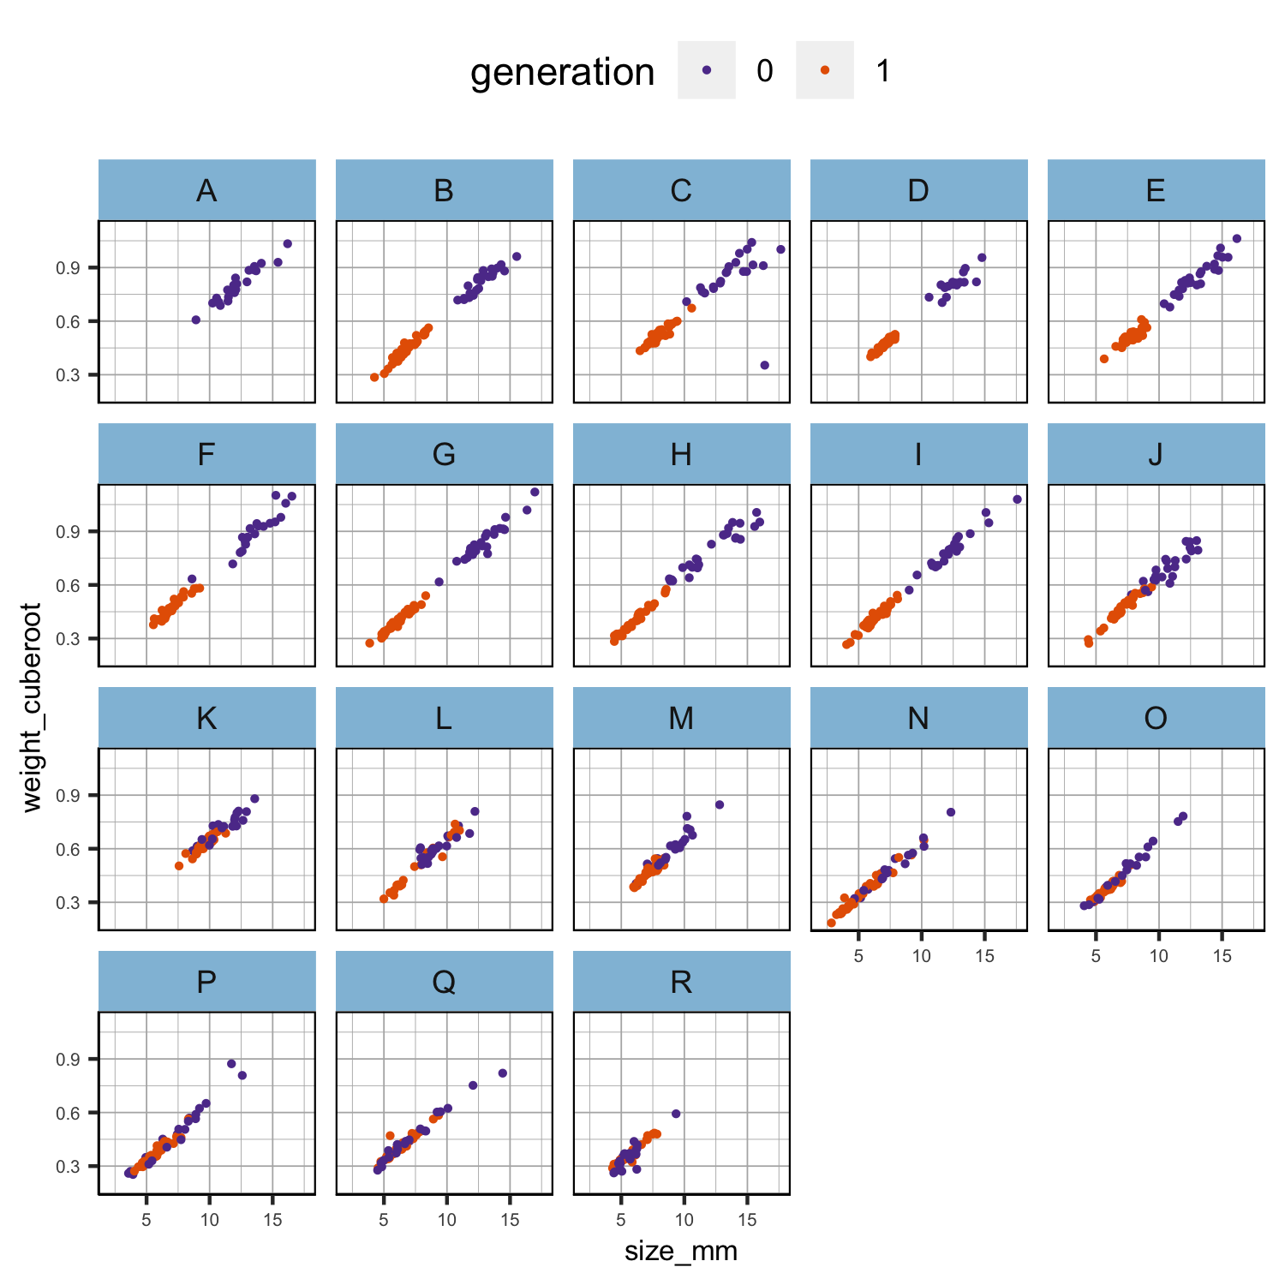
cube_root_weight looks almost perfectly correlated with size! Also, the relationship looks linear across the whole size range and very similar in all populations. It may be that there is no size-independent variation in weight.
Figure 1d. Scatter plots of the relationship between size and the other phenotypes per population in each generation separately. Phenotypic values have not been scaled.

Slide 4
Gen0 is the expected pattern. Gen1 is flat. This is a bit odd.
There are two obvious alternative explanations (not mutually exclusive): sampling was timed for when the size reached a certain point, or size is very plastic. We might separate these effects (partly) by correcting for sampling time (although larger snails were taken at each time point, I guess). Ultimately, this sampling time issue might make it hard to say anything about plasticity for size (or weight).
Figure 2. Boxplot of the scaled cube root of weight per generation and population. Phenotypic values have been scaled.

Slide 5
Gen0 is the expected pattern. Gen1 is flat. This is a bit odd.
There are two obvious alternative explanations (not mutually exclusive): sampling was timed for when the size reached a certain point, or size is very plastic. We might separate these effects (partly) by correcting for sampling time (although larger snails were taken at each time point, I guess). Ultimately, this sampling time issue might make it hard to say anything about plasticity for size (or weight).
Figure 2. Boxplot of the scaled cube root of weight per generation and population. Phenotypic values have been scaled.
The lack of effect of sampling time on weight suggests that larger individuals were chosen on each occasion. I think this means that we really cannot say anything useful about plasticity for size. It is better to concentrate on (a) using size to adjust weight and thickness, and (b) trying to analyze size at maturity.
Figure tmp2. Boxplot of the scaled cube root of weight per generation and population. Generation 1 was further divided into two groups (2 in orange was sampled in June and 3 in green was sampled in August; group x in violet is for unknown samples and contains only six individuals). Phenotypic values have been scaled.

Slide 6
Formula | AIC
weight ~ size | -228.53
weight ~ size + maturity | -241.47
weight ~ size x maturity | -243.26
weight ~ size + population | -249.62
weight ~ size x maturity x population | -256.74
weight ~ size + maturity + population | -264.43
weight ~ size x population | -267.51
Figure 3a. Best model fit to the observed data of generation 0 parents after scaling.

Slide 7
Formula | AIC
weight ~ size x maturity | -1149.83
weight ~ size + maturity | -1151.78
weight ~ size | -1152.26
weight ~ size x maturity x population | -1179.71
weight ~ size + population | -1207.49
weight ~ size + maturity + population | -1211.52
weight ~ size x population | -1216.25
Figure 3b. Best model fit to the observed data of generation 1 offspring after scaling.

Slide 8

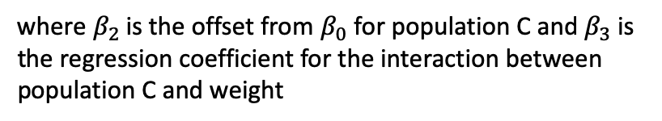

The fact that the interaction is significant actually makes it hard to deal with this situation. Presumably you used the regression for each tank to adjust the weights to the overall mean size? However, where slopes differ, it is not really appropriate just to adjust all weights to the overall mean. I am not sure of the best option but, given that slope variation is not very great, I would suggest sticking with these adjusted values but also comparing the slopes between gen0 and gen1, effectively as another trait.
Formula | AIC
weight ~ size x population x generation
Adjusted weight for population B generation 1 offspring (there is not population A) was
$$\hat{\text{weight}}=β_{0}+β_{1}\text{×} \overline{{\text{size}}_{T}}$$
And for population C generation 1 offspring was
$$\hat{\text{weight}}=β_{0}+β_{1}× \overline{{\text{size}}_{T}}+β_{2}+β_{3}\text{×} \overline{{\text{size}}_{T}}$$
where $β_{2}$ is the offset from $β_{0}$ for population C and $β_{3}$ is the regression coefficient for the interaction between population C and weight
All the variables are scaled

Slide 9
Predict what the mean $\ln{\text{weight}}$ for snails in each tank would be at the overall mean size of snails (after scaling = -0.74) for the experiment (with associated standard error).
Figure 2. Boxplot of the scaled cube root of weight per generation and population. Phenotypic values have been scaled.
Figure 4. Predicted phenotype and 95% CIs for each population using the best model fit and the overall mean size of snails for the experiment.

Slide 10
Predict what the mean $\ln{\text{weight}}$ for snails in each tank would be at the overall mean size of snails (after scaling = -0.74) for the experiment (with associated standard error).
gen0 does still show a weak weight cline (and maybe there is even a hint of a cline in gen1 - so incomplete plasticity). At first sight, this is inconsistent with the analyses in slides 6 and 7. However, 'population' in those analyses had a lot of degrees of freedom (16 or 17?). This makes it hard to get a significant effect (i.e. it lacks power). What we see here is a clinal effect on population means (4 degrees of freedom at most - centre, width and end means).
Despite the strong and apparently invariant relationship between size and weight, it really looks like there is weight variation across the cline. I wonder how much of that is explained by thickness.
Figure 4. Predicted phenotype and 95% CIs for each population using the best model fit and the overall mean size of snails for the experiment.

Slide 11
One option would be to fit a model a bit like the one we discussed for size at maturity, in this case having a constant slope but allowing the intercept to vary clinally. However, it might be better to stick with a simpler option. Just use the size-adjusted weights you have plotted in slide 8 and take them through to the plasticity analysis.

Slide 12
It would be interesting to try the weight ~ size x population x thickness model but it may get difficult to interpret. I think you should (also) run the same analysis for thickness as you have for weight. If weight variation that is not accounted for by size is mainly caused by variation in thickness, then the results for weight and thickness should be very similar after size effects have been removed. You could look at this with simple correlations of the adjusted means and regression coefficients.

