Slide 1
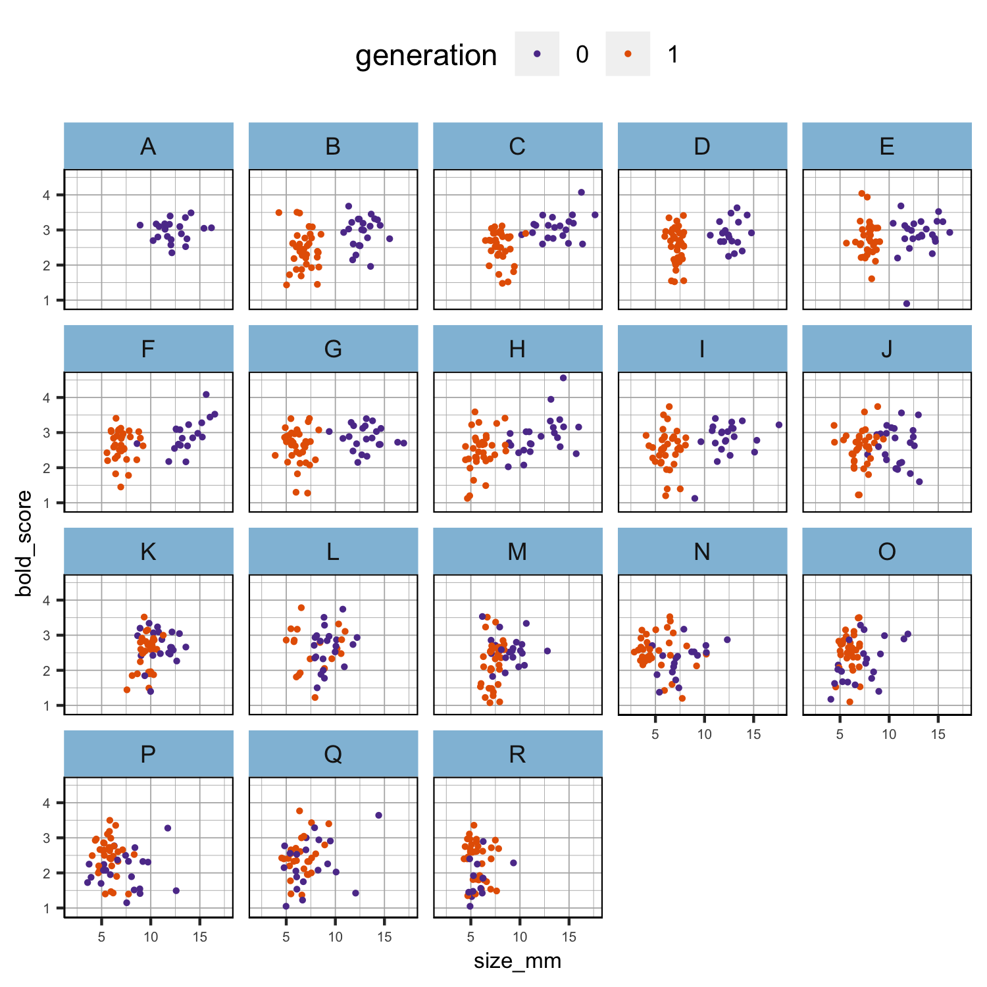
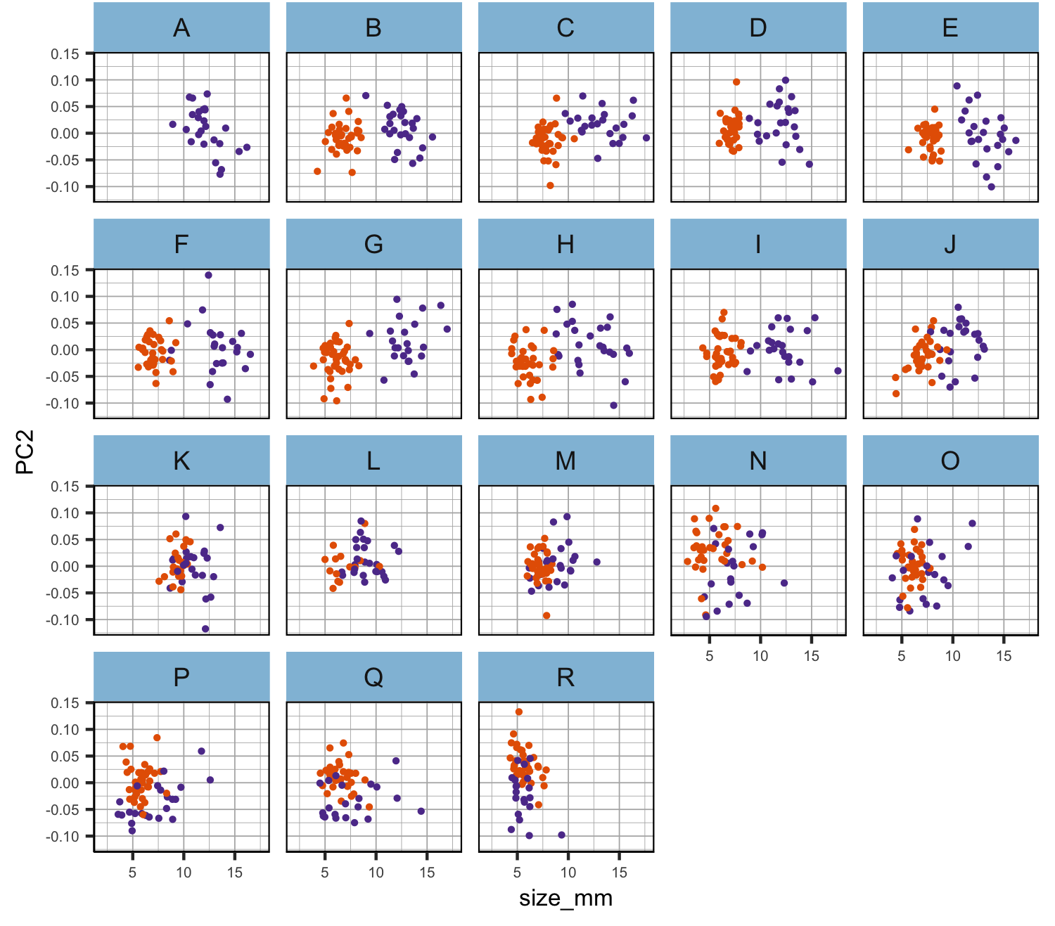
bold and PC2 seem to be size-independent
Figure 1. Scatter plots of the relationship between size and the other phenotypes per population in each generation separately. Phenotypic values have not been scaled.

Slide 2
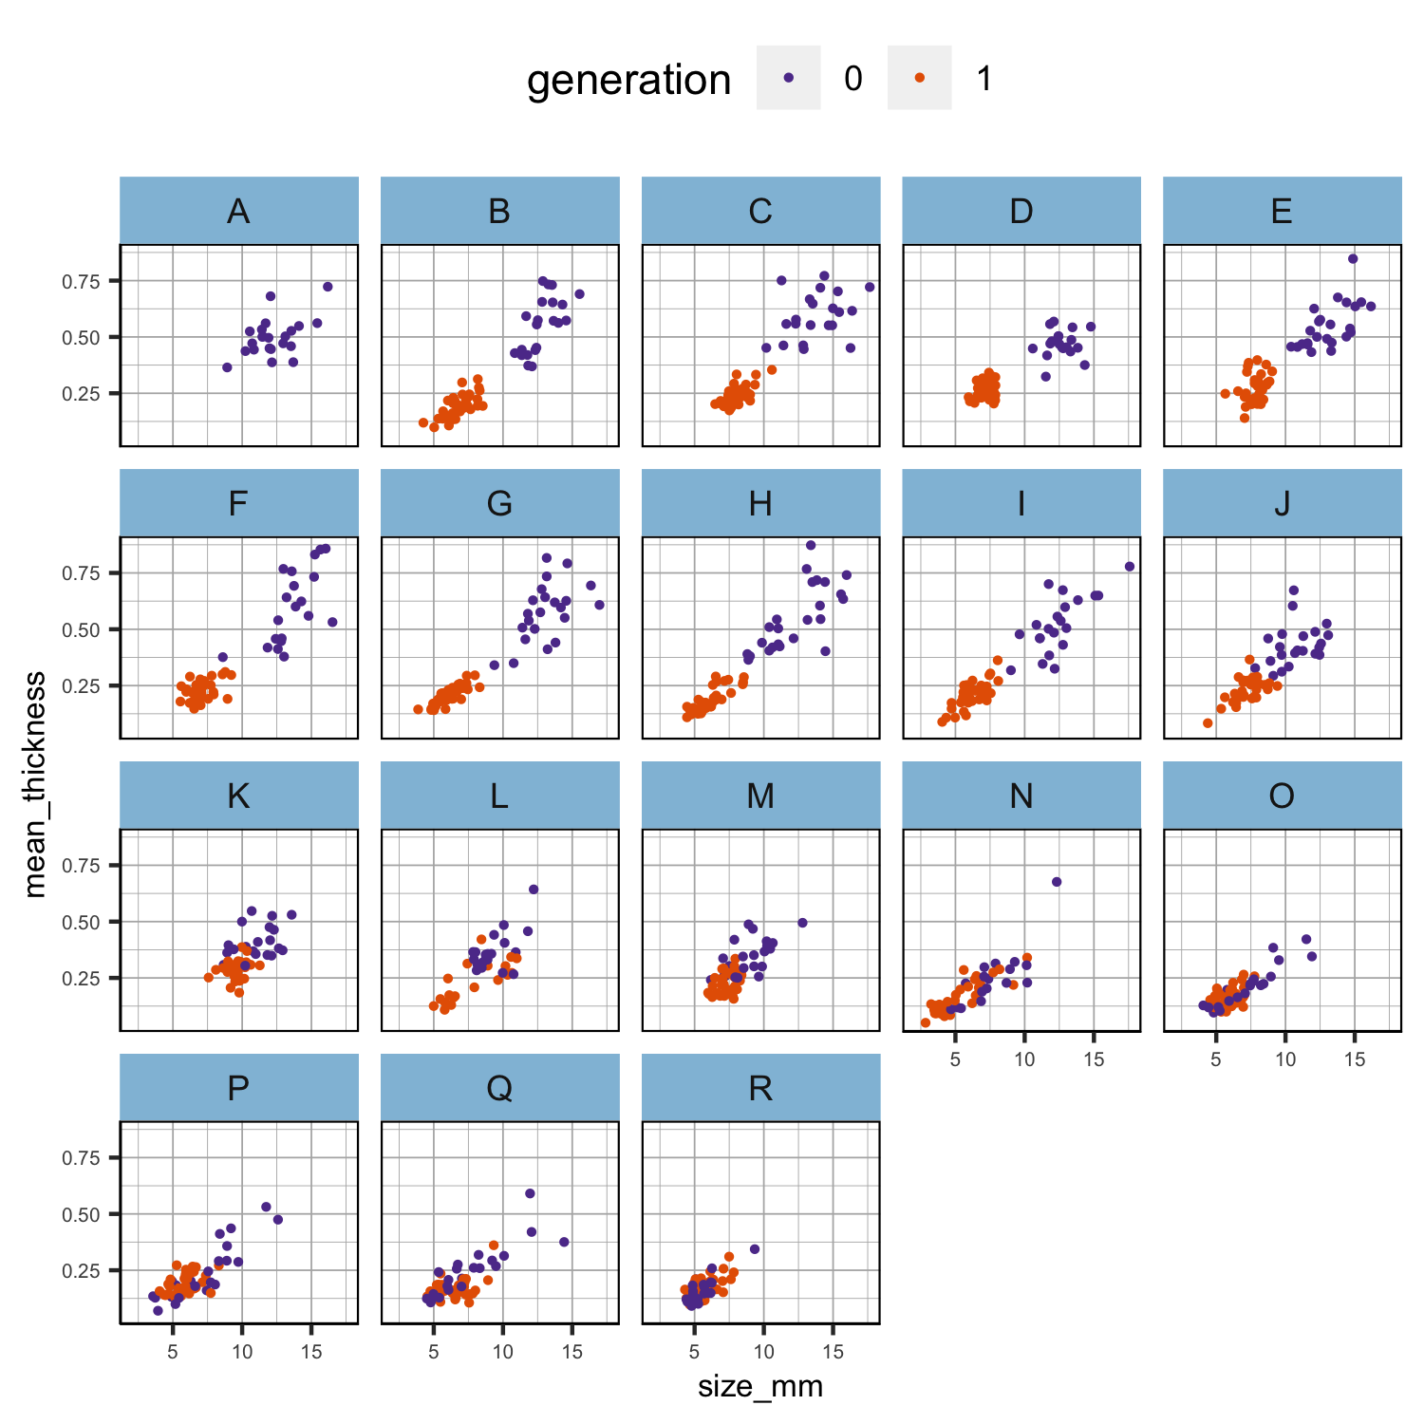
thickness is clearly size-dependent. There is some scatter, which might mean that there is some interesting size-independent thickness variation but it might also just mean that the thickness measurements are noisy!
Figure 1. Scatter plots of the relationship between size and the other phenotypes per population in each generation separately. Phenotypic values have not been scaled.

Slide 3
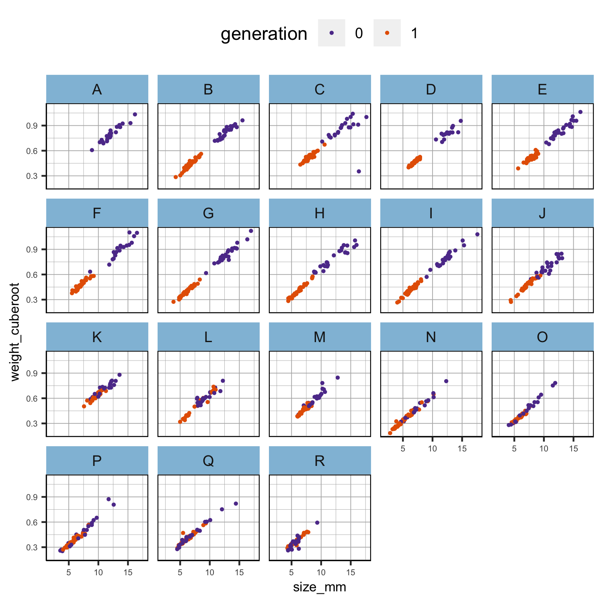
cube_root_weight looks almost perfectly correlated with size! Also, the relationship looks linear across the whole size range and very similar in all populations. It may be that there is no size-independent variation in weight.
Figure 1. Scatter plots of the relationship between size and the other phenotypes per population in each generation separately. Phenotypic values have not been scaled.

Slide 4
Gen0 is the expected pattern. Gen1 is flat. This is a bit odd.
There are two obvious alternative explanations (not mutually exclusive): sampling was timed for when the size reached a certain point, or size is very plastic. We might separate these effects (partly) by correcting for sampling time (although larger snails were taken at each time point, I guess). Ultimately, this sampling time issue might make it hard to say anything about plasticity for size (or weight).
Figure 2. Boxplot of the scaled cube root of weight per generation and population. Phenotypic values have been scaled.

Slide 5
Gen0 is the expected pattern. Gen1 is flat. This is a bit odd.
There are two obvious alternative explanations (not mutually exclusive): sampling was timed for when the size reached a certain point, or size is very plastic. We might separate these effects (partly) by correcting for sampling time (although larger snails were taken at each time point, I guess). Ultimately, this sampling time issue might make it hard to say anything about plasticity for size (or weight).
Figure 2. Boxplot of the scaled cube root of weight per generation and population. Phenotypic values have been scaled.
Figure tmp2. Boxplot of the scaled cube root of weight per generation and population. Generation 1 was further divided into two groups (2 in orange was sampled in June and 3 in green was sampled in August; group x in violet is for unknown samples and contains only six individuals). Phenotypic values have been scaled.

Slide 6
Table tmp1a. Summary of the linear model in generation 0 parents with scaled cube root of the weight as response variable and scaled size plus population as explanatory variables.
Table tmp1b. Summary of the linear model in generation 1 offspring with scaled cube root of the weight as response variable and scaled size plus population as explanatory variables. Population A did not survive.
Parameter | Estimate | Std..Error | t.value | Pr...t..
(Intercept) | 0.104 | 0.053 | 1.975 | 0.049
scaled_size_mm | 0.880 | 0.022 | 40.602 | 0.000
popB | -0.047 | 0.072 | -0.646 | 0.518
popC | -0.209 | 0.074 | -2.824 | 0.005
popD | -0.055 | 0.076 | -0.726 | 0.469
popE | 0.002 | 0.071 | 0.029 | 0.977
popF | 0.093 | 0.075 | 1.249 | 0.213
popG | -0.002 | 0.072 | -0.025 | 0.980
popH | -0.009 | 0.070 | -0.135 | 0.893
popI | -0.060 | 0.073 | -0.817 | 0.415
popJ | -0.098 | 0.072 | -1.356 | 0.176
popK | -0.084 | 0.073 | -1.153 | 0.249
popL | -0.112 | 0.075 | -1.484 | 0.139
popM | -0.085 | 0.076 | -1.120 | 0.263
popN | -0.239 | 0.083 | -2.893 | 0.004
popO | -0.231 | 0.081 | -2.845 | 0.005
popP | -0.193 | 0.080 | -2.410 | 0.016
popQ | -0.291 | 0.080 | -3.635 | 0.000
popR | -0.365 | 0.087 | -4.211 | 0.000
Parameter | Estimate | Std..Error | t.value | Pr...t..
(Intercept) | -0.061 | 0.019 | -3.225 | 0.001
scaled_size_mm | 0.951 | 0.010 | 90.718 | 0.000
popC | 0.025 | 0.020 | 1.220 | 0.223
popD | 0.057 | 0.020 | 2.875 | 0.004
popE | 0.043 | 0.020 | 2.101 | 0.036
popF | 0.078 | 0.020 | 3.894 | 0.000
popG | -0.027 | 0.019 | -1.395 | 0.163
popH | 0.008 | 0.020 | 0.404 | 0.687
popI | 0.015 | 0.020 | 0.755 | 0.451
popJ | 0.022 | 0.020 | 1.092 | 0.275
popK | 0.043 | 0.023 | 1.865 | 0.063
popL | 0.002 | 0.024 | 0.094 | 0.925
popM | 0.000 | 0.020 | 0.001 | 0.999
popN | -0.010 | 0.020 | -0.466 | 0.641
popO | -0.063 | 0.020 | -3.130 | 0.002
popP | -0.018 | 0.020 | -0.926 | 0.355
popQ | -0.030 | 0.020 | -1.494 | 0.136
popR | -0.047 | 0.020 | -2.360 | 0.019

