Slide 1
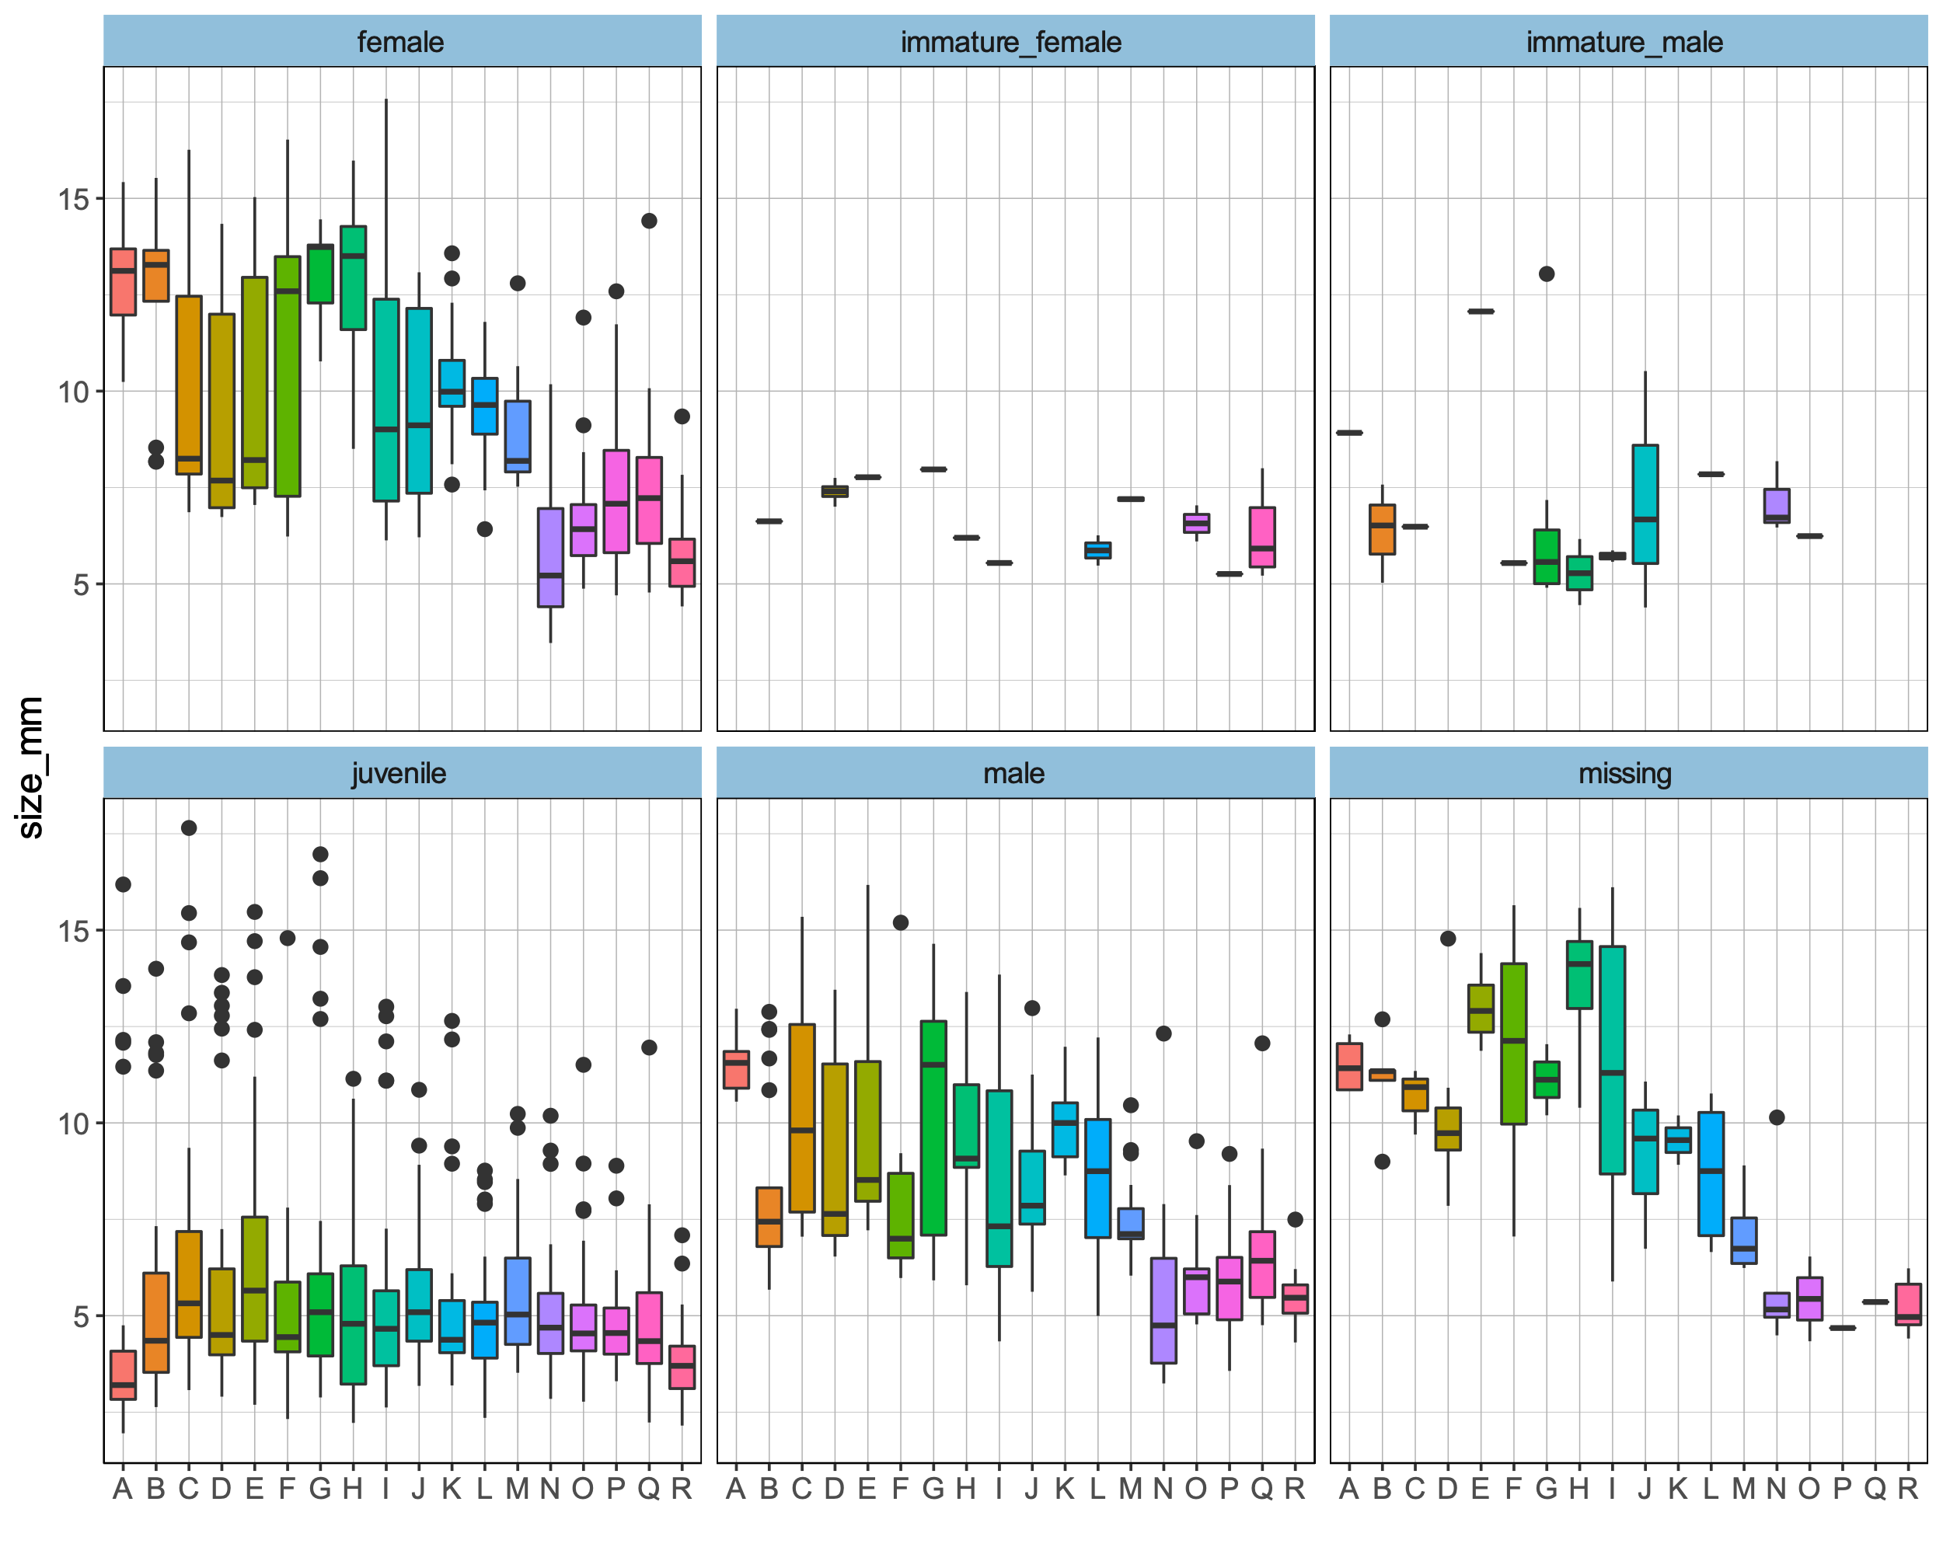
The largest juveniles are snails with no brood and no penis recorded. I believe that some of these are cases where there is an experimenter effect.
Figure 101. Size variation over populations by maturity classes. The boxplot is based on median (horizontal black like), 25th and 75th percentiles (lower and upper hinges), minimum and maximum (lower and upper whisker), outlying points (black dots).

Slide 2
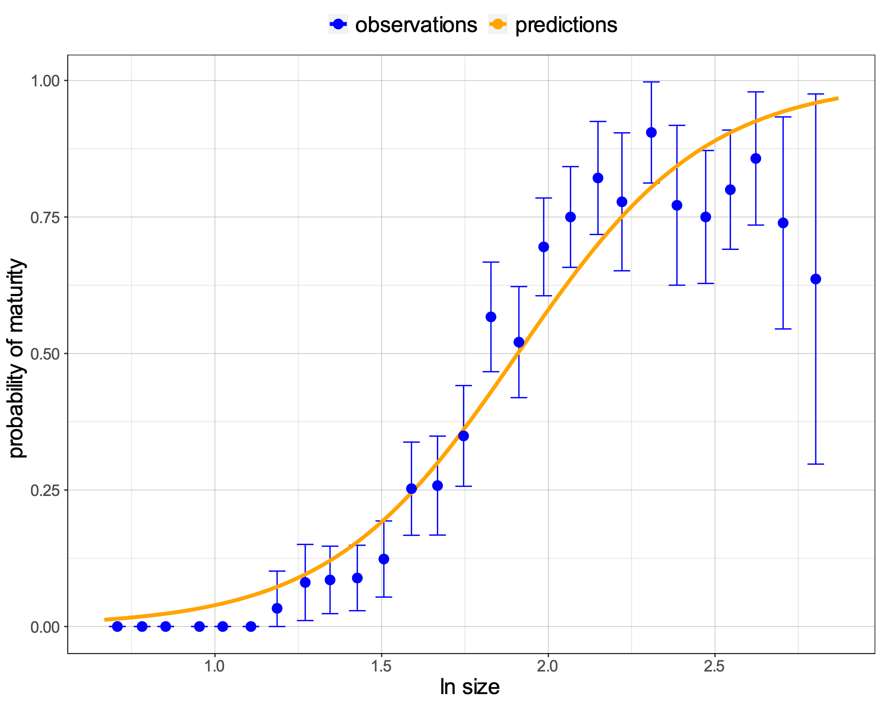
Model 1: All samples combined
Fitting a model where the probability of maturity changes with size. Individuals classified as “immature” were treated as juvenile and no distinction was made between males and females.
s_mat <- function(size, mat, mean, slope) {
logit_p <- (size - mean) / slope
p <- exp(logit_p) / (exp(logit_p)+1)
minusll <- -sum(dbinom(mat, 1, p, log = TRUE))
return(minusll)
}
p is the probability that a snail will be adult, given its size (on natural logarithm scale), the average size at which snails become adult (mean) and a slope (slope) that determines how variable the size at maturity is.
Figure 102. Relationship between probability of maturity and size. Fitted curve in orange is superimposed on the observed proportions of mature snails(blue dots - proportions of adult snails for size bins. Blue error bars – 2.5th and 97.5th percentiles).
SE of the fitted is missing because I was not sure how to compute it. I know that for a simple logit model
dat <- data.frame(x = runif(20), y = rbinom(20, 1, .5), z = runif(20))
o <- glm(y ~ x, data = dat)
I can calculate SE at a given x as:
C <- c(1, x)
std.er <- sqrt(t(C) %*% vcov(o) %*% C)
based on the relationship
yhat = b0 + x*b1
But in our case
yhat = logit(p) = (x – mean) / slope
Can I still use the same formula for computing SE?
Parameter | Estimate | SE
mean | 1.91 | 0.02 | ***
slope | 0.28 | 0.02 | ***
Signif. codes: 0 ‘***’ 0.001 ‘**’ 0.01 ‘*’ 0.05 ‘.’ 0.1 ‘ ’ 1

Slide 3
Model 1: All samples combined
It is odd that the probability of maturity falls off for the largest size classes. This could be 'experimenter error' or, for field samples at least, it could be due to parasitism (sterilized individuals grow bigger). There is probably a case for cleaning out some of the outliers.
Perhaps parasitism can also be considered as “experimenter error” because the data do not include field samples that were recorded as parasitized. However, filtering parasitized field samples does not exclude those that might have been parasitized but parasites were not detected.
The juvenile class contains several snails that are as large as adults (Fig. 101) and I expect that if I remove those samples, the probability of maturity does not fall off.
Figure 102. Relationship between probability of maturity and size. Fitted curve in orange is superimposed on the observed proportions of mature snails(blue dots - proportions of adult snails for size bins. Blue error bars – 2.5th and 97.5th percentiles).
SE of the fitted is missing because I was not sure how to compute it. I know that for a simple logit model
dat <- data.frame(x = runif(20), y = rbinom(20, 1, .5), z = runif(20))
o <- glm(y ~ x, data = dat)
I can calculate SE at a given x as:
C <- c(1, x)
std.er <- sqrt(t(C) %*% vcov(o) %*% C)
based on the relationship
yhat = b0 + x*b1
But in our case
yhat = logit(p) = (x – mean) / slope
Can I still use the same formula for computing SE?
Parameter | Estimate | SE
mean | 1.91 | 0.02 | ***
slope | 0.28 | 0.02 | ***
Signif. codes: 0 ‘***’ 0.001 ‘**’ 0.01 ‘*’ 0.05 ‘.’ 0.1 ‘ ’ 1

Slide 4
Model 1: All samples combined
Given the logistic fit, a value for 'size at maturity' is the intercept (1.91 +/- 0.02 in slide 2) because this is the size at 50% probability of maturity (zero on the logit scale). If we had such an estimate for each tank and each generation, this could be treated as a trait in the plasticity analysis, just like weight, boldness etc. Adding tank to the analysis would give these separate estimates, I guess, or there might be enough data to do the analysis separately for each tank (and generation) (Model 3).
Figure 102. Relationship between probability of maturity and size. Fitted curve in orange is superimposed on the observed proportions of mature snails(blue dots - proportions of adult snails for size bins. Blue error bars – 2.5th and 97.5th percentiles).
SE of the fitted is missing because I was not sure how to compute it. I know that for a simple logit model
dat <- data.frame(x = runif(20), y = rbinom(20, 1, .5), z = runif(20))
o <- glm(y ~ x, data = dat)
I can calculate SE at a given x as:
C <- c(1, x)
std.er <- sqrt(t(C) %*% vcov(o) %*% C)
based on the relationship
yhat = b0 + x*b1
But in our case
yhat = logit(p) = (x – mean) / slope
Can I still use the same formula for computing SE?
Parameter | Estimate | SE
mean | 1.91 | 0.02 | ***
slope | 0.28 | 0.02 | ***
Signif. codes: 0 ‘***’ 0.001 ‘**’ 0.01 ‘*’ 0.05 ‘.’ 0.1 ‘ ’ 1

Slide 5
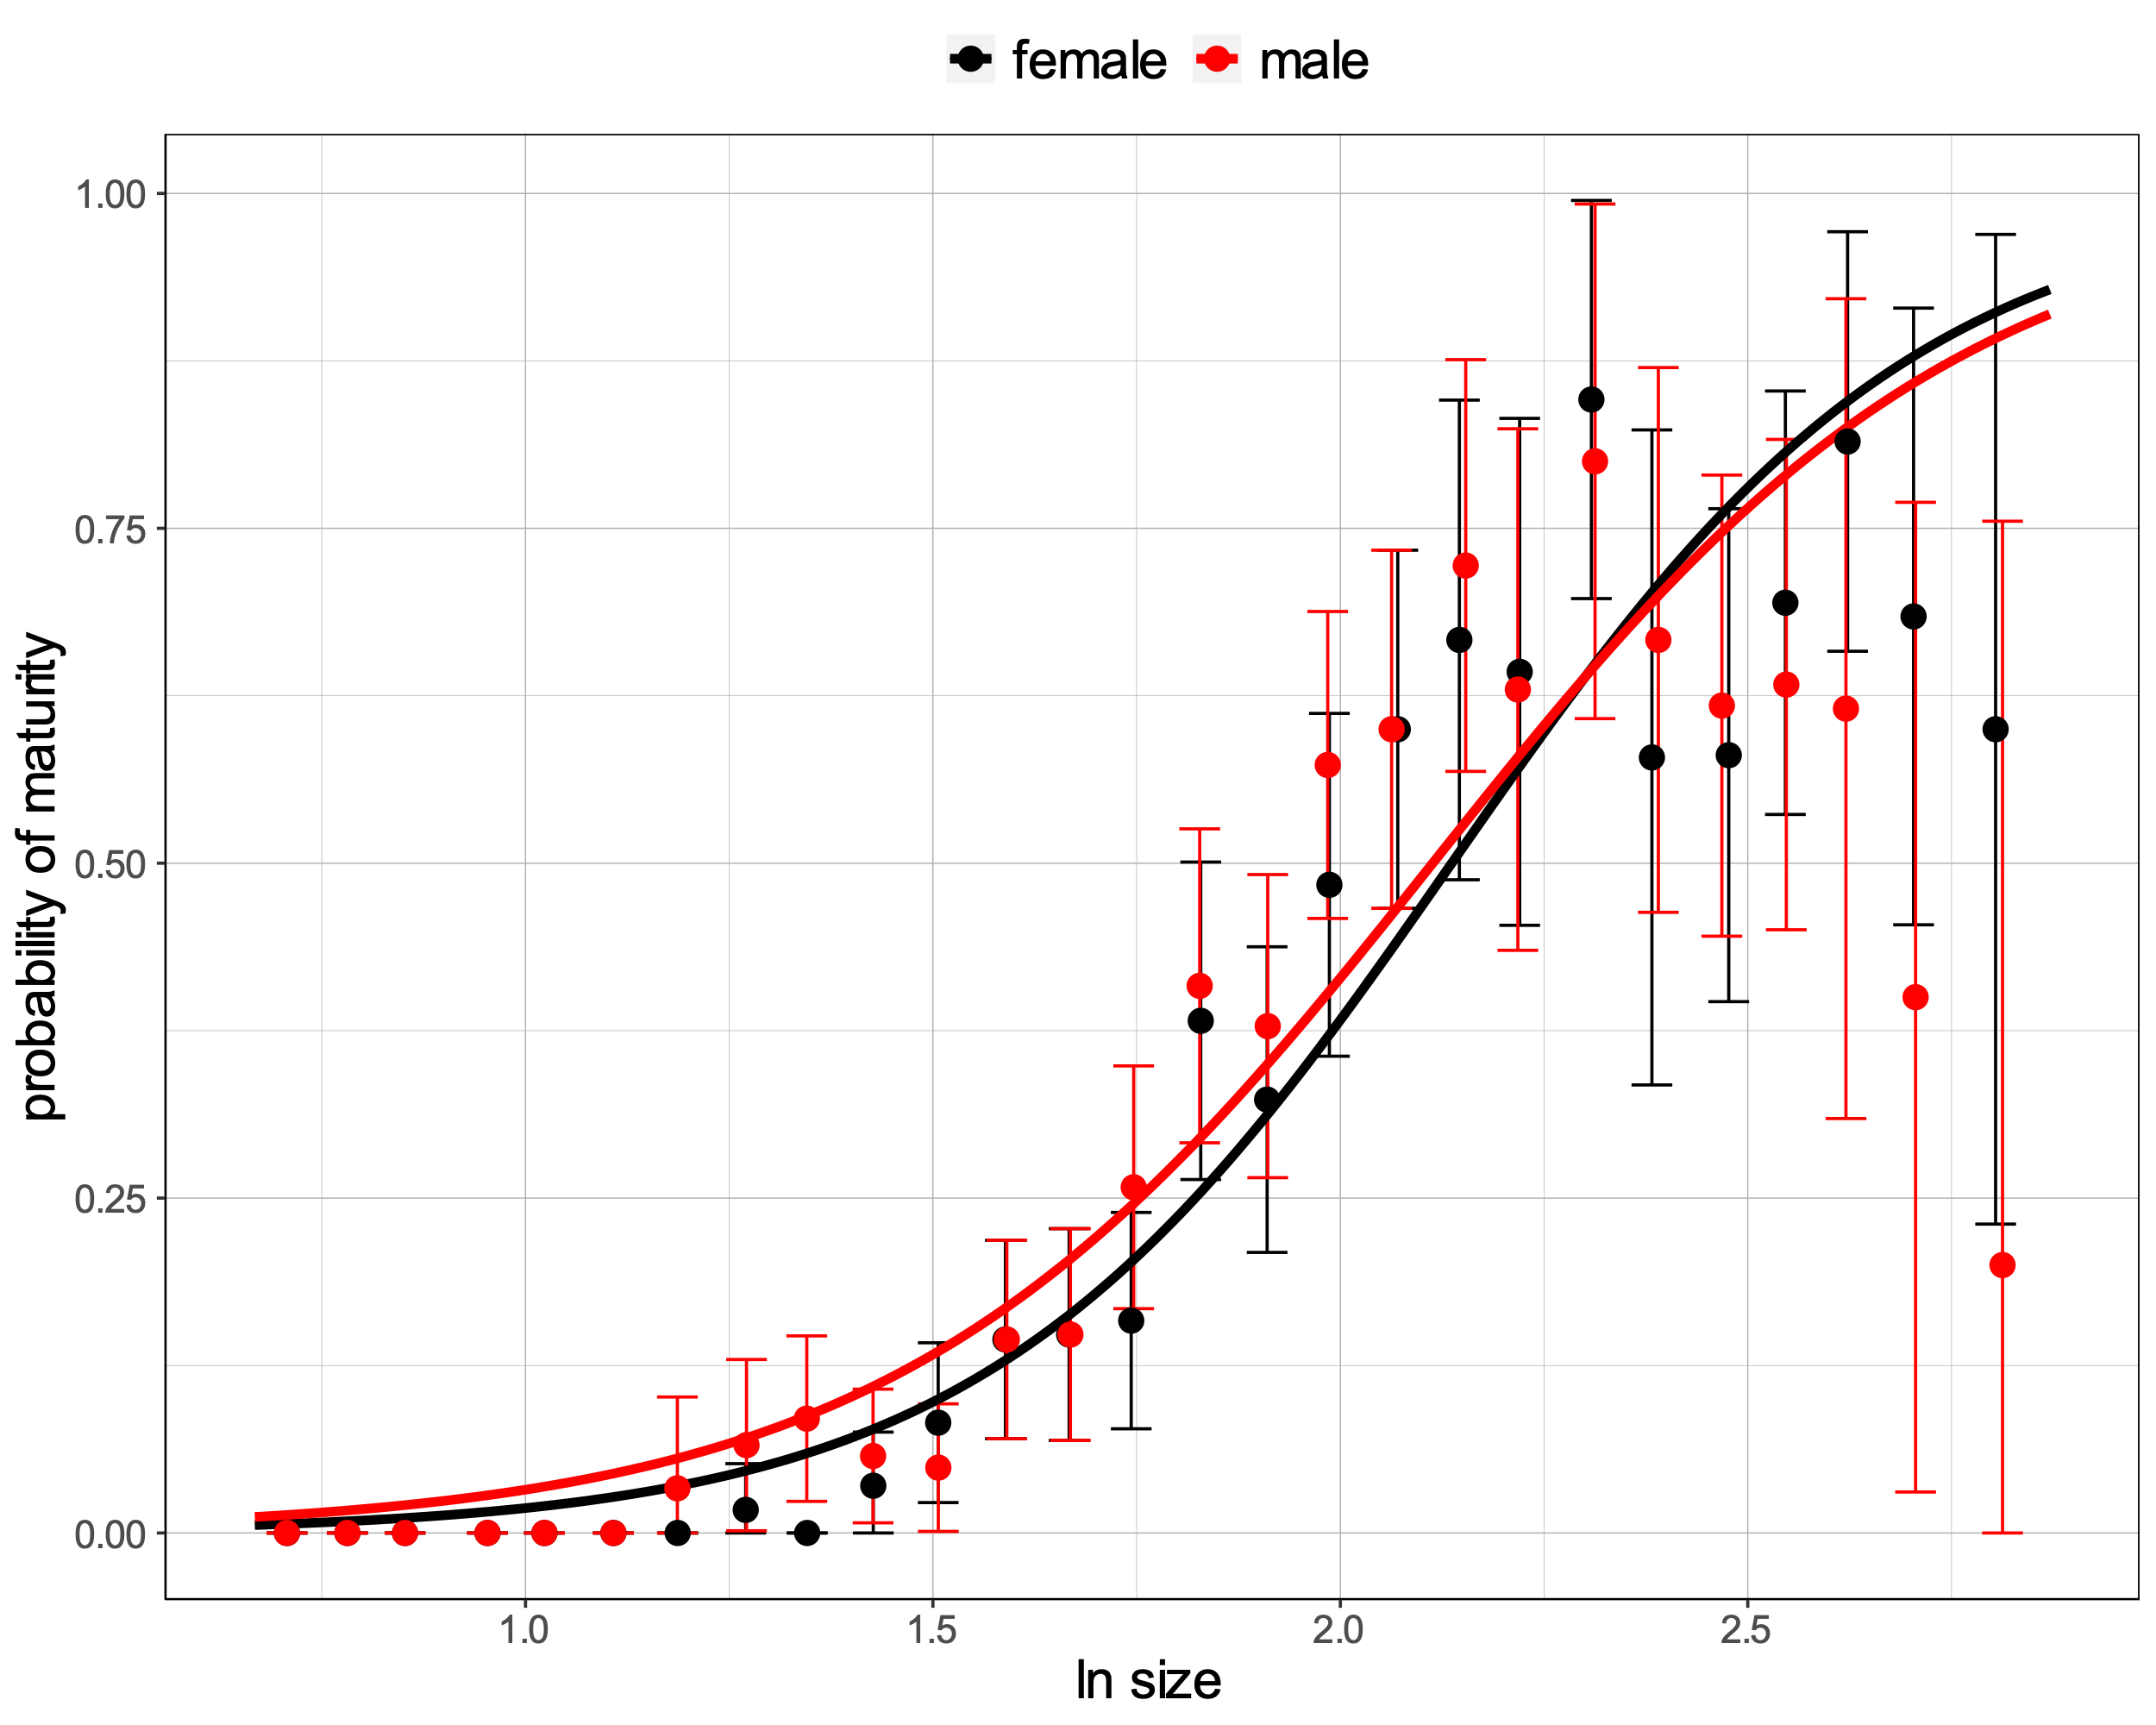
Model 2: two slopes and two sexes
I am also uncertain how to plot the observed data. My first try was to use a female + juvenile dataset and a male + juvenile dataset. Juveniles are shared between the two datasets which means that the original immature females that were treated as juveniles are now included in both the female + juvenile dataset and the male + juvenile dataset. The same goes for immature males.
What are the alternatives?
Fitting a model where the probability of maturity changes with size. Individuals classified as “immature” were treated as juvenile and adults were classified as either females or males.
What is the most sensible function?
The same as Model 1 which can then be fitted to two different data, one where males are removed and another where females are removed.
A function with two means and two slopes
s_mat <- function(size, mat, mean.f, slope.f, mean.m, slope.m) {
logit_pf <- (size – mean.f) / slope.f
logit_pm <- (size – mean.m) / slope.m
pf <- exp(logit_pf) / (exp(logit_pf)+1)
pm <- exp(logit_pm) / (exp(logit_pm)+1)
But here I struggle because I do not know how to combine pf and pm into p. This function should return just one negative LL.
minusll <- -sum(dbinom(mat, 1, p, log = TRUE))
return(minusll)
}
Figure 103. Relationship between probability of maturity and size in females and males. Fitted curve in black (females) and in red (males) are superimposed on the observed proportions of mature females and mature males (black and red dots - proportions of females and males for size bins, respectively. Error bars – 2.5th and 97.5th percentiles).
Option 1 returns:
Parameter | Estimate | SE
mean.m | 2.11 | 0.03 | ***
slope.m | 0.33 | 0.02 | ***
Actually, it looks like there might not be a sex difference, which would be rather surprising.
Parameter | Estimate | SE
mean.f | 2.14 | 0.03 | ***
slope.f | 0.29 | 0.02 | ***

Slide 6
Model 2: two slopes and two sexes
Fitting a model where the probability of maturity changes with size. Individuals classified as “immature” were treated as juvenile and adults were classified as either females or males.
With the sex added there is a problem that I did not think about! The observations become multinomial with 3 classes (male, female, juvenile) rather than binomial. I think the multinomial log-likelihood is just sum(x_i * log(p_i)) (as in the G test, an alternative to chi-square) where the x_i are the observed counts and the p_i are the expected probabilities (that sum to 1). In your case, where you derive the probabilities for each individual, I think this means that you just sum log(p_i(j)) across individuals, where p_i(j) is the probability of the class to which individual j belongs.
s_mat_sex <- function(data, k, y_col, x_col, mean, slope) {
k_count <- table(data[, y_col])
logit_p <- vector(mode = "list", length = length(k_count))
p <- vector(mode = "list", length = length(k_count))
for (k in seq_along(names(k_count))) {
# variable x should be already transformed
x <- data[data[, y_col] == names(k_count)[k], x_col]
logit_p[[k]] <- (x - mean[k]) / slope[k]
p[[k]] <- log(exp(logit_p[[k]])/(exp(logit_p[[k]])+1))
p[[k]] <- sum(p[[k]])
}
minusll <- -sum(dmultinom(x = as.vector(k_count), prob = unlist(p), log = TRUE))
return(minusll)
}
Juvenile (0) | Female (1) | Male (2)
827 | 315 | 331
Figure 103. Relationship between probability of maturity and size in females and males. Fitted curve in black (females) and in red (males) are superimposed on the observed proportions of mature females and mature males (black and red dots - proportions of females and males for size bins, respectively. Error bars – 2.5th and 97.5th percentiles).

Slide 7
Then we could think about fitting a model where the probability of maturity changes with size. If we ignore 'immature' individuals for the moment (probably treat them as juvenile), we can do something like this:
logit(p_m) <- (size - smat_m)/b_m
logit(p_f) <- (size - smat_f)/b_f
p_m and p_f are the probabilities that a male or a female will be adult, given their size, the average size at which males or females become adult (smat_m, smat_f) and a slope (b_m, b_f) that determines how variable the size at maturity is.
Then we also have the unknown sex ratio (sr) in juveniles so a snail is juvenile with probability
p_j <- (1-p_m)*sr + (1-p_f)*(1-sr)
maybe we don't need this because it should just be 1-p_m-p_f (any snail that is not male or female is juvenile)
That means we have 4 unknowns that we can fit given the size and maturity status of the individuals and assuming the parameters are constant across the contact zone. After fitting this model, it could be extended to allow the parameters to vary over tanks (or with space in the clinal data). I did something a bit like this ages ago for ANG, but without separating males and females. It was possible to fit a cline for size at maturity even though we had rather few juveniles in that data set.

Slide 8
single slope for the logistic regressions of maturity on size, in order to focus on comparing the size at 50% maturity among tanks. Probably this should be done separately for gen0 and gen1, where there might be biological reasons for slopes to differ, but perhaps that difference, and the difference between sexes, could first be tested on the full data set. Then the slope could be fixed and individual tank/gen combinations analyses separately to find the size at 50% maturity and its standard error to use in the plasticity analyses (or you could fit a model with one slope and means for different tanks).
Model 3: two slopes and two generations
s_mat <- function(size, mat, mean, slope) {
logit_p <- (size - mean) / slope
p <- exp(logit_p) / (exp(logit_p)+1)
minusll <- -sum(dbinom(mat, 1, p, log = TRUE))
return(minusll)
}
where size is either for individuals of generation 0 or individuals of generation 1.

Slide 9
single slope for the logistic regressions of maturity on size, in order to focus on comparing the size at 50% maturity among tanks. Probably this should be done separately for gen0 and gen1, where there might be biological reasons for slopes to differ, but perhaps that difference, and the difference between sexes, could first be tested on the full data set. Then the slope could be fixed and individual tank/gen combinations analyses separately to find the size at 50% maturity and its standard error to use in the plasticity analyses (or you could fit a model with one slope and means for different tanks).
Model 4: one slope and separate generations
s_mat <- function(size, mat, mean, slope) {
logit_p <- (size - mean) / slope
p <- exp(logit_p) / (exp(logit_p)+1)
minusll <- -sum(dbinom(mat, 1, p, log = TRUE))
return(minusll)
}
where size is either for individuals of generation 0 or individuals of generation 1.

Slide 10
Model 3: tank difference
Given the logistic fit, a value for 'size at maturity' is the intercept (1.91 +/- 0.02 in slide 2) because this is the size at 50% probability of maturity (zero on the logit scale). If we had such an estimate for each tank and each generation, this could be treated as a trait in the plasticity analysis, just like weight, boldness etc. Adding tank to the analysis would give these separate estimates, I guess, or there might be enough data to do the analysis separately for each tank (and generation) (Model 3).
Figure 102. Relationship between probability of maturity and size. Fitted curve in orange is superimposed on the observed proportions of mature snails(blue dots - proportions of adult snails for size bins. Blue error bars – 2.5th and 97.5th percentiles).

