Slide 1
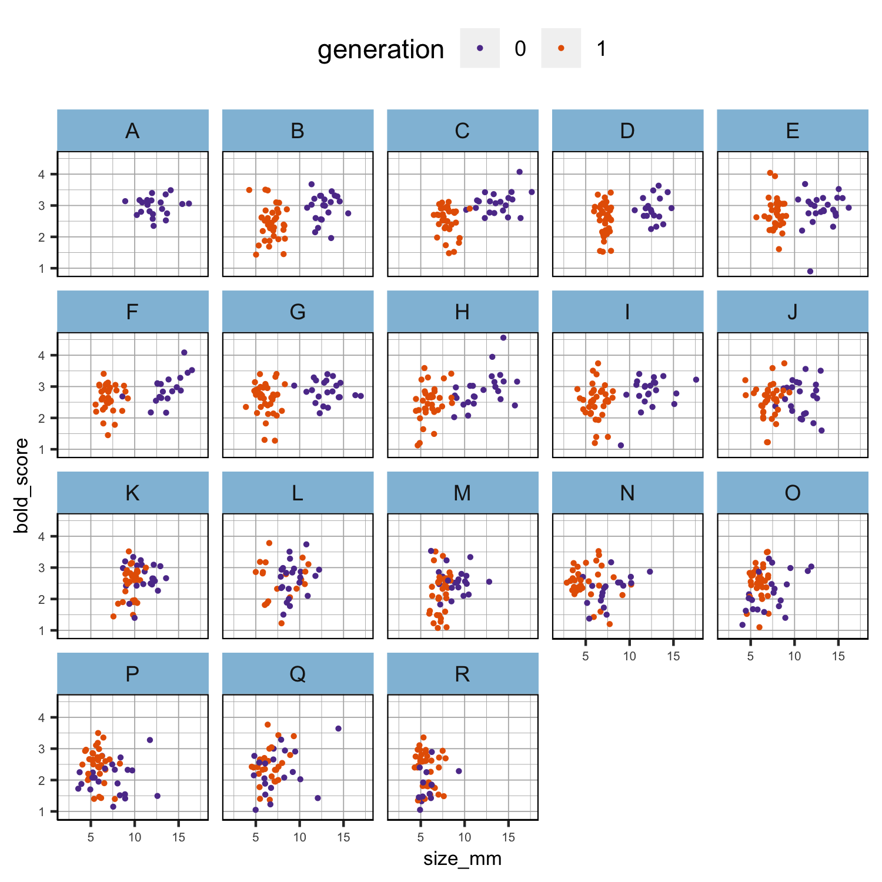
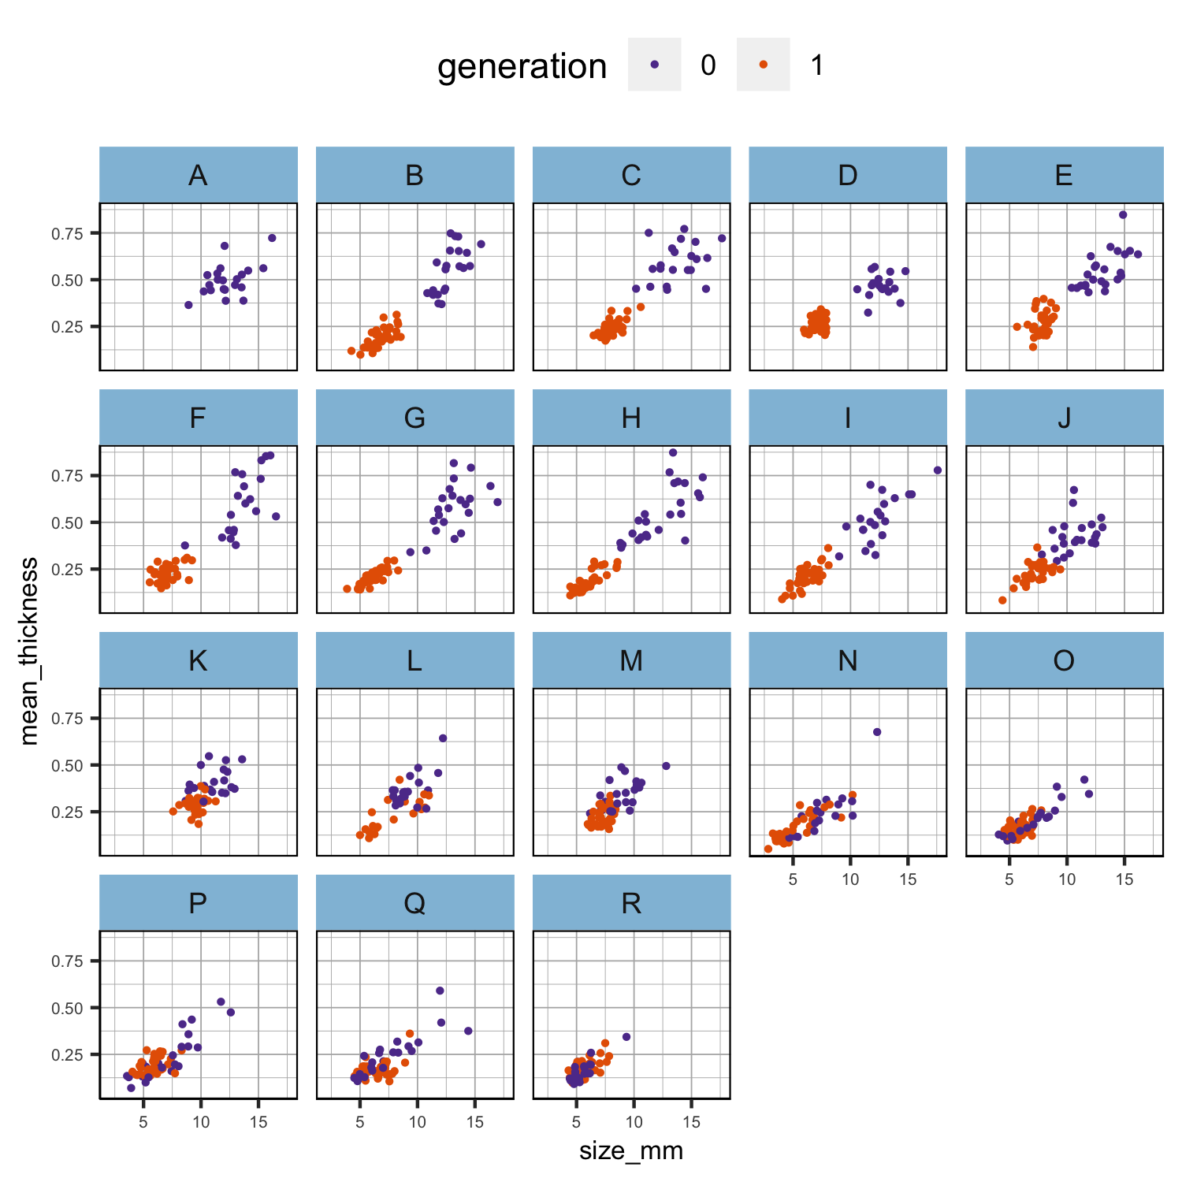
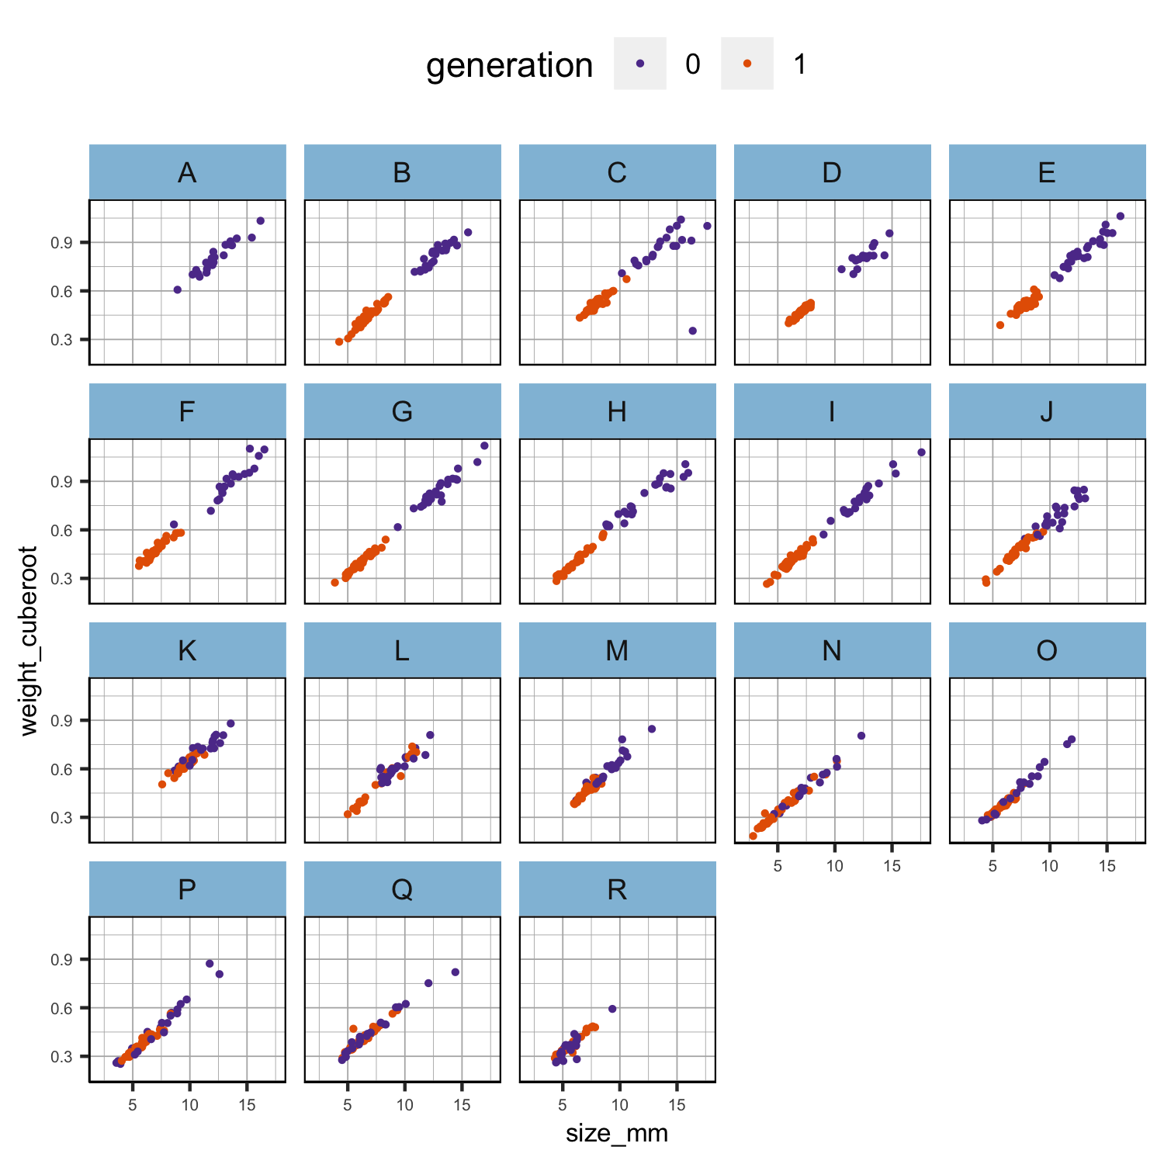
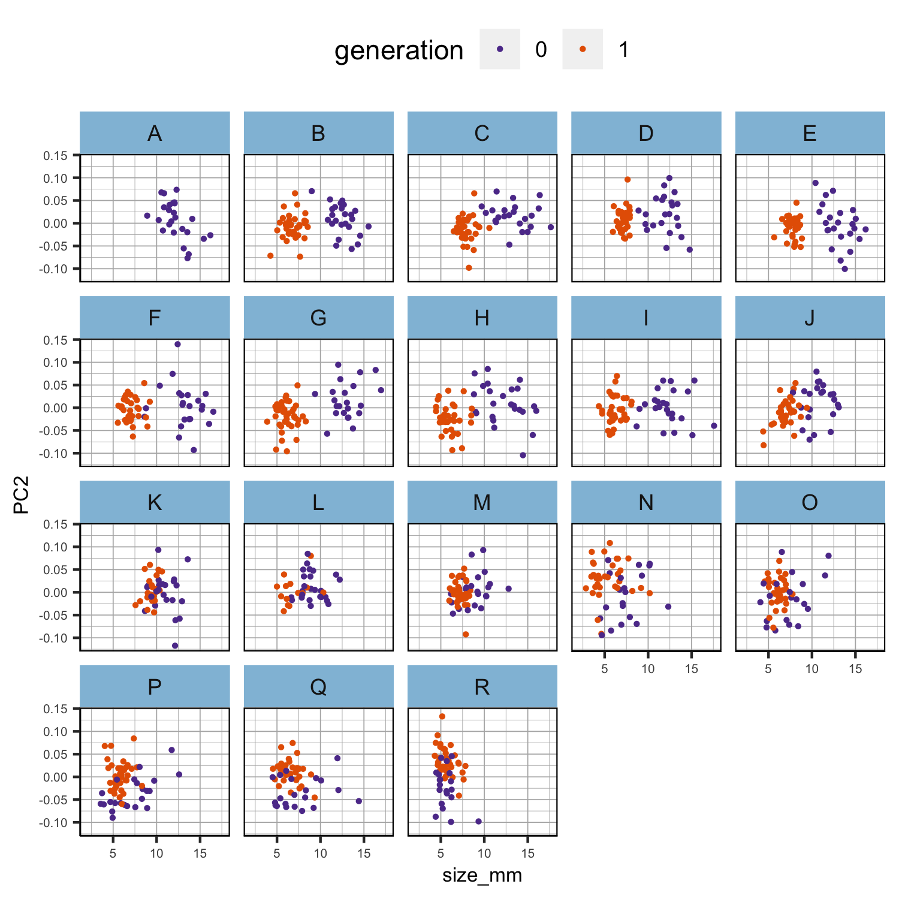
Figure 1. Scatter plots of the relationship between size and the other phenotypes per population in each generation separately. Phenotypic values have not been scaled.

Slide 2
Figure 2. Boxplot of the scaled cube root of weight per generation and population. Phenotypic values have been scaled.

Slide 3
Table tmp1a. Summary of the linear model in generation 0 parents with scaled cube root of the weight as response variable and scaled size plus population as explanatory variables.
Table tmp1b. Summary of the linear model in generation 1 offspring with scaled cube root of the weight as response variable and scaled size plus population as explanatory variables. Population A did not survive.
Parameter | Estimate | Std..Error | t.value | Pr...t..
(Intercept) | 0.104 | 0.053 | 1.975 | 0.049
scaled_size_mm | 0.880 | 0.022 | 40.602 | 0.000
popB | -0.047 | 0.072 | -0.646 | 0.518
popC | -0.209 | 0.074 | -2.824 | 0.005
popD | -0.055 | 0.076 | -0.726 | 0.469
popE | 0.002 | 0.071 | 0.029 | 0.977
popF | 0.093 | 0.075 | 1.249 | 0.213
popG | -0.002 | 0.072 | -0.025 | 0.980
popH | -0.009 | 0.070 | -0.135 | 0.893
popI | -0.060 | 0.073 | -0.817 | 0.415
popJ | -0.098 | 0.072 | -1.356 | 0.176
popK | -0.084 | 0.073 | -1.153 | 0.249
popL | -0.112 | 0.075 | -1.484 | 0.139
popM | -0.085 | 0.076 | -1.120 | 0.263
popN | -0.239 | 0.083 | -2.893 | 0.004
popO | -0.231 | 0.081 | -2.845 | 0.005
popP | -0.193 | 0.080 | -2.410 | 0.016
popQ | -0.291 | 0.080 | -3.635 | 0.000
popR | -0.365 | 0.087 | -4.211 | 0.000
Parameter | Estimate | Std..Error | t.value | Pr...t..
(Intercept) | -0.061 | 0.019 | -3.225 | 0.001
scaled_size_mm | 0.951 | 0.010 | 90.718 | 0.000
popC | 0.025 | 0.020 | 1.220 | 0.223
popD | 0.057 | 0.020 | 2.875 | 0.004
popE | 0.043 | 0.020 | 2.101 | 0.036
popF | 0.078 | 0.020 | 3.894 | 0.000
popG | -0.027 | 0.019 | -1.395 | 0.163
popH | 0.008 | 0.020 | 0.404 | 0.687
popI | 0.015 | 0.020 | 0.755 | 0.451
popJ | 0.022 | 0.020 | 1.092 | 0.275
popK | 0.043 | 0.023 | 1.865 | 0.063
popL | 0.002 | 0.024 | 0.094 | 0.925
popM | 0.000 | 0.020 | 0.001 | 0.999
popN | -0.010 | 0.020 | -0.466 | 0.641
popO | -0.063 | 0.020 | -3.130 | 0.002
popP | -0.018 | 0.020 | -0.926 | 0.355
popQ | -0.030 | 0.020 | -1.494 | 0.136
popR | -0.047 | 0.020 | -2.360 | 0.019

