Slide 1
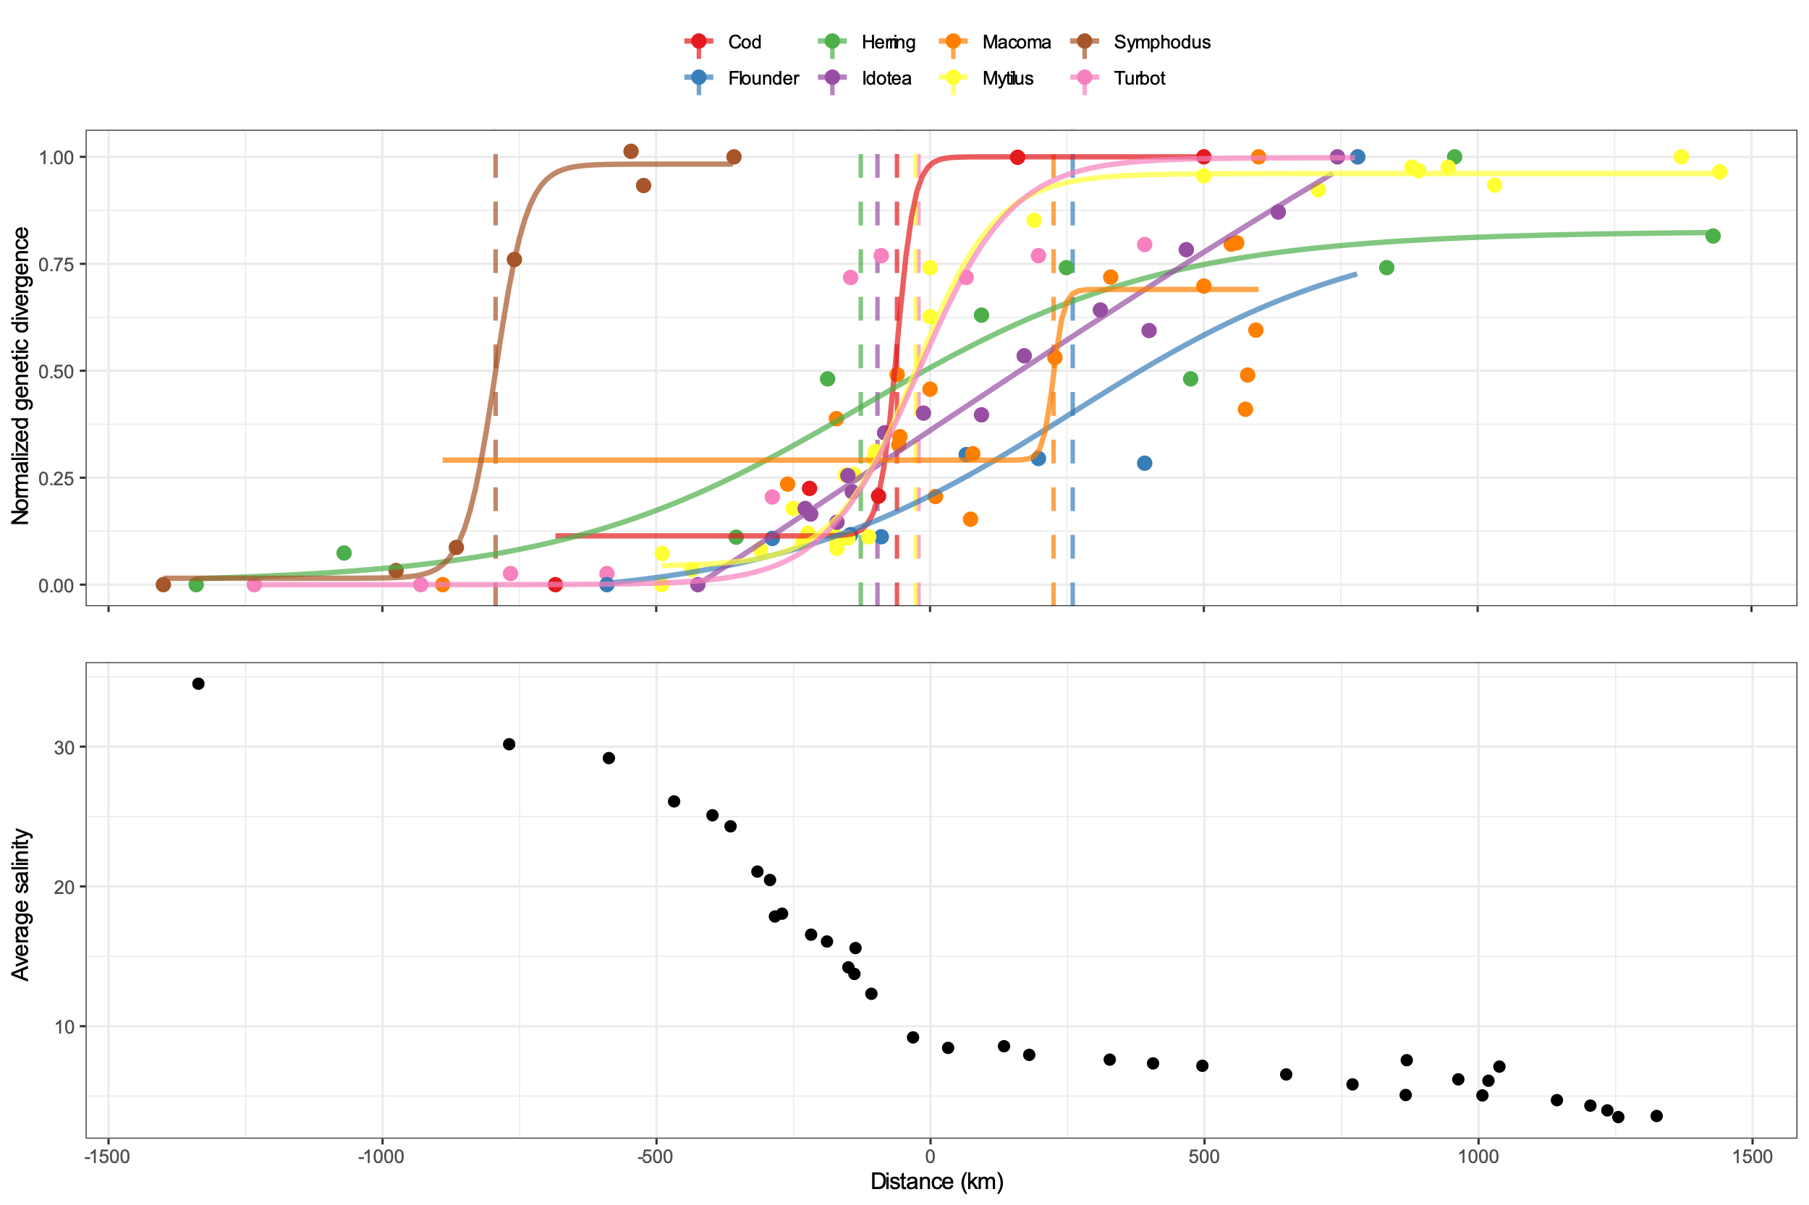
Cod
Herring
Macoma
Symphodus
Flounder
Idotea
Mytilus
Turbot

Slide 2
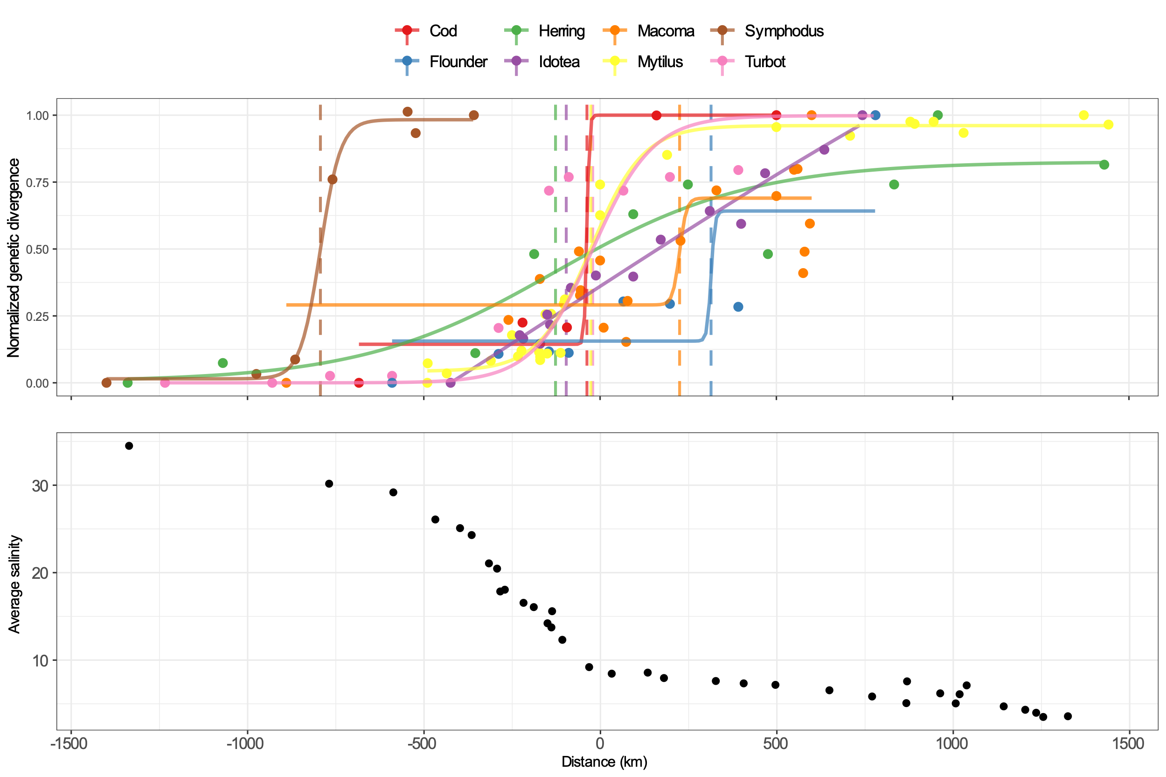
Cod
Herring
Macoma
Symphodus
Flounder
Idotea
Mytilus
Turbot

