Slide 1
Fast Type-based Querying & Indexing of Dynamic Hierarchical Data
Sam Kelly, S.c.M Brown University ‘17

Slide 2
Motivations
In-memory type-based hierarchical data is becoming ubiquitous
Examples
XML (sometimes)
HTML / Document Object Model (DOM)
Abstract syntax trees (ASTs) – compilers / programming languages / grammars
Key Applications
JQuery DOM selectors (get descendants by type)
AST traversals performed in static analysis / flaw detection (get descendants by type)
Type-based queries over these data are common but seldom optimized
Existing indexing techniques either not dynamic or not suited for in-memory applications (XDBMS designed for massive on-disk data)

Slide 3
Case Study: ROSE Compiler Framework
Compiler framework and analysis/translation engine that works with ASTs for C/C++ and a number of other languages
Developed at Lawrence Livermore National Laboratory
Has a static analysis framework called Compass
Compass uses naïve depth-first traversals to analyze ASTs (slow)
Get descendants by type queries very common
No existing (pre-2014) static analysis publications address this issue
Previous work (Kelly, 2014) addresses this with a powerful indexing scheme that only works on static trees

Slide 4
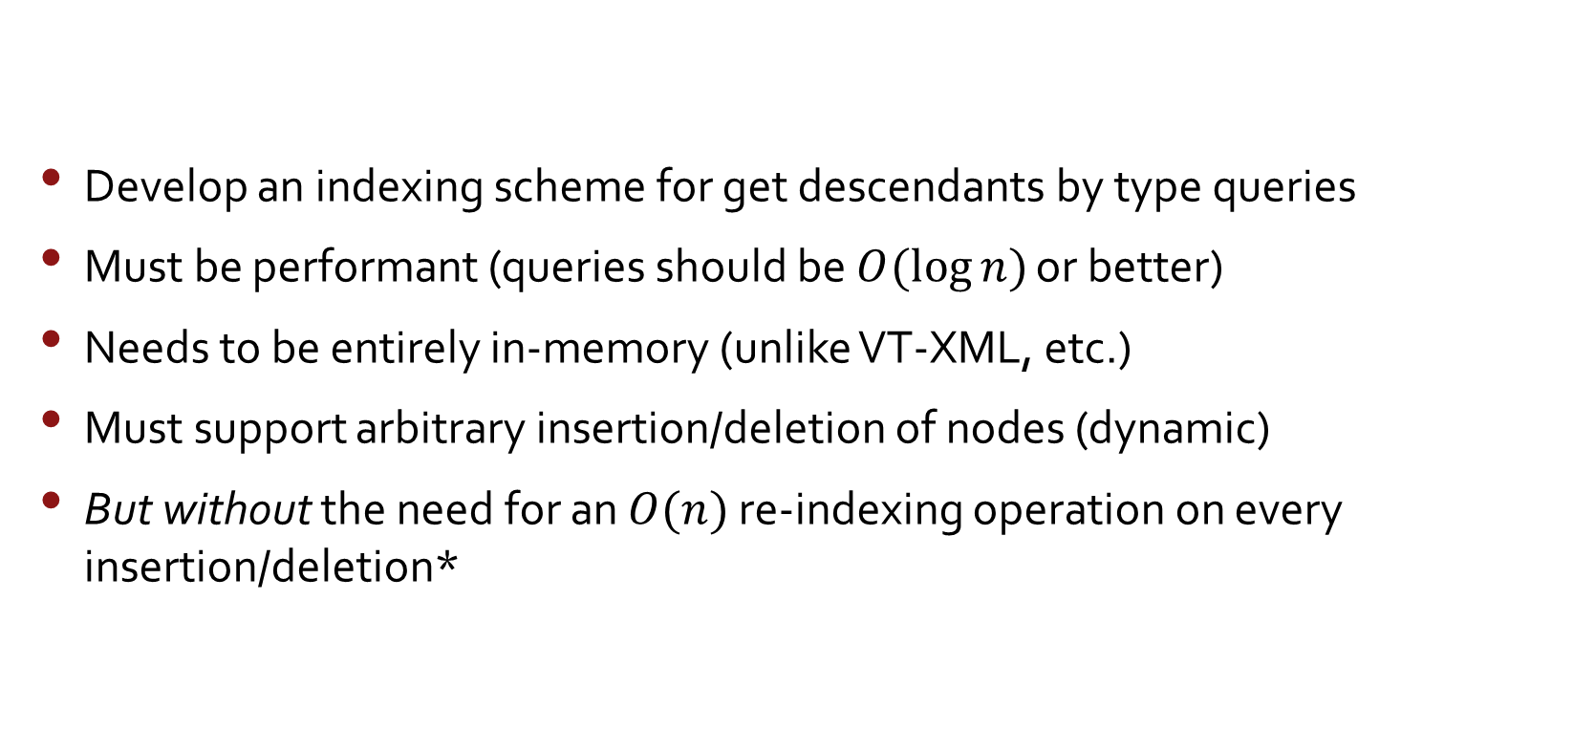
Hierarch Development Goals
Develop an indexing scheme for get descendants by type queries
Must be performant (queries should be $O(\log{n})$ or better)
Needs to be entirely in-memory (unlike VT-XML, etc.)
Must support arbitrary insertion/deletion of nodes (dynamic)
But without the need for an $O(n)$ re-indexing operation on every insertion/deletion*
*(Kelly, 2014) answered queries in $O(1)$ but had an insertion/deletion cost of $O(n)$ which was impractical for dynamic trees

Slide 5
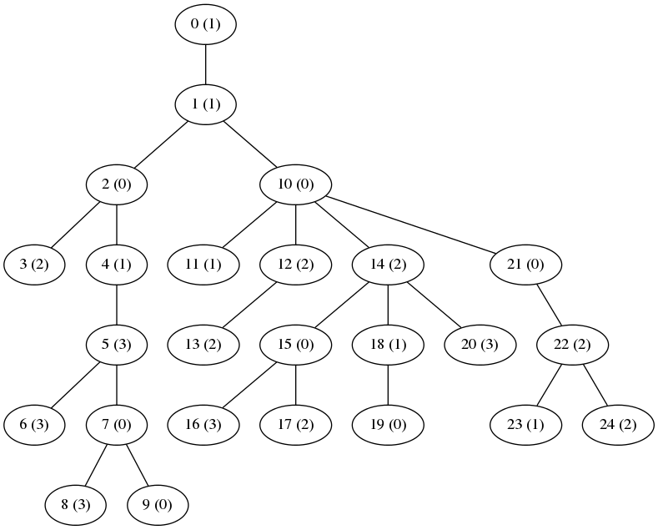
Insight: Depth First Indices

Slide 6
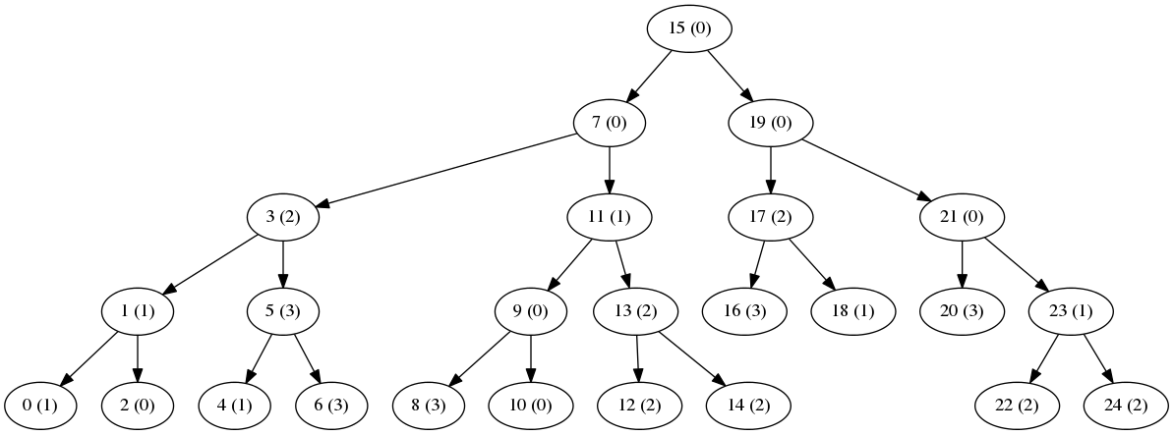
AVL Tree

Slide 7
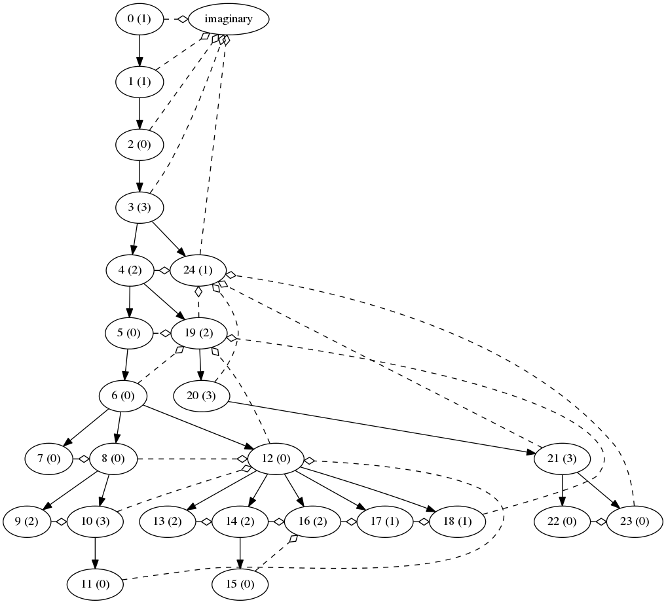
“Successor” Tracking

Slide 8
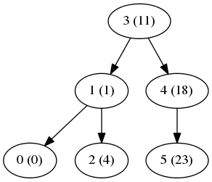
Type AVL Tree (type=2)

Slide 9
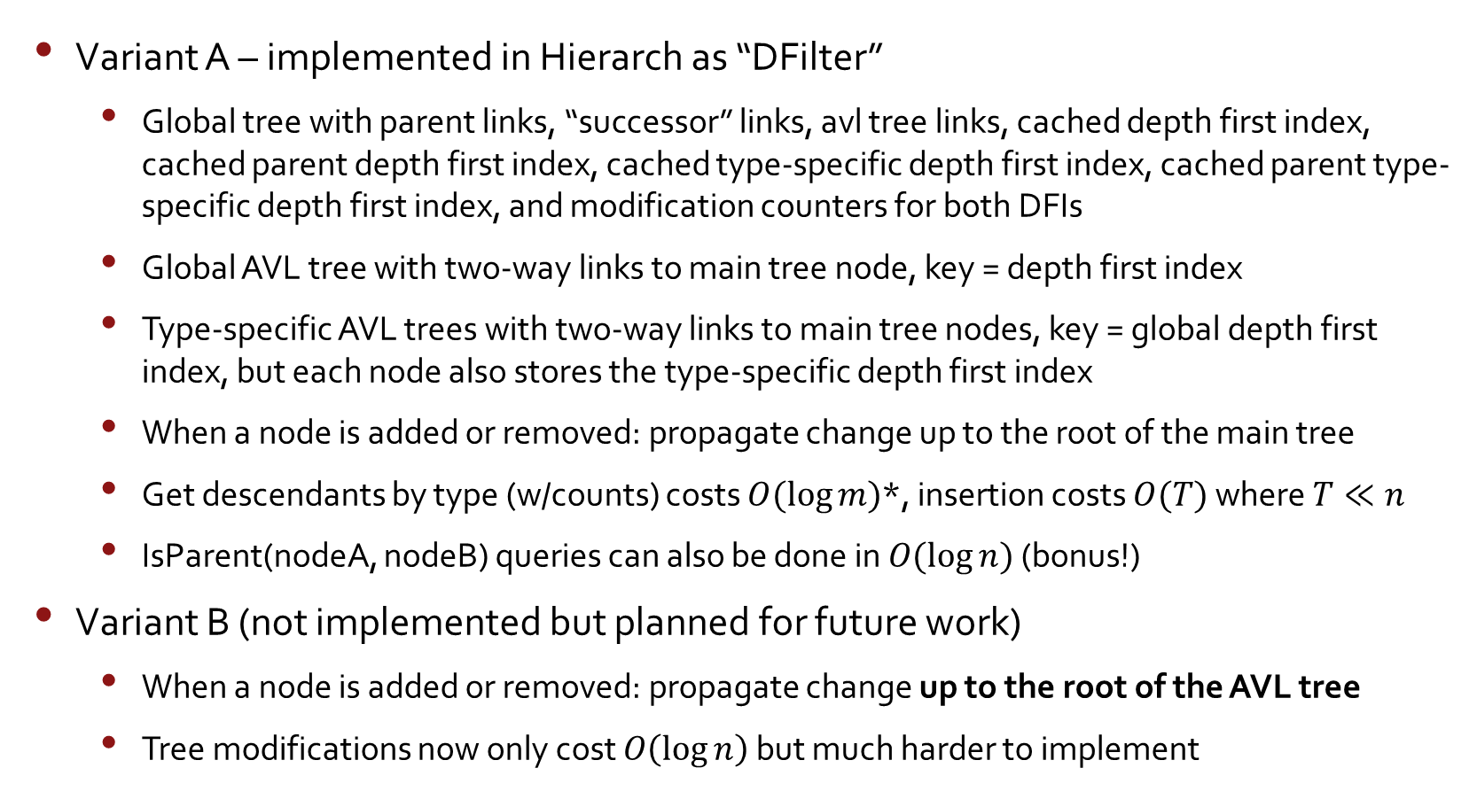
Two Variants
Variant A – implemented in Hierarch as “DFilter”
Global tree with parent links, “successor” links, avl tree links, cached depth first index, cached parent depth first index, cached type-specific depth first index, cached parent type-specific depth first index, and modification counters for both DFIs
Global AVL tree with two-way links to main tree node, key = depth first index
Type-specific AVL trees with two-way links to main tree nodes, key = global depth first index, but each node also stores the type-specific depth first index
When a node is added or removed: propagate change up to the root of the main tree
Get descendants by type (w/counts) costs $O(\log{m)}$*, insertion costs $O(T)$ where $T≪n$
IsParent(nodeA, nodeB) queries can also be done in $O(\log{n})$ (bonus!)
Variant B (not implemented but planned for future work)
When a node is added or removed: propagate change up to the root of the AVL tree
Tree modifications now only cost $O\left(\log{n}\right)$ but much harder to implement
*where $m$ is the number of nodes of type $t$ in the tree ($m≪n$)

Slide 10
1000 nodes
100,000 nodes

Slide 11
Future Work
Implement variant B
Research efficacy of multi-threaded implementation
Support for multi-type queries

Slide 12
Questions?

