Slide 1
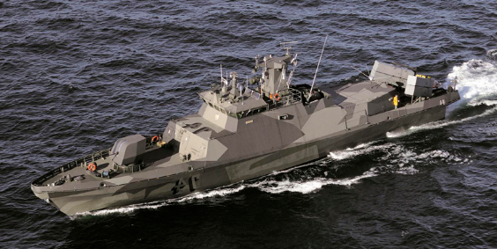
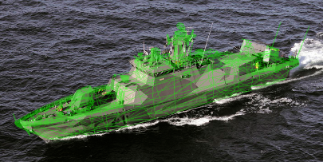
Plan A
2D Covariance Matrix
RPROP Neural Network
2D Covariance Matrix
3D Covariance Matrix
3D Position & Orientation
Pre-Labeled Input Image Region

Slide 2
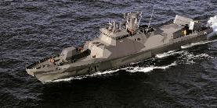

Plan A w/Stereo Vision
Input Video Frame #1
Input Video Frame #2
Stereo Vision
RPROP Neural Network
3D Covariance Matrix
3D Position & Orientation

Slide 3

Plan B
2D Covariance Matrix
6-Way Reference Heuristic
RPROP Neural Network
2D Covariance Matrix
Pre-Labeled Input Image Region
3D Position & Orientation

