Slide 1
21AIE332T- Image and Video Processing
Dr. K. Lakshmi Narayanan
Assistant Professor
Department of Computational Intelligence
SRMIST - KTR Campus

Slide 2
Image and Video Processing Intro
Introduction to Digital Image and Video Processing
Digital image and video processing is a field of study that deals with the manipulation and analysis of images and videos using digital computers. It combines techniques from various disciplines, including mathematics, computer science, and electrical engineering, to improve, modify, or extract information from images and video sequences.
1. Digital Image Processing
A digital image is a representation of a two-dimensional signal (an image) in a discrete (digital) form. It consists of a grid of pixels, where each pixel represents a specific color or intensity value.
2. Digital Video Processing
A digital video consists of a sequence of images (frames) shown in rapid succession to create the perception of motion. Video processing shares many concepts with image processing but adds the complexity of time and motion analysis.

Slide 3
SYLLABUS
Unit-1: Introduction to Digital Image and Video Processing
Gray-Level Image Processing- Tools for Image Fourier Analysis- Binary Image Processing- Basic Linear Filtering with Application to Image Enhancement- Nonlinear Filtering for Image Analysis and Enhancement
Methods for Image Restoration and Identification- Regularization in Image Restoration- Image Reconstruction

Slide 4
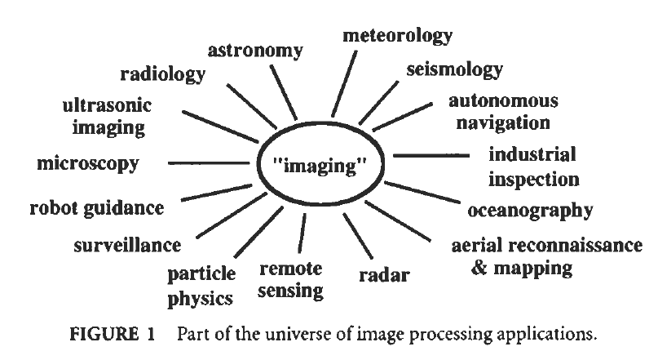
Image and Video Processing Intro
Digital images and digital video are, respectively, pictures and movies that have been converted into a computer-readable binary format consisting of logical Os and 1s.
Digital images or video are usually obtained by converting continuous signals into digital format, although “direct digital” systems are becoming more prevalent.
Another rich aspect of digital imaging is the diversity of image types that arise, and that can derive from nearly every type of radiation.

Slide 5
Types of Images
Reflection images sense radiation that has been reflected from the surfaces of objects.
Most of our daily experience of optical imaging through the eye is of reflection images.
Common nonvisible examples include radar images, sonar images, and some types of electron microscope images.
The type of information that can be extracted from reflection images is primarily about object surfaces, that is, their shapes, texture, color, reflectivity, and so on.
Emission images are even simpler, since in this case the objects being imaged are self-luminous.
Examples include thermal or infrared images, which are commonly encountered in medical, astronomical, and military applications, self-luminous visible light objects, such as light bulbs and stars, and MRI images, which sense particle emissions.
In images of this type, the information to be had is often primarily internal to the object; the image may reveal how the object creates radiation, and thence something of the internal structure of the object being imaged.

Slide 6
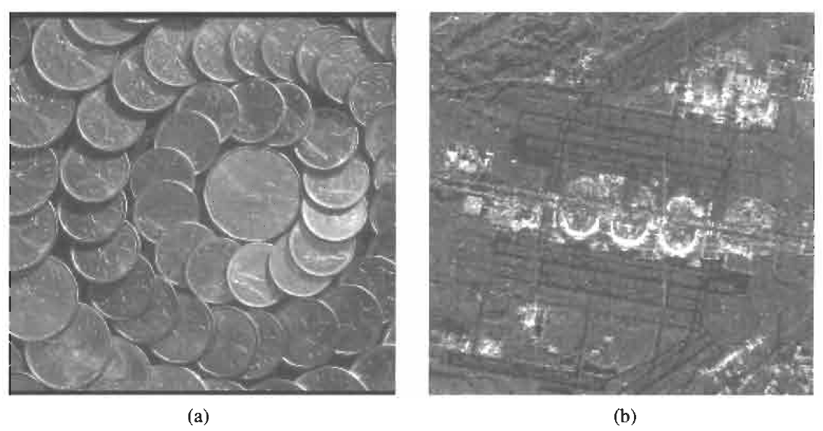
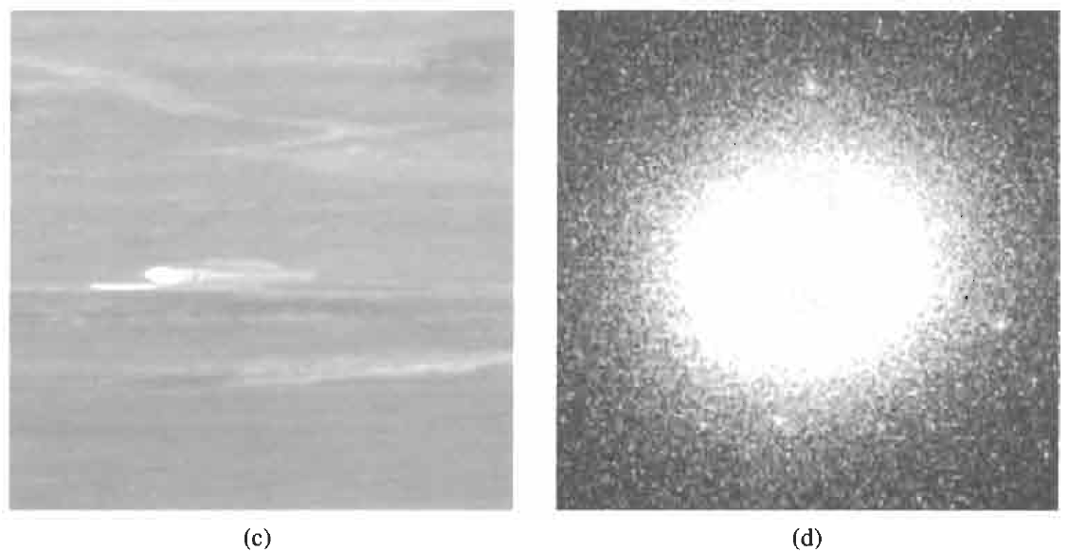
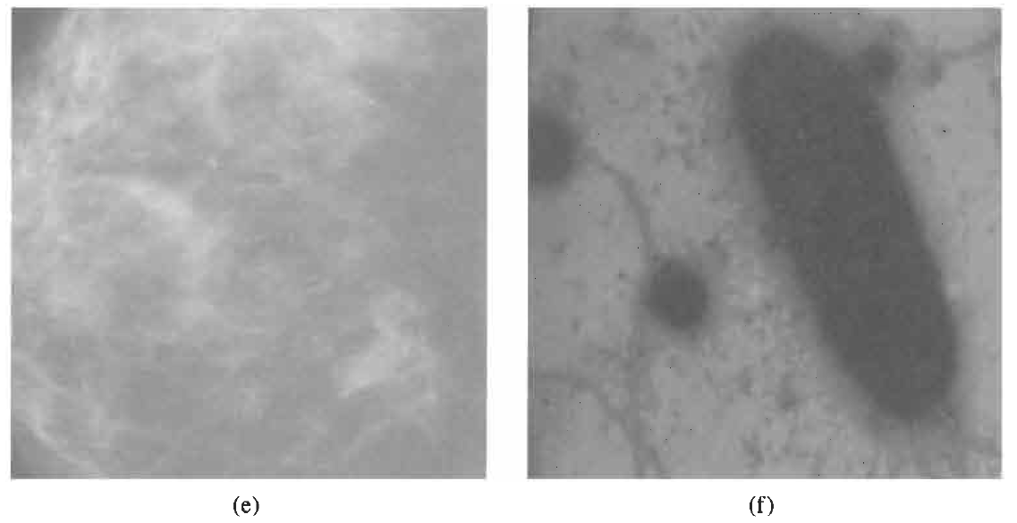
Types of Images
absorption images yield information about the internal structure of objects.
In this case, the radiation passes through objects and is partially absorbed or attenuated by the material composing them.
The degree of absorption dictates the level of the sensed radiation in the recorded image.
Examples include Xray images, transmission microscopic images, and certain types of sonic images.

Slide 7
The scale of an image in image and video processing refers to the representation of the size of objects within the image relative to their actual physical size in the real world.
Scale is critical for understanding, analyzing, and processing images, especially when dimensions, resolutions, or transformations of objects are involved.
Key Concepts of Image Scale
Physical Scale:
  Refers to the physical size that a single pixel or unit of the image represents in real-world dimensions.
  Example: In a satellite image, 1 pixel might represent 1 meter on the ground (spatial resolution).
Pixel Scale:
  The size of an object in the image measured in terms of pixels.
  Example: A car may appear 50 pixels wide in an image, but the physical size depends on the mapping between pixel and physical dimensions.
Scaling in Image Processing:
  Scaling involves resizing an image, either enlarging or shrinking it.
  Methods for scaling include:
    Upscaling: Increasing the size of the image (adding more pixels).
    Downscaling: Reducing the size of the image (removing pixels).

Slide 8
Sampled Image
Definition: A sampled image is an image obtained by sampling a continuous real-world scene or function into a discrete grid of points (pixels). Sampling involves selecting specific points in the spatial domain (x, y) and measuring their intensity or color value.
Quantized Image
Definition: A quantized image is an image where the intensity or color values of each pixel are restricted to a finite number of discrete levels. Quantization occurs after sampling to encode pixel values digitally.
Color Image
Definition: A color image is an image where each pixel contains color information, typically represented by combining multiple color channels (e.g., Red, Green, Blue).

Slide 9
Digital Video Processing is a branch of image and video processing that focuses on analyzing, enhancing, compressing, and manipulating video sequences (series of consecutive images called frames). It involves applying algorithms and techniques to extract information, improve visual quality, or perform specific tasks, such as motion analysis or object tracking.
Sampled Video
A sampled video refers to a digital video obtained by sampling a continuous real-world motion scene in both spatial and temporal domains. Sampling converts an analog, continuous-time video signal into a discrete representation suitable for digital storage, processing, and transmission.
Key Concepts in Video Sampling
1. Spatial Sampling
Spatial sampling refers to the process of converting a continuous image frame into a grid of discrete pixels.
Each frame in the video is essentially sampled just like a digital image, with the spatial resolution determining the number of pixels in each frame.
Resolution: Defines the number of pixels in the horizontal and vertical directions, such as 1920×1080 (Full HD).

Slide 10
2. Temporal Sampling
Temporal sampling refers to capturing video frames at specific time intervals, effectively converting continuous motion into a series of discrete frames.
The rate of temporal sampling is called the frame rate, measured in frames per second (fps).
  Examples:
    24 fps: Standard frame rate for movies.
    30 fps: Common for TV broadcasts.
    60 fps or higher: Used in high-quality video games or sports broadcasts for smoother motion.
3. Color Sampling
In addition to spatial and temporal sampling, videos often undergo color sampling to reduce data while retaining visual quality.
Chrominance (color) is sampled at a lower rate than luminance (brightness) because the human eye is more sensitive to brightness details than color.
Common chroma subsampling formats:
  4:4:4: No chroma subsampling; full color resolution.
  4:2:2: Halves horizontal chroma resolution.
  4:2:0: Reduces both horizontal and vertical chroma resolution (commonly used in video compression).

Slide 11
Grey Level Image Processing in Image and Video Processing
Grey level image processing involves manipulating images that contain shades of grey, where each pixel's intensity is represented by a single value.
1. Understanding Grey Level Images
Definition: A grey level image is a single-channel image where each pixel can have an intensity value ranging from 0 (black) to 255 (white) in an 8-bit representation. This creates a range of 256 different shades of grey.
Representation: Grey level images can be represented as 2D matrices, where the value of each matrix element corresponds to the intensity of a pixel.
2. Key Techniques in Grey Level Image Processing
Image Enhancement:
  Contrast Stretching: This technique enhances the contrast of the image by stretching the range of intensity values to cover the full range from 0 to 255.
  Histogram Equalization: This method improves the image contrast by redistributing the intensity values so that they span a uniform distribution. This is particularly useful in images with poor contrast.
Image Filtering:
  Smoothing Filters: These filters, such as Gaussian or median filters, are used to reduce noise and improve image quality by averaging the pixel values in a neighborhood.
  Sharpening Filters: Techniques like the Laplacian filter enhance edges and fine details by emphasizing rapid intensity changes.
Thresholding:
  This is a method for segmenting images by converting grey level images into binary images (black and white) based on a defined threshold value. Pixels above the threshold are set to one value (e.g., white), while those below are set to another (e.g., black).
Morphological Operations:
  These operations process images based on their shapes and structures, using techniques like dilation and erosion. They are useful in removing noise and filling gaps in binary images.

Slide 12
Edge Detection:
  Techniques like the Sobel, Canny, and Prewitt operators identify boundaries within the image by detecting changes in intensity. Edge detection is crucial for object recognition and segmentation.
Feature Extraction:
  Grey level co-occurrence matrices (GLCM) can be used to extract texture features from images. These features help in analyzing the spatial relationship between pixel intensities.
3. Applications in Image and Video Processing
Medical Imaging: Grey level processing techniques are vital in analyzing X-rays, MRIs, and CT scans, aiding in diagnosis and treatment planning.
Object Detection and Recognition: Segmentation and feature extraction are crucial for identifying and classifying objects in both images and video streams.
Remote Sensing: In satellite imagery, grey level processing helps in analyzing land use, vegetation cover, and other environmental factors.
Facial Recognition: Grey level images are often used in facial recognition systems to analyze features and patterns for identification.
4. Challenges in Grey Level Image Processing
Noise Sensitivity: Grey level images can be susceptible to noise, which can affect the accuracy of processing techniques.
Lighting Variability: Changes in lighting conditions can lead to variations in grey level intensity, complicating image analysis.
Limited Information: Unlike color images, grey level images do not provide color information, which may be crucial for certain applications.

Slide 13
Image Histogram
The histogram is a plot of pixel intensity values on the horizontal axis and the frequency of each intensity value on the vertical axis.
  For a grayscale image, intensity values range from 0 (black) to 255 (white) for 8-bit images.
  For color images, separate histograms can be plotted for each channel (Red, Green, and Blue) in an RGB image.
2. Types of Histograms
Grayscale Histogram: Represents the distribution of pixel intensity values (from 0 to 255 in an 8-bit image).
Color Histogram: Represents the distribution of pixel values in each color channel (R, G, B) for color images.
3. Image Intensity Levels
An image with 8-bit depth has 256 possible intensity levels (0 to 255).
Higher bit depths (e.g., 10-bit or 16-bit images) have more possible levels, offering finer detail.

Slide 14
Linear Point Operations
Linear point operations in image processing refer to operations where the output of a pixel depends linearly on its input value. These operations are applied on a pixel-by-pixel basis, meaning each pixel is processed independently of its neighbors. The transformation applied is typically in the form of a linear mathematical function, which results in changes to the pixel's intensity or color value.
Linear point operations are commonly used for tasks like contrast adjustment, brightness scaling, and normalization in both grayscale and color images.
Mathematical Representation of Linear Point Operations
A linear point operation can generally be described using the following formula:
g(x,y)=a⋅f(x,y)Where:
f(x,y) is the intensity (or color value) of the pixel at location (x,y)in the input image.
g(x,y) is the transformed intensity (or color value) of the pixel at location (x,y) in the output image.
ais a scaling factor that affects the contrast of the image.
bis an offset that affects the brightness of the image.
This operation is applied to each pixel in the image individually.

Slide 15
Image Histogram
Additive image offset refers to the process of shifting the pixel intensity values of an image by adding a constant value to each pixel’s intensity.
This operation is often used to adjust the brightness of the image without affecting its contrast.
Multiplicative image scaling is a type of linear point operation in which each pixel value in an image is multiplied by a constant scaling factor.
This operation is used to modify the contrast or brightness of an image. Unlike the additive image offset, which shifts all pixel values by a fixed amount, multiplicative scaling adjusts the pixel values proportionally.
Image Negative is a type of linear point operation used in image processing that inverts the pixel values of an image. It is typically used for image enhancement or visual effects.
The operation produces a "negative" version of the image where dark regions become light and light regions become dark.

Slide 16
Image Histogram
Full-scale histogram stretch (also known as contrast stretching) is a linear point operation used in image processing to enhance the contrast of an image by expanding its pixel intensity range. This operation is often used when an image has a narrow range of pixel values and we want to stretch them over the full available intensity range to improve visibility and detail.
The goal of full-scale histogram stretch is to map the minimum and maximum pixel values in the original image to the minimum and maximum intensity values in the output image. This leads to an enhanced contrast by utilizing the entire range of pixel values.

Slide 17
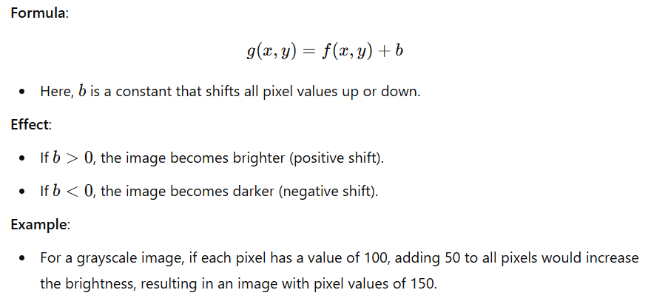
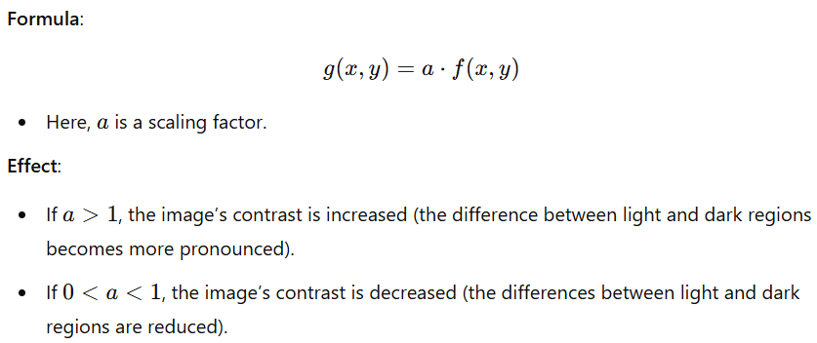
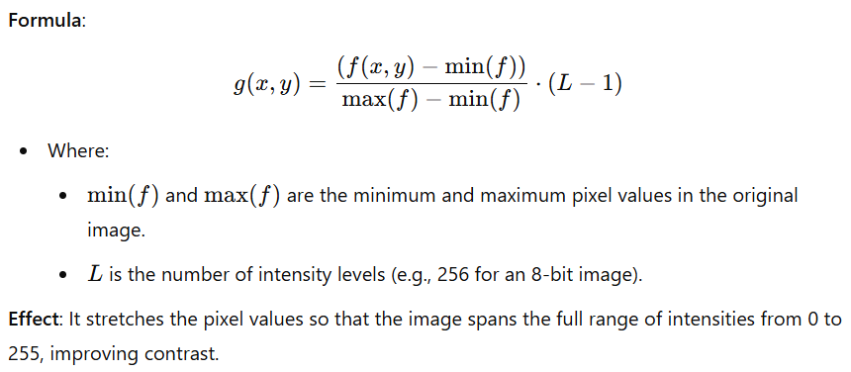
Types of Linear Point Operations
Types of Linear Point Operations
1. Brightness Adjustment
Operation: Adjusting the brightness of an image involves changing the intensity values by adding or subtracting a constant.
2. Contrast Adjustment
Operation: Contrast adjustment enhances or reduces the differences between light and dark areas of an image by scaling the pixel intensities.
3. Linear Contrast Stretching
Operation: Linear contrast stretching involves expanding the range of pixel values so that the image's dynamic range fully utilizes the available intensity range (typically from 0 to 255 for 8-bit images).

Slide 18
Basic Tools for Image Fourier Analysis
In image Fourier analysis, discrete-space sinusoids are mathematical functions used to represent the frequency components of an image in the frequency domain.
The concept of sinusoids (sine and cosine waves) is fundamental to Fourier analysis, as they serve as the basis for decomposing complex signals (such as images) into simpler frequency components.
Sinusoids in Fourier Analysis
In the context of Fourier analysis, the image is represented as a sum of sinusoids, each having a specific frequency, amplitude, and phase.
These sinusoids capture different frequency components of the image, and understanding them helps to manipulate and process images in the frequency domain.
The Fourier transform decomposes an image into these sinusoids and provides a way to express the image's frequency content, making it possible to perform operations such as filtering, compression, and enhancement.

Slide 19
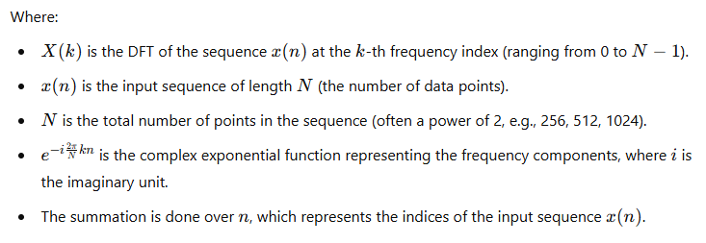


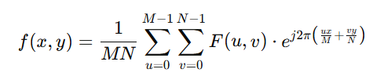
Basic Tools for Image Fourier Analysis
Introduction
What is Fourier Analysis?
  A mathematical tool for transforming signals/images between the spatial and frequency domains.
  Widely used in image and video processing for filtering, compression, and enhancement.
Importance in Image Processing:
  Decomposes images into frequency components for analysis.
  Key for identifying patterns, noise, and details.
1D and 2D Fourier Transform
1D Discrete Fourier Transform (DFT):
Converts 1D signals (e.g., rows/columns of an image) to frequency representation.
2D Discrete Fourier Transform (DFT):
Used for 2D images.
Inverse DFT:

Slide 20
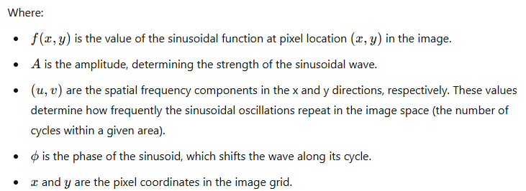
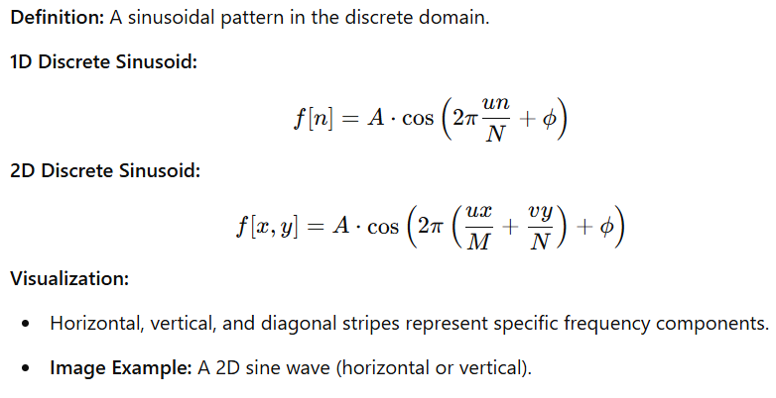
Discrete-Space Sinusoids
A discrete-space sinusoid refers to a sinusoidal wave function sampled at discrete intervals, commonly used to represent periodic patterns, textures, and features in images and videos. This concept is particularly important when analyzing or processing signals in the discrete domain, such as pixels in images or frames in video.

Slide 21
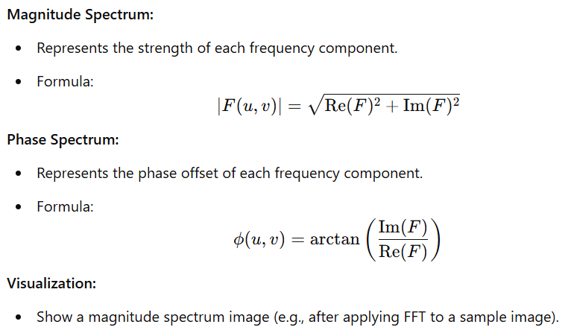
Frequency Domain Representation
Visualization of the Frequency Domain
Magnitude Spectrum: Shows how much of each frequency is present in the image. For a simple image, you may see peaks at certain frequencies corresponding to periodic patterns.
Phase Spectrum: Represents the spatial arrangement of those frequencies within the image.

Slide 22
Filtering in the Frequency Domain
Key Filters:
Low-Pass Filter (LPF): Smooths images by removing high frequencies.
High-Pass Filter (HPF): Enhances edges by removing low frequencies.
Band-Pass Filter: Isolates a specific frequency range.
Examples:
Ideal filter: Circular mask in frequency domain.
Gaussian filter: Smooth transitions in frequency response.
Visualization:
Original image, low-pass filtered image, high-pass filtered image.

Slide 23

Convolution Theorem
Definition: Convolution in the spatial domain equals multiplication in the frequency domain.
Application:
Efficient image filtering by computing FFT, multiplying by a filter, and applying IFFT.
Visualization:
Example: Blurring using a low-pass filter.

Slide 24
Wavelet Transforms and Applications of Fourier Analysis
Why Wavelets?
Combines spatial and frequency analysis.
Multi-resolution representation.
Tools:
Discrete Wavelet Transform (DWT).
Software: Py Wavelets, MATLAB.
Key Applications:
Image Compression (e.g., JPEG).
Noise Removal (e.g., low-pass filtering).
Edge Detection (e.g., high-pass filtering).
Texture Analysis.
Example:
Show a noisy image and a denoised version after low-pass filtering.

Slide 25
Practical Tools and Libraries
Software:
Python: NumPy, SciPy, OpenCV.
MATLAB: fft2, ifft2, fftshift.
GPU Acceleration: CuFFT (NVIDIA GPUs).
Visualization Libraries:
Python: Matplotlib, Seaborn.

Slide 26
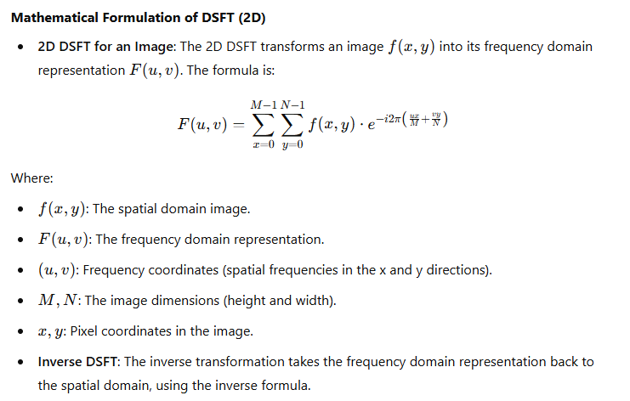
The Discrete-Space Fourier Transform (DSFT)
Definition: The Discrete-Space Fourier Transform (DSFT) is a mathematical tool used to analyze the frequency content of discrete signals, like images or video frames. It is the process of transforming spatial domain data (pixel values) into the frequency domain.
Purpose in Image and Video Processing: DSFT provides insights into the periodic components of an image or video, enabling operations like filtering, enhancement, compression, and texture analysis.

Slide 27
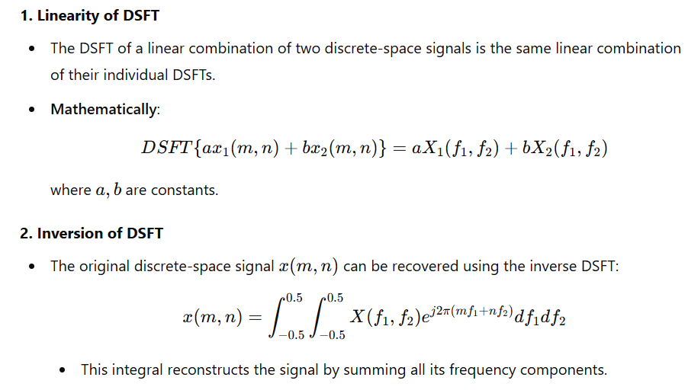
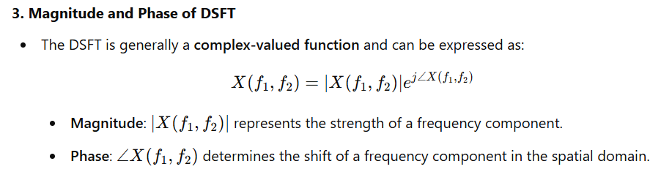
Key Properties of Discrete-Space Fourier Transform (DSFT)

Slide 28
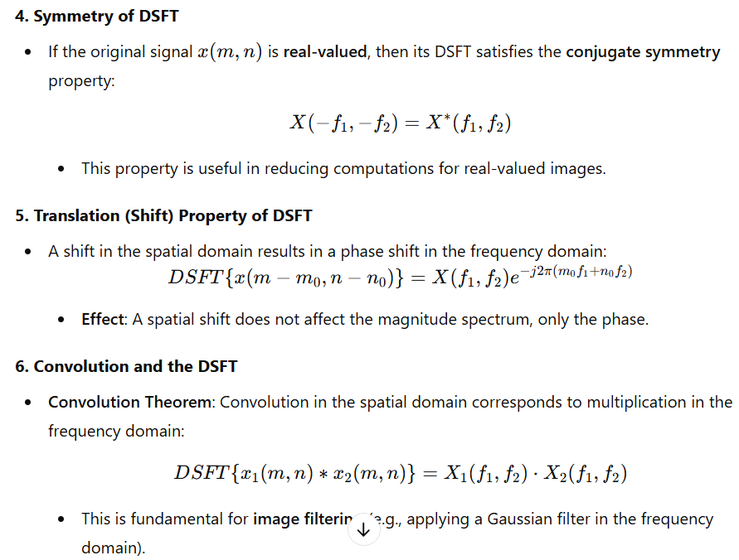
Key Properties of Discrete-Space Fourier Transform (DSFT)

Slide 29
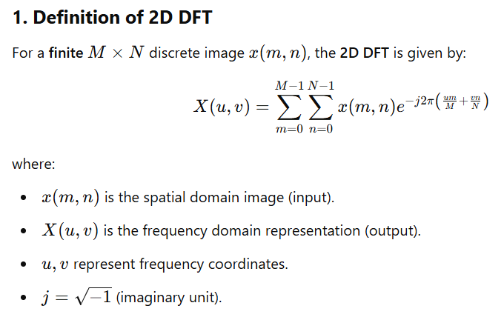
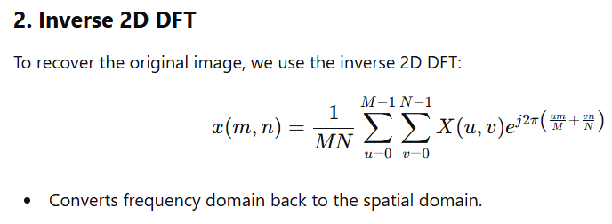
Two-Dimensional Discrete Fourier Transform (DFT) for Image Fourier Analysis
The 2D Discrete Fourier Transform (DFT) is a fundamental tool in image processing, allowing transformation of images from the spatial domain to the frequency domain for analysis and filtering.

Slide 30
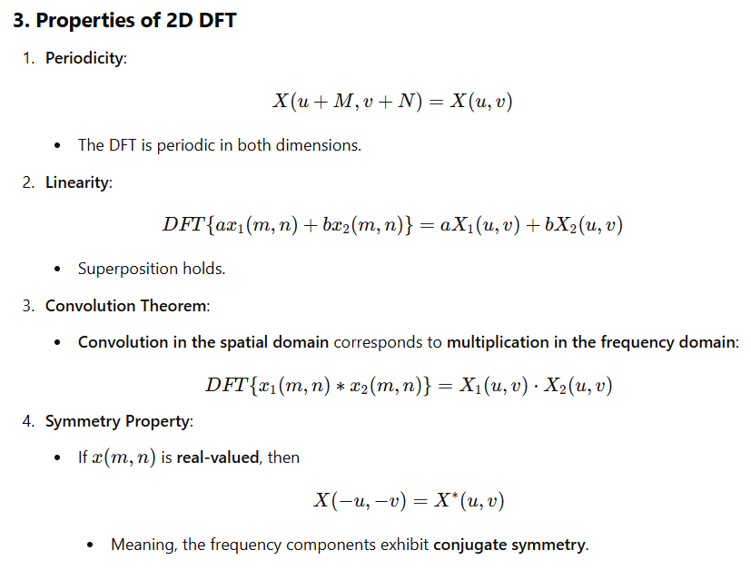
Two-Dimensional Discrete Fourier Transform (DFT) for Image Fourier Analysis

Slide 31
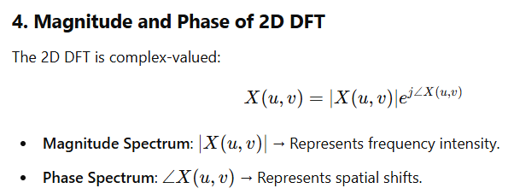
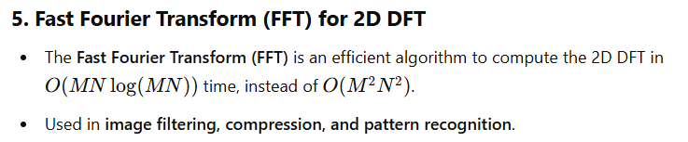
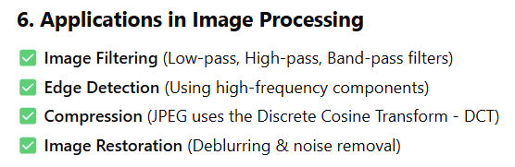
Two-Dimensional Discrete Fourier Transform (DFT) for Image Fourier Analysis

Slide 32
Understanding Image Frequencies and the Discrete Fourier Transform (DFT) in Image Fourier Analysis
1. What Are Image Frequencies?
An image is a 2D signal composed of intensity variations across space.
These variations can be analyzed in terms of their spatial frequencies, which describe how pixel intensities change over an image.
Low frequencies correspond to smooth regions, while high frequencies correspond to edges and fine details.
✅ Example:
A uniform gray image = only low frequencies.
A checkerboard pattern = high frequencies.
2. The Role of the Discrete Fourier Transform (DFT) in Image Analysis
The 2D DFT transforms an image from the spatial domain to the frequency domain, revealing the frequency components of the image.
In the frequency domain, an image can be analyzed and modified more effectively for tasks like filtering, compression, and enhancement.

Slide 33
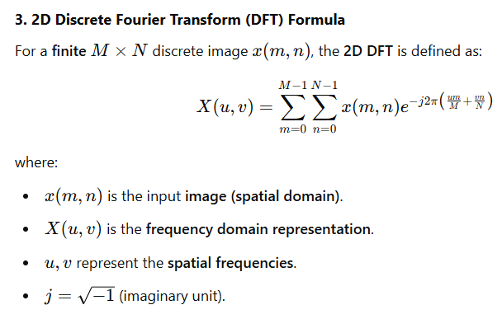
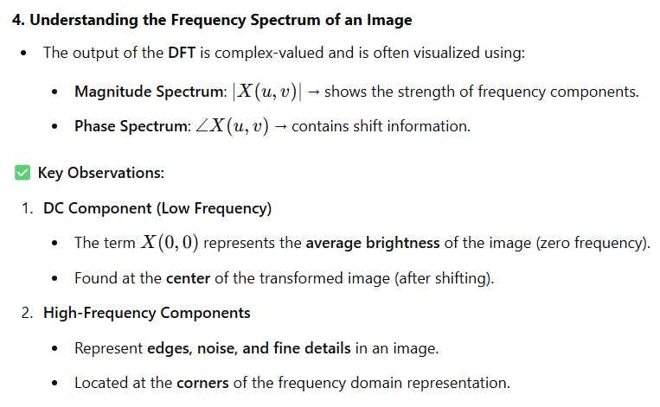
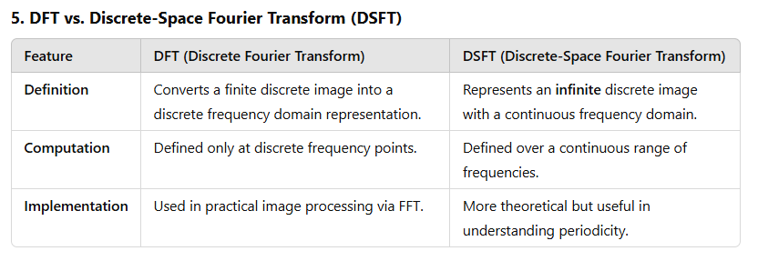
Understanding Image Frequencies and the Discrete Fourier Transform (DFT) in Image Fourier Analysis

Slide 34
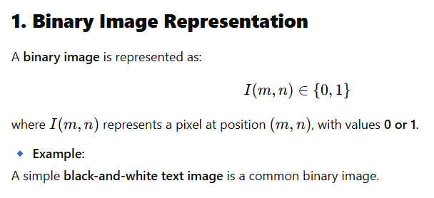
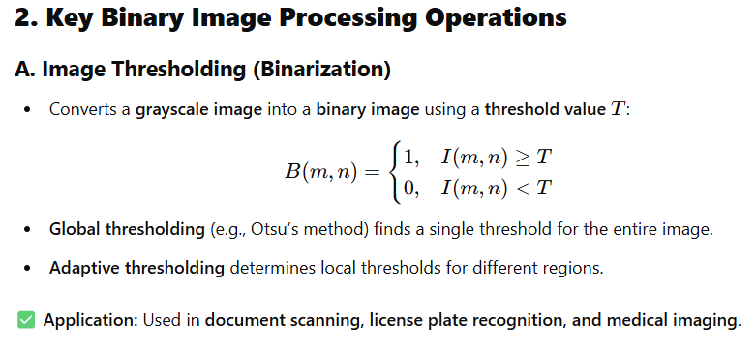
Basic Binary Image Processing
Binary image processing is a fundamental technique in digital image processing where images contain only two pixel values:
0 (black) → Background
1 (white) → Foreground (object of interest)
Binary images are widely used in object detection, segmentation, shape analysis, and OCR (Optical Character Recognition).

Slide 35
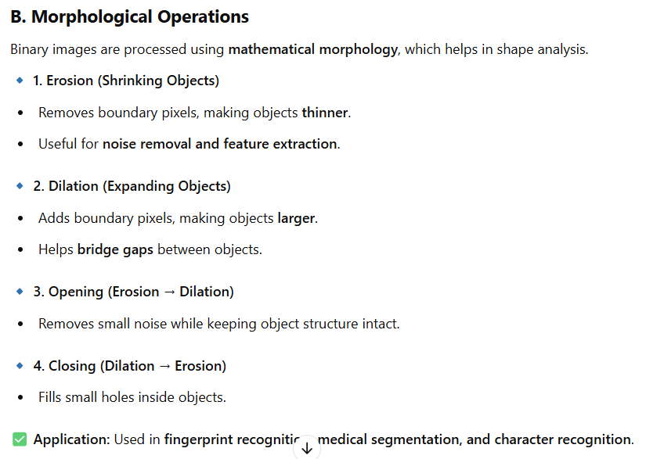
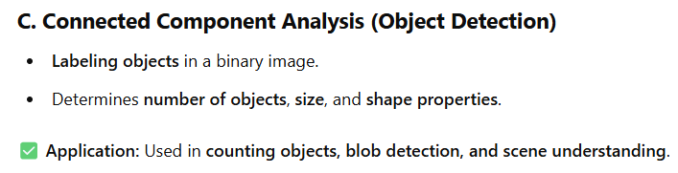
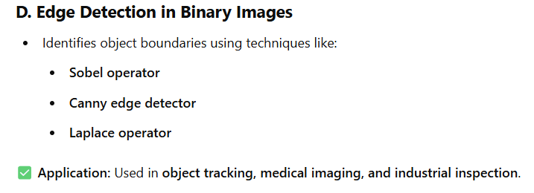
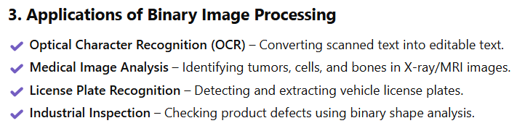
Basic Binary Image Processing

Slide 36
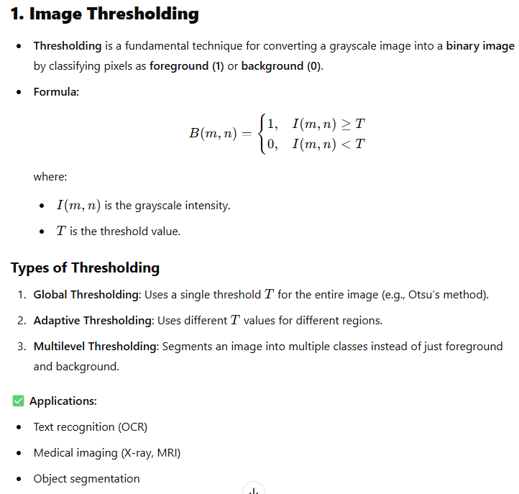
Image Thresholding

Slide 37
Region Labelling
Region labeling assigns unique labels to connected components (objects) in a binary image.
Input: A binary image with objects of interest.
Output: An image where each object has a unique label.
🔹 Example:
An image with three objects will have three unique labels (1, 2, 3).
3. Region Labeling Algorithms
3.1 Region Labeling Algorithm
The two-pass connected component labeling algorithm is commonly used for region labeling.
Algorithm:
First Pass (Assign Labels & Store Equivalence)
  Scan the image pixel by pixel.
  Assign a new label if no neighboring labeled pixels exist.
  If labeled neighbors exist, assign the smallest label and store equivalences.
Second Pass (Resolve Equivalences)
  Merge equivalent labels to ensure each connected object gets a unique label.

Slide 38
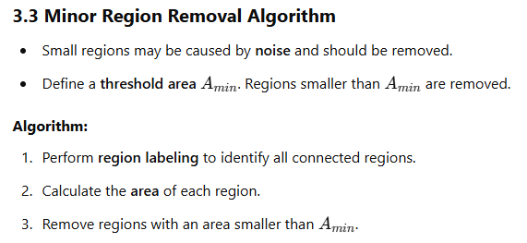
Region Labelling
3.2 Region Counting Algorithm
To count objects, we use the region labeling output and count the number of unique labels.
Algorithm:
Run connected component labeling to label objects.
Count the number of unique labels.
Output the total number of regions.

Slide 39
Binary Image Morphology
Binary Image Morphology
4.1 Logical Operations
4.2 Windows
4.3 Morphological Filters
4.4 Morphological Boundary Detection
4. Binary Image Morphology
4.1 Logical Operations
AND, OR, XOR, NOT operations are applied to binary images.
Used for image masking, segmentation, and object detection.
Example:
  AND: Intersection of two images.
  OR: Union of two images.
  XOR: Difference between images.
4.2 Windows (Structuring Elements)
Windows (structuring elements) define the neighborhood used for processing.
Common shapes: Square, Cross, Disk.
Example: A 3x3 square structuring element scans an image for morphological operations.
4.3 Morphological Filters
Erosion: Shrinks objects by removing boundary pixels.
Dilation: Expands objects by adding pixels to boundaries.
Opening (Erosion → Dilation): Removes small noise while keeping object structure.
Closing (Dilation → Erosion): Fills small holes inside objects.
4.4 Morphological Boundary Detection
Extracts object boundaries using:
  Morphological Gradient:
  Internal Boundary:
  External Boundary:

Slide 40
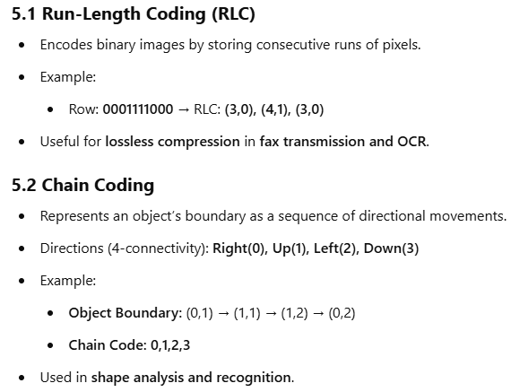
Binary Image Representation and Compression

Slide 41
Basic Linear Filtering with Applications to Image Enhancement
Introduction
2. Impulse Response, Linear Convolution, and Frequency Response
  2.1 Impulse Response
  2.2 Linear Convolution
  2.3 Frequency Response
3. Linear Image Enhancement
  3.1 Moving Average Filter
  3.2 Ideal Low-Pass Filter
  3.3 Gaussian Filter
4. Applications:

Slide 42
Basic Linear Filtering with Applications to Image Enhancement
1. Introduction
Linear filtering is a fundamental technique in image processing for smoothing, sharpening, and noise reduction.
It operates by convolving an image with a filter (kernel) to modify pixel values based on neighboring pixels.
Applications include edge detection, noise suppression, and contrast enhancement.
2. Impulse Response, Linear Convolution, and Frequency Response
2.1 Impulse Response
Describes how a filter responds to a single impulse input.
Characterizes the behavior of linear systems in the spatial domain.
2.2 Linear Convolution
is the input image, is the filter kernel, and is the filtered output.
Used for smoothing, edge detection, and feature extraction.
2.3 Frequency Response
Analyzes the effect of filtering in the Fourier domain.
Low-pass filters attenuate high frequencies (smooth images), and high-pass filters enhance edges.

Slide 43
Basic Linear Filtering with Applications to Image Enhancement
3. Linear Image Enhancement
3.1 Moving Average Filter
A simple low-pass filter that averages pixel values in a local neighborhood.
Formula:
Reduces noise but can blur edges.
3.2 Ideal Low-Pass Filter
Removes high-frequency components in the frequency domain.
Ideal cutoff frequency behavior but causes ringing artifacts.
Not realizable in spatial domain due to sharp frequency cutoff.
3.3 Gaussian Filter
A smooth, bell-shaped filter that effectively removes high-frequency noise while preserving edges.
Defined as:
Less ringing artifacts than the ideal filter and widely used in image smoothing and blurring.

Slide 44
Nonlinear Filtering for Image Analysis and Enhancement
1. Introduction
2.Weighted Median Smoothers
  2.1 Running Median Smoothers
  2.2 Weighted Median Filters
  2.3 Vector Weighted Median Filters
3. Image Noise Cleaning
4. Image Zooming
5. Image Sharpening
6. Edge Detection
What is Nonlinear Filtering?
  A class of filters that do not follow the principle of superposition.
  Often used when linear filters fail to preserve edges or details.
Applications:
  Noise removal, edge preservation, image sharpening, and zooming.
Key Concepts:
  Median filters, weighted median filters, and vector median filters.

Slide 45
Median Smoothers
Weighted Median Smoothers (2.1)
Definition:
  A generalization of the median filter where weights are assigned to each pixel in the neighborhood.
Mathematical Representation:
  Where are weights, and are pixel values.
Advantages:
  Better edge preservation compared to standard median filters.
Running Median Smoothers (2.2)
Definition:
  A sliding-window filter that replaces each pixel with the median of its neighborhood.
Steps:
  Define a window (e.g., 3x3 or 5x5).
  Sort the pixel values in the window.
  Replace the center pixel with the median value.
Applications:
  Effective for removing salt-and-pepper noise.

Slide 46
Median Smoothers
Weighted Median Filters (2.3)
Definition:
  An extension of weighted median smoothers for 2D images.
Kernel Example:
  Weights determine the influence of each pixel on the output.
Advantages:
  Preserves edges while smoothing noise.
Vector Weighted Median Filters (2.4)
Definition:
  A filter for color or multichannel images where each pixel is a vector (e.g., RGB).
Mathematical Representation:
  Where are vector pixel values, and is a distance metric.
Applications:
  Color image denoising and enhancement.

Slide 47
Median Smoothers
Image Sharpening
Objective:
  Enhance edges and fine details in an image.
Nonlinear Filtering Techniques:
  Unsharp masking with median-based preprocessing.
  Edge-preserving weighted median filters.
Advantages:
  Avoids amplification of noise.
Why Edge Detection?
Helps in feature extraction, object recognition, and segmentation.
📌 Nonlinear Edge Detection Methods:
✔️ Laplacian-based methods (enhanced by nonlinear smoothing).
✔️ Bilateral filtering before gradient computation (preserves edges while reducing noise).
✔️ Morphological edge detection (used for structured object detection).
📌 Applications:
Image segmentation, medical image analysis, and computer vision tasks.

Slide 48
Basic Methods for Image Restoration and Identification
Image restoration and identification are crucial tasks in image and video processing, aimed at improving the quality of images and identifying relevant features or objects. Below are some basic methods used in these domains:
Image Restoration
Image restoration focuses on recovering a high-quality image from a degraded version (e.g., noisy, blurred, or compressed images). Common techniques include:
Noise Reduction:
  Gaussian Filtering: Smooths the image by convolving it with a Gaussian kernel, reducing noise.
  Median Filtering: Replaces each pixel with the median of neighboring pixels, effective for salt-and-pepper noise.
  Non-Local Means (NLM): Averages similar patches in the image to reduce noise while preserving edges.
Deblurring:
  Inverse Filtering: Attempts to reverse the blurring process by dividing the Fourier transform of the degraded image by the blur kernel.
  Wiener Filtering: A more robust method that incorporates noise statistics to restore the image.
  Lucy-Richardson Deconvolution: An iterative algorithm that maximizes likelihood to estimate the original image.

Slide 49
Basic Methods for Image Restoration and Identification
Super-Resolution:
  Interpolation-Based Methods: Techniques like bilinear or bicubic interpolation to increase image resolution.
  Deep Learning-Based Methods: Convolutional Neural Networks (CNNs) are used to learn mappings from low-resolution to high-resolution images (e.g., SRCNN, ESRGAN).
Inpainting:
  Diffusion-Based Methods: Fills missing or damaged regions by propagating information from surrounding areas.
  Patch-Based Methods: Uses similar patches from the image to fill in missing regions (e.g., Criminisi's algorithm).
  Deep Learning-Based Methods: Neural networks (e.g., GANs) are trained to predict missing regions.
Compression Artifact Reduction:
  JPEG Deblocking: Reduces blocky artifacts caused by JPEG compression using filtering or deep learning.

Slide 50
Image Identification
Image identification involves detecting and recognizing objects, patterns, or features in an image. Common methods include:
Feature Detection and Extraction:
  Edge Detection: Identifies edges using operators like Sobel, Canny, or Prewitt.
  Corner Detection: Detects key points using algorithms like Harris Corner Detector or FAST.
  Scale-Invariant Feature Transform (SIFT): Extracts robust features invariant to scale and rotation.
  Speeded-Up Robust Features (SURF): A faster alternative to SIFT.
Object Detection:
  Template Matching: Compares a template image with regions of the target image to find matches.
  Haar Cascades: Uses machine learning to detect objects (e.g., faces) based on Haar-like features.
  Deep Learning-Based Methods: CNNs and architectures like YOLO (You Only Look Once), SSD (Single Shot Detector), and Faster R-CNN are widely used for object detection.

Slide 51
Image Identification
Image Classification:
  Traditional Machine Learning: Uses handcrafted features (e.g., HOG, LBP) with classifiers like SVM or Random Forest.
  Deep Learning: CNNs (e.g., ResNet, VGG, Inception) are the state-of-the-art for image classification tasks.
Segmentation:
  Thresholding: Separates objects from the background based on pixel intensity.
  Region-Based Methods: Divides the image into regions based on similarity (e.g., region growing).
  Edge-Based Methods: Uses edge detection to identify object boundaries.
  Deep Learning-Based Methods: U-Net, Mask R-CNN, and other architectures are used for semantic and instance segmentation.
Optical Character Recognition (OCR):
  Traditional Methods: Use feature extraction and pattern matching to recognize text.
  Deep Learning-Based Methods: Models like Tesseract, CRNN, and Transformer-based architectures are used for text recognition.

Slide 52
Image Identification
Video Processing
Video processing extends image processing techniques to sequential frames. Key methods include:
Motion Estimation and Compensation:
  Optical Flow: Estimates the motion of objects between consecutive frames.
  Block Matching: Finds motion vectors for blocks of pixels between frames.
Video Restoration:
  Temporal Filtering: Uses information from multiple frames to reduce noise or artifacts.
  Video Super-Resolution: Enhances video resolution using spatial and temporal information.
Object Tracking:
  Kalman Filter: Predicts the position of objects over time.
  Mean-Shift Algorithm: Tracks objects based on color histograms.
  Deep Learning-Based Methods: Siamese networks and other architectures are used for robust tracking.

Slide 53
Image Identification
Activity Recognition:
  Traditional Methods: Use handcrafted features (e.g., HOG, optical flow) with classifiers.
  Deep Learning-Based Methods: 3D CNNs, RNNs, and Transformer-based models are used to recognize activities in videos.

Slide 54

Introduction to Blur Models
Blur models describe different types of image degradation caused by motion, focus issues, or atmospheric effects.
Understanding blur models is essential for effective image restoration.
Common blur models include:
  No Blur
  Linear Motion Blur
  Uniform Out-of-Focus Blur
  Atmospheric Turbulence Blur
2.1 No Blur
Definition: An ideal scenario where an image is captured without any distortion or degradation. The ideal case where the image is not degraded by any blurring effects. The observed image g(x,y)is identical to the original image f(x,y).
Characteristics:
  Retains all spatial frequencies.
  Sharp edges and fine details are preserved.
  Point Spread Function (PSF) is an impulse function (a single point remains a point).
Practicality: Completely blur-free images are rare due to real-world factors.

Slide 55
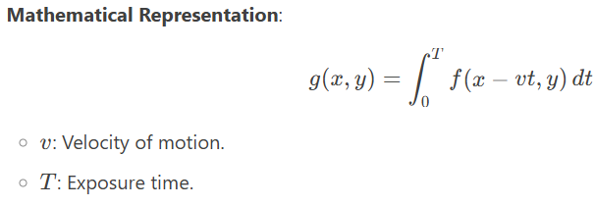
Introduction to Blur Models
2.2 Linear Motion Blur
Definition: Occurs when there is relative motion between the camera and the subject during exposure.
Characteristics:
  Image smearing happens along the direction of motion.
  PSF – Point Spread Function is modeled as a line segment with intensity distributed uniformly along its length.
Causes:
  Handheld camera movement.
  Fast-moving objects during long exposure.
Restoration Approach:
  Motion estimation (length and angle detection).
  Deconvolution techniques.

Slide 56
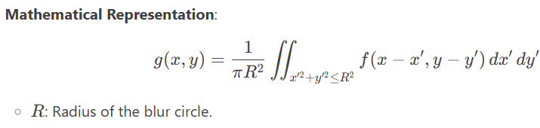
Introduction to Blur Models
3 Uniform Out-of-Focus Blur
Definition: Blur resulting from an improperly focused imaging system.
Characteristics:
  PSF modeled as a uniform disk with a specific radius.
  Each point in the image spreads out evenly in all directions.
  Causes loss of high-frequency details.
Causes:
  Camera lens not focused correctly.
  Depth of field issues.
Restoration Approach:
  Deconvolution methods using a known PSF.
  Applying inverse filtering techniques.

Slide 57
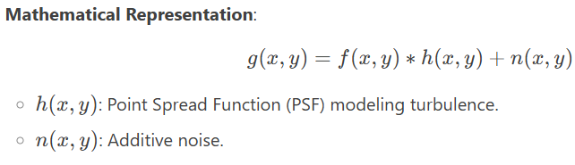
Introduction to Blur Models
2.4 Atmospheric Turbulence Blur
Definition: Blur caused by variations in the refractive index of the atmosphere, especially in long-distance imaging.
Characteristics:
  Random spatial and temporal distortions.
  PSF is typically modeled as a Gaussian function.
  Degrades image contrast and sharpness.
Causes:
  Heat waves.
  Air turbulence in high-altitude imaging.
Restoration Approach:
  Adaptive filtering techniques.
  Multi-frame averaging to counteract distortions.

Slide 58
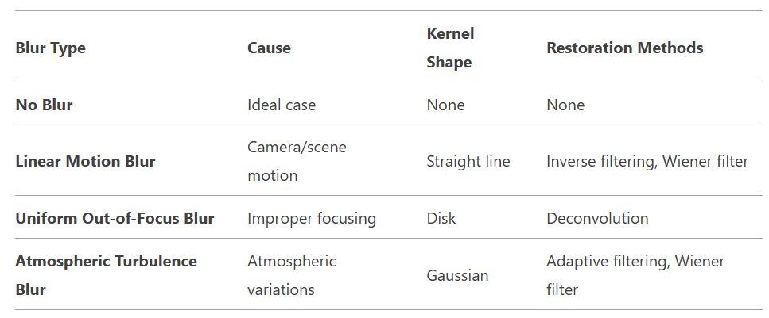
Summary of Blur Models

Slide 59
Applications and Challenges
Applications:
  Medical imaging, satellite imaging, surveillance, and photography.
Challenges:
  Accurate estimation of the blur kernel (PSF).
  Handling noise and artifacts during restoration.
  Computational complexity of advanced restoration methods.

Slide 60
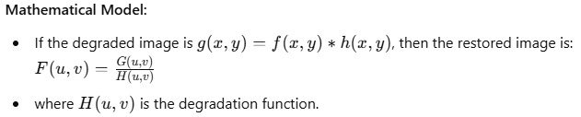
Introduction to Image Restoration
Introduction to Image Restoration
Image restoration aims to recover a high-quality image from a degraded version.
It attempts to reverse known distortions, such as blur, noise, and other artifacts.
Common restoration techniques:
  Inverse Filtering
  Least-Squares Filters
  Iterative Filters
  Boundary Value Problem
3.1 Inverse Filter
Definition: A technique that attempts to recover the original image by directly inverting the degradation function.

Slide 61
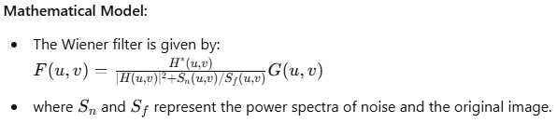
Applications and Challenges
Limitations:
  Highly sensitive to noise.
  Works best when the degradation function is well known.
Applications: Used in scenarios where noise is minimal and the blur function is well defined.
3.2 Least-Squares Filters
Definition: A restoration approach that minimizes the mean squared error between the restored and the original image.
Types:
  Wiener Filter: Balances inverse filtering with noise reduction.
Advantages:
  More robust to noise than inverse filtering.
  Provides a trade-off between noise suppression and image sharpness.
Applications: Used in medical imaging, astronomy, and remote sensing.

Slide 62
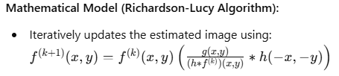
Applications and Challenges
3.3 Iterative Filters
Definition: These filters refine the image restoration process by iterating toward an optimal solution.
Common Techniques:
  Richardson-Lucy Deconvolution
  Landweber Iteration
Advantages:
  Handles complex degradations.
  Suitable for Poisson noise and low-light conditions.
Applications:
  Used in astronomy, microscopy, and computational photography.
3.4 Boundary Value Problem
Definition: A restoration method that accounts for image boundaries to reduce artifacts.
Challenges:
  Image degradation is often influenced by edge effects.
  Incorrect handling leads to ringing and loss of information.

Slide 63
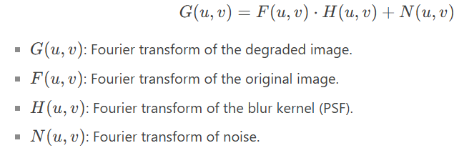
Blur Identification Algorithms
Blur Identification Algorithms
Blur identification is the process of estimating the blur kernel (Point Spread Function, PSF) from a degraded image.
Essential for effective image restoration.
Two key methods:
Spectral Blur Estimation
Maximum-Likelihood Blur Estimation
4.1 Spectral Blur Estimation
Definition:
  Estimates the blur kernel by analyzing the frequency domain (Fourier transform) of the degraded image.
  Assumes the blur kernel has distinct spectral characteristics.
Mathematical Representation:
  Degraded image in frequency domain:

Slide 64
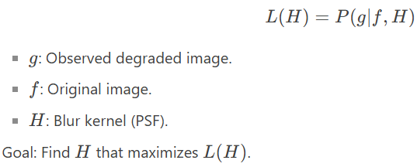
Blur Identification Algorithms
Steps:
  Compute the Fourier transform of the degraded image.
  Identify periodic patterns or zeros in the spectrum caused by the blur kernel.
  Estimate H(u,v)H(u,v) from the spectral characteristics.
Advantages:
  Computationally efficient.
  Works well for blurs with distinct spectral signatures (e.g., motion blur).
Limitations:
  Sensitive to noise.
  Requires prior knowledge of blur type.
4.2 Maximum-Likelihood Blur Estimation
Definition:
  Estimates the blur kernel by maximizing the likelihood of the observed image given the original image and blur model.
  Iterative approach to refine the blur kernel estimate.
Mathematical Representation:
  Likelihood function:

Slide 65
Blur Identification Algorithms
Steps:
  Initialize an estimate of the blur kernel HH.
  Compute the likelihood of the observed image given HH.
  Update HH iteratively to maximize the likelihood.
  Stop when convergence is achieved.
Advantages:
  Robust to noise.
  Can handle complex blur kernels.
Limitations:
  Computationally intensive.
  Requires an initial estimate of the blur kernel.

Slide 66
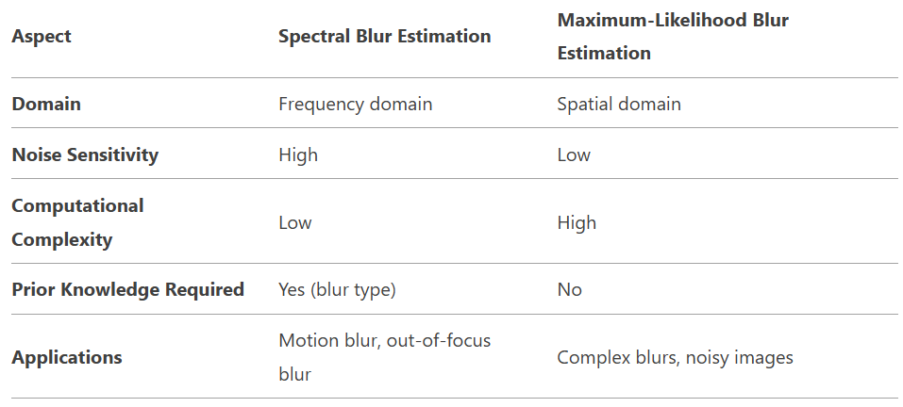
Comparison of Spectral and Maximum-Likelihood Methods

Slide 67
Blur Identification Algorithms
Applications and Challenges
Applications:
  Medical imaging (e.g., MRI, CT scan restoration).
  Satellite and aerial imaging.
  Forensic analysis and surveillance.
Challenges:
  Accurate estimation of the blur kernel in the presence of noise.
  Computational complexity for large images.
  Handling spatially varying blurs.
Summary
Spectral Blur Estimation:
  Works in the frequency domain.
  Efficient but sensitive to noise.
Maximum-Likelihood Blur Estimation:
  Iterative spatial domain approach.
  Robust but computationally intensive.
Both methods are essential for effective image restoration and are chosen based on the specific application and constraints.

Slide 68
Applications and Challenges
Approaches:
  Padding methods (zero-padding, symmetric padding)
  Extrapolation techniques
Mathematical Approach:
  Formulates restoration as a constrained optimization problem.
  Often solved using Partial Differential Equations (PDEs).
Applications:
  Used in super-resolution, tomography, and scientific imaging.

