Slide 1
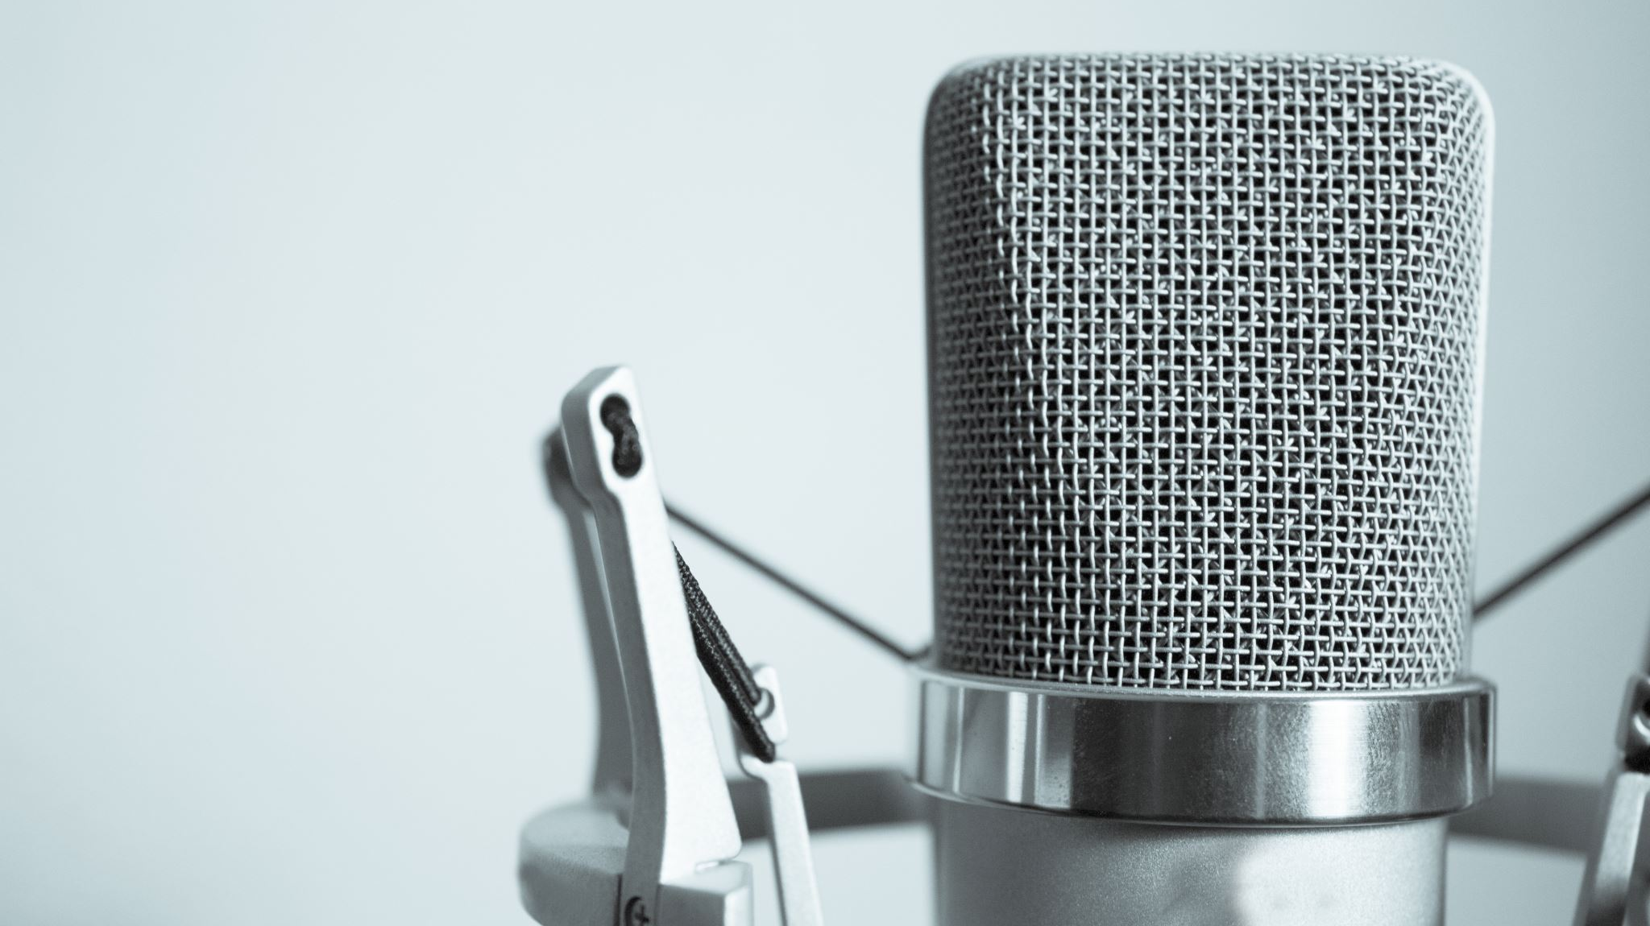
PERSONAL VOICE ASSISTANT
G.SAMANTH-2010030272
G SAITEJA -2010030055
MD.ADNAN-2010030236
K.TRIBHUVAN-2010030402

Slide 2
Introduction
A voice assistant is a digital assistant that uses voice recognition, language processing algorithms, and voice synthesis to listen to specific voice commands and return relevant information or perform specific functions as requested by the user.
Virtual Assistants are software programs that help you ease your day to day tasks, such as showing weather report, creating reminders, making shopping lists etc. They can take commands via text (online chat bots) or by voice. Voice based intelligent assistants need an invoking word or wake word to activate the listener, followed by the command.
This system is designed to be used efficiently on desktops. Personal assistant software improves user productivity by managing routine tasks of the user and by providing information from online sources to the user.

Slide 3
PROBLEM STATEMENT
We already have multiple virtual assistants. But we hardly use it. There arenumberof people who have issues in voice recognition. These systems can understand English phrases but they fail to recognize in our accent. Our way of pronunciation is way distinct from theirs. Also, they are easy to use on mobile devices than desktop systems. There is need of a virtual assistant that can understand English in Indian accent and work on desktop system.

Slide 4
OBJECTIVES
Main objective of building personal assistant software (a virtual assistant) is using semantic data sources available on the web, user generated content and providing knowledge from knowledge databases.
The main purpose of an intelligent virtual assistant is to answer questions that users may have. This may be done in a business environment, for example, on the business website, with a chat interface. Virtual assistants can tremendously save you time. We spend hours in online research and then making the report in our terms of understanding.

Slide 5
techniques
System Architecture
System Components- I. IoT Box II. Firebase cloud server
Data Flow Sequence

Slide 6
conclusion
Voice Controlled Personal Assistant System will use the Natural language processing and can be integrated with artificial intelligence techniques to achieve a smart assistant that can control IoT applications and even solve user queries using web searches.. It can be designed to minimize the human efforts to interact with many other subsystems, which would otherwise have to be performed manually.

Slide 7


References
V. G.Bohouta, "Comparing speech recognition systems," International journal, 2017.
D.Yulli, "Using voice assistant skills," International journal, 2019.
J. F. Hill, "Real conversations with artificial intelligence," International journal, 2015.
Algou+, "Voice assistant," World journal of education, 2016.
"Dillon T," International journal, 2018.
H. j, "Extracting chatbot knowledge from assistant," International journal, 2007

