Slide 1

PY-Phishing
Team MEMBERS:
Gilla Samanth-2010030272
Gande Saiteja-2010030055
Cheethirala Varun-2010030031

Slide 2

Introduction
A phishing attack is a category of cyber attack in which malicious actors send messages pretending to be a trusted person or entity. Phishing messages manipulate users, causing them to perform actions like installing malicious files, clicking harmful links, or divulging sensitive information such as account credentials.

Slide 3
How Does a Phishing Attack Work?
Planning: Phishers decide which business to target and determine how to get e-mail addresses for the customers of that business. They often use the same mass-mailing and address collection techniques as spammers.
Setup: Once they know which business to spoof and who their victims are, phishers create methods for delivering the message and collecting the data. Most often, this involves e-mail addresses and a Web page.
Attack: This is the step people are most familiar with -- the phisher sends a phony message that appears to be from a reputable source.
Collection: Phishers record the information victims enter into Web pages or popup windows.
Identity Theft and Fraud. The phishers use the information they've gathered to make illegal purchases or otherwise commit fraud. As many as a fourth of the victims never fully recover

Slide 4
Types of Phishing Attacks?
Email phishing scams
Spear phishing

Slide 5
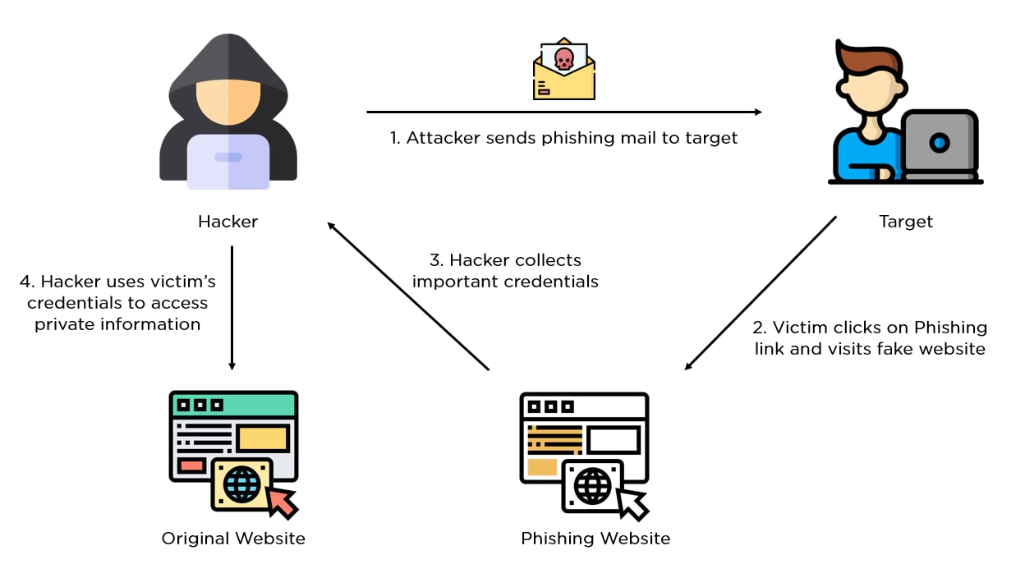
Control FLOW
.

Slide 6
How to Prevent Phishing?
Two-factor authentication (2FA) is the most effective method for countering phishing attacks, as it adds an extra verification layer when logging in to sensitive applications. 2FA relies on users having two things: something they know, such as a password and user name, and something they have, such as their smartphones. Even when employees are compromised, 2FA prevents the use of their compromised credentials, since these alone are insufficient to gain entry.

Slide 7
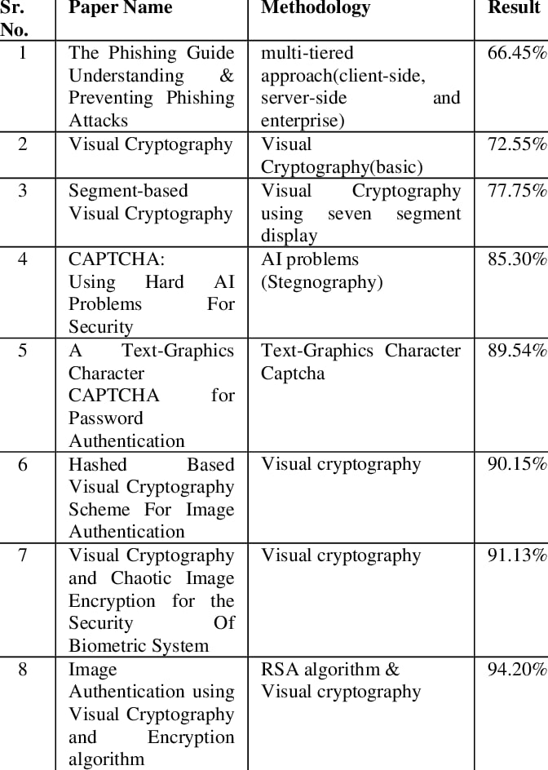
literature survey

Slide 8
Installation
sudo apt install –y php
git clone https://github.com/KasRoudra/PyPhisher
cd PyPhisher
python3 pyphisher.py

Slide 9
Requirements
Python3
Rich Module
PHP
Cloudflare
Ngrok
900MB storage

Slide 10
Steps:
Run
Run the script
Choose
Choose a Website
Wait
Wait sometimes for setting up all
Send
Send the generated link to victim
Wait
Wait for victim login. As soon as he/she logs in, credentials will be captured.

Slide 11
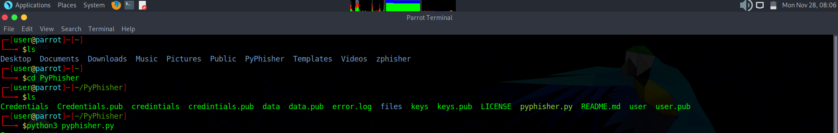
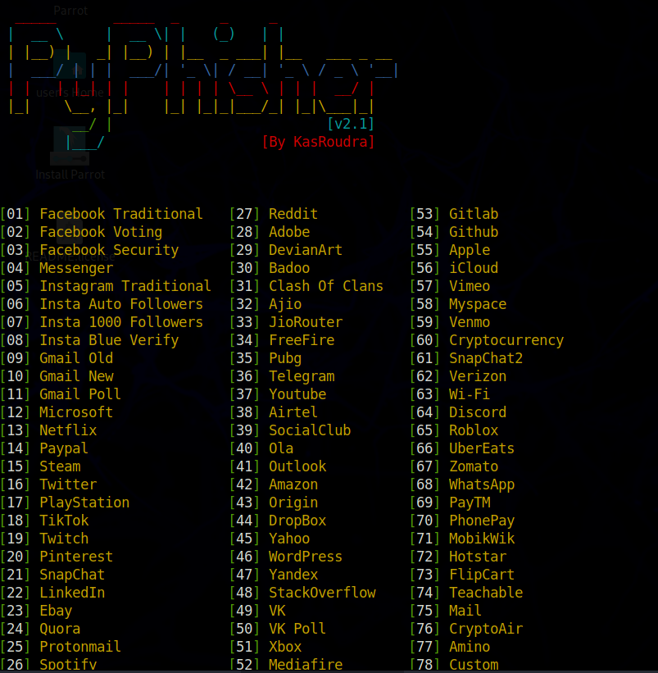
Implementation

Slide 12
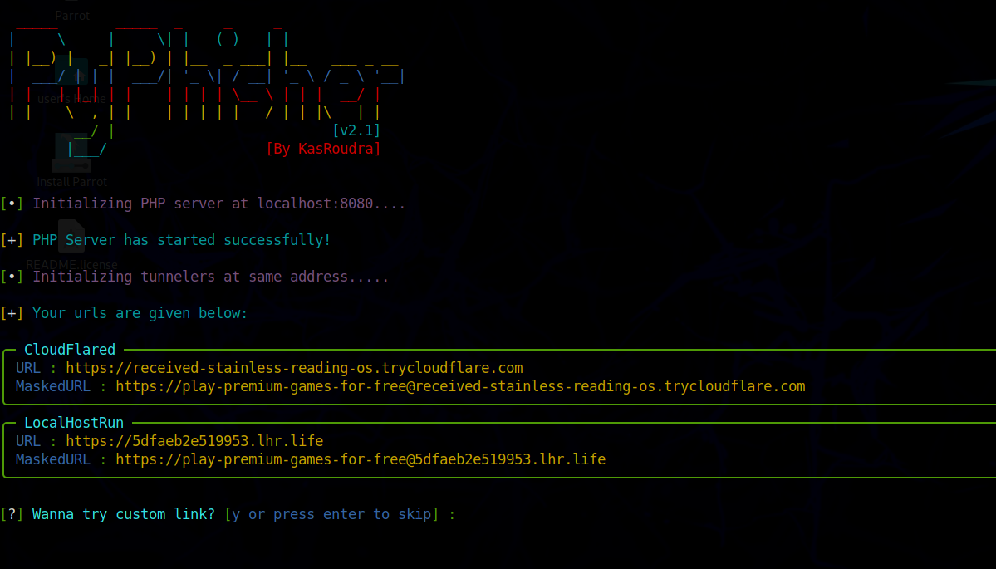
Results

Slide 13
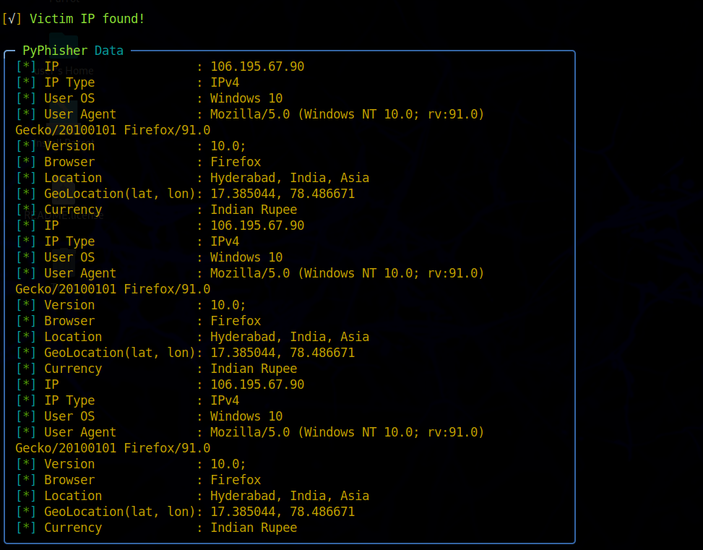
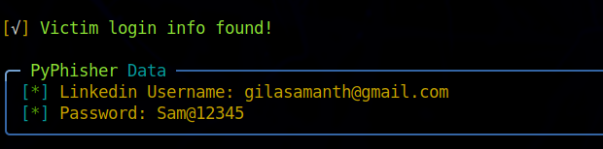
RESULTS

Slide 14
Conclusion
Phishing is a form of criminal conduct that poses increasing threats to consumers, financial institutions, and commercial enterprises in Canada, the United States, and other countries. Because phishing shows no sign of abating, and indeed is likely to continue in newer and more sophisticated forms, law enforcement, other government agencies, and the private sector in both countries will need to cooperate more closely than ever in their efforts to combat phishing, through improved public education, prevention, authentication, and binational and national enforcement efforts.

Slide 15

THANK YOU

