Slide 1
GNU Emacs
Creeping Featurism Is a Strength!

Slide 2
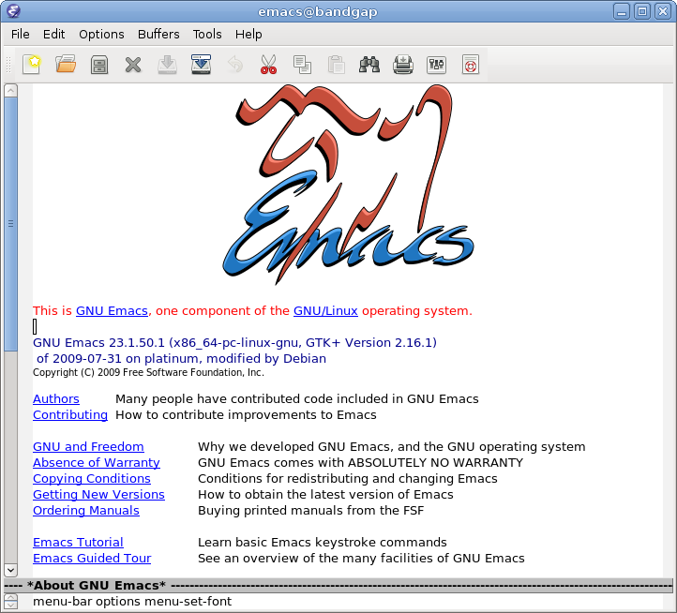

Slide 3
GNU Emacs : Overview
A text editor aging 24 years that is
Extensible
Customizable
Self-documenting
Real-time
Portable

Slide 4
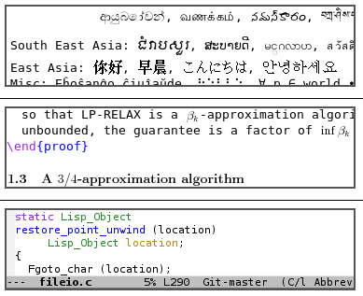
GNU Emacs : Use
Multiple language / markup support

Slide 5
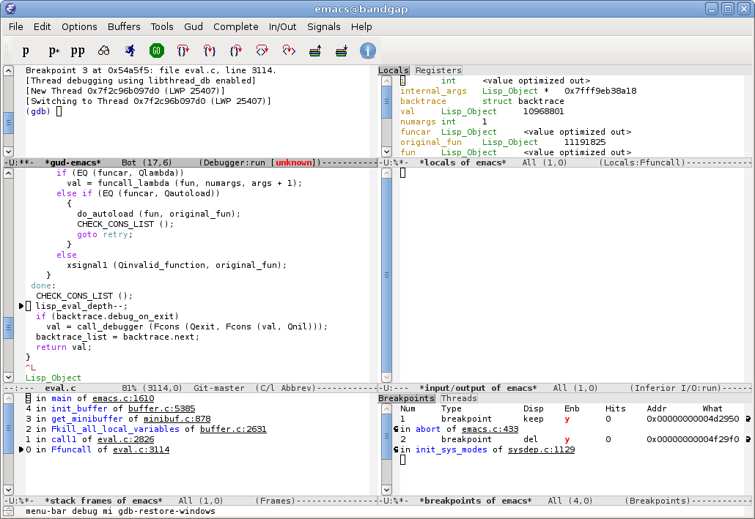
GNU Emacs : Use
Integrated IDE

Slide 6
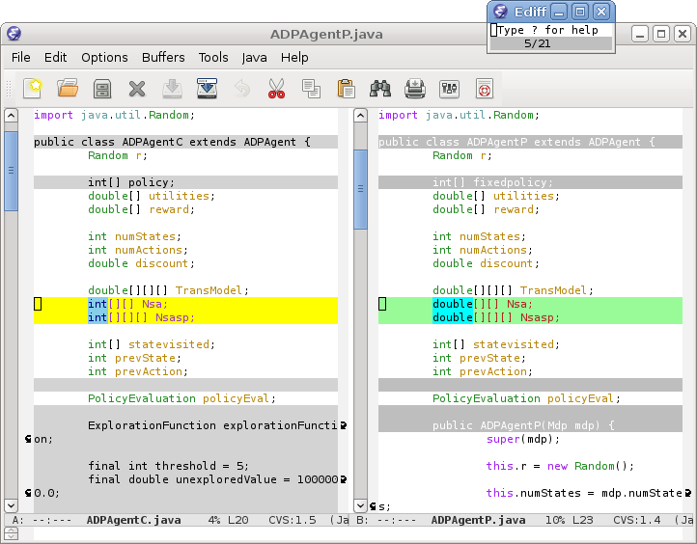
GNU Emacs : Use
Diff Viewer

Slide 7
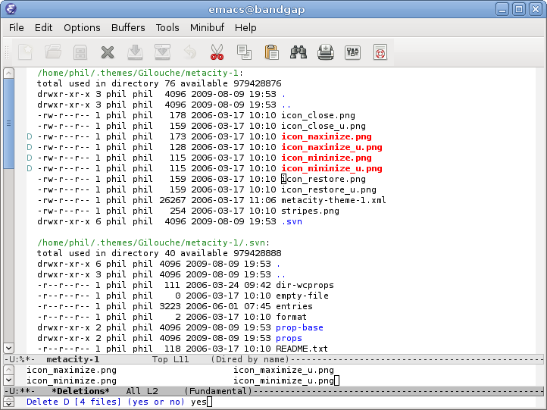
GNU Emacs : Use
File Manager

Slide 8
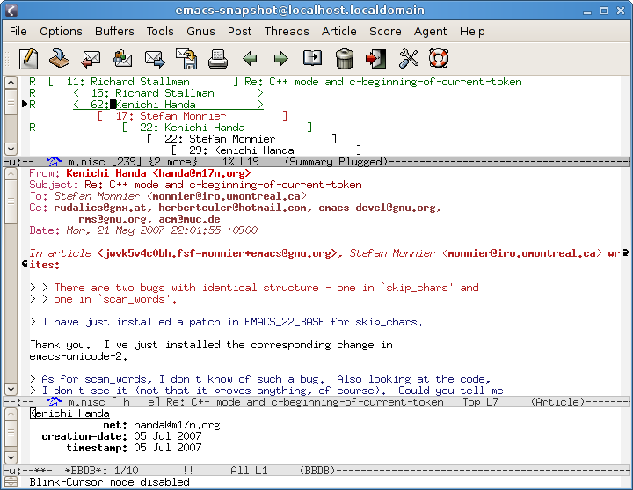
GNU Emacs : Use
Mail and News Reader

Slide 9
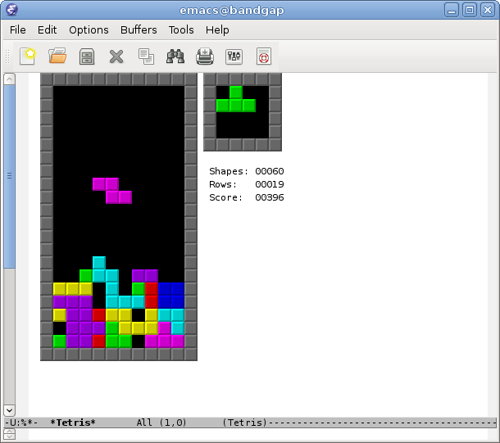
GNU Emacs : Use
Tetris Game !!!

Slide 10
GNU Emacs : Backend
1.1 million lines of Emacs Lisp code
Elisp has no module system – organized by naming conventions
Emacs flouts almost every accepted useful and valuable software engineering principle
Code developed by hundreds of people aging 24 years
But it works, and works well!

Slide 11
GNU Emacs : What you see
Frames
The windows of the Emacs interface
Windows
Subdivision of frames, used for opening multiple buffers on the same frame
Buffers
Any editable text in Emacs resides in a buffer (e.g. file listings in the file manager)
A powerful feature of Emacs
Allows using data of one buffer in another

Slide 12

GNU Emacs : Architecture
Model-View-Controller Architecture
Model
Underlying textual data being manipulated
View
Displays textual data to user
Controller
Takes user interactions (keystrokes, mouse gestures, etc.)
Written almost entirely in LISP
Interestingly, the redisplay code (view) and buffer implementation (model) code can not by customized by LISP

Slide 13
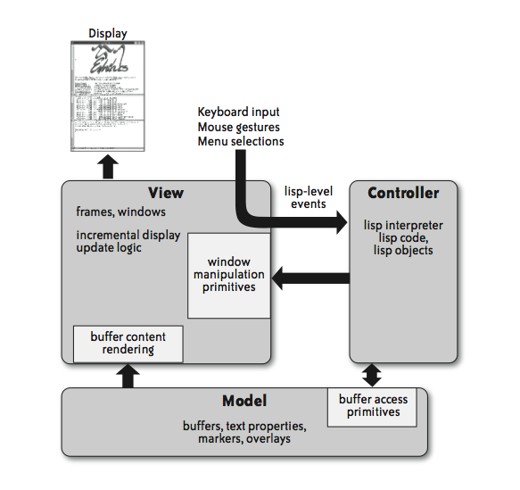
GNU Emacs : Architecture

Slide 14
GNU Emacs : Model
Buffers
Holds text and provides multiple mode of editing (C, XML, etc.)
Text properties
Attached to characters in buffer
Specifies how Emacs displays text, and customizes user interaction
Markers
Floating pointers to track text in the buffer during change
Overlays
Stretch of text in a buffer to define customized display and behavior for the range

Slide 15
GNU Emacs : View
Emacs Redisplay Engine
Displays updates automatically
Controller (Lisp) does not need to invoke the update
The display engine efficiently draws the final state of the Model
Updates display only when waiting for user input
Puts off updating display until it needs to pause for user input
Refresh screen during the pause
Lisp programmers are relieved from dealing with user interface updates

Slide 16
GNU Emacs : Controller
Emacs Lisp
Lisp is an interactive, complete programming language.
Requires very little setup– small customizations and extensions are as easy as one line expressions
Emacs Lisp extensions are first-class citizens – provides all primitive libraries and functions Emacs itself uses
Emacs Lisp is safe – a bad extension will not crash the editor
No module system – all functions are global

Slide 17
Emacs : Creeping Featurism
Extremely easy to build a new extension for personal use
Evolves to a distributable set of commands
Distribute as patches
Challenges
Maintainers need to select most popular well-developed packages
Too many packages can make user interface too complex
Program becomes difficult to maintain

Slide 18
Emacs : Creeping Featurism
Simple Model
Buffer is simply a string of characters
Command-set (Interface)
Recognizes around 2,400 commands and 700 key bindings
Improved visibility – unused commands not displayed
Advanced features available to those who know they exist!
Explore commands using the apropos family of commands
Think of spotlight in mac
Commands use the same interface to prompt for user input

Slide 19
Emacs : Creeping Featurism
Maintainability
More code and developers – harder to maintain
Lisp package authors are requested to maintain it until enough maintainers gather
Distribution of Maintenance
Community of self-directed developers pursuing their own ends
A selection process integrates a release

Slide 20
Emacs : Architectural Advantages
Emacs Lisp insulates code from underlying processor architecture
Implementation of the Emacs core, buffers and redisplay engine decoupled from the LISP controllers

Slide 21
Emacs vs Eclipse
Eclipse – a framework for plugins
Eclipse plugins have low-level control over model and views
Eclipse plugins are unsafe
Developing plugins for eclipse is more complex
Emacs extension system wins over eclipse through separation of concerns and a safe and simpler model

Slide 22
Emacs vs Firefox
Firefox interpreting JavaScript – Emacs interpreting Lisp
Model is DOM
View rendered by Firefox
JS manipulates DOM (Lisp modifying buffers)
Firefox renders the view automatically (redisplay engine)
Firefox plugins still requires significant boilerplate code
Lisp provides excellent way to add new features to Emacs – JS may play that role for Firefox

Slide 23
For Emacs, creeping featurism is a strength

Slide 24
Discussion Questions
In BA11 Emacs, the author discusses the positive aspects of building Emacs from Lisp, what is the flipside of that? Are there any drawbacks/limitations caused by Lisp?
Why has the architecture of Emacs changed so little over time?
The author states that the barrier to entry to extension development for Emacs is low. Would it be lower if it were implemented in a language other than Emacs Lisp?
Do you think Emacs has the usability attribute for the developers?
Although there are some other text editors that has the good user interface, why do think people use Emacs?
In the discussion of Emac’s maintainability, it is mentioned that there is a group of people who co-ordinate to maintain the entire system. When/What is the correct choice of delegating tasks to a group of people?

Slide 25
Thank You

