Slide 1
NINJA
Samir Hasan

Slide 2
Introduction
A build system
Built in 2010 for building Google Chrome on Linux
Primary goal : Speed
Do less work to perform faster
Painfully simple design → superior speed

Slide 3
Ninja vs Make
 | Make | Ninja
Features | Lot of features | Just enough to get builds done
Language | Make’s language files are modifiable by humans | Ninja build files too simple – inconvenient for humans; generate by tools
Workflow | Make is more like a compiler | Ninja is like an assembler
Speed | ~ 10 sec to build Chromium browser project * | Build time is under 1 sec *
* Reference: http://martine.github.io/ninja/manual.html#_comparison_to_make

Slide 4
Design Goals
Very fast (i.e., instant) incremental builds, even for very large projects.
Very little policy about how code is built.
e.g. should objects live alongside the sources or rather reside in a separate directory?
Get dependencies correctly and efficiently
When convenience and speed are in conflict, prefer speed.

Slide 5
Ninja Workflow
Other Build Systems
Build File Generator
Build rules loader
Build command organizer
Command Executor
Ninja
Build File Generator (GYP)
Build rules loader
Build command organizer
Command Executor

Slide 6
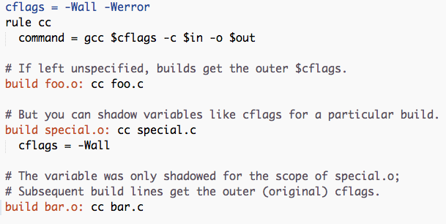
Ninja Build File
build.ninja:

Slide 7
Ninja Build File
Parsed into a (bipartite) dependency graph
Input and output files → Nodes
Build commands → Edges
Build a Plan
Set of edges to be executed to bring target up to date
Execute the Plan
Walk down the graph and check off edges on completion of the corresponding command

Slide 8
Optimizations
Parsing
Canonicalization
Build Log
Dependency Files
Build Execution

Slide 9
Optimizations: Parsing
Started with a simple hand-written lexer and a recursive descent parser
Eventually replaced by re2c – the lexer generator used by PHP
Faster parsing

Slide 10
Optimizations: Canonicalization
foo/../bar.h == bar.h
Ninja uses Node objects instead of strings to identify paths
Two paths are equal → compare two Node pointers
Nodes can be reused when the same path is queried again
Improves performance (no disk check)
Ninja does a lot of path processing – a hot point in profiles

Slide 11
Optimizations: Build Log
Structural optimization
Records full commands carried out by Ninja during build
The first build generates the build log
Subsequent Ninja builds loads the build log
Compare new build’s commands to those in the log
Only if a change is detected, execute the command
Improves the performance of subsequent builds dramatically
Further optimizations – keep only the hash of the command in the log
Compare hashes to detect changes
Reduced log size from 200MB to 2MB, and became 20 times faster

Slide 12
Optimizations: Dependency Files
Head scanner – extract dependencies at build time
Slow, difficult when #ifdef directives are present
Report all dependencies and headers in build files
cumbersome for developers
Better approach – use compile-time output of gcc
Headers used to build the output
Dependencies can be tracked after the first build

Slide 13
Optimizations: Build Execution
Ninja runs build commands in parallel by default
Depends on the # CPUs available
Buffers all outputs from commands
The resulting output appears as if the commands ran serially
Ninja feels fast

Slide 14
Discussion
What does Ninja give up in order to achieve high performance?
The Ninja author makes mention of the feeling of speed from the perspective of the user several times during the paper. Is the illusion of performance as valuable as performance itself? How can the illusion of performance be granted to the user when higher performance is unlikely or impossible?
What factors play into the adoption of projects like Ninja for alternate purposes and projects? Is this a fallout of high quality due to architectural soundness?
The obvious decision to simplify work and delegating expensive tasks to CMake and GYP helped Ninja improve its performance. What are possible disadvantages/drawbacks to this decision?
Is there any dependency that your operating system should have before building ninja in your system or can we easily build it?

