Slide 1
The NoSQL Ecosystem
Samir Hasan

Slide 2
Outline
Introduction
Preliminary Ideas
SQL and Relational Model vs NoSQL
Characteristics of NoSQL
NoSQL Data and Query Models
Important Characteristics
Data Durability
Scaling for Performance
Consistency

Slide 3
Introduction
Not a tool itself
Set of complimentary tools
Alternative to SQL based RDBMS for storing data
More of an architect’s choice

Slide 4
SQL in Use
SQL defines what to do for the system, not how to do it
RDMBS uses query optimizer for this
The relational data model maps entities to tables
Problems:
Can’t accurately predict cost of workload
Strict schemas – too restrictive for less structured data
Scalability issues when capacity requirements rise

Slide 5
Early Roots
Inspired by:
Google’s BigTable
Amazon’s Dynamo
NoSQL Systems:
Hbase – borrows from BigTable
Voldemort – borrows from Dynamo
Cassandra – borrows from both BigTable and Dynamo

Slide 6
NoSQL Characteristics
Simple API for data operations
Allows architect to analyze query performance
Complex queries are handled by the application developer
Compromises transactional semantics for performance
Ensures consistency, durability, scalability

Slide 7
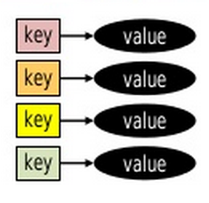
Data and Query Models
Key-based Data Models
Key-Value stores
key mapped to arbitrary data
Key-Data Structures stores
Values are typed elements such as integers or strings, or data structures like list and set
Key-Document Stores
Key maps to structured document – JSON or XML

Slide 8
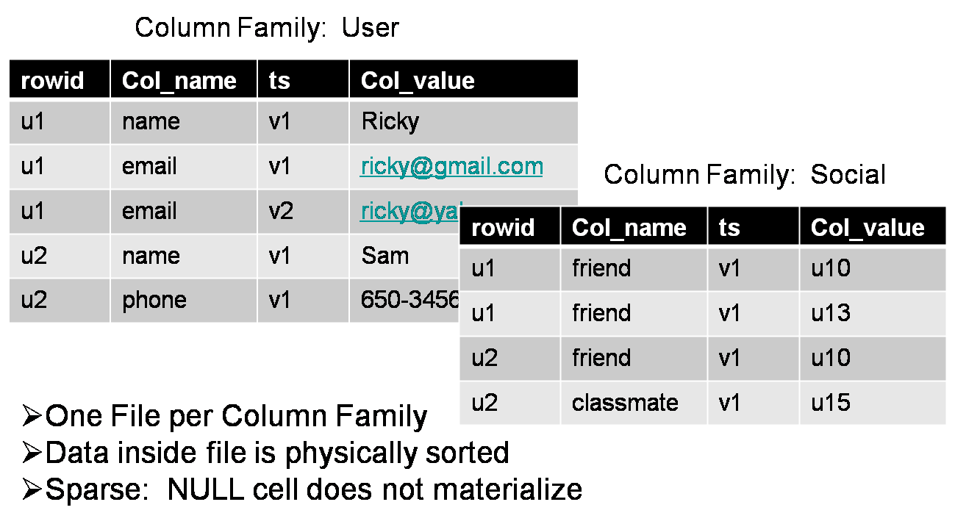
Data and Query Models
BigTable Column Family Stores
Key identifies a row of data stored in one or more Column Families (CF).

Slide 9
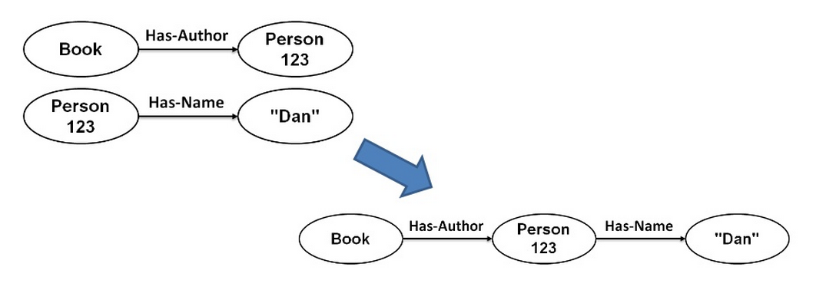
Data and Query Models
Graph Based Storage
Data is stored in a series of nodes, relationships and properties
Queries are usually graph traversals
Ideal when relationships between data is the key – social networks, e.g.

Slide 10
What about complex queries?
NoSQL provides simple a lookup-based interface
Actual implementations add features on top
MongoDB – a high-level language for data retrieval
BigTable -- scanners to iterate over a column family and filter over a column
Most of the NoSQL implementations provide bindings to Hadoop or other MapReduce frameworks for dataset-scale analytical queries

Slide 11
Transactions in NoSQL
Transactions hurt performance
NoSQL prioritizes performance over transactional semantics
Only makes sure two operations on the same key are serialized
The application developer should ensure transactional semantics of the program
Exception – Redis can carry out multiple operations in an atomic batch process

Slide 12
Schema-free Storage
Supports unstructured data
Can modify on-the-fly
Improves performance and modifiability
The application developer is responsible for maintaining the desired structure

Slide 13
Data Durability
Are all data modifications persisted?
Durability is in tension with Performance
Replication/Backup is expensive
Single-server Durability
Multi-server Durability

Slide 14
Single Server Durability
Ensures data modification survives a server restart or power loss
Involves writing the changes to the disk in a single server machine
Affects performance of other processes / OS
Strategies – using fsync cleverly:
Control fsync frequency
Increase Sequential Writes by Logging – use the log file to reorder writes wrt. write location on the disk
Grouping Writes – a single (group) commit for multiple writes to increase throughput but hurting latency

Slide 15
Multi-server Durability
Hard-drives and machines WILL fail
Master-slave approach
All operations on master is sent to the slave in log-like fashion
Slave executes the same operations, can therefore backup the master when that fails
MongoDB and HDFS automatically replicates data
Riak, Cassandra,Voldemort allows choosing the replication factor
Rack-aware configurations for data-center wide failures

Slide 16
Scaling for Performance
Sharding
Splitting read and write workloads across multiple machines
Key-based – key identifies where the splits are located
Sharding adds complexity
Strategies for read-heavy workloads:
Read replicas – replicate data on multiple machines, write and read on different machines
Cache – Memcached running on the memory of multiple servers

Slide 17
Scaling for Performance
Strategies for write-heavy workloads:
Coordinators – proxies for NoSQL implementations that distribute workload based on key

Slide 18
Scaling for Performance
Partitioning Strategies
Where to place a key-value pair?
Hash Partitioning
Hash on keys to distributes key-value pairs among multiple servers
Distributed Hash Tables (DHT)
Range Partitioning
BigTable implementation

Slide 19
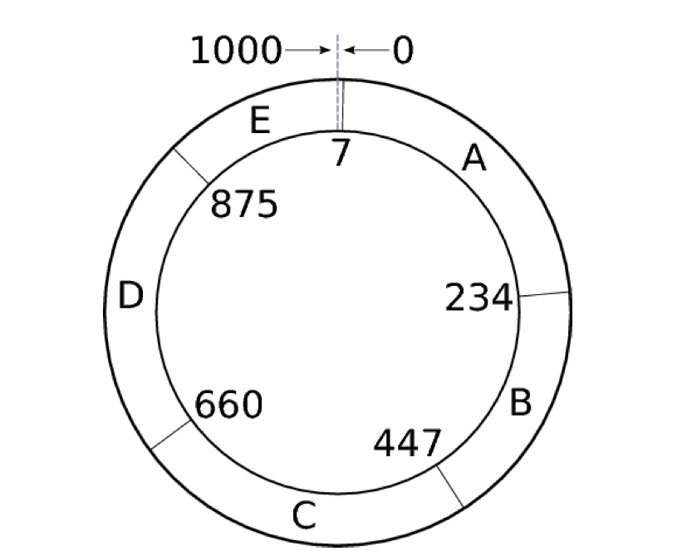
Hash Partitioning
L = 1000
H(A) % L = 7
H(B) % L = 234
H(C) % L = 447
H(D) % L = 660
H(E) % L = 875
Distributed Hash Table Ring

Slide 20
Hash Partitioning
Replicating Data
Pass keys and values for an assigned range to the servers following it in the ring
Better Distribution
The key-space may not be uniform
Use virtual nodes in each physical machine
Each virtual node hashes to a different value

Slide 21
Range Partitioning
Split keyspace into ranges
Each key-range is managed by one machine and replicated
Range-to-server mappings are stored as metadata
Provides fine-grained control for load-balancing
Adds complexity and architectural elements

Slide 22
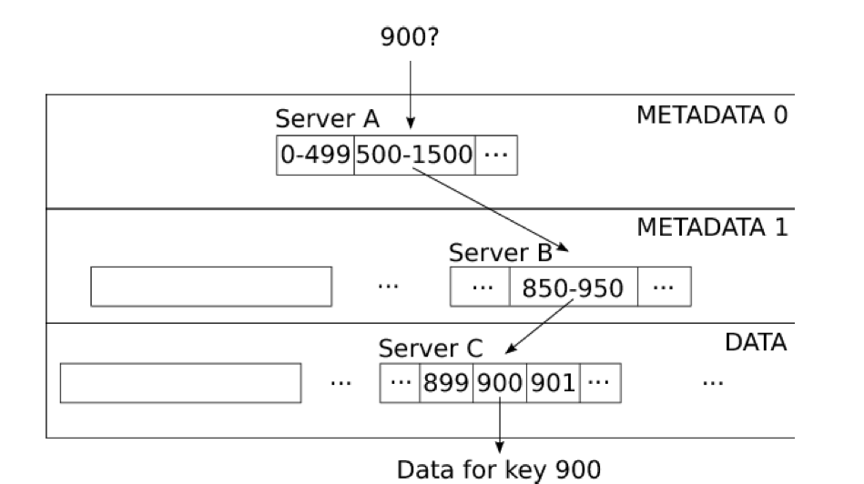
Range Partitioning in BigTable
Metadata can itself grow to be very large
Three layer hierarchy traversal for finding the machine corresponding to a key

Slide 23
Range vs Hash Partitioning
Hash partitioning
Reasonable distribution of data
Simple routing – clients can directly locate the appropriate server
Range Partitioning
Range scans over the keys are efficient
Can load-balance in heavy workload conditions

Slide 24
Consistency
Are all replicas the same?
Strong Consistency
Replicas always remain in sync
Eventual Consistency
Replicas may get out of sync but eventually catch up with one another
Appropriate choice for distributed systems

Slide 25
Strong Consistency
All replicas must agree on the data before user sees it
Coordinator records
N replicas
W replicas confirm writes/updates
R replicas responded on with same data on retrieval request
Strongly Consistncy → R + W > N
Common choice → R + W = N + 1
Timeout/Error when condition not met

Slide 26
Eventual Consistency
Temporarily inconsistent → Eventually consistent
Detecting conflicts
Versioning with vector clocks – (N_A, N_B, N_C) for replicas A, B and C.
On every access to the replica, the corresponding counter is incremented
Conflict resolution – responsibility of the application developer

Slide 27
Eventual Consistency
Optimizations
Read repair
fix the conflicting replicas in asynchronously
Hinted handoff
Replicas irresponsive to write request are replaced by backup nodes
Failed node resumes when back alive
Anti-Entropy
Copy only the out-of-sync range of keys for bandwidth optimization
Gossip
Exchange of known health information between all nodes

Slide 28
Designing NoSQL Systems
Consider requirements for
Data and query model
Durability
Scalability
Partitioning
Consistency
Transactional semantics
Single-server performance
Analytical workloads

Slide 29
Discussion
What are the most important factors in choosing a database?
What can be possible advantages of not involving a schema in a database?
Do you think NoSQL perform better than SQL?
Is there any limitations or disadvantages when we change our relational model database to NoSQL from SQL?
If one has a problem of analyzing high volumes of data with low latency (NoSQL) which requires high level of atomicity, consistency, isolation and durability (SQL), what kind of an architecture would be suitable to handle such a scenario?
If NoSQL is meant as an alternative to SQL (rather than a replacement) and other relational databases, can these two kinds of database be used together to achieve higher consistency in data access?
NoSQL seems to be the distributed database solution of choice. Are relational databases not as useful when computing processes are distributed across hardware? http://apmblog.compuware.com/2011/10/05/nosql-or-rdbms-are-we-asking-the-right-questions/

