Slide 1

Experimental Learning Activity (B. Tech. – 3rd Semester)
Real-time applications on Computer Vision using MATLAB and Python
GROUP MEMBERS:
1. Abhishek Verma (102203309)
2. Samarth Singh Adhikari (102203303)
3. Danveer (102203272)
4. Sanjamjot Singh (102203270)
5. Aryan Chharia (102203313)

Slide 2
INTRODUCTION
This ELC activity is aimed to provide knowledge about Computer vision for transformation of images for imparting different drawing effects in real-time. The student must be able to apply the various concepts of computer-vision to solve and develop the applications of real-life issues.

Slide 3
Brief Description:
Real-time applications in Computer Vision using MATLAB and Python have emerged as powerful solutions that enable rapid and accurate analysis of visual data. Leveraging advanced algorithms and libraries, these programming languages offer a wide array of tools for tasks such as object detection, image segmentation, facial recognition, and gesture tracking. MATLAB's intuitive graphical interface facilitates quick prototyping and model deployment, while Python's extensive libraries like OpenCV and TensorFlow ensure flexibility and scalability. The combination of these two languages empowers developers to build real-time applications that efficiently process live video streams, making it invaluable in various fields like surveillance, autonomous vehicles, medical imaging, and augmented reality, revolutionizing the way we interact with visual information in our increasingly connected world.

Slide 4
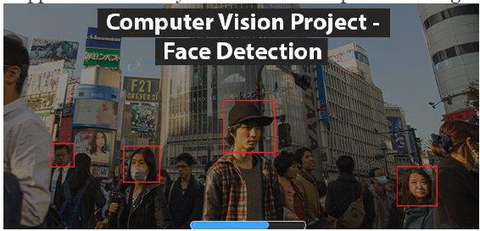
Problem statement : Face Detection
Face detection is a technique to find the location of the human faces in an image. Computers use various types of algorithms to detect if the shape in the image resembles a face or not.

Slide 5
THANK YOU

