Slide 1
Arabic Dialect Classification
Name: Eslam Abdelghany
Email: eslam322_1@hotmail.com

Slide 2
Content:
General Data Preprocessing.
Data Preprocessing For Deep Learning.
Deep Learning Model Architecture And Evaluation.
Data Preprocessing For Machine Learning.
Model Training And Evaluation.
Comparison.

Slide 3
General Data Preprocessing
Data Cleansing by removing:
URLs
emojis
@ABCD
Duplicated characters
Data Normalization by Removing:
الهمزة والنقاط من فوق التاء المربوطة

Slide 4
Data Preprocessing For Deep Learning
Tokenization.
Padding.
Label encoding.
Splitting data to training ,test , and validation sets.

Slide 5
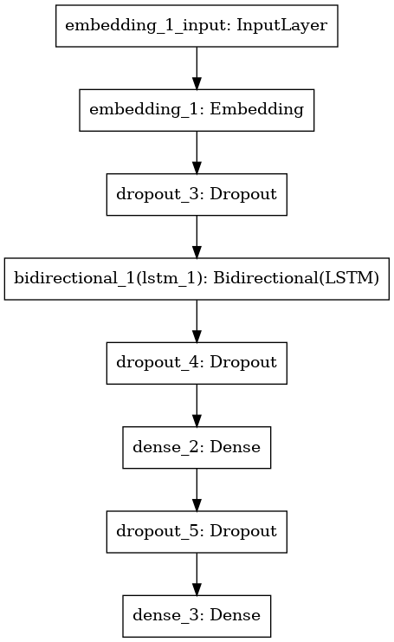
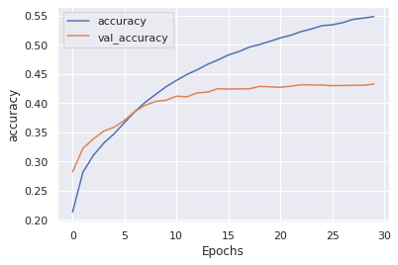
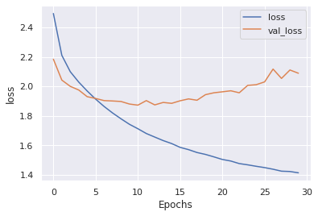
Deep Learning Model Architecture And Evaluation
In fact, did not find enough related-work to adopt a good architecture from. I tried the following architecture I used in sentiment analysis before.
I used the Categorical entropy and accuracy to test the training and model performance.
The learning curves showed that the model is overfitting the data.
I think another DNN architecture should be tried with some hyperparameter tuning.
 | Training | Test
Loss | 1.4133 | 2.1017
Accuracy | 54% | 43%

Slide 6
Data Preprocessing For Machine Learning
Tokenization.
Tfidftransformer.
Label encoding.
Splitting data to training ,test , and validation sets.

Slide 7


Model Training And Evaluation
Used two models the Naïve Bayes and Logistic regression due to their relatively fast training time.
The logistic regression outperformed the Naïve Bayes in terms of
F1-Score and accuracy as shown below.

Slide 8

Comparison
 | Deep Learning Model | Machine Learning Model
Accuracy unseen data | 43% | 51%
Complexity | Complex | Very simple
Training time | Long | Short
Decision:
Logistic Regression will be deployed

