Slide 1
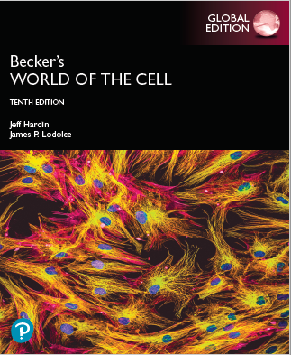
Becker’s World of the Cell
Tenth Edition, Global Edition
Chapter 3
The Macromolecules of the Cell
Lectures by Anna Hegsted, Simon Fraser University
Copyright © 2022 Pearson Education Ltd. All Rights Reserved.
Notes:
If this PowerPoint presentation contains mathematical equations, you may need to check that your computer has the following installed:
1) MathType Plugin
2) Math Player (free versions available)
3) NVDA Reader (free versions available)

Slide 2
The Macromolecules of the Cell
Polymers are synthesized by condensation reactions in which activated monomers are linked together by the removal of water.
Most biological macromolecules in cells are synthesized from about 30 common small molecules.

Slide 3
3.1 Proteins
Proteins are extremely important macromolecules in all organisms, occurring nearly everywhere in the cell.
Proteins fall into nine major classes.

Slide 4
Classes of Proteins (1 of 2)
Enzymes serve as catalysts, increasing the rates of chemical reactions.
Structural proteins—physical support and shape
Motility proteins—contraction and movement
Regulatory proteins—control and coordinate cell function
Transport proteins—move substances into and out of cells

Slide 5
Classes of Proteins (2 of 2)
Signaling proteins—communication between cells
Receptor proteins—enable cells to respond to chemical stimuli from the environment
Defensive proteins—protect against disease
Storage proteins—reservoirs of amino acids

Slide 6
The Monomers Are Amino Acids
Only 20 kinds of amino acids are used in protein synthesis.
Some contain additional amino acids, usually the result of modification.
No two different proteins have the same amino acid sequence.

Slide 7
Common Small Molecules in Cells
Table 3.1 Common Small Molecules in Cells
Kind of Molecules | Number Present | Names of Molecules | Role in Cell | Figure Number for Structures
Amino acids | 20 | See list in Table 3-2 | Monomeric units of all proteins | 3-2
Aromatic bases | 5 | Adenine | Components of nucleic acids | 3-15
 |  | Cytosine |  | 3-15
 |  | Guanine |  | 3-15
 |  | Thymine |  | 3-15
 |  | Uracil |  | 3-15
Sugars | Varies | Ribose | Component of R N A | 3-15
 |  | Deoxyribose | Component of D N A | 3-15
 |  | Glucose | Energy metabolism; component of starch and glycogen | 3-21
Lipids | Varies | Fatty acids | Energy metabolism; Components of phospholipids and membranes | 3-27a
 |  | Cholesterol |  | 3-27e

Slide 8
Amino Acids
Every amino acid has the same basic structure.
Each has a unique side chain, called an R group.
All amino acids except glycine have an asymmetric α carbon atom.
The specific properties of amino acids depend on the nature of their R groups.

Slide 9
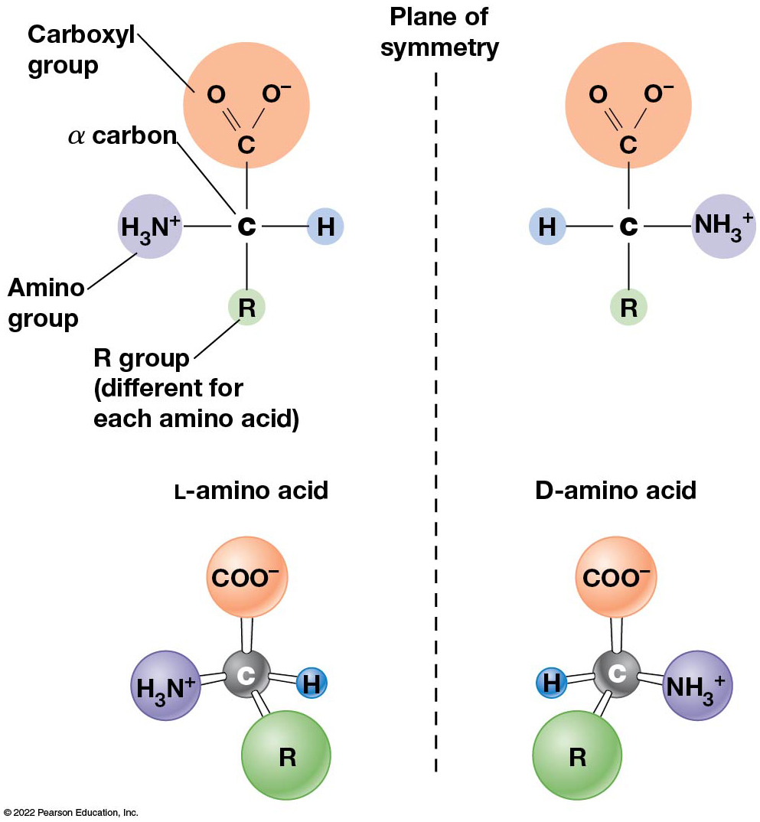
The Structure and Stereochemistry of an Amino Acid
Figure 3.1 The Structure and Stereochemistry of an Amino Acid.
Notes:
Long description:
The illustration shows plane of symmetry as a vertical line in the middle. Amino acid has an asymmetric carbon atom bonded to 4 different groups. The stereoisomers of an amino acid are shown as non-superimposable mirror images on either side of the plane of symmetry.
The chemical structure of L hyphen amino acid and D hyphen amino acid are as follows:
L hyphen amino acid has an alpha carbon atom C in the center which is single hyphen bonded to the amino group H subscript 3 N superscript plus on the left, H on the right, carboxyl group C double bond O angled to the top-left and single bond O superscript minus angled to the top-right above, and R group below which is different for each amino acid.
D hyphen amino acid has a central C which has single bond H on the left, H subscript 3 N superscript plus on the right, C double-bonded to O angled to the top-left and single-bonded to O superscript minus angled to the top-right above, and R group below which is different for each amino acid.
The ball-and-stick model of L hyphen amino acid and D hyphen amino acid are as follows:
L hyphen amino acid in the shape of a tetrahedron has a central carbon sphere bonded to four different spheres labeled as C O O superscript minus above, R below oriented slightly toward right, H subscript 3 N superscript plus on the left, and H on the right.
D hyphen amino acid in the shape of a tetrahedron has a central carbon sphere bonded to four different spheres labeled as C O O superscript minus above, R below oriented slightly toward left, H on the left, and H subscript 3 N superscript plus on the right.

Slide 10
Classes of R Groups
Nine amino acids have nonpolar, hydrophobic R groups.
The remaining 11 amino acids are hydrophilic, with R groups that are either polar or charged at cellular pH.
Acidic amino acids are negatively charged, whereas basic amino acids are positively charged.
Polar amino acids tend to be found on the surfaces of proteins.

Slide 11
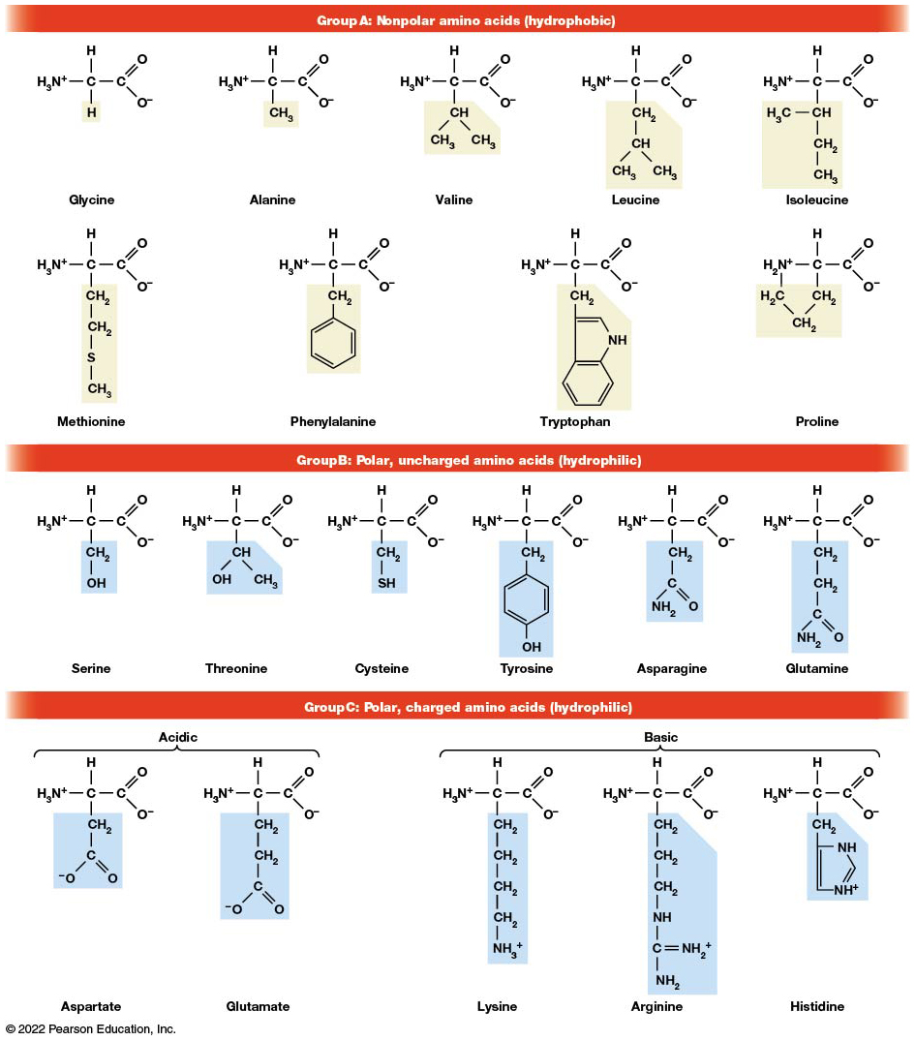
The Structures of the 20 Amino Acids Found in Proteins
Figure 3.2 The Structures of the 20 Amino Acids Found in Proteins.
Notes:
Long description:
The structure of all the twenty amino acids has a central carbon single-bonded to an amino group (H subscript 3 N superscript plus) on the left, a carboxyl group (C double bonded to O and single bonded to O superscript minus) on the right, an H above, and an R group which is a variable side chain of one or more atoms below. The R group is different for each amino acid and is shown in a shaded box. The individual structures of the three groups of amino acids are as follows:
Group A: Nonpolar amino acids which are hydrophobic
Glycine: H subscript 3 N superscript plus; single bond; C single-bonded to H above and “H” below; single bond; C double-bonded to O and single-bonded to O superscript minus. The R group highlighted is H.
Alanine: H subscript 3 N superscript plus; single bond; C single-bonded to H above and “C H subscript 3” below; single bond; C double-bonded to O and single-bonded to O superscript minus. The R group highlighted is C H subscript 3.
Valine: H subscript 3 N superscript plus; single bond; C single-bonded to H above and “C H single-bonded to C subscript H 3 and C H subscript 3” below; single bond; C double-bonded to O and single-bonded to O superscript minus. The R group highlighted is C H single-bonded to C H subscript 3 and C H subscript 3.
Leucine: H subscript 3 N superscript plus; single bond; C single-bonded to H above and “C H subscript 2 single-bonded to C H single-bonded to C H subscript 3 and C H subscript 3” below; single bond; C double-bonded to O and single-bonded to O superscript minus. The R group highlighted is C H subscript 2 single-bonded to C H below which is in turn single-bonded to C H subscript 3 and C H subscript 3 below.
Isoleucine: H subscript 3 N superscript plus; single bond; C single-bonded to H above and “C H single-bonded to C H subscript 3 on the left and single-bonded to C H subscript 2 below which is in turn single-bonded to C H subscript 3” below; single bond; C double-bonded to O and single-bonded to O superscript minus. The R group highlighted is “C H single-bonded to C H subscript 3 on the left and single-bonded to C H subscript 2 below which is in turn single-bonded to C H subscript 3 below”
Methionine: H subscript 3 N superscript plus; single bond; C single-bonded to H above and “C H subscript 2 single-bonded to C H subscript 2 single-bonded to S single-bonded to C H subscript 3” below; single bond; C double-bonded to O and single-bonded to O superscript minus. The R group highlighted is C H subscript 2 single-bonded to C H subscript 2 single-bonded to S single-bonded to C H subscript 3 below.
Phenylalanine: H subscript 3 N superscript plus; single bond; C single-bonded to H above and “C H subscript 2 single-bonded to a benzene ring” below; single bond; C double-bonded to O and single-bonded to O superscript minus. The R group highlighted is C H subscript 2 single-bonded to a benzene ring below.
Tryptophan: H subscript 3 N superscript plus; single bond; C single-bonded to H above and “C H subscript 2 single-bonded to an indole ring” below; single bond; C double-bonded to O and single-bonded to O superscript minus. The R group highlighted is C H subscript 2 single-bonded to an indole ring below.
Proline: H subscript 2 N superscript plus; single bond; C single-bonded to H above and “C H subscript 2 single-bonded to C H subscript 2 single-bonded to C H subscript 2 single-bonded back to H subscript 2 N superscript plus” forming a pentagon ring; single bond; C double-bonded to O and single-bonded to O superscript minus. The R group highlighted is C H subscript 2 single-bonded to C H subscript 2 below single-bonded to C H subscript 2 above.
Group B: Polar, uncharged amino acids which are hydrophilic
Serine: H subscript 3 N superscript plus; single bond; C single-bonded to H above and “C H subscript 2 single-bonded to O H” below; single bond; C double-bonded to O and single-bonded to O superscript minus. The R group highlighted is C H subscript 2 single-bonded to O H below.
Threonine: H subscript 3 N superscript plus; single bond; C single-bonded to H above and “C H single-bonded to O H and C H subscript 3” below; single bond; C double-bonded to O and single-bonded to O superscript minus. The R group highlighted is C H single-bonded to O H and C H subscript 3 below.
Cysteine: H subscript 3 N superscript plus; single bond; C single-bonded to H above and “C H subscript 2 single-bonded to S H” below; single bond; C double-bonded to O and single-bonded to O superscript minus. The R group highlighted is C H subscript 2 single-bonded to S H below.
Tyrosine: H subscript 3 N superscript plus; single bond; C single-bonded to H above and “C H subscript 2 single-bonded to a benzene ring which is in turn single-bonded to O H” below; single bond; C double-bonded to O and single-bonded to O superscript minus. The R group highlighted is C H subscript 2 single-bonded to a benzene ring which is in turn single-bonded to O H below.
Asparagine: H subscript 3 N superscript plus; single bond; C single-bonded to H above and “C H subscript 2 single-bonded to C which is double-bonded to O and single-bonded to N H subscript 2” below; single bond; C double-bonded to O and single-bonded to O superscript minus. The R group highlighted is C H subscript 2 single-bonded to C which is double-bonded to O and single-bonded to N H subscript 2 below.
Glutamine: H subscript 3 N superscript plus; single bond; C single-bonded to H above and “C H subscript 2 single-bonded to C H subscript 2 single-bonded to C which is double-bonded to O and single-bonded to N H subscript 2” below; single bond; C double-bonded to O and single-bonded to O superscript minus. The R group highlighted is C H subscript 2 single-bonded to C H subscript 2 single-bonded to C which is double-bonded to O and single-bonded to N H subscript 2 below.
Group C: Polar, charged amino acids which are hydrophilic
Aspartate: H subscript 3 N superscript plus; single bond; C single-bonded to H above and “C H subscript 2 single-bonded to C which is double-bonded to O and single-bonded to O superscript minus” below; single bond; C double-bonded to O and single-bonded to O superscript minus. The R group highlighted is C H subscript 2 single-bonded to C which is double-bonded to O and single-bonded to O superscript minus below.
Glutamate: H subscript 3 N superscript plus; single bond; C single-bonded to H above and “C H subscript 2 single-bonded to C H subscript 2 single-bonded to C which is double-bonded to O and single-bonded to O superscript minus” below; single bond; C double-bonded to O and single-bonded to O superscript minus. The R group highlighted is C H subscript 2 single-bonded to C H subscript 2 single-bonded to C which is double-bonded to O and single-bonded to O superscript minus below.
Lysine: H subscript 3 N superscript plus; single bond; C single-bonded to H above and “C H subscript 2 single-bonded to C H subscript 2 single-bonded C H subscript 2 single-bonded to CH subscript 2 single-bonded to N H subscript 3 superscript plus” below; single bond; C double-bonded to O and single-bonded to O superscript minus. The R group highlighted is C H subscript 2 single-bonded to C H subscript 2 single-bonded C H subscript 2 single-bonded to CH subscript 2 single-bonded to N H subscript 3 superscript plus
Arginine: H subscript 3 N superscript plus; single bond; C single-bonded to H above and “C H subscript 2 single-bonded to C H subscript 2 single-bonded C H subscript 2 single-bonded to N H single-bonded to C which is double-bonded to N H subscript 2 superscript plus and single-bonded to N H subscript 2” below; single bond; C double-bonded to O and single-bonded to O superscript minus. The R group highlighted is C H subscript 2 single-bonded to C H subscript 2 single-bonded C H subscript 2 single-bonded to N H single-bonded to C which is double-bonded to N H subscript 2 superscript plus and N H subscript 2.
Histidine: H subscript 3 N superscript plus; single bond; C single-bonded to H above and “C H subscript 2 single-bonded to an imidazole ring” below; single bond; C double-bonded to O and single-bonded to O superscript minus. The R group highlighted is C H subscript 2 single-bonded to an imidazole ring.
Aspartate and glutamate are acidic. Lysine, arginine, and histidine are basic.

Slide 12
Table 3.2 Abbreviations for Amino Acids
Amino Acid | Three-Letter Abbreviation | One-Letter Abbreviation
Alanine | Ala | A
Arginine | Arg | R
Asparagine | Asn | N
Aspartate | Asp | D
Cysteine | Cys | C
Glutamate | Glu | E
Glutamine | Gln | Q
Glycine | Gly | G
Histidine | His | H
Isoleucine | Ile | I
Leucine | Leu | L
Lysine | Lys | K
Methionine | Met | M
Phenylalanine | Phe | F
Proline | Pro | P
Serine | Ser | S
Threonine | Thr | T
Tryptophan | Trp | W
Tyrosine | Tyr | Y
Valine | Val | V

Slide 13
The Polymers Are Polypeptides and Proteins
Amino acids are linked together stepwise into a linear polymer by dehydration (or condensation) reactions.
As the three atoms comprising the H₂O are removed, a covalent C—N bond (a peptide bond) is formed.

Slide 14
Directionality of Polypeptides
Because of the way peptide bonds are formed, polypeptides have directionality.
The end with the amino group is called the N- (or amino) terminus.
The end with the carboxyl group is called the C- (or carboxyl) terminus.

Slide 15
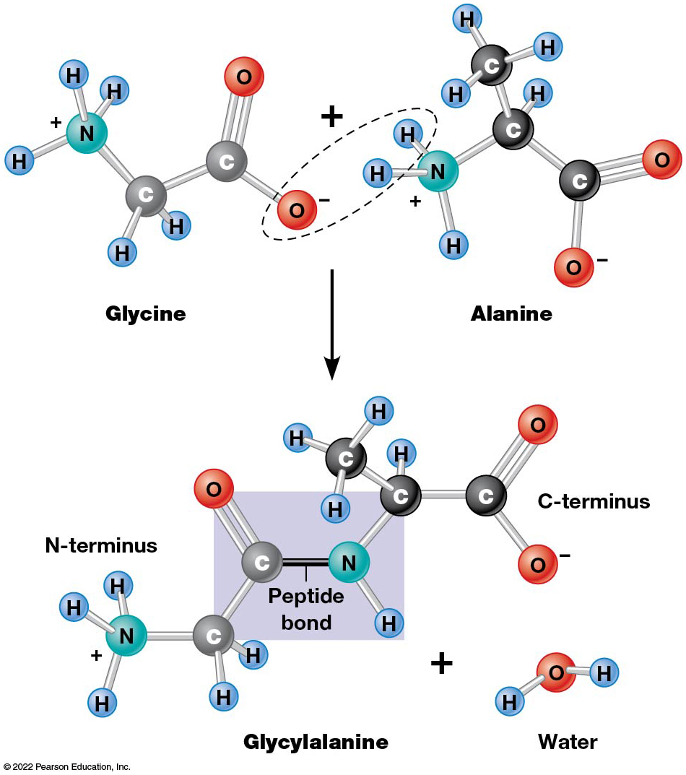
Peptide Bond Formation
Figure 3.3 Peptide Bond Formation.
Notes:
Long description:
The details of the model are as follows:
Glycine has the structure from left to right as follows: H subscript 3 N superscript plus, single-bond, C single-bonded to H on both sides; single-bond; C double-bonded to O on one side and single-bonded to O superscript minus on the other side.
Alanine has the structure from left to right as follows: H subscript 3N superscript plus; single-bond; C single-bonded to H and C H subscript 3; single bond; C double-bonded to O on one side and single-bonded to O superscript minus on the other side.
The O superscript minus in the carboxyl group of glycine and the two H in the amino group of alanine are highlighted.
Dehydration reaction forms the dipeptide glycylalanine plus a water molecule.
The structure of the resulting dipeptide from N hyphen terminus to C hyphen terminus is as follows: H subscript 3 N superscript plus; single bond; C single-bonded to H on both sides; single bond; C double-bonded to O above; peptide bond; N single-bonded to H below; single bond; C single-bonded to H and C H subscript 3; single bond; C double-bonded to O on one side and single-bonded to O superscript minus on the other side.
Structure of the water molecule released has a central O single-bonded to H on both sides in the shape of an inverted V.

Slide 16
Proteins and Polypeptides
The process of elongating a chain of amino acids is called protein synthesis.
However, the immediate product of amino acid polymerization is a polypeptide.
A polypeptide does not become a protein until it has assumed a unique, stable, three-dimensional shape and is biologically active.

Slide 17
Monomeric and Multimeric Proteins
Proteins that consist of a single polypeptide are monomeric proteins, whereas multimeric proteins consist of two or more polypeptides.
Proteins consisting of two or three polypeptides are called dimers or trimers, respectively.
Hemoglobin is a tetramer, consisting of two α subunits and two β subunits.

Slide 18
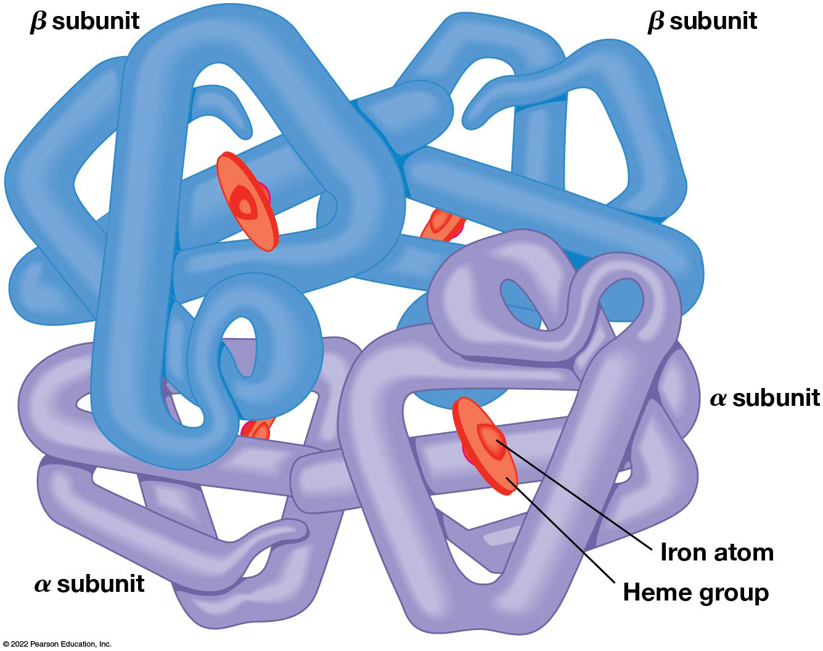
The Structure of Hemoglobin
Figure 3.4 The Structure of Hemoglobin.

Slide 19
Several Kinds of Bonds and Interactions Are Important in Protein Folding and Stability
Both covalent bonds and noncovalent interactions are needed for a protein to adopt its proper shape, or conformation.
These same bonds and interactions are required for polypeptides to form multimeric proteins.
The interactions involve carboxyl, amino, and R groups of the amino acids, called amino acid residues once incorporated into a polypeptide.

Slide 20
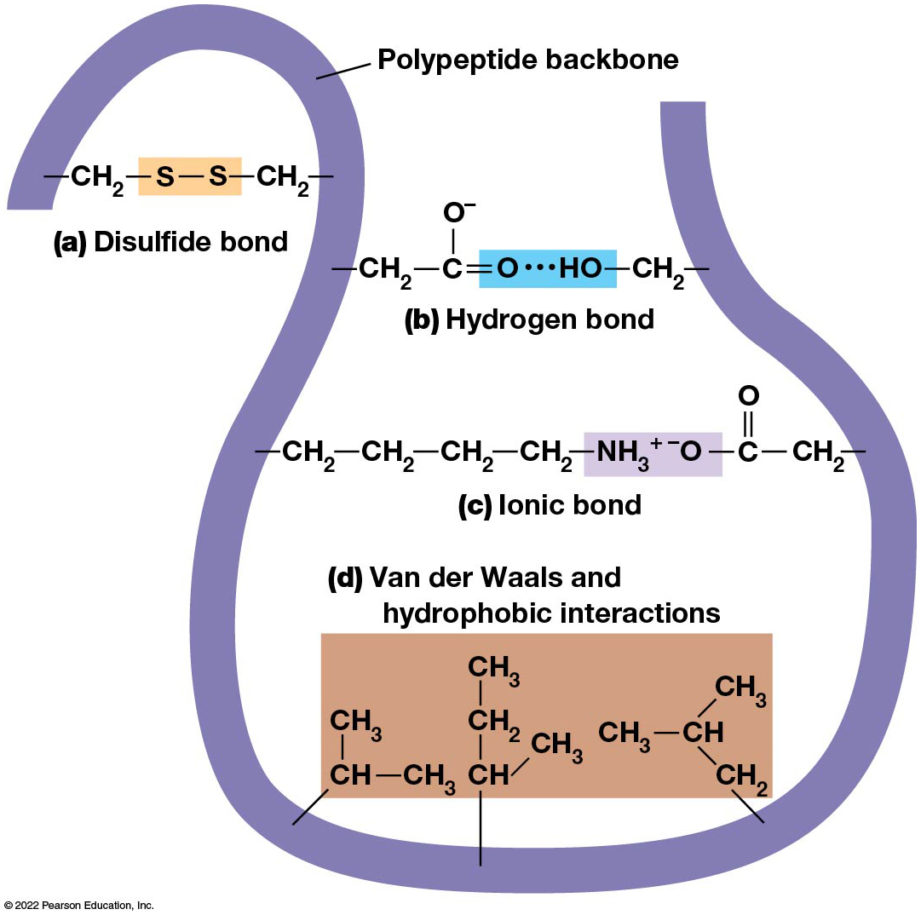
Bonds and Interactions Involved in Protein Folding and Stability
Figure 3.5 Bonds and Interactions Involved in Protein Folding and Stability.
Notes:
Long description:
The illustration lists the following four kinds of bonds and interactions:
(a) Disulfide bond: This is a covalent bond between two sides of a narrow U-bend. It reads: Polypeptide backbone; single bond; C H subscript 2; single bond; S; single bond; S; single bond; C H subscript 2; single bond; polypeptide backbone. S-single bond-S is highlighted.
(b) Hydrogen bond: This is a non-covalent bond between two sides of a folded polypeptide backbone. It reads: Polypeptide backbone; single bond; C H subscript 2; single bond; C single-bonded to O superscript minus above; double bond; O; dotted bond; H O; single bond; C H subscript 2; single bond; polypeptide backbone. O-dotted bond-H O is highlighted.
(c) Ionic bond: This is a non-covalent bond between two sides of a folded polypeptide backbone. It reads: Polypeptide backbone; single bond; C H subscript 2; single bond; C H subscript 2; single bond; C H subscript 2; single bond; C H subscript 2; N H subscript 3 superscript plus; superscript minus O; single bond; C double-bonded to O above; single bond; C H subscript 2; single bond; polypeptide backbone. N H subscript 3 superscript plus-superscript minus O is highlighted.
(d) Van der Waals and hydrophobic interactions: These are non-covalent interactions in the bent portion of a polypeptide backbone. It reads: Polypeptide backbone; single bond angled to top-right; C H single-bonded to C H subscript 3 above; single bond; C H subscript 3. Polypeptide backbone; single bond above; C H single-bonded to C H subscript 3 angled to top-right and single-bonded to C H subscript 2 above; this C H subscript 2 is in turn single-bonded to C H subscript 3 above. Polypeptide backbone; single bond angled to top-left; C H subscript 2; single bond angled to top-left C H; this C H is single-bonded to C H subscript 3 on the left and single-bonded to C H subscript 3 angled to top-right. The whole of these interactions is highlighted.

Slide 21
Disulfide Bonds
Covalent disulfide bonds form between the sulfur atoms of two cysteine residues.
They form through the removal of two hydrogen ions (oxidation) and can be broken only by the addition of two hydrogens (reduction).
Once formed, disulfide bonds confer considerable stability to the protein conformation.

Slide 22
Categories of Disulfide Bonds
Intramolecular disulfide bonds form between cysteines in the same polypeptide.
Intermolecular disulfide bonds form between cysteines in two different polypeptides.
They link the two polypeptides together.

Slide 23
Noncovalent Bonds and Interactions
Noncovalent bonds and interactions include hydrogen bonds, ionic bonds, van der Waals interactions, and hydrophobic interactions.
These are individually weaker than covalent bonds but collectively can strongly influence protein structure and stability.

Slide 24
Hydrogen Bonds
Hydrogen bonds form in water and between amino acids in a polypeptide chain via their R groups.
Hydrogen bond donors (e.g., hydroxyl or amino groups) have hydrogen atoms covalently linked to more electronegative atoms.
Hydrogen bond acceptors (e.g., carbonyl or sulfhydryl groups) have an electronegative atom that attracts the donor hydrogen.

Slide 25
Ionic Bonds
Ionic bonds, or electrostatic interactions, form between positively and negatively charged R groups.
They exert attractive forces over longer distances than some of the other noncovalent interactions.
Because they depend on the charge on the R groups, changes in pH can disrupt ionic bonds.

Slide 26
Van Der Waals Interactions
Molecules with nonpolar covalent bonds may have transient positively and negatively charged regions.
These are called dipoles, and two molecules with dipoles will be attracted to one another if they are close enough.
This transient interaction is called a van der Waals interaction or van der Waals force.

Slide 27
Hydrophobic Interactions
A hydrophobic interaction is the tendency of hydrophobic molecules or parts of molecules to be excluded from interactions with water.
Amino acids with hydrophobic side chains tend to be found within proteins.
Protein folding is a balance between the tendency of hydrophilic groups to interact with water and of hydrophobic groups to avoid interaction with water.

Slide 28
Chaperone Interactions
Molecular chaperones are proteins that aid in the proper and accurate folding of other proteins.
They act during protein synthesis or facilitate refolding.
The general mechanism involves shielding parts of the protein from the interactions discussed until more of the protein can be made.

Slide 29
Protein Structure Depends on Amino Acid Sequence and Interactions
The overall shape and structure of a protein are described in terms of four levels of organization
Primary structure—amino acid sequence
Secondary structure—local folding of polypeptide
Tertiary structure—three-dimensional conformation
Quaternary structure—interactions between monomeric proteins to form a multimeric unit

Slide 30
Levels of Organization of Protein Structure
Table 3.3 Levels of Organization of Protein Structure
Level of Structure | Basis of Structure | Kinds of Bonds and Interactions Involved
Primary | Amino acid sequence | Covalent peptide bonds
Secondary | Folding into α helix, β sheet, or random coil | Hydrogen bonds between NH and CO groups of peptide bonds in the backbone
Tertiary | Three-dimensional folding of a single polypeptide chain | Disulfide bonds, hydrogen bonds, ionic bonds, van der Waals interactions, hydrophobic interactions
Quaternary | Association of multiple polypeptides to form a multimeric protein | Same as for tertiary structure

Slide 31
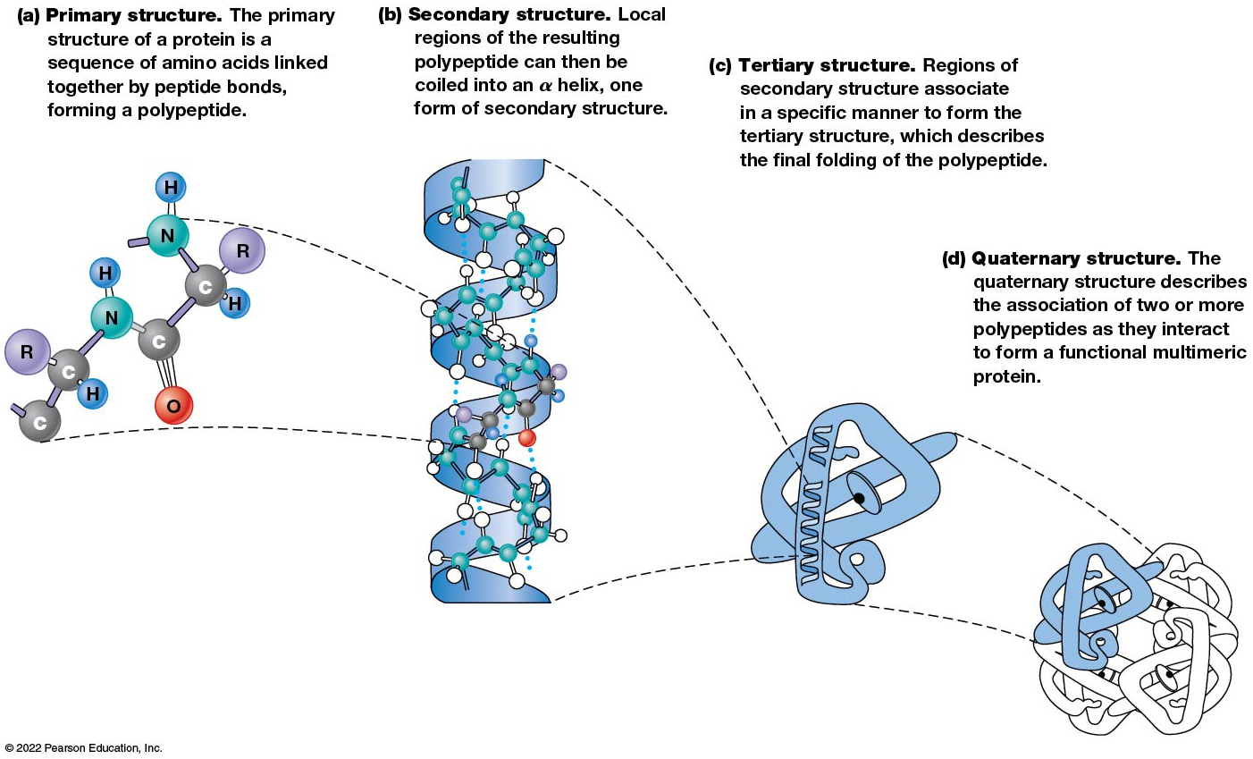
The Four Levels of Organization of Protein
Figure 3.6 The Four Levels of Organization of Protein Structure.
Notes:
Long description:
Illustration (a) shows the primary structure of hemoglobin. The primary structure of a protein is a sequence of amino acids linked together by peptide bonds, forming a polypeptide. A ball-and-stick model shows two amino acids linked by a peptide bond. The detailed structure is a chain of C; C bonded to R above and H below; N bonded to H above; C double-bonded to O below; C bonded to R and H on the right; N bonded to H above; and so on.
Illustration (b) shows the secondary structure of hemoglobin. Local regions of the resulting polypeptide can then be coiled into an alpha helix, one form of secondary structure. The illustration shows ball-and-stick model of a polypeptide chain condensed to form an alpha helix.
Illustration (c) shows the tertiary structure of hemoglobin. Regions of secondary structure associate in a specific manner to form the tertiary structure, which describes the final folding of the polypeptide. The illustration shows alpha helices folded in a specific manner to form the tertiary structure.
Illustration (d) shows the quaternary structure of hemoglobin. The quaternary structure describes the association of two or more polypeptides as they interact to form a functional multimeric protein. The illustration shows a folded protein subunit linked with three other folded subunits to form the quaternary structure.

Slide 32
Primary Structure
Primary structure refers to the amino acid sequence.
By convention, amino acid sequences are written from the N-terminus to the C-terminus, the direction in which the polypeptide was synthesized.
The first protein to have its amino acid sequence determined was the hormone insulin.
Insulin consists of one A and one B subunit with 21 and 30 amino acids, respectively.

Slide 33
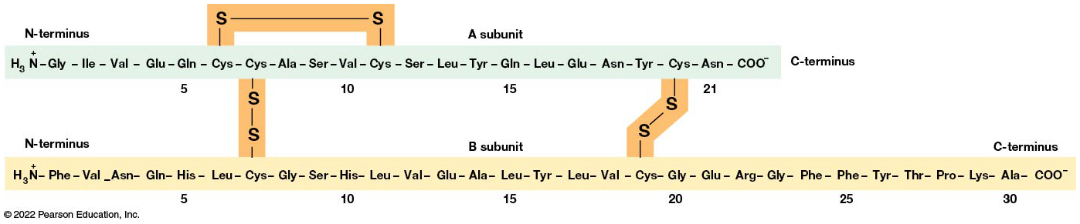
The Structure of Insulin
Figure 3.7 The Structure of Insulin.
Notes:
Long description:
The details of insulin structure are as follows:
Insulin consists of two polypeptide chains labeled as A subunit and B subunit.
A subunit has the sequence from N-terminus to C-terminus which consists of 21 amino acids, as follows: H subscript 3 N superscript plus; glycine; isoleucine; valine; glutamate; glutamine; cysteine; cysteine; alanine; serine; valine; cysteine; serine; leucine; tyrosine; glutamine; leucine; glutamate; asparagine; tyrosine; cysteine; asparagine; C O O superscript minus.
B subunit has the sequence from N-terminus to C-terminus which consists of 30 amino acids, as follows: H subscript 3 N superscript plus; phenylalanine; valine; asparagine; glutamine; histidine; leucine; cysteine; glycine; serine; histidine; leucine; valine; glutamate; alanine; leucine; tyrosine; leucine; valine; cysteine; glycine; glutamate; arginine; glycine; phenylalanine; phenylalanine; tyrosine; threonine; proline; lysine; alanine; C O O superscript minus.
A disulfide bridge is formed within the A subunit between cysteine in the sixth position and cysteine in the eleventh position. A and B subunits are connected by two disulfide bonds; the first disulfide bond is formed between cysteine in the seventh position of A subunit and cysteine in the seventh position of B subunit; the second disulfide bond is formed between cysteine in the twentieth position of A subunit and cysteine in the nineteenth position of B subunit.

Slide 34
Determining Amino Acid Sequence
Sanger obtained the Nobel Prize for his work on the insulin protein sequence.
He cleaved the protein into smaller fragments and analyzed the amino acid order within individual overlapping fragments.
Sanger’s work paved the way for the sequencing of hundreds of other proteins and for advancements in the methods used for sequencing proteins.

Slide 35
The Importance of Primary Structure
Primary structure is important genetically because the sequence is specified by the order of nucleotides in the corresponding messenger R N A.
It is important structurally because the order and identity of amino acids directs the formation of the higher-order (secondary and tertiary) structures.

Slide 36
Secondary Structure
The secondary structure of a protein describes local regions of structure that result from hydrogen bonding between N H and C O groups along the polypeptide backbone.
These result in two major patterns, the α helix and the β sheet.

Slide 37
The α Helix (1 of 2)
The α helix is spiral in shape, consisting of the peptide backbone, with R groups jutting out from the spiral.
There are 3.6 amino acids per turn of the helix.
A hydrogen bond forms between the N H group of one amino acid and the C O group of a second amino acid that is one turn away from the first.

Slide 38
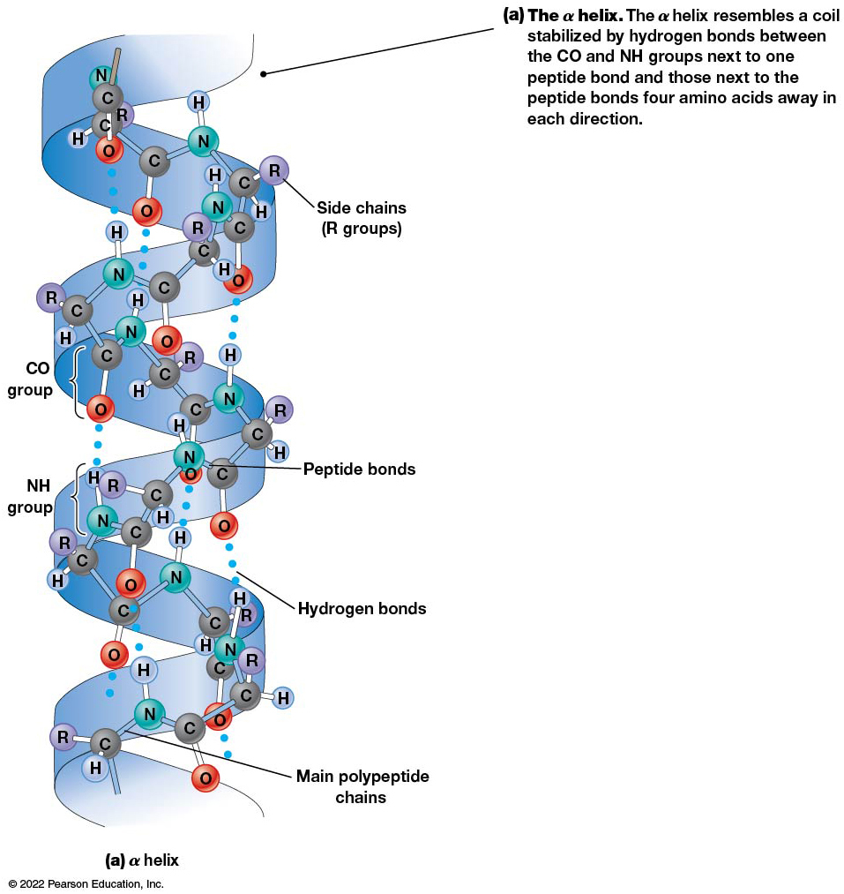
The α Helix (2 of 2)
Figure 3.8 The α Helix and β Sheet.
Notes:
Long description:
Illustration (a) shows the alpha helix. The alpha helix resembles a coil stabilized by hydrogen bonds between the C O and N H groups next to one peptide bond and those next to the peptide bonds four amino acids away in each direction. The illustration shows the ball-and-stick model of a polypeptide chain over an alpha helix. The alpha helix is held together by two kinds of bonds between C O and N H groups; the peptide bonds are between C and N and the hydrogen bonds are between O and H. The main polypeptide chain has C and N, and the side chains have R groups.
Illustration (b) shows the beta sheet. The beta sheet involves two polypeptide regions whose backbones are parallel, with the R groups of the amino acids sticking out on alternating sides of the sheet. This structure is stabilized by hydrogen bonds between the C O and N H groups next to peptide bonds in the adjacent polypeptide regions. The illustration shows the ball-and-stick model of two separate polypeptide chain over two parallel beta sheets. The beta sheets are held together by hydrogen bonds formed between C O and N H groups, adjacent to the peptide bonds. The main polypeptide chains have C and N, and the side chains have R groups.

Slide 39
The β Sheet (1 of 3)
The β sheet is an extended sheetlike conformation with successive atoms of the polypeptide chain located at “peaks” or “troughs.”
The R groups jut out on alternating sides of the sheet.
Because of the formation of peaks and troughs, it is sometimes referred to as a β-pleated sheet.

Slide 40
The β Sheet (2 of 3)
The β sheet is characterized by a maximum of hydrogen bonding, but β sheet formation may involve different polypeptides or different regions of a single polypeptide.
If the parts of polypeptides forming the β sheet have the same polarity (relative to the N- and C- termini), they are called parallel.
If the parts of polypeptides forming the β sheet have opposite polarity, they are called antiparallel.

Slide 41
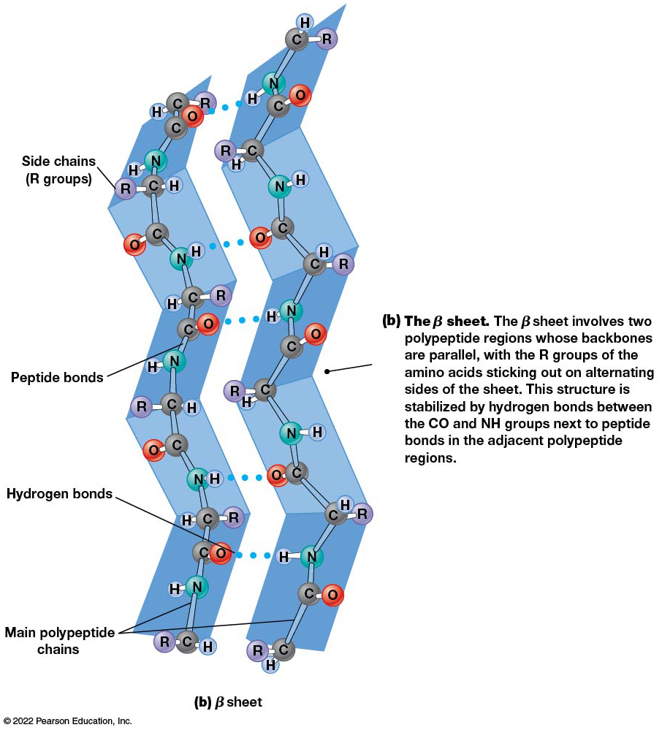
The β Sheet (3 of 3)
Figure 3.8 The Helix and Sheet.
Notes:
Long description:
Illustration (a) shows the alpha helix. The alpha helix resembles a coil stabilized by hydrogen bonds between the C O and N H groups next to one peptide bond and those next to the peptide bonds four amino acids away in each direction. The illustration shows the ball-and-stick model of a polypeptide chain over an alpha helix. The alpha helix is held together by two kinds of bonds between C O and N H groups; the peptide bonds are between C and N and the hydrogen bonds are between O and H. The main polypeptide chain has C and N, and the side chains have R groups.
Illustration (b) shows the beta sheet. The beta sheet involves two polypeptide regions whose backbones are parallel, with the R groups of the amino acids sticking out on alternating sides of the sheet. This structure is stabilized by hydrogen bonds between the C O and N H groups next to peptide bonds in the adjacent polypeptide regions. The illustration shows the ball-and-stick model of two separate polypeptide chain over two parallel beta sheets. The beta sheets are held together by hydrogen bonds formed between C O and N H groups, adjacent to the peptide bonds. The main polypeptide chains have C and N, and the side chains have R groups.

Slide 42
Amino Acid Sequence and Secondary Structure
Certain amino acids (e.g., leucine, methionine, glutamate) tend to form α helices, whereas others (e.g., isoleucine, valine, phenylalanine) tend to form β sheets.
Proline cannot form hydrogen bonds and tends to disrupt α helix structures by introducing a bend in the helix.

Slide 43
Motifs
Certain combinations of α helices and β sheets have been identified in many proteins.
These units of secondary structure consist of short stretches of α helices and β sheets and are called motifs.
Examples include the β–α–β, the hairpin loop, and the helix-turn-helix motifs.

Slide 44
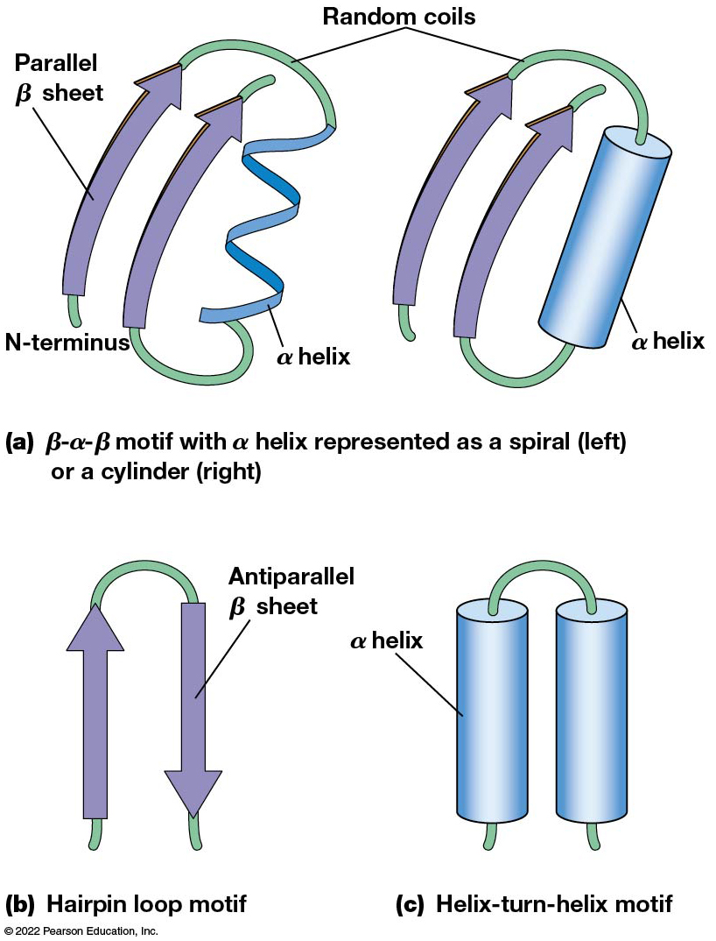
Common Structural Motifs
Figure 3.9 Common Structural Motifs.
Notes:
Long description:
Illustration (a) shows beta hyphen alpha hyphen beta motif with alpha helix represented as a spiral on the left or a cylinder on the right. The pattern of this motif shows N hyphen terminus, parallel beta sheet, random coils, alpha helix shown as a spiral on the left, and N hyphen terminus, parallel beta sheet, random coils, and alpha helix shown as a cylinder on the right.
Illustration (b) shows hairpin loop motif with antiparallel beta sheet arranged in the pattern of a hairpin loop.
Illustration (c) shows helix hyphen turn hyphen helix motif with two alpha helices that are represented as a cylinder arranged in the pattern of an alpha helix, a turn by random coil, and another alpha helix, thus forming the shape of an inverted U.

Slide 45
Tertiary Structure
The tertiary structure reflects the unique aspect of the amino acid sequence because it depends on interactions of the R groups.
Tertiary structure is neither repetitive nor easy to predict.
It results from the sum of hydrophobic residues avoiding water, hydrophilic residues interacting with water, the repulsion of similarly charged residues, and attraction between oppositely charged residues.

Slide 46
Native Conformation
The most stable possible three-dimensional structure of a particular polypeptide is called the native conformation.
Proteins can be divided into two broad categories
Fibrous proteins
Globular proteins

Slide 47
Fibrous Proteins
Fibrous proteins have extensive regions of secondary structure, giving them a highly ordered, repetitive structure.
Some examples include:
Fibroin proteins of silk
Keratin proteins of hair and wool
Collagen found in tendons and skin
Elastin found in ligaments and blood vessels

Slide 48
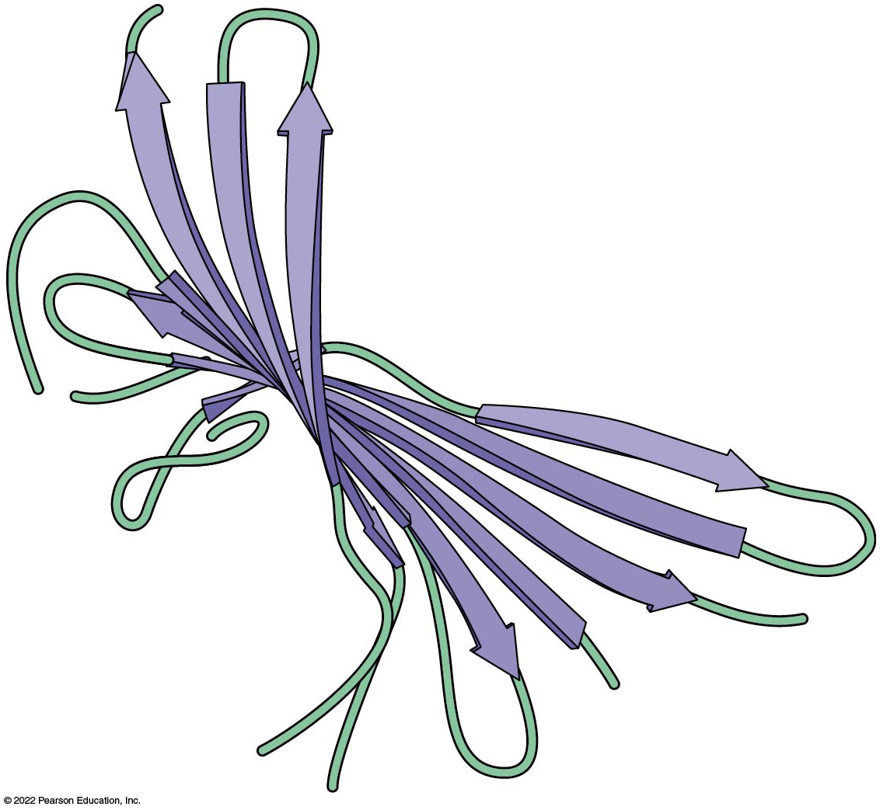
The Fibroin Structure
Figure 3.10 Fibroin Structure.

Slide 49
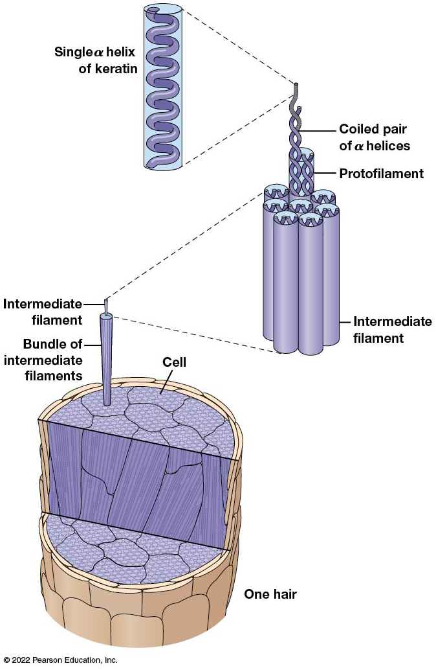
The Structure of Hair
Figure 3.11 The Structure of Hair.
Notes:
Long description:
The cutaway view of one hair shows many cells having bundles of intermediate filaments. An exploded view of a single intermediate filament shows a bundle of many protofilaments. Each protofilament is made of a coiled pair of alpha helices. An exploded view of this coiled pair shows a single alpha helix of keratin.

Slide 50
Globular Proteins
Most proteins are globular proteins that are folded into compact structures.
Each type of globular protein has its own unique tertiary structure.
Most enzymes are globular proteins.

Slide 51
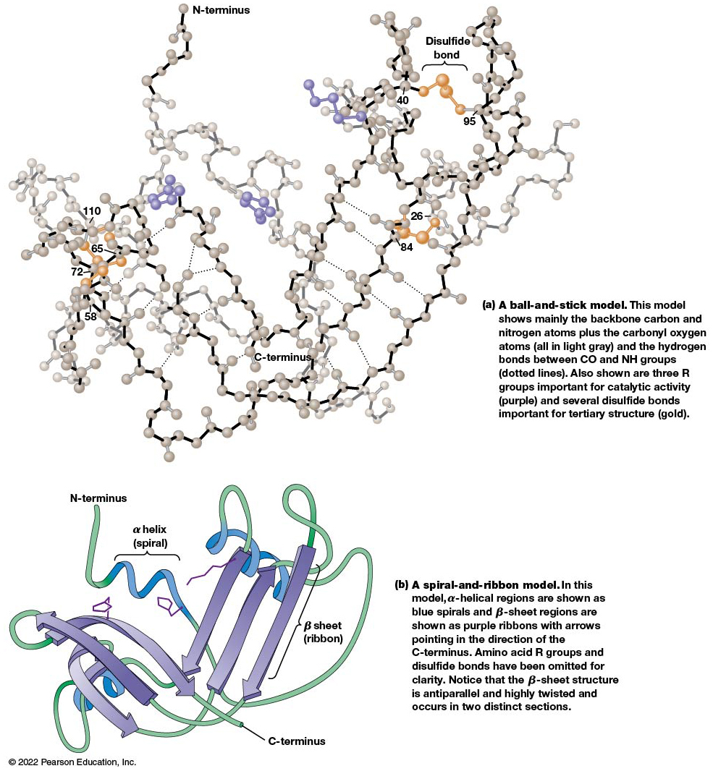
The Three-Dimensional Structure of Ribonuclease
Figure 3.12 The Three-Dimensional Structure of Ribonuclease.
Notes:
Long Description:
Illustration (a) shows a ball-and-stick model of ribonuclease. This model shows mainly the backbone carbon and nitrogen atoms plus the carbonyl oxygen atoms (all shown in light gray) and the hydrogen bonds between C O and N H groups (shown as dotted lines). Also shown are three R groups in purple which are important for catalytic activity and several disulfide bonds in gold which are important for tertiary structure. The illustration shows the three-dimensional structure of ribonuclease, as follows: N hyphen terminus; spiral polypeptide chain region having a R group; coiled region having a R group and a disulfide bond formed between amino acid 40 and amino acid 95; three antiparallel polypeptide backbone regions held together by many hydrogen bonds and having a disulfide bond formed between amino acid 26 and amino acid 84; coiled region; spiral backbone region having a R group; three twisted and anti-parallel polypeptide backbone regions held together by many hydrogen bonds and having a disulfide bond formed between amino acid 65 and amino acid 72; C hyphen terminus.
Illustration (b) shows a spiral-and-ribbon model of ribonuclease. In this model, alpha hyphen helical regions are shown as blue spirals and beta hyphen sheet regions are shown as purple ribbons with arrows pointing in the direction of the C hyphen terminus. Amino acid R groups and disulfide bonds have been omitted for clarity. Notice that the beta hyphen sheet structure is antiparallel and highly twisted and occurs in two distinct sections. The illustration shows the three hyphen dimensional structure of ribonuclease, as follows: N hyphen terminus; random coil; spiral alpha helix; random coils; spiral alpha helix; antiparallel ribbon beta sheets; random coils; spiral alpha helix; anti hyphen parallel ribbon beta sheets that are twisted; C hyphen terminus.

Slide 52
Structures of Globular Proteins
Globular proteins can be mainly α helical, mainly β sheet, or a mixture of both structures.
Many globular proteins consist of a number of segments called domains.

Slide 53
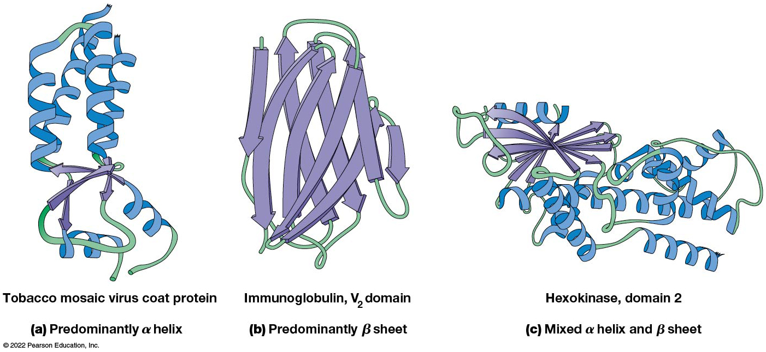
The Structures of Several Globular Proteins
Figure 3.13 Structures of Several Globular Proteins.
Notes:
Long Description:
Illustration (a) shows the tertiary structure of tobacco mosaic virus coat protein which is predominantly alpha helix. It consists of many alpha helices, very less number of beta sheets, and some random coils.
Illustration (b) shows the tertiary structure of V subscript 2 domain of immunoglobulin which is predominantly beta sheet. It consists of many beta sheets and some random coils, with no alpha helix.
Illustration (c) shows the tertiary structure of domain 2 of hexokinase which is a mixture of alpha helix and beta sheet. It consists of many alpha helices, many beta sheets, and some random coils.

Slide 54
Protein Domains
A domain is a discrete, locally folded unit of tertiary structure, usually with a specific function.
A domain is typically 50–350 amino acids long, with regions of α helices and β sheets packed together.
Proteins with similar functions often share a common domain.
Proteins with multiple functions usually have a separate domain for each function, like modular units from which globular proteins are constructed.

Slide 55
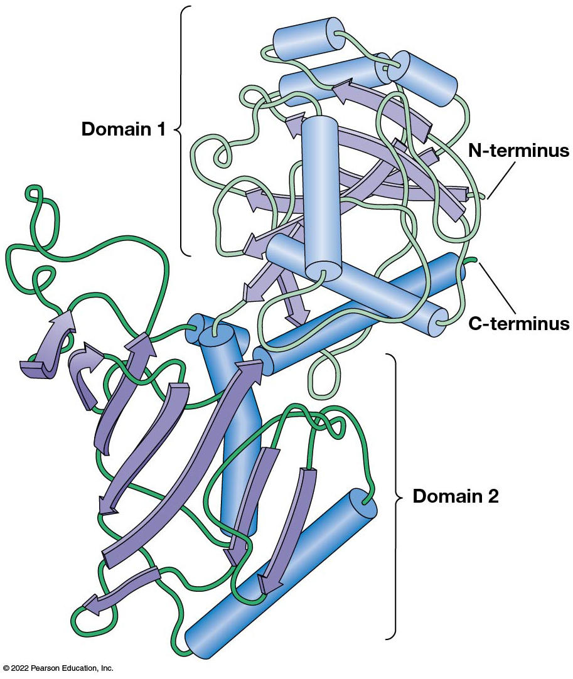
An Example of Protein Containing Two Functional Domains
Figure 3.14 An Example of a Protein Containing Two Functional Domains.

Slide 56
Prediction of Tertiary Structure
It is known that primary structure determines the final folded shape of a protein.
However, we are still not able to predict exactly how a given protein will fold, especially for larger proteins.

Slide 57
Quaternary Structure
The quaternary structure of a protein is the level of organization concerned with subunit interactions and assembly.
The term applies specifically to multimeric proteins.
Some proteins consist of multiple identical subunits; others, such as hemoglobin, contain two or more types of polypeptides.

Slide 58
Maintenance of Quaternary Structure
The bonds and forces maintaining quaternary structure are the same as those responsible for tertiary structure.
The process of subunit formation is usually spontaneous.
Sometimes, molecular chaperones are required to assist the process.

Slide 59
Higher Levels of Assembly
A higher level of assembly is possible in the case of proteins (often enzymes) that are organized into multiprotein complexes.
Each protein in the complex may be involved sequentially in a common multistep process.
An example is the pyruvate dehydrogenase complex, in which three enzymes and five other proteins form a multienzyme complex.

Slide 60
3.2 Nucleic Acids
Nucleic acids are of paramount importance to the cells because they store, transmit, and express genetic information.
They are linear polymers of nucleotides.
D N A is deoxyribonucleic acid, and R N A is ribonucleic acid.

Slide 61
D N A and R N A Differ
D N A and R N A differ chemically and in their role in the cell
R N A contains the five-carbon sugar ribose, and D N A contains the related sugar deoxyribose.
D N A serves as the repository of genetic information, whereas R N A plays several roles in expressing that information.

Slide 62
The Monomers Are Nucleotides
R N A and D N A each consist of only four different types of nucleotides, the monomeric units.
Each nucleotide consists of a five-carbon sugar to which a phosphate group and N-containing aromatic base are attached.
Each base is either a purine or a pyrimidine.

Slide 63
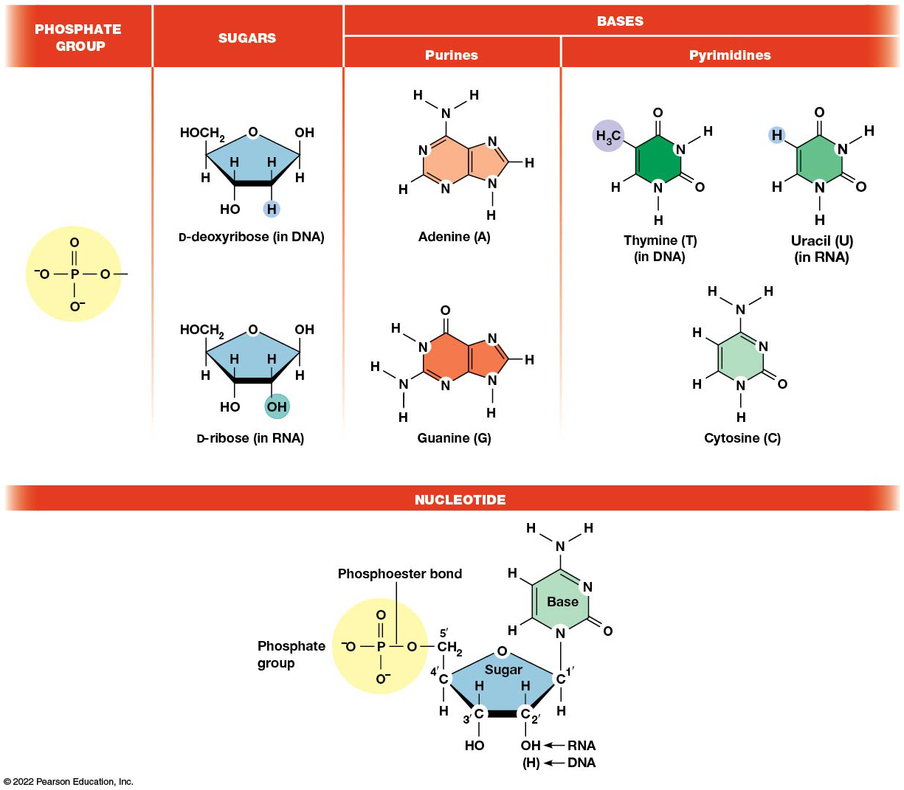
The Structure of a Nucleotide
Figure 3.15 The Structure of a Nucleotide.
Notes:
Long Description:
The details of nucleotide structure and its individual components are as follows:
Phosphate group:
Structure of phosphate group consists of a central P which is single-bonded to O superscript minus on the left, single-bonded to O on the right, double-bonded to O above, and single-bonded to O superscript minus below.
Sugars:
Structure of D hyphen deoxyribose present in D N A consists of a pentagon ring with O at the top. C 1 is single-bonded to O H above and H below; C 2 is single-bonded to H above and H below; C 3 is single-bonded to H above and O H below; and C 4 is single-bonded to C H subscript 2 O H above and H below. The H below C 2 is highlighted.
Structure of D hyphen ribose present in R N A consists of a pentagon ring with O at the top. C 1 is single-bonded to O H above and H below; C 2 is single-bonded to H above and O H below; C 3 is single-bonded to H above and O H below; and C 4 is single-bonded to C H subscript 2 O H above and H below. The O H below C 2 is highlighted.
Bases:
Purines are made of a double-ring
Structure of adenine represented as A consists of fused six-membered and five-membered rings. The first 6 positions belong to the six-membered ring and the last 3 positions belong to the 5-membered ring. The first position is N; second position is C single-bonded to H angled at bottom-left; third position is N; fourth position is C; fifth position is C; sixth position is C single-bonded to N H subscript 2 above; seventh position is N; eighth position is C single-bonded to H on the right; and ninth position is N single-bonded to H below.
Structure of guanine represented as G consists of fused six-membered and five-membered rings. The first 6 positions belong to the six-membered ring and the last 3 positions belong to the 5-membered ring. The first position is N single-bonded to H angled at top-left; second position is C single-bonded to N H subscript 2 angled at bottom-left; third position is N; fourth position is C; fifth position is C; sixth position is C double-bonded to O above; seventh position is N; eighth position is C single-bonded to H on the right; and ninth position is N single-bonded to H below.
Pyramidines are made of a single-ring
Structure of thymine represented as T, present only in D N A, consists of a six-membered ring. The first position is N single-bonded to H below; second position is C single-bonded to H angled at bottom-left; third position is C single-bonded to C H subscript 3 angled at top-left and highlighted; fourth position is C double-bonded to O above; fifth position is N single-bonded to H angled at top-right; and sixth position is C double-bonded to O angled at bottom-right.
Structure of uracil represented as U, present only in R N A, consists of a six-membered ring. The first position is N single-bonded to H below; second position is C single-bonded to H angled at bottom-left; third position is C single-bonded to H angled at top-left and highlighted; fourth position is C double-bonded to O above; fifth position is N single-bonded to H angled at top-right; and sixth position is C double-bonded to O angled at bottom-right.
Structure of cytosine represented as C consists of a six-membered ring. The first position is N single-bonded to H below; second position is C single-bonded to H angled at bottom-left; third position is C single-bonded to H angled at top-left; fourth position is N single-bonded to N H subscript 2 above; fifth position is N; and sixth position is C double-bonded to O angled at bottom-right.
Nucleotide:
Structure of a nucleotide consists of a phosphate group attached to a five carbon sugar, which is in turn attached to a nitrogenous base that can be a purine or a pyramidine. In R N A, C subscript 2 dash of sugar is single-bonded to O H; in D N A, C subscript 2 dash of sugar is single-bonded to H. The sugar is attached to the phosphate group by means of a phosphoester bond.

Slide 64
Types of Nucleotides
Purines are adenine (A) and guanine (G).
Pyrimidines are thymine (T) and cytosine (C), and in R N A, uracil (U).
The sugar-base portion without the phosphate group is called a nucleoside.

Slide 65
Nomenclature
Nucleosides with one phosphate group can be thought of as nucleoside monophosphates (example: adenosine monophosphate, A M P).
Adenosine diphosphate (A D P) has two phosphate groups, and adenosine triphosphate (A T P) has three.

Slide 66
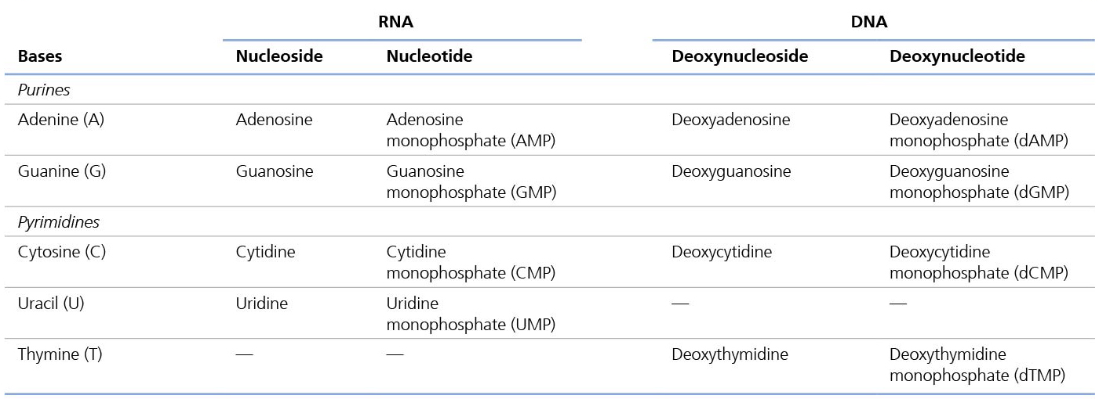
The Bases, Nucleosides, and Nucleotides of R N A and D N A
Table 3.4 The Bases, Nucleosides, and Nucleotides of R N A and D N A
Notes:
Long Description:
The data from the table for different bases are as follows:
Purines:
Adenine (A): RNA Nucleoside – Adenosine, RNA Nucleotide: Adenosine monophosphate (AMP); DNA, Deoxynucleoside – Deoxyadenosine, DNA Deoxynucleotide – Deoxyadenosine monophosphate (dAMP)
Guanine (G): RNA Nucleoside – Guanosine, RNA Nucleotide: Guanosine monophosphate (GMP); DNA, Deoxynucleoside – Deoxyguanosine, DNA Deoxynucleotide – Deoxyguanosine monophosphate (dGMP)
Pyrimidines:
Cytosine (C): RNA Nucleoside – Cytidine, RNA Nucleotide: Cytidine monophosphate (CMP); DNA, Deoxynucleoside – Deoxycytidine, DNA Deoxynucleotide – Deoxycytidine monophosphate (dCMP)
Uracil (U): RNA Nucleoside – Uridine, RNA Nucleotide: Uridine monophosphate (UMP)
Thymine (T): DNA, Deoxynucleoside – Deoxythymidine, DNA Deoxynucleotide – Deoxythymidine monophosphate (dTMP)

Slide 67
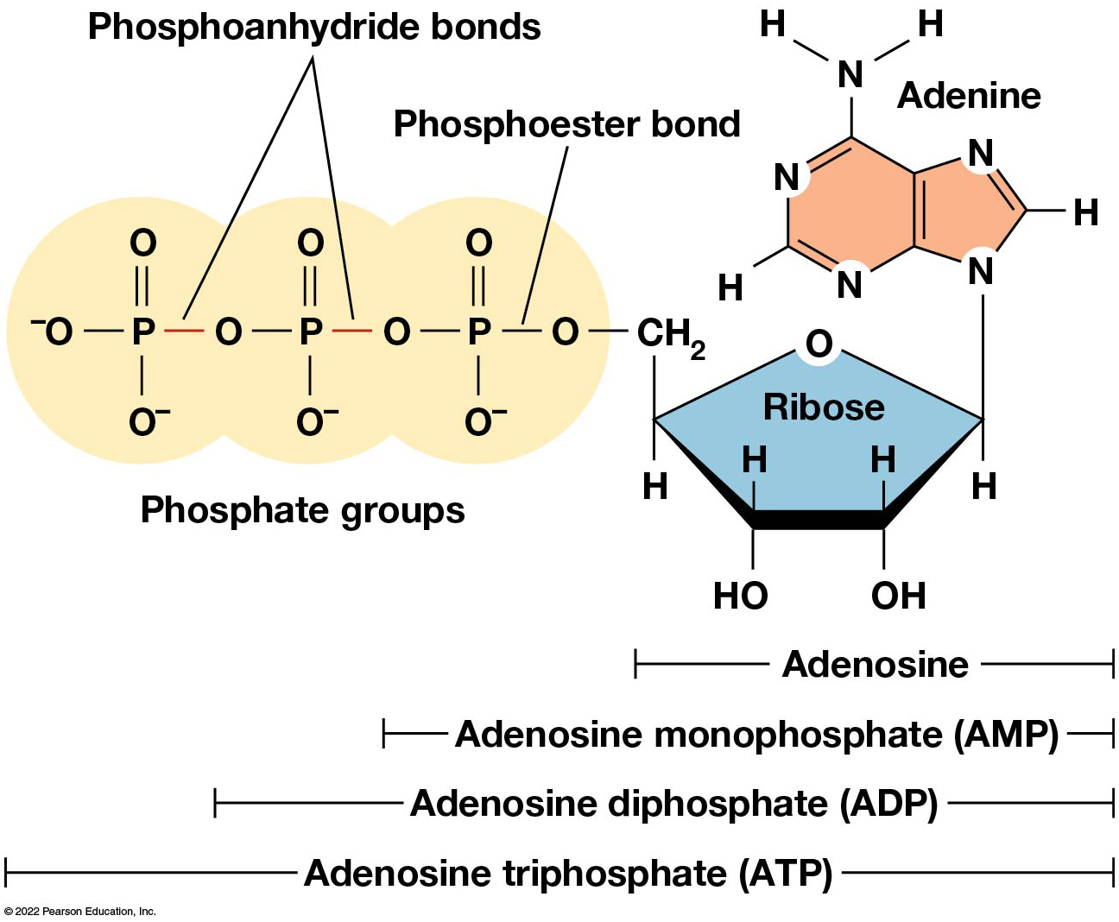
The Phosphorylated Forms of Adenosine
Figure 3.16 The Phosphorylated Forms of Adenosine.
Notes:
Long Description:
The details of the structure are as follows:
Adenosine is made of adenine plus ribose
A M P or adenosine monophosphate is made of adenosine plus a phosphate group
A D P or adenosine diphosphate is made of A M P plus a phosphate group
A T P or adenosine triphosphate is made of A D P plus a phosphate group
Structure of adenine consists of fused six-membered and five-membered rings. The first 6 positions belong to the six-membered ring and the last 3 positions belong to the 5-membered ring. The first position is N; second position is C single-bonded to H angled at bottom-left; third position is N; fourth position is C; fifth position is C; sixth position is C single-bonded to N H subscript 2 above; seventh position is N; eighth position is C single-bonded to H on the right; and ninth position is N single-bonded to the ribose below.
Structure of ribose consists of a five-membered ring with O at the top. C 1 is single-bonded to adenine above and H below; C 2 is single-bonded to H above and O H below; C 3 is single-bonded to H above and O H below; and C 4 is single-bonded to C H subscript 2 O phosphate groups above and H below.
Ribose sugar is attached to alpha phosphate group by means of a phosphoester bond. Beta and gamma phosphate groups are attached by means of phosphoanhydride bonds.

Slide 68
The Polymers Are D N A and R N A
Nucleic acids are linear polymers of nucleotides linked by a 3′, 5′ phosphodiester bridge, a phosphate group linked to two adjacent nucleotides via two phosphodiester bonds.
The polynucleotide formed by this process has a directionality with a 5′ phosphate group at one end and a 3′ hydroxyl group at the other.
Nucleotide sequences are conventionally written in the 5′ to 3′ direction.

Slide 69
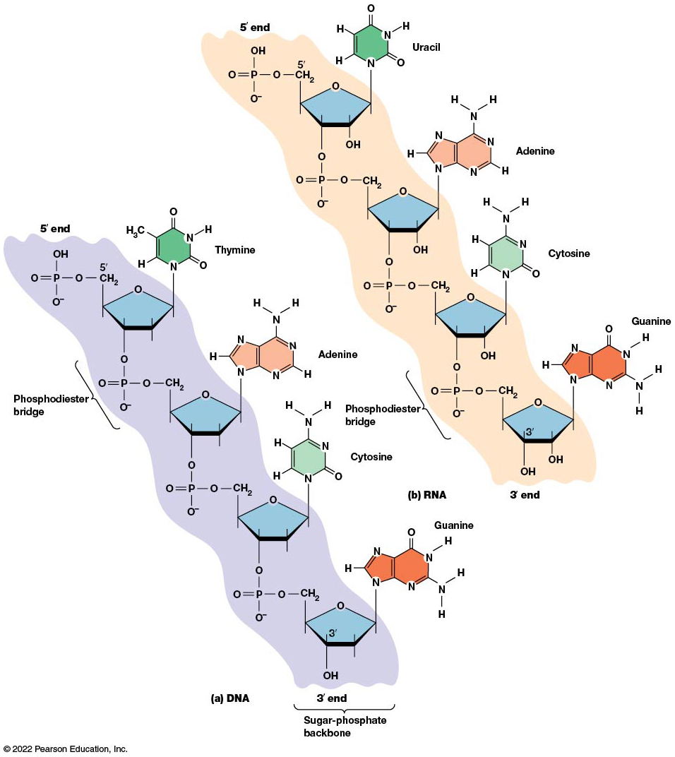
The Structure of Nucleic Acids
Figure 3.17 The Structure of Nucleic Acids.
Notes:
Long Description:
Structure (a) of D N A shows a nucleotide chain consisting of a sugar-phosphate backbone. The sequence of nucleosides from 5 dash end to 3 dash end is thymidine, adenosine, cytidine, and guanosine which are linked by phosphodiester bridge.
Structure (b) of R N A shows a nucleotide chain consisting of a sugar-phosphate backbone. The sequence of nucleosides from 5 dash end to 3 dash end is uridine, adenosine, cytidine, and guanosine which are linked by phosphodiester bridge.

Slide 70
Nucleic Acid Synthesis
A preexisting molecule is used to ensure that new nucleotides (N T P s for R N A, d N T P s for D N A) are added in the correct order.
This molecule is called a template, and correct base pairing between the template and the incoming nucleotide is required to specify correct order.
A complementary relationship exists between certain purines and pyrimidines.

Slide 71
Complementary Base Pairing
Complementary base pairing allows A to form two hydrogen bonds with T and G to form three hydrogen bonds with C.
This base pairing is a fundamental property of nucleic acids.

Slide 72
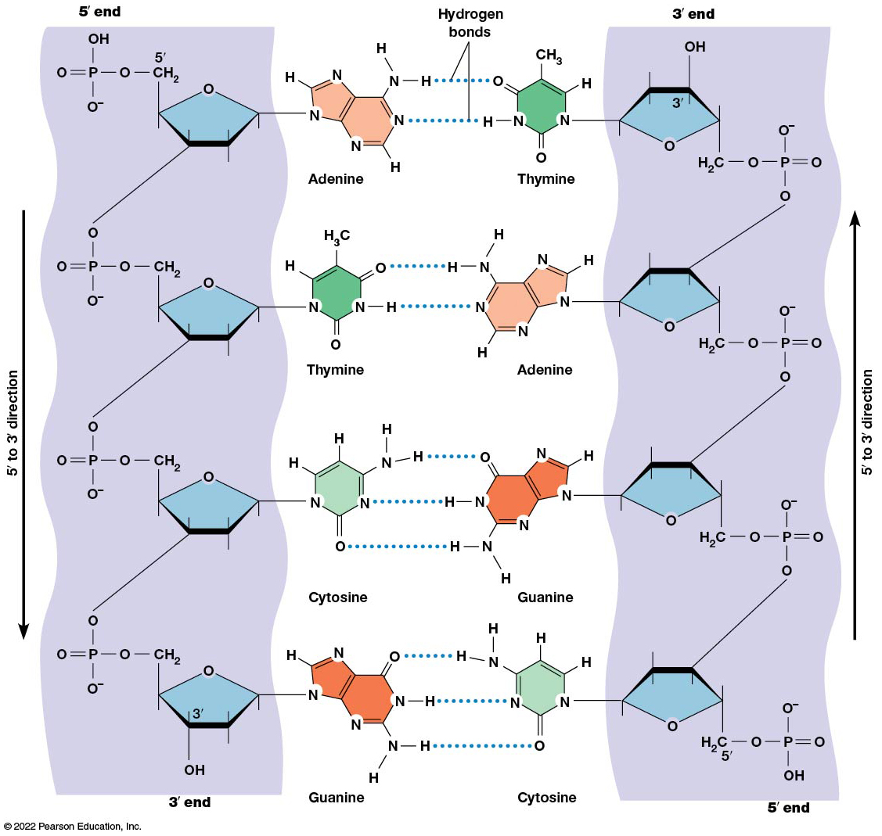
Hydrogen Bonding in D N A Nucleic Acid Structure
Figure 3.18 Hydrogen Bonding in DNA Nucleic Acid Structure.
Notes:
Long Description:
The details of the structure are as follows:
The two strands are antiparallel as their 5 dash to 3 dash direction is opposite to each other.
The sugar-phosphate backbone is on the sides and the base pairs are in the middle.
The two nucleotide chains are linked by hydrogen bonding between complementary base pairs. Adenine and thymine are held together by two hydrogen bonds and guanine and cytosine are held together by three hydrogen bonds.

Slide 73
The D N A Molecule Is a Double-Stranded Helix
Francis Crick and James Watson postulated the double helix structure of D N A in 1953.
The structure accounted for the known physical and chemical properties of D N A.
It also suggested a mechanism for D N A replication.
Two antiparallel and complementary strands of D N A twist around a common axis to form a right-handed spiral structure.

Slide 74
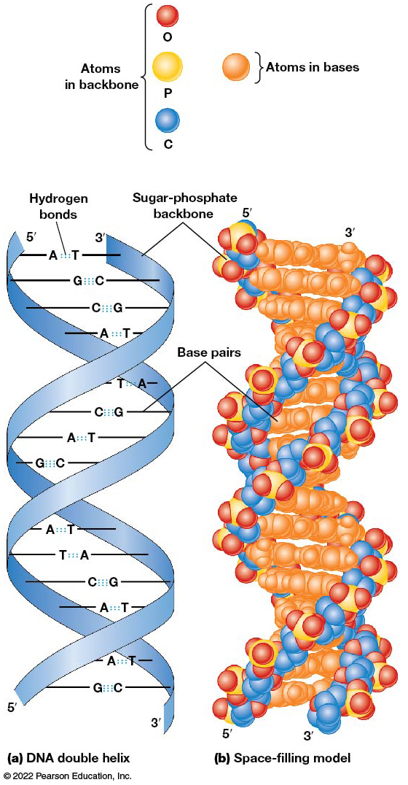
The Structure of Double-Stranded D N A
Figure 3.19 The Structure of Double-Stranded D N A.
Notes:
Long Description:
Double helical model (a) of D N A double helix shows two strands that are wound around each other in the shape of a twisted ladder. The strands run in opposite directions; one strand is 5 dash to 3 dash and the other strand is 3 dash to 5 dash from top to bottom. The sides of the ladder are made of sugar-phosphate backbones and the rungs of the ladder are made of nitrogenous base pairs linked by hydrogen bonds shown as dotted lines.
Space-filling model (b) of D N A double helix shows spheres of different colors arranged in the shape of a twisted ladder. Atoms in the backbone which are in the periphery are colored red for O, yellow for P, and blue for C. Atoms in bases which are in the middle are colored orange.

Slide 75
Base Pairing and R N A
R N A is normally single stranded.
R N A structure also depends on base pairing.
However, the pairing is usually between bases in different areas of the same molecule and is less extensive than that of D N A.

Slide 76
3.3 Polysaccharides
Polysaccharides are long chain polymers of sugars and sugar derivatives.
They serve primarily in structure and storage.
They usually consist of a single kind of repeating unit or sometimes an alternating pattern of two kinds.
Short polymers, oligosaccharides, are sometimes attached to cell surface proteins.

Slide 77
The Monomers Are Monosaccharides
Repeating units of polysaccharides are monosaccharides.
A sugar may be an aldehyde, aldosugars with a terminal carbonyl group; or ketone, ketosugars with an internal carbonyl group.
Sugars within these groups are named generically based on how many carbon atoms they contain.

Slide 78
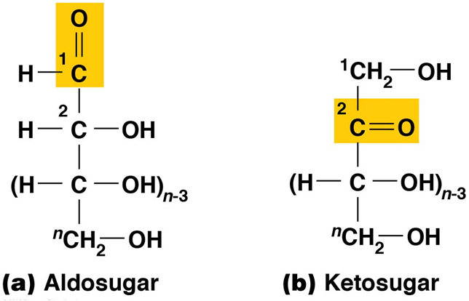
Structures of Monosaccharides
Figure 3.20 Structures of Monosaccharides.
Notes:
Long Description:
Structure (a) of aldosugar from top to bottom is: Superscript 1 C double-bonded to O above and single-bonded to H on the left; single bond; superscript 2 C single-bonded to H on the left and O H on the right; single bond; (n minus 3) times C single-bonded to H on the left and O H on the right; single bond; superscript n C H subscript 2 single-bonded to O H on the right. Superscript 1 C double-bonded to O is highlighted.
Structure (b) of ketosugar from top to bottom is: Superscript 1 C H subscript 2 single-bonded to O H; single bond; superscript 2 C double-bonded to O on the right; single bond; (n minus 3) times C single-bonded to H on the left and O H on the right; single bond; superscript n C H subscript 2 single-bonded to O H on the right. Superscript 2 C double-bonded to O is highlighted.

Slide 79
Classification of Sugars
Most sugars have between three and seven carbons and are classified as
Trioses (three carbons)
Tetroses (four carbons)
Pentoses (five carbons)
Hexoses (six carbons)
Heptoses (seven carbons)

Slide 80
Glucose
The single most common monosaccharide is the aldohexose d-glucose (C₆H₁₂O₆).
The formula C_{n}H_{2n}O_{n} is common for sugars and led to the general term carbohydrate.
For every molecule of CO₂ incorporated into a sugar, one water molecule is consumed.
The carbons of glucose (and other organic molecules) are numbered from the more oxidized, carbonyl end.

Slide 81
The Structure of Glucose
d-glucose is the most stable form of glucose though many other stereoisomers are possible.
d-glucose is often depicted as a linear molecule, as in the Fischer projection, in which the H and OH groups are intended to project out of the plane of the diagram.
In the cell, d-glucose exists in a dynamic equilibrium between the linear and ring form.
The Haworth projection shows the ring form of the molecule.

Slide 82
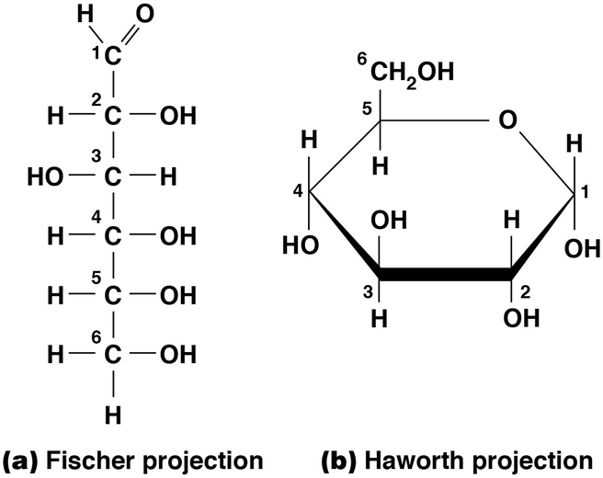
The Structure of d-Glucose
Figure 3.21 The Structure of d-Glucose.
Notes:
Long Description:
Structure (a) shows Fischer projection which is a linear chain of D hyphen glucose.
The six carbon structure from top to bottom is as follows: A single-bonded, condensed chain of C 1 single-bonded to H on top-left and double-bonded to O on top-right, C 2 single-bonded to H on left and single-bonded to O H on right, C 3 single-bonded to O H on left and single-bonded to H on right, C 4 single-bonded to H on left and single-bonded to O H on right, C 5 single-bonded to H on left and single-bonded to O H on right, C 6 single-bonded to H on left and single-bonded to O H on right, H below.
The orientation of the O H is reversed in carbon 3 relative to the O H groups on the other carbon atoms.
The first carbon forms the aldehyde group C H O.
Structure (b) shows Haworth projection which is a ring form of D hyphen glucose.
A six-membered ring with O at top-right. C 1 is single-bonded to H above and O H below; C 2 is single-bonded to H above and O H below; C 3 is single-bonded to O H above and H below; C 4 is single-bonded to H above and O H below; and C 5 is single-bonded to C 6 as C H subscript 2 O H above and H below.

Slide 83
Two Ring Forms of d-Glucose
The formation of a ring by d-glucose can result in two alternative forms.
These depend on the spatial orientation of the hydroxyl group on carbon number 1.
These forms are designated α (hydroxyl group downward) and β (hydroxyl group upward).

Slide 84
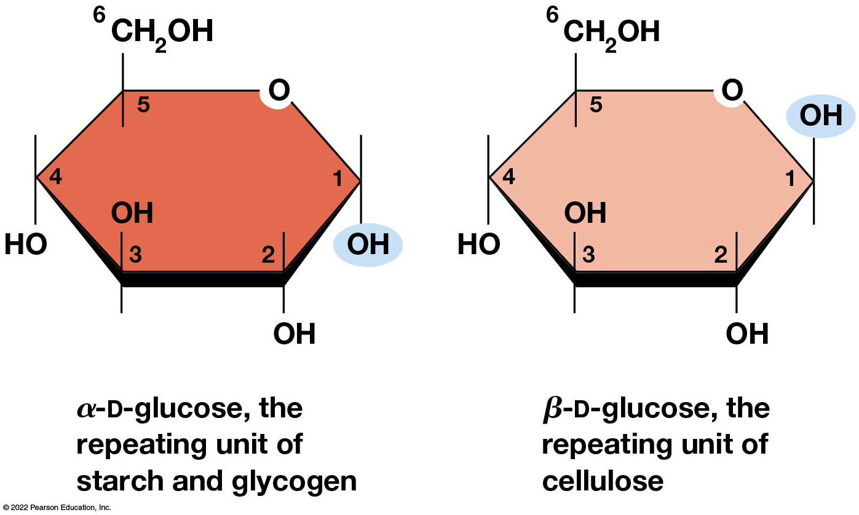
The Ring Forms of d-Glucose
Figure 3.22 The Ring Forms of d-Glucose.
Notes:
Long Description:
Structure (a) shows alpha hyphen D hyphen glucose which is the repeating unit of starch and glycogen. It is a six-membered ring with O at top-right. C 1 is single-bonded to H above and O H below; C 2 is single-bonded to H above and O H below; C 3 is single-bonded to O H above and H below; C 4 is single-bonded to H above and O H below; and C 5 is single-bonded to C 6 as C H subscript 2 O H above and H below. The O H bonded below C 1 is highlighted.
Structure (b) shows beta hyphen D hyphen glucose which is the repeating unit of cellulose. It is a six-membered ring with O at top-right. C 1 is single-bonded to O H above and H below; C 2 is single-bonded to H above and O H below; C 3 is single-bonded to O H above and H below; C 4 is single-bonded to H above and O H below; and C 5 is single-bonded to C 6 as C H subscript 2 O H above and H below. The O H bonded above C1 is highlighted.

Slide 85
Glucose Also Exists in Disaccharides
Glucose exists in disaccharides, in which two monosaccharide units are covalently linked.
Common disaccharides include
Maltose, two glucose units
Lactose, one glucose linked to one galactose
Sucrose, one glucose linked to one fructose

Slide 86
Disaccharides
The linkage of disaccharides is a glycosidic bond, formed between two monosaccharides by the elimination of water.
Glycosidic bonds involving the α form of glucose are called α glycosidic bonds (e.g., maltose); those involving the β form are called β glycosidic bonds (e.g., lactose).

Slide 87
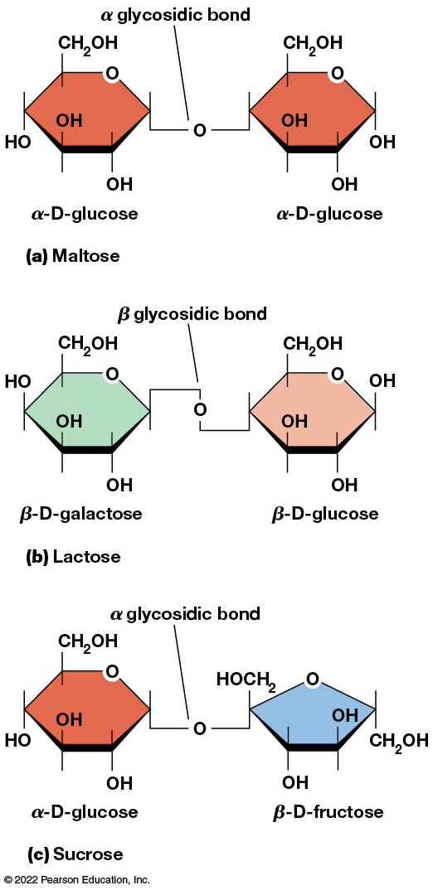
Some Common Disaccharides
Figure 3.23 Some Common Disaccharides.
Notes:
Long Description:
Structure (a) of maltose shows the ring form of two molecules of alpha hyphen D hyphen glucose linked together by alpha hyphen one, four glycosidic bond.
Structure (b) of lactose shows the ring form of beta hyphen D hyphen galactose and beta hyphen D hyphen glucose linked together by beta hyphen one, four glycosidic bond.
Structure (c) of sucrose shows the ring form of alpha hyphen D hyphen glucose and beta hyphen D hyphen fructose linked together by alpha hyphen one, two glycosidic bond.

Slide 88
The Polymers Are Storage and Structural Polysaccharides
The most familiar storage polysaccharides are starch in plant cells and glycogen in animal cells and bacteria.
Both consist of α-d-glucose units linked by α glycosidic bonds, involving carbons 1 and 4 (1→4).
Occasionally α(1→6) bonds may form, allowing for the formation of side chains (branching).

Slide 89
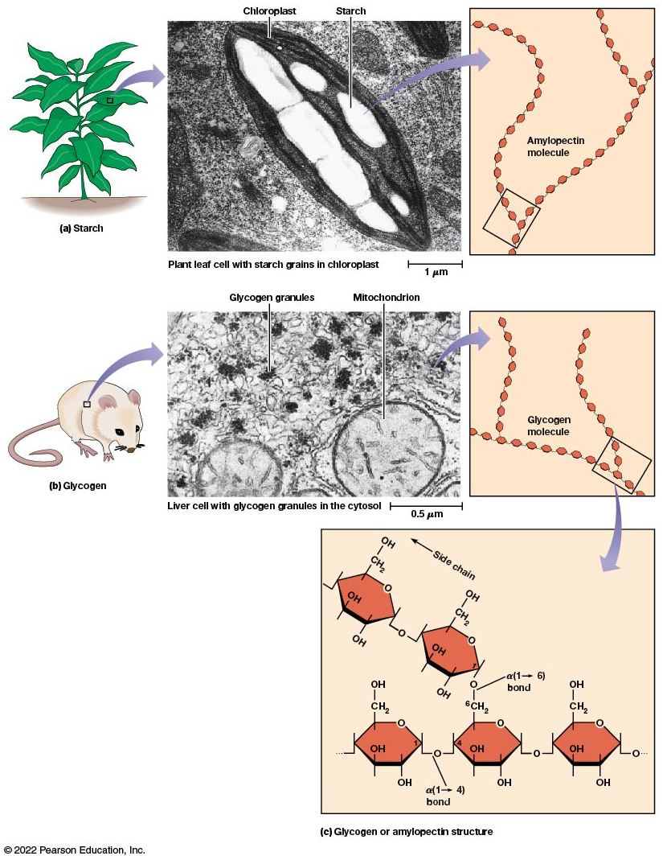
The Structure of Starch and Glycogen
Figure 3.24 The Structure of Starch and Glycogen.
Notes:
Long Description:
Illustration (a) shows a plant with starch. An exploded view of a portion of a leaf shows a micrograph at a scale of 1 micrometer. The micrograph shows starch grains stored in a chloroplast of a plant leaf cell. An exploded view of a starch grain shows its chemical structure. The chemical structure consists of glucose molecules shown as hexagons linked in a linear manner for amylose and in an occasional branched manner for amylopectin. The amylopectin molecule at one of the branch points is highlighted.
Illustration (b) shows a rat with glycogen. An exploded view of a portion of the rat shows a micrograph at a scale of 0.5 micrometer. The micrograph shows glycogen granules stored in the cytosol of a liver cell; a few mitochondria are shown near the glycogen granules. An exploded view of a glycogen granule shows its chemical structure. The chemical structure consists of glucose molecules shown as hexagons linked in a compact and branched manner.
Illustration (c) shows the exploded view of a branch point of glycogen or amylopectin structure. The linear chain consists of alpha hyphen D hyphen glucose molecules linked by alpha (1 to 4) glycosidic bonds, whereas side chains start from the linear chain at alpha (1 to 6) glycosidic bond.

Slide 90
Glycogen
Glycogen is highly branched, the branches occurring every 8–10 glucose units along the backbone.
Glycogen is stored mainly in the liver (as a source of glucose) and muscle tissues (as a fuel source for muscle contraction) of animals.
Bacteria also store glycogen as a glucose reserve.

Slide 91
Starch (1 of 2)
Starch is the glucose reserve commonly found in plant tissue.
It occurs both as unbranched amylose (10–30%) and branched amylopectin (70–90%).
Amylopectin has α(1→6) branches once every 12–25 glucose units and has longer side chains than glycogen.

Slide 92
Starch (2 of 2)
Starch is stored as starch grains within the plastids:
Chloroplasts, the sites of carbon fixation and sugar synthesis in photosynthesis
Amyloplasts, which are specialized for starch storage

Slide 93
Structural Polysaccharides
The best-known structural polysaccharide is the cellulose found in plant cell walls.
Cellulose, composed of repeating monomers of β-d-glucose, is very abundant in plants.
Mammals cannot digest cellulose (though some have microorganisms in their digestive systems that can).

Slide 94
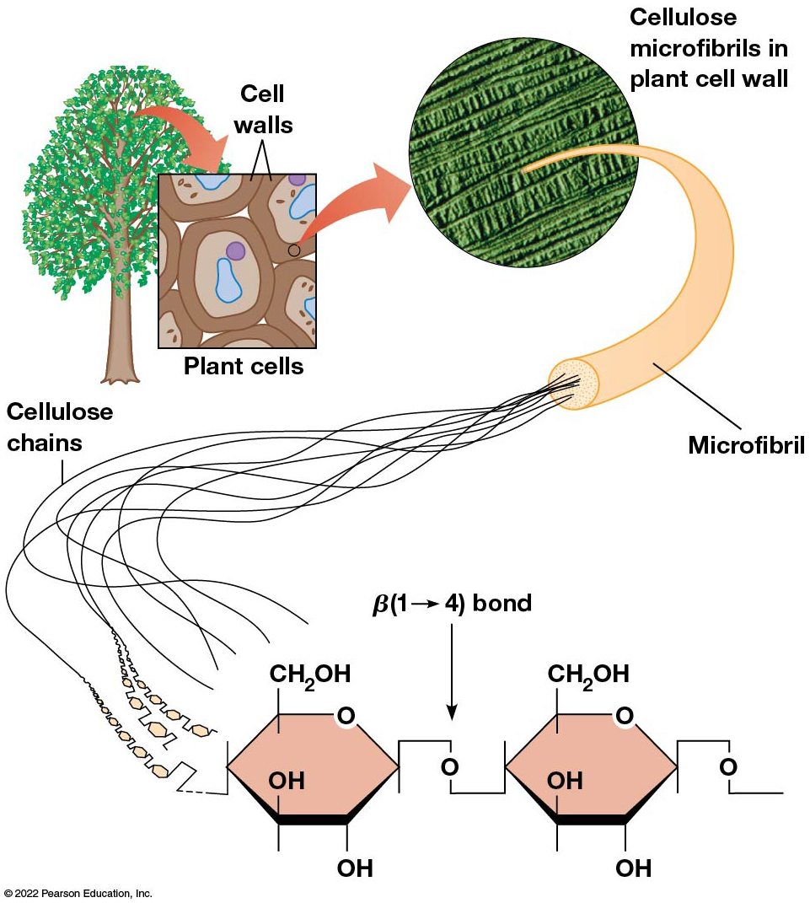
The Structure of Cellulose
Figure 3.25 The Structure of Cellulose.
Notes:
Long Description:
The illustration shows a tree with plant cells. An exploded view of a plant cell shows a micrograph displaying a group of plant cells having rigid cell walls. An exploded view of a portion of the plant cell wall shows a micrograph displaying cellulose microfibrils in parallel arrays. A single microfibril is made of many long, unbranched cellulose chains. Each chain is made of beta hyphen D hyphen glucose molecules arranged in a linear manner and linked together by beta (1 to 4) glycosidic bonds.

Slide 95
Other Structural Polysaccharides
The cellulose of fungal cell walls differs from that of plants and may contain either β(1→4) or β(1→3) linkages.
Bacterial cell walls contain two kinds of sugars: GlcNAc (N-acetylglucosamine) and MurNAc (N-acetylmuramic acid).
Both are derivatives of β-glucosamine and are linked alternately in cell walls.

Slide 96
Chitin
The polysaccharide chitin consists of GlcNAc units only, joined by β(1→4) bonds.
Chitin is found in insect exoskeletons, crustacean shells, and fungal cell walls.

Slide 97
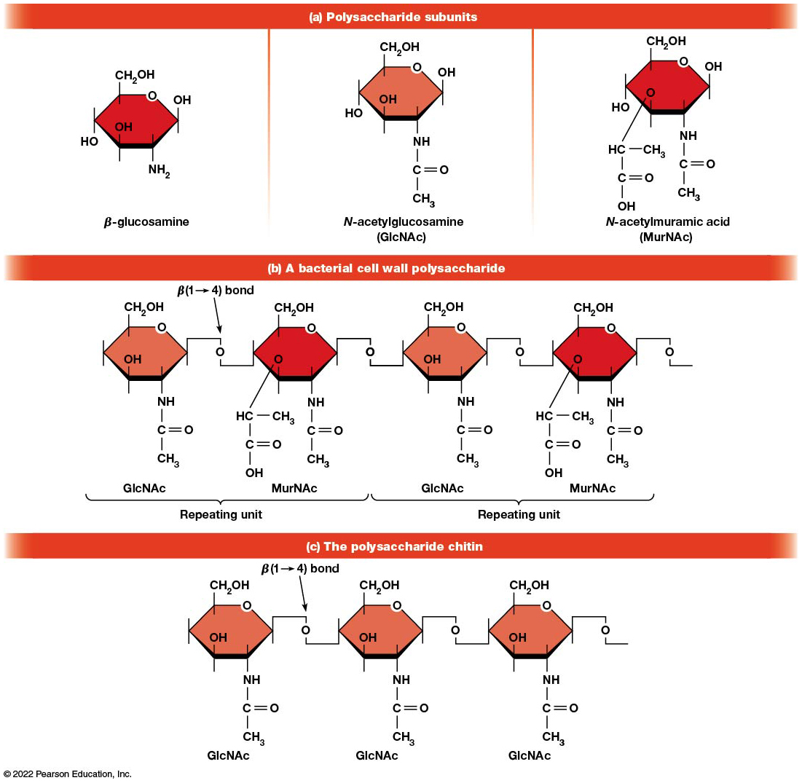
Polysaccharides of Bacterial Cell Walls and Insect Exoskeletons
Figure 3.26 Polysaccharides of Bacterial Cell Walls and Insect Exoskeletons.
Notes:
Long description:
The structure is described as below:
Polysaccharide subunits:
Beta glucosamine: A hexagonal structure shows C H subscript 2 O H, O, N H subscript 2 and three O H bonds in each vertex.
N hyphen acetylglucosamine (G l c N A c): A hexagonal structure shows C H subscript 2 O H, O bond, a N H single bond C double bond O and a single bond with C H subscript 3, three OH bonds in each vertex.
N hyphen acetylmuramic acid (M u r N A c): A hexagonal structure shows C H subscript 2 O H, O bond, a N H single bond C double bond O and a single bond with C H subscript 3, two O H bonds and a O to C H single bond C H subscript 3, C double bond O and a single bond to O H in each carbon atom.
A bacterial cell wall polysaccharide
There are repeating units of two hexagonal blocks. The first hexagon labeled as “G l c N A c” is a C H subscript 2 O H and N H single bond C double bond O and a single bond CH3, one O and an O H bond. The second hexagon labeled as “M u r N A c” shows a C H subscript 2 O H, one N H single bond C double bond O and single bond C H subscript 3, and an O to C H to C H subscript 3, a C double bond O, and a single bond OH. There is an Oxygen bond between the two hexagons and is a beta 1 to 4 bond.
The polysaccharide chain
It shows repeating “G l c N A c” structures. Each is a hexagonal bond of C H subscript 2 O H, O, OH, and an N H to C double bond O single bond C H subscript 3. Between every hexagon structure, there is an oxygen bond labeled as beta 1 to 4 bond.

Slide 98
Polysaccharide Structure Depends on the Type of Glycosidic Bonds Involved
α and β glycosidic bonds are associated with marked structural differences.
Starch and glycogen (α polysaccharides) form loose helices that are not highly ordered because of the side chains.
Cellulose (that forms β linkages) exists as rigid linear rods that aggregate into microfibrils, about 5–20 nm in diameter.
Plant and fungal cells walls contain these rigid microfibrils in a noncellulose matrix containing other polymers (hemicellulose, pectin) and a protein called extensin.

Slide 99
3.4 Lipids
Lipids are not formed by the same type of linear polymerization that forms proteins, nucleic acids, and polysaccharides.
However, they are regarded as macromolecules because of their high molecular weight and their importance in cellular structures, particularly membranes.

Slide 100
Features of Lipids
Although heterogeneous, all have a hydrophobic nature and thus little affinity for water; they are readily soluble in nonpolar solvents such as chloroform or ether.
They have relatively few polar groups, but some are amphipathic, having polar and nonpolar regions.
Functions include energy storage, membrane structure, or specific biological functions such as signal transmission.

Slide 101
The Main Classes of Lipids (1 of 2)
The lipids can be divided into six classes based on their structure:
Fatty acids
Triacylglycerols
Phospholipids
Glycolipids
Steroids
Terpines

Slide 102
The Main Classes of Lipids (2 of 2)
Figure 3.27 The Main Classes of Lipids.
Notes:
Long Description:
The structure is described as below:
Polysaccharide subunits:
Beta glucosamine: A hexagonal structure shows C H subscript 2 O H, O, N H subscript 2 and three O H bonds in each vertex.
N hyphen acetylglucosamine (G l c N A c): A hexagonal structure shows C H subscript 2 O H, O bond, a N H single bond C double bond O and a single bond with C H subscript 3, three OH bonds in each vertex.
N hyphen acetylmuramic acid (M u r N A c): A hexagonal structure shows C H subscript 2 O H, O bond, a N H single bond C double bond O and a single bond with C H subscript 3, two O H bonds and a O to C H single bond C H subscript 3, C double bond O and a single bond to O H in each carbon atom.
A bacterial cell wall polysaccharide
There are repeating units of two hexagonal blocks. The first hexagon labeled as “G l c N A c” is a C H subscript 2 O H and N H single bond C double bond O and a single bond CH3, one O and an O H bond. The second hexagon labeled as “M u r N A c” shows a C H subscript 2 O H, one N H single bond C double bond O and single bond C H subscript 3, and an O to C H to C H subscript 3, a C double bond O, and a single bond OH. There is an Oxygen bond between the two hexagons and is a beta 1 to 4 bond.
The polysaccharide chain
It shows repeating “G l c N A c” structures. Each is a hexagonal bond of C H subscript 2 O H, O, OH, and an N H to C double bond O single bond C H subscript 3. Between every hexagon structure, there is an oxygen bond labeled as beta 1 to 4 bond.

Slide 103
Fatty Acids Are the Building Blocks of Several Classes of Lipids
Fatty acids are components of several other kinds of lipids.
A fatty acid is a long amphipathic, unbranched hydrocarbon chain with a carboxyl group at one end.
The polar carboxyl group is the “head,” and the nonpolar hydrocarbon chain is the “tail.”

Slide 104
Fatty Acid Structure (1 of 2)
The hydrocarbon tails are variable in length but usually 12 to 20 carbons long.
Even numbers of carbons are favored because fatty acid synthesis occurs via the stepwise addition of two-carbon units to the growing chain.
Fatty acids are highly reduced and so yield a large amount of energy upon oxidation.

Slide 105
Some Common Fatty Acids in Cells
Table 3.5 Some Common Fatty Acids in Cells
Number of Carbons | Number of Double Bonds | Common Name*
12 | 0 | Laurate
14 | 0 | Myristate
16 | 0 | Palmitate
18 | 0 | Stearate
20 | 0 | Arachidate
16 | 1 | Palmitoleate
18 | 1 | Oleate
18 | 2 | Linoleate
18 | 3 | Linolenate
20 | 4 | Arachidonate
*Shown are the names for the ionized forms of the fatty acids as they exist at the near neutral pH of most cells. For the names of the free fatty acids, simply replace the –ate ending with –ic acid.

Slide 106
Fatty Acid Structure (2 of 2)
In saturated fatty acids, each carbon atom in the chain is bonded to the maximum number of hydrogens.
These have long straight chains that pack together well.
Unsaturated fatty acids have one or more double bonds, so they have bends in the chains and are less tightly packed.

Slide 107
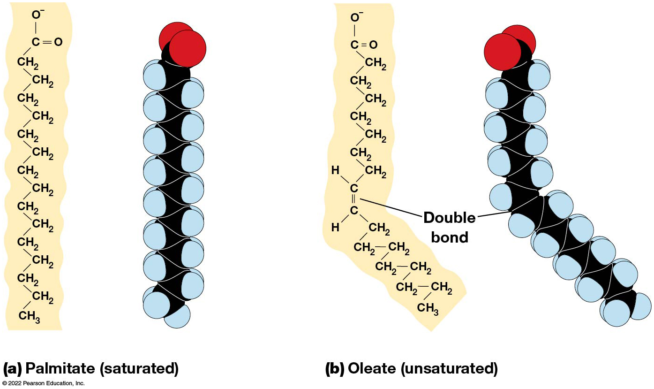
Structures of Saturated and Unsaturated Fatty Acids
Figure 3.28 Structures of Saturated and Unsaturated Fatty Acids.
Notes:
Long description:
Palmitate has sixteen carbon molecules as fourteen single bond C H subscript 2 molecules and one C with double bond to oxygen and single bond to O negative. It shows a vertical structure of C H subscript 2 on the left and right sides alternating with a single bond and ends with a C H subscript 3.
Oleate has eighteen carbon molecules of fourteen single bond C H subscript 2 and one C H to C H double bond at the center. There is a C to O double bond and C to O negative single bond. The chain ends with a C H subscript 3. The structure looks inclined at an angle beyond the double bond.

Slide 108
Trans Fats
Trans fats are a type of unsaturated fatty acid with a particular type of double bond that causes less of a bend in the chain.
They are relatively rare in nature and are produced artificially in shortening and margarine.
They have been linked to increased risk of heart disease and elevated cholesterol levels.

Slide 109
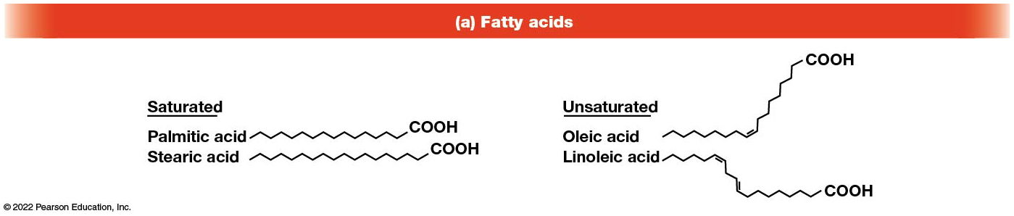
Fatty Acids
Figure 3.27 The Main Classes of Lipids.
Notes:
Long description:
The structures of various compounds are described below:
Fatty acids:
Saturated fatty acids are palmitic acid and stearic acid, which are single bonds of C O O H. Unsaturated fatty acids are oleic acid and linoleic acid, which are single bonds of C O O H with a couple of double bonds in between. Where there is a double bond in oleic acid and two double bonds in linoleic acid, the structure tends to take an inclined angle.
2. Triacylglycerols and their synthesis:
The equation shows glycerol plus three fatty acids gives triacylglycerol and gives out three molecules of water. Glycerol shows three C molecules single bond to O H and H, and additional two H atoms. Three fatty acids show three C double bond O and single bond O H. Triacylglecerol shows a C single bond to H, H, O and the O has a single bond to C double bond O molecule. Thus structure repeats thrice for Triacylglecerol. The third structure in inclined to the bottom at a double bond.
3. Phospholipids where R equals any of several hydrophilic compounds.
Phosphoglycerides
R single bond P single bond glycerol. The glycerol structure is two C molecules single bond to O H and H, C H subscript 2, and the O are bonded to C double bond O.
b) Sphingolipids
R single bond P single bond sphingosine. The Sphingosine is two C molecules, where the first C is single bond O H, H, C to H, to double bond with another C. The second C is single bond H, bond N H, single bond to C double bond to O. The second has a single bond to C H subscript 2, which is turn has a single bond with P.
4. Glycolipids where R is carbohydrate chain of 1 to 6 monosaccharide units. It shows a Sphingosine bond with a C double bond O. The Sphingosine is two C molecules, where the first C is single bond O H, H, C to H, to double bond with another C. The second C is single bond H, bond N H, single bond to C double bond to O. The second has a single bond to C H subscript 2.
5. Steroids: It shows four ringed hydrocarbon skeleton of steroids. The vertex of the three hexagons are numbered as 1 to 5, 6 to 10, and 11 to 14 respectively. The fourth pentagon shows vertices 15 to 17. Number 18 and 19 and bonds between the first and second hydrocarbon and third and fourth hydrocarbons. The second structure shows the position of O H.
6. Terpenes: It is labeled Vitamin A. It shows isoprene getting delineated to isoprene units of vitamin A. An isoprene is a C double bond C H subscript 2, single bond C H subscript 3, single bond C H with a double bond C H subscript 2. The delineated isoprene unit is a structure of C H single bond C single bond C H subscript 3, the C has a double bond with C single bond H single bond C H and H. The second isoprene unit has a C H subscript 2 O H to C. The structure has a hexagon on the top with a C single bond H connecting with the double bond with the isoprene structures.

Slide 110
Triacylglycerols Are Storage Lipids
Triacylglycerols, also known as triglycerides, consist of a glycerol molecule with three fatty acids attached to it.
Glycerol is a three-carbon alcohol with a hydroxyl group on each carbon.
Fatty acids are linked to glycerol, one at a time, by ester bonds formed by the removal of water.

Slide 111
Triacylglycerol Structure
Monoacylglycerols contain a single fatty acid.
Diacylglycerols have two fatty acids.
The three fatty acids on a triacylglycerol may vary in length and degree of saturation.

Slide 112
Triacylglycerol Function
The main function of triacylglycerols is energy storage.
Triacylglycerols containing mostly saturated fats are usually solid or semisolid at room temperature and are called fats.
Triacylglycerols in plants are liquid at room temperature (e.g., vegetable oil) and are predominantly unsaturated.

Slide 113
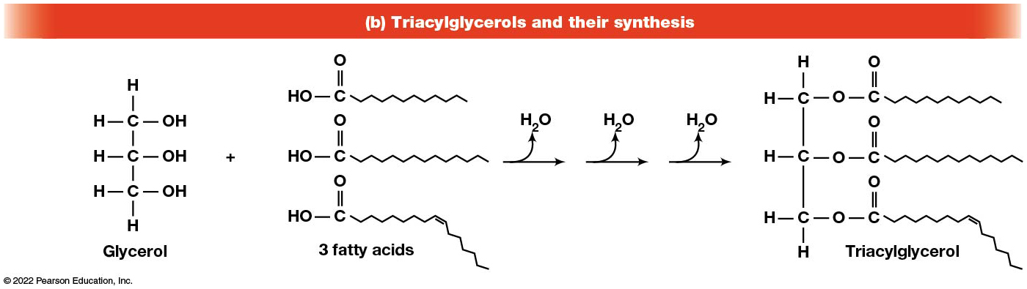
Triacylglycerols and Their Synthesis
Figure 3.27 The Main Classes of Lipids.
Notes:
Long description:
The structures of various compounds are described below:
Fatty acids:
Saturated fatty acids are palmitic acid and stearic acid, which are single bonds of C O O H. Unsaturated fatty acids are oleic acid and linoleic acid, which are single bonds of C O O H with a couple of double bonds in between. Where there is a double bond in oleic acid and two double bonds in linoleic acid, the structure tends to take an inclined angle.
2. Triacylglycerols and their synthesis:
The equation shows glycerol plus three fatty acids gives triacylglycerol and gives out three molecules of water. Glycerol shows three C molecules single bond to O H and H, and additional two H atoms. Three fatty acids show three C double bond O and single bond O H. Triacylglecerol shows a C single bond to H, H, O and the O has a single bond to C double bond O molecule. Thus structure repeats thrice for Triacylglecerol. The third structure in inclined to the bottom at a double bond.
3. Phospholipids where R equals any of several hydrophilic compounds.
Phosphoglycerides
R single bond P single bond glycerol. The glycerol structure is two C molecules single bond to O H and H, C H subscript 2, and the O are bonded to C double bond O.
b) Sphingolipids
R single bond P single bond sphingosine. The Sphingosine is two C molecules, where the first C is single bond O H, H, C to H, to double bond with another C. The second C is single bond H, bond N H, single bond to C double bond to O. The second has a single bond to C H subscript 2, which is turn has a single bond with P.
4. Glycolipids where R is carbohydrate chain of 1 to 6 monosaccharide units. It shows a Sphingosine bond with a C double bond O. The Sphingosine is two C molecules, where the first C is single bond O H, H, C to H, to double bond with another C. The second C is single bond H, bond N H, single bond to C double bond to O. The second has a single bond to C H subscript 2.
5. Steroids: It shows four ringed hydrocarbon skeleton of steroids. The vertex of the three hexagons are numbered as 1 to 5, 6 to 10, and 11 to 14 respectively. The fourth pentagon shows vertices 15 to 17. Number 18 and 19 and bonds between the first and second hydrocarbon and third and fourth hydrocarbons. The second structure shows the position of O H.
6. Terpenes: It is labeled Vitamin A. It shows isoprene getting delineated to isoprene units of vitamin A. An isoprene is a C double bond C H subscript 2, single bond C H subscript 3, single bond C H with a double bond C H subscript 2. The delineated isoprene unit is a structure of C H single bond C single bond C H subscript 3, the C has a double bond with C single bond H single bond C H and H. The second isoprene unit has a C H subscript 2 O H to C. The structure has a hexagon on the top with a C single bond H connecting with the double bond with the isoprene structures.

Slide 114
Phospholipids Are Important in Membrane Structure
Phospholipids are important to membrane structure because of their amphipathic nature.
Phospholipids can be divided into phosphoglycerides or sphingolipids, depending on their chemistry.

Slide 115
Phosphoglycerides (1 of 2)
Phosphoglycerides are the predominant phospholipids in most membranes.
The basic components of phosphoglycerides is phosphatidic acid, which has two fatty acids and a phosphate group attached to a glycerol.
Membrane phosphoglycerides invariably have a small hydrophilic alcohol linked to the phosphate by an ester bond.

Slide 116
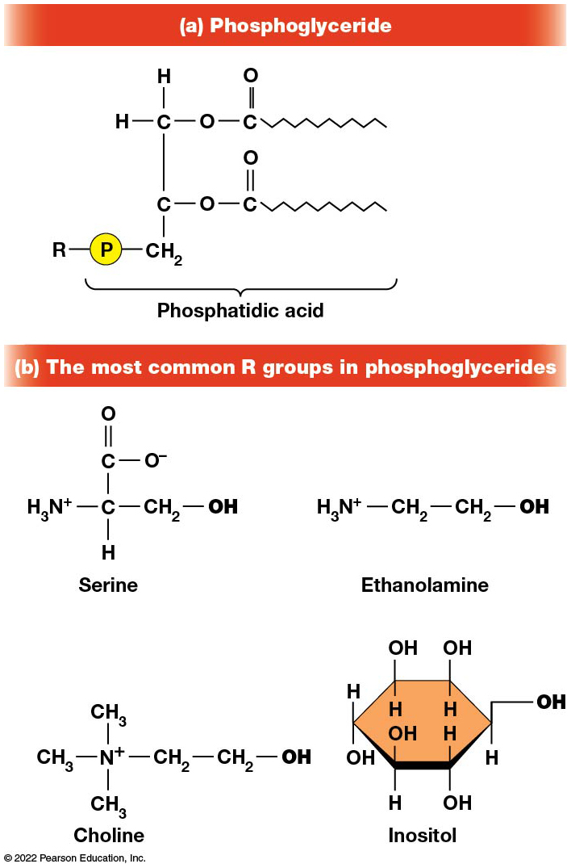
Structures of Common Phosphoglycerides
Figure 3.29 Structures of Common Phosphoglycerides.
Notes:
Long description:
Structure of phosphoglyceride: R single bond P single bond C H subscript 2 single bond C O C double bond O. Another link shows C single bond C H subscript 2 O C double bond O. The entire bond from P molecule is termed as phosphatidic acid.
Structure of the most common R groups in phosphoglycerides:
Serine: A carbon atom bonds with N positive H subscript 3, C H subscript 2 single bond O H, H, and C double bond O and a single bond O negative.
Ethanolamine: N positive H subscript 3 single bond C H subscript 2 single bond C H subscript 2 single O H.
Choline: Molecule of N plus with three C H subscript 3 single bonds and one single bond of C H subscript 2 single bond C H subscript 2 O H.
Inositol: One hexagon having O H single bond H in all the vertices.
O H is highlighted in all these four structures.

Slide 117
Phosphoglycerides (2 of 2)
The alcohol is usually serine, ethanolamine, choline, or inositol, which contributes to the polar nature of the phospholipid head group.
Typical phosphoglycerides often have one saturated and one unsaturated fatty acid.
The length and degree of saturation of the fatty acids have profound effects on membrane fluidity.

Slide 118
Sphingolipids (1 of 2)
Sphingolipids are based on the amine sphingosine, which has a long hydrocarbon chain with a single site of unsaturation near the polar end.
Sphingosine can form an amide bond to a long-chain fatty acid, resulting in a molecule called a ceramide.

Slide 119
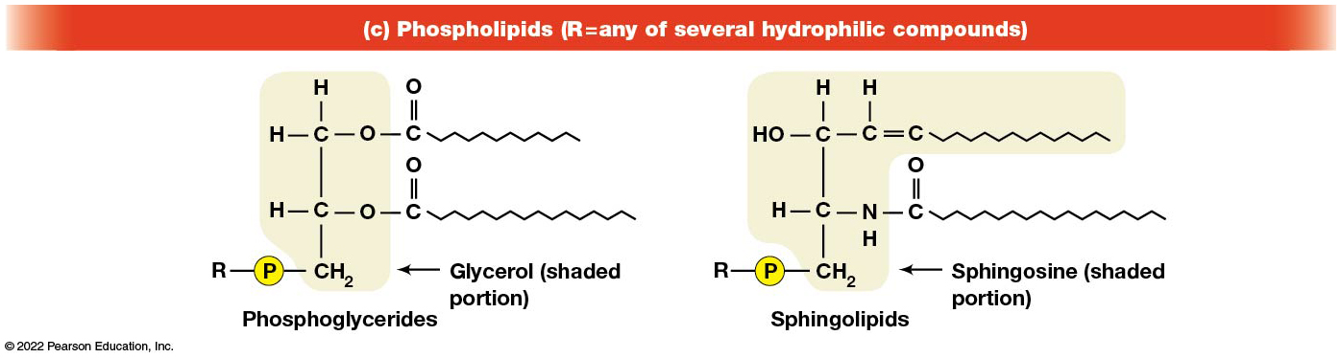
Phospholipids
Figure 3.27 The Main Classes of Lipids.
Notes:
Long description:
The structures of various compounds are described below:
Fatty acids:
Saturated fatty acids are palmitic acid and stearic acid, which are single bonds of C O O H. Unsaturated fatty acids are oleic acid and linoleic acid, which are single bonds of C O O H with a couple of double bonds in between. Where there is a double bond in oleic acid and two double bonds in linoleic acid, the structure tends to take an inclined angle.
2. Triacylglycerols and their synthesis:
The equation shows glycerol plus three fatty acids gives triacylglycerol and gives out three molecules of water. Glycerol shows three C molecules single bond to O H and H, and additional two H atoms. Three fatty acids show three C double bond O and single bond O H. Triacylglecerol shows a C single bond to H, H, O and the O has a single bond to C double bond O molecule. Thus structure repeats thrice for Triacylglecerol. The third structure in inclined to the bottom at a double bond.
3. Phospholipids where R equals any of several hydrophilic compounds.
Phosphoglycerides
R single bond P single bond glycerol. The glycerol structure is two C molecules single bond to O H and H, C H subscript 2, and the O are bonded to C double bond O.
b) Sphingolipids
R single bond P single bond sphingosine. The Sphingosine is two C molecules, where the first C is single bond O H, H, C to H, to double bond with another C. The second C is single bond H, bond N H, single bond to C double bond to O. The second has a single bond to C H subscript 2, which is turn has a single bond with P.
4. Glycolipids where R is carbohydrate chain of 1 to 6 monosaccharide units. It shows a Sphingosine bond with a C double bond O. The Sphingosine is two C molecules, where the first C is single bond O H, H, C to H, to double bond with another C. The second C is single bond H, bond N H, single bond to C double bond to O. The second has a single bond to C H subscript 2.
5. Steroids: It shows four ringed hydrocarbon skeleton of steroids. The vertex of the three hexagons are numbered as 1 to 5, 6 to 10, and 11 to 14 respectively. The fourth pentagon shows vertices 15 to 17. Number 18 and 19 and bonds between the first and second hydrocarbon and third and fourth hydrocarbons. The second structure shows the position of O H.
6. Terpenes: It is labeled Vitamin A. It shows isoprene getting delineated to isoprene units of vitamin A. An isoprene is a C double bond C H subscript 2, single bond C H subscript 3, single bond C H with a double bond C H subscript 2. The delineated isoprene unit is a structure of C H single bond C single bond C H subscript 3, the C has a double bond with C single bond H single bond C H and H. The second isoprene unit has a C H subscript 2 O H to C. The structure has a hexagon on the top with a C single bond H connecting with the double bond with the isoprene structures.

Slide 120
Sphingolipids (2 of 2)
A whole family of sphingolipids exists, with different polar groups attached to the hydroxyl group of the ceramide.
Sphingolipids are predominantly found in the outer leaflet of the plasma membrane bilayer, often in lipid rafts, localized domains within a membrane.
Lipid rafts are important in communication between a cell and its external environment.

Slide 121
Glycolipids Are Specialized Membrane Components
Glycolipids are lipids containing a carbohydrate instead of a phospholipid and are often derivatives of sphingosine and glycerol (glycosphingolipids).
Carbohydrate groups attached to a glycolipid may be one to six sugar units (d-glucose, d-galactose, or N-acetyl-d-galactosamine).
Glycolipids occur largely on the outer monolayer of the plasma membrane.

Slide 122
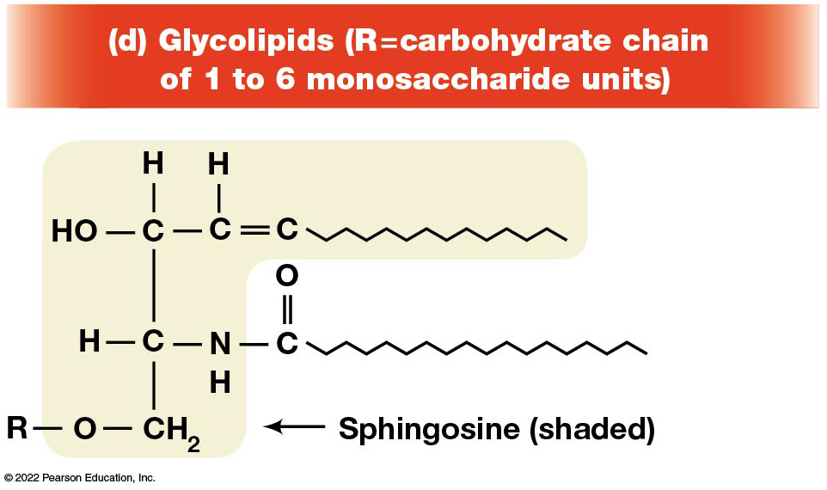
Glycolipids
Figure 3.27 The Main Classes of Lipids.
Notes:
Long description:
The structures of various compounds are described below:
Fatty acids:
Saturated fatty acids are palmitic acid and stearic acid, which are single bonds of C O O H. Unsaturated fatty acids are oleic acid and linoleic acid, which are single bonds of C O O H with a couple of double bonds in between. Where there is a double bond in oleic acid and two double bonds in linoleic acid, the structure tends to take an inclined angle.
2. Triacylglycerols and their synthesis:
The equation shows glycerol plus three fatty acids gives triacylglycerol and gives out three molecules of water. Glycerol shows three C molecules single bond to O H and H, and additional two H atoms. Three fatty acids show three C double bond O and single bond O H. Triacylglecerol shows a C single bond to H, H, O and the O has a single bond to C double bond O molecule. Thus structure repeats thrice for Triacylglecerol. The third structure in inclined to the bottom at a double bond.
3. Phospholipids where R equals any of several hydrophilic compounds.
Phosphoglycerides
R single bond P single bond glycerol. The glycerol structure is two C molecules single bond to O H and H, C H subscript 2, and the O are bonded to C double bond O.
b) Sphingolipids
R single bond P single bond sphingosine. The Sphingosine is two C molecules, where the first C is single bond O H, H, C to H, to double bond with another C. The second C is single bond H, bond N H, single bond to C double bond to O. The second has a single bond to C H subscript 2, which is turn has a single bond with P.
4. Glycolipids where R is carbohydrate chain of 1 to 6 monosaccharide units. It shows a Sphingosine bond with a C double bond O. The Sphingosine is two C molecules, where the first C is single bond O H, H, C to H, to double bond with another C. The second C is single bond H, bond N H, single bond to C double bond to O. The second has a single bond to C H subscript 2.
5. Steroids: It shows four ringed hydrocarbon skeleton of steroids. The vertex of the three hexagons are numbered as 1 to 5, 6 to 10, and 11 to 14 respectively. The fourth pentagon shows vertices 15 to 17. Number 18 and 19 and bonds between the first and second hydrocarbon and third and fourth hydrocarbons. The second structure shows the position of O H.
6. Terpenes: It is labeled Vitamin A. It shows isoprene getting delineated to isoprene units of vitamin A. An isoprene is a C double bond C H subscript 2, single bond C H subscript 3, single bond C H with a double bond C H subscript 2. The delineated isoprene unit is a structure of C H single bond C single bond C H subscript 3, the C has a double bond with C single bond H single bond C H and H. The second isoprene unit has a C H subscript 2 O H to C. The structure has a hexagon on the top with a C single bond H connecting with the double bond with the isoprene structures.

Slide 123
Steroids Are Lipids with a Variety of Functions
Steroids are derivatives of a four-ringed hydrocarbon skeleton, which distinguishes them from other lipids.
They are relatively nonpolar and therefore hydrophobic.
Steroids differ from one another in the positions of double bonds and functional groups.
The most common steroid in animal cells is cholesterol.

Slide 124
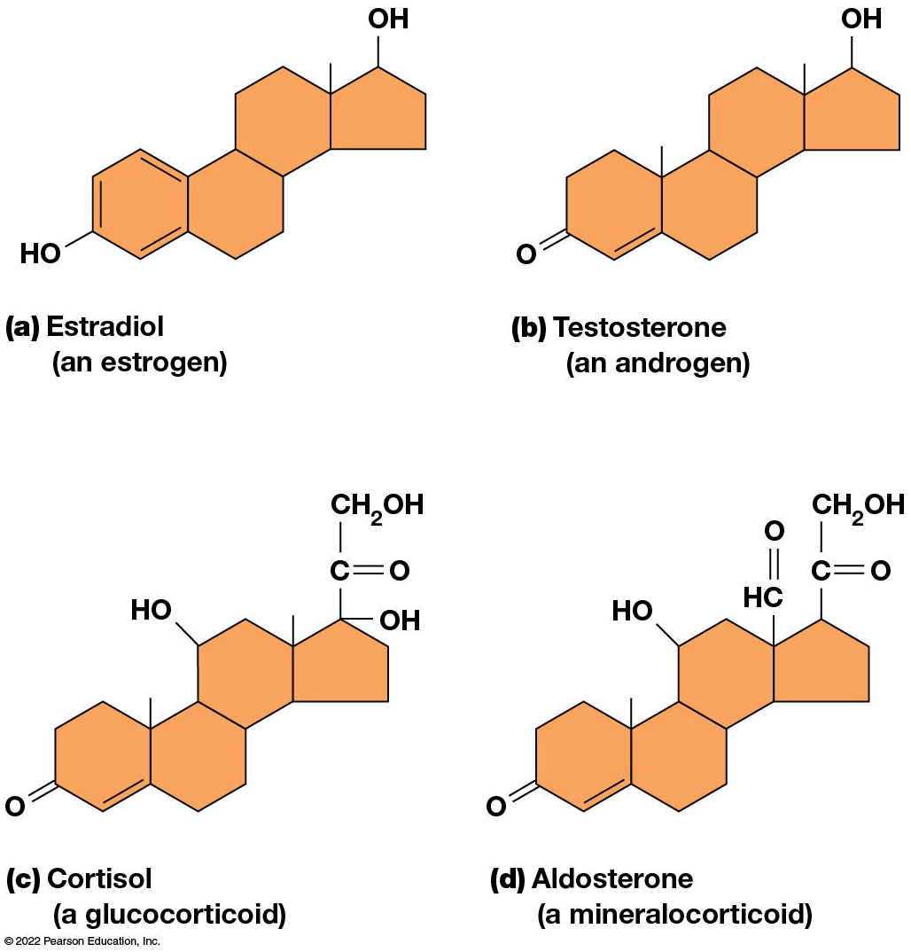
Structures of Several Common Steroid Hormones
Figure 3.30 Structures of Several Common Steroid Hormones.
Notes:
Long Description:
The structures are described as below:
Estradiol: A hexagonal molecule with three alternate double bonds and a single bond with O H. Two more hexagon molecules and a pentagon molecule with a single bond of O H are attached to it.
Testosterone: A hexagonal molecule with one double bond and a double bond with O. Two more hexagon molecules and a pentagon molecule with a single bond of O H are attached to it.
Cortisol: A hexagonal molecule with one double bond and a double bond with O. Two more hexagon molecules and a pentagon molecule of a C molecule with double bond O, single bond O H and a single bond C H subscript 2 O H are attached to it. One of the hexagon molecule has a single O H bond.
Aldosterone: A hexagonal molecule with one double bond and a double bond with O. Two more hexagon molecules and a pentagon molecule of a C H molecule with double bond O and a C double bond O single bond C H subscript 2 O H are attached to it. One of the hexagon molecule has a single O H bond.

Slide 125
A Variety of Sterols
Cholesterol is insoluble and found primarily in plasma membranes of animal cells and most membranes of organelles.
Similar molecules are found in plant cells (stigmasterol and sitosterol) and fungal cells (ergosterol).

Slide 126
Steroid Hormones (1 of 2)
Cholesterol is the starting material for synthesis of steroid hormones, including male and female sex hormones, the glucocorticoids, and the mineralocorticoids.
Sex hormones include estrogens produced by the ovaries of females (e.g., estradiol) and androgens produced by male testes (e.g., testosterone).

Slide 127
Steroid Hormones (2 of 2)
The glucocorticoids (e.g., cortisol) are a family of hormones that promote synthesis of glucose and suppress inflammation.
Mineralocorticoids (e.g., aldosterone) regulate ion balance by promoting reabsorption of sodium, chloride, and bicarbonate ions by the kidney.

Slide 128
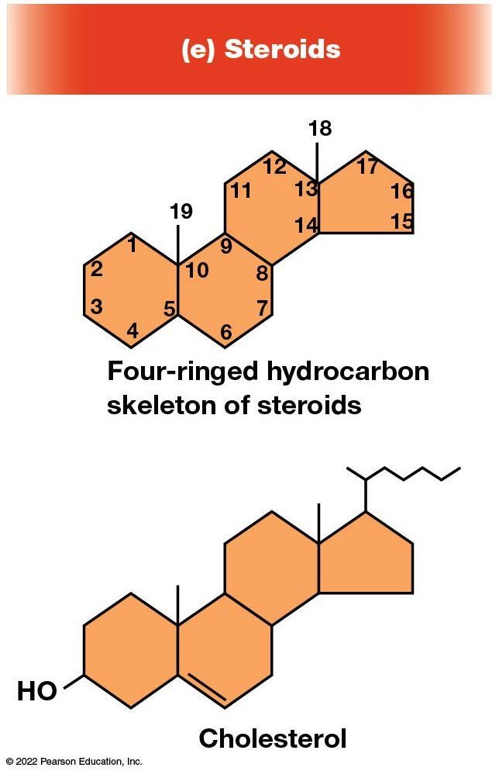
Steroids
Figure 3.27 The Main Classes of Lipids.
Notes:
Long description:
The structures of various compounds are described below:
Fatty acids:
Saturated fatty acids are palmitic acid and stearic acid, which are single bonds of C O O H. Unsaturated fatty acids are oleic acid and linoleic acid, which are single bonds of C O O H with a couple of double bonds in between. Where there is a double bond in oleic acid and two double bonds in linoleic acid, the structure tends to take an inclined angle.
2. Triacylglycerols and their synthesis:
The equation shows glycerol plus three fatty acids gives triacylglycerol and gives out three molecules of water. Glycerol shows three C molecules single bond to O H and H, and additional two H atoms. Three fatty acids show three C double bond O and single bond O H. Triacylglecerol shows a C single bond to H, H, O and the O has a single bond to C double bond O molecule. Thus structure repeats thrice for Triacylglecerol. The third structure in inclined to the bottom at a double bond.
3. Phospholipids where R equals any of several hydrophilic compounds.
Phosphoglycerides
R single bond P single bond glycerol. The glycerol structure is two C molecules single bond to O H and H, C H subscript 2, and the O are bonded to C double bond O.
b) Sphingolipids
R single bond P single bond sphingosine. The Sphingosine is two C molecules, where the first C is single bond O H, H, C to H, to double bond with another C. The second C is single bond H, bond N H, single bond to C double bond to O. The second has a single bond to C H subscript 2, which is turn has a single bond with P.
4. Glycolipids where R is carbohydrate chain of 1 to 6 monosaccharide units. It shows a Sphingosine bond with a C double bond O. The Sphingosine is two C molecules, where the first C is single bond O H, H, C to H, to double bond with another C. The second C is single bond H, bond N H, single bond to C double bond to O. The second has a single bond to C H subscript 2.
5. Steroids: It shows four ringed hydrocarbon skeleton of steroids. The vertex of the three hexagons are numbered as 1 to 5, 6 to 10, and 11 to 14 respectively. The fourth pentagon shows vertices 15 to 17. Number 18 and 19 and bonds between the first and second hydrocarbon and third and fourth hydrocarbons. The second structure shows the position of O H.
6. Terpenes: It is labeled Vitamin A. It shows isoprene getting delineated to isoprene units of vitamin A. An isoprene is a C double bond C H subscript 2, single bond C H subscript 3, single bond C H with a double bond C H subscript 2. The delineated isoprene unit is a structure of C H single bond C single bond C H subscript 3, the C has a double bond with C single bond H single bond C H and H. The second isoprene unit has a C H subscript 2 O H to C. The structure has a hexagon on the top with a C single bond H connecting with the double bond with the isoprene structures.

Slide 129
Terpenes Are Formed from Isoprene
Terpenes are synthesized from the five-carbon compound isoprene and are sometimes called isoprenoids.
Isoprene and its derivatives are joined in various combinations to produce substances such as vitamin A and carotenoid pigments.

Slide 130
Other Isoprene-Based Compounds
The isoprene-based compounds, dolichols, are involved in activating sugar compounds.
Electron carriers such as coenzyme Q and plastoquinone are also isoprene derivatives.
Polyisoprenoids, polymers of isoprene, are found in cell membranes of the Archaea.

Slide 131
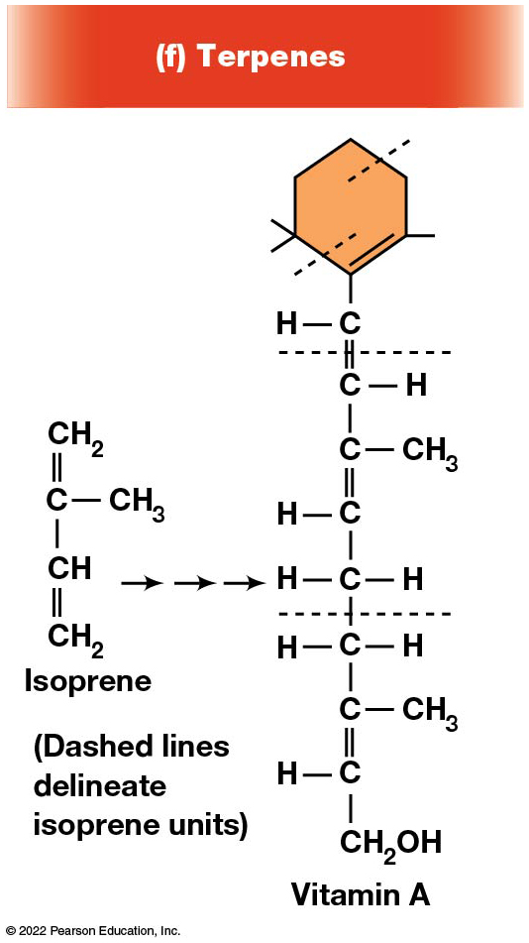
Terpenes
Figure 3.27 The Main Classes of Lipids.
Notes:
Long description:
The structures of various compounds are described below:
Fatty acids:
Saturated fatty acids are palmitic acid and stearic acid, which are single bonds of C O O H. Unsaturated fatty acids are oleic acid and linoleic acid, which are single bonds of C O O H with a couple of double bonds in between. Where there is a double bond in oleic acid and two double bonds in linoleic acid, the structure tends to take an inclined angle.
2. Triacylglycerols and their synthesis:
The equation shows glycerol plus three fatty acids gives triacylglycerol and gives out three molecules of water. Glycerol shows three C molecules single bond to O H and H, and additional two H atoms. Three fatty acids show three C double bond O and single bond O H. Triacylglecerol shows a C single bond to H, H, O and the O has a single bond to C double bond O molecule. Thus structure repeats thrice for Triacylglecerol. The third structure in inclined to the bottom at a double bond.
3. Phospholipids where R equals any of several hydrophilic compounds.
Phosphoglycerides
R single bond P single bond glycerol. The glycerol structure is two C molecules single bond to O H and H, C H subscript 2, and the O are bonded to C double bond O.
b) Sphingolipids
R single bond P single bond sphingosine. The Sphingosine is two C molecules, where the first C is single bond O H, H, C to H, to double bond with another C. The second C is single bond H, bond N H, single bond to C double bond to O. The second has a single bond to C H subscript 2, which is turn has a single bond with P.
4. Glycolipids where R is carbohydrate chain of 1 to 6 monosaccharide units. It shows a Sphingosine bond with a C double bond O. The Sphingosine is two C molecules, where the first C is single bond O H, H, C to H, to double bond with another C. The second C is single bond H, bond N H, single bond to C double bond to O. The second has a single bond to C H subscript 2.
5. Steroids: It shows four ringed hydrocarbon skeleton of steroids. The vertex of the three hexagons are numbered as 1 to 5, 6 to 10, and 11 to 14 respectively. The fourth pentagon shows vertices 15 to 17. Number 18 and 19 and bonds between the first and second hydrocarbon and third and fourth hydrocarbons. The second structure shows the position of O H.
6. Terpenes: It is labeled Vitamin A. It shows isoprene getting delineated to isoprene units of vitamin A. An isoprene is a C double bond C H subscript 2, single bond C H subscript 3, single bond C H with a double bond C H subscript 2. The delineated isoprene unit is a structure of C H single bond C single bond C H subscript 3, the C has a double bond with C single bond H single bond C H and H. The second isoprene unit has a C H subscript 2 O H to C. The structure has a hexagon on the top with a C single bond H connecting with the double bond with the isoprene structures.

