Slide 1
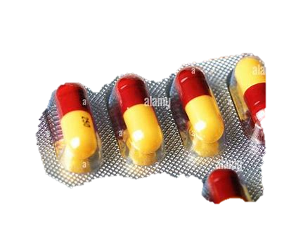
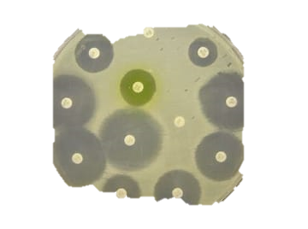
Antibiotics
BT233 – General Microbiology Laboratory

Slide 2
We learned that we can control bacterial growth by chemical and physical factors.
Last time, we studied the physical factor of oxygen requirement.
Today, we will study the effect of antibiotics, which is one type of chemical factor .

Slide 3
How can we classify chemical and physical factors?
Bactericidal factors kill bacteria, meaning that the bacteria cannot regrow if placed in optimum conditions
2. Bacteriostatic factors slow down bacterial growth, meaning that the bacteria can regrow if placed in optimum conditions

Slide 4
What are some examples of physical bactericidal and bacteriostatic factors?
Low temperature causes bacterial growth to stop until temperatures rise (bacteriostatic)
High temperature denature bacterial enzymes and kill the bacteria (bactericidal)

Slide 5
How can we classify chemical factors?
Based on source (natural or synthetic)
2. Based on application (antiseptic or disinfectant)

Slide 6
What is the difference between natural and synthetic chemical factors?
Penicillin is an antibiotic
In previous years, penicillin would be derived from the Penicillium fungi. In this case, it considered natural
After its chemical structure was discovered, penicillin is now artificially produced. In this case, it is considered synthetic

Slide 7
What is the difference between antiseptic and disinfectant chemical factors?
Antiseptics are substances that can be used with the human body, such as antibiotics.
Disinfectants are substance that are used on the surfaces of living and non-living things, such as alcohol, HiGeen, Lifebuoy soap.

Slide 8
What is 75% alcohol and how does it affect bacteria?
It is a bactericide that is composed of 75 mL alcohol and 25 mL water
It kills bacteria in two ways:
The alcohol dissolves the bacterial cell wall to leave a protoplast
The water acts as a hypotonic solution to cause the protoplast to lyse/burst

Slide 9
How do bacteriostatic and bactericidal factors affect bacterial growth?
1. Cell wall
i) Break it down
ii) Prevent synthesis of cell wall material
2. Plasma membrane
i) Break it down
ii) Prevent synthesis of plasma membrane material
iii) Affect permeability
- Increase will cause enzymes to leave the cell
- Decrease will prevent nutrients from entering and waste from leaving the cell

Slide 10
3. Genetic material
i) Interfere with DNA replication leading to no cell growth
4. Transcription and translation
i) Prevent transcription/ mRNA cannot be formed from DNA
ii) Prevent translation/ Linear protein structure cannot be formed from mRNA either by interfering with tRNA or ribosomes
5. Metabolic pathways
i) Inhibit enzymatic function

Slide 11
How can we study the effects of antibiotics on bacteria?
- By using the Kirby method, which is also called the disc diffusion method

Slide 12
What factors affect the Kirby method?
Type of media must have the highest possible antibiotic diffusion rate and its components must not react with the Antibiotic
- Mueller-Hinton agar
2. Titre of the bacteria must not exceed 107
- ↑titre = ↓effectiveness of antibiotic
3. Type of antibiotic
- Broad-spectrum antibiotics targets a wide range of bacteria
- Narrow-spectrum antibiotics target a specific group of bacteria
4. Concentration of antibiotic
- Different antibiotics have different optimal concentrations
- Excess antibiotic can be used as a nutrient by fungi
5. Type of bacteria

Slide 13
What is the relationship between rate of antibiotic diffusion and rate of bacterial growth?
- Rate of antibiotic diffusion / rate of bacterial growth ≥ 1
- This means that the rate of antibiotic diffusion has to be equal to or greater than the rate of bacterial growth

Slide 14
What happens if the rate of antibiotic diffusion is less than the rate of bacterial growth?
The bacterial cell will transform into a colony before the antibiotic reaches it
Even if the antibiotic kills some of the bacteria, we will still be able to see the colony and this will give us a false result
If the rate of antibiotic diffusion is equal to or greater than rate of bacterial growth, the antibiotic will reach the bacterial cell before a colony is formed, and it might or might not interfere kill it

Slide 15
Kirby Method (Disc Diffusion Method)
1. Wash your hands with liquid soap and water
2. Disinfect benchtop
3. Turn on bunsen burner
4. Retrieve the nutrient broth culture from our last lab
5. Prepare a bacterial lawn (each point on the media is inoculated with bacteria)
i) By adding 2 mL of broth and manually rotating the plate
ii) By surface-spreading
iii) By swabbing

Slide 16
Kirby Method
6. Vortex the nutrient broth tube
7. Flame the mouth of the nutrient broth tube before and after opening the lid and before closing it
8. Roll the swab inside the nutrient broth tube for 10 seconds
9. Swab the entire surface of the plate
10. Rotate the plate 90° (1st time)
11. Repeat steps 6 to 8
12. Rotate the plate 90° (2nd time)
13. Repeat steps 6 to 8
14. Rotate the plate 90° (3rd time)
15. Repeat steps 6 to 8
16. Rotate the plate 90° (4th time)
17. Repeat steps 6 to 8

Slide 17
Kirby Method

Slide 18
Kirby Method
18. Using sterile forceps, gently press the antibiotic strip against the agar
19. Incubate upside-down overnight
20. Tomorrow, come to the lab and observe the plates. Are there any clear zones around the discs? Measure them using a ruler.

Slide 19
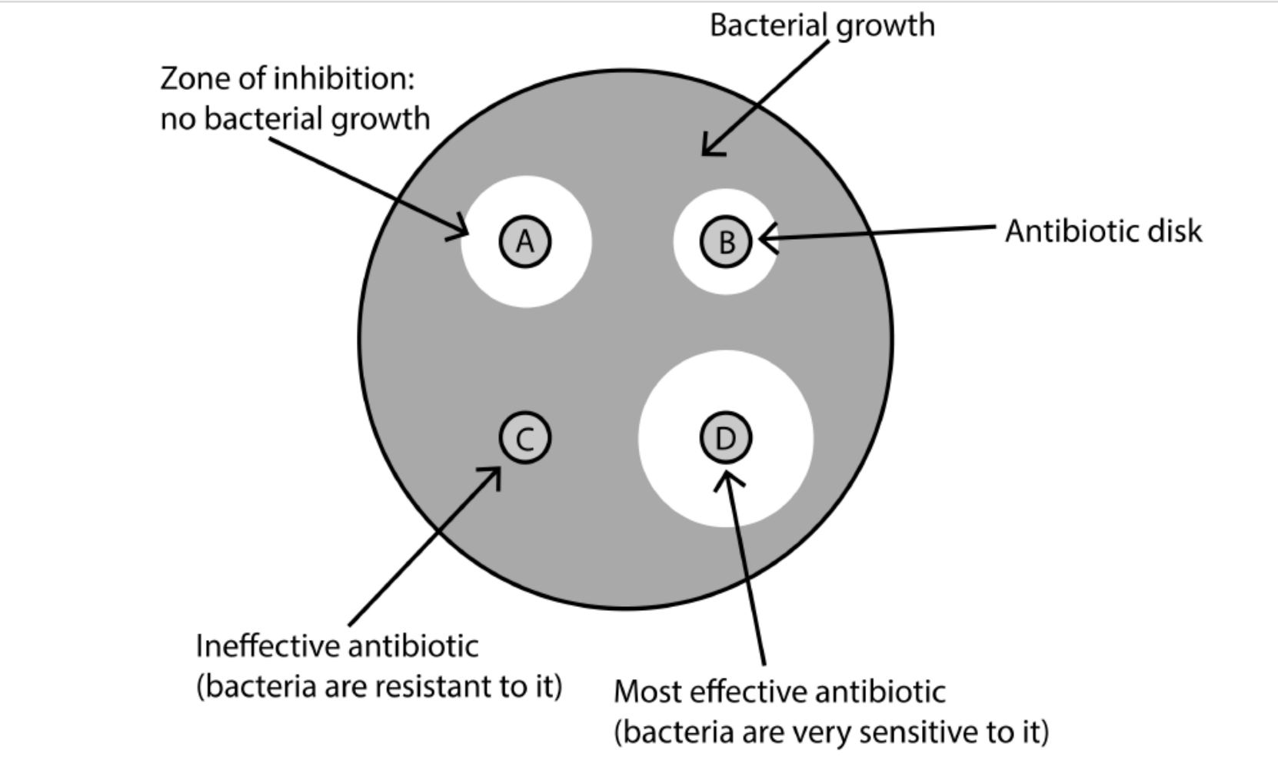
Kirby Method

Slide 20
How can we determine which antibiotic is the most effective against this type of bacteria?
- We cannot rely on the size of the measured zone alone.
- We must calculate the real zone, which is the measured zone minus the standard zone
- If the inhibition zone is greater than the standard, then the bacteria is sensitive to that antibiotic. If the inhibition zone is smaller, then the bacteria is resistant.

Slide 21
- Most charts online have already calculated the real zone for you

Slide 22
The End

