Slide 1
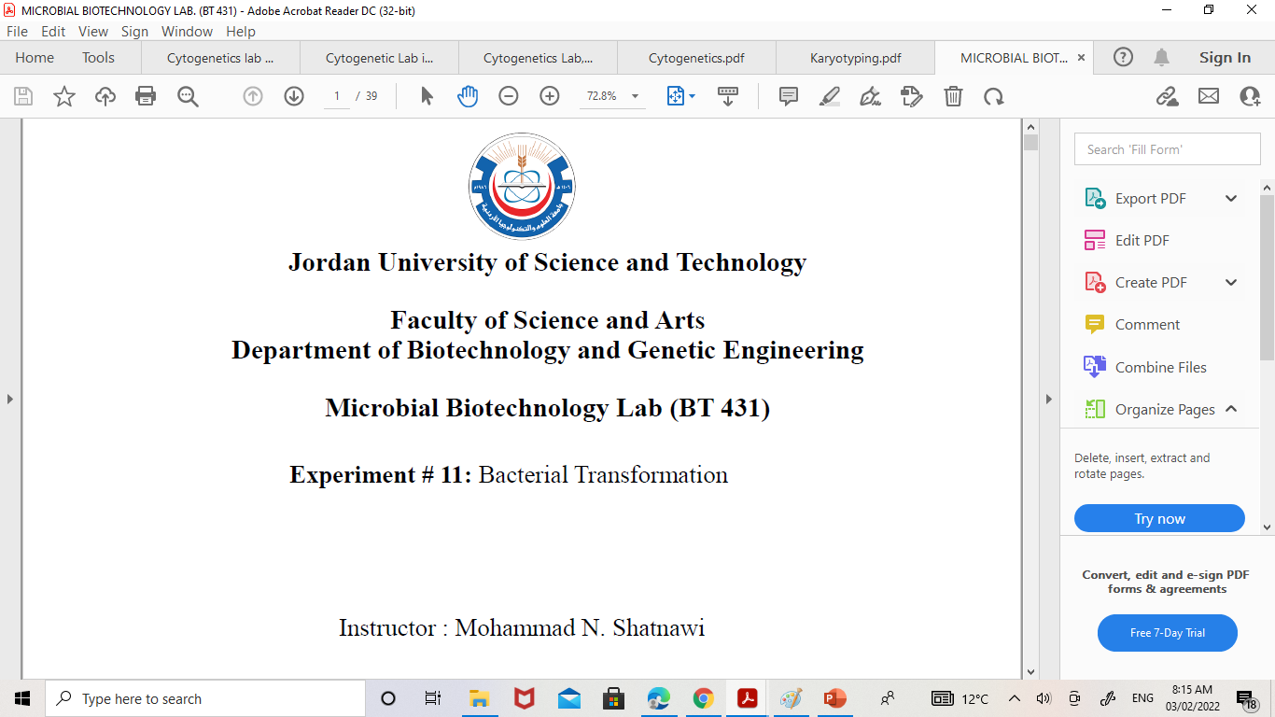
Karyotyping Human lymphocyte culture and harvesting
CYTOGENETICS LAB (BT456)

Slide 2
Karyotyping
Karyotyping is the process of pairing and ordering all the chromosomes of an organism.
A karyotype is an individual's collection of chromosomes in Metaphase, spread out on a slide.

Slide 3
A karyotype test may be used to:
Check an unborn baby for genetic disorders
Diagnose a genetic disease in a baby or young child, and if there a genetic disorder that could be passed along to the children from parents
Find out if a chromosomal defect is preventing a woman from getting pregnant or is causing miscarriages
Check a stillborn to see if a chromosomal defect was the cause of death
Diagnose or make a treatment plan for certain types of cancer and blood disorders

Slide 4
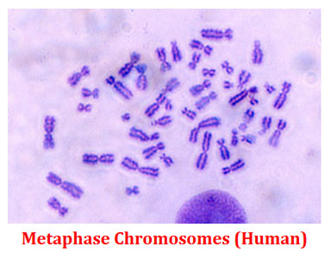
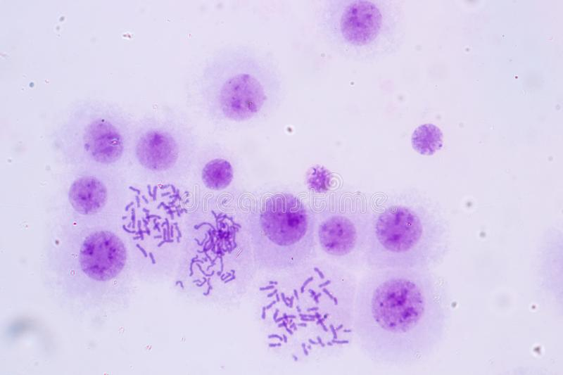

Slide 5
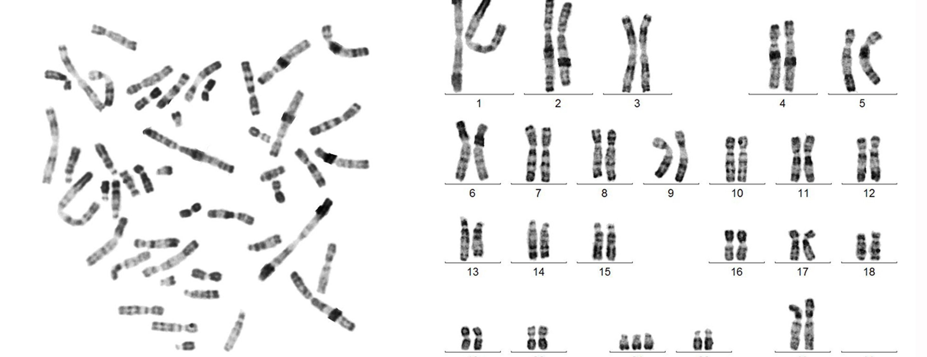

Slide 6
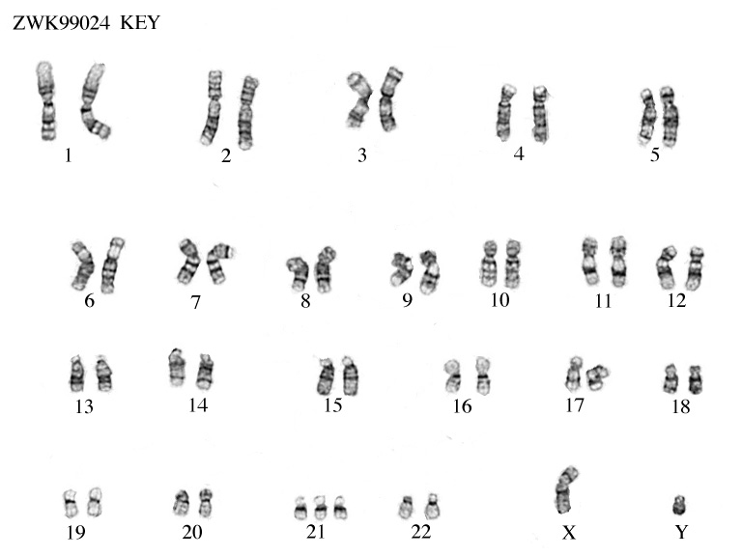

Slide 7
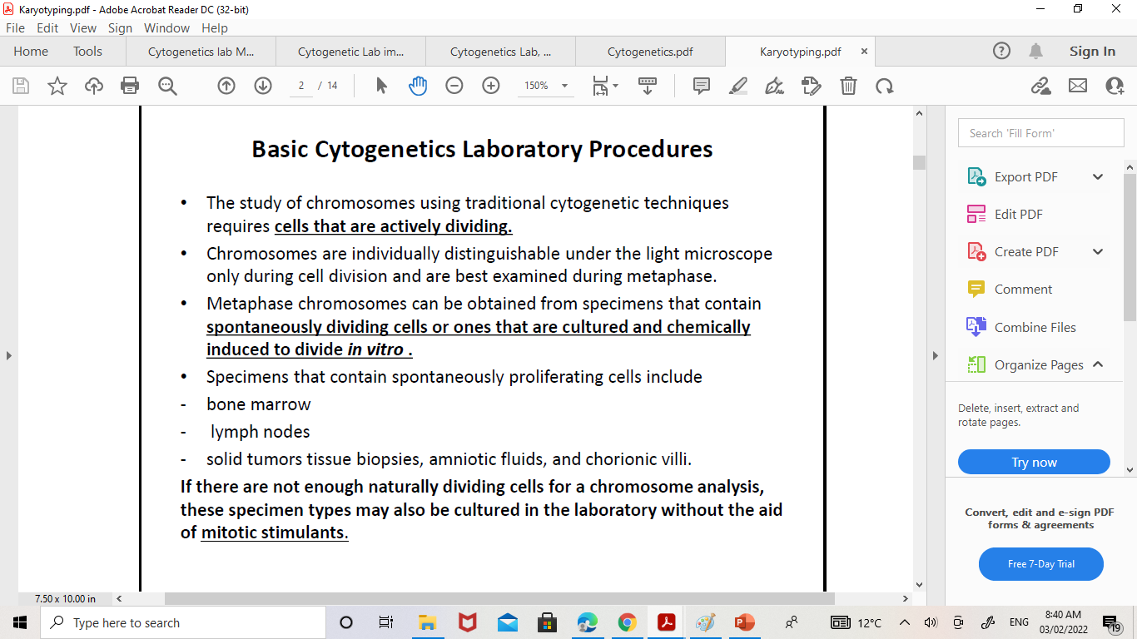
Basic Karyotyping procedure
Sample collecting
Culture
Harvesting
Dropping & Staining

Slide 8
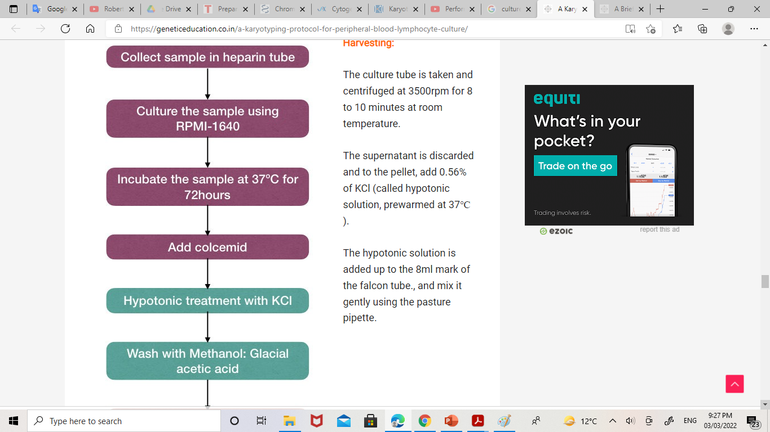
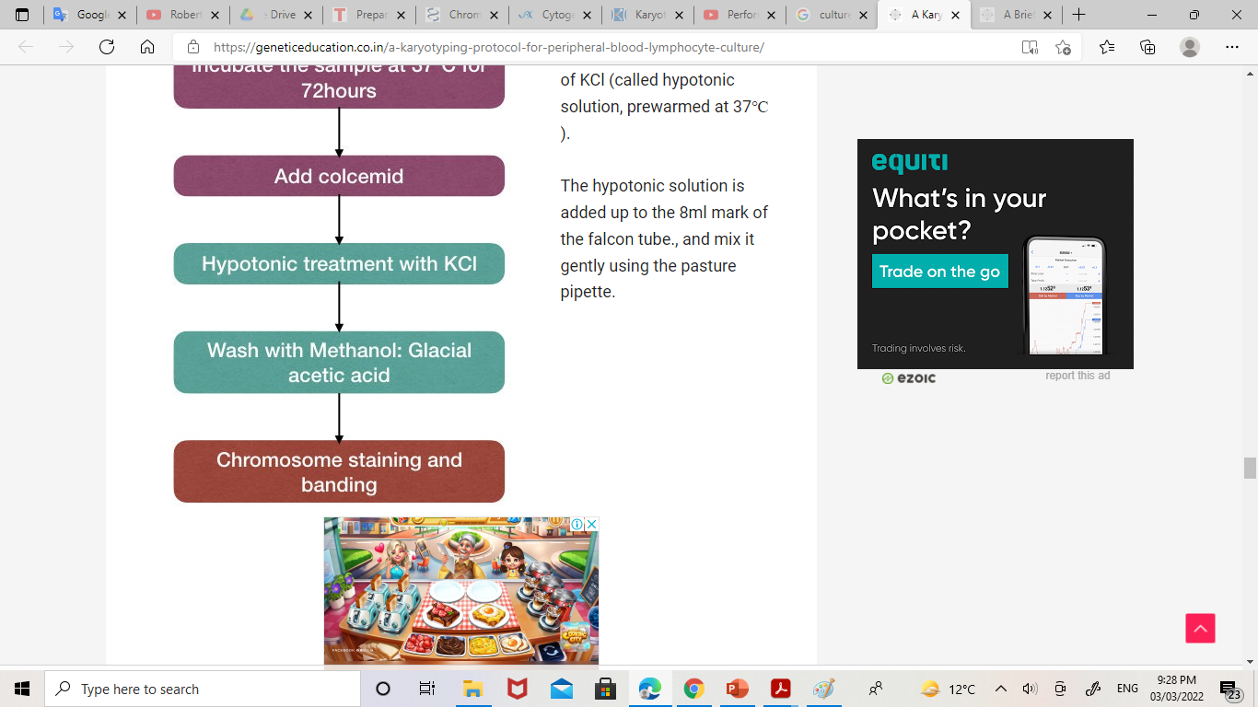
Culture
Harvesting

Slide 9
Prenatal
Chorionic villus sampling (CVS) Amniotic fluid (AF) Products of conception (POC)
Postnatal
Solid tumor Bone Marrow Lymph nodes Blood

Slide 10
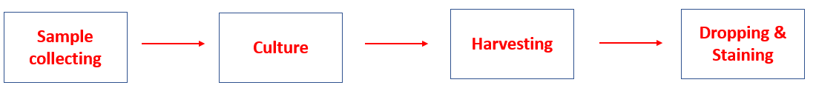
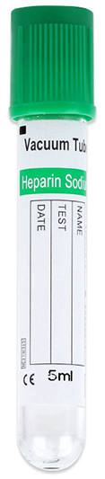
Sample collecting:
- 3-5 mL of peripheral Blood in sodium/ lithium heparin vacutainer tube
Why are heparin tubes used in the sample collection for karyotyping?
Sodium / lithium heparin is an anticoagulant, prevents blood clotting
Sodium / lithium heparin is used as an anticoagulant that can’t affect cell division activities.

Slide 11
Culture
Suspension
Sample type | Blood Bone Marrow
Culturing time | Blood: - Child & Adult: 3-4 days - Newborn: 1 day Bone Marrow: 1 day
Attached Monolayer
Sample type | Rest types of samples (CVS), (AF), (POC) Solid tumor Lymph nodes
Culturing time | Need 14 days for culturing

Slide 12
Add 1 mL of blood into 9 mL of complete karyotyping media in falcon tube and incubate at 37°C for 3-4 days.
Complete karyotyping media Contains:
Component | Function
15% Fetal Calf Serum (FCS) | Growth factors
1% Penicillin \ Streptomycin | Antibacterial agents
1% L-Glutamine | Nutrients & Energy
3% Phytohemagglutinin (PHA) | Mitogen
Phenol Red | PH indicator
Sodium Bicarbonate | Buffer

Slide 13
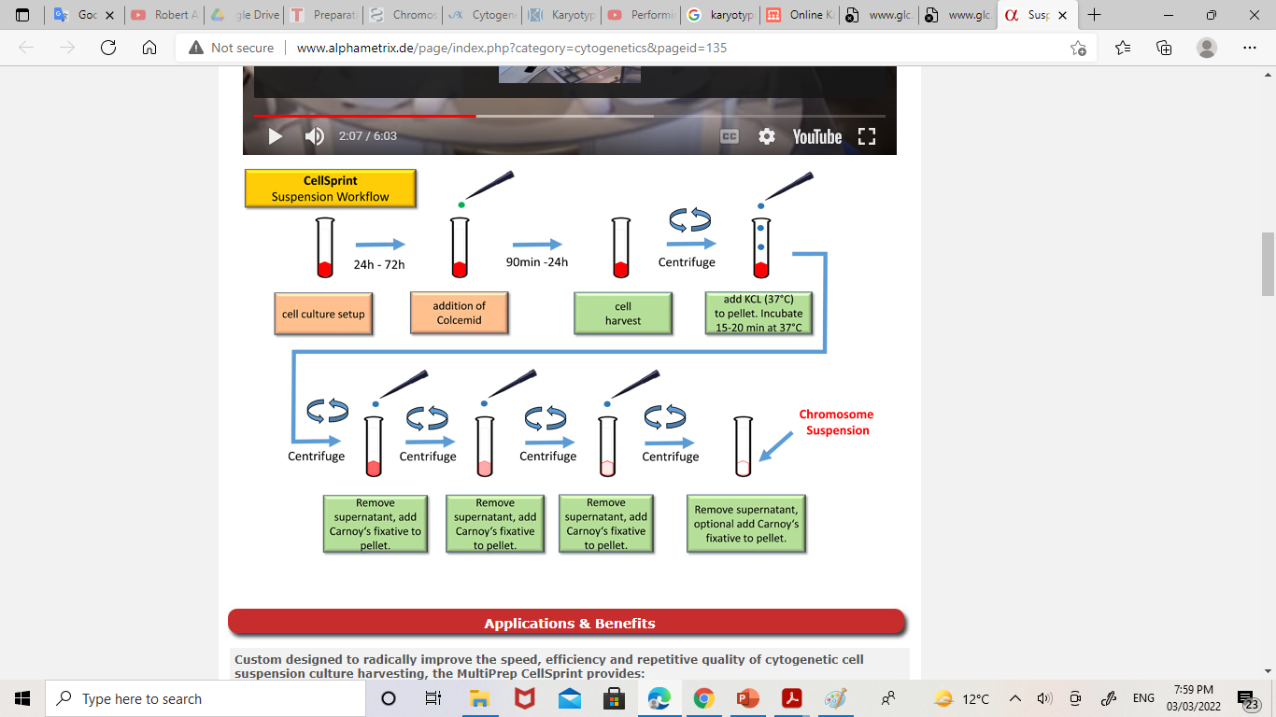
Harvesting: arrest cells in the metaphase portion of the cell cycle, when chromosomes assume their most condensed conformations.

Slide 14
Harvesting
Add 100 µL of colcemid to the cell culture, Mix well, and incubate for 1 hour.
Centrifuge at 1000 rpm for 10 minutes.
Discard the supernatant and resuspend the pellet.
Add pre-warmed hypotonic solution (0.075M KCL) up to 10 mL.
Put the culture in water bath (37°C) for not more 27 minutes.
Centrifuge at 1000 rpm for 6 minutes.
Discard the supernatant and resuspend the pellet.
Add fixative (3 Methanol : 1 Acetic acid) up to 10 mL and keep the culture at room temperature for 30 minutes.
Centrifuge at 1000 rpm for 10 minutes.
Discard the supernatant and resuspend the pellet.
Washing step.

Slide 15
Washing:
Add fixative up to 10 mL.
Centrifuge at 1000 rpm for 10 minutes.
Discard the supernatant and resuspend the pellet.
Add fixative up to 10 mL.
Centrifuge at 1000 rpm for 10 minutes.
Don’t Discard the supernatant.
6. Keep the sample in refrigerator (4°C).

Slide 16
Harvesting
Component | Function
Colchicine/colcemid | Prevents spindle fiber formation during the cell division. This action will arrest the cell in the metaphase stage.
Hypotonic solution | Allows the intake of water that results in the cell swelling and cell burst. helps in the separation of chromosomes.
Fixative | Encourages RBC’s lysis. Preserves chromosomes. Hardening the lymphocyte Removes other cell debris.

Slide 17
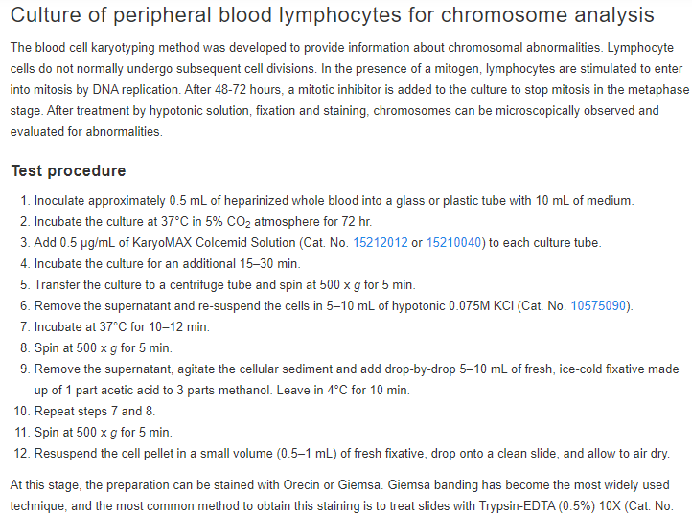

Slide 18
Important Explanations:
Incubate the cell culture more than 1 hour after the addition of colcemid:
The Mitotic index will be high, So chromosomes will be shorter.
Hypotonic Solution must be prewarmed:
37°C helps in softening the plasma membrane & facilitate water entry to the cells.

Slide 19
Hypotonic Solution and fixative must be added drop by drop:
To prevent cell sock.
Centrifugation time of cell culture after the addition of hypotonic solution is 6 min:
To prevent rupture of WBC’s, Because they are swelled.
Fixative must be freshly prepared:
Prevent the reaction between methanol and acetic acid.

