Slide 2
Masters of Adaptation
The waters of Laguna Salada de Torrevieja in Spain are many times saltier than seawater
At certain times of the year, the water appears pink
The color comes from trillions of living prokaryotes

Slide 3
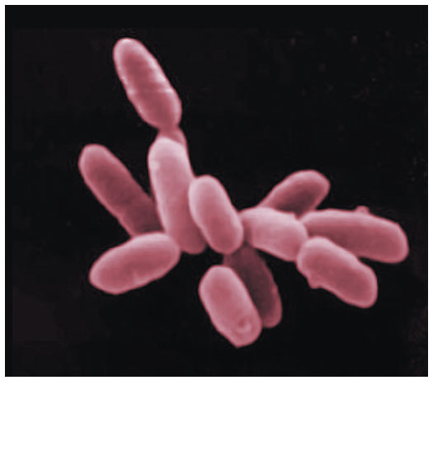
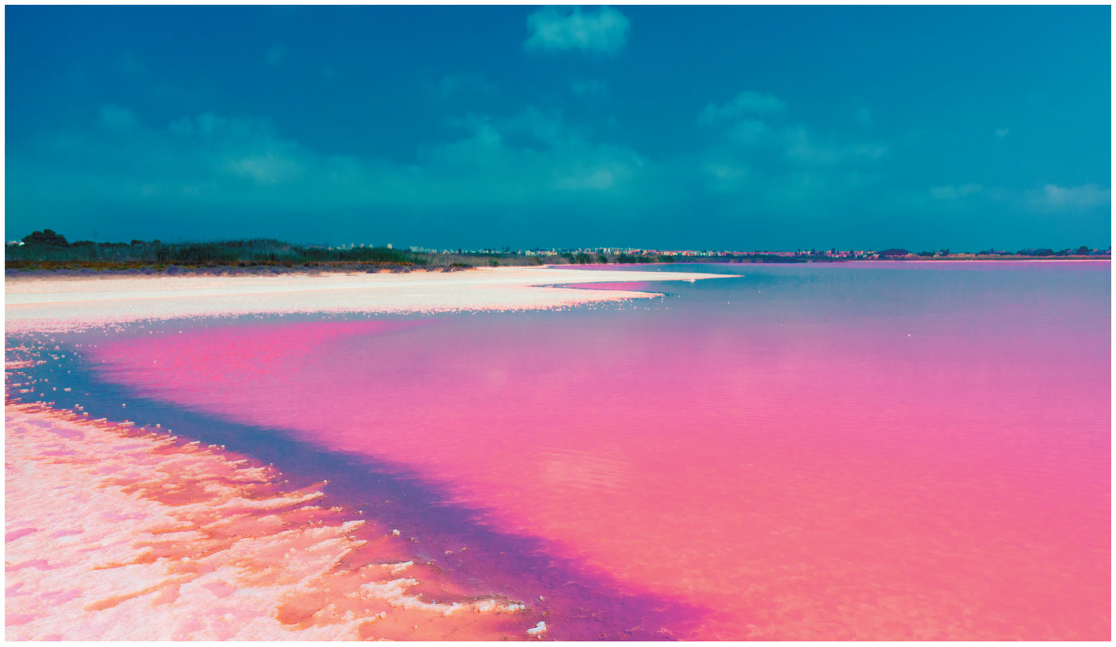
Figure 27.1
Figure 27.1: Why is this lake’s water pink?
Archaea in the genus
Halobacterium

Slide 4
Prokaryotes thrive almost everywhere, including places too acidic, salty, cold, or hot for most other organisms
Due to their ability to adapt to diverse habitats, prokaryotes are the most abundant organisms on Earth
Prokaryotes are divided into two domains: bacteria and archaea

Slide 5
Concept 27.1: Structural and functional adaptations contribute to prokaryotic success
Prokaryotes were the first organisms to inhabit the Earth
Most are unicellular, although some species form colonies
Most prokaryotic cells are 0.5–5 µm, much smaller than the 10–100 µm of many eukaryotic cells
Prokaryotic cells have a variety of shapes
The three most common shapes are spheres (cocci), rods (bacilli), and spirals

Slide 6
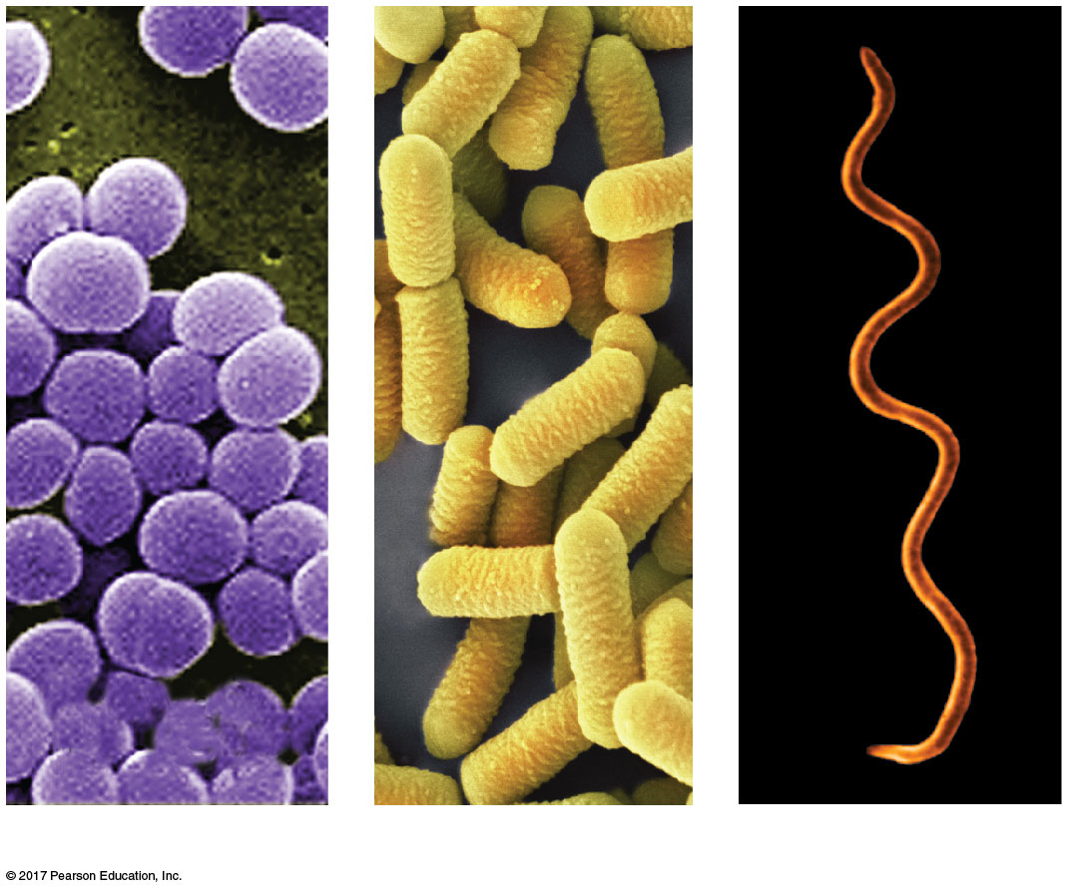
Figure 27.2
1 µm
1 µm
3 µm
(a) Spherical
(b) Rod-shaped
(c) Spiral
Notes:
Figure 27.2 The most common shapes of prokaryotes

Slide 7
Cell-Surface Structures
The cell wall maintains cell shape, protects the cell, and prevents it from bursting in a hypotonic environment
Eukaryote cell walls are made of cellulose or chitin
Most bacterial cell walls contain peptidoglycan, a network of sugar polymers cross-linked by polypeptides

Slide 8
Archaea contain polysaccharides and proteins but lack peptidoglycan
Scientists use the Gram stain to classify bacteria by cell wall composition
Gram-positive bacteria have simpler walls with a large amount of peptidoglycan
Gram-negative bacteria have less peptidoglycan and an outer membrane that contains lipopolysaccharides

Slide 9
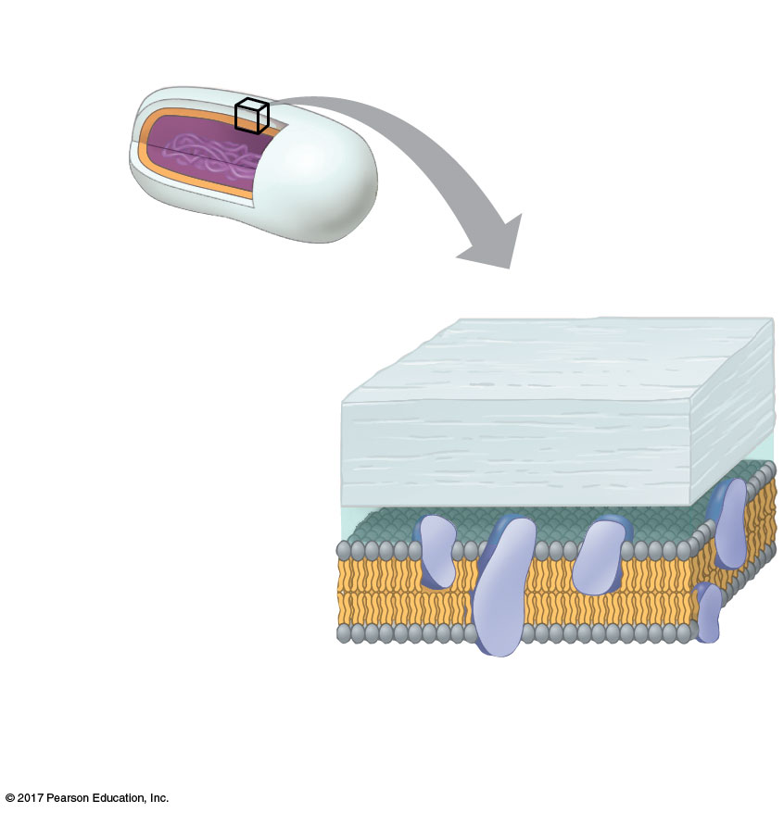
Figure 27.3a
(a) Gram-positive bacteria
Peptido-
glycan
layer
Cell
wall
Plasma
membrane
Peptidoglycan traps crystal violet,
which masks the red safranin dye.
Notes:
Figure 27.3a Gram staining (part 1: Gram-positive)

Slide 10
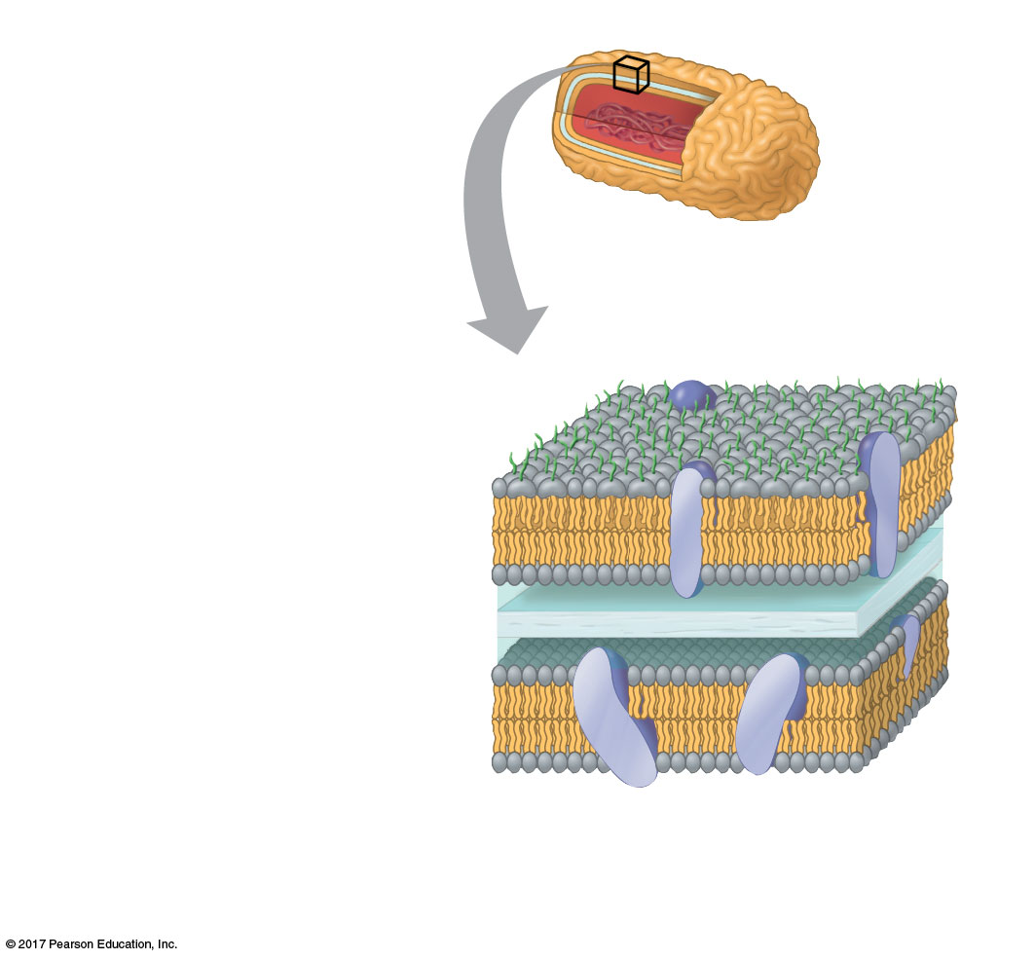
Figure 27.3b
(b) Gram-negative bacteria
Carbohydrate portion
of lipopolysaccharide
Outer
membrane
Cell
wall
Peptidoglycan
layer
Plasma membrane
Crystal violet is easily rinsed away, revealing
the red safrinin dye.
Notes:
Figure 27.3b Gram staining (part 2: Gram-negative)

Slide 11
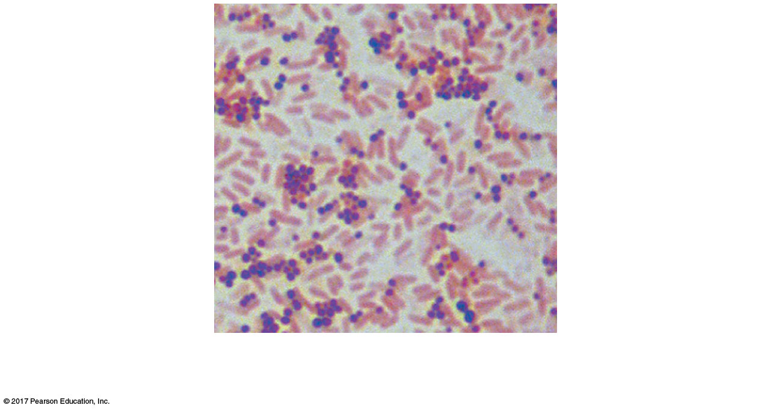
Figure 27.3c
Gram-positive
bacteria
Gram-negative
bacteria
10 µm
Notes:
Figure 27.3c Gram staining (part 3: micrograph)

Slide 12
Many antibiotics target peptidoglycan and damage bacterial cell walls
Gram-positive bacteria are particularly susceptible to this type of antibiotics
A sticky outer layer of polysaccharide or protein called a capsule is present in some prokaryotes
The capsule allows adherence to the substrate, or other individuals, and can shield pathogenic bacteria from the host immune system

Slide 13
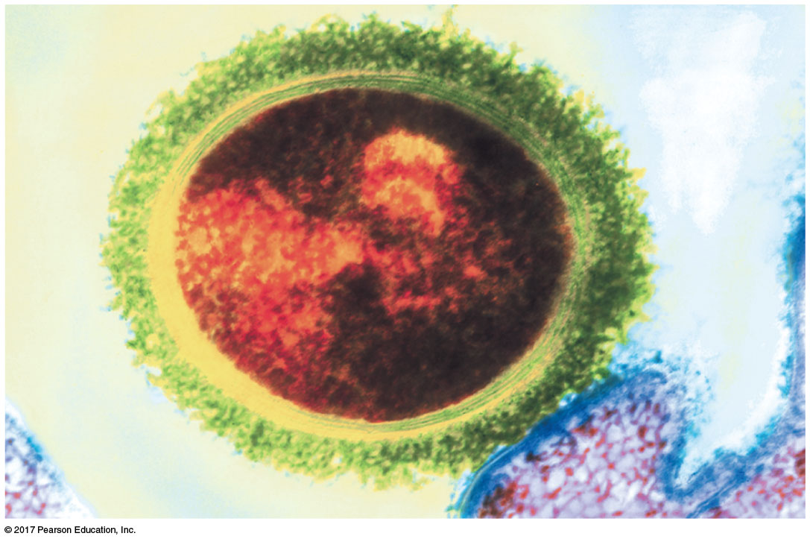
Figure 27.4
Bacterial
capsule
Bacterial
cell wall
Tonsil
cell
200 nm
Notes:
Figure 27.4 Capsule

Slide 14
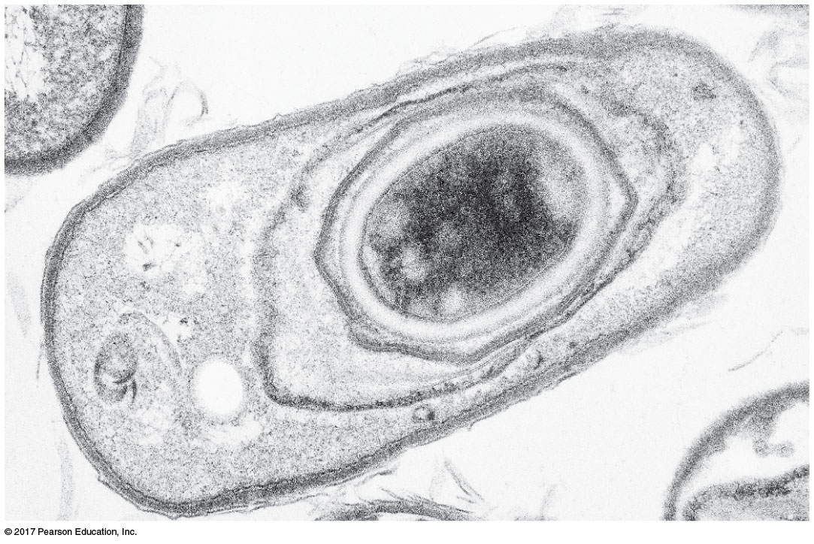
Figure 27.5
Many prokaryotes form metabolically inactive endospores, which can remain viable in harsh conditions for centuries
Endospore
Coat
0.3 µm
Notes:
Figure 27.5 An endospore

Slide 15
Some prokaryotes have hairlike appendages called fimbriae that allow them to stick to their substrate or other individuals in a colony
Pili (or sex pili) are longer than fimbriae and allow prokaryotes to exchange DNA

Slide 16
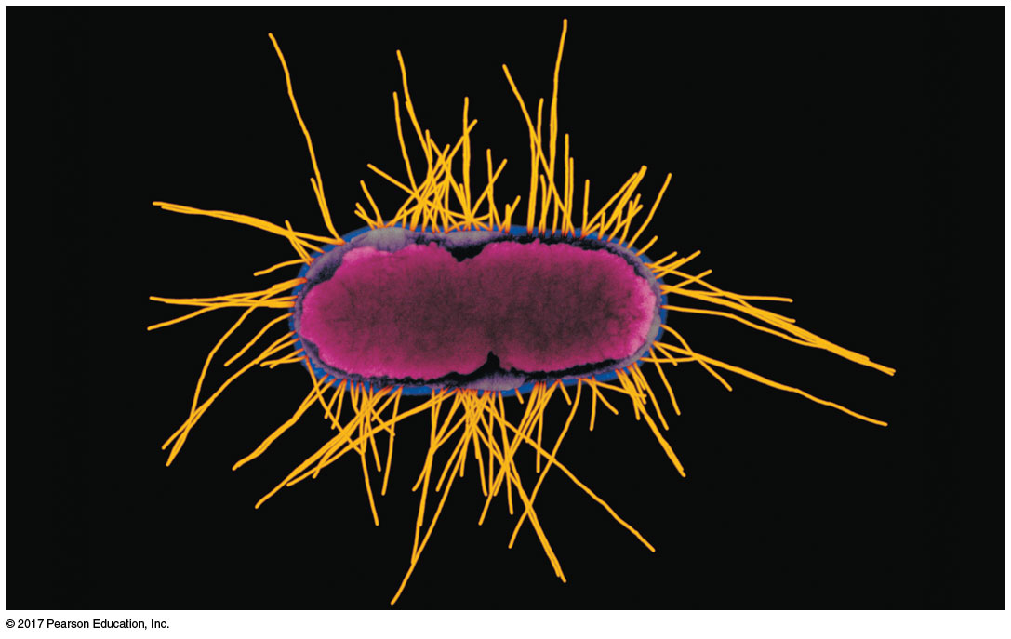
Figure 27.6
Fimbriae
1 µm
Notes:
Figure 27.6 Fimbriae

Slide 17
Motility
About half of all prokaryotes exhibit taxis, the ability to move toward or away from a stimulus
For example, chemotaxis is the movement toward or away from a chemical stimulus

Slide 18
Flagella are the most common structures used by prokaryotes for movement
Flagella may be scattered about the surface or concentrated at one or both ends of the cell
The flagella of prokaryotes and eukaryotes differ in structure, mechanism of propulsion, and molecular composition

Slide 19
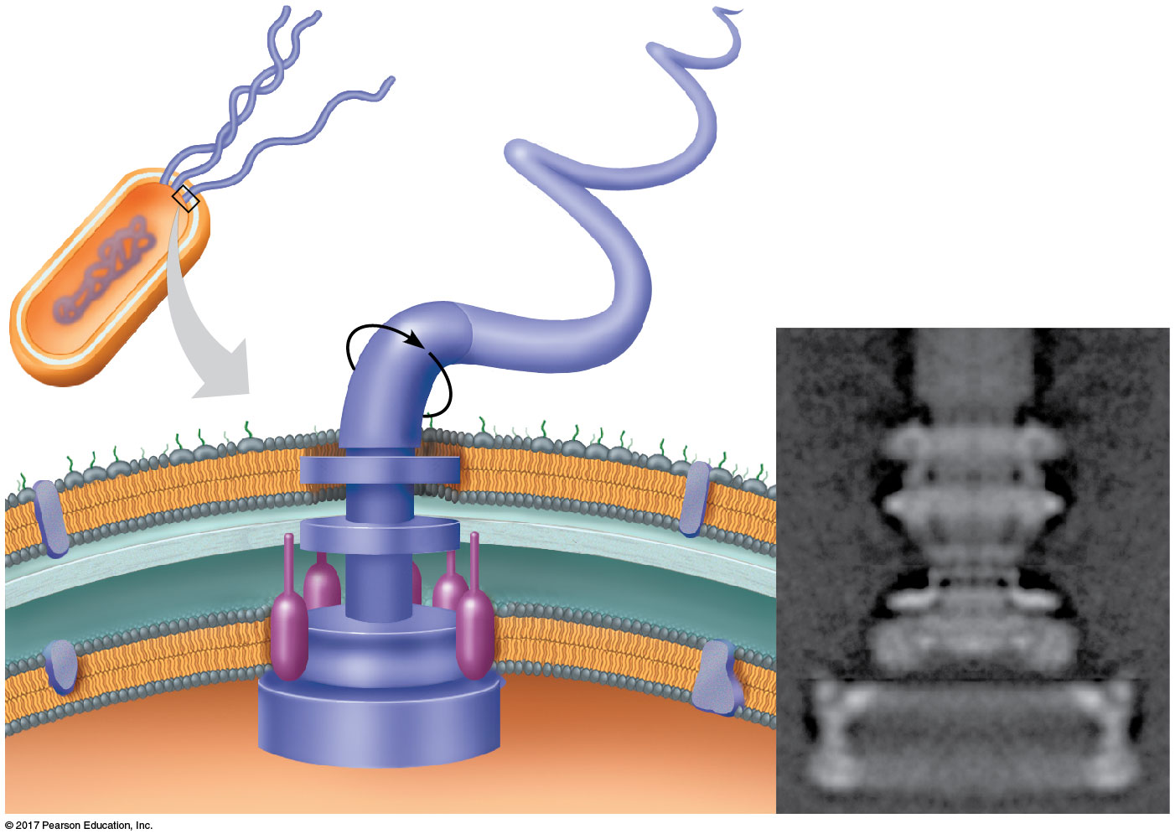
Figure 27.7
Flagellum
Filament
20 nm
Hook
Cell wall
Motor
Plasma
membrane
Peptidoglycan
layer
Rod
Notes:
Figure 27.7 A prokaryotic flagellum

Slide 20
Evolutionary Origins of Bacterial Flagella
Bacterial flagella are composed of 42 different kinds of proteins that form a motor, hook, and filament

Slide 21
Most of the proteins in the flagella are modified versions of bacterial proteins with different functions
Flagella likely evolved as existing proteins were added to an ancestral secretory system
This is an example of exaptation, where structures adapted for one function take on new functions through descent with modification

Slide 22
Internal Organization and DNA
Prokaryotic cells usually lack complex compartmentalization
Some prokaryotes do have specialized membranes that perform metabolic functions
These are usually infoldings of the plasma membrane

Slide 23
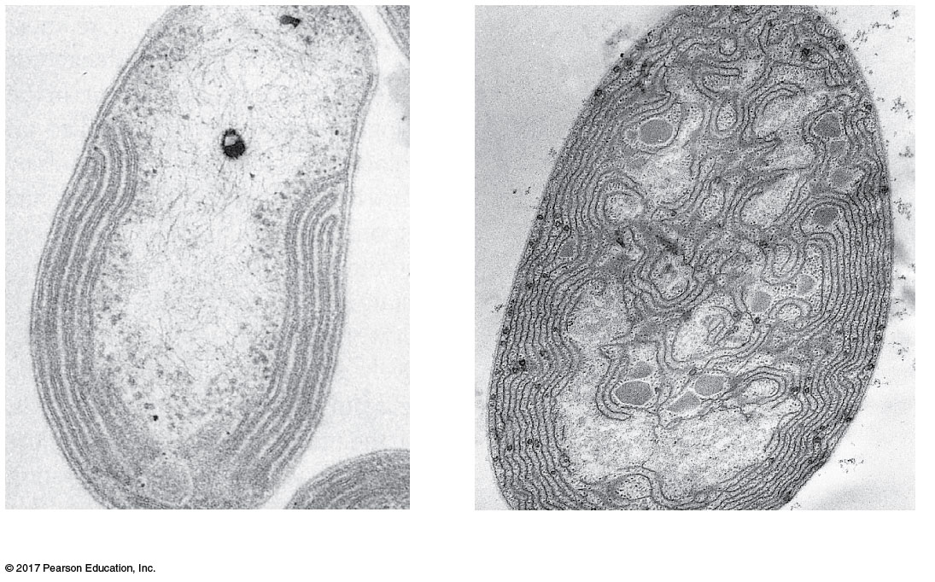
Figure 27.8
0.2 µm
1 µm
Respiratory
membrane
Thylakoid
membranes
Thylakoid
membranes
(a) Aerobic prokaryote
(b) Photosynthetic prokaryote
Notes:
Figure 27.8 Specialized membranes of prokaryotes

Slide 24
The prokaryotic genome has less DNA than the eukaryotic genome
Most of the genome consists of a circular chromosome
The chromosome is not contained in a nucleus; it is located in the nucleoid region with no surrounding membrane
Typical prokaryotes also have smaller rings of independently replicating DNA called plasmids

Slide 25
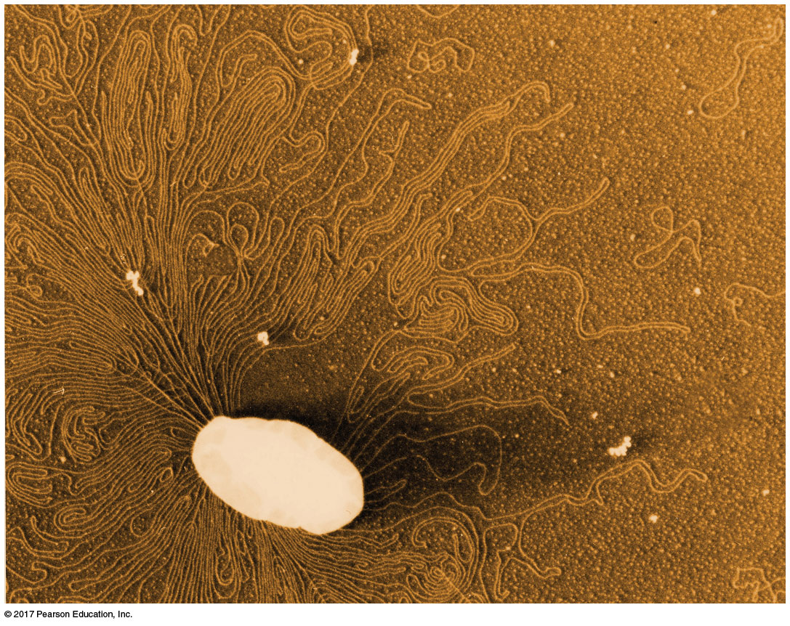
Figure 27.9
Chromosome
Plasmids
1 µm
Notes:
Figure 27.9 A prokaryotic chromosome and plasmids

Slide 26
There are some differences between prokaryotes and eukaryotes in DNA replication, transcription, and translation
These differences allow people to use certain antibiotics to inhibit bacterial growth without harming themselves

Slide 27
Reproduction
Prokaryotes reproduce quickly by binary fission and can divide every 1–3 hours under optimal conditions
Key features of prokaryote biology:
They are small
They reproduce by binary fission
They have short generation times

Slide 28
Concept 27.2: Rapid reproduction, mutation, and genetic recombination promote genetic diversity in prokaryotes
Prokaryotes have considerable genetic variation
Three factors contribute to this genetic diversity:
Rapid reproduction
Mutation
Genetic recombination

Slide 29
Rapid Reproduction and Mutation
Prokaryotes reproduce asexually; offspring cells are generally identical
For example, Escherichia coli cells reproduce using binary fission
Mutation rates are low, but mutations accumulate rapidly because generation times are short and populations are large
Prokaryotes have simpler cells than eukaryotes, but their rapid adaptation to environmental change indicates that they are highly evolved

Slide 30
Genetic Recombination
Genetic recombination, the combining of DNA from two sources, contributes to diversity
Prokaryotic DNA from different individuals can be brought together by transformation, transduction, and conjugation
Movement of genes among individuals from different species is called horizontal gene transfer

Slide 31
Transformation and Transduction
A prokaryotic cell can take up and incorporate foreign DNA from the surrounding environment in a process called transformation
Transduction is the movement of genes between bacteria by phages (from “bacteriophages,” viruses that infect bacteria)

Slide 32
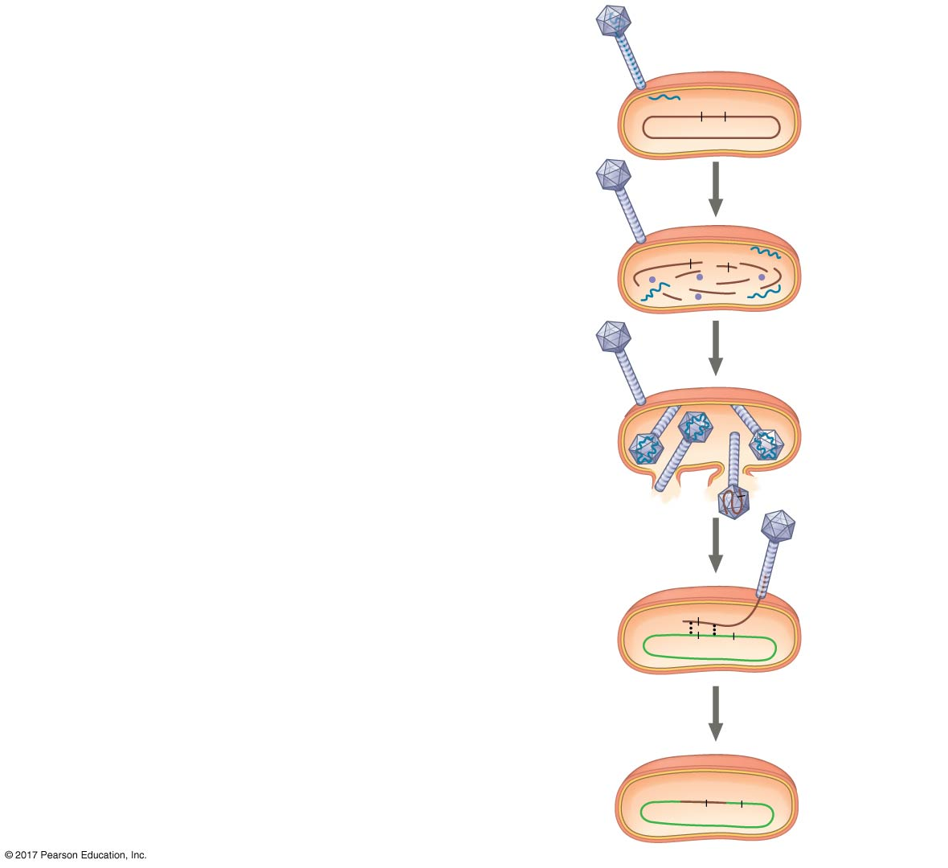
Figure 27.11_5
Phage DNA
1
Phage infects bacterial donor
cell that carries the A⁺ and B⁺
alleles.
A⁺
B⁺
Donor cell
2
Phage DNA is replicated and
phage proteins are synthesized.
A⁺
B⁺
3
Fragment of bacterial DNA
with A⁺ allele is packaged
within a phage capsid.
A⁺
Crossing
over
4
Phage with A⁺ allele infects
bacterial recipient cell.
A⁺
A⁻
B⁻
Recipient
cell
5
Incorporation of phage DNA
creates recombinant cell with
genotype A⁺ B⁻.
Recombinant
cell
A⁺
B⁻
Notes:
Figure 27.11_5 Transduction (step 5)

Slide 33
Conjugation and Plasmids
Conjugation is the process where genetic material is transferred between prokaryotic cells
In bacteria, the DNA transfer is always one way
A donor cell attaches to a recipient by a pilus, pulls it closer, and transfers DNA through a structure called the “mating bridge”
A piece of DNA called the F factor is required for the production of pili

Slide 34
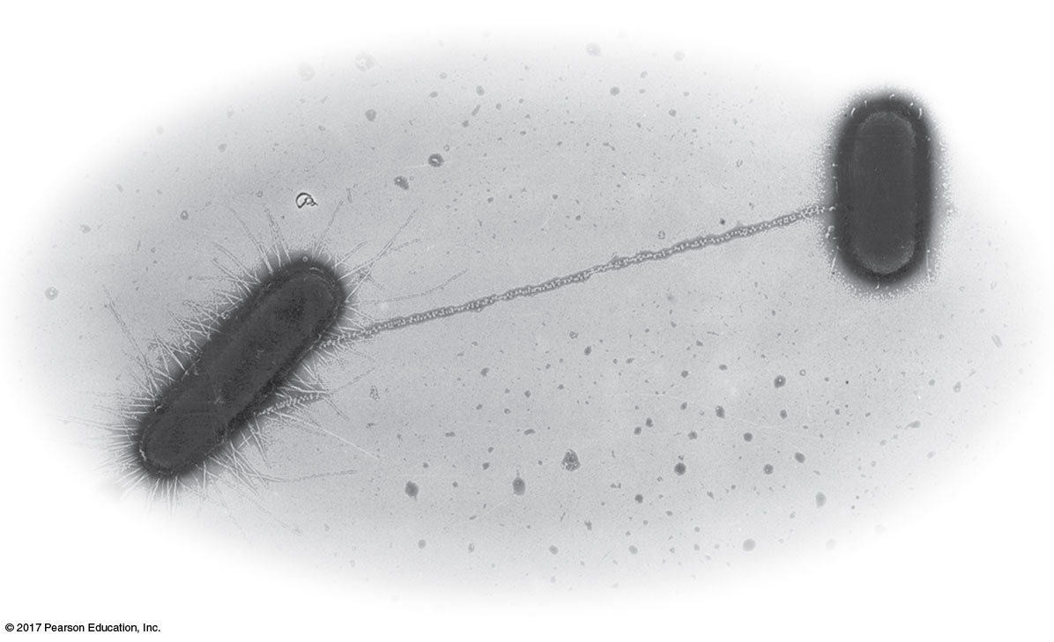
Figure 27.12
Pilus
1 µm
Notes:
Figure 27.12 Bacterial conjugation

Slide 35
The F Factor as a Plasmid
Cells containing the F plasmid function as DNA donors during conjugation
Cells without the F factor function as DNA recipients during conjugation
The F factor is transferable during conjugation
Provided some of the F plasmid’s DNA is transferred, the recipient cell becomes a recombinant cell

Slide 36
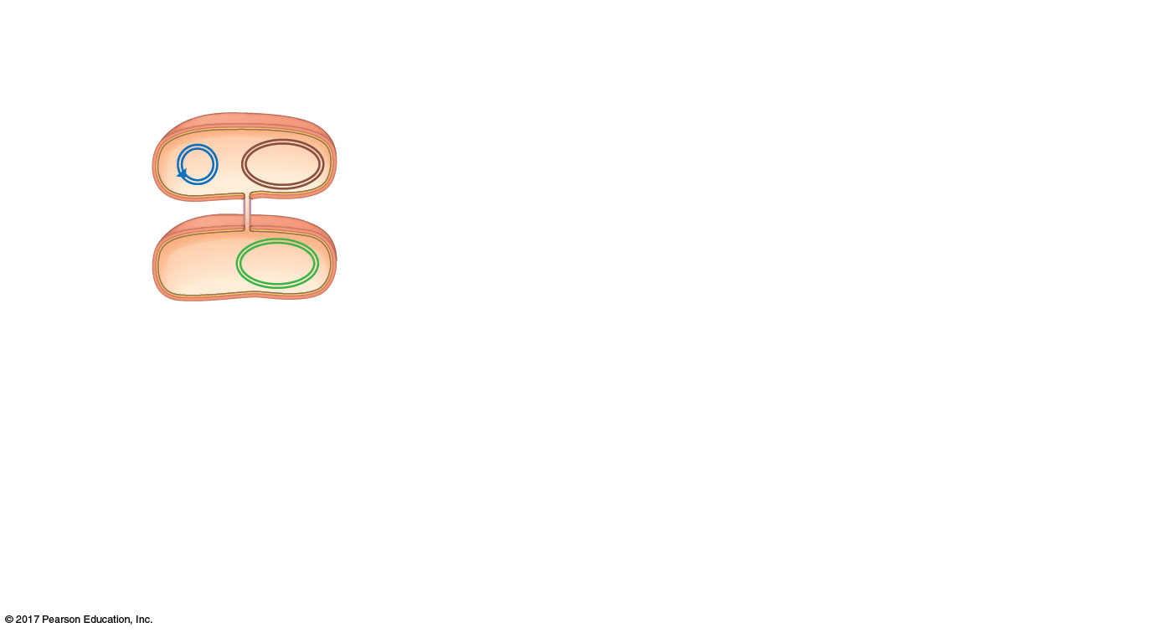
Figure 27.13a_1
Bacterial
chromosome
F plasmid
F⁺ cell
(donor)
Mating
bridge
F⁻ cell
(recipient)
Bacterial
chromosome
1
One strand of
F⁺ cell plasmid
DNA breaks at
arrowhead.
(a) Conjugation and transfer of an F plasmid
Notes:
Figure 27.13a_1 Conjugation and recombination in E. coli (part 1, step 1)

Slide 37
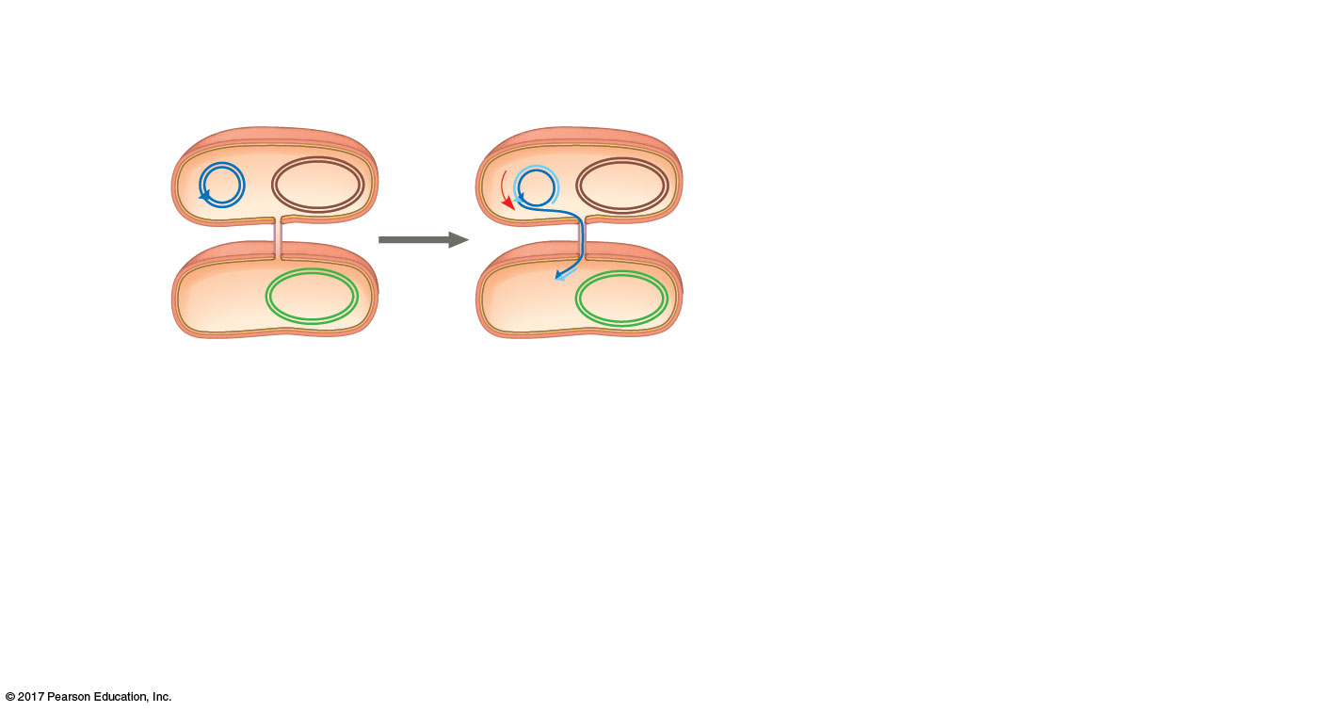
Figure 27.13a_2
Bacterial
chromosome
F plasmid
F⁺ cell
(donor)
Mating
bridge
F⁻ cell
(recipient)
Bacterial
chromosome
1
One strand of
F⁺ cell plasmid
DNA breaks at
arrowhead.
2
Broken strand
peels off and
enters F⁻ cell.
(a) Conjugation and transfer of an F plasmid
Notes:
Figure 27.13a_2 Conjugation and recombination in E. coli (part 1, step 2)

Slide 38
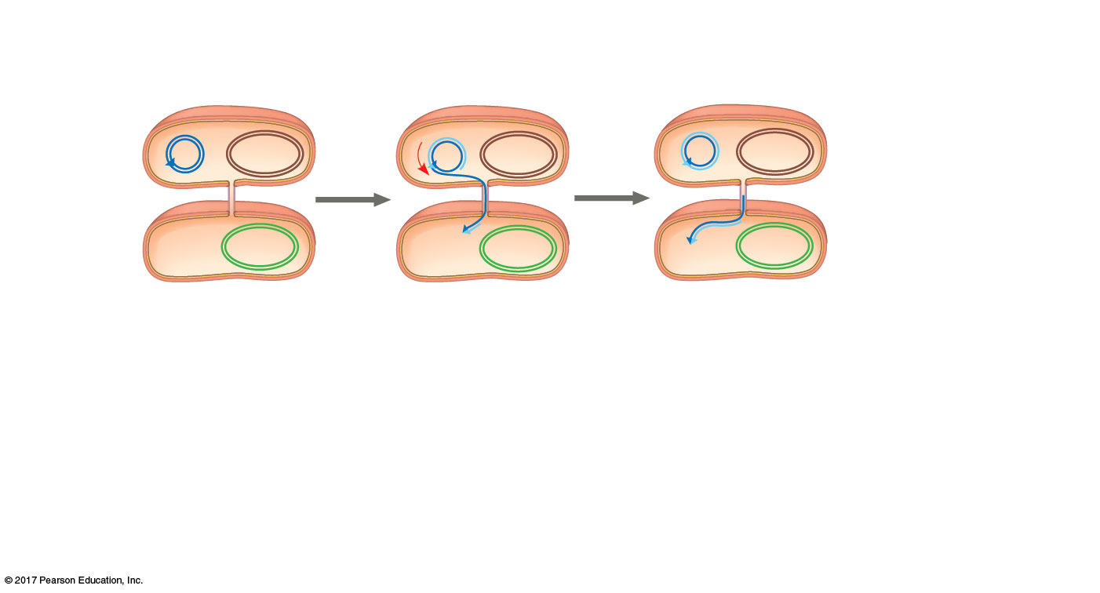
Figure 27.13a_3
Bacterial
chromosome
F plasmid
F⁺ cell
(donor)
Mating
bridge
F⁻ cell
(recipient)
Bacterial
chromosome
1
One strand of
F⁺ cell plasmid
DNA breaks at
arrowhead.
2
Broken strand
peels off and
enters F⁻ cell.
3
Donor and
recipient cells
synthesize
complementary
DNA strands.
(a) Conjugation and transfer of an F plasmid
Notes:
Figure 27.13a_3 Conjugation and recombination in E. coli (part 1, step 3)

Slide 39
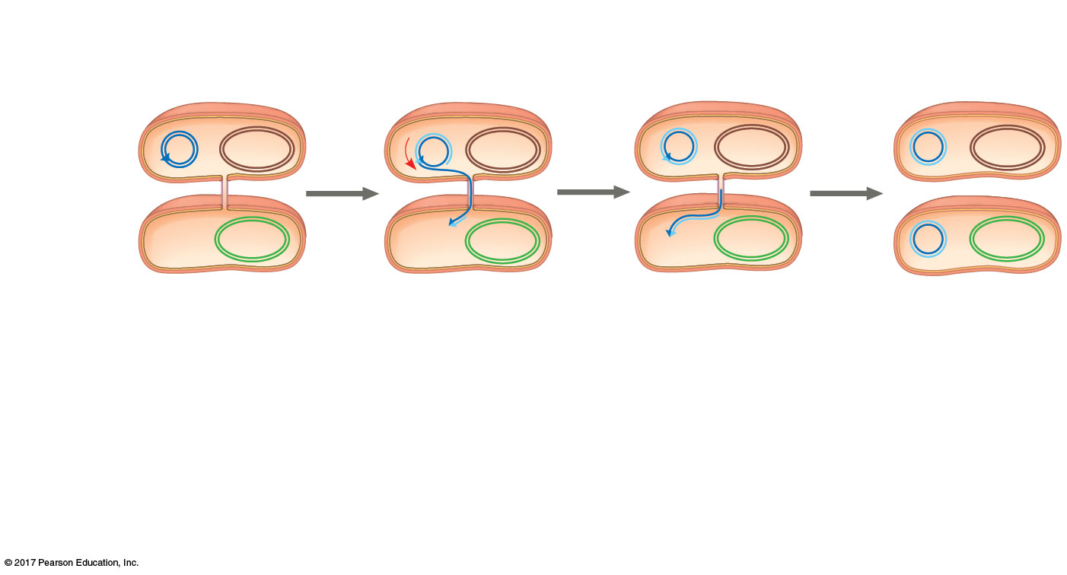
Figure 27.13a_4
Bacterial
chromosome
F plasmid
F⁺ cell
(donor)
F⁺ cell
Mating
bridge
F⁻ cell
(recipient)
F⁺ cell
Bacterial
chromosome
1
One strand of
F⁺ cell plasmid
DNA breaks at
arrowhead.
2
Broken strand
peels off and
enters F⁻ cell.
3
Donor and
recipient cells
synthesize
complementary
DNA strands.
4
Recipient cell
is now a
recombinant
F⁺ cell.
(a) Conjugation and transfer of an F plasmid
Notes:
Figure 27.13a_4 Conjugation and recombination in E. coli (part 1, step 4)

Slide 40
The F Factor in the Chromosome
A cell with the F factor built into its chromosome functions as a donor during conjugation
Such cells are called Hfr cells (for high frequency of recombination)
The recipient becomes a recombinant bacterium, with DNA from two different cells

Slide 41
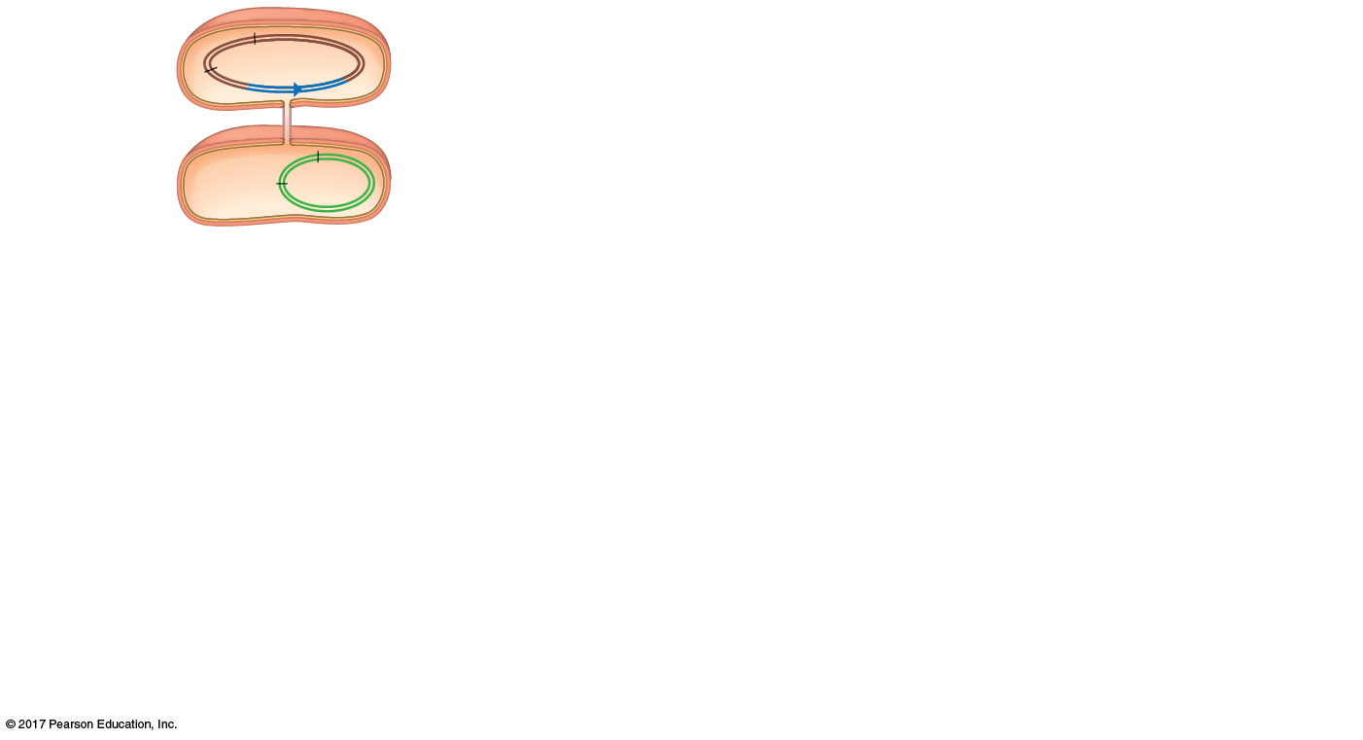
Figure 27.13b_1
Hfr cell
(donor)
B⁺
A⁺
F factor
A⁻
B⁻
F⁻ cell
(recipient)
1
An Hfr cell
forms a
mating bridge
with an F⁻ cell.
(b) Conjugation and transfer of part of an Hfr bacterial chromosome, resulting in recombination
Notes:
Figure 27.13b_1 Conjugation and recombination in E. coli (part 2, step 1)

Slide 42
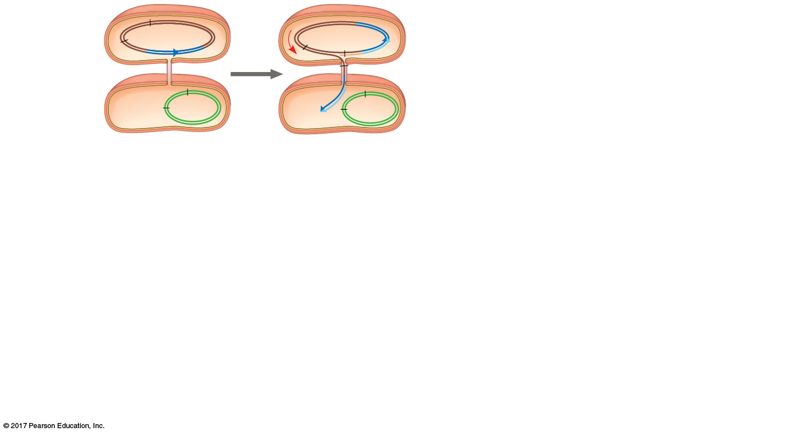
Figure 27.13b_2
Hfr cell
(donor)
B⁺
A⁺
B⁺
A⁺
F factor
A⁺
A⁻
B⁻
A⁻
B⁻
F⁻ cell
(recipient)
1
An Hfr cell
forms a
mating bridge
with an F⁻ cell.
2
A single strand
of the F factor
breaks and
begins to move
through the
bridge.
(b) Conjugation and transfer of part of an Hfr bacterial chromosome, resulting in recombination
Notes:
Figure 27.13b_2 Conjugation and recombination in E. coli (part 2, step 2)

Slide 43
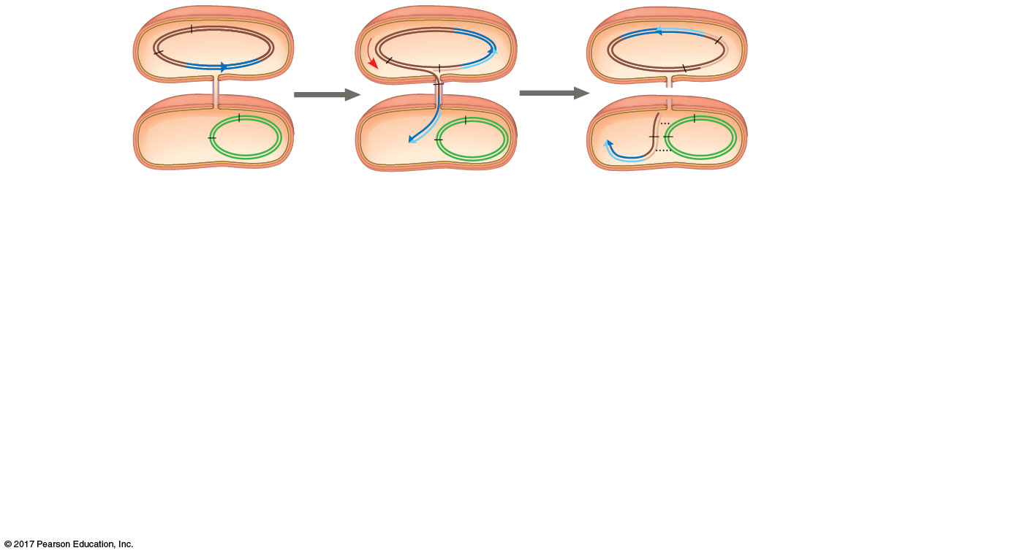
Figure 27.13b_3
Hfr cell
(donor)
B⁺
A⁺
B⁺
A⁺
B⁺
A⁺
F factor
A⁺
A⁻
B⁻
A⁻
B⁻
A⁺
A⁻
B⁻
F⁻ cell
(recipient)
1
An Hfr cell
forms a
mating bridge
with an F⁻ cell.
2
A single strand
of the F factor
breaks and
begins to move
through the
bridge.
3
Crossing over
can result in
exchange of
homologous
genes.
(b) Conjugation and transfer of part of an Hfr bacterial chromosome, resulting in recombination
Notes:
Figure 27.13b_3 Conjugation and recombination in E. coli (part 2, step 3)

Slide 44
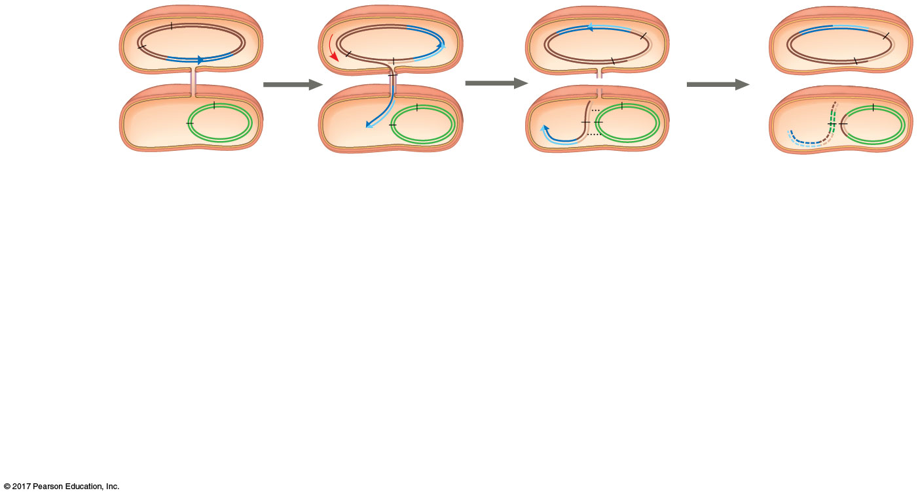
Figure 27.13b_4
Hfr cell
(donor)
B⁺
A⁺
B⁺
A⁺
B⁺
A⁺
B⁺
A^{+ /}
F factor
A⁺
A⁻
B⁻
A⁻
B⁻
A⁺
A⁻
B⁻
A⁻
A⁺
B⁻
F⁻ cell
(recipient)
Recombinant
F⁻ bacterium
1
An Hfr cell
forms a
mating bridge
with an F⁻ cell.
2
A single strand
of the F factor
breaks and
begins to move
through the
bridge.
3
Crossing over
can result in
exchange of
homologous
genes.
4
Enzymes
degrade any
DNA not
incorporated.
Recipient cell
is now a
recombinant
F⁻ cell.
(b) Conjugation and transfer of part of an Hfr bacterial chromosome, resulting in recombination
Notes:
Figure 27.13b_4 Conjugation and recombination in E. coli (part 2, step 4)

Slide 45
R Plasmids and Antibiotic Resistance
R plasmids carry genes for antibiotic resistance
Antibiotics kill sensitive bacteria, but not bacteria with specific R plasmids
Through natural selection, the fraction of bacteria with genes for resistance increases in a population exposed to antibiotics

Slide 46
Many R plasmids have genes that encode pili, making it possible for resistance genes to be transferred between bacterial cells
Some R plasmids carry genes for resistance to multiple antibiotics
Antibiotic-resistant strains of bacteria are becoming more common, and the infections they cause are now harder to treat

Slide 47
Concept 27.3: Diverse nutritional and metabolic adaptations have evolved in prokaryotes
Prokaryotes can be categorized by how they obtain energy and carbon:
Phototrophs obtain energy from light
Chemotrophs obtain energy from chemicals
Autotrophs require CO₂ or related compounds as a carbon source
Heterotrophs require an organic nutrient to make organic compounds

Slide 48
Energy and carbon sources are combined to give four major modes of nutrition:
Photoautotroph
Chemoautotroph
Photoheterotroph
Chemoheterotroph

Slide 49
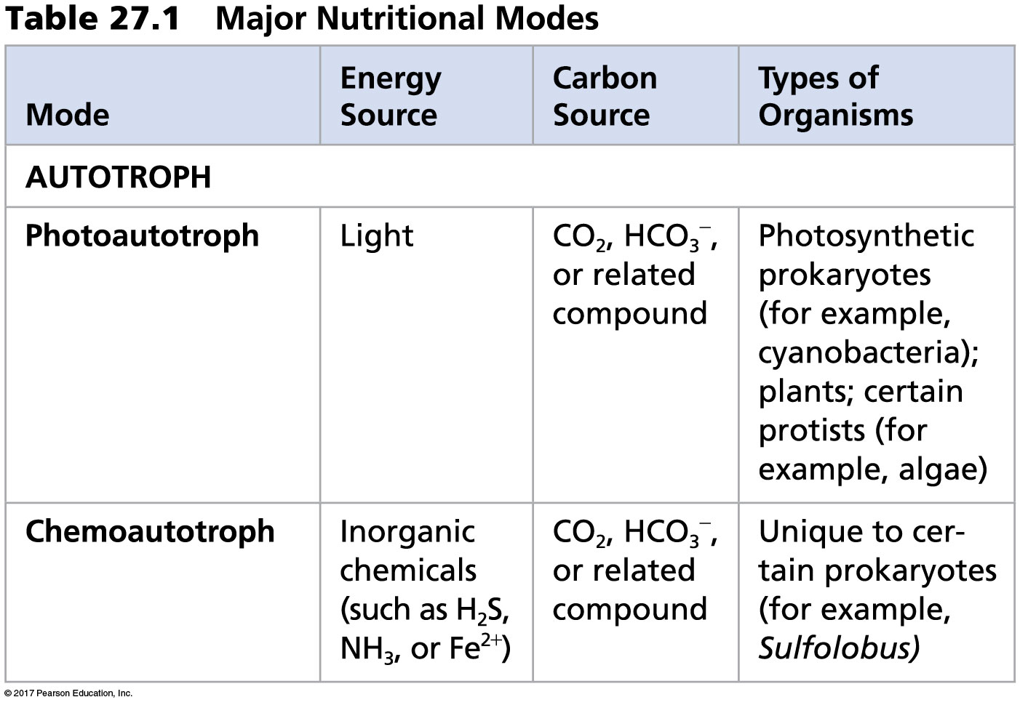
Table 27.1a
Notes:
Table 27.1a Major nutritional modes (part 1)

Slide 50
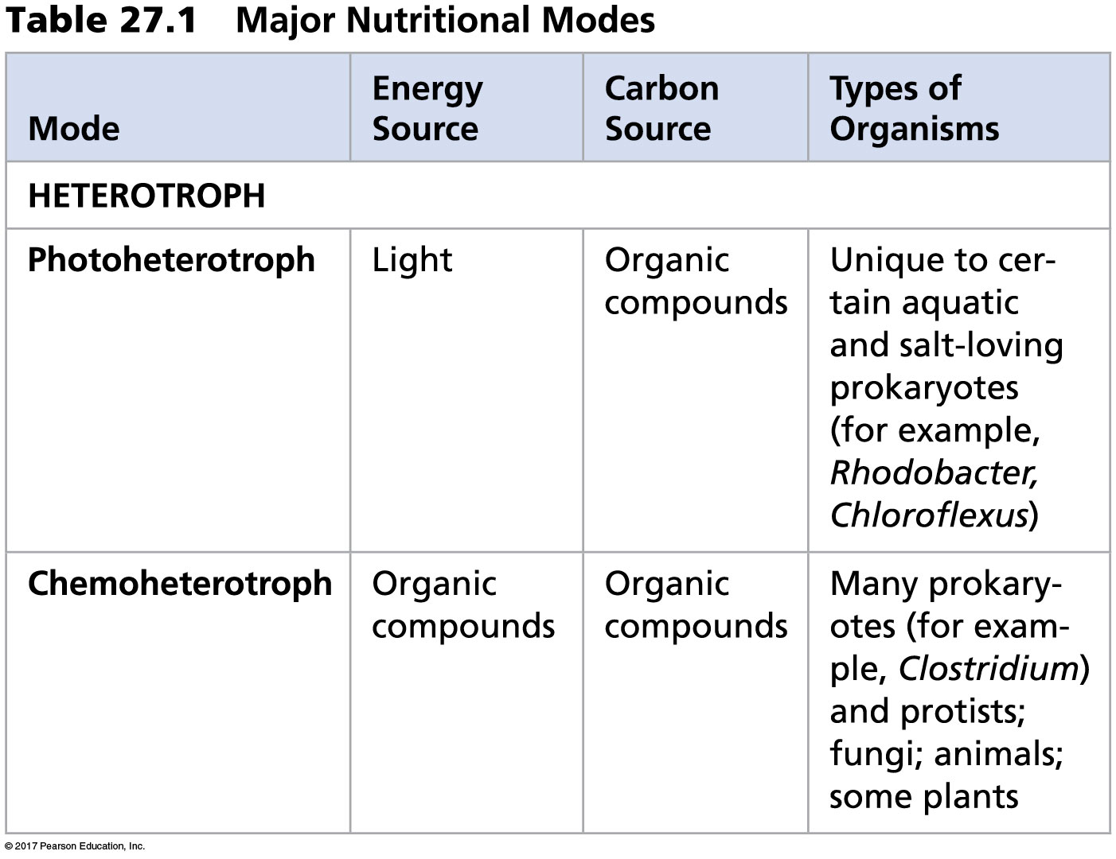
Table 27.1b
Notes:
Table 27.1b Major nutritional modes (part 2)

Slide 51
The Role of Oxygen in Metabolism
Prokaryotic metabolism varies with respect to O₂
Obligate aerobes require O₂ for cellular respiration
Obligate anaerobes are poisoned by O₂ and live by fermentation or use substances other than O₂ for anaerobic respiration
Facultative anaerobes can use O₂ if it is present or carry out fermentation or anaerobic respiration if it is not

Slide 52
Nitrogen Metabolism
Nitrogen is essential for the production of amino acids and nucleic acids in all organisms
Prokaryotes can metabolize nitrogen in a variety of ways
For example, some prokaryotes convert atmospheric nitrogen (N₂) to ammonia (NH₃) in a process called nitrogen fixation

Slide 53
Metabolic Cooperation
Cooperation between prokaryotes allows them to use environmental resources they could not use as individual cells
In the cyanobacterium Anabaena, photosynthetic cells and nitrogen-fixing cells called heterocysts (or heterocytes) exchange metabolic products

Slide 54
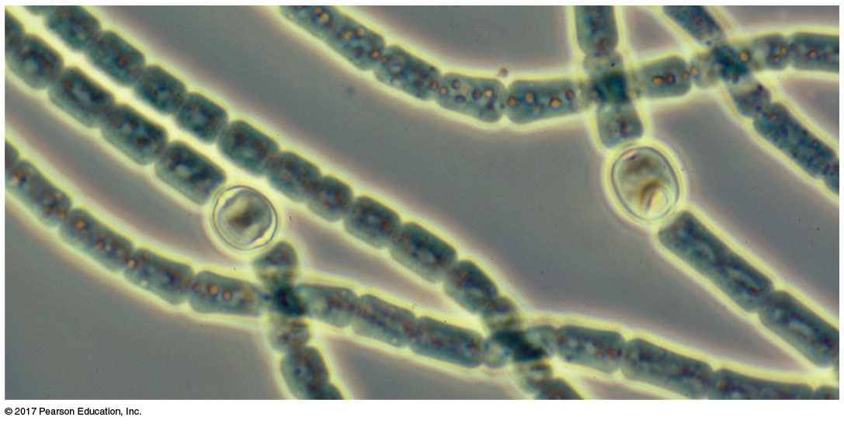
Figure 27.14
Photosynthetic
cells
Heterocyst
20 µm
Notes:
Figure 27.14 Metabolic cooperation in a prokaryote

Slide 55
Metabolic cooperation occurs between different prokaryotic species in surface-coating colonies called biofilms
Sulfate-consuming bacteria and methane-consuming bacteria on the ocean floor use each other’s waste products

Slide 56
Concept 27.4: Prokaryotes have radiated into a diverse set of lineages
The origin of prokaryotes dates back to 3.5 billion years ago
Prokaryotes now inhabit every environment known to support life
Advances in genomics are beginning to reveal the extent of prokaryotic diversity

Slide 57
An Overview of Prokaryotic Diversity
Genetic analysis led to the division of prokaryotes into two domains, Bacteria and Archaea
A few taxonomic groups are monophyletic, but others are scattered throughout several lineages
Advances in molecular techniques help to add new branches to the tree of life each year

Slide 58
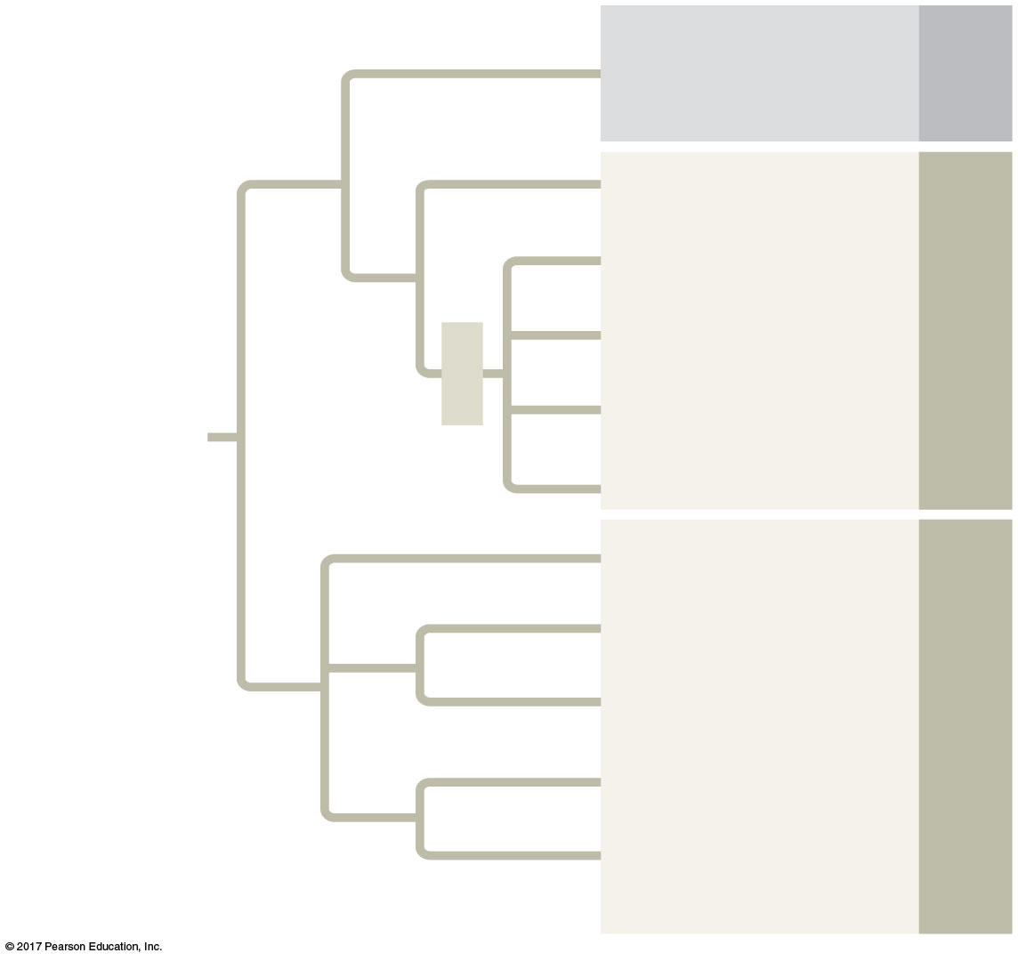
Figure 27.15
Eukarya
Domain
Eukaryotes
Euryarchaeotes
Domain Archaea
Thaumarchaeotes
TACK
Aigarchaeotes
Crenarchaeotes
UNIVERSAL
ANCESTOR
Korarchaeotes
Proteobacteria
Chlamydias
Domain Bacteria
Spirochetes
Cyanobacteria
Gram-positive
bacteria
Notes:
Figure 27.15 A simplified phylogeny of prokaryotes

Slide 59
The use of polymerase chain reaction (PCR) has allowed for more rapid sequencing of prokaryote genomes
A handful of soil may contain 10,000 prokaryotic species
Horizontal gene transfer between prokaryotes obscures the root of the tree of life

Slide 60
Bacteria
Bacteria include the vast majority of prokaryotic species familiar to most people
Diverse nutritional types are represented among bacteria

Slide 61
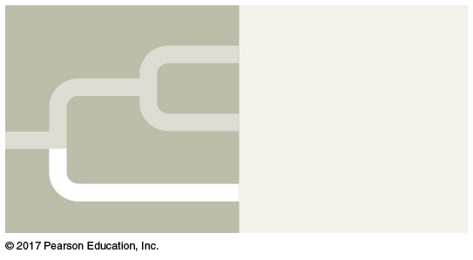
Figure 27.UN01
Eukarya
Archaea
Bacteria
Notes:
Figure 27.UN01 In-text figure, bacteria mini-tree, p. 635

Slide 62
Proteobacteria
These gram-negative bacteria include photoautotrophs, chemoautotrophs, and heterotrophs
Some are anaerobic and others aerobic
There are currently five subgroups of proteobacteria recognized by molecular systematists

Slide 63

Figure 27.16aa
Alpha
Beta
Gamma
Proteobacteria
Delta
Epsilon
Notes:
Figure 27.16aa Exploring selected major groups of bacteria (part 1a: proteobacteria tree)

Slide 64
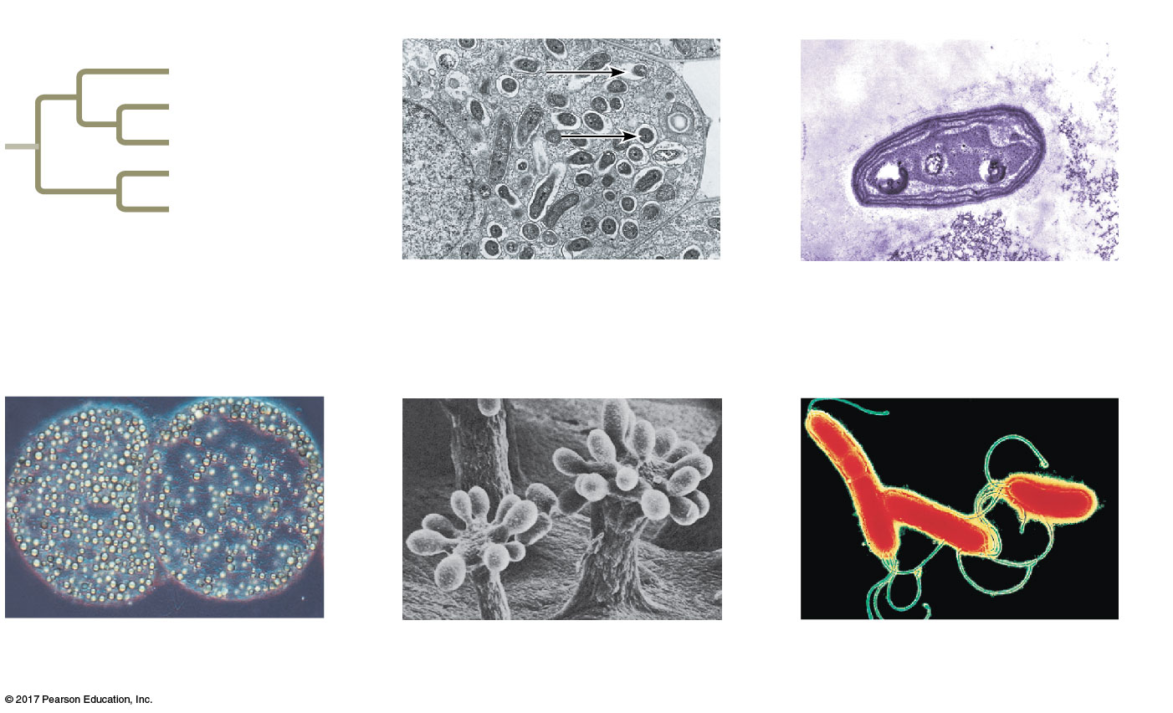
Figure 27.16a
Alpha subgroup
Beta subgroup
Alpha
Beta
Gamma
Proteo-
bacteria
Delta
Epsilon
2.5 µm
1 µm
Rhizobium (arrows)
(TEM)
Nitrosomonas
(TEM)
Gamma subgroup
Delta subgroup
Epsilon subgroup
200 µm
300 µm
2 µm
Thiomargarita
namibiensis (LM)
Chondromyces
crocatus (SEM)
Helicobacter pylori
(TEM)
Notes:
Figure 27.16a Exploring selected major groups of bacteria (part 1)

Slide 65
Chlamydias
These bacteria are parasites that live within animal cells
Example: Chlamydia trachomatis causes blindness and nongonococcal urethritis by sexual transmission

Slide 66
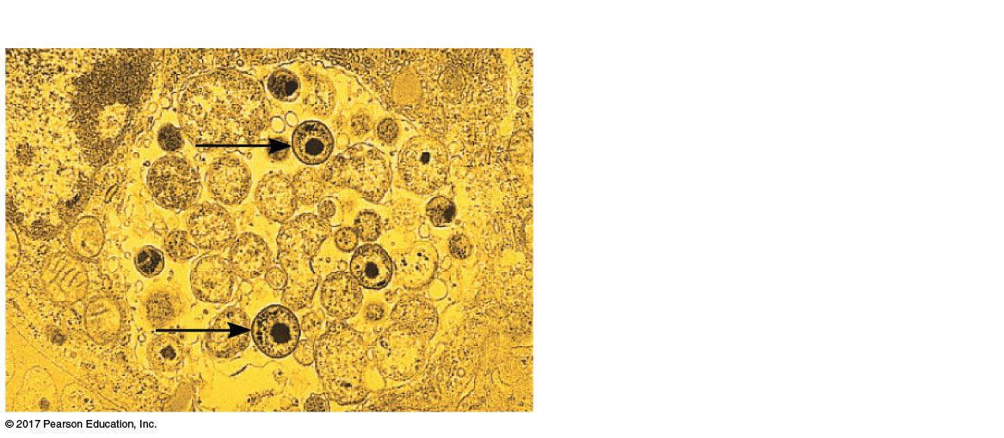
Figure 27.16ba
Chlamydias
Chlamydia (arrows) inside an
animal cell (colorized TEM)
2.5 µm
Notes:
Figure 27.16ba Exploring selected major groups of bacteria (part 2a: chlamydias)

Slide 67
Spirochetes
These bacteria are helical gram-negative heterotrophs
Some are parasites, including Treponema pallidum, which causes syphilis, and Borrelia burgdorferi, which causes Lyme disease

Slide 68
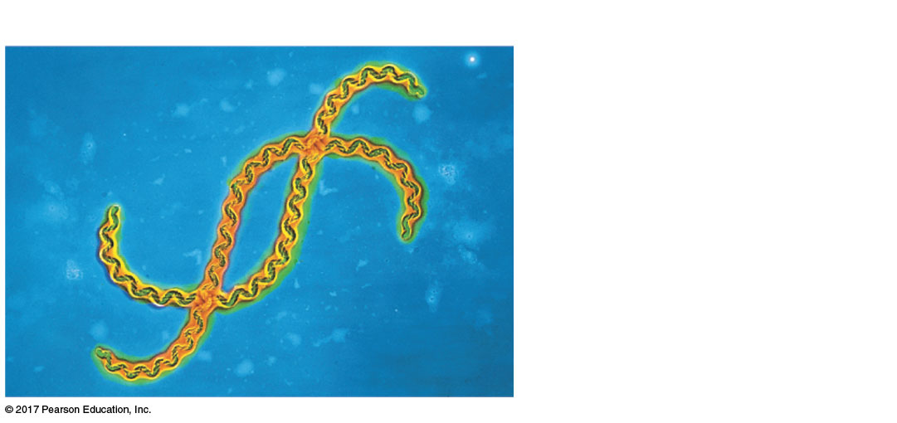
Figure 27.16bb
Spirochetes
Leptospira, a spirochete
(colorized TEM)
5 µm
Notes:
Figure 27.16bb Exploring selected major groups of bacteria (part 2b: spirochetes)

Slide 69
Cyanobacteria
These are gram-negative photoautotrophs that generate O₂
Plant chloroplasts likely evolved from cyanobacteria by the process of endosymbiosis
Cyanobacteria are abundant components of freshwater and marine phytoplankton

Slide 70
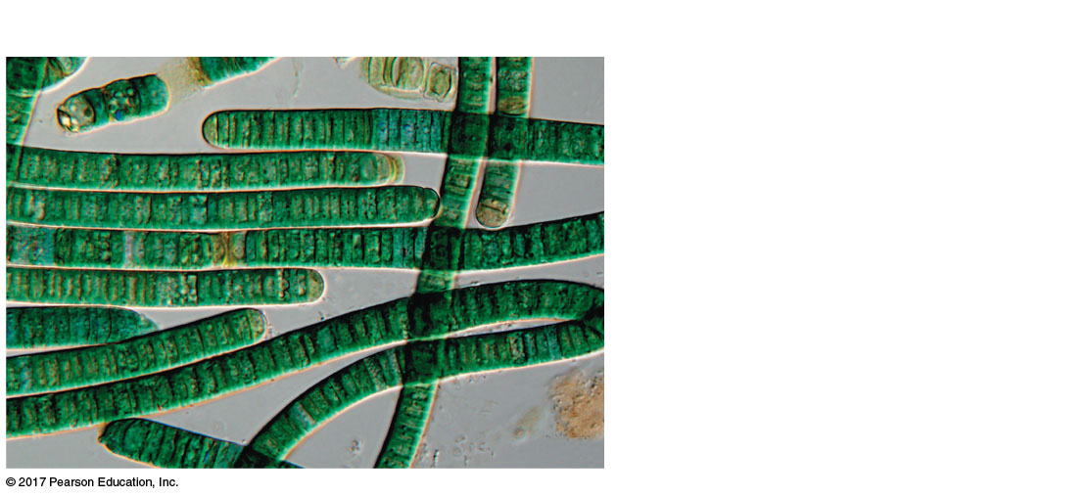
Figure 27.16bc
Cyanobacteria
Oscillatoria, a filamentous
cyanobacterium
40 µm
Notes:
Figure 27.16bc Exploring selected major groups of bacteria (part 2c: cyanobacteria)

Slide 71
Gram-Positive Bacteria
Gram-positive bacteria include
Colony-forming groups, such as actinomycetes, many of which help decompose organic matter
Solitary species including Bacillus anthracis, the cause of anthrax; Clostridium botulinum, the cause of botulism; and various Staphylococcus and Streptococcus species
Mycoplasmas, the smallest known cells, lack cell walls

Slide 72
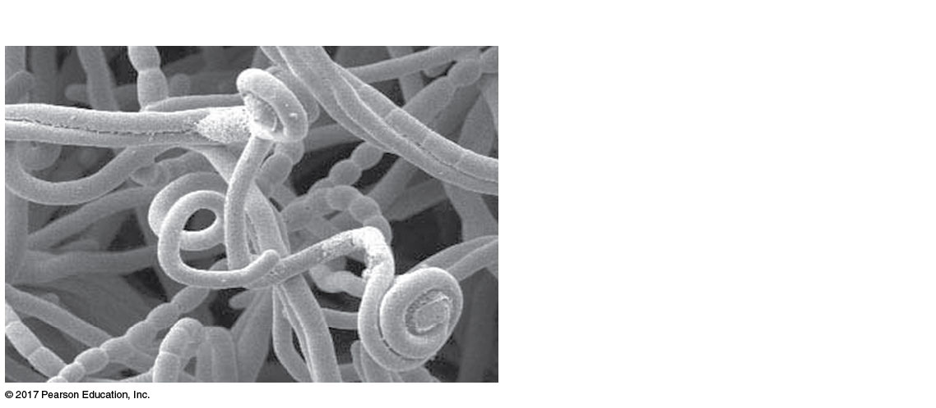
Figure 27.16bd
Gram-positive bacteria
Streptomyces, the source of
many antibiotics (SEM)
5 µm
Notes:
Figure 27.16bd Exploring selected major groups of bacteria (part 2d: Gram-positive, Streptomyces)

Slide 73
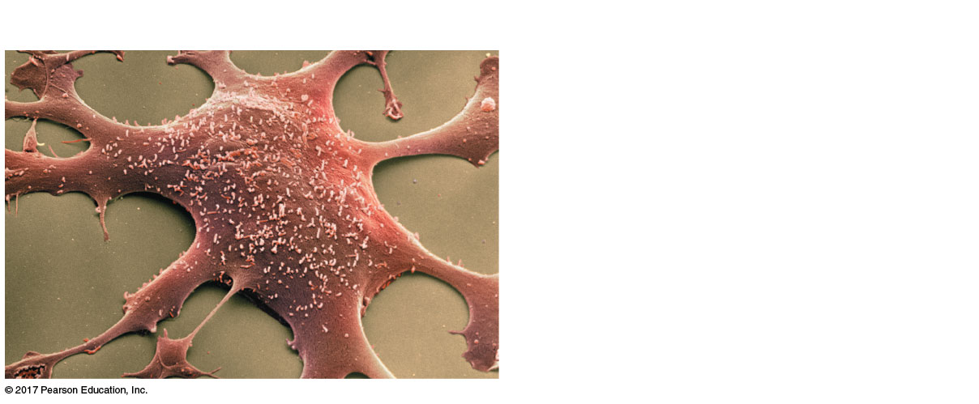
Figure 27.16be
Gram-positive bacteria
Hundreds of mycoplasmas
covering a human fibroblast cell
(colorized SEM)
2 µm
Notes:
Figure 27.16be Exploring selected major groups of bacteria (part 2e: Gram-positive, mycoplasmas)

Slide 74
Archaea
Archaea share certain traits with bacteria and other traits with eukaryotes
They also have many unique characteristics

Slide 75
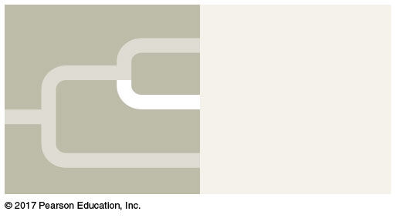
Figure 27.UN02
Eukarya
Archaea
Bacteria
Notes:
Figure 27.UN02 In-text figure, Archaea mini-tree, p. 638

Slide 76
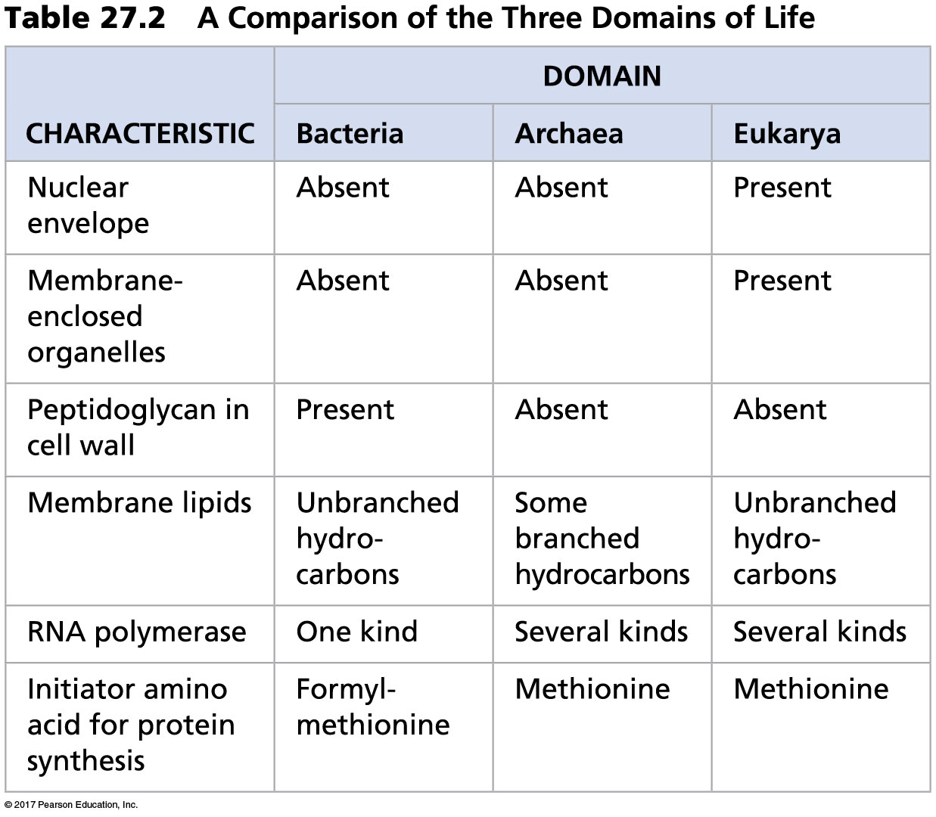
Table 27.2a
Notes:
Table 27.2a A comparison of the three domains of life (part 1)

Slide 77
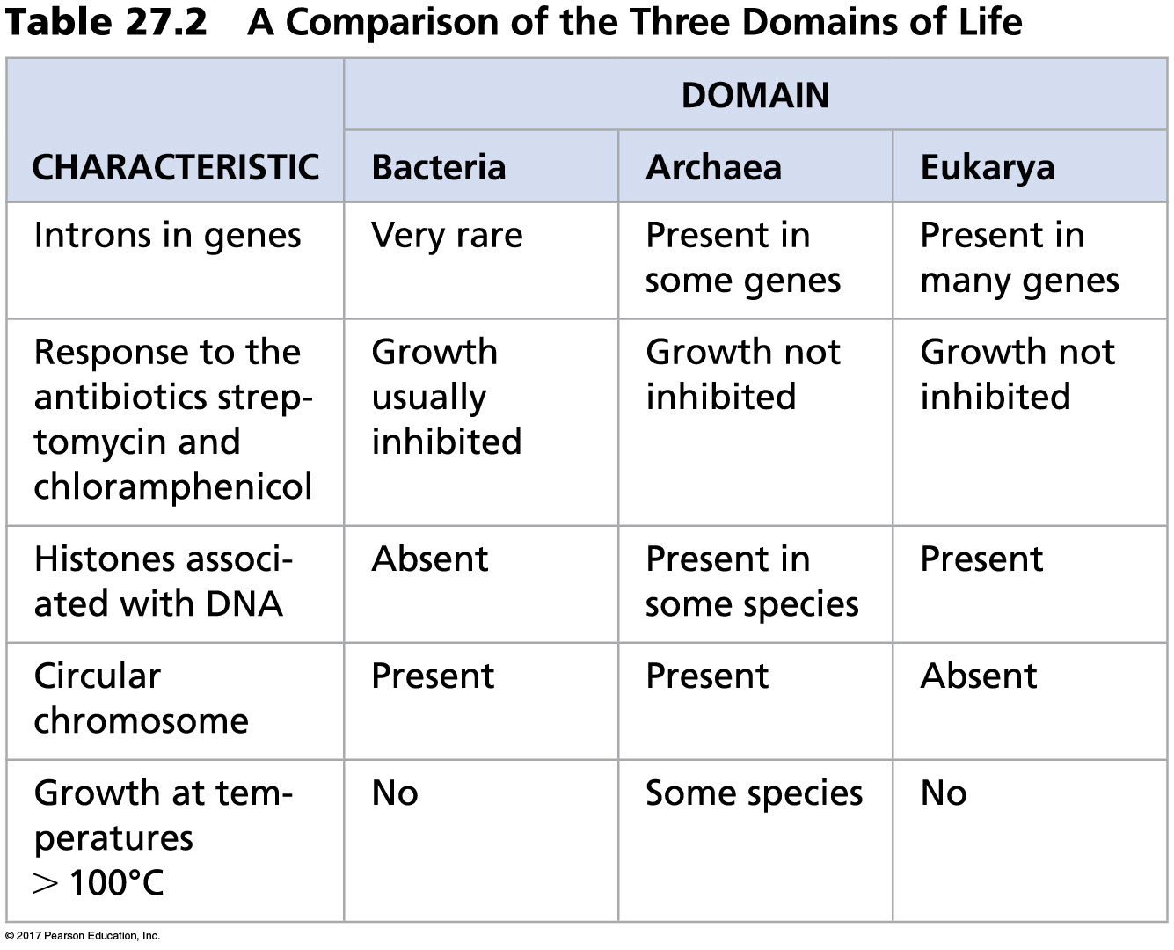
Table 27.2b
Notes:
Table 27.2b A comparison of the three domains of life (part 2)

Slide 78
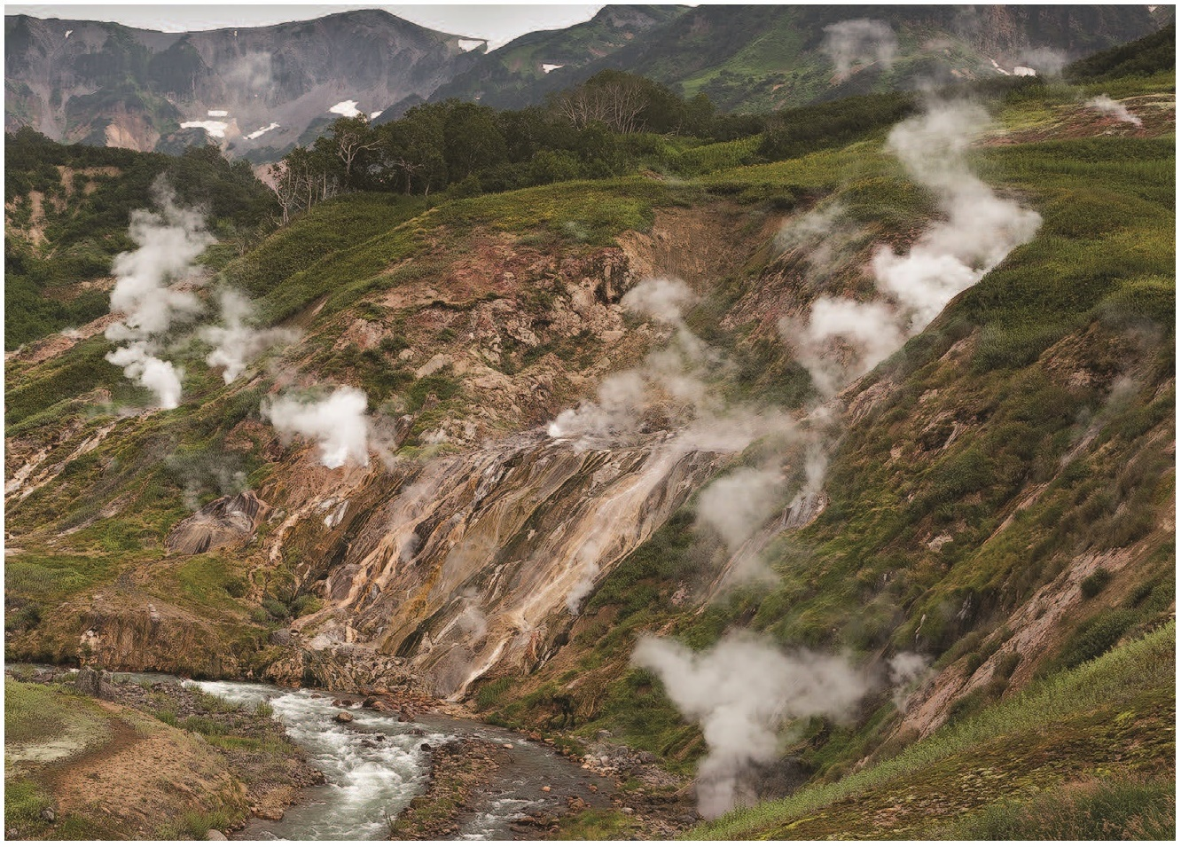
Some archaea live in extreme environments and are called extremophiles
Extreme halophiles live in highly saline environments
Extreme thermophiles thrive in very hot environments

Slide 79
Methanogens live in swamps and marshes and produce methane as a waste product
Methanogens are strict anaerobes and are poisoned by O₂

Slide 80
New research findings continue to inform our understanding of archaeal phylogeny
For example, a recently discovered group called Lokiarchaeota may represent the sister group of the eukaryotes
The characteristics of lokiarchaeotes could shed light on the evolution of eukaryotes from their prokaryotic ancestors

Slide 81
Concept 27.5: Prokaryotes play crucial roles in the biosphere
Prokaryotes are so important that if they were to disappear, the prospects for any other life surviving on Earth would be dim

Slide 82
Chemical Recycling
Prokaryotes play a major role in the recycling of chemical elements between the living and nonliving components of the environment
Some chemoheterotrophic prokaryotes function as decomposers, breaking down dead organisms and waste products

Slide 83
Prokaryotes can convert some molecules to forms that can be taken up by other organisms
For example, under some conditions, prokaryotes can increase the availability of nutrients required for plant growth

Slide 84
Prokaryotes can also “immobilize” or decrease the availability of nutrients by using them in their own cells

Slide 85
Ecological Interactions
Symbiosis is an ecological relationship in which two species live in close contact: a larger host and smaller symbiont
Prokaryotes often form symbiotic relationships with larger organisms

Slide 86
In mutualism, both symbiotic organisms benefit
In commensalism, one organism benefits while neither harming nor helping the other in any significant way
In parasitism, an organism called a parasite harms but does not kill its host
Parasites that cause disease are called pathogens

Slide 87
The existence of some ecosystems depends on prokaryotes
For example, the ecological communities of hydrothermal vents depend on chemoautotrophic bacteria for energy

Slide 88
Concept 27.6: Prokaryotes have both beneficial and harmful impacts on humans
Some prokaryotes are human pathogens, but many others have positive interactions with humans

Slide 89
Mutualistic Bacteria
Human intestines are home to about 500–1,000 species of bacteria
Many of these are mutualists and break down food that is undigested by our intestines

Slide 90
Pathogenic Bacteria
Bacteria cause about half of all human diseases
Some bacterial diseases are transmitted by other species
For example, Lyme disease is caused by a bacterium and carried by ticks

Slide 91
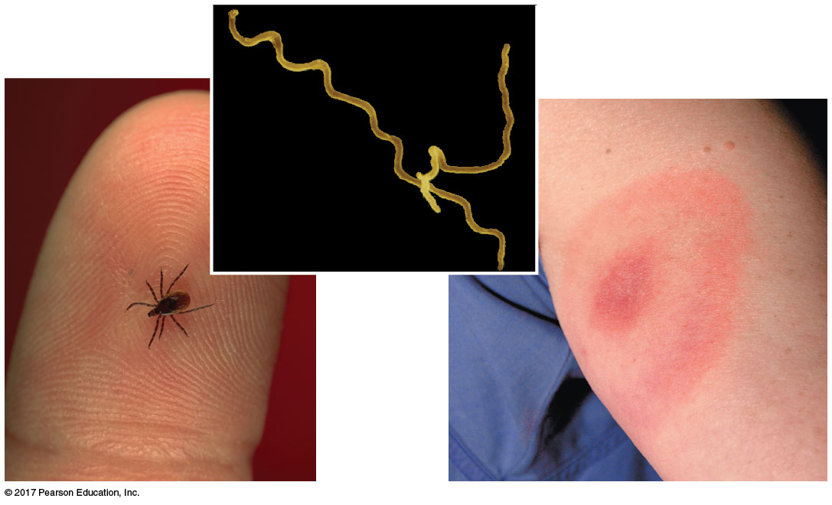
Figure 27.20
5 µm
Notes:
Figure 27.20 Lyme disease

Slide 92
Pathogenic prokaryotes typically cause disease by releasing exotoxins or endotoxins
Exotoxins are secreted and cause disease even if the prokaryotes that produce them are not present
Endotoxins are released only when bacteria die and their cell walls break down

Slide 93
Horizontal gene transfer can spread genes associated with virulence
For example, pathogenic strains of E. coli contain genes that were acquired through transduction

Slide 94
Prokaryotes in Research and Technology
Experiments using prokaryotes have led to important advances in DNA technology
For example, E. coli is used in gene cloning
For example, the prokaryotic CRISPR-Cas system can alter genes in other organisms
Bacteria can be used to make natural plastics

Slide 95
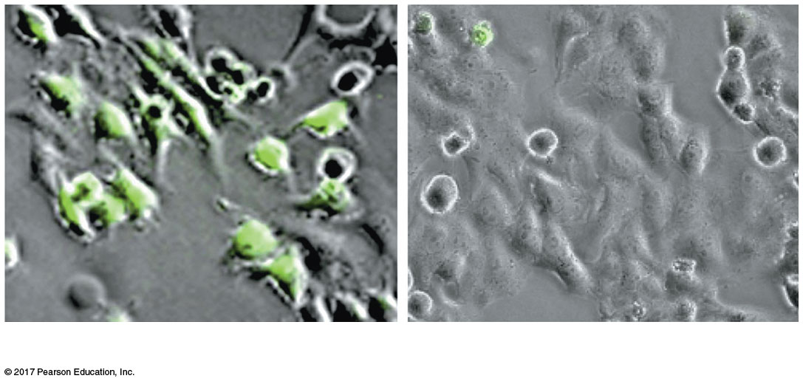
Figure 27.21
(a) Control cells
(b) Experimental cells
Notes:
Figure 27.21 CRISPR: Opening new avenues of research for treating HIV infection

Slide 96
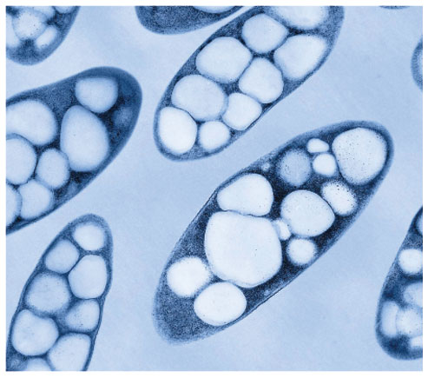
Bacteria are also being engineered to produce ethanol from agricultural and municipal waste biomass, switchgrass, and corn
Figure 27.22: Bacteria synthesizing and storing PHA, a component of biodegradeable plastics.

Slide 97
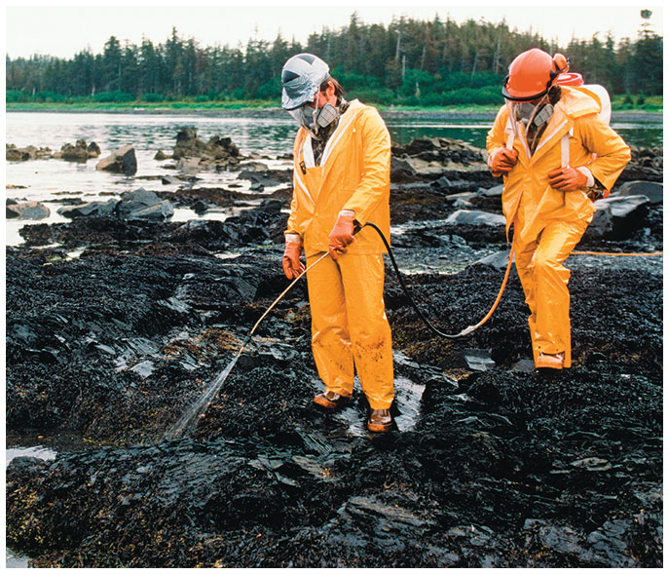
Prokaryotes can also be used in bioremediation, the use of organisms to remove pollutants from the environment

Slide 98
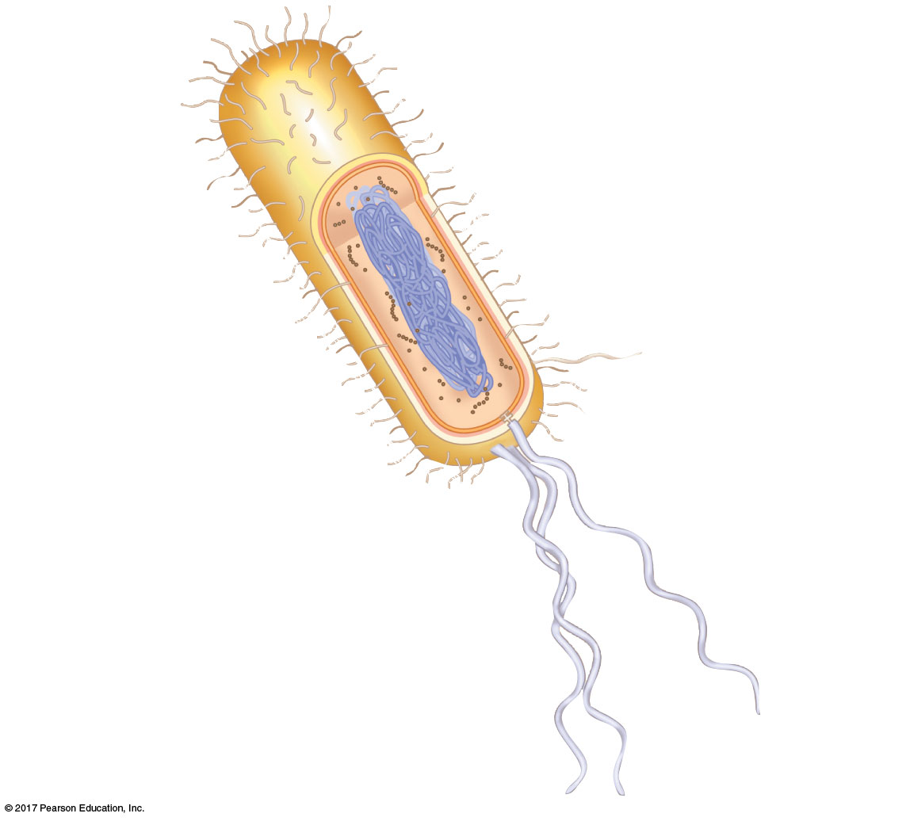
Figure 27.UN04
Fimbriae
Cell wall
Circular chromosome
Capsule
Pilus
Internal organization
Flagella
Notes:
Figure 27.UN04 Summary of key concepts: prokaryote adaptations

