Slide 1
Notes:
1

Slide 2
Recognition and Response
Pathogens, agents that cause disease, infect a wide range of animals, including humans
Dedicated cells of the immune system interact with and destroy pathogens
First lines of defense help prevent pathogens from gaining entry to the body
Within the body, two types of molecular recognition allow detection of nonself molecules, particles, and cells

Slide 3
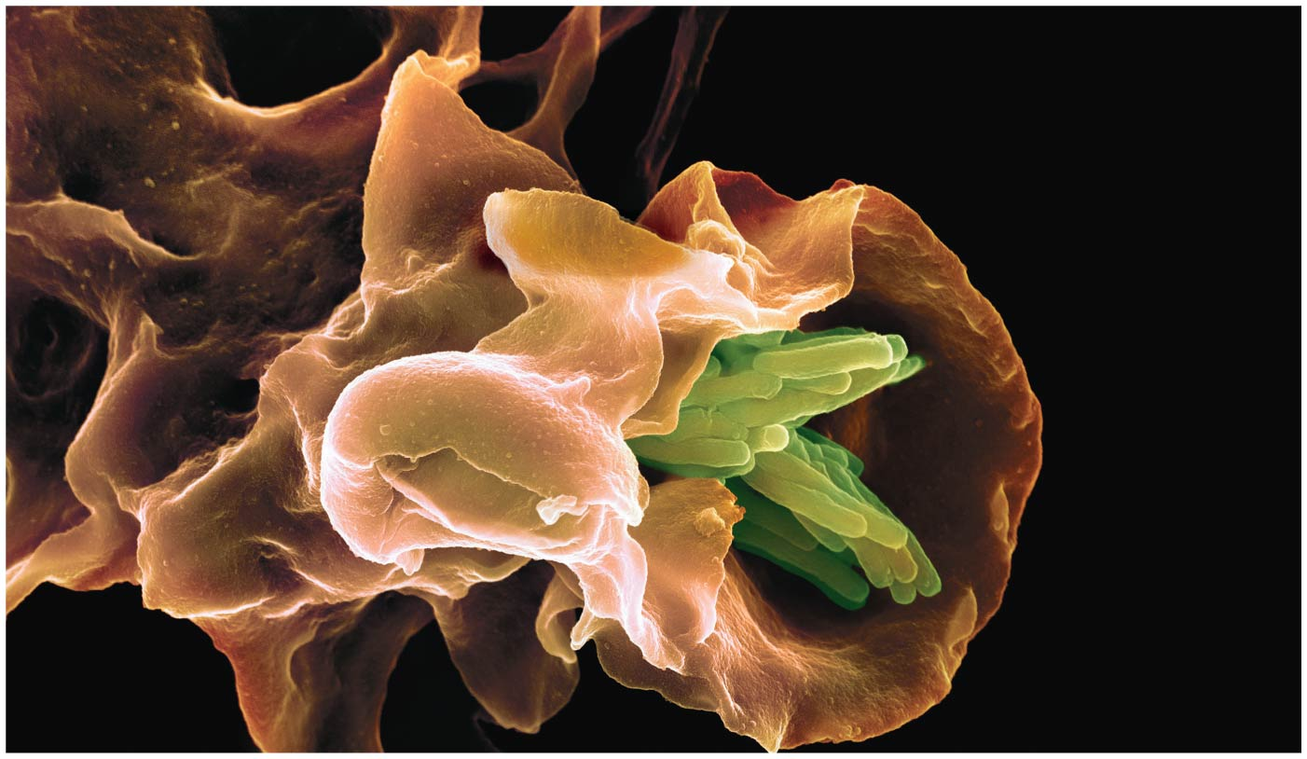
Figure 47.1
Notes:
Figure 47.1 What triggered this attack by an immune cell on a clump of bacteria?

Slide 4
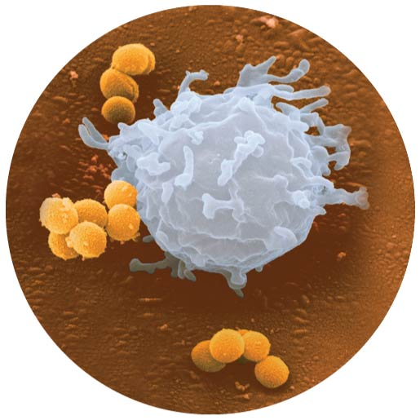
Figure 47.1a
Notes:
Figure 47.1a What triggered this attack by an immune cell on a clump of bacteria? (part 1: lymphocyte)

Slide 5
All animals have innate immunity, a defense active immediately upon infection
Innate immunity includes barrier defenses
Vertebrates also have adaptive immunity
The adaptive immune response is activated after the innate response and develops more slowly

Slide 6
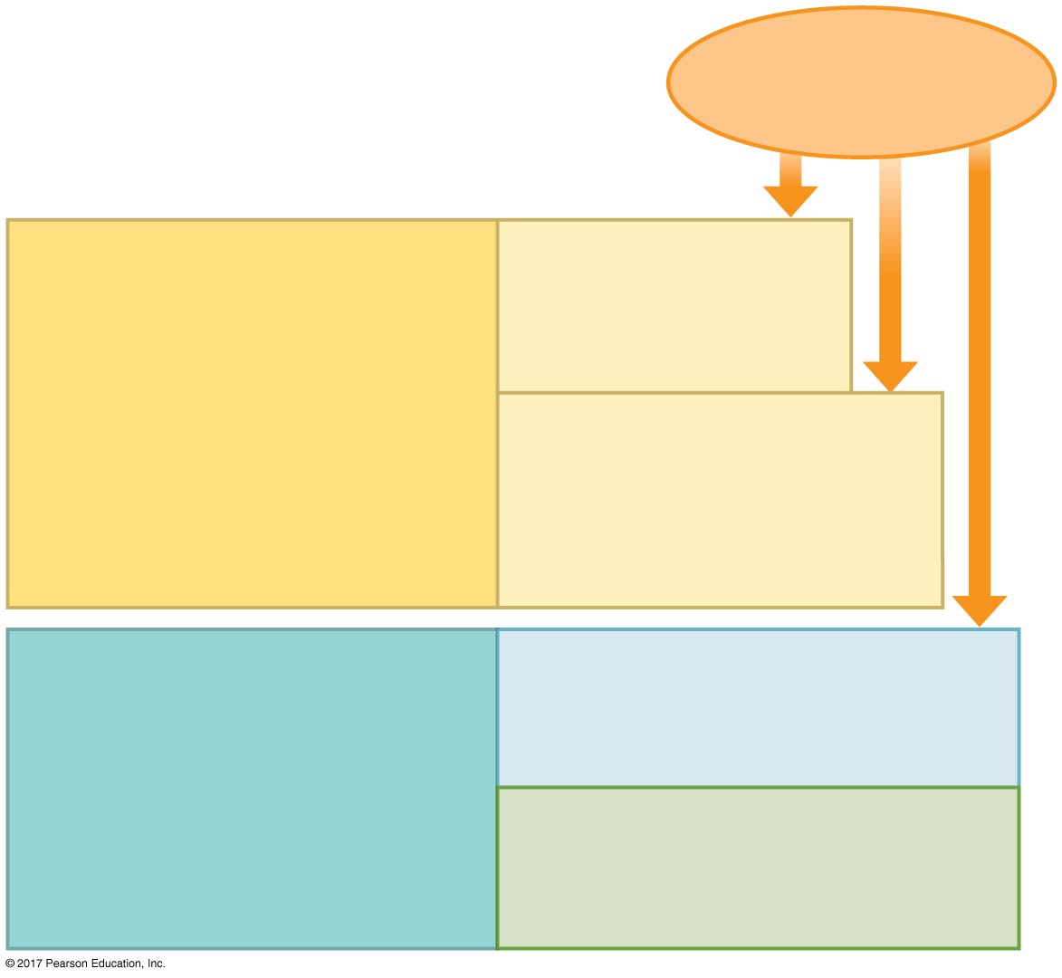
Figure 47.2
Pathogens
(such as bacteria,
fungi, and viruses)
INNATE IMMUNITY
(all animals)
Barrier defenses:
Skin
Mucous membranes
Secretions
Recognition of traits shared by broad ranges of pathogens, using a small set of receptors
Internal defenses:
Phagocytic cells
Natural killer cells
Antimicrobial proteins
Inflammatory response
Rapid response
ADAPTIVE IMMUNITY
(vertebrates only)
Humoral response:
Antibodies defend against
infection in body fluids.
Recognition of traits specific to particular pathogens, using a vast array of receptors
Cell-mediated response:
Cytotoxic cells defend
against infection in body cells.
Slower response
Notes:
Figure 47.2 Overview of animal immunity

Slide 7
Concept 47.1: In innate immunity, recognition and response rely on traits common to groups of pathogens
Innate immunity is found in all animals and plants
In vertebrates, innate immunity is a first response to infections and the foundation of adaptive immunity

Slide 8
Innate Immunity of Invertebrates
In insects, an exoskeleton made of chitin forms the first barrier to pathogens
The digestive system is protected by a chitin-based barrier and lysozyme, an enzyme that breaks down bacterial cell walls
Hemocytes circulate within hemolymph and carry out phagocytosis, the ingestion and digestion of foreign substances including bacteria

Slide 9
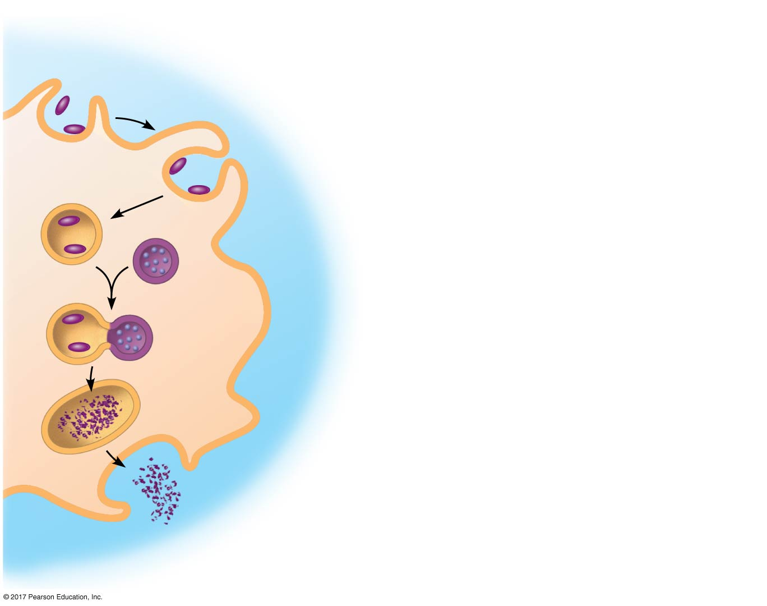
Figure 47.3
1
Pseudopodia surround pathogens.
Pathogen
2
Pathogens are engulfed by endocytosis.
PHAGOCYTIC
CELL
3
Vacuole forms.
Lysosome
containing
enzymes
Vacuole
4
Vacuole and lysosome fuse.
5
Pathogens destroyed.
6
Debris from pathogens released.
Notes:
Figure 47.3 Phagocytosis

Slide 10
Hemocytes also secrete antimicrobial peptides that disrupt the plasma membranes of fungi and bacteria
The immune system recognizes bacteria and fungi by structures on their cell walls
Insects also have defenses against viruses, based on recognition of double-stranded RNA

Slide 11
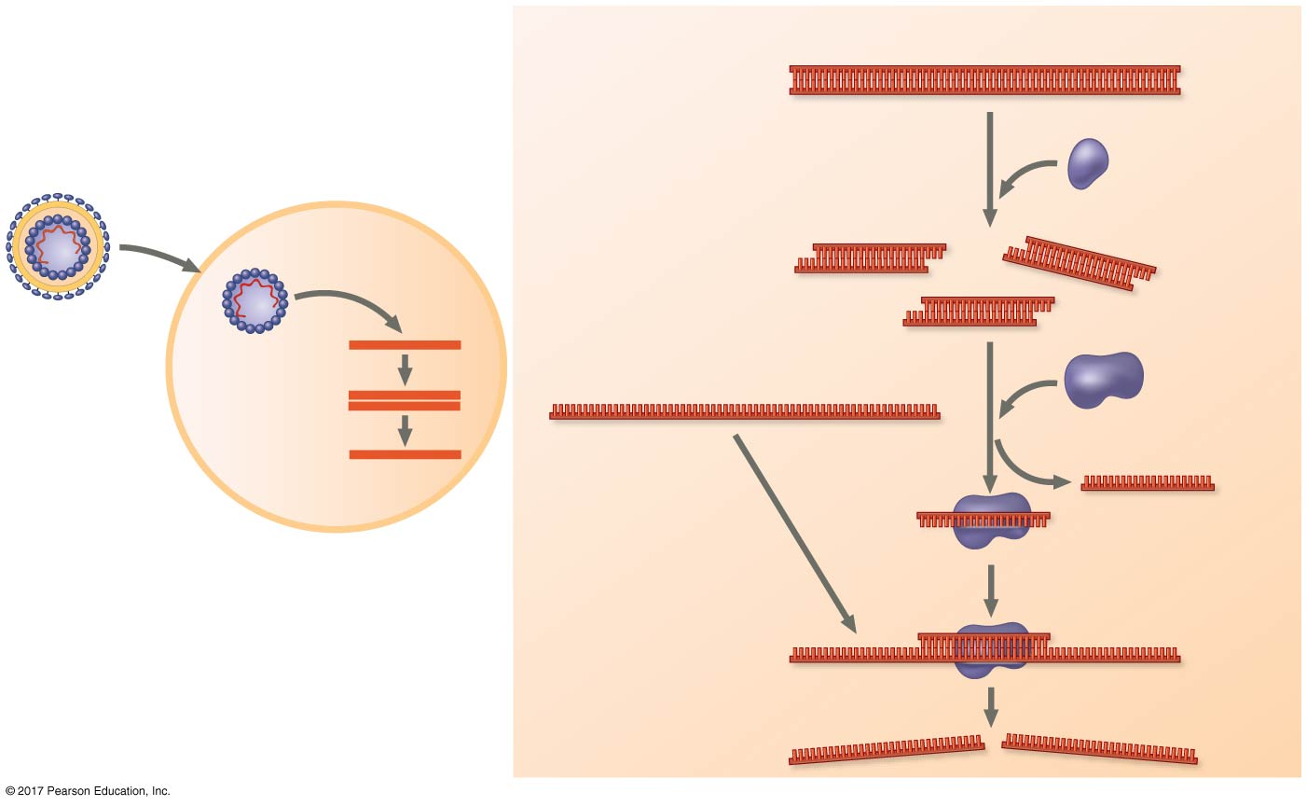
Figure 47.4
Double-stranded viral RNA
Viral infection
Host defense
1
Dicer-2
enzyme
RNA virus
HOST CELL
Single-stranded
viral mRNA
Argo
protein
complex
Viral RNA
genome
2
3
HOST CELL
Notes:
Figure 47.4 Antiviral defense in insects

Slide 12
Innate Immunity of Vertebrates
Innate defenses of mammals are similar to those of invertebrates
These include barrier defenses, phagocytosis, and antimicrobial peptides
Additional defenses unique to vertebrates are natural killer cells, interferons, and the inflammatory response

Slide 13
Barrier Defenses
Barrier defenses include the skin and mucous membranes of the respiratory, urinary, and reproductive tracts
Mucus traps and allows for the removal of microbes
Many body fluids including saliva, mucus, and tears are hostile to many microbes
The low pH of skin and the digestive system prevents growth of many bacteria

Slide 14
Cellular Innate Defenses
Innate immune cells in mammals detect, devour, and destroy invading pathogens
These cells recognize groups of pathogens using TLRs, or Toll-like receptors
TLRs recognize fragments of molecules characteristic of a set of pathogens

Slide 15
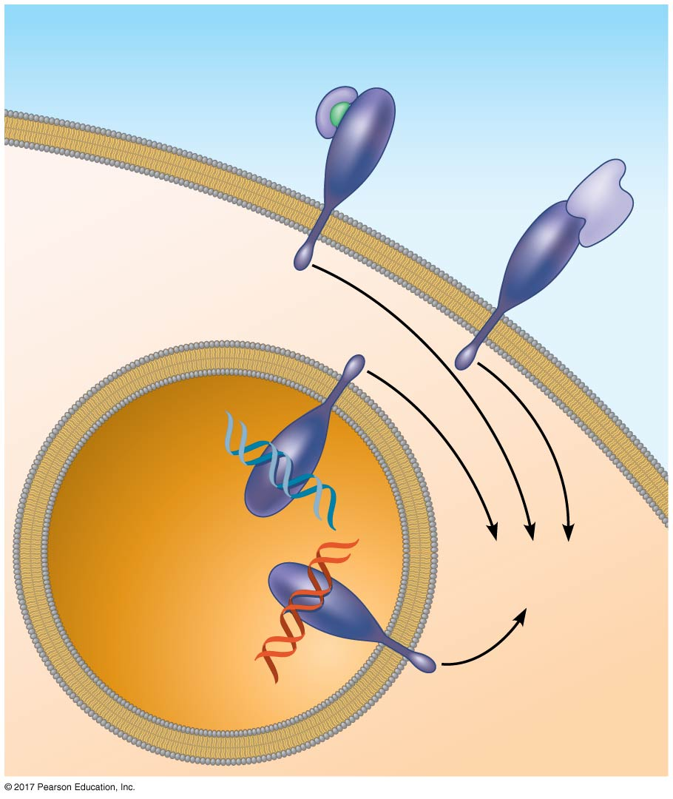
Figure 47.5
EXTRACELLULAR
FLUID
Lipopolysaccharide
Helper
protein
Flagellin
TLR4
PHAGOCYTIC CELL
TLR5
CpG
DNA
TLR9
Innate immune
responses
VESICLE
dsRNA
TLR3
Notes:
Figure 47.5 TLR signaling

Slide 16
There are two main types of phagocytic cells, which engulf and destroy pathogens, in the mammalian body:
Neutrophils circulate in the blood
Macrophages migrate through the body or reside permanently in organs and tissues
There are two additional types of phagocytic cells:
Dendritic cells stimulate development of adaptive immunity
Eosinophils discharge destructive enzymes against parasites

Slide 17
Cellular innate defenses in vertebrates also involve natural killer cells
These circulate through the body and detect abnormal cells
They release chemicals leading to cell death, inhibiting the spread of virally infected or cancerous cells
Many cellular innate defenses involve the lymphatic system

Slide 18
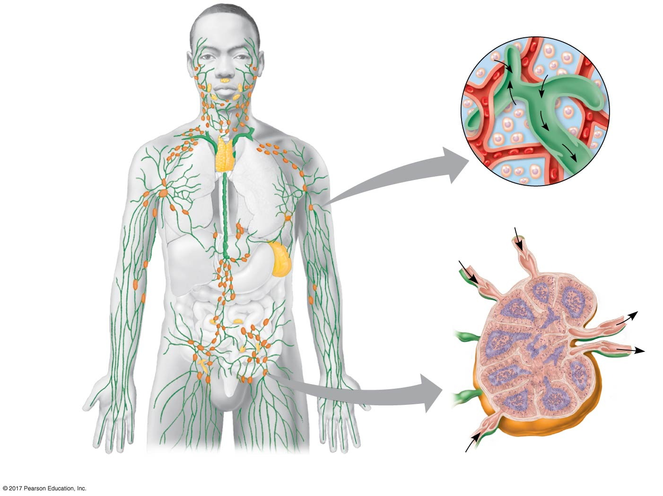
Figure 47.6
Blood
capillary
Interstitial fluid
Adenoid
Tonsils
Lymphatic
vessels
Thymus
Tissue
cells
Lymphatic
vessel
Lymphatic
vessel
Peyer’s
patches
(in small
intestine)
Spleen
Lymph
nodes
Appendix
(cecum)
Lymph node
Masses of
defensive cells
Notes:
Figure 47.6 The human lymphatic system

Slide 19
Antimicrobial Peptides and Proteins
Peptides and proteins function in innate defense by attacking pathogens or impeding their reproduction
Interferon proteins provide innate defense, interfering with viruses and helping activate macrophages
About 30 proteins make up the complement system, which causes lysis of invading cells and helps trigger inflammation

Slide 20
Inflammatory Response
The inflammatory response, such as pain and swelling, is brought about by molecules released upon injury or infection
Mast cells, immune cells found in connective tissue, release histamine, which triggers blood vessels to dilate and become more permeable

Slide 21
Activated complement proteins promote further release of histamine, attracting more phagocytic cells
Enhanced blood flow to the site helps deliver antimicrobial peptides
The result is an accumulation of pus, a fluid rich in white blood cells, dead pathogens, and cell debris from damaged tissues

Slide 22
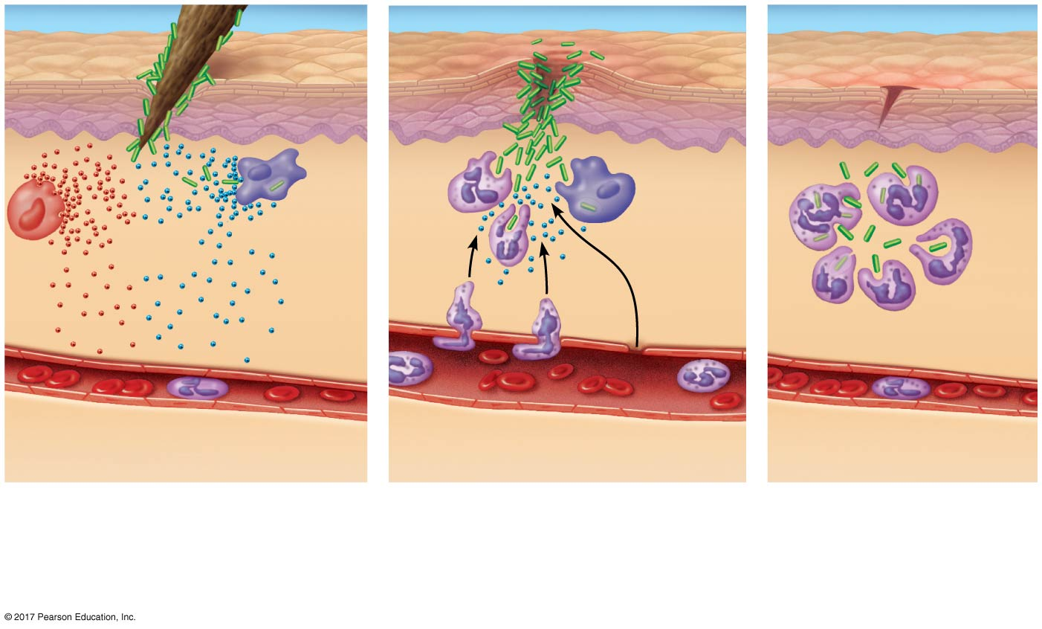
Figure 47.7_3
Pathogen
Splinter
Movement
of fluid
Signaling
molecules
Macro-
phage
Mast
cell
Capillary
Phagocytosis
Red blood
cells
Neutrophil
1
2
3
Mast cells release
histamines. Capillaries
dilate.
Neutrophils and anti-
microbial peptides
enter tissue.
Neutrophils
digest pathogens
and cell debris.
Tissue heals.
Notes:
Figure 47.7_3 Major events in a local inflammatory response (step 3)

Slide 23
Inflammation can be either local or systemic (throughout the body)
Fever is a systemic inflammatory response triggered by substances released by macrophages in response to certain pathogens
Septic shock is a life-threatening condition caused by an overwhelming inflammatory response

Slide 24
Evasion of Innate Immunity by Pathogens
Some pathogens avoid destruction by modifying their surface to prevent recognition or by resisting breakdown following phagocytosis
Streptococcus pneumoniae is one such bacterium, a major cause of pneumonia and meningitis in humans
Tuberculosis (TB), another such disease, kills more than a million people a year

Slide 25
Concept 47.2: In adaptive immunity, receptors provide pathogen-specific recognition
The adaptive response relies on two types of lymphocytes, or white blood cells
Lymphocytes that mature in the thymus, above the heart, are called T cells, and those that mature in bone marrow are called B cells

Slide 26
T cells bind to antigen fragments displayed or presented on a host cell
These antigen fragments are bound to cell-surface proteins called major histocompatibility complex (MHC) molecules
MHC molecules are host proteins that display the antigen fragments on the cell surface

Slide 27
In infected cells, MHC molecules bind and transport antigen fragments to the cell surface, a process called antigen presentation
A T cell can then bind both the antigen fragment and the MHC molecule
This interaction is necessary for the T cell to participate in the adaptive immune response

Slide 28
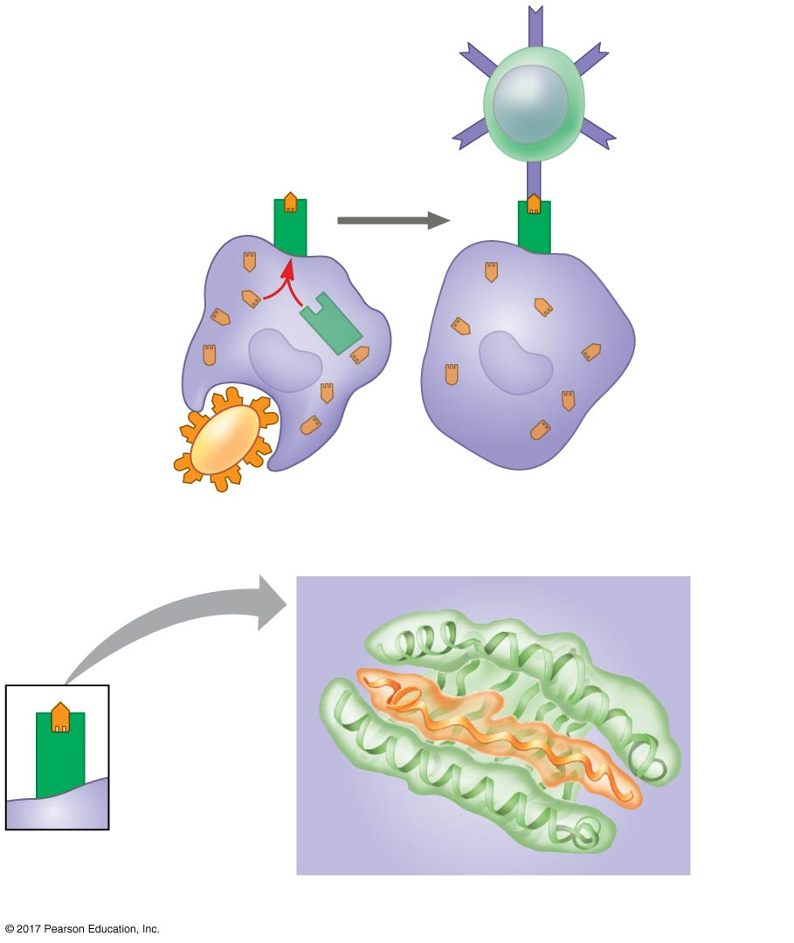
Figure 47.12
Displayed
antigen
fragment
T cell
MHC
molecule
T cell antigen
receptor
Antigen
fragment
Pathogen
Host cell
(a) Antigen recognition by a T cell
Top view
Antigen
fragment
MHC
molecule
Host cell
(b) A closer look at antigen presentation
Notes:
Figure 47.12 Antigen recognition by T cells

Slide 29
B Cell and T Cell Development
The adaptive immune system has four major characteristics:
Immense diversity of lymphocytes and receptors
Self-tolerance: lack of reactivity against an animal’s own molecules and cells
B and T cells proliferate after activation
Immunological memory

Slide 30
Generation of B and T Cell Diversity
By combining variable elements, the immune system assembles millions of different antigen receptors from a small number of parts
An immunoglobulin (Ig) gene encodes the light chain of the B cell receptor
Many different chains can be produced from the same gene by rearrangement of the V, J, and C regions

Slide 31
The recombinase enzyme complex acts randomly to connect different V and J segments in each B cell
The heavy chain gene undergoes a similar rearrangement
The rearrangements are permanent and passed on to daughter cells when the lymphocyte divides
The rearranged genes are transcribed and translated to produce unique antigen receptors

Slide 32
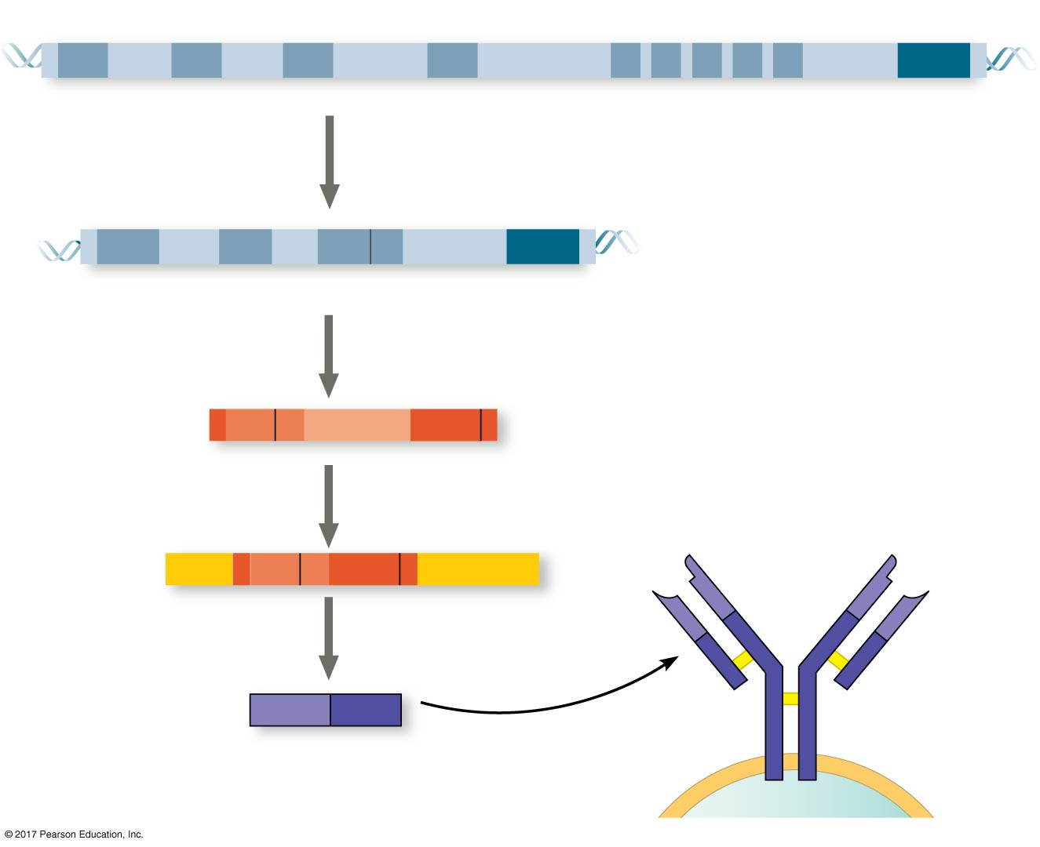
Figure 47.13
DNA of undifferentiated B cell
V₃₇
V₃₈
V₃₉
V₄₀
J₁
J₂
J₃
J₄
J₅
Intron
C
DNA of
differentiated
B cell
1
Recombination deletes DNA between
randomly selected V segment and
J segment
V₃₇
V₃₈
V₃₉
J₅
Intron
C
Functional gene
2
Transcription of permanently
rearranged, functional gene
pre-mRNA
V₃₉
J₅
Intron
C
3
RNA processing
mRNA
Cap
V₃₉
J₅
C
Poly-A tail
V
V
4
Translation
V
V
C
C
Light-chain
polypeptide
V
C
Antigen receptor
C C
Variable
region
Constant
region
B cell
Notes:
Figure 47.13 Immunoglobulin (antibody) gene rearrangement

Slide 33
Origin of Self-Tolerance
Antigen receptors are generated by random rearrangement of DNA
As lymphocytes mature in bone marrow or the thymus, they are tested for self-reactivity
Some B and T cells with receptors specific for the body’s own molecules are destroyed by apoptosis, or programmed cell death
The remainder are rendered nonfunctional

Slide 34
Proliferation of B Cells and T Cells
In the body there are few lymphocytes with antigen receptors for any particular epitope
In the lymph nodes, an antigen is exposed to a steady stream of lymphocytes until a match is made
This binding of a mature lymphocyte to an antigen initiates events that activate the lymphocyte

Slide 35
Once activated, a B or T cell undergoes multiple cell divisions (clonal selection) to produce a clone of identical cells
Some cells from the clone become effector cells that act immediately against the antigen
Effector cells are plasma cells that secrete antibodies
The remaining cells in the clone become long-lived memory cells that can give rise to effector cells if the same antigen is encountered again

Slide 36
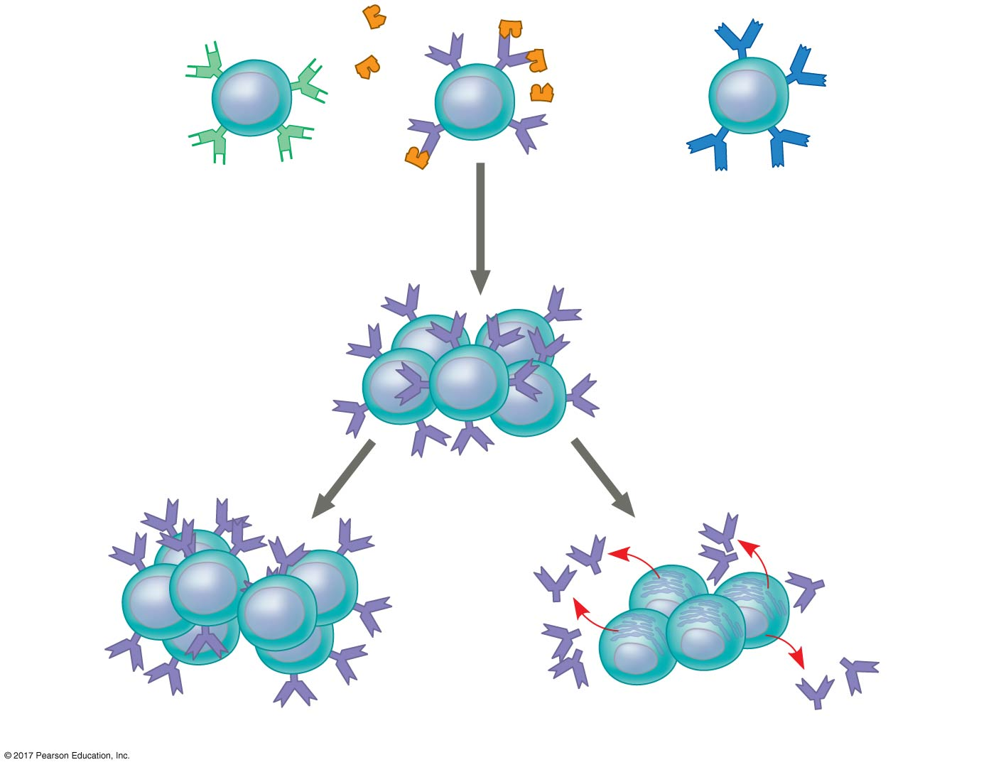
Figure 47.14
B cells that
differ in
antigen
specificity
Antigen
Antigen
receptor
Antibody
Memory cells
Plasma cells
Notes:
Figure 47.14 Clonal selection of B cells

Slide 37
Immunological Memory
Immunological memory is responsible for long-term protections against diseases
The first exposure to a specific antigen represents the primary immune response
A clone of lymphocytes is formed
In the secondary immune response, memory cells facilitate a faster, more efficient response from a reservoir of T and B memory cells

Slide 38
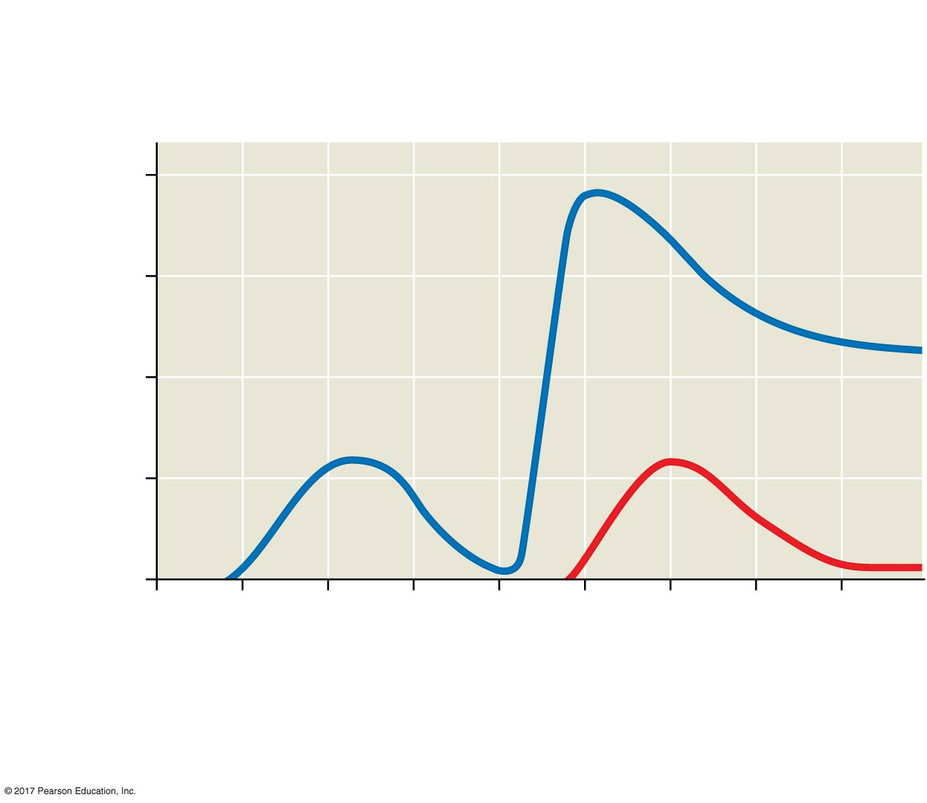
Figure 47.15
Primary immune
response to
antigen A
Secondary immune
response to
antigen A
Primary immune
response to
antigen B
10⁴
Antibody concentration
(arbitrary units)
10³
Antibodies
to A
10²
Antibodies
to B
10¹
10⁰
0
7
14
21
28
35
42
49
56
Exposure
to antigen A
Exposure to
antigens A and B
Time (days)
Notes:
Figure 47.15 The specificity of immunological memory

Slide 39
Concept 47.3: Adaptive immunity defends against infection of body fluids and body cells
The defenses provided by B and T lymphocytes can be divided into the humoral immune response and the cell-mediated immune response
In the humoral immune response, antibodies help neutralize or eliminate toxins and pathogens in the blood and lymph
In the cell-mediated immune response, specialized T cells destroy affected host cells

Slide 40
Helper T Cells: Activating Adaptive Immunity
A type of T cell called a helper T cell activates both the humoral and cell-mediated immune responses
This requires the presence of a foreign molecule that can bind the antigen receptor on the helper T cell
And the antigen must be displayed on the surface of an antigen-presenting cell
Antigen-presenting cells have class I and II MHC molecules on their surfaces

Slide 41
Class II MHC molecules provide the molecular signature by which antigen-presenting cells are recognized
Antigen receptors on the surface of helper T cells bind to the antigen and the class II MHC molecule; then cytokine signals are exchanged between the two cells
The helper T cell is activated, proliferates, and forms a clone of helper T cells, which then activate the appropriate B cells

Slide 42
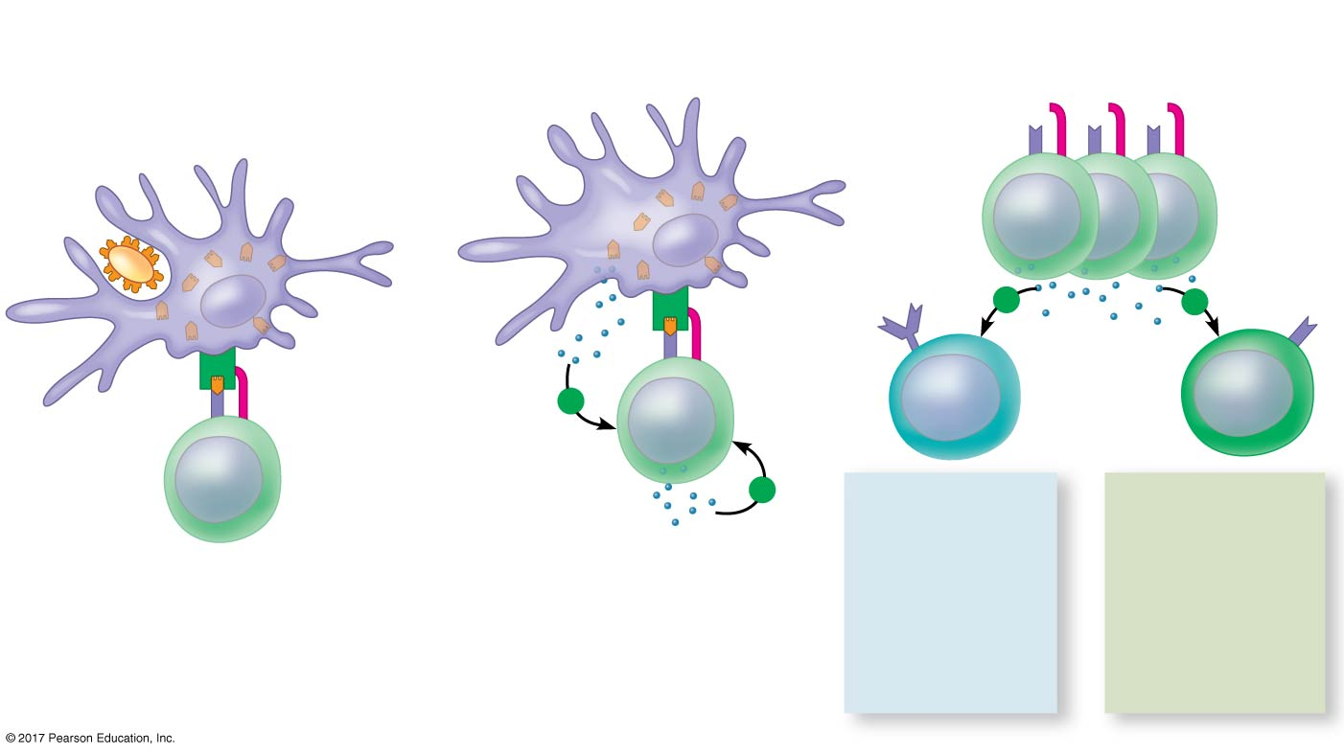
Figure 47.16
1
Antigen-
presenting
cell
2
3
Antigen
fragment
Clone of activated helper T cells
Pathogen
+
+
Class ΙΙ
MHC
molecule
+
B cell
Cytotoxic
T cell
Antigen
receptor
Accessory
protein
(CD4)
+
HUMORAL
IMMUNITY
(secretion of
antibodies
by plasma
cells)
CELL-
MEDIATED
IMMUNITY
(attack on
infected
cells)
Cytokines
Helper T cell
Notes:
Figure 47.16 The central role of helper T cells in humoral and cell-mediated immune responses

Slide 43
B Cells and Antibodies: A Response to Extracellular Pathogens
The humoral response is characterized by secretion of antibodies by B cells
It begins with activation of the B cells

Slide 44
Activation of B Cells
Activation of B cells involves helper T cells and proteins on the surface of pathogens
When an antigen binds a B cell, the cell takes in a few foreign molecules by receptor-mediated endocytosis
The class II MHC protein of the B cell then presents an antigen fragment to a helper T cell, a process that is critical to B cell activation

Slide 45
An activated B cell gives rise to thousands of identical plasma cells
These begin producing and secreting antibodies
Most antigens recognized by B cells contain multiple epitopes
A variety of B cells activated by one antigen will give rise to plasma cells producing antibodies directed against different epitopes of the common antigen

Slide 46
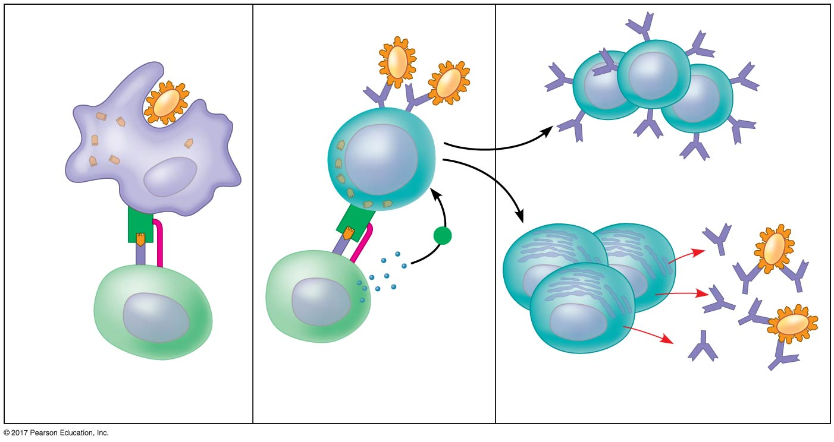
Figure 47.17_3
Antigen-
presenting
cell
Pathogen
B cell
Memory B cells
Antigen
fragments
MHC
+
Antigen
receptor
CD4
Cytokines
Activated
helper T cell
Plasma
cells
Secreted
antibodies
1
Helper T cell
2
3
Notes:
Figure 47.17_3 Activation of a B cell in the humoral immune response (step 3)

Slide 47
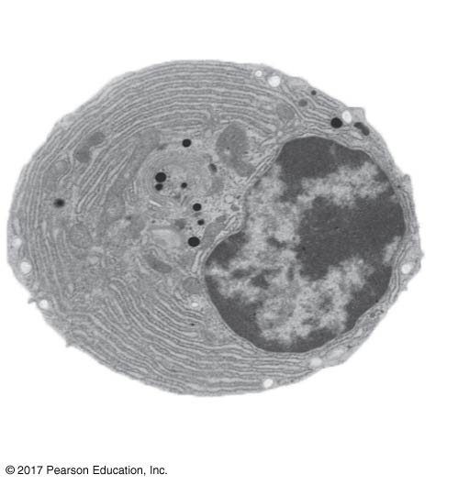
Figure 47.17a
Plasma
cell
2 µm
Notes:
Figure 47.17a Activation of a B cell in the humoral immune response (part 1: plasma cell, TEM)

Slide 48
Antibody Function
Antibodies do not kill pathogens; instead, they mark pathogens for inactivation or destruction
In neutralization, antibodies bind to viral surface proteins, preventing infection of a host cell
Antibodies may also bind to toxins in body fluids and prevent them from entering body cells

Slide 49
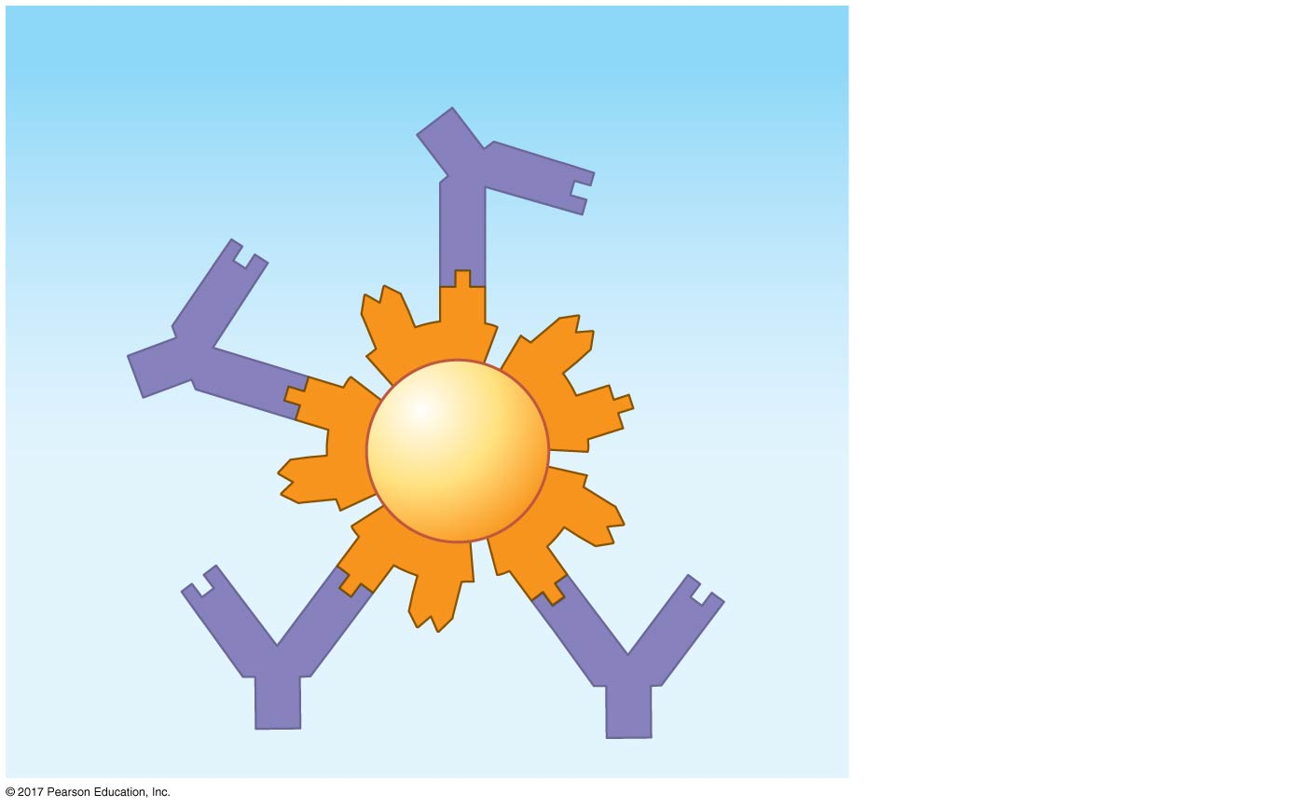
Figure 47.18
Antibody
Blocking of ability
of virus to bind to
a host cell
Virus
Notes:
Figure 47.18 Neutralization

Slide 50
In opsonization, antibodies bind to antigens on bacteria, triggering phagocytosis
Antigen-antibody complexes may bind to a complement protein, which triggers a cascade of complement protein activation
Ultimately, a membrane attack complex forms a pore in the membrane of the foreign cell, leading to its lysis

Slide 51
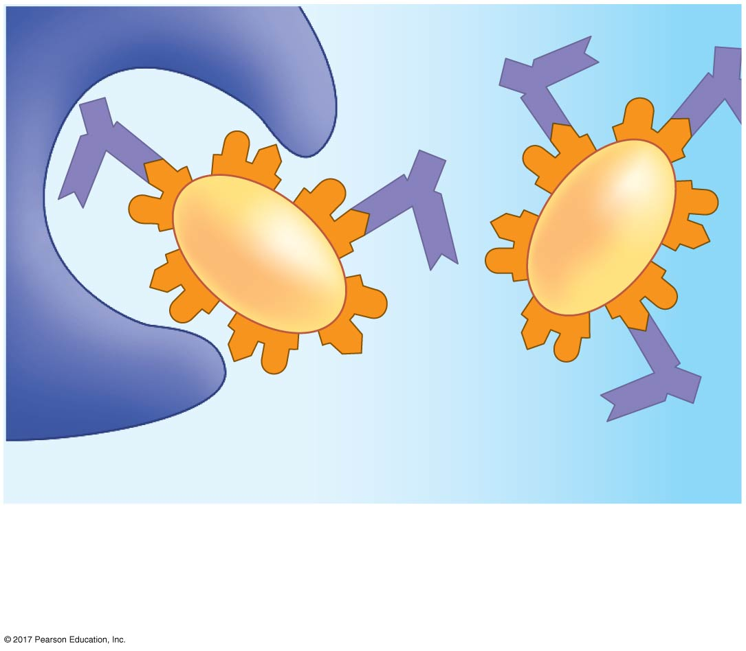
Figure 47.19
Bacterium
Macrophage
Promotion of phagocytosis of
bacteria by macrophages and
neutrophils
Notes:
Figure 47.19 Opsonization

Slide 52
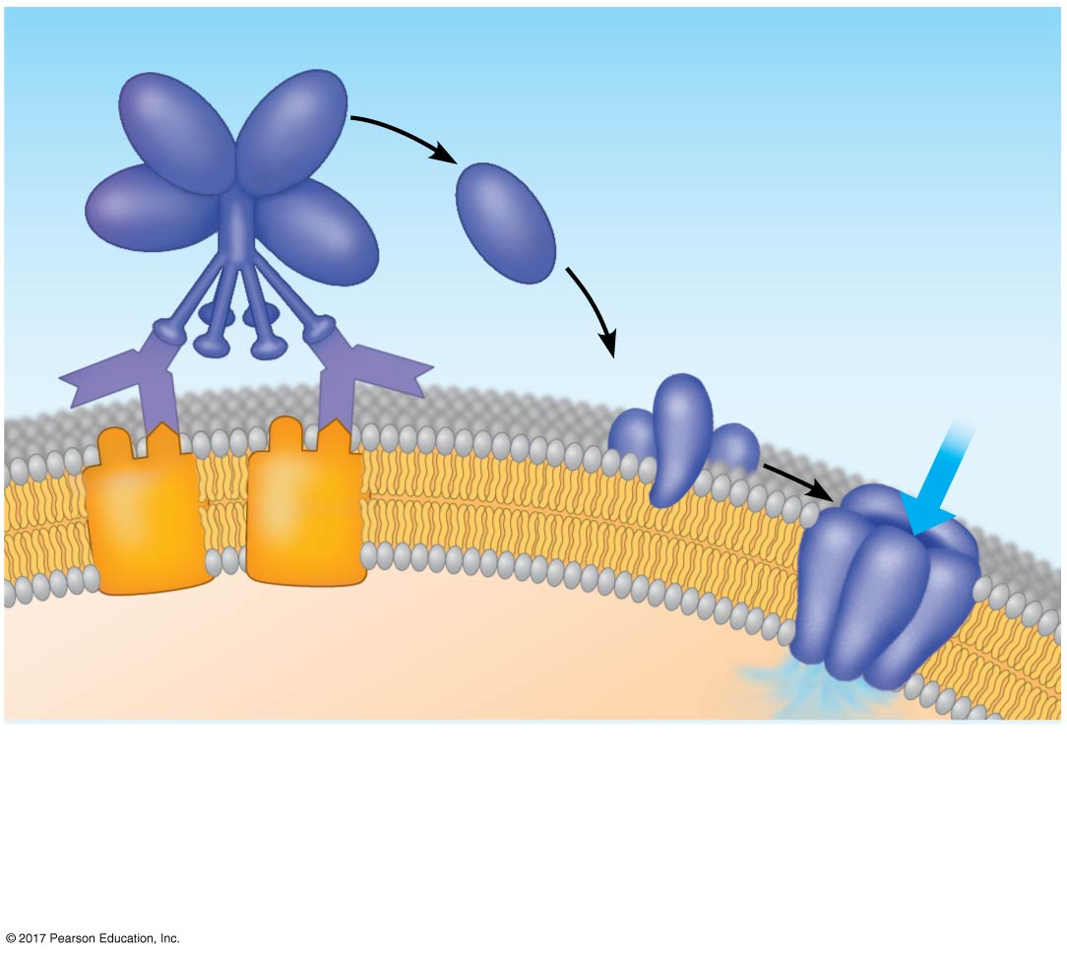
Figure 47.20
Complement proteins
Formation of
membrane
attack complex
Flow of water
and ions
Pore
Foreign
cell
Antigen
Binding of antibodies
activates the complement
system
Membrane attack complex
forms pores in the foreign
cell’s membrane. The cell
swells and lyses.
Notes:
Figure 47.20 Activation of complement system and pore formation

Slide 53
B cells can express five different forms (or classes) of immunoglobulin (Ig) with similar antigen-binding specificity but different heavy chain C regions
IgD is membrane bound, while the other four, IgA, IgE, IgG, and IgM, are soluble

Slide 54
Cytotoxic T Cells: A Response to Infected Cells
Cytotoxic T cells use toxic proteins to kill cells infected by viruses or other intracellular pathogens
Cytotoxic T cells recognize fragments of foreign proteins produced by infected cells
The activated cytotoxic T cell secretes proteins that disrupt the membranes of target cells and trigger apoptosis

Slide 55
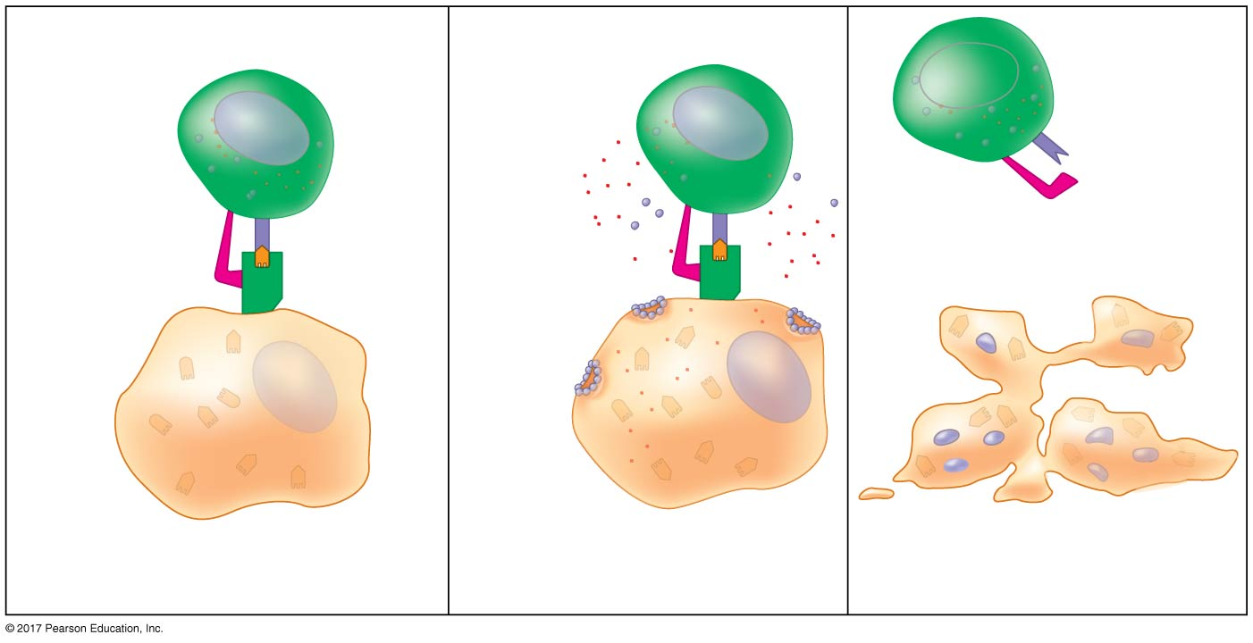
Figure 47.21_3
Cytotoxic
T cell
Granzymes
Released
cytotoxic
T cell
Dying
infected
cell
CD8
Antigen
receptor
Perforin
MHC
Pore
Infected
cell
Antigen
fragment
1
2
3
Notes:
Figure 47.21_3 The killing action of cytotoxic T cells on an infected host cell (step 3)

Slide 56
Summary of the Humoral and Cell-Mediated Immune Responses
Both the humoral and cell-mediated responses can include primary and secondary immune responses
Memory cells enable the secondary response

Slide 57
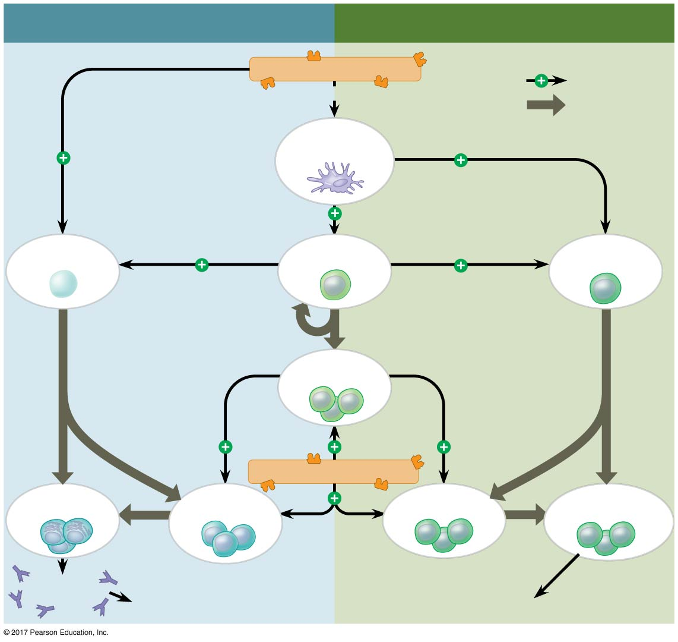
Figure 47.22
HUMORAL IMMUNE RESPONSE
CELL-MEDIATED IMMUNE RESPONSE
Antigen (1st exposure)
Stimulates
Taken in by
Gives rise to
Antigen-
presenting cell
B cell
Helper T cell
Cytotoxic
T cell
Memory
helper T cells
Antigen (2nd exposure)
Plasma
cells
Memory
B cells
Memory
cytotoxic T cells
Active
cytotoxic T cells
Secreted
antibodies
Defend against
intracellular pathogens
and cancer
Defend against
extracellular pathogens
Notes:
Figure 47.22 An overview of the adaptive immune response

Slide 58
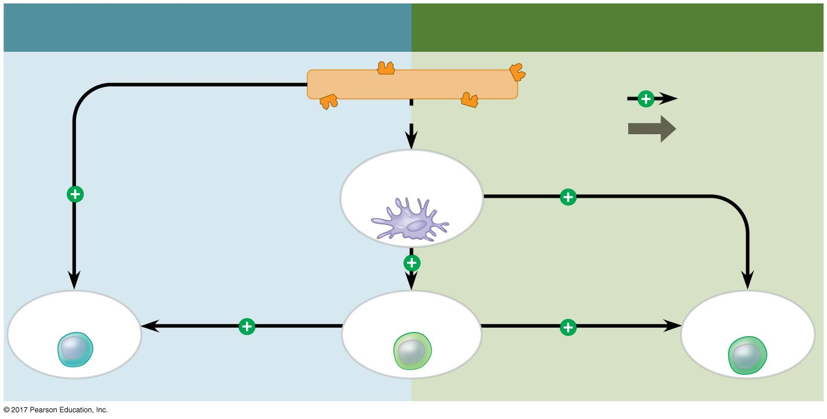
Figure 47.22a
HUMORAL IMMUNE RESPONSE
CELL-MEDIATED IMMUNE RESPONSE
Antigen (1st exposure)
Stimulates
Taken in by
Gives rise to
Antigen-
presenting cell
B cell
Helper T cell
Cytotoxic
T cell
Notes:
Figure 47.22a An overview of the adaptive immune response (part 1: 1st exposure)

Slide 59
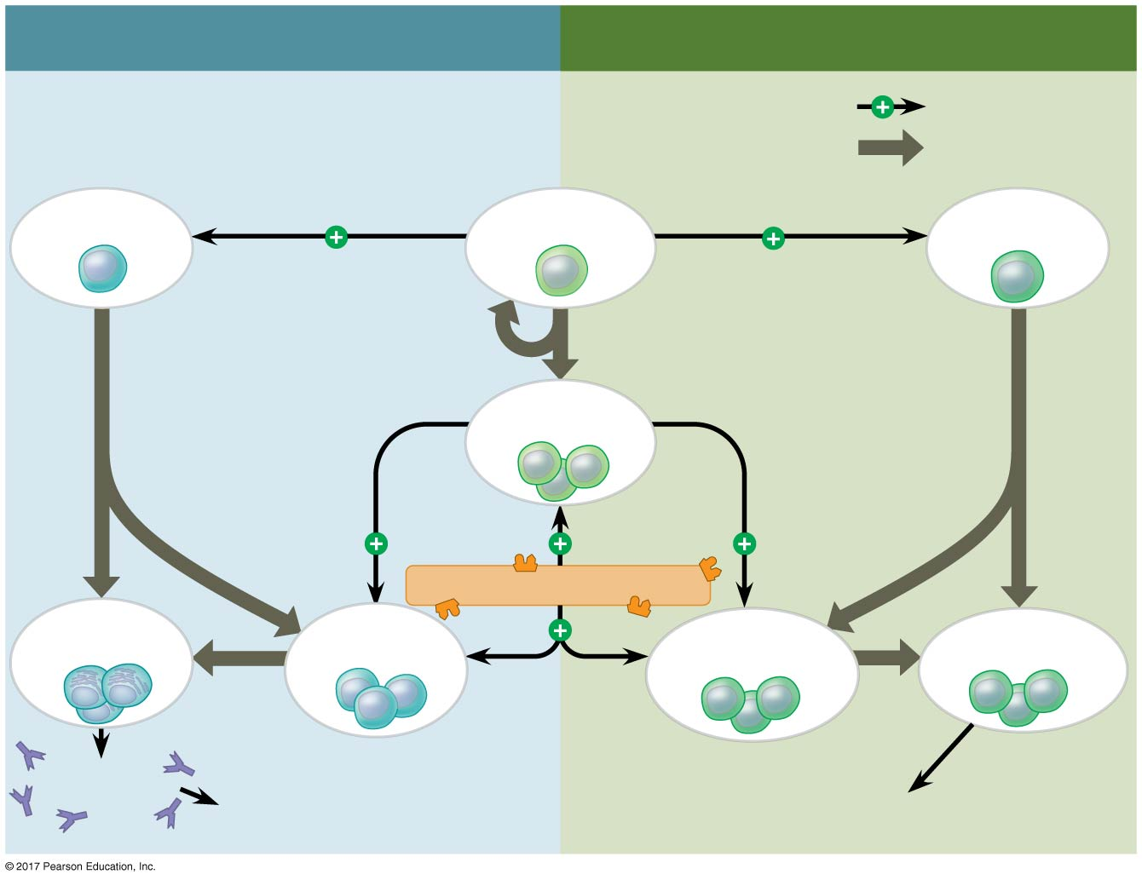
Figure 47.22b
HUMORAL IMMUNE RESPONSE
CELL-MEDIATED IMMUNE RESPONSE
Stimulates
Gives rise to
B cell
Helper T cell
Cytotoxic
T cell
Memory
helper T cells
Antigen (2nd exposure)
Plasma
cells
Memory
B cells
Memory
cytotoxic T cells
Active
cytotoxic T cells
Secreted
antibodies
Defend against
intracellular pathogens
and cancer
Defend against
extracellular pathogens
Notes:
Figure 47.22b An overview of the adaptive immune response (part 2: 2nd exposure)

Slide 60
Immunization
The projection provided by a second immune response provided the basis for immunization
Antigens are artificially introduced into the body to generate adaptive immune response and memory cell formation
Immunizations are carried out with vaccines, preparations of antigens from many sources
Vaccination programs have been successful against many infectious diseases

Slide 61
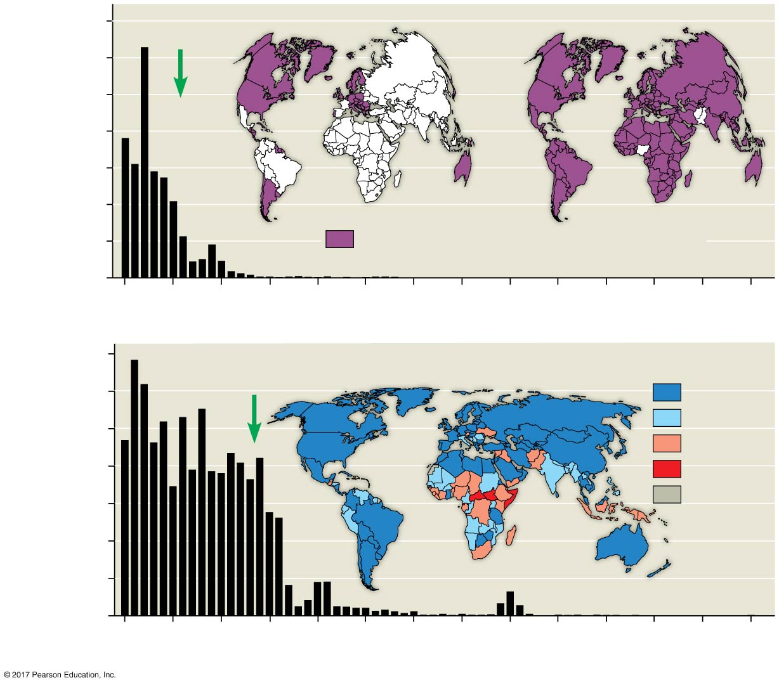
Figure 47.23
3,500
Vaccine
introduced
1988
2014
Annual deaths from
polio in U.S.
3,000
2,500
2,000
1,500
1,000
500
Countries that have eliminated polio
0
1950
1955
1960
1965
1970
1975
1980
1985
1990
1995
2000
2005
2010
2015
Year
700
Vaccine
introduced
Rates of measles vaccination for infants in 2014
Annual deaths from
measles in U.S.
600
90–100%
500
80–89%
50–79%
400
<50%
300
Data not
available
200
100
0
1950
1955
1960
1965
1970
1975
1980
1985
1990
1995
2000
2005
2010
2015
Year
Notes:
Figure 47.23 Vaccine-based protection against two life-threatening communicable diseases

Slide 62
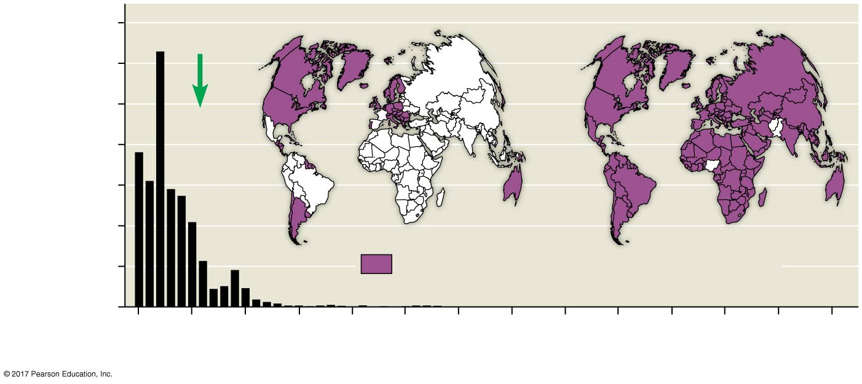
Figure 47.23a
3,500
Vaccine
introduced
1988
2014
Annual deaths from
polio in U.S.
3,000
2,500
2,000
1,500
1,000
500
Countries that have eliminated polio
0
1950
1955
1960
1965
1970
1975
1980
1985
1990
1995
2000
2005
2010
2015
Year
Notes:
Figure 47.23a Vaccine-based protection against two life-threatening communicable diseases (part 1: polio)

Slide 63
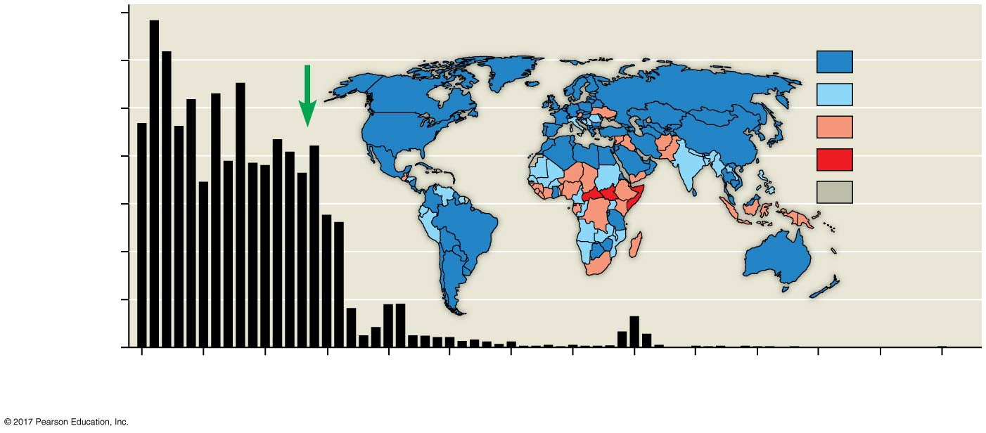
Figure 47.23b
700
Vaccine
introduced
Rates of measles vaccination for infants in 2014
Annual deaths from
measles in U.S.
600
90–100%
80–89%
500
50–79%
400
<50%
Data not
available
300
200
100
0
1950
1955
1960
1965
1970
1975
1980
1985
1990
1995
2000
2005
2010
2015
Year
Notes:
Figure 47.23b Vaccine-based protection against two life-threatening communicable diseases (part 2: measles)

Slide 64
Active and Passive Immunity
Active immunity develops naturally when a pathogen invades the body and elicits a primary or secondary immune response
Passive immunity provides immediate, short-term protection
It is conferred naturally when IgG crosses the placenta from mother to fetus or when IgA passes from mother to infant in breast milk

Slide 65
Both active and passive immunity can be induced artificially
Active immunity can develop following immunization
In artificial passive immunization, antibodies from an immune animal are injected into a nonimmune animal

Slide 66
Antibodies as Tools
Antibodies produced by an animal after exposure to an antigen are the products of many different clones of plasma cells
However, monoclonal antibodies can be prepared from a single clone of B cells grown in culture
These antibodies are identical and specific for one epitope
Monoclonal antibodies are used in many types of medical diagnoses and treatments

Slide 67
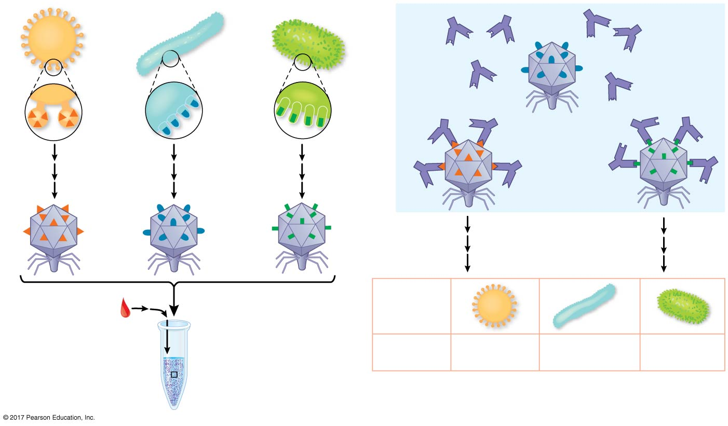
Figure 47.24
1
3
Unbound
antibodies
Antibodies
bound to
viral peptides
Bacteriophage
Peptide
DNA sequencing
2
Virus
Drop of blood
Mixture of
bacteriophages
and antibodies
Prior
exposure?
Yes
No
Yes
Notes:
Figure 47.24 A comprehensive test for past viral encounters

Slide 68
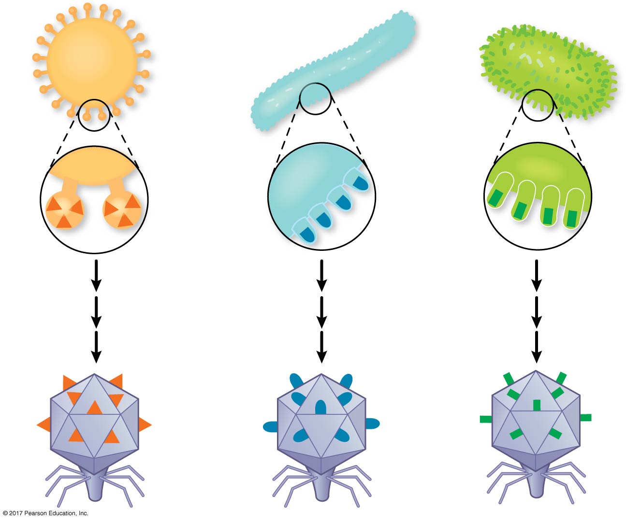
Figure 47.24a
1
Bacteriophage
Peptide
Notes:
Figure 47.24a A comprehensive test for past viral encounters (part 1: generation of bacteriophages)

Slide 69
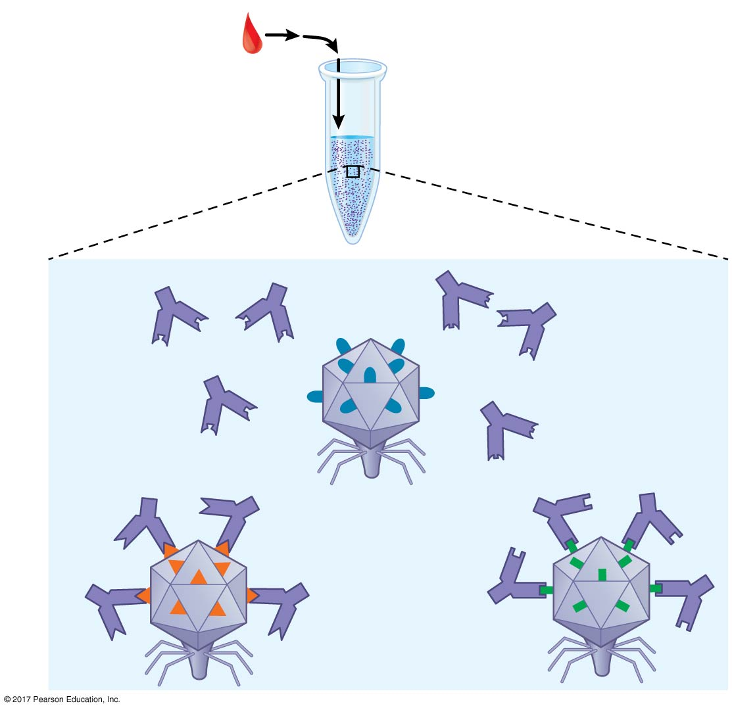
Figure 47.24b
2
Drop of blood
Mixture of
bacteriophages
and antibodies
3
Unbound
antibodies
Antibodies
bound to
viral peptides
Notes:
Figure 47.24b A comprehensive test for past viral encounters (part 2: antibody binding)

Slide 70
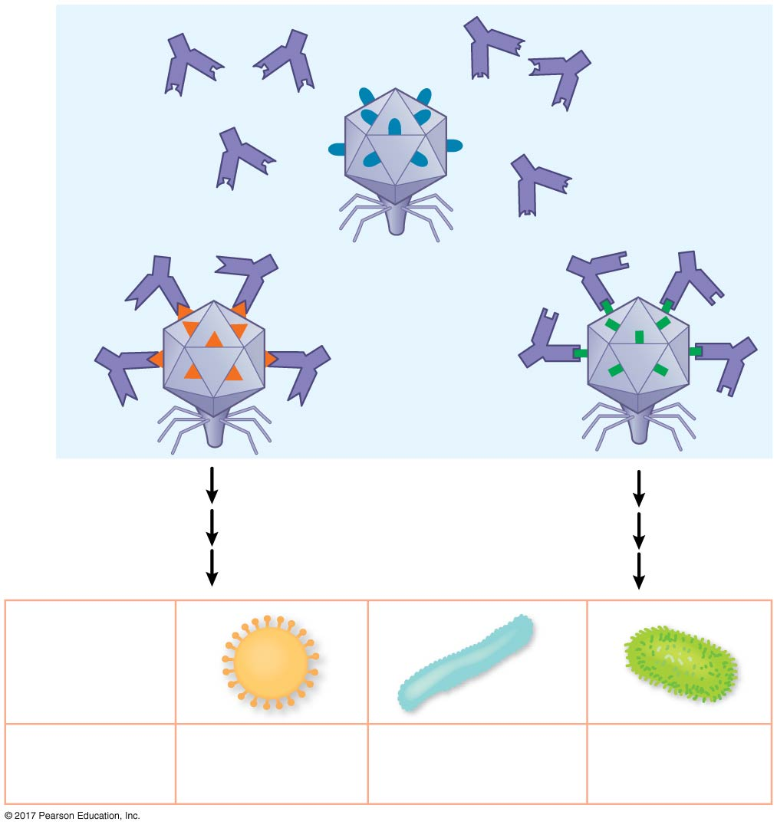
Figure 47.24c
3
Unbound
antibodies
Antibodies
bound to
viral peptides
DNA sequencing
Virus
Prior
exposure?
Yes
No
Yes
Notes:
Figure 47.24c A comprehensive test for past viral encounters (part 3: DNA sequencing)

Slide 71
Immune Rejection
Cells transferred from one person to another can be attacked by immune defenses
This complicates blood transfusions and the transplant of tissues or organs
To minimize rejection of a transplant or graft, surgeons use donor tissue with MHC molecules as similar as possible to those of the recipient
In addition, the recipient takes medicines that suppress immune responses

Slide 72
Blood Groups
Antigens on red blood cells determine whether a person has blood type A (A antigen), B (B antigen), AB (both A and B antigens), or O (neither antigen)
Antibodies to nonself blood types exist in the body
Transfusion with incompatible blood leads to destruction of the transfused cells

Slide 73
Concept 47.4: Disruptions in immune system function can elicit or exacerbate disease
Some pathogens have evolved ways to diminish the effectiveness of host immune responses

Slide 74
Exaggerated, Self-Directed, and Diminished Immune Responses
When allergic, autoimmune, or immunodeficiency disorders disrupt the delicate balance of immune responses, the effects can be severe

Slide 75
Allergies
Allergies are exaggerated (hypersensitive) responses to antigens called allergens
In localized allergies such as hay fever, IgE antibodies produced after first exposure to an allergen (such as pollen grains) attach to receptors on mast cells
The next time the allergen enters the body, it binds to mast-cell-associated IgE molecules

Slide 76
Mast cells release histamine and other inflammatory chemicals that bring about typical allergy symptoms
An acute allergic response can lead to anaphylactic shock, a life-threatening reaction, within seconds of allergen exposure
An injection of epinephrine can rapidly counteract the allergic response

Slide 77
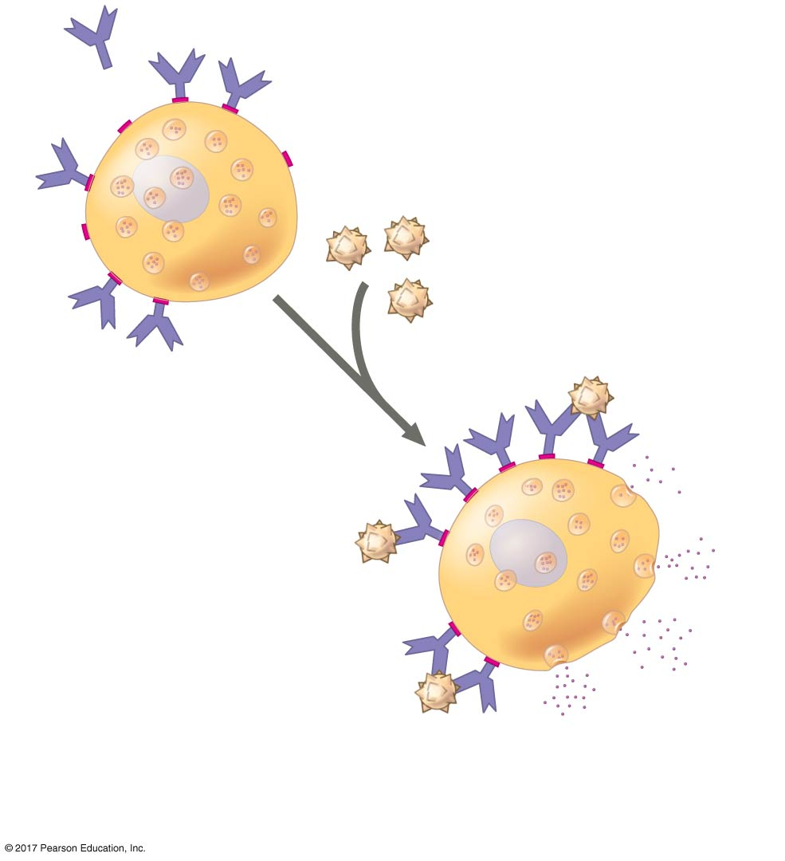
Figure 47.25
IgE
Allergen
(second exposure)
Mast
cell
1
Initial exposure
2
Subsequent
exposure
Vesicle
Histamine
3
Cross-linking triggers
release of histamine.
Notes:
Figure 47.25 Mast cells, IgE, and the allergic response

Slide 78
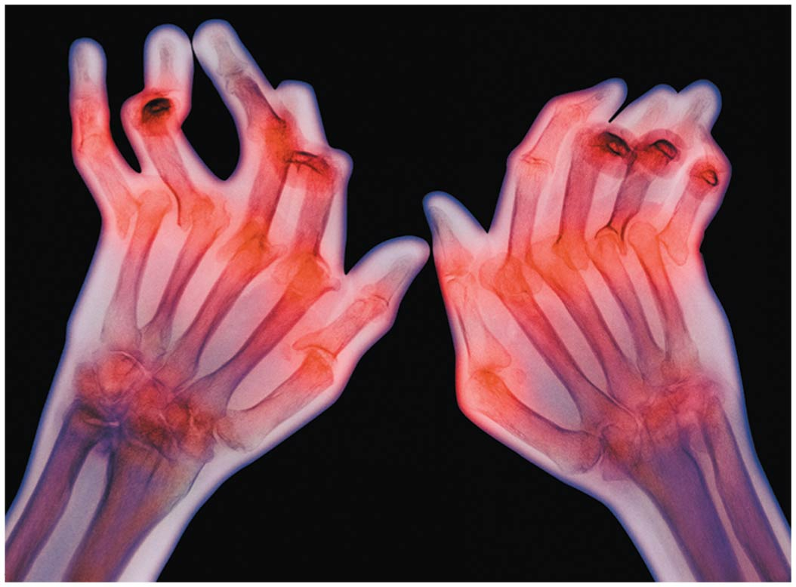
Autoimmune Diseases
In individuals with autoimmune diseases, the immune system loses tolerance for self and turns against certain molecules of the body
Autoimmune diseases include systemic lupus erythematosus, rheumatoid arthritis, insulin-dependent diabetes mellitus, and multiple sclerosis

Slide 79
Exertion, Stress, and the Immune System
Moderate exercise improves immune system function, though exercise to exhaustion leads to more frequent infections
Psychological stress has been shown to disrupt immune system regulation by altering the interactions of the hormonal, nervous, and immune systems
Sufficient rest is also important for immunity

Slide 80
Immunodeficiency Diseases
Inborn immunodeficiency results from a genetic or developmental defect in the innate or adaptive defenses, or both
Acquired immunodeficiency develops later in life due to exposure to chemical and biological agents

Slide 81
Evolutionary Adaptations of Pathogens That Underlie Immune System Avoidance
Pathogens have evolved mechanisms to thwart immune responses
NOOOOOOO

Slide 82
Antigenic Variation
Through antigenic variation, some pathogens are able to change epitope expression and prevent recognition
The human influenza virus mutates rapidly, and new flu vaccines must be made each year
Human viruses occasionally exchange genes with the viruses of domesticated animals
This poses a danger, as human immune systems are unable to recognize the new viral strain
NOOOOOOOOOO

Slide 83
Latency
Some viruses may remain in a host in an inactive state called latency
Herpes simplex viruses can be present in a human host without causing symptoms
NOOOOOOO

Slide 84
Attack on the Immune System: HIV
Human immunodeficiency virus (HIV) infects helper T cells
HIV persists in the host—despite an immune response—because it has a high mutation rate that promotes antigen variation
Over time, an untreated HIV infection not only avoids the adaptive immune response, but also abolishes it
NOOOOOOOOOO

Slide 85
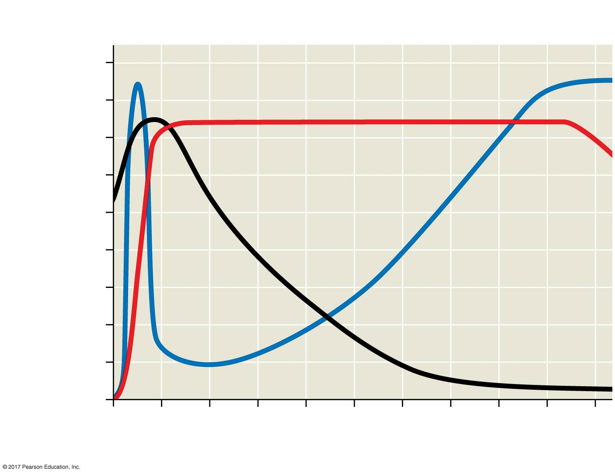
Figure 47.27
Latency NOOOOOOOOOOOOOOO
AIDS
Relative anti-HIV antibody
concentration
Helper T cell concentration
In blood (cells/mm₃)
800
Relative HIV
concentration
600
Helper T cell
concentration
400
200
0
0
1
2
3
4
5
6
7
8
9
10
Years after untreated infection
Notes:
Figure 47.27 The progress of an untreated HIV infection

Slide 86
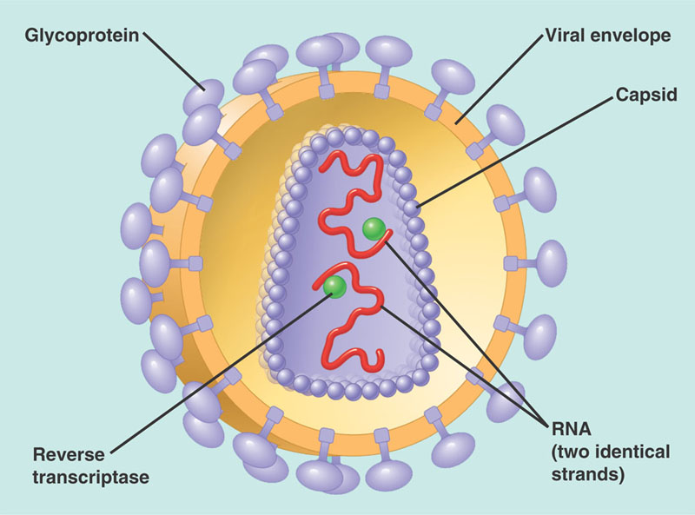
HIV infection leads to acquired immunodeficiency syndrome (AIDS)
People with AIDS are highly susceptible to opportunistic infections and cancers that a normal immune system would usually defeat
The spread of HIV is a worldwide problem
The best approach for slowing this spread is education about practices that transmit the virus
NOOOOOOOOOOOOO

Slide 87
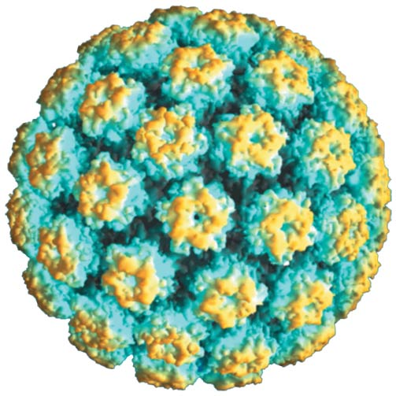
Cancer and Immunity
The frequency of certain cancers increases when adaptive immunity is inactivated
15–20% of all human cancers involve viruses
The immune system can act as a defense against viruses that cause cancer and cancer cells that harbor viruses
In 2006, a vaccine was released that acts against human papillomavirus (HPV), a virus associated with cervical cancer
NOOOOOOOOOOOO

