Slide 1
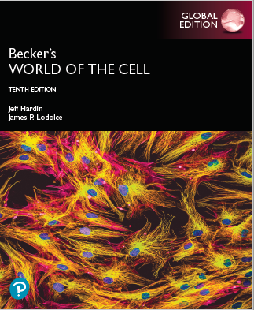
Becker’s World of the Cell
Tenth Edition, Global Edition
Chapter 7
Membranes: Their Structure, Function, and Chemistry
Lectures by Anna Hegsted, Simon Fraser University
Copyright © 2022 Pearson Education Ltd. All Rights Reserved.
Notes:
If this PowerPoint presentation contains mathematical equations, you may need to check that your computer has the following installed:
1) MathType Plugin
2) Math Player (free versions available)
3) NVDA Reader (free versions available)

Slide 2
Membranes: Their Structure, Function, and Chemistry
Membranes define the boundaries of a cell and its internal compartments.
Membranes play multiple roles in the life of a cell.

Slide 3
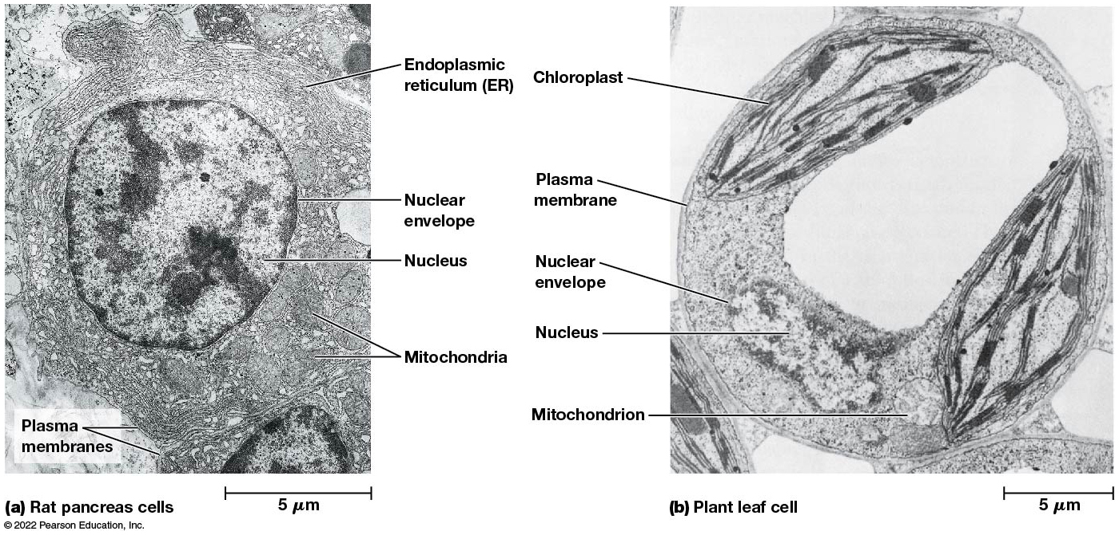
The Prominence of Membranes Around and Within Eukaryotic Cells
Figure 7.1 The Prominence of Membranes Around and Within Eukaryotic Cells.
Notes:
Long Description:
The measurement at the bottom left end of the micrographs read 5 micrometers.
The details are as below:
Rat pancreas cells:
The plasma membrane is the outer layer of the cell.
The innermost nucleus is surrounded by a nuclear envelope.
Endoplasmic reticulum (ER) and mitochondria are outside the nucleus.
Plant leaf cell:
The plasma membrane is the outer layer of the cell.
The other parts found within the plasma membrane are nucleus within a nuclear envelope, mitochondrion, and chloroplast.

Slide 4
7.1 The Functions of Membranes (1 of 2)
Define boundaries of a cell and organelles and act as permeability barriers.
Serve as sites for biological functions, such as electron transport in the mitochondria or protein processing in the ER.
Possess transport proteins that regulate the movement of substances into and out of cells and organelles.

Slide 5
7.1 The Functions of Membranes (2 of 2)
Contain protein molecules that act as receptors to detect external signals.
Provide mechanisms for cell-to-cell contact, adhesion, and communication.

Slide 6
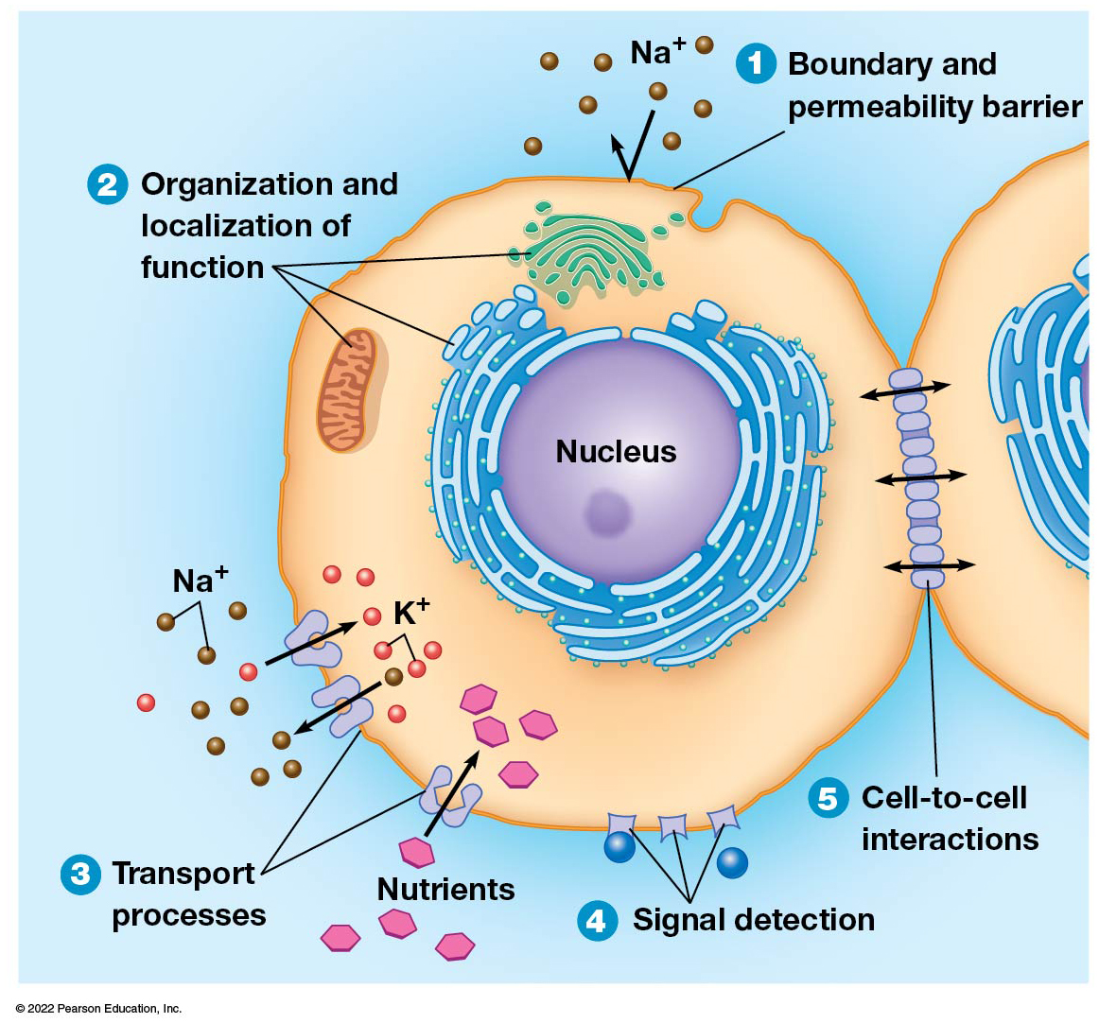
Functions of Membranes
Figure 7.2 Functions of Membranes.
Notes:
Long Description:
The five functions are as below:
Nucleus present in center of the membrane.
Boundary and permeability barrier. Na plus ion deflected back from entering the cell.
Organization and localization of function. Like in mitochondria and endoplasmic reticulum.
Transport processes. Nutrients are absorbed into the cell. Na plus are pushed outside the cell. K plus are absorbed into the cell.
Signal detection. Receptors detect extracellular signals.
Cell-to-cell interactions. Adhesion and communication between two adjoining cells are aided by the plasma membrane.

Slide 7
Membranes Define Boundaries and Serve as Permeability Barriers
Membranes define boundaries of the cell and its components.
They are effective permeability barriers because their interior is hydrophobic.
The plasma membrane surrounds the whole cell, whereas intracellular membranes compartmentalize functions within the cell.

Slide 8
Membranes Contain Specific Proteins and Therefore of Specific Functions
Membranes are associated with specific functions because the molecules responsible for the functions are embedded in or localized on membranes.
The specific enzymes associated with particular membranes can be used to characterize a specific membrane.

Slide 9
Membrane Proteins Regulate the Transport of Solutes
Membrane proteins carry out and regulate the transport of substances across the membrane.
Cells and organelles take up nutrients, ions, gases, water, and other substances, and they expel products and wastes.
Some substances diffuse directly across membranes, whereas others must be moved by specific transporters.

Slide 10
Membrane Proteins Detect and Transmit Electrical and Chemical Signals
A cell receives information from its environment as electrical or chemical signals at its surface.
Signal transduction describes the mechanisms by which signals are transmitted from the outer surface to the interior of a cell.
Chemical signal molecules usually bind to membrane proteins, known as receptors, on the outer surface of the plasma membrane.

Slide 11
Signal Transduction
Binding of signal molecules to their receptors triggers chemical events on the inner membrane surface that ultimately lead to changes in cell function.
Membrane receptors allow cells to recognize, transmit, and respond to a variety of specific signals in nearly all types of cells.

Slide 12
Membrane Proteins Mediate Cell Adhesion and Cell-to-Cell Communication
In multicellular organisms, cells are generally in contact with other cells.
Adhesive junctions hold cells together and are mediated by cadherins.
Tight junctions form seals that block the passage of fluids between cells.
Gap junctions allow for communication between adjacent animal cells and plasmodesmata perform a similar function in plant cells.

Slide 13
7.2 Models of Membrane Structure: An Experimental Perspective
The fluid mosaic model is thought to be descriptive of all biological membranes.
The model envisions a membrane as two fluid layers of lipids with proteins within and on the layers.
It is fluid because lipids and proteins can easily move laterally in the membrane.
It is mosaic because of the presence of proteins within the membrane.

Slide 14
Overton and Langmuir: Lipids Are Important Components of Membranes
In the 1890s, Charles Overton observed the easy penetration of lipid-soluble substances into cells and concluded that the cell surface had a lipid “coat” on it.
Irving Langmuir dissolved phospholipids in benzene and found that they formed a monolayer on water. Because they are amphipathic, he reasoned that they must orient on water, with the hydrophobic tails away from the water.

Slide 15
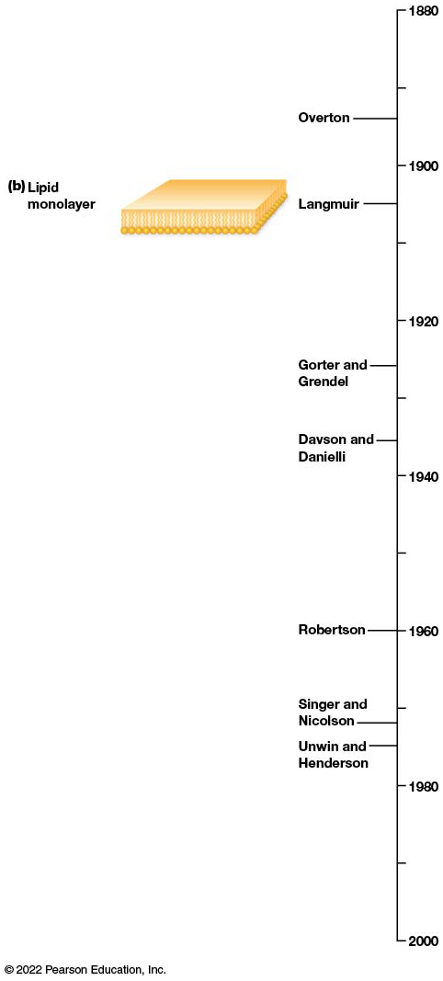
Timeline for Development of the Fluid Mosaic Model: Lipid Nature of Membrane and Monolayer
Figure 7.3 Timeline for Development of the Fluid Mosaic Model.
Notes:
Long Description:
The chronology is as below:
Lipid nature of membrane. 1880 to 1900. Overton. Polar is radiated back and nonpolar is absorbed by the lipid layer.
Lipid monolayer. 1900 to 1920. Langmuir
Lipid bilayer. 1920 to 1930. Gorter and Grendel.
Lipid bilayer plus protein sheets. 1930 to 1940. Davson and Danielli.
Unit membrane. 1960. Robertson.
Fluid mosaic model. 1970 to 1980. Singer and Nicolson. Unwin and Henderson.
Membrane protein structure. 1980 to 2000. An alpha helix protein structure through the two layers of the lipid bilayer.

Slide 16
Gorter and Grendel: The Basis of Membrane Structure Is a Lipid Bilayer
In 1925, these two physiologists extracted lipids from red blood cells and spread the lipids in a monolayer on a water surface.
The film on the water was twice the surface area of the blood cells, suggesting that lipids on the cell surface consisted of two layers.
They suggested that the most favorable structure would be a lipid bilayer, with the nonpolar regions of the lipids facing inward.

Slide 17
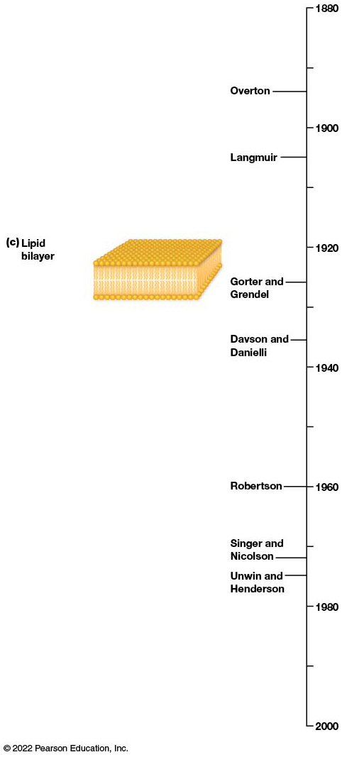
Timeline for Development of the Fluid Mosaic Model: Lipid Bilayer
Figure 7.3 Timeline for Development of the Fluid Mosaic Model.
Notes:
Long Description:
The chronology is as below:
Lipid nature of membrane. 1880 to 1900. Overton. Polar is radiated back and nonpolar is absorbed by the lipid layer.
Lipid monolayer. 1900 to 1920. Langmuir
Lipid bilayer. 1920 to 1930. Gorter and Grendel.
Lipid bilayer plus protein sheets. 1930 to 1940. Davson and Danielli.
Unit membrane. 1960. Robertson.
Fluid mosaic model. 1970 to 1980. Singer and Nicolson. Unwin and Henderson.
Membrane protein structure. 1980 to 2000. An alpha helix protein structure through the two layers of the lipid bilayer.

Slide 18
Davson and Danielli: Membranes Also Contain Proteins
Hugh Davson and James Danielli showed that the bilayer alone could not account for all properties of membranes, especially
Surface tension
Solute permeability
Electrical resistance
They suggested that proteins are present in membranes, as thin sheets, coating the lipids.

Slide 19
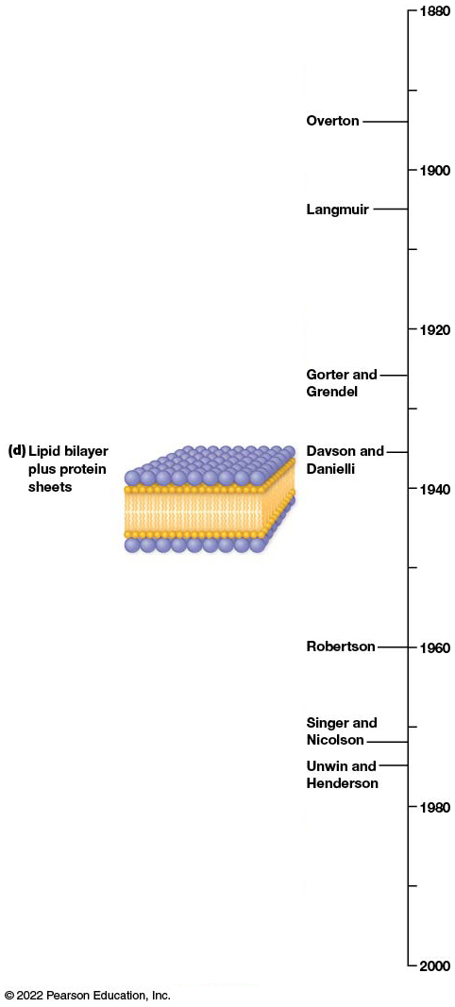
Timeline for Development of the Fluid Mosaic Model: Lipid Bilayer Plus Protein Sheets
Figure 7.3 Timeline for Development of the Fluid Mosaic Model.
Notes:
Long Description:
The chronology is as below:
Lipid nature of membrane. 1880 to 1900. Overton. Polar is radiated back and nonpolar is absorbed by the lipid layer.
Lipid monolayer. 1900 to 1920. Langmuir
Lipid bilayer. 1920 to 1930. Gorter and Grendel.
Lipid bilayer plus protein sheets. 1930 to 1940. Davson and Danielli.
Unit membrane. 1960. Robertson.
Fluid mosaic model. 1970 to 1980. Singer and Nicolson. Unwin and Henderson.
Membrane protein structure. 1980 to 2000. An alpha helix protein structure through the two layers of the lipid bilayer.

Slide 20
Robertson: All Membranes Share a Common Underlying Structure
Using electron microscopy, biologists could verify the presence of membranes around cells and organelles.
A trilaminar structure, visible under the TEM, was observed for all membranes, leading to the suggestion of a common membrane structure, called the unit membrane.

Slide 21
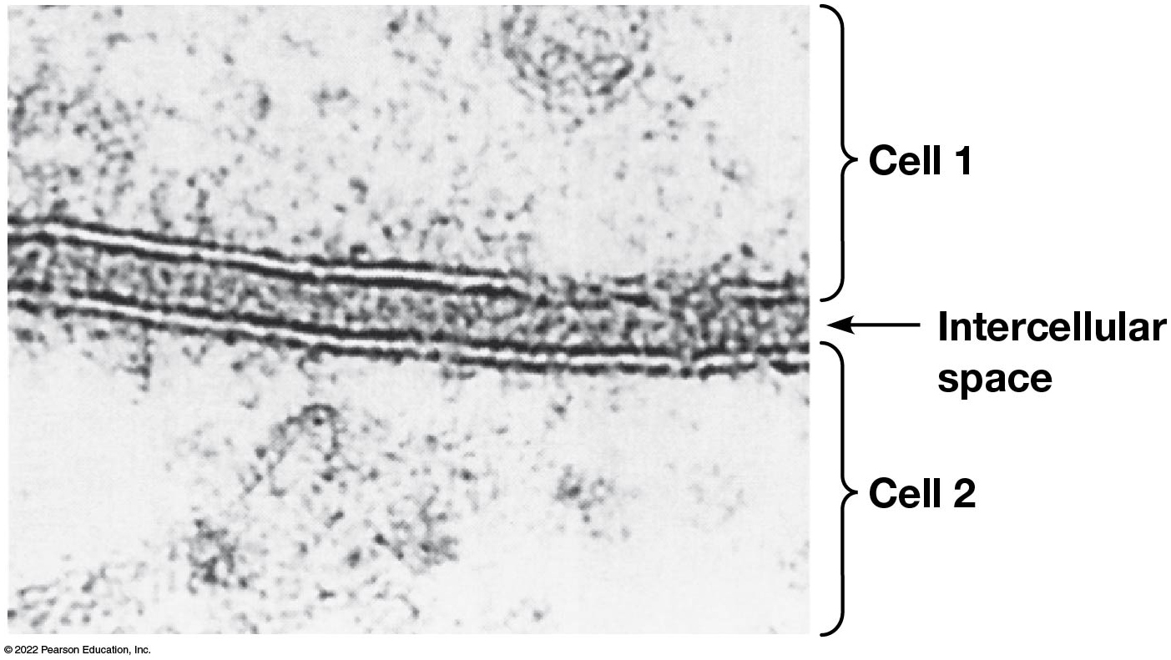
Trilaminar Appearance of Cellular Membranes
Figure 7.4 Trilaminar Appearance of Cellular Membranes.
Notes:
Long Description:
An electron micrograph of the trilaminar appearance of cellular membranes showing the small intercellular space between the plasma membranes of two adjacent cells named cell 1 and cell 2. The two dark lines are the plasma membranes of the adjacent cells and are separated by a slightly stained central part.

Slide 22
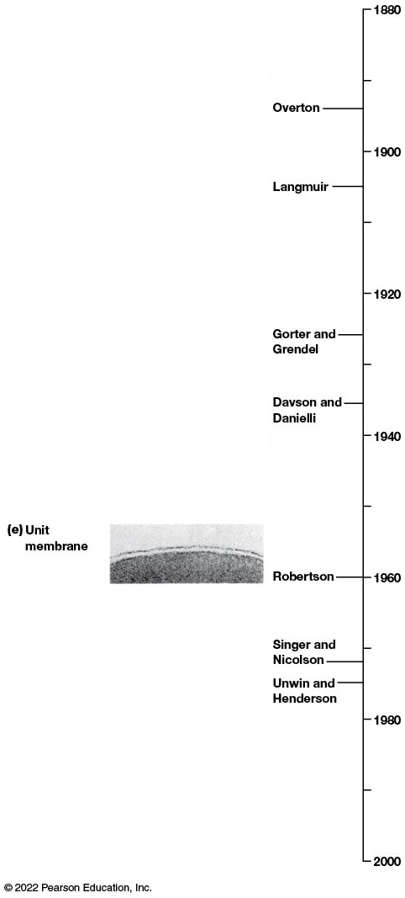
Timeline for Development of the Fluid Mosaic Model: Unit Membrane
Figure 7.3 Timeline for Development of the Fluid Mosaic Model.
Notes:
Long Description:
The chronology is as below:
Lipid nature of membrane. 1880 to 1900. Overton. Polar is radiated back and nonpolar is absorbed by the lipid layer.
Lipid monolayer. 1900 to 1920. Langmuir
Lipid bilayer. 1920 to 1930. Gorter and Grendel.
Lipid bilayer plus protein sheets. 1930 to 1940. Davson and Danielli.
Unit membrane. 1960. Robertson.
Fluid mosaic model. 1970 to 1980. Singer and Nicolson. Unwin and Henderson.
Membrane protein structure. 1980 to 2000. An alpha helix protein structure through the two layers of the lipid bilayer.

Slide 23
Further Research Revealed Major Shortcomings of the Davson–Danielli Model
There is not enough space on either side of the bilayer for a protein coat.
The chemical composition of membranes, especially the protein/lipid ratio varied.
Phospholipases digest the head group of phospholipids. This could not occur if the membrane was coated in protein.
Membrane proteins are hydrophobic or amphipathic.

Slide 24
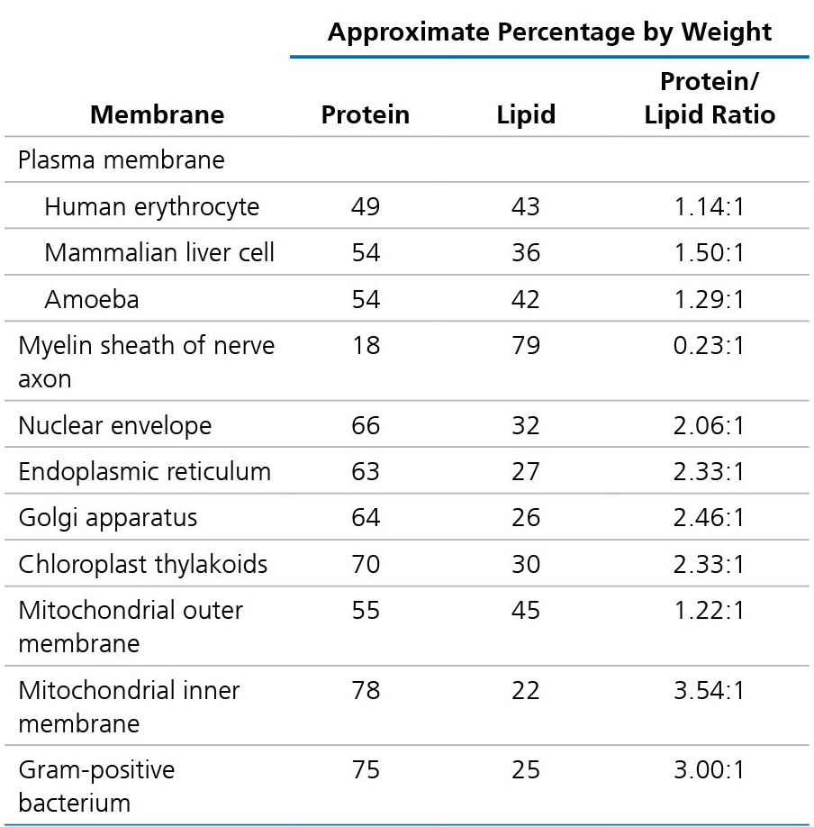
Protein, Lipid, and Carbohydrate Content of Biological Membranes
Table 7.1 Protein and Lipid Content of Biological Membranes
Notes:
Long Description:
Approximate Percentage by Weight
Membrane
Protein
Lipid
Protein /Lipid Ratio
Plasma membrane
Human erythrocytes
49
43
1.14:1
Mammalian liver cell
54
36
1.50:1
Amoeba
54
42
1.29:1
Myelin sheath of nerve axon
18
79
0.23:1
Nuclear envelope
66
32
2.06:1
Endoplasmic reticulum
63
27
2.33:1
Golgi apparatus
64
26
2.46:1
Chloroplast thylakoids
70
30
2.33:1
Mitochondrial outer membrane
55
45
1.22:1
Mitochondrial inner membrane
78
22
3.54:1
Gram-positive bacterium
75
25
3.00:1

Slide 25
Singer and Nicholson: A Membrane Consists of a Mosaic of Proteins in a Fluid Lipid Bilayer
The fluid mosaic bilayer model accounts for all the inconsistencies with previous models.
The model has two key features:
A mosaic of proteins attached to or embedded in the bilayer
A fluid lipid bilayer

Slide 26
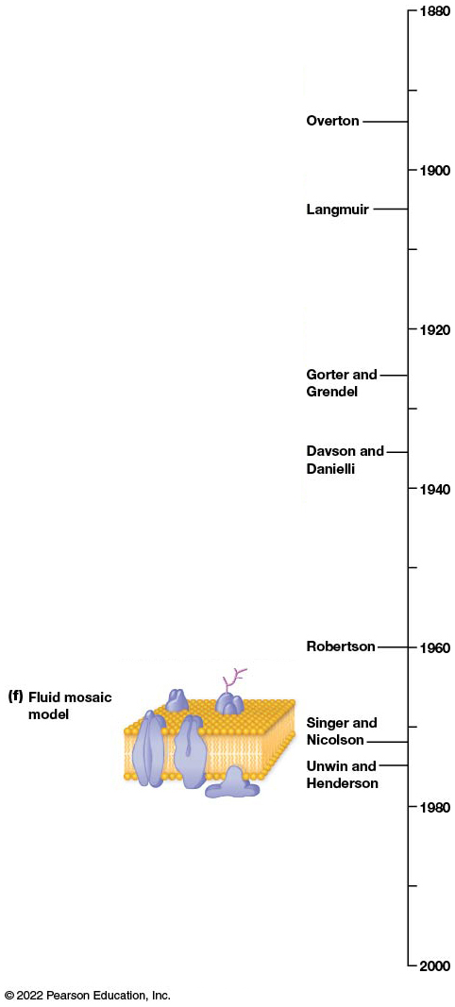
Timeline for Development of the Fluid Mosaic Model: Fluid Mosaic Model
Figure 7.3 Timeline for Development of the Fluid Mosaic Model.
Notes:
Long Description:
The chronology is as below:
Lipid nature of membrane. 1880 to 1900. Overton. Polar is radiated back and nonpolar is absorbed by the lipid layer.
Lipid monolayer. 1900 to 1920. Langmuir
Lipid bilayer. 1920 to 1930. Gorter and Grendel.
Lipid bilayer plus protein sheets. 1930 to 1940. Davson and Danielli.
Unit membrane. 1960. Robertson.
Fluid mosaic model. 1970 to 1980. Singer and Nicolson. Unwin and Henderson.
Membrane protein structure. 1980 to 2000. An alpha helix protein structure through the two layers of the lipid bilayer.

Slide 27
Unwin and Henderson: Most Membrane Proteins Contain Transmembrane Segments
Most integral membrane proteins have one or more hydrophobic segments that span the lipid bilayer.
These transmembrane segments anchor the protein to the membrane.
Bacteriorhodopsin was the first membrane protein shown to possess this structural feature.
Recent findings suggest membranes are not homogenous.

Slide 28
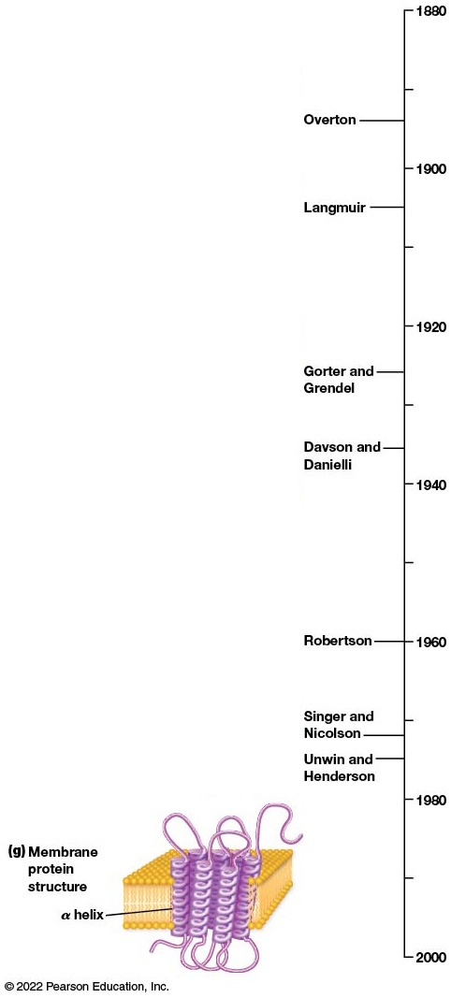
Timeline for Development of the Fluid Mosaic Model: Membrane Protein Structure
Figure 7.3 Timeline for Development of the Fluid Mosaic Model.
Notes:
Long Description:
The chronology is as below:
Lipid nature of membrane. 1880 to 1900. Overton. Polar is radiated back and nonpolar is absorbed by the lipid layer.
Lipid monolayer. 1900 to 1920. Langmuir
Lipid bilayer. 1920 to 1930. Gorter and Grendel.
Lipid bilayer plus protein sheets. 1930 to 1940. Davson and Danielli.
Unit membrane. 1960. Robertson.
Fluid mosaic model. 1970 to 1980. Singer and Nicolson. Unwin and Henderson.
Membrane protein structure. 1980 to 2000. An alpha helix protein structure through the two layers of the lipid bilayer.

Slide 29
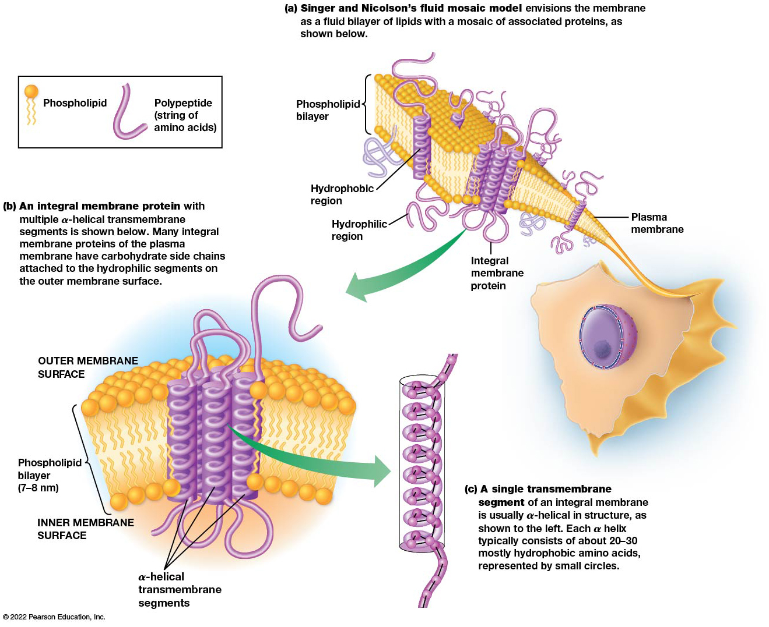
The Fluid Mosaic Model of Membrane Structure
Figure 7.5 The Fluid Mosaic Model of Membrane Structure.
Notes:
Long Description:
The details are as below:
Singer and Nicolson’s fluid mosaic model: Envisions the membrane as a fluid bilayer of lipids with a mosaic of associated proteins:
There is a phospholipid bilayer with integral protein membrane through the layers. They are polypeptide strings of amino acid. The cell is bound by a plasma membrane. The protein membrane has strands of hydrophilic region on the outside and hydrophobic region between the layers.
An integral membrane protein: An integral membrane protein with multiple alpha-helical transmembrane segments. Many integral membrane proteins of the plasma membrane have carbohydrate side chains attached to the hydrophilic segments on the outer membrane surface. The phospholipid bilayer is 7 to 8 nanometer in height. Both the inner and outer membrane surfaces are made of phospholipids. The inner membrane surface shows alpha-helical transmembrane segments. The outer membrane surface shows hydrophilic regions.
A single transmembrane segment: A single transmembrane segment of an integral membrane is usually alpha-helical in structure. Each helix typically consists of about 20–30 mostly hydrophobic amino acids, represented by small circles. These small circles form a chain along the helical structure.

Slide 30
7.3 Membrane Lipids: The “Fluid” Part of the Model
Membrane lipids are important components of the “fluid” part of the fluid mosaic model.

Slide 31
Membranes Contain Several Major Classes of Lipids
The fluid mosaic model of membrane structure retains the lipid bilayer of earlier models.
However, there is a greater diversity and fluidity of lipids than originally thought.
The main classes of membrane lipids are phospholipids, glycolipids, and sterols.

Slide 32
Phospholipids (1 of 3)
Phospholipids are the most abundant lipid in cell membranes.
Phospholipid consists of a backbone with two fatty acids, a negatively charged phosphate group, and a charged head group attached to the phosphate.
Amphipathic nature comes from the polar head and the two non-polar tails. This is critical for membrane structure.

Slide 33
Phospholipids (2 of 3)
The backbone is either glycerol, a three-carbon alcohol, or sphingosine.
Many types of phospholipids in membranes including the glycerol-based phosphoglycerolipids, phosphoglycerides, and the sphingosine-based phosphosphingolipids.
Because phospholipids are amphipathic, other amphipathic molecules, like detergents, can disrupt membranes.

Slide 34
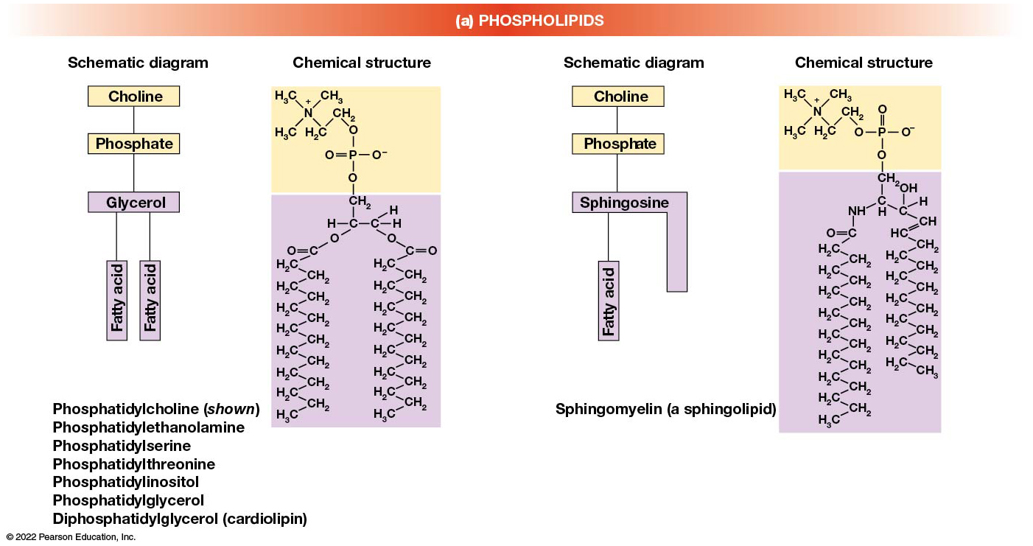
Phospholipids (3 of 3)
Figure 7.6 The Three Major Classes of Membrane Lipids.
Notes:
Long Description:
The details are as below.
Schematic diagram of phospholipids: The flow is as follows: Choline to phosphate to glycerol to multiple fatty acids. The corresponding compounds are:
Phosphatidylcholine
Phosphatidylethanolamine
Phosphatidylserine
Phosphatidylthreonine
Phosphatidylinositol
Phosphatidylglycerol
Diphosphatidylglycerol (cardiolipin)
Chemical structure of phospholipids: N has three single bonds to C H subscript 3, and a single bond to C H subscript 2. The C of C H subscript 2 bonds with C H subscript 2 single bond O to P double bond with O and two single bonds with O and O negative respectively. This is choline and phosphate structure. The structures of glycerol and fatty acids are as follows: There is a C single bond C in which one C has single bonds with H, O and a C H subscript 2 which bonds with the O of phosphate. This O single bonds with C which have two single bonds with an O and fourteen C H subscript 2 molecules in a chain and ends with a C H subscript 3. In the same way, the other C has two single bonds with H and a single bond with O which bonds with C double bond O followed by fourteen C H subscript 2 chain and ends with C H subscript 3.
The second schematic diagram of phospholipids: The flow is as follows: Choline to phosphate to Sphingosine to a single fatty acid. Sphingomyelin is a sphingolipid.
Chemical structure of phospholipids: N has three single bonds to C H subscript 3 and a single bond with C H subscript 2. The C of C H subscript 2 bonds with C H subscript 2 single bond O to P which double bonds with O and two single bonds with O and O negative respectively. This is choline and phosphate structure. The structures of Sphingosine and fatty acid are as follows: The O of phosphate bonds with the Sphingosine C H subscript 2 whose C single bonds with C H single bond C. In this, C H single bonds with N H, and this N single bonds with C double bond O and a chain of sixteen C H subscript 2 molecules and ends with a C H subscript 3. The other C has three single bonds with o H, H, C H which has a double bond with C H and the chain continues with twelve C H subscript 2 molecules and ends with a C H subscript 3.
Schematic diagram of glycolipids: Galactose to Sphingosine to a single fatty acid. Cerebrosides is a galactocerebroside. Gangliosides.
Chemical structure of glycolipids: There is a hexagon bond where three vertex shows H bond O H bond. One of the vertexes shows C H subscript 2 O H. Another vertex shows O and the last vertex shows O H. This is the structure of galactose. The structure of sphingosine and fatty acid is The O of the last vertex of Galactose bonds with C H subscript 2 of Sphingosine. This C bonds with C H single bond C H. One of the C H single bonds with N H. This N single bonds with C which had double bonds with O and a C H subscript chain of fourteen C H subscript 2 and ends with C H subscript 3. The other C H has two single bonds with OH and C H. This C H has double bonds with C H and continues with a chain of twelve C H subscript 2 molecules and ends with a C H subscript 3.
Schematic diagram of sterols: The structure shows three hexagon bonds with a pentagon bond and a double line. The first hexagon shows a ring structure equivalent to O H in the chemical structure. The chain structure is as follows:
Cholesterol
Phytosterols
Ergosterol
Hopanoids
Chemical structure of sterols (Cholesterol): There is one C H subscript 3 bond between the first and the second hexagon and the other is between the third hexagon and pentagon. The second hexagon has one double bond in it. The final pentagon bonds with C H single bond C H subscript 3 and this C H has three C H subscript 2 bonds in a chain and continues with C H bond which in turn has two C H subscript 3 bonds.

Slide 35
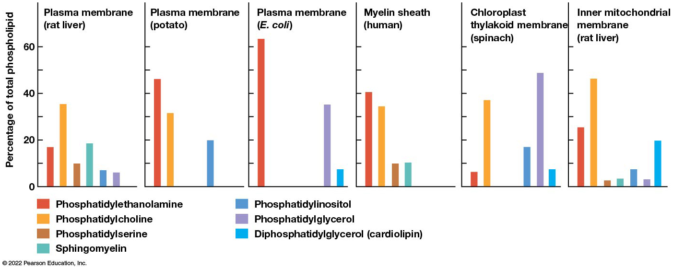
Phospholipid Composition of Several Types of Membranes
Figure 7.7 Phospholipid Composition of Several Kinds of Membranes.
Notes:
Long Description:
The different membranes are plasma membranes of rat liver, potato, E.coli, myelin sheath of human, chloroplast thylakoid membrane of spinach, and inner mitochondrial membrane of rat liver.
The Y axis shows the percentage of total phospholipid and the X axis shows the different phospholipids.
The relative abundance of different kinds of phospholipids varies with different sources and the approximate data of the bar chart are as below:
Plasma membrane of rat liver
18 percent of Phosphatidylethanolamine
37 percent of Phosphatidylcholine
9 percent of Phosphatidylserine
19 percent of Sphingomyelin
6 percent of Phosphatidylinositol
5 percent of Phosphatidylglycerol
Plasma membrane of potato
48 percent of Phosphatidylethanolamine
31 percent of Phosphatidylcholine
20 percent of Phosphatidylinositol
Plasma membrane of E.coli
62 percent of Phosphatidylethanolamine
35 percent of Phosphatidylglycerol
7 percent of Diphosphatidylglycerol (cardiolipin)
Myelin sheath of human
40 percent of Phosphatidylethanolamine
35 percent of Phosphatidylcholine
10 percent of Phosphatidylserine
10 percent of Sphingomyelin
Chloroplast thylakoid membrane of spinach
6 percent of Phosphatidylethanolamine
38 percent of Phosphatidylcholine
18 percent of Phosphatidylinositol
49 percent of Phosphatidylglycerol
5 percent of Diphosphatidylglycerol (cardiolipin)
Inner mitochondrial membrane of rat liver
25 percent of Phosphatidylethanolamine
48 percent of Phosphatidylcholine
2 percent of Phosphatidylserine
3 percent of Sphingomyelin
7 percent of Phosphatidylinositol
3 percent of Phosphatidylglycerol
20 percent of Diphosphatidylglycerol (cardiolipin)

Slide 36
Glycolipids (1 of 2)
Glycolipids are formed by the addition of carbohydrates to lipids.
Some are glycerol based (the glycoglycerolipids), and some are sphingosine based (the glycosphingolipids).
The most common glycosphingolipids are cerebrosides and gangliosides.

Slide 37
Cerebrosides and Gangliosides
Cerebrosides are neutral glycolipids; each molecule has an uncharged sugar as its head group.
A ganglioside has an oligosaccharide head group with one or more negatively charged sialic acid.
Cerebrosides and gangliosides are especially prominent in brain and nerve cells.
Gangliosides function as antigens on the plasma membrane surface.

Slide 38
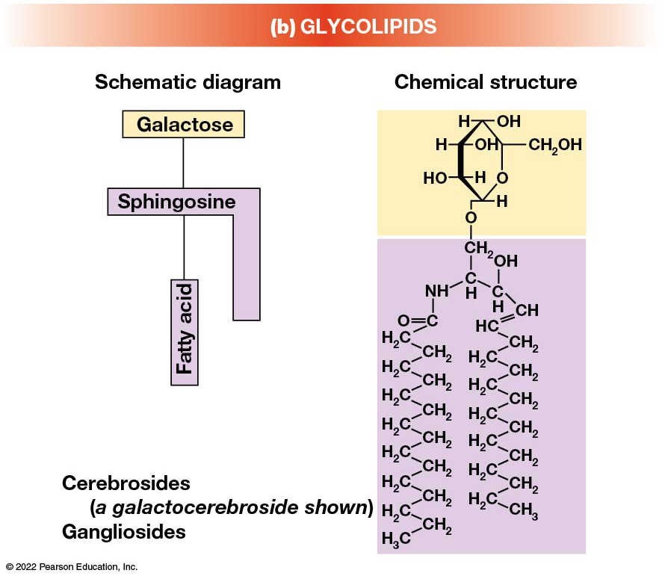
Glycolipids (2 of 2)
Figure 7.6 The Three Major Classes of Membrane Lipids.
Notes:
Long Description:
The details are as below.
Schematic diagram of phospholipids: The flow is as follows: Choline to phosphate to glycerol to multiple fatty acids. The corresponding compounds are:
Phosphatidylcholine
Phosphatidylethanolamine
Phosphatidylserine
Phosphatidylthreonine
Phosphatidylinositol
Phosphatidylglycerol
Diphosphatidylglycerol (cardiolipin)
Chemical structure of phospholipids: N has three single bonds to C H subscript 3, and a single bond to C H subscript 2. The C of C H subscript 2 bonds with C H subscript 2 single bond O to P double bond with O and two single bonds with O and O negative respectively. This is choline and phosphate structure. The structures of glycerol and fatty acids are as follows: There is a C single bond C in which one C has single bonds with H, O and a C H subscript 2 which bonds with the O of phosphate. This O single bonds with C which have two single bonds with an O and fourteen C H subscript 2 molecules in a chain and ends with a C H subscript 3. In the same way, the other C has two single bonds with H and a single bond with O which bonds with C double bond O followed by fourteen C H subscript 2 chain and ends with C H subscript 3.
The second schematic diagram of phospholipids: The flow is as follows: Choline to phosphate to Sphingosine to a single fatty acid. Sphingomyelin is a sphingolipid.
Chemical structure of phospholipids: N has three single bonds to C H subscript 3 and a single bond with C H subscript 2. The C of C H subscript 2 bonds with C H subscript 2 single bond O to P which double bonds with O and two single bonds with O and O negative respectively. This is choline and phosphate structure. The structures of Sphingosine and fatty acid are as follows: The O of phosphate bonds with the Sphingosine C H subscript 2 whose C single bonds with C H single bond C. In this, C H single bonds with N H, and this N single bonds with C double bond O and a chain of sixteen C H subscript 2 molecules and ends with a C H subscript 3. The other C has three single bonds with o H, H, C H which has a double bond with C H and the chain continues with twelve C H subscript 2 molecules and ends with a C H subscript 3.
Schematic diagram of glycolipids: Galactose to Sphingosine to a single fatty acid. Cerebrosides is a galactocerebroside. Gangliosides.
Chemical structure of glycolipids: There is a hexagon bond where three vertex shows H bond O H bond. One of the vertexes shows C H subscript 2 O H. Another vertex shows O and the last vertex shows O H. This is the structure of galactose. The structure of sphingosine and fatty acid is The O of the last vertex of Galactose bonds with C H subscript 2 of Sphingosine. This C bonds with C H single bond C H. One of the C H single bonds with N H. This N single bonds with C which had double bonds with O and a C H subscript chain of fourteen C H subscript 2 and ends with C H subscript 3. The other C H has two single bonds with OH and C H. This C H has double bonds with C H and continues with a chain of twelve C H subscript 2 molecules and ends with a C H subscript 3.
Schematic diagram of sterols: The structure shows three hexagon bonds with a pentagon bond and a double line. The first hexagon shows a ring structure equivalent to O H in the chemical structure. The chain structure is as follows:
Cholesterol
Phytosterols
Ergosterol
Hopanoids
Chemical structure of sterols (Cholesterol): There is one C H subscript 3 bond between the first and the second hexagon and the other is between the third hexagon and pentagon. The second hexagon has one double bond in it. The final pentagon bonds with C H single bond C H subscript 3 and this C H has three C H subscript 2 bonds in a chain and continues with C H bond which in turn has two C H subscript 3 bonds.

Slide 39
Sterols (1 of 2)
The membranes of most eukaryotes contain significant amounts of sterols.
The main sterol in animal cell membranes is cholesterol, which is needed to stabilize and maintain membranes.
Plant cell membranes contain small amounts of phytosterols, whereas fungal cell membranes contain ergosterol, similar to cholesterol.

Slide 40
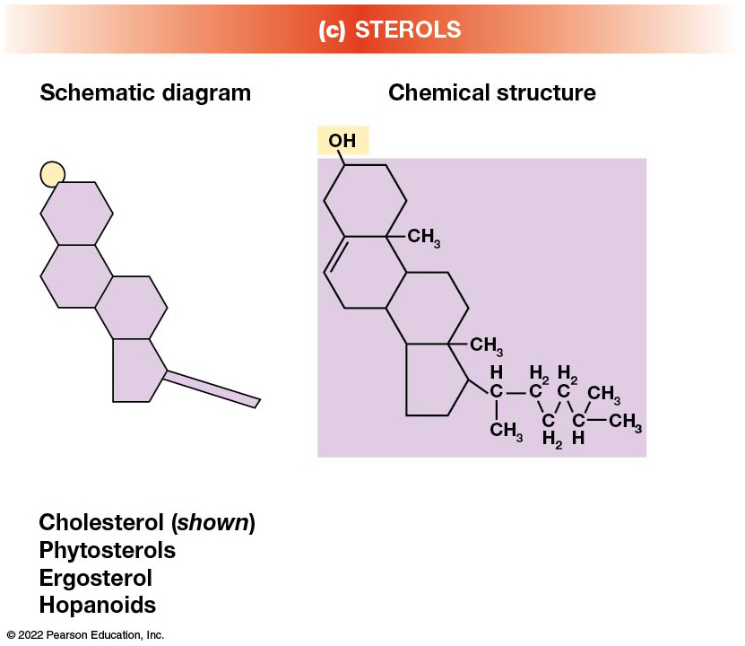
Sterols (2 of 2)
Figure 7.6 The Three Major Classes of Membrane Lipids.
Notes:
Long Description:
The details are as below.
Schematic diagram of phospholipids: The flow is as follows: Choline to phosphate to glycerol to multiple fatty acids. The corresponding compounds are:
Phosphatidylcholine
Phosphatidylethanolamine
Phosphatidylserine
Phosphatidylthreonine
Phosphatidylinositol
Phosphatidylglycerol
Diphosphatidylglycerol (cardiolipin)
Chemical structure of phospholipids: N has three single bonds to C H subscript 3, and a single bond to C H subscript 2. The C of C H subscript 2 bonds with C H subscript 2 single bond O to P double bond with O and two single bonds with O and O negative respectively. This is choline and phosphate structure. The structures of glycerol and fatty acids are as follows: There is a C single bond C in which one C has single bonds with H, O and a C H subscript 2 which bonds with the O of phosphate. This O single bonds with C which have two single bonds with an O and fourteen C H subscript 2 molecules in a chain and ends with a C H subscript 3. In the same way, the other C has two single bonds with H and a single bond with O which bonds with C double bond O followed by fourteen C H subscript 2 chain and ends with C H subscript 3.
The second schematic diagram of phospholipids: The flow is as follows: Choline to phosphate to Sphingosine to a single fatty acid. Sphingomyelin is a sphingolipid.
Chemical structure of phospholipids: N has three single bonds to C H subscript 3 and a single bond with C H subscript 2. The C of C H subscript 2 bonds with C H subscript 2 single bond O to P which double bonds with O and two single bonds with O and O negative respectively. This is choline and phosphate structure. The structures of Sphingosine and fatty acid are as follows: The O of phosphate bonds with the Sphingosine C H subscript 2 whose C single bonds with C H single bond C. In this, C H single bonds with N H, and this N single bonds with C double bond O and a chain of sixteen C H subscript 2 molecules and ends with a C H subscript 3. The other C has three single bonds with o H, H, C H which has a double bond with C H and the chain continues with twelve C H subscript 2 molecules and ends with a C H subscript 3.
Schematic diagram of glycolipids: Galactose to Sphingosine to a single fatty acid. Cerebrosides is a galactocerebroside. Gangliosides.
Chemical structure of glycolipids: There is a hexagon bond where three vertex shows H bond O H bond. One of the vertexes shows C H subscript 2 O H. Another vertex shows O and the last vertex shows O H. This is the structure of galactose. The structure of sphingosine and fatty acid is The O of the last vertex of Galactose bonds with C H subscript 2 of Sphingosine. This C bonds with C H single bond C H. One of the C H single bonds with N H. This N single bonds with C which had double bonds with O and a C H subscript chain of fourteen C H subscript 2 and ends with C H subscript 3. The other C H has two single bonds with OH and C H. This C H has double bonds with C H and continues with a chain of twelve C H subscript 2 molecules and ends with a C H subscript 3.
Schematic diagram of sterols: The structure shows three hexagon bonds with a pentagon bond and a double line. The first hexagon shows a ring structure equivalent to O H in the chemical structure. The chain structure is as follows:
Cholesterol
Phytosterols
Ergosterol
Hopanoids
Chemical structure of sterols (Cholesterol): There is one C H subscript 3 bond between the first and the second hexagon and the other is between the third hexagon and pentagon. The second hexagon has one double bond in it. The final pentagon bonds with C H single bond C H subscript 3 and this C H has three C H subscript 2 bonds in a chain and continues with C H bond which in turn has two C H subscript 3 bonds.

Slide 41
Fatty Acids Are Essential to Membrane Structure and Function
Fatty acids are components of all membrane lipids except the sterols.
Their long hydrocarbon tails provide a barrier to diffusion of polar solutes.
The sizes of membrane fatty acids range between 12 and 20 carbons long, which is optimal for bilayer formation and dictates the usual thickness of membranes (6–8 nm).

Slide 42
Fatty Acids Vary in Degree of Saturation
Fatty acids vary considerably in the presence and number of double bonds.
Palmitate (16 carbons) and stearate (18 carbons) are common saturated fatty acids.
Oleate (one double bond) and linoleate (two double bonds) are both 18-carbon unsaturated fatty acids.

Slide 43
Polyunsaturated Fatty Acids
Polyunsaturated fatty acids have more than one double bond.
Polyunsaturated fatty acids found in membranes include linoleate, has 18 carbons and 3 double bonds (18:3) and arachidonate (20:4).
Omega-3 fatty acids are polyunsaturated fatty acids with a double bond on the third carbon.
They are essential for normal human development and may reduce the risk of heart disease.

Slide 44
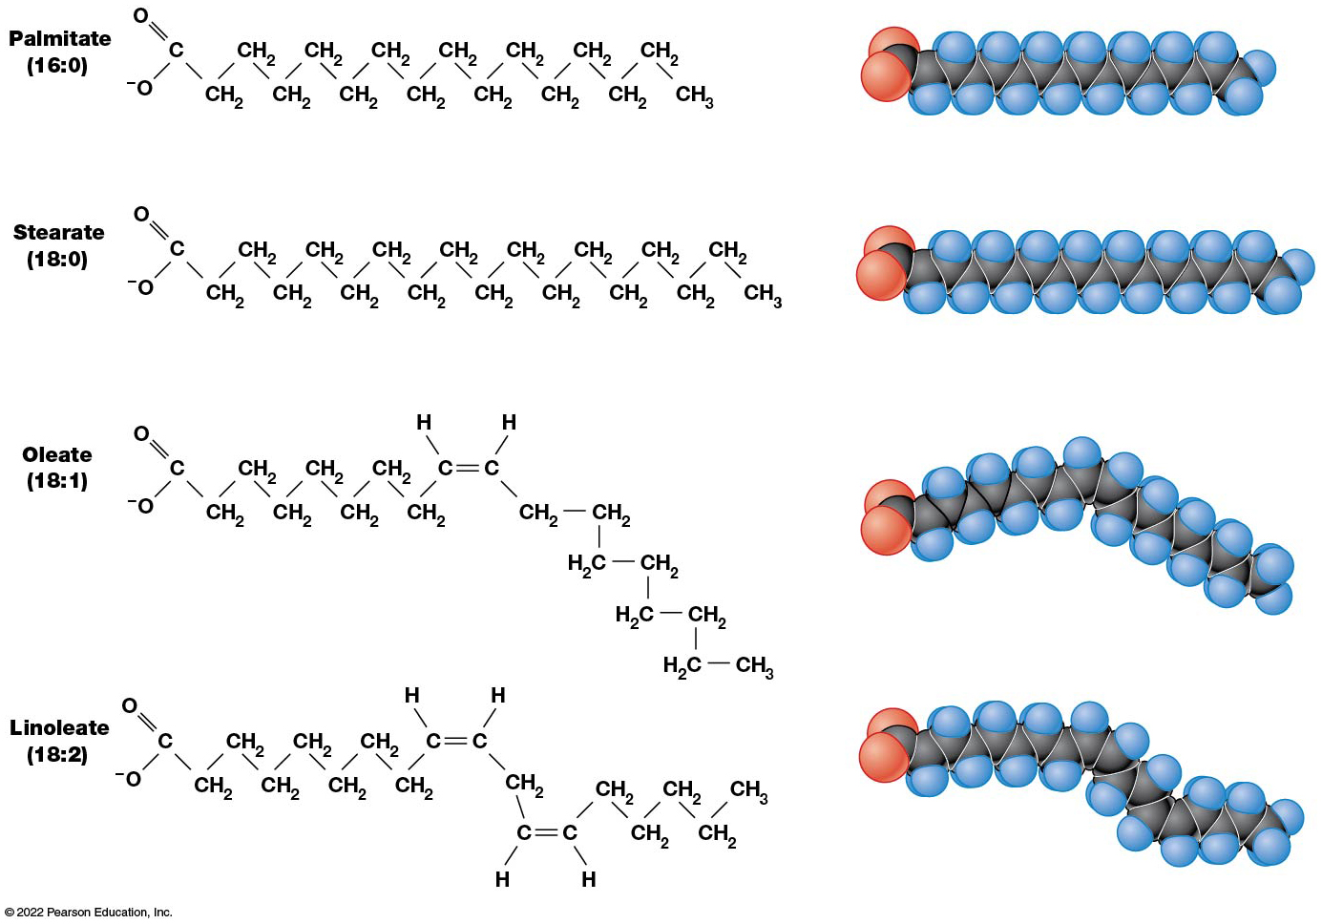
Structures of Some Common Fatty Acids Found in Membranes
Figure 7.8 Structures of Some Common Fatty Acids Found in Membranes.
Notes:
Long Description:
The structures are as below:
Palmitate which has 16 carbons and 0 double bonds: A linear structure that has a C double bond O and a single bond O negative. The C has fourteen C H subscript 2 molecules connected with single bonds in a chain and a C H subscript 3 bond at the end. The structure represented with red molecules at the head depicts oxygen and a linear blue and black depicts the hydrocarbon structure.
Stearate which has 18 carbons and 0 double bonds: A linear structure has a C double bonded with O and single bonded with O negative. The C has sixteen C H subscript 2 connected with single bonds in a chain and a C H subscript 3 at the end. The structure represented with red molecules at the head depicts oxygen and a linear blue and black depicts the hydrocarbon structure.
Oleate which has 18 carbons and 2 double bonds: A curved structure that has a C double bond O and a single bond O negative. The C has seven C H subscript 2 single bonds. Then a C is bonded to a C double bond C with a H bond to each C bond. The C then has seven C H subscript 2 bonds and a final C H subscript 3 bond.
Linoleate with 18 carbons and 3 double bonds: A curved structure that has a C double bonded with O and single bonded with O negative. The C has 7 C H subscript 2 single bonds. Then a C is double bonded to a C with a H bond to each C. The C has a C H subscript 2 bond and the chain repeats with two C double bond C, each with a H bond followed by four C H subscript 2 single bonds and a final C H subscript 3 bond. The structure has two curves or bends and it is where the two C double bonds are present.

Slide 45
Thin-Layer Chromatography Is an Important Technique for Lipid Analysis
Lipids can be isolated, separated, and studied using nonpolar solvents such as acetone and chloroform.
Thin-layer chromatography (T L C) is used to separate different kinds of lipids based on their relative polarities.
A glass plate is coated with silicic acid, and lipids are spotted onto a position near the bottom of the plate called the origin.

Slide 46
Principle of Separation of Lipids via T L C
A nonpolar organic solvent moves up the plate by capilary action, taking different lipids with it to varying degrees.
Nonpolar lipids have little affinity for the silicic acid on the plate, so they move readily with the solvent, near the solvent front.
Polar lipids will interact variably (depending on how polar they are) with the silicic acid, and their movement will be slowed proportionately.

Slide 47
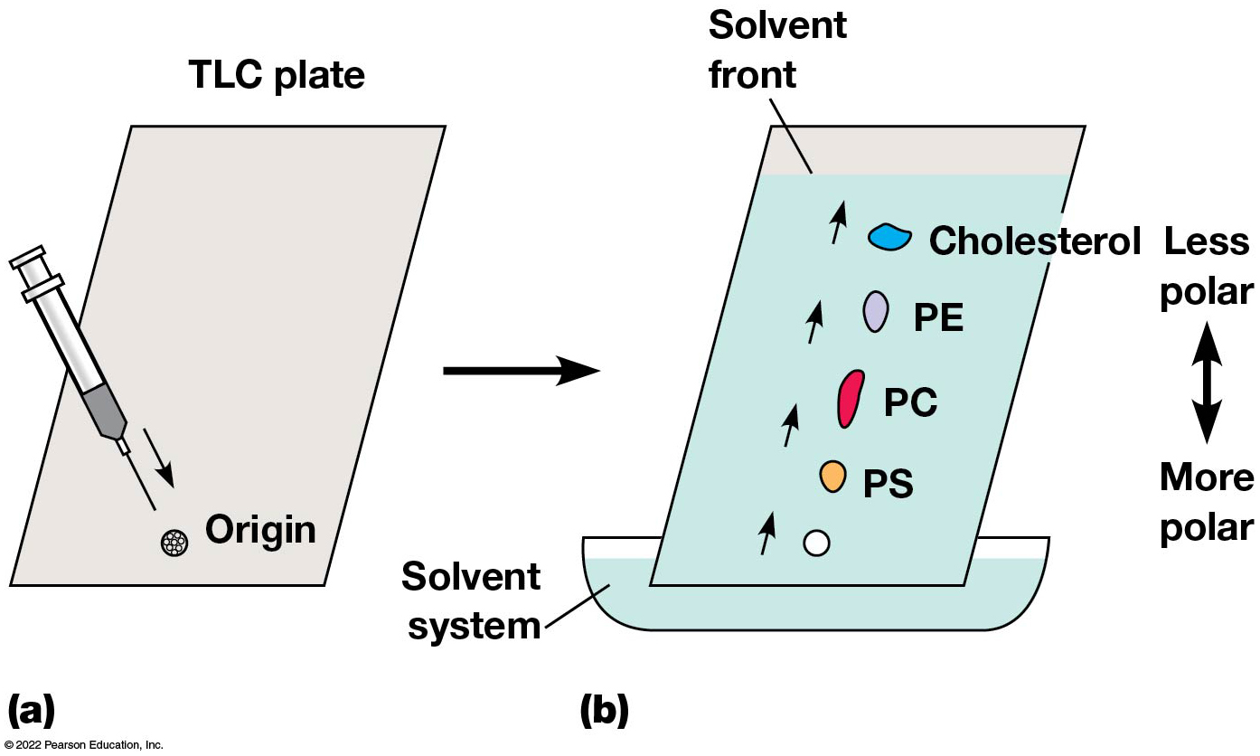
Using Thin-Layer Chromatography to Separate and Analyze Membrane Lipids
Figure 7.9 Using Thin-Layer Chromatography to Separate and Analyze Membrane Lipids.
Notes:
Long Description:
Image “a” shows a syringe with a sample solution being placed on a spot on a small area of a glass TLC plate and is the point of origin.
Image “b” shows the order of the components moving upward from more polar toward less polar when the TLC plate is placed in a solvent system. The components are in the order of PS, PC, PE, and cholesterol. The solvent front is above the cholesterol level.

Slide 48
Membrane Asymmetry: Most Lipids Are Distributed Unequally Between the Two Monolayers
Membrane asymmetry is the difference between the monolayers regarding the kind of lipids present and the degree of saturation of fatty acids in the phospholipids.
Most of the glycolipids in the plasma membrane of animal cells are in the outer layer.
Membrane asymmetry is established during the synthesis of the membrane.

Slide 49
Membrane Asymmetry Tends to Be Maintained
Once established, membrane asymmetry does not change much.
The movement of lipids from one monolayer to another requires their hydrophilic heads to move all the way through the hydrophobic interior of the bilayer.
This transverse diffusion (or “flip-flop”) is relatively rare.

Slide 50
Lipids Move Freely Within Their Monolayer
Lipids are mobile within their monolayer.
Rotation of phospholipids about their axes can occur.
Phospholipids can also move within the monolayer, via lateral diffusion.
Both types of movement are rapid and random.

Slide 51
Transverse Diffusion Does Occur
Though rare, phospholipid flip-flop does occur in natural membranes.
Some membranes, in particular the smooth ER membrane, have proteins that catalyze the flip-flop of membrane lipids.
These proteins are called phospholipid translocators, or flippases.

Slide 52
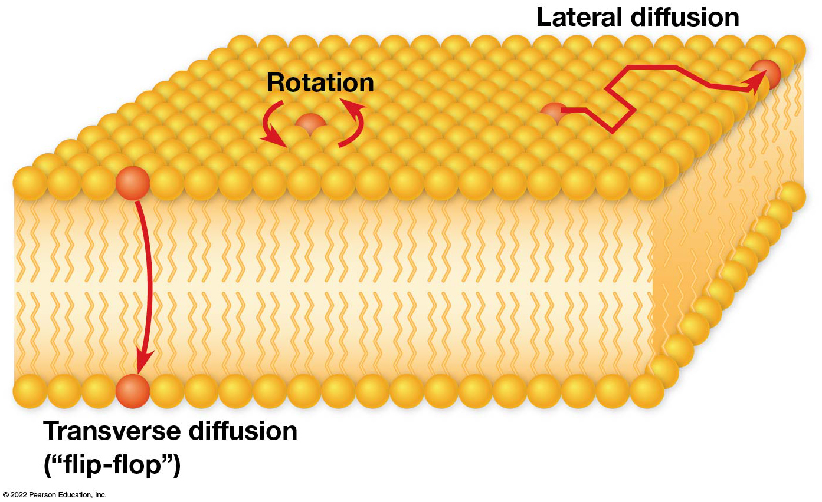
Movements of Phospholipid Molecules Within Membranes
Figure 7.10 Movements of Phospholipid Molecules Within Membranes.
Notes:
Long Description:
Transverse diffusion of a phospholipid molecule happens from one monolayer to the other layer. Rotation happens along the long axis. Lateral diffusion happens when a molecule exchanges place with a neighboring molecule in the same monolayer.

Slide 53
The Lipid Bilayer Is Fluid
The lipid bilayer behaves as a fluid that permits the movement of both lipids and proteins.
Lipids can move as much as several μm per second within the monolayer.
Lateral diffusion can be demonstrated using fluorescence recovery after photobleaching (F R A P).

Slide 54
Membranes Function Properly Only in the Fluid State
Membrane fluidity changes with temperature, decreasing as temperature falls and vice versa.
Every lipid bilayer has a characteristic transition temperature T_{m}, the temperature at which it becomes fluid.
This change of state is called a phase transition, in this case from solid to liquid.
Below the T_{m}, any functions that rely on membrane fluidity will be disrupted.

Slide 55
Measuring the Transition Temperature of a Membrane
The transition temperature can be measured by differential scanning calorimetry.
The membrane is placed inside a calorimeter, and the uptake of heat is measured as temperature is increased.
The T_{m} is the point of maximum heat absorption as the membrane changes from the gel to the fluid state.

Slide 56
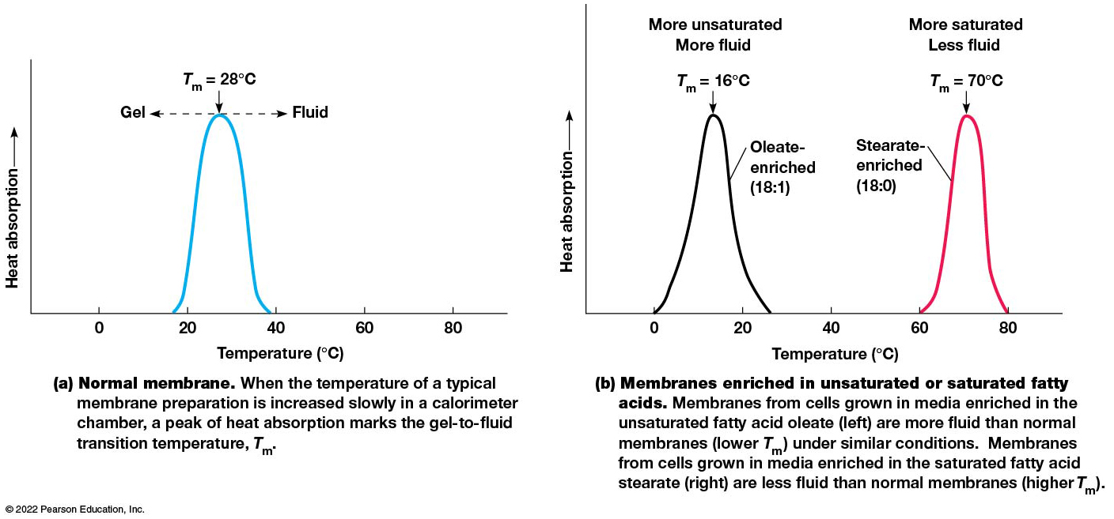
Determination of Membrane Transition Temperature by Differential Scanning Calorimetry
Figure 7.11 Determination of Membrane Transition Temperature by Differential Scanning Calorimetry.
Notes:
Long Description:
The X axis shows temperature in degree Celsius from 0 to 80, in increments of 20, and heat absorption on the Y axis.
The details of the graphs are as below.
Normal membrane: The heat absorption is a normal curve from about 18 degrees to 39 degrees. The T sub m, which is the peak value of heat absorption is at 28 degrees Celsius. Below this is the gel state and above the T sub m is the fluid state. The T sub m is the transition from gel to fluid state.
Membranes enriched in unsaturated or saturated fatty acids: Oleate enriched with 18 carbons and 1 double bond shows a normal curve for heat absorption from 0 to 25 degrees Celsius. The T sub m is at 16 degrees Celsius, which is the peak. More unsaturated, more fluid it is.
Another example is Stearate enriched with 18 carbons and 0 double bonds. It shows a normal curve for heat absorption from 60 to 80 degrees Celsius. The T sub m, which is the peak, is at 70 degrees Celsius. More saturated, less fluid it is.

Slide 57
Effects of Fatty Acid Composition on Membrane Fluidity
Fluidity of a membrane depends mainly on the fatty acids that it contains.
The length of fatty acid chains and the degree of saturation both affect the fluidity of the membrane.
Long-chain and saturated fatty acids have higher T_{m} values, whereas short-chain and unsaturated fatty acids have lower T_{m} values.

Slide 58
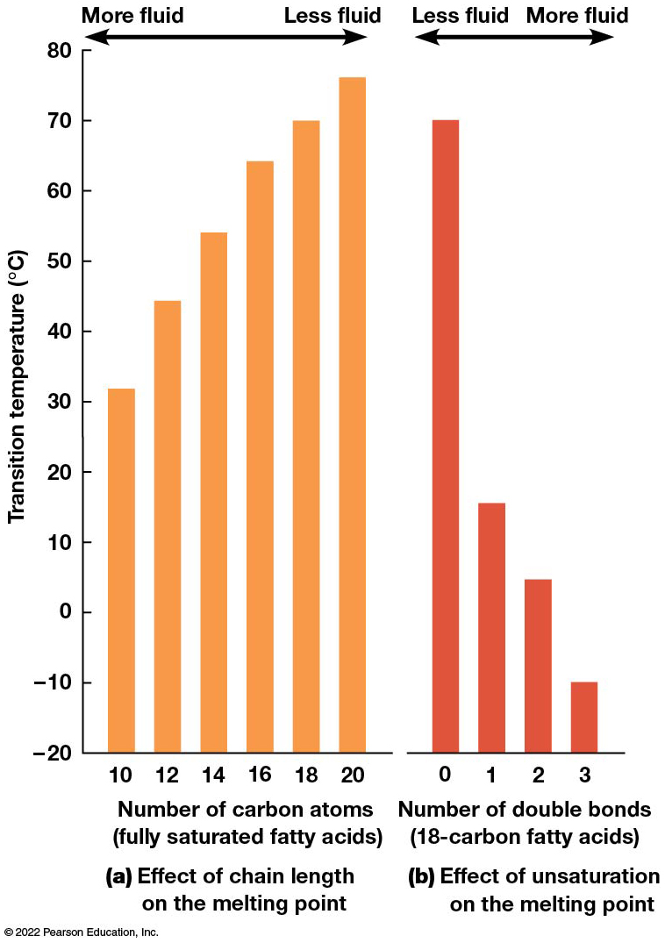
Chain Length and Degree of Unsaturation Affect the Melting Point of Fatty Acids
Figure 7.12 Chain Length and Degree of Unsaturation Affect the Melting Point of Fatty Acids.
Notes:
Long Description:
The details of the graph are as below:
Effect of chain length on the melting point: The X axis shows number of carbon atoms for fully saturated fatty acids from 10 to 20, in increments of 2. The Y axis shows transition temperature in degree Celsius from negative 20 to 80, in increments of 10. The data points are approximately (10, 31); (12, 45); (14, 55); (16, 65); (18, 70); and (20, 78). When the number of carbon atoms is less, it is more fluid and when it is more, it is less fluid.
Effect of unsaturation on the melting point: The X axis shows number of double bonds with 18 carbon fatty acids. The data points for transition temperature are approximately (0, 70); (1, 16); (2, 5); and (3, 10). More the number of double bonds, less fluid it is and lesser number of double bonds, more fluid it is.

Slide 59
Fatty Acid Saturation and Membrane Fluidity
Saturated fatty acids pack together well in the membrane.
Fatty acids with one or more double bonds have bends in the chains that prevent them from packing together neatly.
Thus, unsaturated fatty acids are more fluid than saturated fatty acids and have lower T_{m} values.

Slide 60
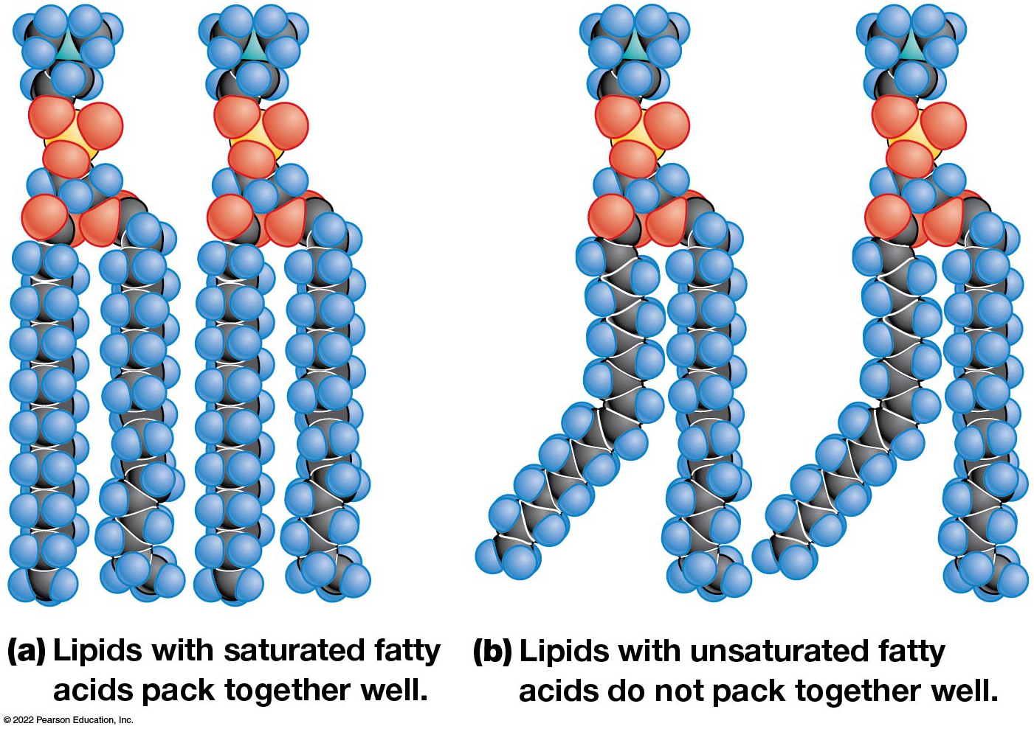
The Effect of Unsaturated Fatty Acids on the Packing of Membrane Lipids
Figure 7.13 The Effect of Unsaturated Fatty Acids on the Packing of Membrane Lipids.
Notes:
Long Description:
The lipids with saturated fatty acids pack together well. There is a common stem of hydrocarbons, followed by red yellow represented molecules. It then branches into two parallel linear hydrocarbon chains.
The lipids with unsaturated fatty acids do not pack well together. There is a common stem of hydrocarbons, followed by red yellow represented molecules. It then branches into hydrocarbon chains, where one is linear and vertical and the lower half of the other is bent outward.

Slide 61
Membrane Composition
Most plasma membrane fatty acids vary in chain length and degree of saturation.
This helps to ensure that membranes are fluid at physiological temperatures.
Most unsaturated fatty acids have cis double bonds, unlike the commercially produced trans fats, which pack together like saturated fats do.

Slide 62
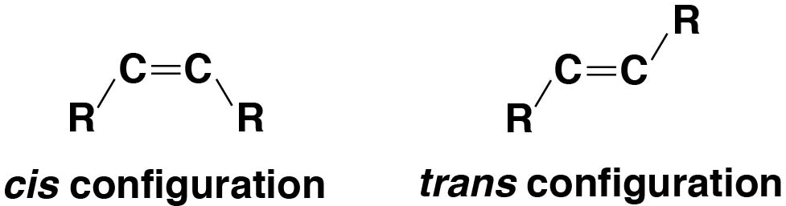
Cis and Trans Configuration
Notes:
Long Description:
Cis configuration shows a C to C double bond. Each carbon atom has an R bonded to it. In trans configuration, the R attached to each C atom is on the opposite side.

Slide 63
Effects of Sterols on Membrane Fluidity
Membrane fluidity is influenced by sterols.
The intercalation of rigid cholesterol molecules into a membrane decreases its fluidity and increases the T_{m}.
However, cholesterol also prevents hydrocarbon chains of phospholipids from packing together tightly and so reduces the tendency of membranes to gel upon cooling.
Therefore, cholesterol is a fluidity buffer; sterols in other organisms may function similarly.

Slide 64
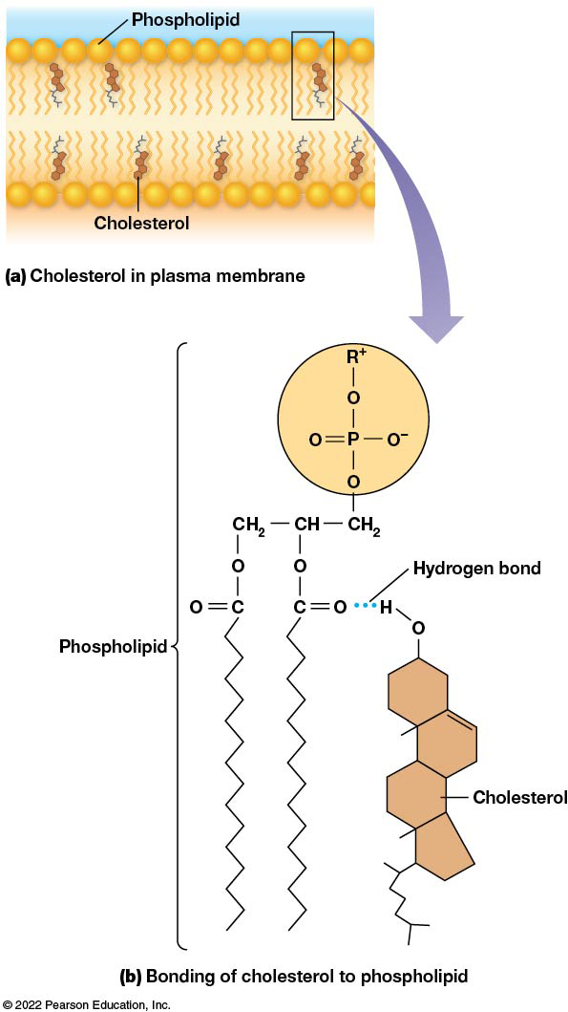
Orientation of Cholesterol Molecules in a Lipid Bilayer
Figure 7.14 Orientation of Cholesterol Molecules in a Lipid Bilayer.
Notes:
Long Description:
The image description is as below.
The phospholipid molecules are on both the layers of the plasma membrane. Cholesterol are seen as strands within the bilayer.
Each cholesterol is bound to the phospholipid molecule with a O single bond H and a hydrogen bond with O double bond C single bond O single bond C H single bond C H subscript 2. The C of the C H is bond to a C H subscript single bond O single bond C and is double bonded with O. The phospholipid has a P to O and O negative bond, O and R positive bond. The P has a double bond with O too.

Slide 65
Other Effects of Sterols on Membranes
Sterols decrease the permeability of membranes to ions and small polar molecules.
This is likely because they fill spaces between the hydrocarbon chains of phospholipids.
This effectively blocks the routes that ions and small molecules would take through the membrane.

Slide 66
Most Organisms Can Regulate Membrane Fluidity
Most organisms can regulate membrane fluidity by varying the lipid composition of the membranes.
This is most important in poikilotherms, organisms that cannot regulate their body temperature.
Poikilotherms use homeoviscous adaptation, compensating for changes in temperature by altering the length and degree of saturation of fatty acids in their membranes.

Slide 67
Oxygen and Desaturase Enzyme
Some organisms have a desaturase enzyme, which introduces double bonds into fatty acids as needed.
In plants and yeasts, temperature-related fluidity changes are tied to the increased solubility of oxygen at lower temperatures.
More oxygen is available at low temperatures, and oxygen acts as a substrate for desaturase, allowing membrane fluidity to be maintained at lower temperatures.

Slide 68
Lipid Micro- and Nanodomains May Localize Molecules in Membranes (1 of 2)
Lipid components of the membrane are not homogenous.
Lipid rafts (or microdomains) are areas of a membrane that are localized, nonhomogeneous regions within a monolayer that sequester proteins.
These are dynamic structures that change in composition as lipids and proteins move in and out of them.

Slide 69
Lipid Micro- and Nanodomains May Localize Molecules in Membranes (2 of 2)
This area of study is still under investigation and debate.
Many cell biologists currently think membranes are organized in transient lipid “nanodomains.”

Slide 70
7.4 Membrane Proteins: The “Mosaic” Part of the Model
The mosaic part of the fluid mosaic model includes lipid domains.
However, membrane proteins are the main components.

Slide 71
The Membrane Consists of a Mosaic of Proteins: Evidence from Freeze-Fracture Microscopy
Support for the fluid mosaic model came from studies involving freeze fracturing.
A bilayer or membrane is frozen and then hit sharply with a diamond knife.
The resulting fracture often follows the plane between the two layers of membrane lipid.

Slide 72
Freeze-Fracture Analysis of Membranes (1 of 2)
When a fracture plane splits a membrane into its two layers, particles the size and shape of globular proteins can be seen.
The E surface is the exoplasmic face, and the P surface is the protoplasmic face.
The protein/lipid ratio varies among cell types.

Slide 73
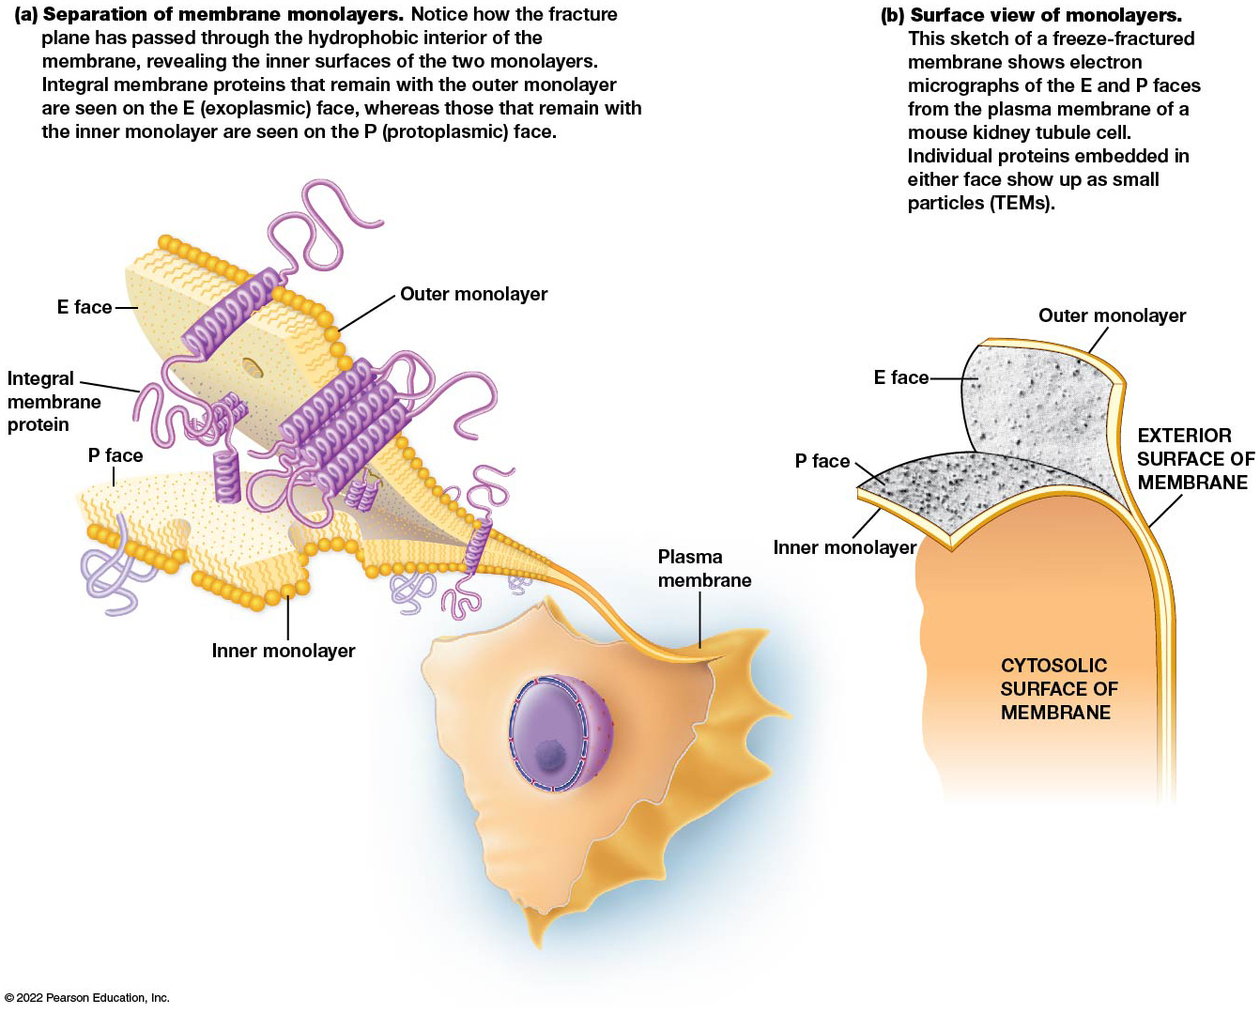
Freeze-Fracture Analysis of a Membrane (2 of 2)
Figure 7.15 Freeze-Fracture Analysis of a Membrane.
Notes:
Long Description:
The details are as below:
Separation of membrane monolayers: A note reads, “Notice how the fracture plane has passed through the hydrophobic interior of the membrane, revealing the inner surfaces of the two monolayers. Integral membrane proteins that remain with the outer monolayer are seen on the E (exoplasmic) face, whereas those that remain with the inner monolayer are seen on the P (protoplasmic) face.”
A fracture plane view shows outer monolayer, E-face below the outer monolayer, a network of helical integral membrane protein, inner monolayer, P-face above the inner monolayer, and plasma membrane.
Surface view of monolayers: A note reads, “This sketch of a freeze-fractured membrane shows electron micrographs of the E and P faces from the plasma membrane of a mouse kidney tubule cell. Individual proteins embedded in either face show up as small particles (TEMs).”
The layers labeled are cytosolic surface of membrane, exterior surface of membrane, outer monolayer, E-face, P-face, and inner monolayer.

Slide 74
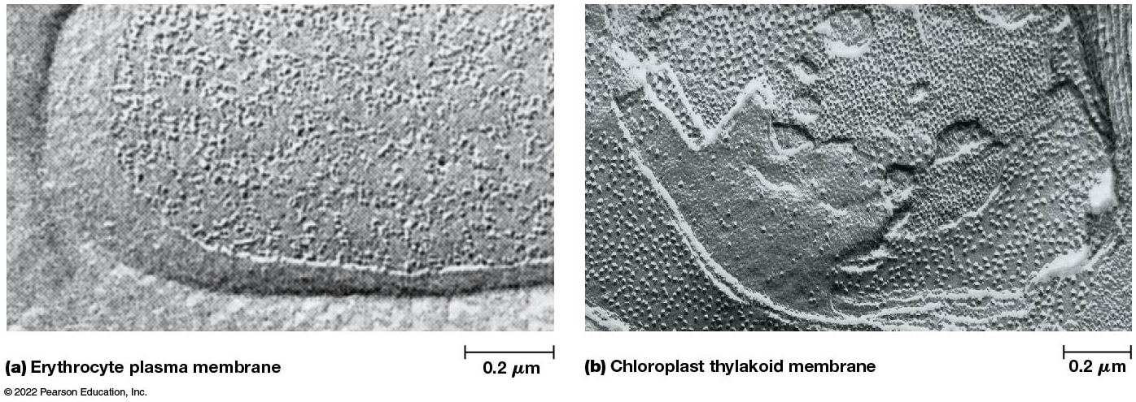
Membrane Proteins Visualized by Freeze-Fracture Electron Microscopy
Figure 7.16 Membrane Proteins Visualized by Freeze-Fracture Electron Microscopy.
Notes:
Long Description:
Erythrocyte plasma membrane: The electron micrographs show no patches on the top
Chloroplast thylakoid membrane: It has rough patches on the top.
The measurement at the bottom left bottom reads 0.2 micrometers.

Slide 75
Membranes Contain Integral, Peripheral, and Lipid-Anchored Proteins
Membrane proteins have different hydrophobicities and so occupy different positions in or on membranes.
This, in turn, determines how easily such proteins can be extracted from membranes.
Membrane proteins fall into three categories: integral, peripheral, and lipid anchored.

Slide 76
Classes of Membrane Proteins
Integral membrane proteins are embedded in the lipid bilayer because of their hydrophobic regions.
Peripheral proteins are hydrophilic and located on the surface of the bilayer.
Lipid-anchored proteins are hydrophilic and attached to the bilayer by covalent attachments to lipid molecules embedded in the bilayer.

Slide 77
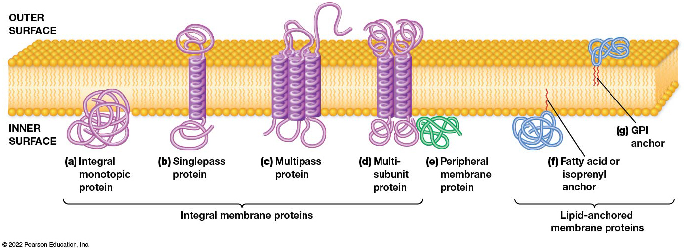
The Main Classes of Membrane Proteins
Figure 7.17 The Main Classes of Membrane Proteins.
Notes:
Long Description:
The layers are as below:
Integral membrane proteins
Integral monotopic protein
Singlepass protein
Multipass protein
Multi-subunit protein
Peripheral membrane protein
Lipid-anchored membrane proteins
Fatty acid or isoprenyl anchor
GPI anchor

Slide 78
Integral Membrane Proteins (1 of 2)
Most membrane proteins possess one or more hydrophobic regions with an affinity for the interior of the lipid bilayer.
These are integral membrane proteins, with hydrophobic regions embedded in the interior membrane bilayer.
They are difficult to remove from membranes by standard isolation procedures.

Slide 79
Integral Membrane Proteins (2 of 2)
Some integral membrane proteins, called integral monotopic proteins, are embedded in just one side of the bilayer.
However, most are transmembrane proteins that span the membrane and protrude on both sides.
Transmembrane proteins cross either once (singlepass proteins) or several times (multipass proteins).

Slide 80
Transmembrane Proteins
The transmembrane segments of transmembrane proteins is the hydrophobic portion that crosses the lipid bilayer.
In most cases, the polypeptide chain appears to span the membrane in an α-helical conformation about 20–30 amino acids long with hydrophobic R groups.
Some are arranged as a closed β sheet called a β barrel, especially those that form pores.

Slide 81
Singlepass Membrane Proteins
Singlepass membrane proteins have the C-terminus extending from one surface of the membrane and the N-terminus from the other.
For example, glycophorin is a singlepass protein on the erythrocyte plasma membrane that is oriented so the C-terminus is on the inner surface and the N-terminus is on the outer.

Slide 82
Multipass Membrane Proteins
Multipass membrane proteins have 2–20 (or more) transmembrane segments.
For example, bacteriorhodopsin has seven transmembrane segments positioned to form a channel.

Slide 83
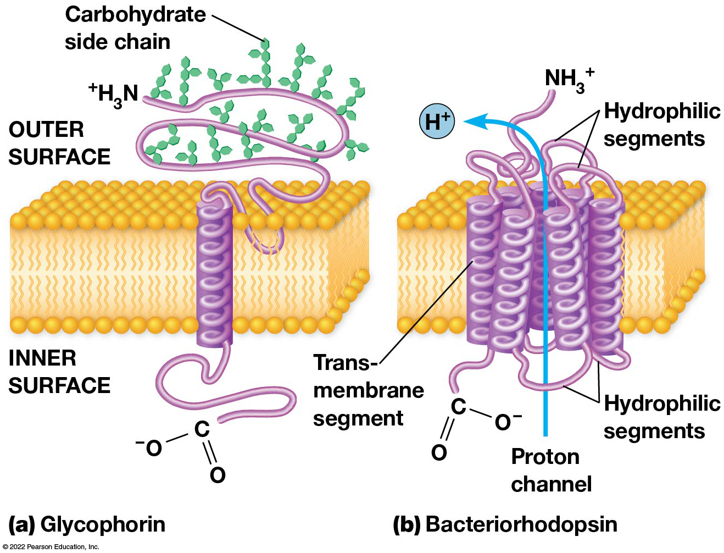
The Structures of Two Integral Membrane Proteins
Figure 7.18 The Structures of Two Integral Membrane Proteins.
Notes:
Long Description:
The details are as below:
Glycophorin
A single helical protein structure passes through the outer and inner surfaces. The outer surface of the protein structure shows N H subscript 3 positive and the inner surface shows C double bond O and single bond O negative. There are carbohydrate side chains on the protein structure on the outer surface.
Bacteriorhodopsin
A group of multiple helical protein structures passes through the outer and inner surfaces. The outer surface of the protein structure shows N H subscript 3 positive and the inner surface shows C double bond O and single bond O negative. The ends of these protein structures are hydrophilic segments on the outer and inner surface. A trans-membrane segment surrounds the protein structure. A proton channel from the inner to outer layer showing H plus passes through the layer.

Slide 84
Peripheral Membrane Proteins
Membrane proteins that lack discrete hydrophobic regions do not penetrate the lipid bilayer.
These peripheral membrane proteins are bound to membrane surfaces through weak electrostatic forces and hydrogen bonds.
Some hydrophobic residues play a role in anchoring them to the membrane surface.
Can be removed from a membrane by changing pH or ionic strength.

Slide 85
Lipid-Anchored Membrane Proteins
The polypeptide chains of lipid-anchored membrane proteins are located on the surfaces of membranes.
They are covalently bound to lipid molecules embedded in the bilayer.
Proteins bound to the inner surface of the plasma membrane are linked to fatty acids, or isoprenyl groups.

Slide 86
Types of Lipid-Anchored Membrane Proteins
Fatty acid-anchored membrane proteins are attached to a saturated fatty acid, usually myristic acid (14C) or palmitic acid (16C).
Isoprenylated membrane proteins are synthesized in the cytosol and then modified by addition of multiple isoprenyl groups (5C) usually farnesyl (15C) or geranylgeranyl (20C) groups.
GPI-anchored membrane proteins are covalently linked to glycosylphosphatidylinositol.

Slide 87
Membrane Proteins Can Be Isolated and Analyzed
Membrane proteins can be solubilized and extracted from membranes so that they can be studied.

Slide 88
Isolation of Membrane Proteins
Peripheral membrane proteins are usually easy to isolate by altering pH or ionic strength.
Chelating (cation-binding) agents are also used to solubilize peripheral membrane proteins.
Lipid-anchored proteins are isolated by similar means.

Slide 89
Isolating Integral Membrane Proteins
Integral membrane proteins are difficult to isolate from membranes.
Often detergents are used that disrupt hydrophobic interactions and dissolve the lipid bilayer.
This can lead to a disruption in biological function of the integral membrane protein.

Slide 90
Separation (1 of 2)
Solubilized membrane proteins can be analyzed using gel electrophoresis.
Electrophoresis is a group of techniques that use an electric field to separate charged molecules according to size.
How quickly a molecule moves during electrophoresis depends on both charge and size.
Electrophoresis uses various support media, most commonly polyacrylamide or agarose.

Slide 91
Separation (2 of 2)
During electrophoresis, proteins are separated by size and charged.
After electrophoresis, polypeptides can be identified by Western blotting.
This technique is important for identifying which proteins are in a sample and their relative abundance.

Slide 92
Affinity Labeling
Affinity labeling utilizes radioactive molecules that bind to certain proteins based on function.
For example, cytochalasin B is an inhibitor of glucose transport.
Membranes exposed to radioactive cytochalasin B will likely have the radioactivity bound to proteins involved in glucose transport.

Slide 93
Membrane Reconstitution
In membrane reconstitution, proteins are extracted from membranes and separated individually.
The purified proteins are mixed with phospholipids to form vesicles call liposomes.
Liposomes can be loaded with specific molecules and tested for their ability to carry out certain functions.

Slide 94
Determining the Three-Dimensional Structure of Membrane Proteins Is Becoming Easier
X-ray crystallography can be used to determine the structure of proteins that can be isolated in crystalline form.
Membrane proteins are hard to isolate and crystallize.
An alternative approach called hydropathy analysis can be used.

Slide 95
X-Ray Crystallography
X-ray crystallography is widely used to determine the three-dimensional structure of proteins.
Integral membrane proteins are difficult to isolate and crystallize, but recent techniques have improved.
Now, over 900 membrane proteins have been studied using this method.

Slide 96
Hydropathy Analysis
The number and location of transmembrane segments in a membrane protein can be inferred if the protein sequence is known.
A hydropathy (or hydrophobicity) plot is used for this.
A computer program identifies clusters of hydrophobic residues, calculating a hydropathy index for successive “windows” along the protein.

Slide 97
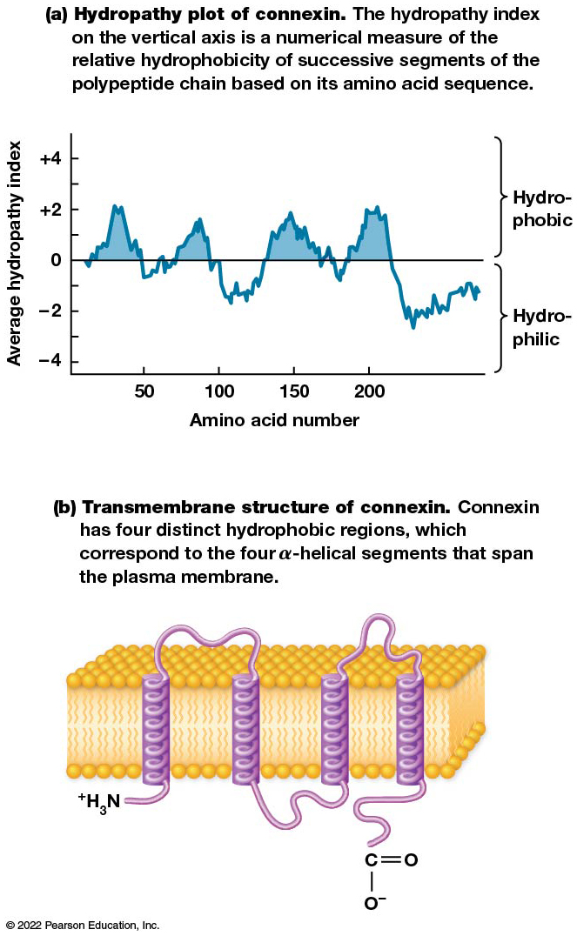
Hydropathy Analysis of an Integral Membrane Protein
Figure 7.19 Hydropathy Analysis of an Integral Membrane Protein.
Notes:
Long Description:
The details are as below:
Hydropathy plot of connexin
The X axis shows amino acid number from 0 to 200, in increments of 50. The Y axis shows average hydropathy index from negative 4 to 4, in increments of 2. The hydrophilic region is below 0 and hydrophobic region is above 0. The hydrophobic region shows a consistent up-down pattern with peak of 2 and a low of 0 at regular intervals. The hydrophilic region shows increasing hydropathy index from 1 to 3 as the amino acid number increases. It shows an up-down pattern between peak and 0.
Transmembrane structure of connexion
Connexin has four distinct hydrophobic regions, which correspond to the four a-helical segments that span the plasma membrane. Single strands of interconnected protein structures pass through the two layers of the membrane. The starting end shows N H subscript 3 positive and the final end shows C that double bonds with O and single bonds with O negative.

Slide 98
Molecular Biology Has Contributed Greatly to Our Understanding of Membrane Proteins
The study of membrane proteins has been revolutionized by D N A sequencing and recombinant D N A technology.
Amino acid sequence can be deduced from D N A sequence.
Site-specific mutagenesis allows determination of how certain amino acids affect protein function.

Slide 99
Membrane Proteins Have a Variety of Functions
Some membrane proteins are enzymes, which accounts for the localization of specific functions to specific membranes.
Electron transport proteins such as cytochromes and iron-sulfur proteins involved in energy production.

Slide 100
Solute Transport Across Membranes
Transport proteins facilitate the movement of nutrients across membranes.
Channel proteins provide hydrophilic passageways through hydrophobic membranes.
Transport A T P ases use the energy of A T P to transport ions across membranes.

Slide 101
Signaling Across Membranes
Receptors recognize and mediate the effects of specific chemical signals on the surface of the cell.
Hormones, neurotransmitters, and growth-promoting substances are examples of chemical signals.

Slide 102
Communication Between Cells
Membrane proteins involved with intercellular communication include
Proteins that form connexons at gap junctions in animal cells
Proteins that make up plasmodesmata in plant cells

Slide 103
Membrane Proteins Play Roles in Other Cell Functions
Membrane proteins play roles in uptake and secretion of substances by endocytosis and exocytosis.
They take part in targeting, sorting, and modifying proteins in the endoplasmic reticulum and Golgi complex.
They detect light.
They participate in autophagy, the digestion of a cell’s own organelles or structures.

Slide 104
Stabilizing and Shaping the Cell Membrane
Membrane-associated proteins play structural roles in stabilizing and shaping the cell membrane.
In animal cells, a cytoskeletal meshwork of peripheral membrane proteins underlies the plasma membrane of many kinds of cells.

Slide 105
Membrane Proteins Are Oriented Asymmetrically Across the Lipid Bilayer
Membrane proteins exhibit asymmetric orientation with respect to the lipid bilayer.
Once in place, in or on one of the monolayers, proteins cannot move across the membrane from one surface to the other.
All the molecules of a particular protein are oriented the same way in the membrane.

Slide 106
Detecting Proteins on Specific Membrane Proteins
Radioactive labeling procedures are used to distinguish between proteins on inner and outer surfaces of membrane vesicles.
The enzyme lactoperoxidase (LP) can be used to attach ¹²⁵I to proteins on the outer surface.
LP and ¹²⁵I can be used to label the inner surface. This can be accomplished by permeabilizing the vesicle so LP enters. The vesicle is transferred to an isotonic solution with ¹²⁵I present. ¹²⁵I enters the cells and labels the inner surface.

Slide 107
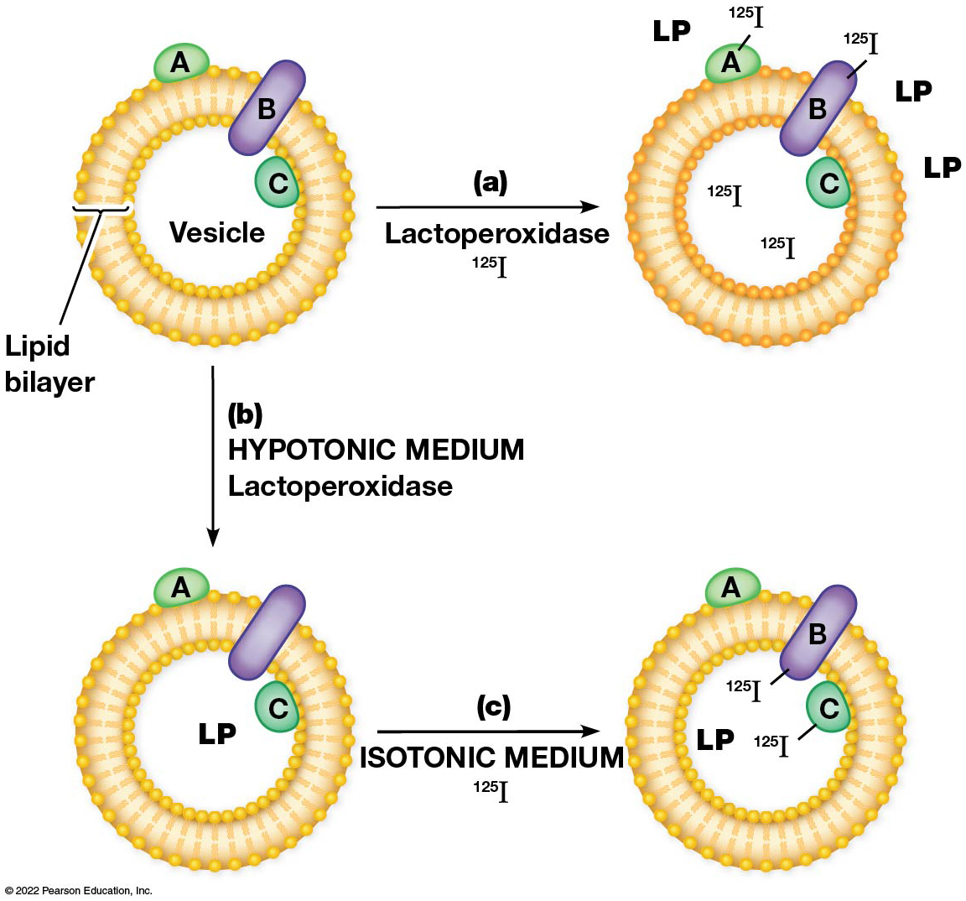
A Method for Labeling Proteins Exposed on One or Both Surfaces of a Membrane Vesicle
Figure 7.20 A Method for Labeling Proteins Exposed on One or Both Surfaces of a Membrane Vesicle.
Notes:
Long Description:
The process is as follows:
Lactoperoxidase of superscript 125 I: Membrane proteins on the outer surface of the membrane vesicle, A and B are superscript 125 I.
Hypotonic medium: Lactoperoxidase. “A” and “C” are only labeled.
Isotonic medium: B and C are superscript 125 I.

Slide 108
Many Membrane Proteins and Lipids Are Glycosylated
Many membranes contain small amounts of carbohydrates.
Glycoproteins are membrane proteins with carbohydrate chains covalently linked to amino acid side chains.
The addition of a carbohydrate side chain to a protein is called glycosylation.
Glycosylation occurs in the ER and Golgi compartments.

Slide 109
Glycosylation
Glycosylation involves linkage of the carbohydrate to either:
The nitrogen atom of an amino group (N-linked glycosylation) of an asparagine residue.
The oxygen atom of a hydroxl group (O-linked glycosylation) of a serine, threonine, or modified lysine or proline residue (hydroxylysine or hydroxyproline).

Slide 110
Carbohydrate Chains Attached to Proteins
Carbohydrate chains attached to peptides can be either straight or branched and range in length from 2 to about 60 sugar units.
The most common sugars are galactose, mannose, N-acetylglucosamine, and sialic acid.

Slide 111
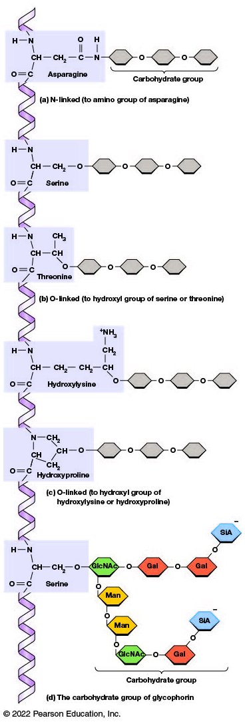
N-Linked and O-Linked Glycosylation of Membrane Proteins
Figure 7.21 N-Linked and O-Linked Glycosylation of Membrane Proteins.
Notes:
Long Description:
The carbohydrate groups are as below:
N-linked (to amino group of asparagine)
The carbohydrate group is linked to asparagine, which is C H single bond C H subscript 2 single bond C single bond N bond with a C double bond O and N single bond H. The C of C H has a N to H bond and a C double bond O bond. The carbohydrate group is linked to N.
O-linked (to hydroxyl group of serine or threonine)
The carbohydrate group is linked to serine, which is C H single bond C H subscript 2 single bond O bond. The C of C H has a N to H bond and a C double bond O bond. The carbohydrate group is linked to O.
The carbohydrate group is linked to threonine, which is C H single bond C H bond. The C of C H has a C double bond O and a N H bond. The C of the other C H is bond to C H subscript 3 and O. The carbohydrate group is linked at O.
O-linked (to hydroxyl group of hydroxylysine or hydroxyproline)
The carbohydrate group is linked to hydroxylysine, which is C H single bond C H subscript 2 single bond C H subscript 2 single bond C H bond. The first C of C H has a N to H bond and a C double bond O bond. The last C of C H is linked to C H subscript 2 single bond N H subscript 3 and O bonds. The carbohydrate group is linked to O.
The carbohydrate group is linked to hydroxyproline, which is a circular bond of C H single bond N single bond C H subscript 2 single bond C H single bond C H single bond 2. The first C of C H has a C double bond O. The C of the other C H is bond to O. The carbohydrate group is linked at O.
The carbohydrate group of glycophorin
The carbonate group consists of Sia negative to O to Gal to O to GlcNAc to O to Man to O to Man to GlcNAc to O to Gal to O to Gal to SiA negative. The carbohydrate chain is connected to serine, which is C H single bond C H subscript 2 single bond O bond. The C of C H has a N to H bond and a C double bond O bond. The carbohydrate group is linked to O.

Slide 112
Roles of Glycoproteins
Glycoproteins are most prominent in plasma membranes, where they play a role in cell-cell recognition.
The carbohydrate groups protrude on the outer surface of the cell membrane.
Lectins are plant proteins that bind specific sugar groups very tightly and can be used to study membrane glycoproteins.

Slide 113
Roles of Glycolipids
Play a role in cell-cell recognition.
The ABO blood group system depends on genetically determined structural differences in the branched carbohydrate attached to a specific glycolipid in red blood cells.

Slide 114
Glycocalyx
In animal cells, the carbohydrate groups of plasma membrane glycoproteins and glycolipids form a surface coat called a glycocalyx.
Functions of the glycocalyx include cell-cell recognition and adhesion, protection of the cell surface, and the creation of permeability barriers.

Slide 115
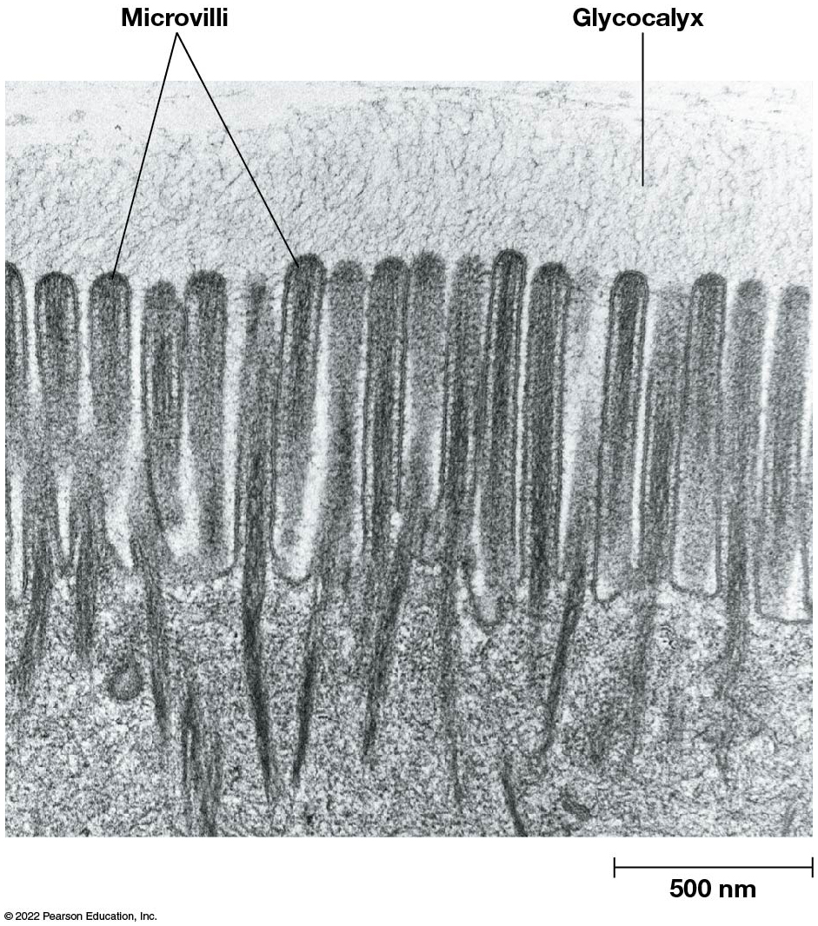
The Glycocalyx of an Intestinal Epithelial Cell
Figure 7.22 The Glycocalyx of an Intestinal Epithelial Cell.
Notes:
Long Description:
The electron micrograph of an intestinal epithelial cell shows finger-like projections called microvilli and the cell surface with glycocalyx. The measurement at the bottom left end reads 500 nanometers.

Slide 116
Membrane Proteins Vary in Their Mobility
Membrane proteins are more variable than lipids in their ability to move freely within the membrane.
Some proteins can move freely, whereas others are constrained because they are anchored to protein complexes.

Slide 117
Experimental Evidence for Protein Mobility
Evidence for mobility of some membrane proteins comes from cell fusion experiments.
These experiments were performed by David Frye and Michael Edidin.

Slide 118
The Frye and Edidin Experiments
Frye and Edidin fused human and mouse cells and used two fluorescent antibodies, each with a differently colored dye linked to it.
The anti-mouse antibodies were linked to fluorescein, a green dye; and the anti-human antibodies were linked to rhodamine, a red dye.
Within a few minutes of fusion, the red and green region proteins began to intermix.

Slide 119
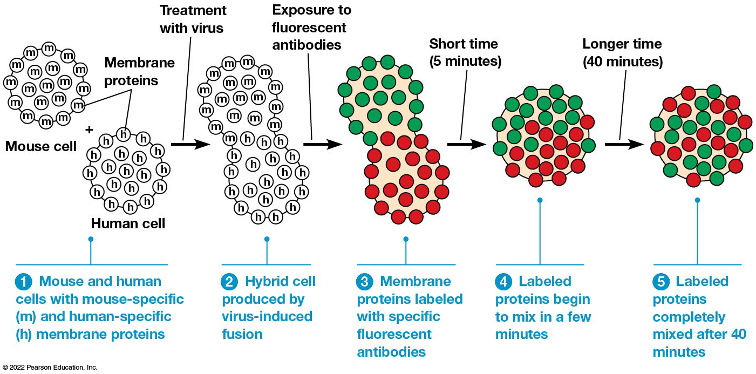
Demonstration of Mobility of Membrane Proteins by Cell Fusion
Figure 7.23 Demonstration of the Mobility of Membrane Proteins by Cell Fusion.
Notes:
Long Description:
The process is explained as below:
Mouse and human cells with mouse-specific (m) membrane proteins and human-specific (h) membrane proteins are added.
On treatment with virus, hybrid cell is produced by virus-induced fusion.
On exposure to fluorescent antibodies, membrane proteins labeled with specific fluorescent antibodies is formed. It shows distinct molecules of mouse cell and human cell on two sides joined at the center.
In a short time of 5 minutes, the labeled proteins begin to mix. The molecules mix together forming a circular chain of molecules.
After a longer time of 40 minutes, labeled proteins completely mix.

Slide 120
Experimental Evidence for Restricted Mobility
Although many types of membrane proteins do move freely through the bilayer, their rates of movement vary.
Fluorescence recovery after photobleaching (F R A P) experiments can be used to determine diffusion rates.
Membrane proteins are much more variable in diffusion rates compared to lipids.

Slide 121
Membrane Domains
Diffusion of many membrane proteins is restricted to a limited area of the membrane.
Some membranes consist of separate membrane domains that differ in protein composition and therefore in function.

Slide 122
Mechanisms for Restricting Protein Mobility
Membrane proteins aggregate within the membrane, forming large, slow-moving complexes.
Membrane proteins also form structures that become barriers to diffusion, creating membrane domains.

Slide 123
Membrane Protein Anchoring
The most common restraint on mobility of membrane proteins is anchoring of such proteins to structures to one side of the membrane or the other.
For example, many proteins of the plasma membrane are anchored either to cytoskeleton or to extracellular structures.

Slide 124
The Erythrocyte Membrane Contains an Interconnected Network of Membrane-Associated Proteins
The plasma membrane of erythrocytes is one of the most widely studied.
An intricate meshwork of peripheral and integral membrane proteins is associated with the inner surface of the plasma membrane.
This meshwork supports the membrane, helps maintain cell shape, and helps the cell withstand stress.

Slide 125
Peripheral Proteins of the Erythrocyte Plasma Membrane
The main peripheral proteins of the erythrocyte plasma membrane are spectrin, ankyrin, and band 4.1 protein.
Spectrin and its associated proteins provide mechanical support to the plasma membrane.
Glyceraldehyde-3-phosphate dehydrogenase (G A P D H) is a peripheral membrane protein with a role in catabolism of blood glucose.

Slide 126
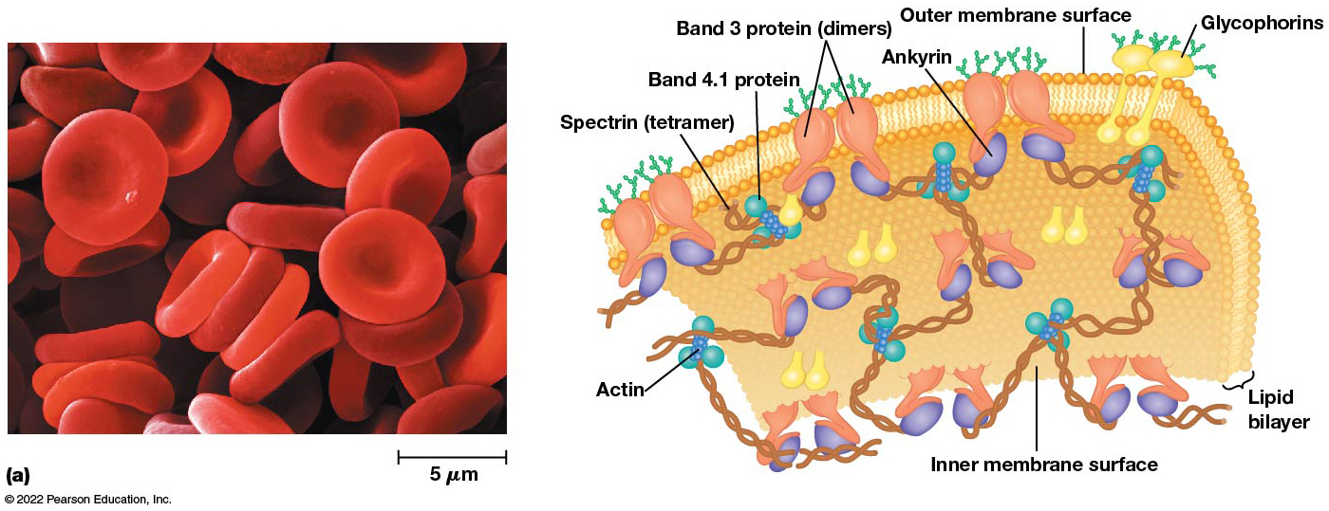
Structural Features of the Erythrocyte Plasma Membrane
Figure 7.24 Structural Features of the Erythrocyte Plasma Membrane.
Notes:
Long Description:
The description is as below:
Human erythrocytes are small red-colored disc-shaped cells. The measurement at the bottom left end reads 5 micrometers.
The parts labeled on the erythrocyte plasma membrane are spectrin or tetramer, band 4.1 protein, band 3 protein or dimers, ankyrin, glycophorins, and actin. The inner surface of the lipid bilayer is the inner membrane surface and the outer layer is the outer membrane surface.

