Slide 1
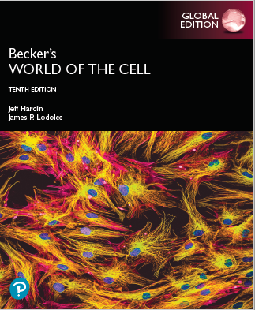
Becker’s World of the Cell
Tenth Edition, Global Edition
Chapter 23
Signal Transduction Mechanisms: II. Messengers and Receptors
Lectures by Anna Hegsted, Simon Fraser University
Copyright © 2022 Pearson Education Ltd. All Rights Reserved.
Notes:
If this PowerPoint presentation contains mathematical equations, you may need to check that your computer has the following installed:
1) MathType Plugin
2) Math Player (free versions available)
3) NVDA Reader (free versions available)

Slide 2
Signal Transduction Mechanisms: II. Messengers and Receptors
An exploration of how cells respond to nonneuronal signals.
Copyright © 2022 Pearson Education Ltd. All Rights Reserved.

Slide 3
23.1 Chemical Signals and Cellular Receptors
Cells produce signals, in some cases by displaying molecules on their surfaces or by releasing a chemical signal.
Multicellular organisms regulate and coordinate the various activities of cells and tissues.
Copyright © 2022 Pearson Education Ltd. All Rights Reserved.

Slide 4
Chemical Signaling Involves Several Key Components
Multicellular organisms can control the activities of specialized cells through release of chemical messengers.
Copyright © 2022 Pearson Education Ltd. All Rights Reserved.

Slide 5
Short- Versus Long-Range Signals
Signaling molecules are often classified based on the distance between the site of production and the target.
Endocrine signals are produced far from the target tissues, which they reach via the circulatory system.
Paracrine signals are diffusible and act over a short range.

Slide 6
Types of Signals
Classification of signaling molecules
Juxtacrine signals require physical contact between sending and receiving cells.
Autocrine signals act on the same cell that produces them.

Slide 7
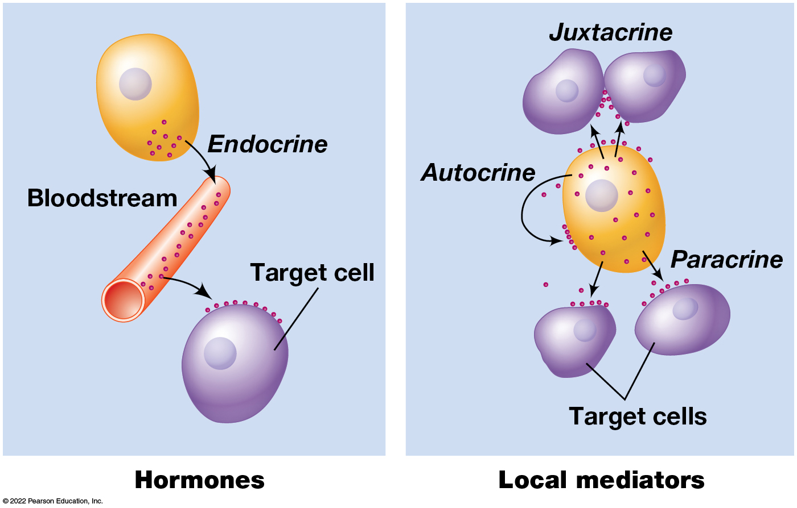
Cell-to-Cell Signaling by Hormones and Local Mediators
Figure 23.1 Cell-to-Cell Signaling by Hormones and Local Mediators.
Notes:
Long Description:
In the case of hormones, endocrine hormones are carried by bloodstream and then transported to the target cell. In local mediators, paracrine signals act on nearby cells, autocrine signals are produced by cells themselves, and juxtacrine signals are carried by cell to cell contact.

Slide 8
Receptors and Ligands
When a messenger reaches its target, it binds to receptors on the surface of the target cell.
A messenger that binds a target receptor is called a ligand; it may bind a receptor on the surface or inside the target cell.
Ligands bind to receptors in a closely fitting binding site (or binding pocket). Where the necessary amino acid side chains in the receptor, are positioned to form chemical bonds with the messenger.

Slide 9
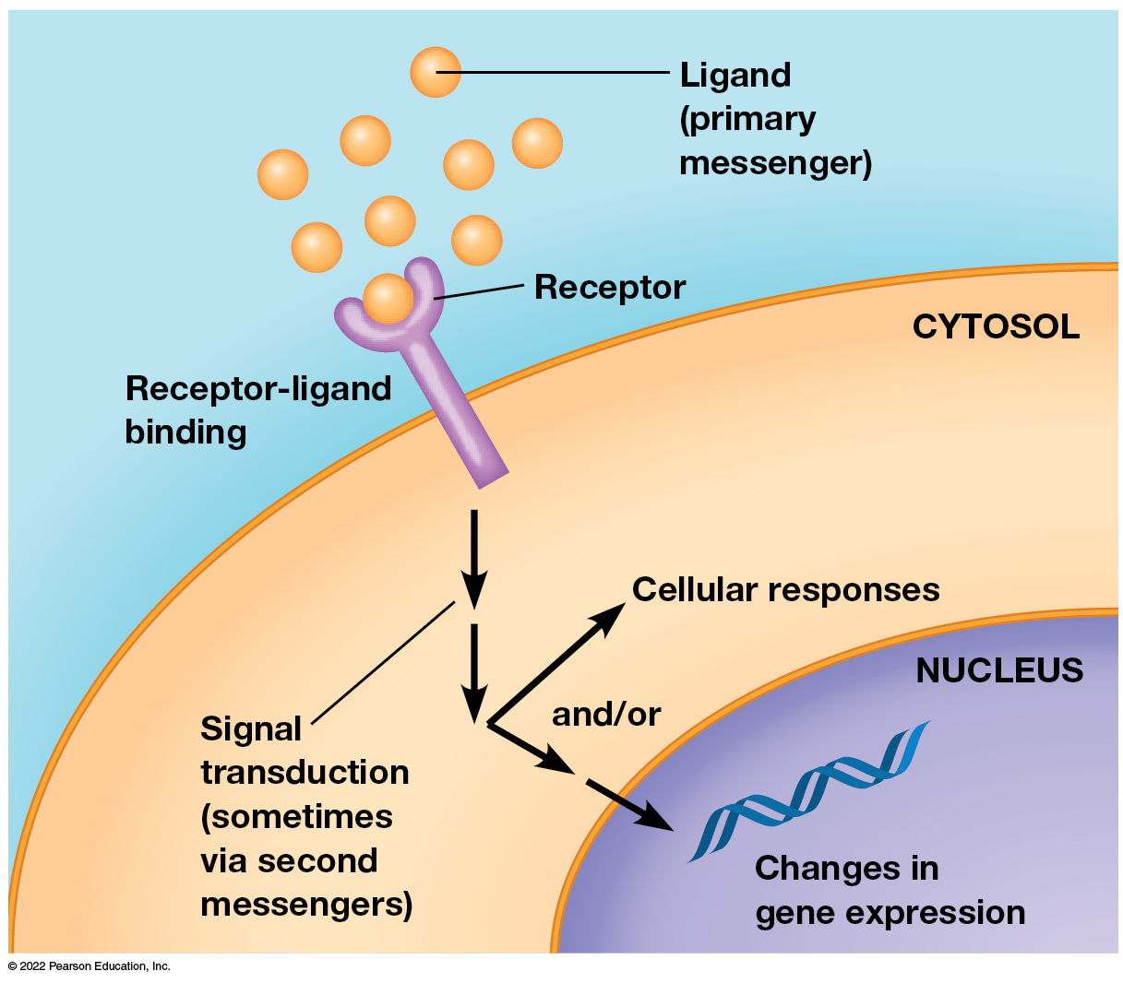
The Overall Flow of Information During Cell Signaling
Figure 23.2 The Overall Flow of Information During Cell Signaling.
Notes:
Long Description:
The ligands are primary messengers found outside the cell. They attach to the receptors on the cell labeled as receptor-ligand binding. Signal transduction, sometimes via second messengers, happens from receptors to the interior of the cell through the cytosol. This results in cellular response in the cytosol and or changes in gene expressions within the nucleus.

Slide 10
Signal Transduction
Ligand binding is a first step in cell-cell signaling, leading to production of additional molecules or ions within the cell.
These are called second messengers.
A cascade of changes may be induced in the receiving cell.
The ability of a cell to respond to ligand-receptor binding by altering its behavior or gene expression is called signal transduction.

Slide 11
Preprogrammed Responses (1 of 2)
Ligand binding alters the receptor in one of two main ways.
It can cause a change in conformation of the receptor or can cause receptors to cluster together or both.
The receptor initiates a preprogrammed sequence of signal transduction events.

Slide 12
Preprogrammed Responses (2 of 2)
“Preprogrammed” means that cells have a repertoire of functions, some of which are unused until a triggering signal is received.
Specific preprogrammed responses of a cell depend on the cell’s past history.

Slide 13
Receptor Binding Involves Quantitative Interactions Between Ligands and Their Receptors
In most cases, the binding of a receptor and ligand resembles the binding of an enzyme and its substrate.
A receptor binds the ligand, the receptor is said to be occupied.
As ligand concentration increases, saturation is reached (meaning most receptors are occupied).

Slide 14
Receptor Affinity
The relationship between the ligand concentration in solution and the number of receptors occupied can be described in terms of receptor affinity.
The dissociation constant, K_{d}, is the concentration of free ligand needed to produce a state in which half the receptors are occupied.
Receptors with high ligand affinity have low K_{d}, and vice versa.

Slide 15
Analysis of Receptor-Ligand Affinity (1 of 4)
Imagine a hormone (H), and receptor (R) interacting at equilibrium, where HR represents hormone bound to receptor.
The equilibrium constant, association constant, or affinity constant, K_{a}, can be described as
Notes:
Long Description:
Concentration of H plus concentration of R gives concentration of H R. The concentration compound or atom is shown by enclosing the chemical formula or symbol for the same in a square bracket. The reaction is reversible and concentration of H R gives concentration of H plus concentration of R.

Slide 16
Analysis of Receptor-Ligand Affinity (2 of 4)
The dissociation constant, K_{d}, is the inverse of K_{a}
The fraction of receptor bound by ligand, the fractional occupancy, is the ratio of ligand bound/total concentration of receptor

Slide 17
Analysis of Receptor-Ligand Affinity (3 of 4)
When ligand concentration ([H]) is zero, the fractional occupancy is 0.
When ligand concentration is many times K_{d}, fractional occupancy approaches 1.

Slide 18
Analysis of Receptor-Ligand Affinity (4 of 4)
When the receptor is half saturated with hormone, that hormone concentration ([H]_{1/2}) is equal to K_{d}
Thus, K_{d} provides a measure of affinity of a receptor and for its ligand.
Notes:
Long description:
One divided by 2 equals to the concentration of H subscript 1 divided by 2 divided by open bracket K subscript d plus the concentration of H subscript 1 divided by 2 bracket closed.
The equation is further simplified as open bracket K subscript d plus the concentration of H subscript 1 divided by 2 bracket closed equals to 2 times concentration of H subscript 1 divided by 2. This further equals to K subscript d equals to the concentration of H. The concentration compound or atom is shown by enclosing the chemical formula or symbol for the same in a square bracket.

Slide 19
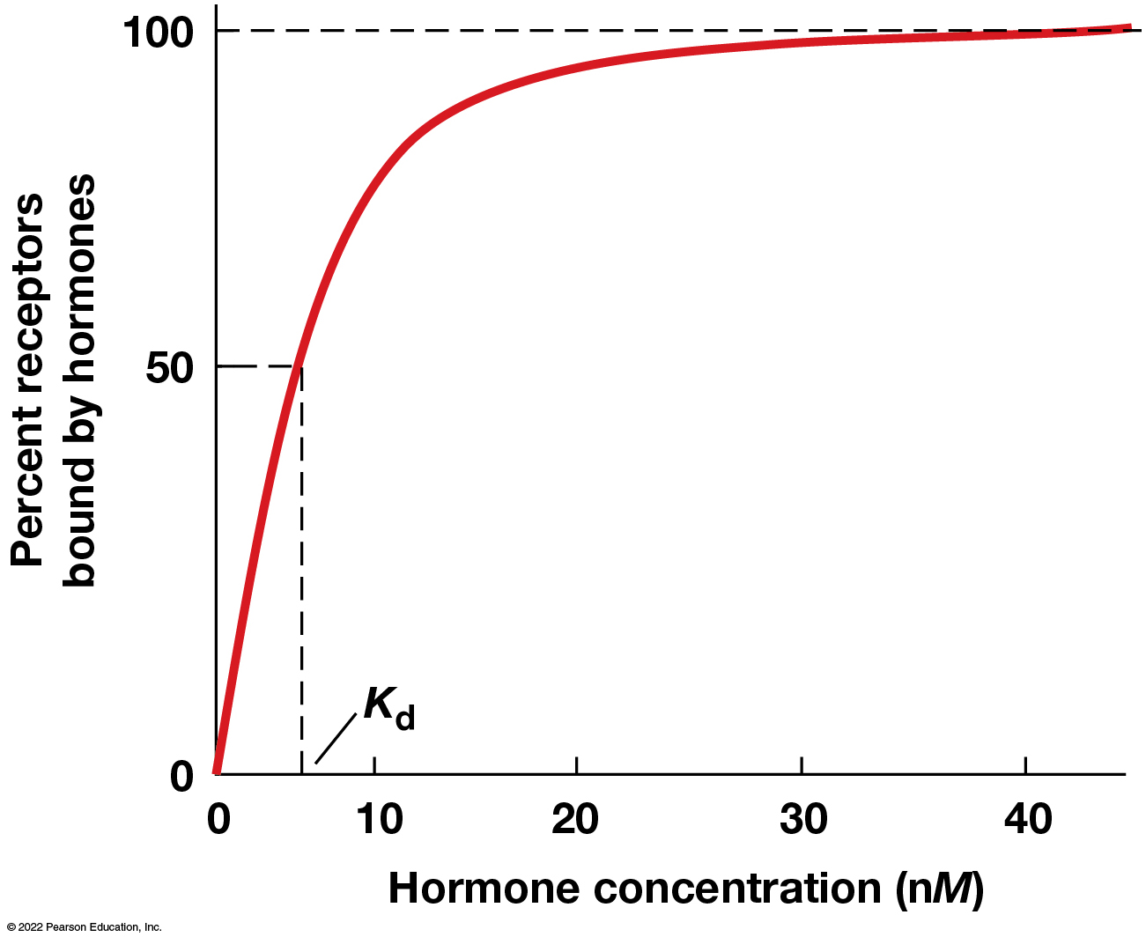
Concentration Dependence of Ligand Binding for a Simple Receptor-Ligand System
Figure 23.3 Concentration Dependence of Ligand Binding for a Simple Receptor-Ligand System.
Notes:
Long Description:
The approximate data points are as follows: (5, 50); (20, 98); (30, 99.5); and (40, 100). The line is a constant beyond 40 n M hormone concentration. The point at (5, 50) is marked as K sub d.

Slide 20
Reciprocal Plots
Like in enzyme kinetics, reciprocal plots can be used to estimate K_{d}. (Scatchard equation)
Measuring real-world K_{d} values is technically challenging and often done indirectly.
The importance of the K_{d} value is predicting the concentration a particular ligand will be effective in producing cellular response.

Slide 21
Agonists and Antagonists
It is possible to make synthetic ligands that bind even more tightly or selectively than the real ligand.
Agonists: drugs that activate the receptor they are bound to.
Antagonists: bind receptors without triggering a change and prevent the naturally occurring messenger from activating the receptor.

Slide 22
Turning Receptors “Off” (1 of 2)
Cells can shut down signaling in two common ways:
By reducing the amount of free ligand and thus the amount of signal
By reducing the sensitivity of the receptor or amount of receptor
Cells are geared to sense changes in ligand concentration.

Slide 23
Turning Receptors “Off” (2 of 2)
When receptors are occupied for long periods, the cell adapts, no longer responding to the ligand.
This is called receptor desensitization.
Cells can change the density of receptors, removing them via receptor-mediated endocytosis.
Biochemical changes can also reduce the receptor’s affinity for ligand.
The addition or removal of phosphate groups to amino acids is a way to accomplish this.

Slide 24
Coreceptors
Coreceptors on the cell surface help facilitate the interaction of the receptor with its ligand.
A well-studied class of these is heparan sulfate proteoglycans, including glypicans and syndecans.

Slide 25
Cells Can Amplify Signals Once They Are Received
Very small quantities of ligand are often sufficient to elicit a response from a target cell.
At each step in the resulting cascade of events, a signaling intermediate stimulates the production of many molecules needed for the next step.
This multiplication of the effect of the signal is called signal amplification.

Slide 26
Example of Signal Amplification
Glycogen in liver cells is broken down in response to the hormone epinephrine.
A single epinephrine ligand can stimulate the release of hundreds of millions of glucose molecules from glycogen.

Slide 27
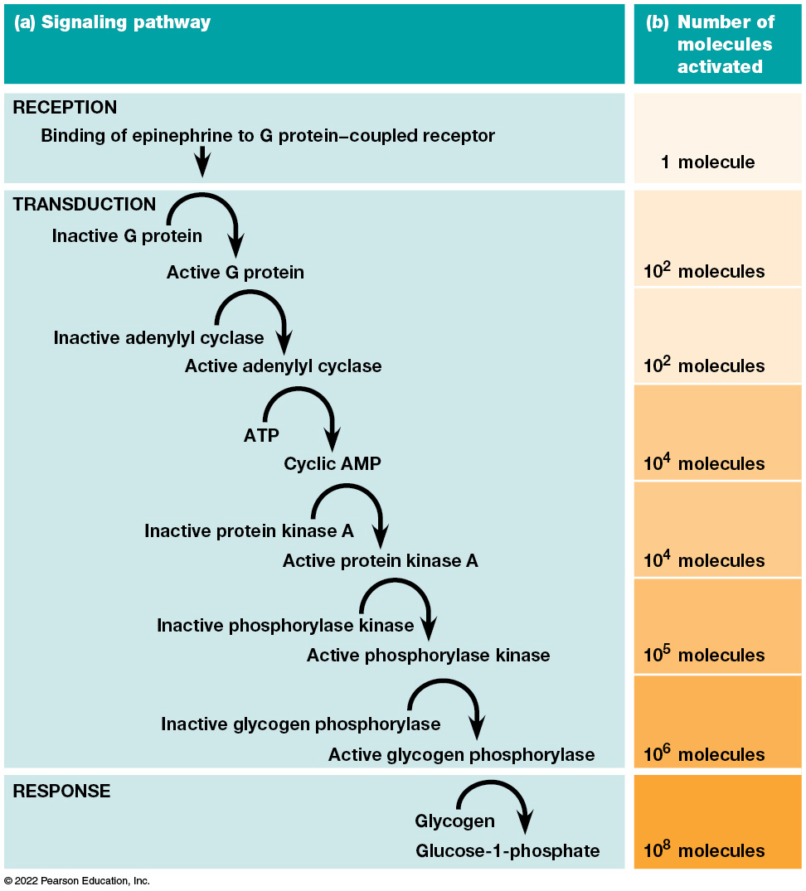
Signal Transduction Pathways Can Amplify the Cellular Response to an External Signal
Figure 23.4 Signal Transduction Pathways Can Amplify the Cellular Response to an External Signal.
Notes:
Long Description:
The data on signaling pathway and the number of molecules activated are as below:
Reception: Binding of epinephrine to G protein−coupled receptor: 1 molecule.
Transduction: The flow is as below:
Inactive G protein to active G protein. 10 power 2 molecules.
Inactive adenylyl cyclase to active adenylyl cyclase. 10 power 2 molecules.
ATP to cyclic AMP. 10 power 4 molecules.
Inactive protein kinase A to active protein kinase A. 10 power 4 molecules.
Inactive phosphorylase kinase to active phosphorylase kinase. 10 power 5 molecules.
Inactive glycogen phosphorylase to active glycogen phosphorylase. 10 power 6 molecules.
Response: Glycogen to Glucose-1-phosphate. 10 power 8 molecules.

Slide 28
Cell-Cell Signals Act Through a Limited Number of Receptors and Signal Transduction Pathways
Cells use a limited number of basic signaling pathways.
Many ligands are hydrophilic compounds, which include proteins, small peptides, amino acids and their derivatives, and nucleotides or nucleosides. They bind to transmembrane receptor proteins.
Hydrophobic ligands act on receptors in the cytosol. They can move into the nucleus to regulate transcription.

Slide 29
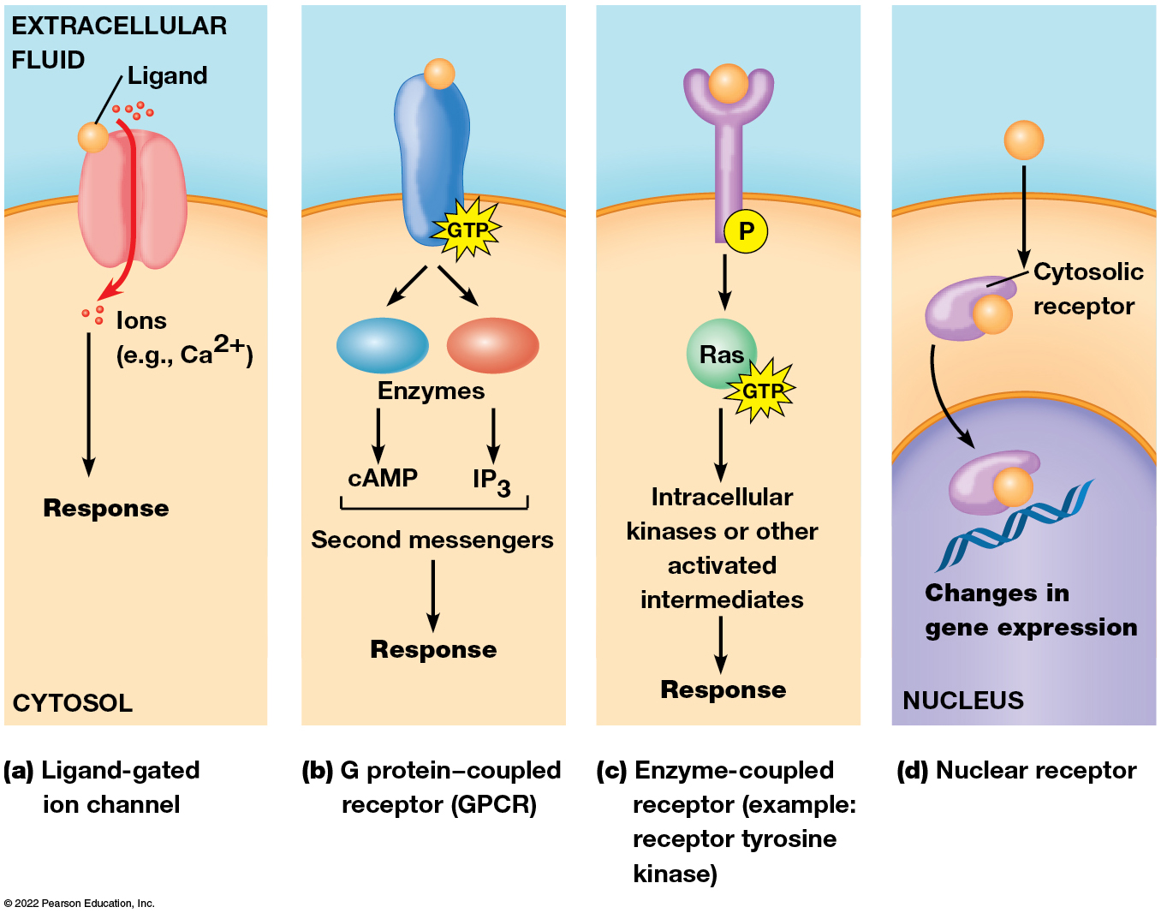
Some Basic Types of Signaling Pathways
Figure 23.5 Some Basic Types of Signaling Pathways
Notes:
Long Description:
The details are as below:
Ligand-gated ion channel:
Ligands that are spherical attach to the channel. Ions pass through the channel like calcium 2 plus from the extracellular fluid to the cytosol.
G protein−coupled receptor (GPCR):
GPCR, on GTP, splits into cAMP and IP3 as second messengers, which is the response.
Enzyme-coupled receptor (Example: receptor tyrosine kinase):
Ligand attached to the receptor. P to Ras with GTP as a sub-process. Ras to intracellular kinases or other activated intermediates. Finally, it leads to response.
Nuclear receptor:
Ligands attach to cytosolic receptor within the cytosol, leading into the nucleus and causes changes in gene expression.

Slide 30
Signaling Pathways
Hydrophilic ligands bind transmembrane receptors.
An example is ligand-gated ion channels.
A system that relies on hydrolysis of GTP involves G protein−coupled receptors.
Another involves receptors that activate cytosolic enzymes, often protein kinases.

Slide 31
Hydrophobic Ligands
Hydrophobic ligands bind receptors in the cytosol.
A receptor bound to a ligand enters the nucleus to regulate transcription of specific genes.
Among the messengers are steroid hormones and retinoids.

Slide 32
23.2 G Protein−Coupled Receptors
The G protein–coupled receptors (GPCRs) are so named because ligand binding causes a change in receptor conformation that activates a particular G protein.
G protein: guanine-nucleotide binding protein.

Slide 33
G Protein-Coupled Receptors Act Via Hydrolysis of GTP
A portion of an activated G protein binds a target protein (like an enzyme or channel protein), altering its activity.
Examples include olfactory receptors, β-adrenergic receptors, and hormone receptors.
A class of receptors of great clinical importance is the opioid receptors, to which narcotic drugs such as morphine bind.

Slide 34
The Structure and Regulation of GPCRs (1 of 3)
G protein−coupled receptors all have a similar structure but quite different amino acid sequences.
The receptor forms seven transmembrane α helices connected by alternating cytosolic or extracellular loops.
The extracellular portion of each receptor has a unique messenger-binding site, and the cytosolic portion allows the receptor to interact with only certain types of G proteins.

Slide 35
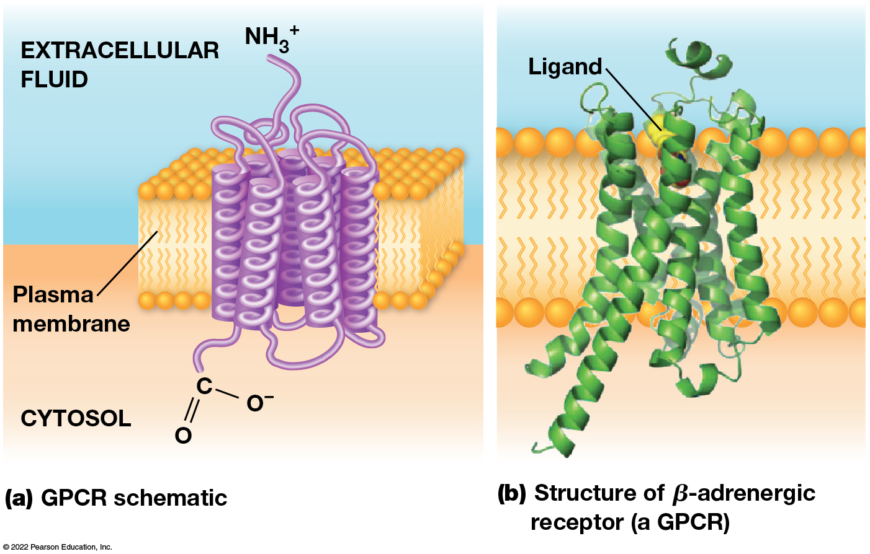
The Structure of G Protein–Coupled Receptors (GPCRs).
Figure 23.6 The Structure of G Protein–Coupled Receptors (GPCRs).
Notes:
Long Description:
Schematic diagram:
One part of the alpha helices on the plasma membrane lies in the extracellular fluid with NH3 plus ends. The other half of the helices lies in the cytosol with C double bond O, single bond O.
Structure of beta-adrenergic receptor:
The model shows ligand binding to the receptors on the plasma membrane.

Slide 36
The Structure and Regulation of GPCRs (2 of 3)
G protein−coupled receptors can be regulated in several ways.
One is via phosphorylation of amino acids in the cytosolic domain, carried out by G protein−coupled receptor kinases (GRKs), which act on activated receptors.
β-arrestin binds phosphorylated β-adrenergic receptors and inhibits them.

Slide 37
The Structure and Regulation of GPCRs (3 of 3)
Protein kinase A is activated by G protein−mediated signaling.
Protein kinase A can phosphorylate other amino acids on the receptor and inhibit it.
This is a good example of negative feedback during cell signaling.

Slide 38
The Structure, Activation, and Inactivation of G Proteins
G proteins act like molecular switches: “on” and “off” states depend on whether they are bound to guanosine triphosphate (GTP) or guanosine diphosphate (GDP).
There are large heterotrimeric G proteins and small monomeric G proteins.
The heterotrimeric G proteins mediate signal transduction through G protein−coupled receptors and have G_{α}, G_{β}, and G_{γ} subunits.

Slide 39
G Protein Structure and Mode of Activation: Steps 1 and 2
G_{α} is the largest subunit of G_{αβγ} and binds to a guanine nucleotide (GDP or GTP). When G_{α} binds to GTP, it detaches from the G_{βγ} subunits (which are permanently bound together).
G_{s} are stimulators of signal transduction, G_{i} are inhibitors of signal transduction.
When a messenger binds to a GPCR on the cell surface, the receptor changes conformation, this causes the G_{βγ} subunits to associate with the receptor, and this causes G_{α} to release GDP.

Slide 40
G Protein Structure and Mode of Activation: Steps 3 and 4
The G_{α} acquires a new molecule of GTP and detaches from the complex.
Depending on the G protein and cell type free GTP-G_{α} and/or G_{βγ} complex can initiate signal transduction events.
Each portion of the G protein exerts its effect by binding to a particular enzyme or protein in the cell.
This persists if G_{α} is bound to GTP and G_{α} and G_{βγ} are separate.

Slide 41
G Protein Structure and Mode of Activation: Steps 5 and 6
Because the G_{α} subunit catalyzes GTP hydrolysis, it remains active only until it hydrolyzes its associated GTP.
Then G_{α} reassociates with G_{βγ}. Allowing the signal transduction pathway to shut down once the messenger is no longer present.

Slide 42
Regulation of G Proteins
G protein activity (for GTP hydrolysis) is greatly enhanced by regulators of G protein signaling (RGS) proteins.
These GTPase activating proteins (GAPs) are important regulators of G protein function.
The most important G protein function is release or formation of second messengers.

Slide 43
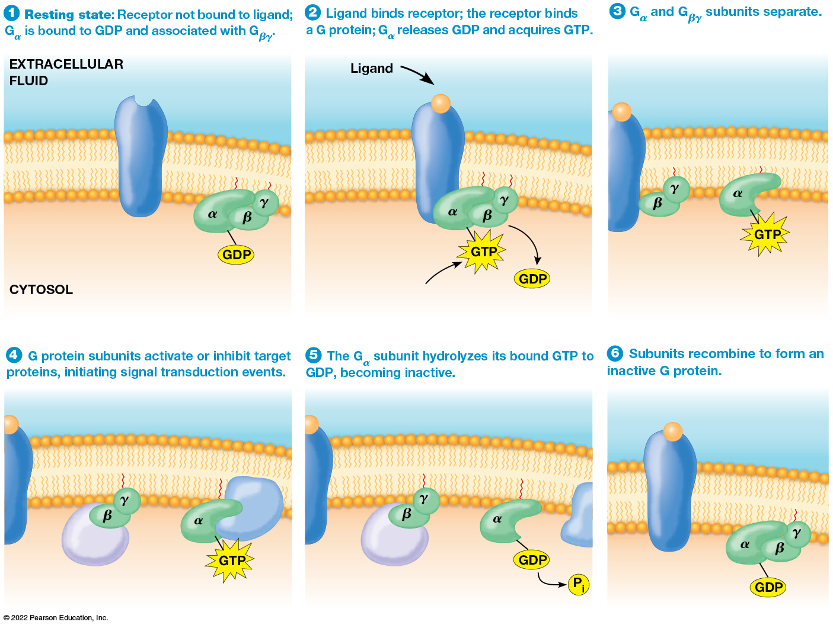
The G Protein Activation/Inactivation Cycle
Figure 23.7 The G Protein Activation/Inactivation Cycle.
Notes:
Long Description:
The steps are as below:
Resting state: Receptor not bound to ligand; G alpha is bound to GDP and associated with G beta gamma on the cytosol side of the plasma membrane.
Ligand binds receptor; the receptor binds a G protein; G alpha releases GDP and acquires GTP.
G alpha and G beta gamma subunits separate.
G protein subunits activate or inhibit target proteins, initiating signal transduction events.
The G alpha subunit hydrolyzes its bound GTP to GDP, becoming inactive.
Subunits recombine to form an inactive G protein.

Slide 44
α and βγ Subunits and Signaling
The α subunits of activated G proteins can interact with proteins such as adenylyl cyclase and phospholipase C.
G protein receptor kinases can be activated by the βγ subunit of a dissociated G protein.

Slide 45
Example of Signaling by βγ Subunits
When acetylcholine binds the muscarinic acetylcholine receptor, the βγ subunit of the G protein causes potassium channels in the membrane to open.
The channels close again when acetylcholine is no longer present.

Slide 46
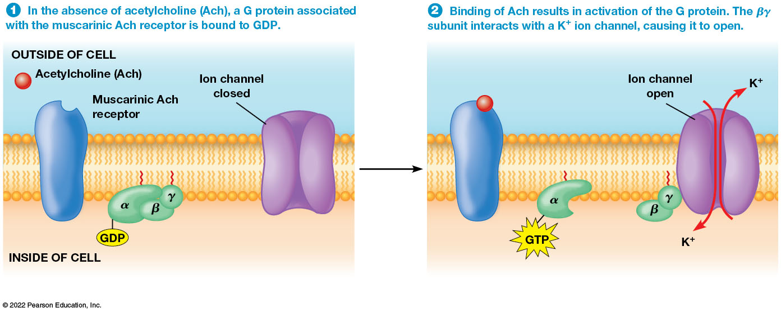
The G_{βγ} Subunits of G Protein Can Engage in Signaling
Figure 23.8 The G_{βγ} Subunits of G Protein Can Engage in Signaling.
Notes:
Long Description:
The steps are as below:
In the absence of acetylcholine (Ach), a G protein associated with the muscarinic Ach receptor is bound to GDP.
Binding of Ach results in activation of the G protein. The beta gamma subunit interacts with a K plus ion channel, causing it to open.

Slide 47
Cyclic AMP Is a Second Messenger Whose Production Is Regulated by Some G Proteins (1 of 2)
There are many GPCRs, thus there are many G protein-mediated signal transduction events.
The most important and widespread G protein–mediated signaling events involve the release or formation of second messengers.
Two common second messengers are cyclic AMP and calcium ions.

Slide 48
Cyclic AMP Is a Second Messenger Whose Production Is Regulated by Some G Proteins (2 of 2)
Cyclic AMP (cAMP) is a second messenger formed from cytosolic ATP by adenylyl cyclase.
The enzyme is inactive until bound to activated G_{sα} (by receptor-ligand-stimulated acquisition of GTP and release from G_{sβγ}).
GTP-G_{sα} activates adenylyl cyclase.

Slide 49
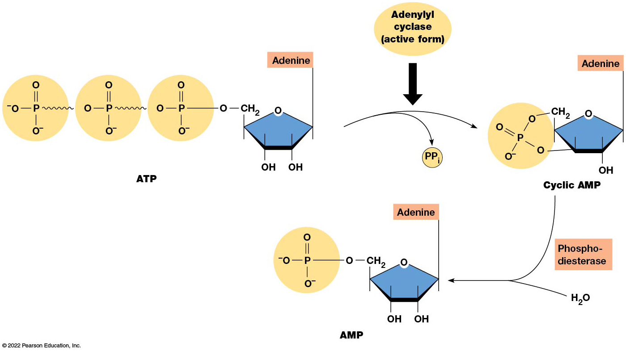
The Structure and Metabolism of cAMP
Figure 23.9 The Structure and Metabolism of cAMP.
Notes:
Long Description:
The steps are as below:
ATP is 3 molecules of P double bond O and 2 single bond O negative with O, C H 2, O, 2 O H molecules, and adenine.
Adenylyl cyclase, which is the active form occurs and causes release of P P inorganic.
It results in P double bond O and 3 single bond O negative with a O to C H 2 and O to O H bond. This is attached to adenine.
This causes hydrolysis of c AMP in cyclic AMP reactions and release of AMP and phosphodiesterase.

Slide 50
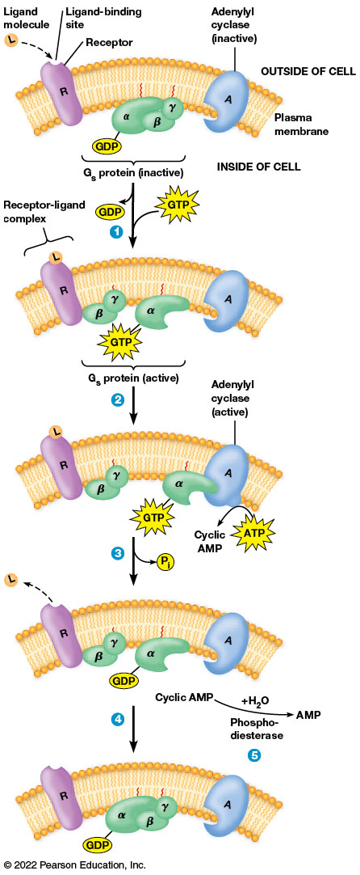
The Roles of G Proteins and Cyclic AMP in Signal Transduction
Figure 23.10 The Roles of G Proteins and Cyclic AMP in Signal Transduction.
Notes:
Long Description:
The steps are as below:
The ligand molecules bind to the receptor on the plasma membrane on the receptor binding site. The G sub s protein in inactive state includes GDP alpha, beta, and gamma molecules. The adenylyl cyclase in inactive form is on the plasma membrane. The dissociation of the G sub s alpha - GTP complex occurs.
The GTP-G s alpha complex binds to adenylyl cyclase in active state. This synthesizes cyclic AMP.
The ligand leaves the receptor; GDP is formed with the alpha part of the protein.
The G s alpha reassociates with the G s beta gamma complex.
Cyclic AMP in the cytosol are hydrolysed to AMP by the phosphodiesterase.

Slide 51
G Proteins Are Active Only a Short time
Because G proteins remain active for a very short time, they can respond quickly to changing conditions.
Once a G_{sα} protein becomes inactive, adenylyl cyclase stops making cAMP.
The cAMP that remains is degraded by phosphodiesterase.

Slide 52
cAMP Function
cAMP is important in many cellular events.
Its main target is protein kinase A (PKA), which it regulates by separating the regulatory and catalytic subunits.
PKA phosphorylates a variety of proteins on serine or threonine residues, using ATP as the source of phosphate.
Increase in cAMP concentration has different affects in different cells.

Slide 53
Examples of Cell Functions Regulated by cAMP
Table 23.1 Examples of Cell Functions Regulated by cAMP
Regulated Function | Target Tissues | Hormone
Glycogen degradation | Muscle, liver | Epinephrine
Fatty acid production | Adipose | Epinephrine
Heart rate, blood pressure | Cardiovascular | Epinephrine
Water reabsorption | Kidney | Antidiuretic hormone
Bone resorption | Bone | Parathyroid hormone

Slide 54
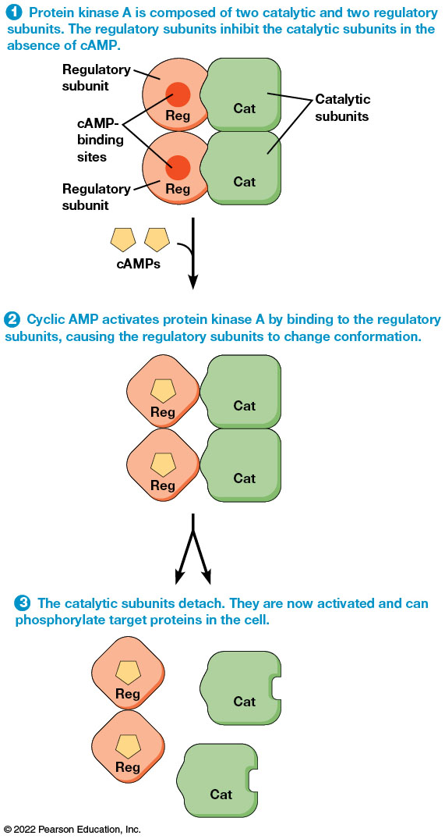
The Activation of Protein Kinase A by Cyclic AMP
Figure 23.11 The Activation of Protein Kinase A by Cyclic AMP.
Notes:
Long Description:
The steps are as below:
Protein kinase A is composed of two catalytic and two regulatory subunits. The regulatory subunits inhibit the catalytic subunits in the absence of cAMP. The parts labeled are regulatory subunits and the cAMP binding sites at the center. They are attached to the catalytic subunits.
Cyclic AMP activates protein kinase A by binding to the regulatory subunits, causing the regulatory subunits to change conformation.
The catalytic subunits detach. They are now activated and can phosphorylate target proteins in the cell.

Slide 55
Disruption of G Protein Signaling Causes Human Disease (1 of 2)
Vibrio cholerae causes cholera through secretion of cholera toxin.
This toxin modifies G_{s} so that it cannot hydrolyze GTP.
This alters secretion of salts and fluids in the intestine through the cystic fibrosis chloride transporter (CFTR) and can cause death by dehydration.

Slide 56
Disruption of G Protein Signaling Causes Human Disease (2 of 2)
Whooping cough: Bordetella pertussis secretes pertussis toxin that acts on G_{i}, so that it can no longer inhibit adenylyl cyclase.
This causes an accumulation of fluid in the lungs and the persistent cough associated with the disease.

Slide 57
Many G Proteins Act Through Inositol Trisphosphate and Diacylglycerol
Inositol-1,4,5-trisphosphate (IP₃) functions as a second messenger.
It is generated from PIP₂ (phosphatidylinositol-4, 5-bisphosphate) when the enzyme phospholipase C is activated.
It cleaves PIP₂ into IP₃ (inositol triphosphate) and diacylglycerol (DAG).

Slide 58
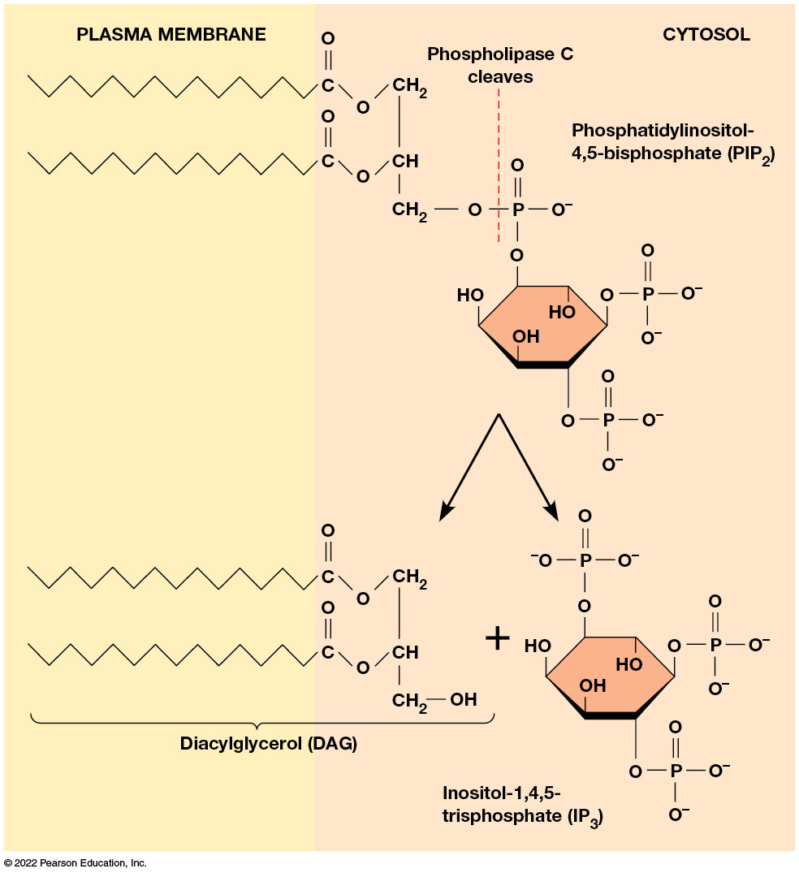
The Formation of Inositol Trisphosphate and Diacylglycerol
Figure 23.12 The Formation of Inositol Trisphosphate and Diacylglycerol.
Notes:
Long Description:
Phospholipase C cleaves phosphatidylinositol-4,5-bisphosphate. In the resultant, the product diacylglycerol or D A G remains on the plasma membrane and inositol-1,4,5-trisphosphate or I P 3 is released into the cytosol.

Slide 59
Examples of Cell Functions Regulated by Inositol Trisphosphate Diacylglycerol
Table 23.2 Examples of Cell Functions Regulated by Inositol Trisphosphate and Diacylglycerol
Regulated Function | Target Tissues | Messenger
Platelet activation | Blood platelets | Thrombin
Muscle contraction | Smooth muscle | Acetylcholine
Insulin secretion | Pancreas, endocrine | Acetylcholine
Amylase secretion | Pancreas, exocrine | Acetylcholine
Glycogen degradation | Liver | Antidiuretic hormone
Antibody production | B lymphocytes | Foreign antigens

Slide 60
IP₃ and Diacylglycerol in Signaling (1 of 2)
A ligand binds its membrane receptor, leading to activation of a G protein, G_{q}.
G_{q} activates a phospholipase C called C_{β}, generating both IP₃ and diacylglycerol.
IP₃ diffuses through the cytosol and binds a ligand-gated calcium channel, the IP₃ receptor channel.

Slide 61
IP₃ and Diacylglycerol in Signaling (2 of 2)
When IP₃ binds the receptor, calcium is released into the cytosol, which elicits the response.
Calcium and diacylglycerol (DAG) activate members of the protein kinase C (PKC) family, which then phosphorylate serine and threonine residues on a variety of target proteins.
Cellular effects include stimulating cell growth, regulation of ion channels, changes in the cytoskeleton, increases in cellular pH, and effects on secretion of proteins and other substances.

Slide 62
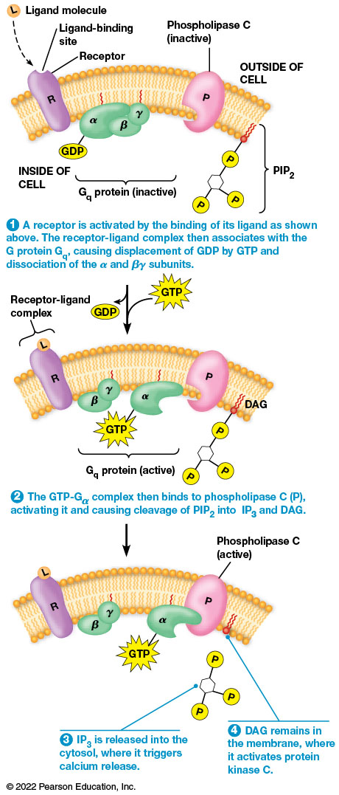
The Role of IP₃ and DAG on Signal Transduction
Figure 23.13 The Role of IP₃ and DAG on Signal Transduction.
Notes:
Long Description:
The sequence of events is as follows:
A receptor is activated by the binding of its ligand as shown above. The receptor-ligand complex then associates with the G protein G sub q, causing displacement of GDP by GTP and dissociation of the alpha and beta gamma subunits.
The parts labeled are ligand molecule, ligand-binding site, and receptor R on the plasma membrane, phospholipase C in inactive state, P I P 2 within the cell, G sub q protein in inactive state comprising of GDP alpha, beta, and gamma.
The GTP-Ga complex then binds to phospholipase C (P), activating it and causing cleavage of P I P sub 2 into I P sub 3 and D A G. The parts labeled are receptor-ligand complex, G sub q protein in active state comprising of GDP and alpha G T P, P, and D A G in the cell.
IP sub 3 is released into the cytosol, where it triggers calcium release.
D A G remains in the membrane, where it activates protein kinase C.

Slide 63
The Release of Calcium Ions Is a Key Event in Many Signaling Processes
Ca²⁺ plays an essential role in regulating a variety of cellular functions.
Calcium concentrations are maintained at low levels through calcium ATPases in the plasma membrane and ER.
These transport calcium ions out of the cytosol leaving the cytosolic calcium concentration at 0.1 μM.

Slide 64
Calcium ATPases (Pumps)
Calcium ATPases in the plasma membrane transport calcium out of the cell.
In the ER, they sequester calcium in the lumen of the ER.
Some cells have sodium-calcium exchangers to further reduce cytosolic calcium concentration.
Mitochondria transport calcium into the mitochondrial matrix.

Slide 65
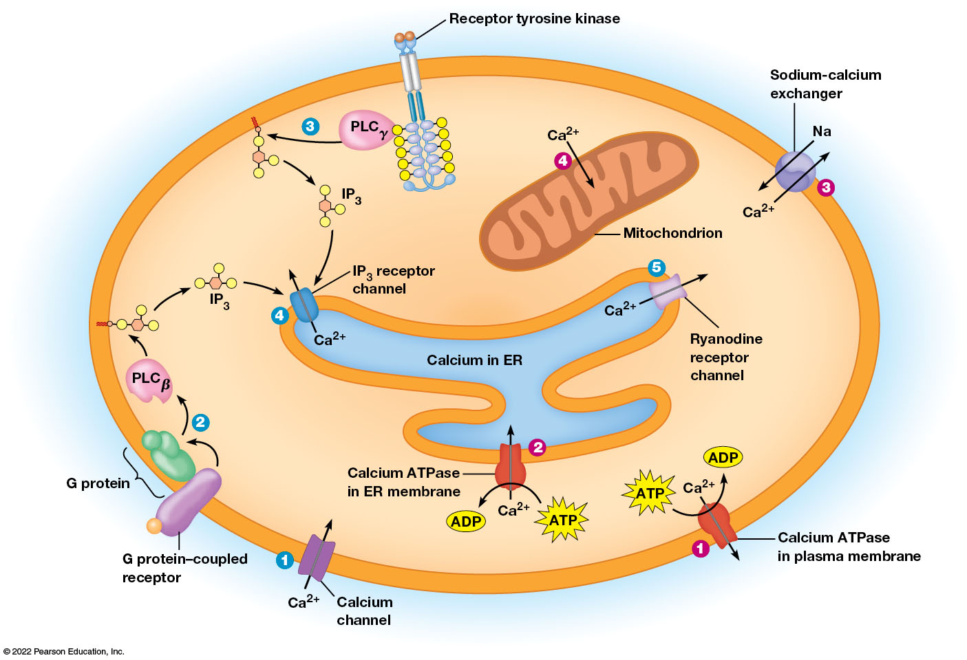
An Overview of Calcium Regulation in Cells
Figure 23.14 An Overview of Calcium Regulation in Cells.
Notes:
Long Description:
The steps are as below:
Increased calcium concentration in the cytosol:
Calcium 2 plus enters the cytosol through the calcium channel.
G-protein coupled receptor to P L C sub beta to I P 3.
Receptor tyrosine kinase to P L C sub gamma to I P 3.
I P 3 into the E R channel through the I P 3 receptor channel and C a 2 plus from the E R into the cytosol through the same receptor channel.
C a 2 plus from the E R into the cytosol through the ryanodine receptor channel.
Decreased calcium concentration:
C a 2 plus from the cytosol to outside through the calcium ATPase in plasma membrane. ATP to ADP occurs.
C a 2 plus from the cytosol into the ER through the calcium ATPase in ER membrane.
C a 2 plus from the cytosol to the exterior and sodium from the exterior into the cytosol through the sodium-calcium exchanger.
C a 2 plus from the cytosol into the mitochondrion.

Slide 66
Calcium in Signaling via Increasing Cytosolic Calcium Concentration
Calcium concentrations can be released by opening calcium channels in the plasma membrane, as in neuronal signaling.
Signaling via GPCRs and other receptors activates different isoforms of phospholipase C.
Calcium can also be released from storage in the ER through the IP₃ receptor channel and through the ryanodine receptor channel.

Slide 67
Calcium in Signaling: IP₃ and Ryanodine Receptor Channels
The IP₃ receptor channel and the ryanodine receptor channels are sensitive to calcium.
A rapid increase in calcium ions can cause the ryanodine receptor channels to open, allowing calcium to enter the cytoplasm from the ER.
This is termed calcium-induced calcium release.

Slide 68
Measuring and Manipulating Calcium Levels
Calcium-sensitive fluorescent dyes (calcium indicators) can be used to demonstrate the importance of calcium release in signaling.
Treating cells with calcium ionophores results in the release of calcium in the absence of a stimulus and further implicates calcium as an intermediary in IP₃ signaling.

Slide 69
Calcium Release Following Fertilization of Animal Eggs
Animal sperm are activated by release of calcium.
Activated sperm then bind to the surfaces of mature eggs and unite with them, triggering the release of Ca²⁺ from internal stores.
Ca²⁺ release begins at the site of sperm entry then spreads across the egg surface like a wave.

Slide 70
Roles of Calcium in Fertilization
Calcium release is necessary for two crucial events:
It stimulates vesicles called cortical granules to release their contents and alter the properties of the vitelline envelope (slow block to polyspermy).
It induces egg activation, the resumption of metabolic processes and reorganization of egg contents necessary for embryonic development to proceed.

Slide 71
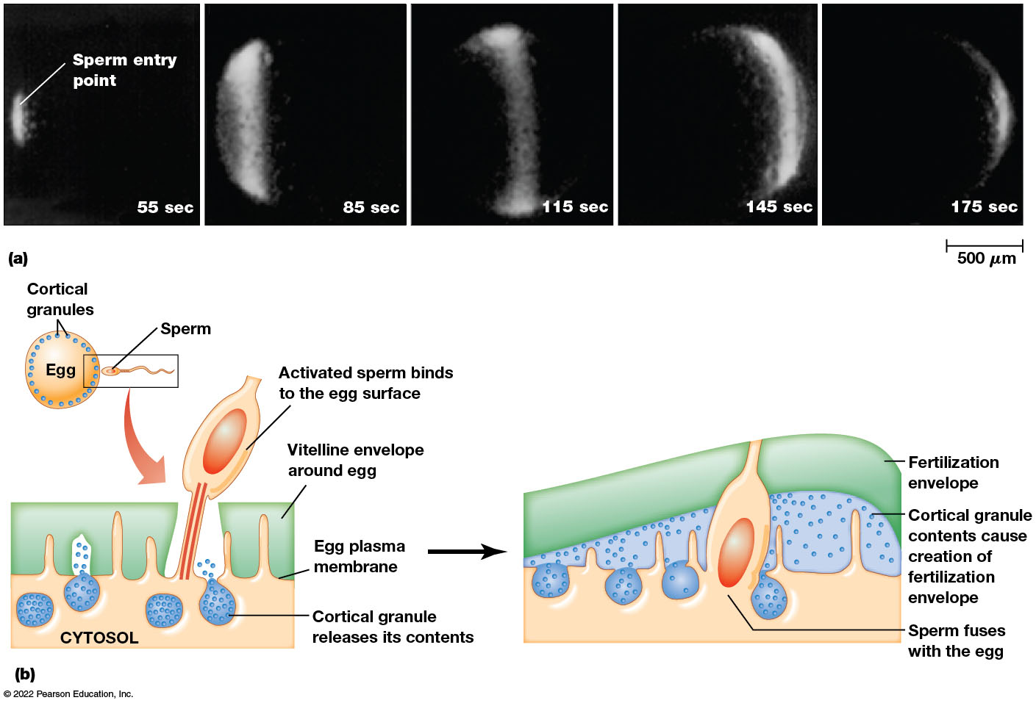
Transient Increase in Free Ca²⁺ Concentration That Occurs in Egg Cell Immediately After Fertilization
Figure 23.15 Transient Increase in Free Ca²⁺ Concentration That Occurs in Egg Cell Immediately After Fertilization.
Notes:
Long Description:
The events and the timings as recorded in the micrographs are as below:
Sperm entry point at 55 seconds at one end of the egg. The injected aequorin emits little light indicating lesser C a 2 plus.
AT 85 seconds, the C a 2 plus concentration is much higher as indicated by more light emitted by aequorin.
At 115 seconds, the light and therefore the C a 2 plus concentration moves toward the center of the egg.
At 145 seconds, the light and the C a 2 plus concentration move toward the opposite end of the egg. The concentration is much lesser.
At 175 seconds, the light and the C a 2 plus concentration are very feeble.
The illustration shows the following steps.
Sperm entering the egg that is lined with cortical granules.
Activated sperm binds to the egg surface.
Vitelline envelope around the egg is formed.
Egg plasma membrane.
Cortical granules release from the cytosol its contents.
In the second stage, the below parts are labeled.
Sperm fuses with the egg.
Cortical granule contents cause creation of fertilization envelope.
Fertilization envelope.

Slide 72
Calcium Binding Activates Many Effector Proteins
Calcium can bind directly to effector proteins, altering their activity.
The protein calmodulin mediates calcium-activated processes in the cell.
Calmodulin has a structure like an arm with a hand at each end; each binds two Ca²⁺.

Slide 73
Calmodulin Function
Two Ca²⁺ bind at each “hand” of calmodulin, inducing a conformation change and forming the active calcium-calmodulin complex.
In the presence of a protein with a calmodulin-binding site, calmodulin binds it by wrapping around the binding site.
Calmodulin binding can dramatically alter the protein’s activity.

Slide 74
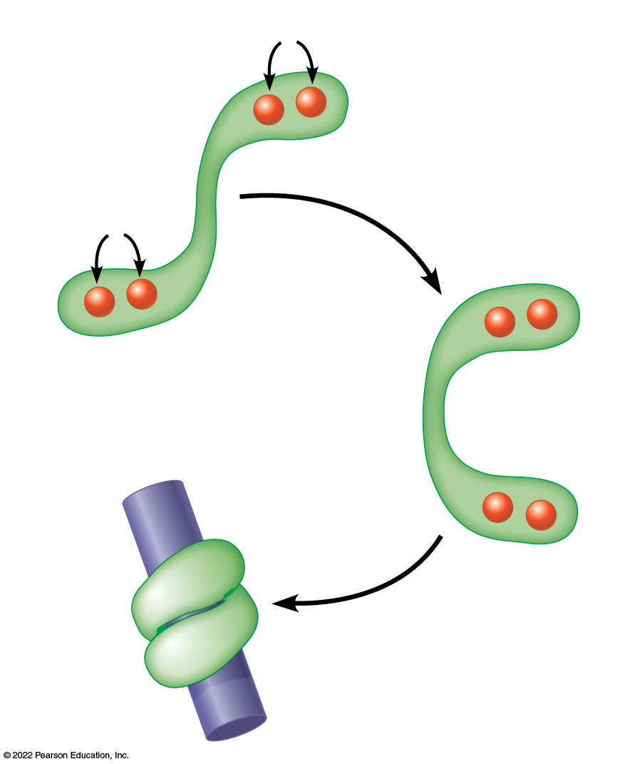
The Structure and Function of the Calcium-Calmodulin Complex
Figure 23.16 The Structure and Function of the Calcium-Calmodulin Complex.
Notes:
Long Description:
The steps are as below:
Calmodulin binds four calcium ions.
Calmodulin changes conformation, resulting in an active complex.
The two globular “hands” of the complex wrap around a binding site on a target protein. The target protein and calmodulin-binding site are labeled.

Slide 75
23.3 Enzyme-Coupled Receptors
Family of receptors that are enzymes, generally kinases.
Ligand binding stimulates their kinase activities.
Signaling of these receptor kinases is transmitted through a phosphorylation cascade.
Kinases are either tyrosine kinases or serine/threonine kinases.

Slide 76
Growth Factors Often Bind Protein Kinase-Associated Receptors
For cells to divide, they need enough nutrients for growth and signals to stimulate cell growth.
Cultured cells in vitro will not grow, even with enough nutrients, unless blood serum is provided.
Messengers in the serum that stimulate growth are called growth factors.

Slide 77
Components of Blood Plasma and Serum
Plasma is whole blood, including platelets (which contain clotting components) but without red and white blood cells.
Plasma cannot support cell growth.
Serum is the clear fluid remaining after blood has clotted, during which the platelets secrete growth factors.

Slide 78
Platelet-Derived Growth Factor
The growth factors secreted by platelets stimulate fibroblasts to form new connective tissue.
The serum that remains after clotting contains large amounts of platelet-derived growth factor (PDGF).
The receptor for PDGF is a receptor tyrosine kinase.

Slide 79
Receptor Tyrosine Kinases
Several growth factors stimulate receptor tyrosine kinases:
Insulin
Insulin-like growth factor-1
Fibroblast growth factor
Epidermal growth factor
Nerve growth factor

Slide 80
Examples of Growth Factor Families
Table 23.3 Examples of Growth Factor Families
Growth Factor | Target Cells | Type of Receptor Complex
Epidermal growth factor (EGF) | Wide variety of epithelial and mesenchymal cells | Tyrosine kinase
Transforming growth factor α (TGF α ) | Same as EGF | Tyrosine kinase
Platelet-derived growth factor (PDGF) | Mesenchyme, smooth muscle, trophoblast | Tyrosine kinase
Transforming growth factor β (TGF β ) | Fibroblastic cells | Acetylcholine
Fibroblast growth factor (FGF) | Mesenchyme, fibroblasts, many other cell types | Tyrosine kinase
Interleukin-2 (IL-2) | Cytotoxic T lymphocytes | Foreign antigens
Colony-stimulating factor-1 (CSF-1) | Macrophage precursors | Tyrosine kinase
Wnts | Many types of embryonic cells | Frizzled (seven-pass protein)
Hedgehogs | Many types of embryonic cells, melanocytes | Patched (seven-pass protein)

Slide 81
Receptor Tyrosine Kinases Aggregate and Undergo Autophosphorylation
Many receptor tyrosine kinases (RTKs) trigger a chain of events in the cell that culminate in cell growth, proliferation, or specialization.

Slide 82
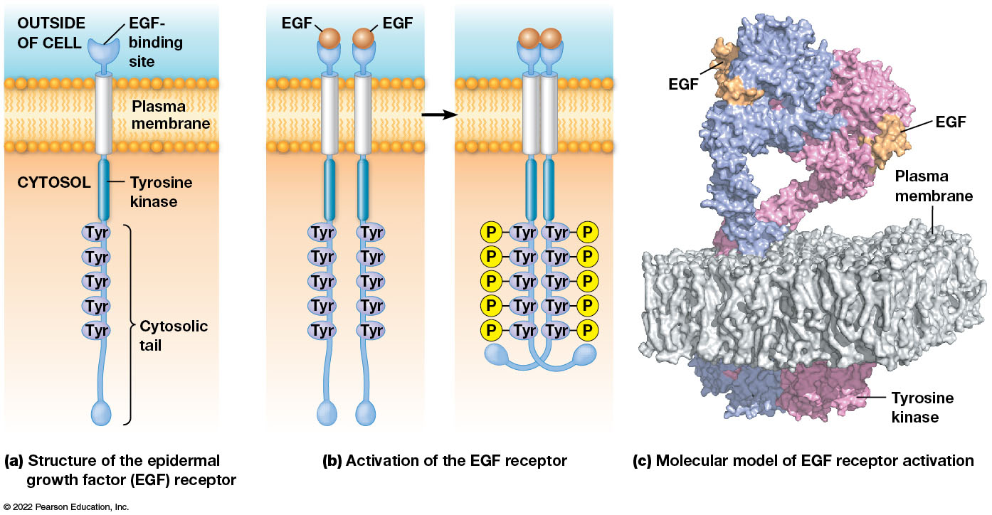
The Structure and Activation of a Receptor Tyrosine Kinase
Figure 23.17 The Structure and Activation of a Receptor Tyrosine Kinase.
Notes:
Long Description:
Structure of the epidermal growth factor EGF receptor:
The E F G binding site is on the plasma membrane and tyrosine kinase is in the cytosol. The cytosolic tail shows 5 Tyr structures like a chain.
Activation of the EGF receptor
There are two EGF bound to the binding site with five Tyr structures in each. When the two structures join together, the five Tyr structures integrate together with one P molecule to each.
Molecular model of EGF receptor activation
The parts labeled are EGF, plasma membrane, and tyrosine kinase.

Slide 83
The Structure of Receptor Tyrosine Kinases (1 of 2)
Receptor tyrosine kinases often consist of a single polypeptide chain with just one transmembrane segment.
The extracellular part of the receptor contains the ligand-binding domain.
On the cytosolic side is the tyrosine kinase domain.

Slide 84
The Structure of Receptor Tyrosine Kinases (2 of 2)
Sometimes the receptor and tyrosine kinase are two separate proteins.
In this case, the nonreceptor tyrosine kinase binds to the receptor and is activated in response to ligand binding.

Slide 85
The Activation of Receptor Tyrosine Kinases
Signal transduction is initiated upon ligand binding.
In some cases (for example, fibroblast growth factor, FGF), receptors dimerize upon ligand binding and phosphorylate each other.
In other cases (for example, epidermal growth factor, EGF), ligand binding leads to clustering of receptors.
Because they phosphorylate the same type of receptor as themselves, this is called autophosphorylation.

Slide 86
Receptor Tyrosine Kinases Initiate a Signal Transduction Cascade Involving Ras and MAP Kinase
Once autophosphorylation of the receptors occurs, the receptor recruits cytosolic proteins.
The cytosolic proteins have amino acid stretches (domains) that recognize the phosphotyrosine and nearby residues on the receptor. One such domain is called the SH2 domain.
Recruitment of SH2 domain proteins activates different signal transduction pathways, including several pathways at the same time.

Slide 87
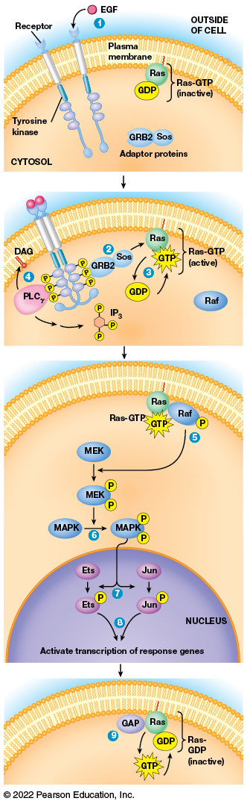
Signal Transduction Through Receptor Tyrosine Kinases
Figure 23.18 Signal Transduction Through Receptor Tyrosine Kinases.
Notes:
Long Description:
The parts labeled are as below:
E G F binds to the receptors outside of the cell. Tyrosine kinase, Ras, GDP, Ras-GDP in inactive state, and adaptor proteins that include G R B 2 and S o s are labeled.
The two tyrosine kinase integrate together and a P is attached to each Tyr structure. The other parts labeled are D A G, P L C sub gamma, G R B 2, S o s, R a s to G D P to G T P. The Ras-GTP in active state.
The reactions inside the cytosol are as below: Ras-GTP, G T P, P attached to Raf. The P attached to M E K that reacts with M A P K. Two P molecules attach to M A P K. The reactions inside the nucleus are as follows: The two P molecules attached to M A P K, where each P is attached to Ets and Jun. The Ets and Jun activate transcription of response genes.
The parts labeled in the cytosol are G A P, R a s to G T P and G T P to G D P. The R a s-G D P is in the inactive state.

Slide 88
Ras
Ras is important in regulating the proliferation of cells; it is a small monomeric G protein.
Ras and other such molecules can bind GDP or GTP but are active only when bound to GTP.
Ras requires assistance from a guanine-nucleotide exchange factor (GEF) called Sos to acquire a GTP molecule.

Slide 89
Ras Signaling (1 of 4)
For Sos to become active, it must bind the receptor through another protein called GRB2, which has an SH2 domain (Sos, GRB2, and the receptor form a complex).
Sos then stimulates Ras to release GDP and bind a GTP molecule, which activates Ras.

Slide 90
Ras Signaling (2 of 4)
Alternatively, some activated RTKs can activate phospholipase Cγ.
Activated Ras triggers a series of phosphorylations.
The first protein phosphorylated is Raf, a protein kinase.

Slide 91
Ras Signaling (3 of 4)
Raf phosphorylates serine and threonine residues in a protein kinase called MEK.
MEK in turn phosphorylates threonine and tyrosine residues in a class of proteins called mitogen-activated protein kinases (MAPKs).

Slide 92
Ras Signaling (4 of 4)
MAPKs are activated in response to a signal to grow and divide, sometimes called a mitogen.
MAPKs phosphorylate transcription factors that enter the nucleus to alter gene expression.
For example, Jun and Ets family members regulate the expression of genes needed for growth and division.

Slide 93
Inactivation of Ras
Once Ras is in the active state, it must be inactivated to avoid continual stimulation of the Ras pathway.
This is accomplished by a GTPase activating protein (GAP) that facilitates GTP hydrolysis.
GDP-bound Ras is now inactive.

Slide 94
The Key Steps in RTK Signaling Can Be Dissected Using Mutants
Specific effects are predicted when proteins important in RTK signaling are disrupted.
Mutations can be induced in the receptors themselves or in the “downstream” signaling components.
RTK signaling was understood based on this type of approach.

Slide 95
Mutant Receptors
Normal FGFs (fibroblast growth factors) undergo autophosphorylation in response to ligand binding.
Some types of mutant fibroblast growth factor receptors (FGFRs) can bind ligand but cannot undergo normal autophosphorylation.
This type of mutant receptor can interact with normal receptors and prevent them from functioning properly.

Slide 96
Dominant Negative Receptor Mutations
These mutant receptors interfere with normal receptor function because they can dimerize with normal receptors but no autophosphorylation occurs.
A mutant that overrides normal function in this way is called a dominant negative mutation.

Slide 97
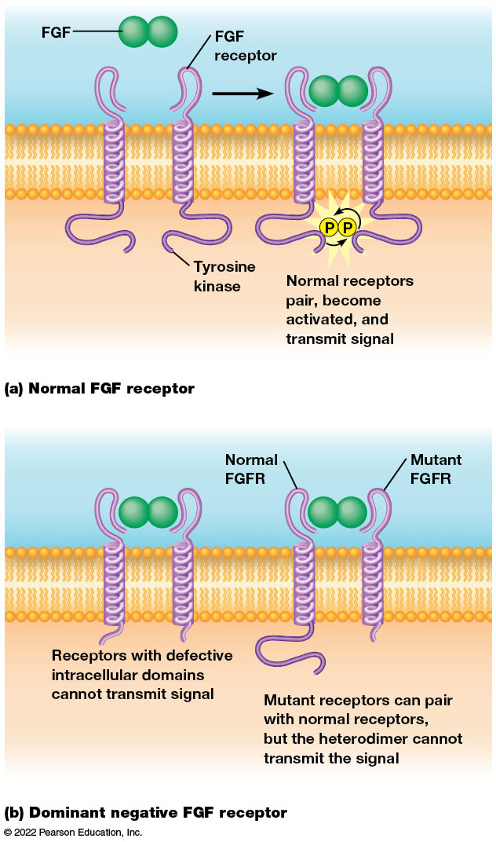
Dominant Negative Disruption of FGF Receptor Function
Figure 23.19 Dominant Negative Disruption of FGF Receptor Function.
Notes:
Long Description:
Normal F G F receptor:
There are two F G F receptors that are bound together by F G F molecules. Two P molecules are attached to the tyrosine kinase in the cytosol. Normal receptors pair, become activated, and transmit signal. Normal receptors form dimers after binding FGF and transmit the appropriate signal via Ras and MAPK.
Dominant negative F G F receptor:
Receptors with defective intracellular domains cannot transmit signal. Mutant receptors can pair with normal receptors, but the heterodimer cannot transmit the signal. When a cell makes mutant FGF receptors, normal receptors can dimerize as in part a, or the defective receptors can bind to FGF and dimerize with normal receptors. In this case, no signal is transmitted. When sufficient quantities of the mutant receptor are present, most of the normal receptors are paired with mutant receptors, resulting in overall disruption in signaling.

Slide 98
Constitutive Mutations
Some mutations make FGFRs active in signaling, even when not bound to ligand.
These mutations are called constitutively active mutations because they cause the receptor to stay switched “on” all the time.
In humans, a dominant mutation in FGFR-3 causes a form of dwarfism called achondroplasia.

Slide 99
Genetic Analysis of RTK Signaling
The use of genetic model systems revolutionized the ability to connect the functions of specific proteins with important signaling pathways.
The Drosophila compound eye is composed of 800 ommatidia.
Mutations in Ras can affect the appearance of the eye because formation of the eye depends on an RTK encoded by the sevenless (sev) gene.

Slide 100
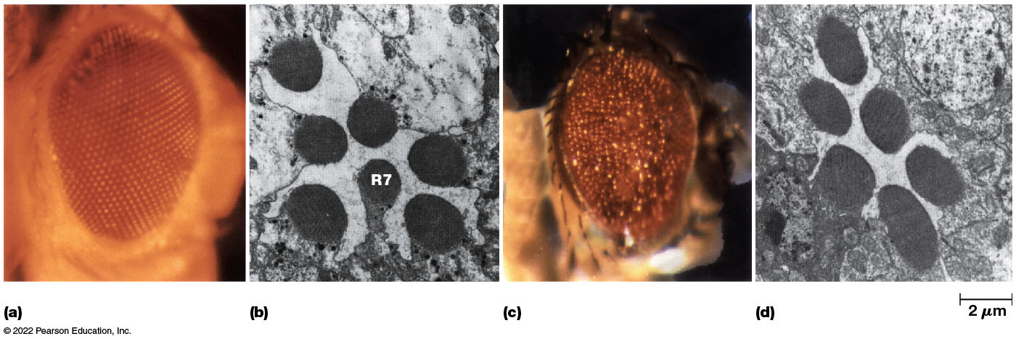
The Compound Eye of Drosophila
Figure 23.20 The Compound Eye of Drosophila.
Notes:
Long Description:
A normal eye in a light micrograph shows a closely formed smooth mosaic structure. The cross section of a normal ommatidium at high magnification shows 6 structure along with the R7 that lies in the center. An eye expressing a dominant, activated form of Ras appears rough and the mosaic structure is prominently visible. In a sevenless mutant, there are six cells and the R7 is absent.

Slide 101
Sevenless Signaling
Loss of Sev leads to loss of the R7 cell, one of eight photoreceptors in each ommatidium.
Studies identified a ligand on the neighboring R8 cell that activates the Sevenless receptor, called Bride of sevenless (Boss).
Geneticists used a sensitized background to identify additional components of the sev pathway.

Slide 102
Identifying Additional Components of Sevenless Signaling
The “sensitized” background involved conditions that produced just enough Sev receptor to allow the R7 cell to develop.
Then mutations were identified that resulted in eye defects only in this sensitized background.
Several important components of RTK signaling were identified this way.

Slide 103
Connections to Ras
In some types of studies, the effects of multiple mutations in the sev pathway were examined.
In double mutants that lack functional Sevenless but also have a dominant mutation in Ras, the R7 cell develops.
This suggests that the sev pathway normally works by activating Ras.

Slide 104
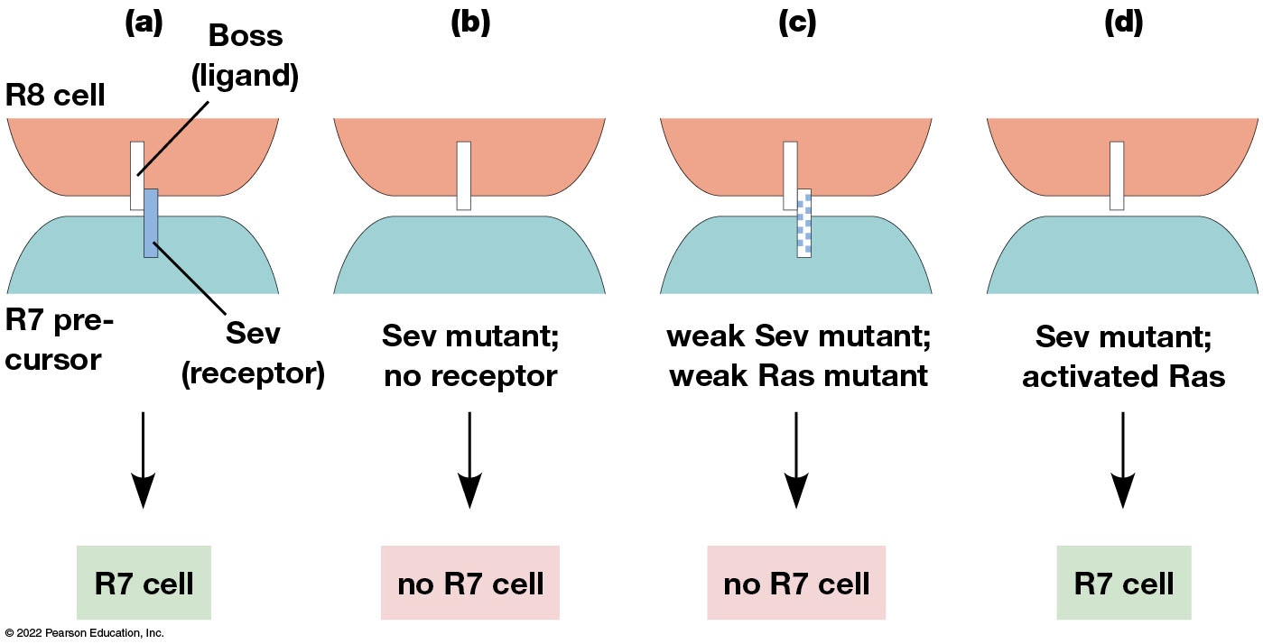
Mutations in the Ras Pathway Can Either Bypass or Enhance Defects in RTK Signaling
Figure 23.21 Dominant Negative Disruption of FGF Receptor Function.
Notes:
Long Description:
The combinations are as below:
R8 cell with boss ligand and R 7 precursor with sev as the receptor.
Sev mutant with no receptor. There is no R 7 cell.
Weak sev mutant and weak R a s mutant. There is no R 7 cell.
Sev mutant with activated R a s. The R 7 cell is present.

Slide 105
Receptor Tyrosine Kinases Activate a Variety of Other Signaling Pathways
Receptor tyrosine kinases can also activate phospholipase Cγ, leading to production of IP₃ and DAG.
The phospholipase Cγ in this case contains an SH2 domain and must bind to the receptor.
RTKs can also activate enzymes such as PI 3-kinase (phosphatidylinositol-3-kinase).

Slide 106
Other Growth Factors Transduce Their Signals via Receptor Serine-Threonine Kinases
A major class of serine-threonine kinases are the transforming growth factor β (TGF β) family of growth factors.
TGF β signaling begins when the growth factor binds the transmembrane receptor.
There are type I and type II receptors in the receiving cell.

Slide 107
TGF β Signaling
Some TGF β family members dimerize before binding the receptors.
Upon ligand binding, the type II receptor phosphorylates the type I receptor, which then initiates a signal transduction cascade.
It phosphorylates a class of proteins called Smads.

Slide 108
Three Types of Smads
Some are phosphorylated by a complex of anchoring proteins and receptors and are called receptor-regulated, or R-Smads.
Smad4 forms a multiprotein complex with phosphorylated R-Smads; the whole complex can then enter the nucleus.
Other Smads act at various points to inhibit the TGF β pathway.

Slide 109
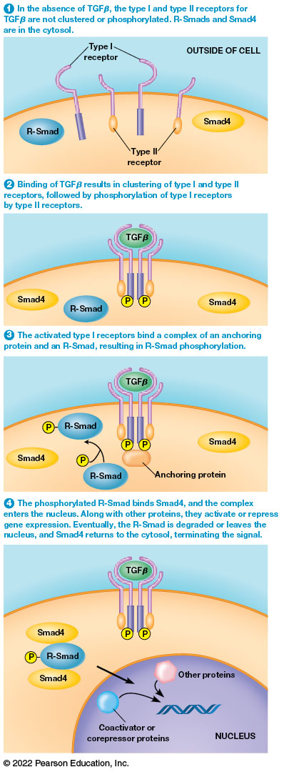
Signal Transduction Pathway of TGF β Receptor Family Proteins
Figure 23.22 Signal Transduction Pathway of TGF β Receptor Family Proteins.
Notes:
Long Description:
The details of the steps are as below:
In the absence of TGF beta, the type 1 and type 2 receptors for TGF beta are not clustered or phosphorylated. R-Smads and Smad4 are in the cytosol. The parts labeled are type 1 receptors on the plasma membrane, R-Smad, type 2 receptors, and Smad4 in the cytosol.
Binding of TGF beta results in clustering of type 1 and type 2 receptors, followed by phosphorylation of type 1 receptors by type 2 receptors. The parts labeled are T G F beta on the outside of the cell, two P in the cytosol, Smad4, and R-Smad.
The activated type 1 receptors bind a complex of an anchoring protein and an R-Smad, resulting in R-Smad phosphorylation. An anchoring protein is attached to the two P molecules. P molecules are attached to R-Smad. Smad4 are found in the cytosol.
The phosphorylated R-Smad binds Smad4, and the complex enters the nucleus. Along with other proteins, they activate or repress gene expression. Eventually, the R-Smad is degraded or leaves the nucleus, and Smad4 returns to the cytosol, terminating the signal. The parts labeled are TGF beta, P molecules, Smad 4, and P to R-smad, which impacts the nucleus. The other proteins and coactivator or corepressor proteins impact the gene sequence in the nucleus.

Slide 110
Other Enzyme-Coupled Receptor Families
Tyrosine phosphatase receptor family members remove phosphate groups from tyrosine receptors.
They regulate tyrosine receptor kinases.
Guanylyl cyclase family of enzyme-coupled receptors produce cyclic GMP (cGMP).
Play a role in the photoreceptor cells of the retina, fluid regulation in the gut, and vasodilation.

Slide 111
23.4 Putting It All Together: Signal Integration
Signal transduction pathways do not happen in isolation. A cell can be coordinating many pathways at once.
Cells coordinate responses to many simultaneous signals in many ways.
These include localizing signaling complexes via scaffolds and integration of different signaling pathways

Slide 112
Scaffolding Complexes Can Facilitate Cell Signaling
Signaling components such as those in the Ras pathway are sometimes assembled into large multiprotein complexes that make cascades more efficient.
For example, in yeast, cells of mating type a secrete a signal called a factor, which can bind to G protein−coupled receptors on nearby α cells.
The α cells secrete α factor.

Slide 113
Cell Signaling and Yeast Mating (1 of 2)
The mating factor signaling results in large-scale changes including polarized secretion, cytoskeletal changes, and gene expression changes.
The signaling is mediated through the activated G_{βγ} subunit of a G protein, which recruits Step5, a large scaffolding protein, to the plasma membrane.

Slide 114
Cell Signaling and Yeast Mating (2 of 2)
Step5 increases efficiency of signaling by recruiting all of the kinases in the cascade into a large complex.
Other similar scaffolding complexes have been identified in yeast and other organisms.
Cells can “mix and match” parts of signaling pathways.

Slide 115
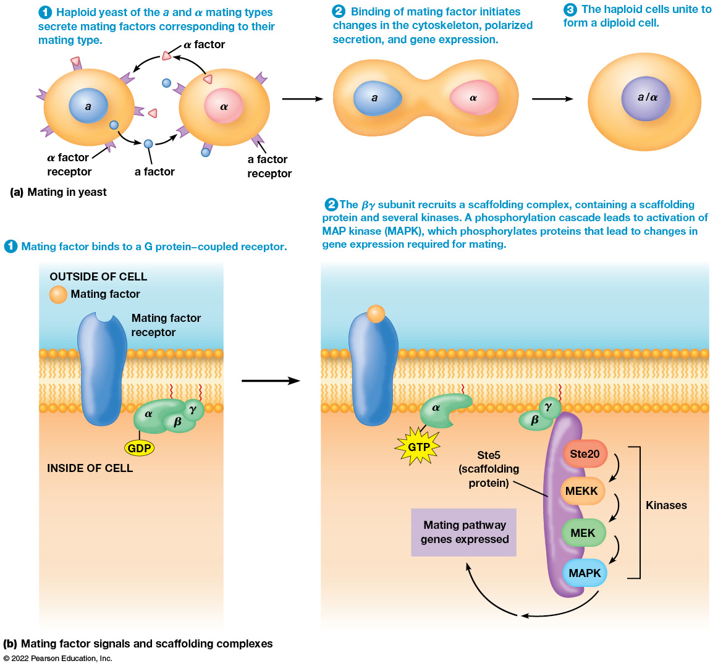
Scaffolding Complexes Can Facilitate Cell Signaling
Figure 23.23 Scaffolding Complexes Can Facilitate Cell Signaling.
Notes:
Long Description:
Mating in yeast: The three steps involved in this process are as below:
Haploid yeast of the “a” and alpha mating types secrete mating factors corresponding to their mating type. The alpha factor receptor is on the “a” type. The “a” factor from the “a” type binds to the “a” factor receptor on the alpha type. The alpha factor from the alpha type binds to the alpha factor receptor of the “a” type.
Binding of mating factor initiates changes in the cytoskeleton, polarized secretion, and gene expression. The “a” and the alpha types join together.
The haploid cells unite to form a diploid cell. The “a” and the alpha types form a single nucleus.
Mating factor signals and scaffolding complexes:
The steps involved in the process are:
Mating factor binds to a G protein−coupled receptor. The parts labeled are mating factor and mating factor receptor on the outside of the cell. The GDP alpha, beta, gamma on the inside of the cell.
The beta gamma subunit recruits a scaffolding complex, containing a scaffolding protein and several kinases. A phosphorylation cascade leads to activation of MAP kinase (MAPK), which phosphorylates proteins that lead to changes in gene expression required for mating. The beta and gamma are attached to the Ste5 scaffolding protein. The Ste 5 scaffolding protein consists of fur kinases, namely Ste20 to MEKK to MEK to MAPK. From M A P K, the mating pathway genes are expressed.

Slide 116
Different Signaling Pathways Are Integrated Through Crosstalk
Cells can be exposed to a multitude of signals at any given moment.
Cells must integrate these signals to produce appropriate responses.
A single receptor can activate multiple pathways, or multiple pathways can converge onto the same molecules.

Slide 117
Crosstalk
Sometimes activated components from one pathway affect components of another pathway.
This is called signaling crosstalk.
Signaling is more of a network of biochemical pathways than a linear sequence of events.

Slide 118
Signal Integration
Several pathways lead to production of second messengers such as IP₃ and calcium ions.
Many pathways ultimately lead to phosphorylation of target proteins.
The target proteins then carry out many different cellular functions.
The opportunities for crosstalk are numerous.

Slide 119
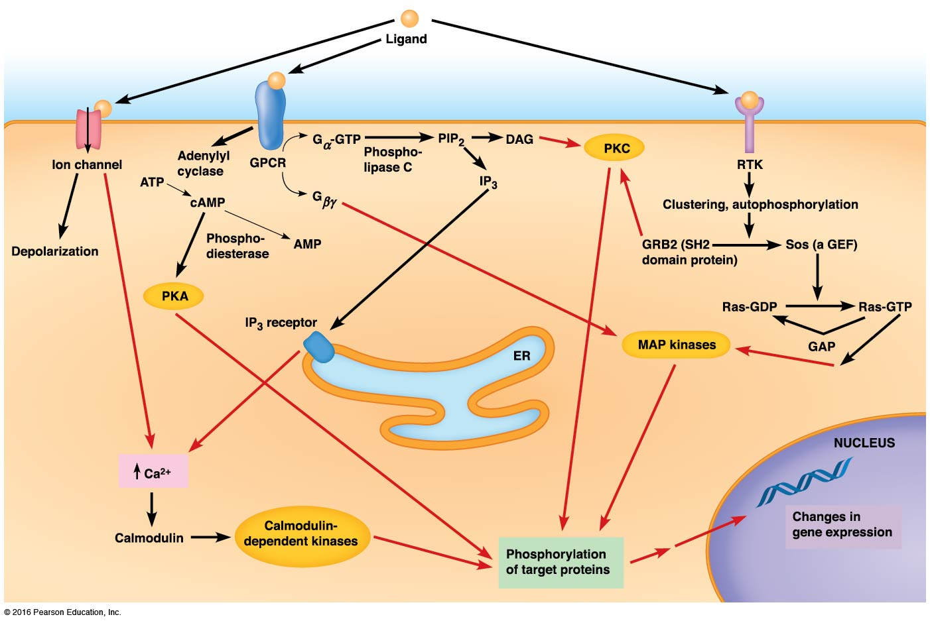
Signaling Crosstalk
Figure 23.24 Signaling Crosstalk.
Notes:
Long Description:
The details are as below:
Signaling pathways:
The signaling pathways are ligand to ion channel to depolarization, GPCR to adenylyl cyclase, and to RTK.
ATP to c AMP to AMP.
GPCR to G alpha GTP, in the presence of phospholipase C to PIP 2 to D A G and IP 3.
GPCR to G beta gamma.
IP3 to IP3 receptor.
C AMP to PKA, in the presence of phosphodiesterase.
RTK to clustering, autophosphorylation. GRB 2, which is SH 2 domain protein to Sos, which is a G E F. This impacts the Ras-GDP to Ras-GTP.
The locations where crosstalk can occur are as below:
Ion channel to C a 2 plus.
I P 3 receptor to C a 2 plus.
G beta gamma M A P kinases.
G A P to M A P kinases.
Calmodulin-dependent kinases, P K A, P K C, and M A P kinases to Phosphorylation of target proteins. The target proteins cause changes in gene expressions in the nucleus.
Crosstalk at the level of second messengers:
C a 2 plus.
Crosstalk at protein kinases:
Calmodulin dependent kinases.
P K A.
M A P kinases.
P K C.
The proteins phosphorylated by these kinases:
Phosphorylation of target proteins.
The level of gene expression:
Changes in gene expression.
R T K.

Slide 120
23.5 Hormones and Other Long-Range Signals
To coordinate signals involving different tissues and organs, plants and animals use secreted chemical signals called hormones.

Slide 121
Endocrine Hormones
Endocrine hormones travel from sending to receiving cells via the circulatory system.
They are synthesized by endocrine tissues and are secreted directly into the bloodstream, with a life span ranging from a few seconds to many hours.
As they circulate, they encounter their receptors in target tissues.

Slide 122
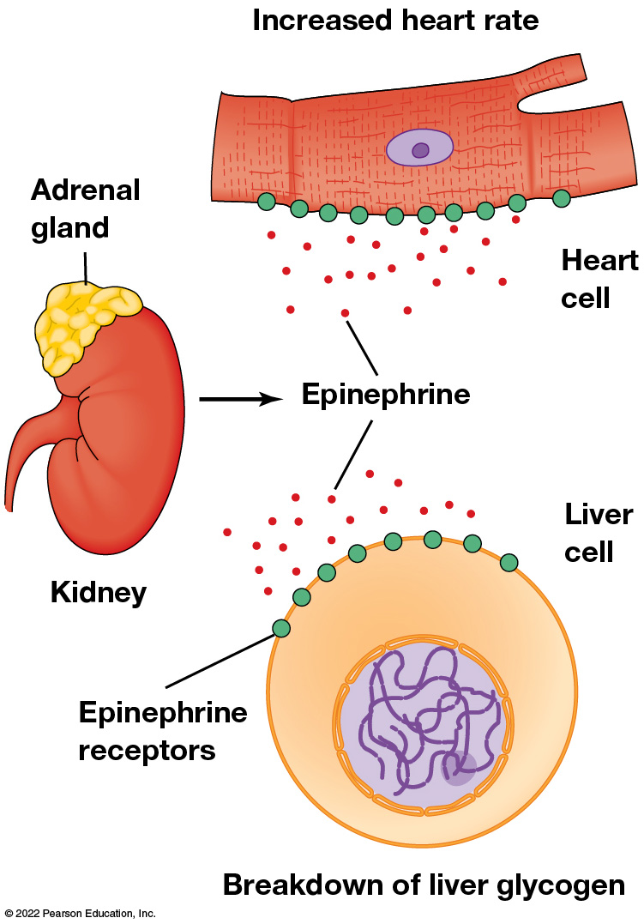
Target Tissues for Endocrine Hormones
Figure 23.25 Target Tissues for Endocrine Hormones.
Notes:
Long Description:
The parts labeled are heart cell with an increased heart rate, adrenal gland on the kidney, and breakdown of liver glycogen in the liver cell.

Slide 123
Hormones Can Be Classified by Their Chemical Properties
Endocrine hormones fall into four categories
Amino acid derivatives (for example, epinephrine)
Peptides (for example, vasopressin)
Proteins (for example, insulin)
Lipid-like hormones such as steroids (for example, testosterone)

Slide 124
Chemical Classification and Function of Hormones
Table 23.4 Chemical Classification and Function of Hormones
Chemical Classification | Example | Regulated Function
Endocrine Hormones
Amino acid derivatives | Epinephrine (adrenaline) and norepinephrine (both derived from tyrosine) | Stress responses: regulation of heart rate and blood pressure; release of glucose and fatty acids from storage sites
 | Thyroxine (derived from tyrosine) | Regulation of metabolic rate
Peptides | Antidiuretic hormone (vasopressin) | Regulation of body water and blood pressure
 | Hypothalamic hormones (releasing factors) | Regulation of tropic hormone release from pituitary gland

Slide 125
Table 23.4 Chemical Classification and Function of Hormones
Proteins | Anterior pituitary hormones | Regulation of other endocrine systems
Steroids | Sex hormones (androgens and estrogens) | Development and control of reproductive capacity and secondary sexual characteristics
 | Corticosteroids | Stress responses; control of blood electrolytes
Paracrine Hormones
Amino acid derivative | Histamine | Local responses to allergens, stress and injury
Arachidonic acid derivatives | Prostaglandins | Local responses to stress and injury

Slide 126
The Endocrine System Controls Multiple Signaling Pathways to Regulate Glucose Levels
Adrenergic hormones, epinephrine and norepinephrine, function to put body functions on hold and redirect resources to the heart and skeletal muscles in dangerous or stressful situations.
Produced by the adrenal glands, they stimulate breakdown of glycogen to supply glucose to the muscles.

Slide 127
Adrenergic Receptors
Adrenergic hormones bind to a family of G protein−coupled receptors, adrenergic receptors, classified as α- and β-adrenergic receptors.
α-adrenergic receptors bind epinephrine and norepinephrine; these receptors are located on smooth muscles regulating flow to visceral organs.
β-adrenergic receptors bind epinephrine better than norepinephrine and are located on smooth muscles associated with arterioles feeding the heart, lungs, and skeletal muscles.

Slide 128
Adrenergic Receptors and G Proteins
α- and β-adrenergic receptors are linked to different G proteins and so stimulate different signal transduction pathways.
For example, α-adrenergic receptors are G_{q} proteins, whereas the β-adrenergic receptors activate G_{s.}
G_{s} stimulates the cAMP signal transduction pathway, inducing relaxation of certain smooth muscles.

Slide 129
Adrenergic Hormones and Control of Glycogen Degradation
The breakdown of glycogen is facilitated by the enzyme glycogen phosphorylase, resulting in release of a glucose-1-phosphate.
Glycogen degradation begins when an epinephrine molecule binds to a β-adrenergic receptor on a liver or muscle cell.
The receptor activates a neighboring G_{s} protein that in turn stimulates adenylyl cyclase.

Slide 130
Control of Glycogen Degradation (1 of 2)
Adenylyl cyclase generates cAMP from ATP; the cAMP increase activates protein kinase A. (1)
PKA activates another cascade of events starting with phosphorylation of the enzyme phosphorylase kinase. (2)
This leads to conversion of the less active b form of glycogen phosphorylase to the more active a form. (3)

Slide 131
Control of Glycogen Degradation (2 of 2)
The activation of glycogen phosphorylase a leads to an increased rate of glycogen breakdown. (4)
cAMP also stimulates the inactivation of the enzyme system responsible for synthesis of glycogen.
PKA also phosphorylates glycogen synthase, and inactivates it.

Slide 132
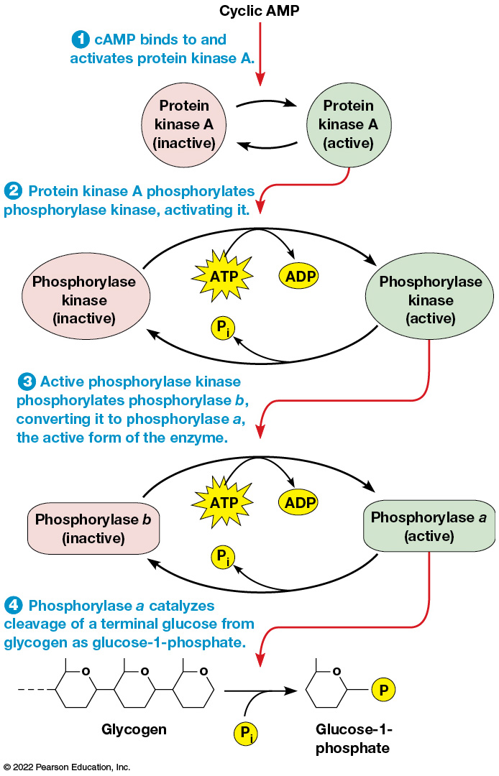
Stimulation of Glycogen Breakdown by Epinephrine
Figure 23.26 Stimulation of Glycogen Breakdown by Epinephrine.
Notes:
Long Description:
The details are as below:
cAMP binds to and activates protein kinase A. The protein kinase “A” inactive form protein kinase “A” active form and vice versa.
Protein kinase A phosphorylates phosphorylase kinase, activating it. ATP to ADP occurs. P inorganic is released from phosphorylase kinase active to phosphorylase kinase inactive.
Active phosphorylase kinase phosphorylates phosphorylase b, converting it to phosphorylase a, the active form of the enzyme.
Phosphorylase a catalyzes cleavage of a terminal glucose from glycogen as glucose-1-phosphate.

Slide 133
α₁-Adrenergic Receptors and the IP₃ Pathway
α₁-adrenergic receptors stimulate formation of IP₃ and DAG.
When the receptors are stimulated, the formation of IP₃ causes an increase in intracellular Ca²⁺ concentration.
Elevated calcium causes smooth muscle contraction, constricting blood vessels and reducing blood flow.

Slide 134
Insulin Signaling and Pl 3-Kinase
Specialized cells in the pancreas called the islets of Langerhans secrete two peptide hormones that regulate normal glucose levels.
Glucagon acts to increase blood glucose through glycogen breakdown; it acts via the same G protein as epinephrine.
Insulin reduces blood glucose levels by stimulating uptake into muscle and adipose cells and stimulating glycogen synthesis.

Slide 135
Diabetes
Type I diabetes results in loss of insulin-producing cells in the islets of Langerhans.
It can be successfully treated with insulin.
Type II diabetes appears to result from resistance to insulin and so is not effectively treated with insulin.

Slide 136
Insulin Signaling
Insulin has both rapid and longer-lasting effects on a variety of cells.
Insulin binds to receptor tyrosine kinases, which have two α and two β subunits.
When insulin binds the receptor, the β subunits phosphorylate insulin receptor substrate 1 (IRS-1).

Slide 137
Insulin Signaling: Two Pathways
Phosphorylated IRS-1 stimulates two different pathways.
IRS-1 can recruit GRB2, activating the Ras pathway. (1)
IRS-1 can also bind phosphatidylinositol-3-kinase (PI 3-kinase, or PI3K), which converts PIP₂ into PIP₃. (2)

Slide 138
Insulin Signaling: Akt Activation
PIP₃ binds a protein called Akt (or protein kinase B). (3)
An enzyme that opposes P1 3-kinase is PTEN, a phosphatase that removes a phosphate from PIP₃, preventing activation of Akt.
Activation of Akt has two important consequences.

Slide 139
Insulin Signaling: Consequences of Activating Akt
Activation of Akt leads to movement of a glucose transporter, GLUT4, to the plasma membrane, allowing glucose uptake.
Also, Akt can phosphorylate glycogen synthase kinase 3 (GSK3), reducing its activity.
This leads to an increase in the amount of the active form of glycogen synthase, enhancing glycogen production.

Slide 140
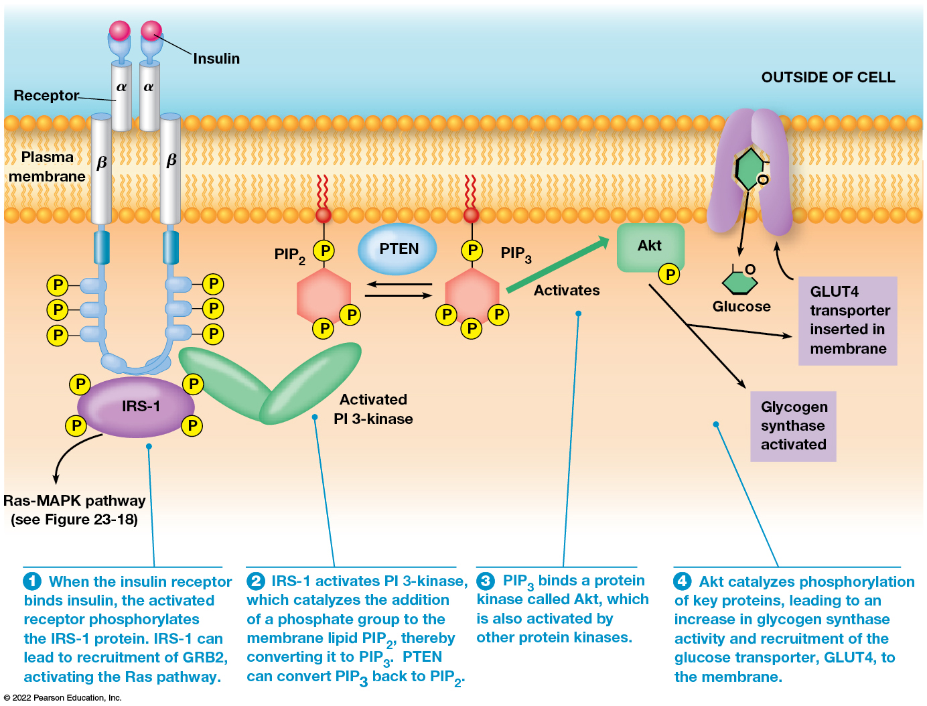
The Insulin Signaling Pathway
Figure 23.27 The Insulin Signaling Pathway.
Notes:
Long Description:
The steps involved are as below:
When the insulin receptor binds insulin, the activated receptor phosphorylates the IRS-1 protein. IRS-1 can lead to recruitment of G R B 2, activating the R a s pathway.
I R S -1 activates P I 3-kinase, which catalyzes the addition of a phosphate group to the membrane lipid P I P 2, thereby converting it to P I P 3. P T E N can convert P I P 3 back to P I P 2.
P I P 3 binds a protein kinase called Akt, which is also activated by other protein kinases.
Akt catalyzes phosphorylation of key proteins, leading to an increase in glycogen synthase activity and recruitment of the glucose transporter, GLUT4, to the membrane.

Slide 141
Steroid Hormones Bind Hormones in the Cytosol and Carry Them into the Nucleus
Steroid hormones bind to receptors that act primarily in the nucleus.
Steroid receptor proteins mediate the actions of steroid hormones such as progesterone, estrogen, testosterone, and glucocorticoids.

Slide 142
Action of Steroid Hormones
Steroid hormones are hydrophobic and can pass relatively easily through the plasma membrane.
Once inside the cell, the hormone binds its receptor, triggering a cascade of events that activate (sometimes inhibit) transcription of a set of target genes.

Slide 143
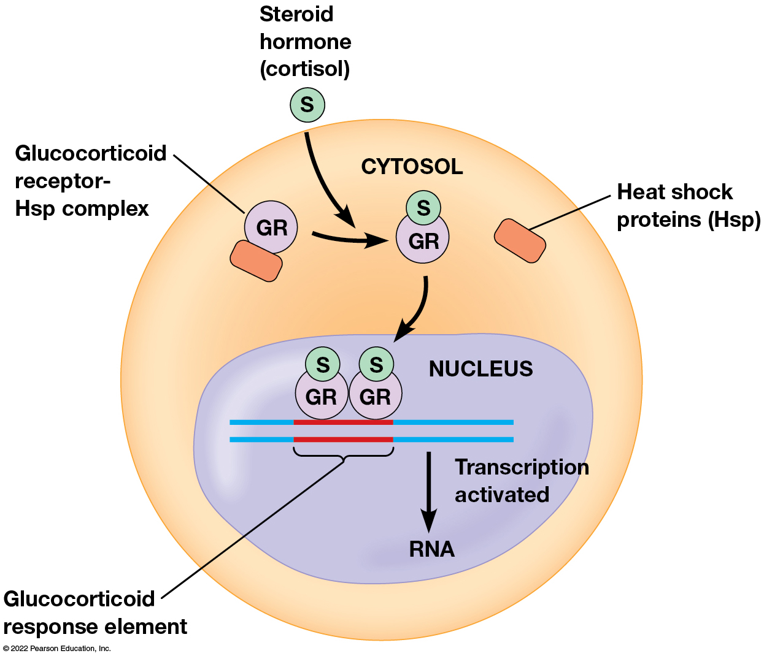
Activation of Gene Transcription by Steroid Hormone Receptors
Figure 23.28 Stimulation of Glycogen Breakdown by Epinephrine.
Notes:
Long Description:
Glucocorticoid receptor-H s p complex combines with steroid hormone cortisol in the cytosol and the heat shock proteins H s p is released. Two G R with S combine in the nucleus and the glucocorticoid response element is formed in the DNA. Transcription activated results in RNA.

Slide 144
Gases Can Act as Cell Signals
Dissolved gases can sometimes serve as signals.
In animals, O₂ and CO₂ are key long-range signals in respiration.
In plants, the ripening of fruit is mediated by ethylene gas.

Slide 145
Nitrous Oxide
An important example of gaseous signaling is nitric oxide (NO).
It is especially important in the nervous system.

