Slide 1
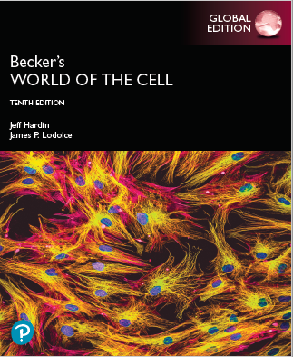
Becker’s World of the Cell
Tenth Edition, Global Edition
Chapter 4
Cells and Organelles
Lectures by Anna Hegsted, Simon Fraser University
Copyright © 2022 Pearson Education Ltd. All Rights Reserved.
Notes:
If this PowerPoint presentation contains mathematical equations, you may need to check that your computer has the following installed:
1) MathType Plugin
2) Math Player (free versions available)
3) NVDA Reader (free versions available)

Slide 2
Cells and Organelles
Two questions to consider
Where did the first cells come from?
How do today’s cells function?

Slide 3
4.1 The Origins of the First Cells
The appearance of cells involved four phases:
Abiotic (nonliving) synthesis of simple organic compounds
Abiotic polymerization of these into macromolecules
Emergence of a macromolecule capable of replication and storing genetic information
Encapsulation of the first living molecule within a simple membrane

Slide 4
Simple Organic Molecules May Have Formed Abiotically in the Young Earth
In a classic experiment, Stanley Miller (1953) tested the hypothesis that energy from lightning could have powered production of simple organic compounds from atmospheric gases.
The early atmosphere was thought to consist largely of reduced gases such as hydrogen (H₂), methane (C H₄), ammonia (N H₃), and water vapor (H₂O).

Slide 5
Results of the Experiment
After a week of continuous exposure of gases to electrical discharge, Miller checked the flask.
He detected two simple amino acids (alanine and glycine) in the flask.
This suggested that some organic compounds could be produced under abiotic conditions.

Slide 6
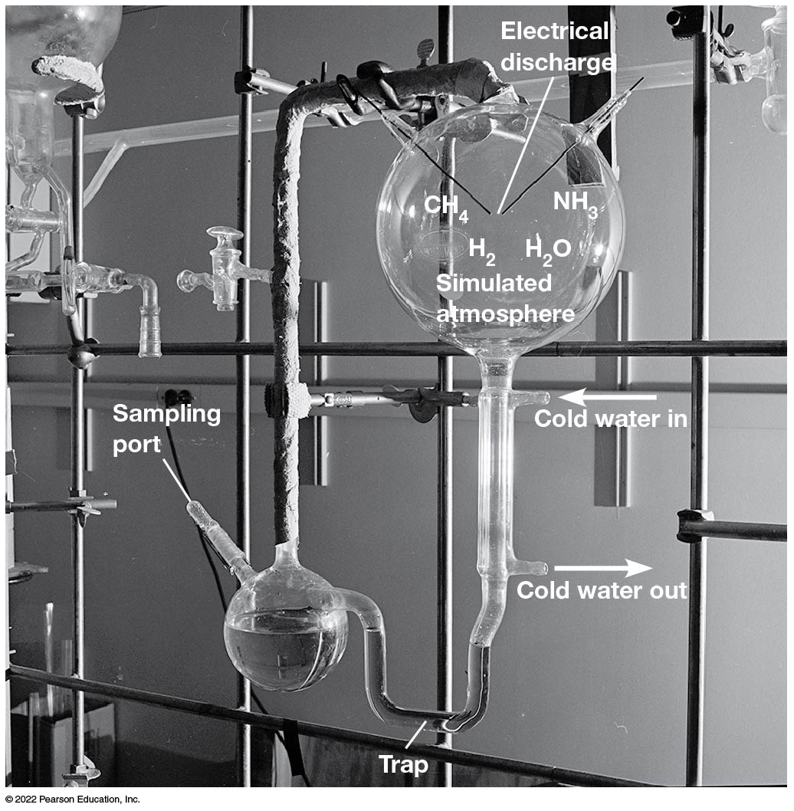
Miller’s Apparatus for Abiotic Synthesis of Simple Organic Compounds
Figure 4.1 Miller’s Apparatus for Abiotic Synthesis of Simple Organic Compounds.
Notes:
Long Description:
The tube from the lower flask forms a “U” shaped trap and connects to the flask at the top with an inlet for cold water and an outlet for cold water. The top flask simulated atmosphere with H subscript 2, H subscript 2 O, and electrical discharge. There are two outlets for C H subscript 4 and N H subscript 3.

Slide 7
Additional Experiments
Other researchers have tested different proposed atmospheres exposed to electrical discharge.
They have detected a variety of simple organic compounds produced in this way.

Slide 8
Models for Formation of Organic Compounds
Formation in the atmosphere, precipitation into the oceans, and concentration into “primordial soup” as simulated by Miller’s experiments
Deep-sea hydrothermal vents provided a catalytic environment for combining dissolved gases into organic molecules.

Slide 9
RNA May Have Been the First Informational Molecule
Deoxyribonucleic acids, used to form D N A, are derived enzymatically from the corresponding ribonucleotides.
R N A s called ribozymes are capable of performing certain enzymatic reactions; for example, the formation of the peptide bonds during translation.
This suggests that an “R N A world” existed before the appearance of D N A and proteins.

Slide 10
Liposomes May Have Defined the First Primitive Protocells
Using lipids, scientists have produced hollow, membrane-bound vesicles called liposomes.
Under some circumstances, these can carry out simple metabolic reactions.
Primordial lipids may have come together in an early ocean, trapping R N A s and forming the first “protocells.”

Slide 11
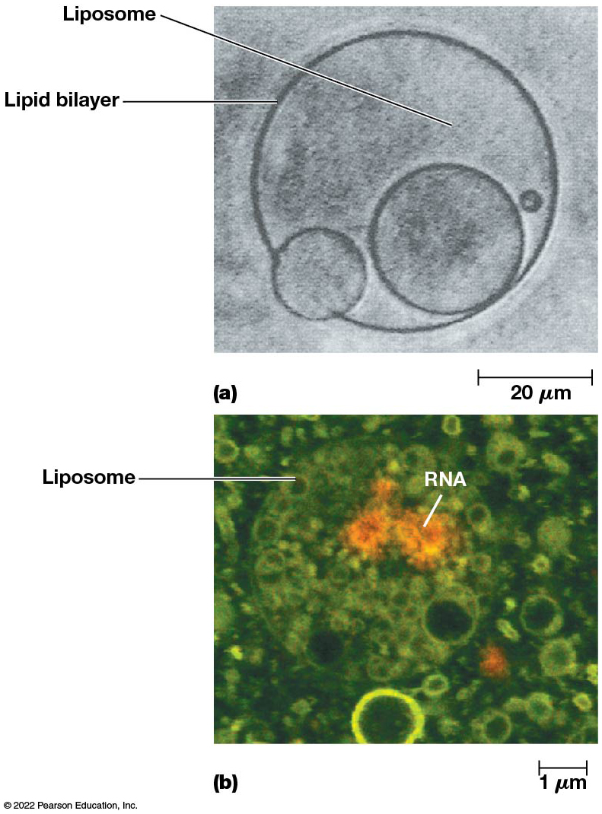
Artificial Liposomes
Figure 4.2 Artificial Liposomes.
Notes:
Long Description:
Image “a” of liposomes shows two smaller vesicles within a bigger one and another vesicle on the circumference of the bigger vesicle. A small vesicle is also found next to the bigger one. Both these vesicles along with liposome are enclosed by lipid bilayer. It shows a measurement of 20 micrometer at the left end. Image “b” shows a measurement of 1 micrometer at the left end and shows liposomes enclosed in a circular body. The R N A is shown in yellow coloured round shaped bodies inside liposomes.

Slide 12
4.2 Basic Properties of Cells
Several general characteristics of cells
Organizational complexity
Molecular components
Sizes and shapes
Specialization

Slide 13
The Three Domains of Life Are Bacteria, Archaea, and Eukaryotes
Biologists recognized two types of cells.
The simpler type is characteristic of bacteria and archaea (prokaryotes), and the more complex type is characteristic of plants, animals, fungi, algae, and protozoa (eukaryotes).
The main distinction between the two cell types is the membrane-bounded nucleus of eukaryotic cells.

Slide 14
A Changing View of Prokaryotes
Recently, the term prokaryote has become unsatisfactory in describing the non-nucleated cells.
Sharing of a gross structural feature is not necessarily evidence of relatedness.
Based on r R N A sequence analysis, prokaryotic cells can be divided into the widely divergent bacteria and archaea.

Slide 15
Three Domains
Bacteria and archaea are as divergent from one another as humans and bacteria are.
Biologists now recognize three domains, the Archaea, Bacteria, and Eukarya (eukaryotes).

Slide 16
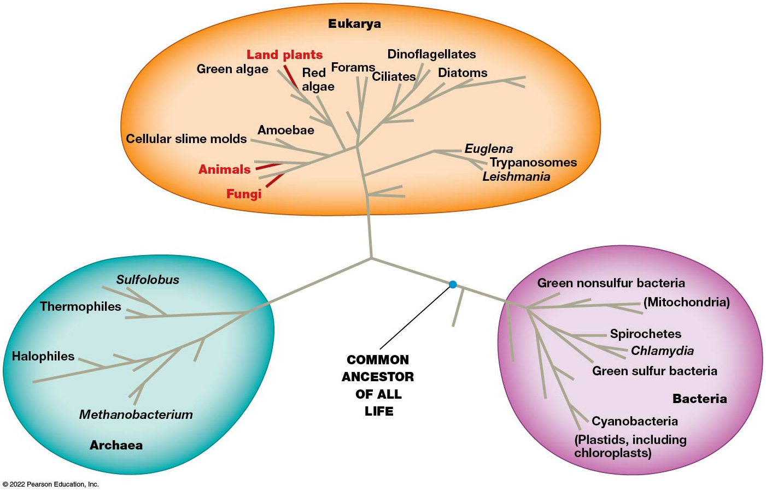
The Three Domains of Life
Figure 4.3 The Three Domains of Life.
Notes:
Long Description:
The composition of each domain is as below:
Bacteria: The components are green nonsulfur bacteria with mitochondria, spirochetes, chlamydia, green sulfur bacteria, and cyanobacteria with plastids, including chloroplasts.
Eukarya: The main components are land plants, animals, and fungi. The other parts shown as branches are dinoflagellates, diatoms, ciliates, euglena, trypanosomes, leishmania, cellular slime molds, amoebae, green algae, red algae, and forams.
Archaea: The components are sulfolobus, thermophiles, halophiles, and methanobacterium.

Slide 17
A Comparison of Some Properties of Bacterial, Archaeal, and Eukaryotic Cells (1 of 2)
Table 4.1 A Comparison of Some Properties of Bacterial, Archaeal, and Eukaryotic Cells*
Property | Bacteria | Archaea | Eukaryotes | Refer to
Typical size | Small ( 1–5 μ m) | Small ( 1–5 μ m) | Large (10–100 μ m) | —
Nucleus and organelles | No | No | Yes | —
Microtubules and microfilaments | Actin-like and tubulin-like proteins | Actin-like and tubulin-like proteins | Actin and tubulin proteins | Chapter 13
Exocytosis and endocytosis | No | No | Yes | Chapter 12
Cell wall | Peptidoglycan | Varies from proteinaceous to peptidoglycan-like | Cellulose and pectin in plants, cellulose or chitin in fungi; none in animals, protozoa | Chapter 15
Mode of cell division | Binary fission | Binary fission | Mitosis or meiosis plus cytokinesis | Chapter 24
Typical form of chromosomal D N A | Usually circular, few associated proteins | Usually circular, associated with histone-like proteins | Linear, associated with histone proteins | Chapter 16

Slide 18
A Comparison of Some Properties of Bacterial, Archaeal, and Eukaryotic Cells (2 of 2)
Table 4.1 A Comparison of Some Properties of Bacterial, Archaeal, and Eukaryotic Cells* (Continued)
Property | Bacteria | Archaea | Eukaryotes | Refer to
RNA processing | Minimal | Moderate | Extensive | Chapter 18
Transcription initiation | Bacterial type | Eukaryotic type | Eukaryotic type | Chapter 18
R N A polymerase | Bacterial type | Some features of both bacterial, eukaryotic types | Eukaryotic type | Chapter 18
Ribosome size and number of proteins and R N A s | 70S with 54 proteins and 3 r R N A s | 70S with 65 proteins and 3–4 r R N A s | 80S with ~80 proteins and 4 r R N A s | Chapter 19
Translation initiation | Bacterial type | Eukaryotic type | Eukaryotic type | Chapter 19
Membrane phospholipids | Glycerol-3-phosphate + linear fatty acids | Glycerol-1-phosphate + branched polyisoprenoids | Glycerol-3-phosphate + linear fatty acids | Chapter 7
*This table lists many features that we have not yet discussed in detail. Its main purpose is to point out that, despite some sharing of characteristics, each of the three main cell types has a unique set of properties. Each will be considered in more detail in later chapters.

Slide 19
Bacteria
These include most of the commonly encountered single-celled, non-nucleated organisms that were traditionally called bacteria.
Examples include
Escherichia coli
Pseudomonas aeruginosa
Streptococcus lactis

Slide 20
Archaea (1 of 2)
Archaea were originally called archaebacteria before they were discovered to be so different from bacteria.
They include many species that live in extreme habitats and have diverse metabolic strategies.

Slide 21
Archaea (2 of 2)
Types of archaea include
Methanogens—obtain energy from hydrogen and convert C O₂ into methane
Halophiles—occupy extremely salty environments
Thermacidophiles—thrive in acidic hot springs
They are considered to have descended from a common ancestor that also gave rise to eukaryotes long after diverging from bacteria.

Slide 22
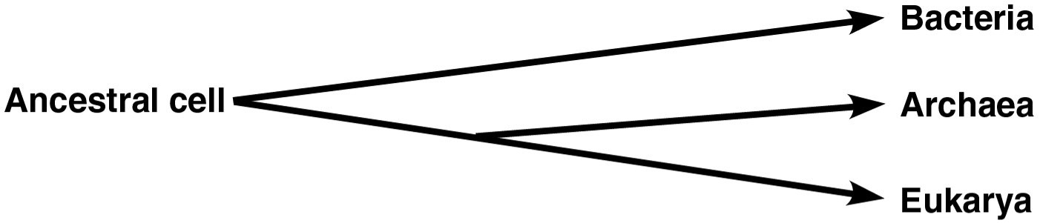
The Common Ancestor of Bacteria, Archaea, and Eukarya

Slide 23
There Are Several Limitations on Cell Size
Cells come in various sizes and shapes.
Some of the smallest bacteria are about 0.2–0.3 μm in diameter.
Some highly elongated nerve cells may extend a meter or more.
Despite the extremes, cells in general fall into predictable size ranges.

Slide 24
Size Ranges
Bacteria cells normally range from 1 to 5 μm in diameter.
Animal cells have dimensions in the range of 10–100 μm.
Cells are usually very small.
There are three main limitations on cell size.

Slide 25
Limitations on Cell Size
Cell size is limited by:
The requirement for adequate surface area relative to volume
The rates at which molecules can diffuse
The need to maintain adequate local concentrations of substances required for necessary cellular functions

Slide 26
Surface Area/Volume Ratio
In most cases, the major limit on cell size is set by the need to maintain an adequate surface area/volume ratio.
Surface area is important because exchanges between the cell and its surroundings take place at the cell surface.
The cell’s volume determines the amount of exchange that must take place across the available surface area.

Slide 27
Maintaining Adequate Surface Area/Volume Ratio
The volume of a cell increases with the cube of its length.
But the surface area of the cell increases with the square of its length, so larger cells have proportionately smaller surface areas.
Beyond a certain threshold, a large cell would not have a large enough surface area to allow for sufficient intake of nutrients and release of wastes.

Slide 28
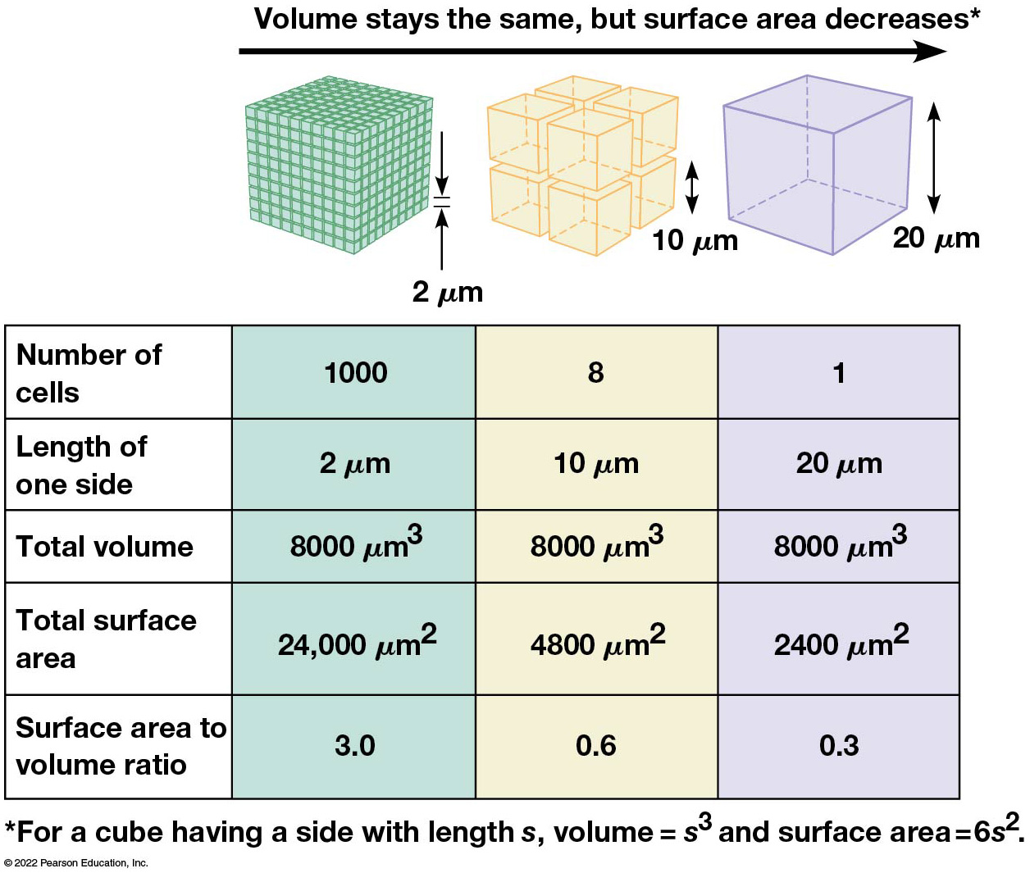
The Effect of Cell Size on the Surface Area/Volume
Figure 4.4 The Effect of Cell Size on the Surface Area/Volume Ratio.
Notes:
Long Description:
The first cube with the greatest surface area comprises of multiple smaller cubes, each of side 2 micrometers. The second is made of many cubes of side 10 micrometers. The third with the least surface area is a single cube of side 20 micrometers.
The properties in the order of cubes with 2 micrometer, 10 micrometers, and 20 micrometers are as below:
Number of cells: 1000, 8, and 1
Length of one side: 2 micrometer, 10 micrometer, and 20 micrometer
Total volume: 8000 micrometer cubed, 8000 micrometer cubed, and 8000 micrometer cubed
Total surface area: 24,000 micrometer square, 4800 micrometer square, and 2400 micrometer square.
Surface area to volume ratio: 3.0, 0.6, and 0.3

Slide 29
Cells Specialized for Absorption
Cells that are specialized for absorption have characteristics to maximize their surface area.
For example, cells lining the small intestine have microvilli—fingerlike projections that increase the surface area.

Slide 30
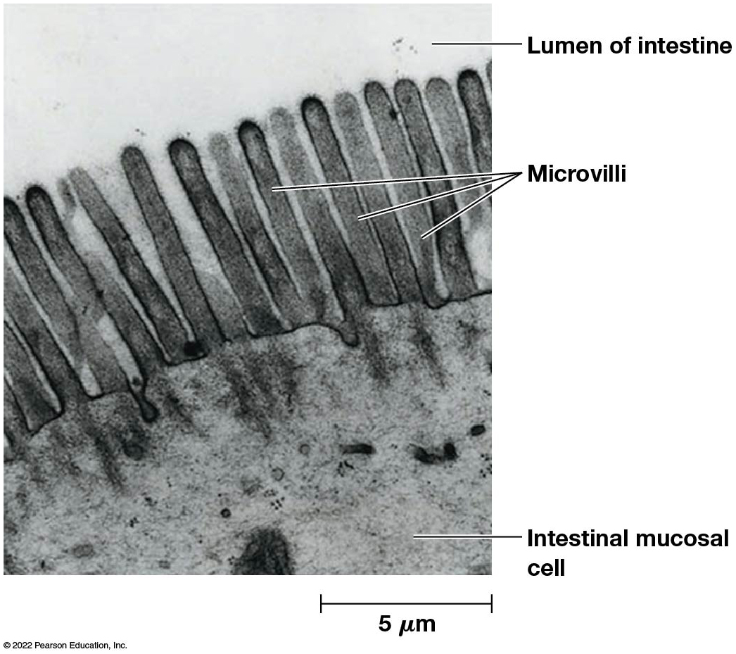
The Microvilli of Intestinal Mucosal Cells
Figure 4.5 The Microvilli of Intestinal Mucosal Cells.
Notes:
Long Description:
The measurement shows 5 micrometer at the right bottom corner.

Slide 31
Diffusion Rates of Molecules
The internal volume of the cell, not including the nucleus, is the cytoplasm.
Cytoplasm contains organelles, cytoskeletal fibers, and the semifluid cytosol in which they are suspended.
Many molecules move through this liquid-based environment by diffusion, the unassisted movement of a substance from a region of high concentration to a region of low concentration.

Slide 32
Limitation on Rates of Diffusion
The rate of diffusion of molecules decreases as the size of the molecule increases.
This limits diffusion for macromolecules such as proteins and nucleic acids.

Slide 33
Avoiding Limitations of Rates of Diffusion
Eukaryotic cells can avoid the problem of slow diffusion rates by using carrier proteins to actively transport materials through the cytoplasm.
Some cells use cytoplasmic streaming (cyclosis in plants) to actively move cytoplasmic contents.
Other cells move molecules through the cell in vesicles that are transported along protein fibers.

Slide 34
The Need for Adequate Concentrations of Reactants and Catalysts
For a reaction to occur, the reactants must collide with and bind to a particular enzyme.
The frequency of such collisions is greatly increased by higher concentrations of enzymes and reactants.
As cell size increases, the number of molecules increases proportionately with volume.

Slide 35
Compartmentalization of Cellular Activities
A solution to the concentration problem is the compartmentalization of activities within specific regions of the cell.
Most eukaryotic cells have a variety of organelles, membrane-bounded compartments that are specialized for specific functions.
For example, cells in a plant leaf have most of the materials needed for photosynthesis compartmentalized into structures called chloroplasts.

Slide 36
Bacteria, Archaea, and Eukaryotes Differ from Each Other in Many Ways
There are shared characteristics among cells of each of the domains, Bacteria, Archaea, and Eukarya.
However, each type of cell has a unique set of distinguishing properties.

Slide 37
Presence of a Membrane-Bounded Nucleus
A eukaryotic cell has a true, membrane-bounded nucleus.
The genetic information of a bacterial or archaeal cell is folded into a compact structure called the nucleoid and is attached to the cell membrane.

Slide 38
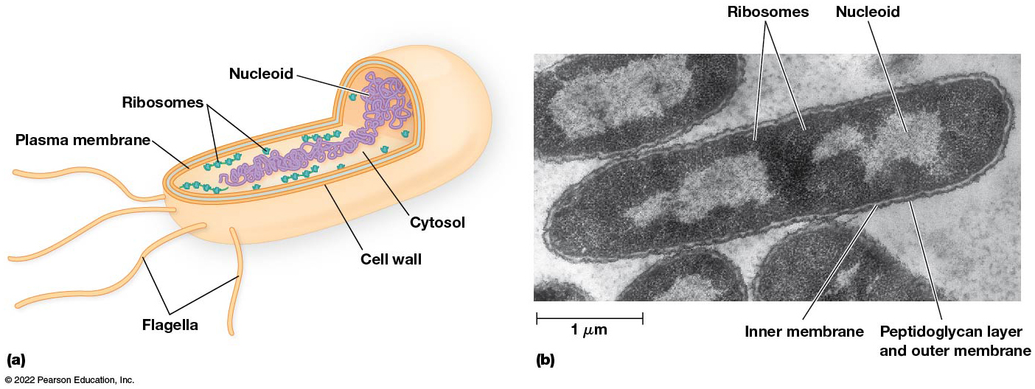
Structure of a Rod-Shaped Bacterial Cell
Figure 4.6 Structure of a Rod-Shaped Bacterial Cell.
Notes:
Long Description:
Image “a” shows the following parts of a rod shaped bacterial cell: cell wall, internal cytosol, a network of nucleoid, multiple ribosomes, plasma membrane, and flagella from the outer cell wall. The electron micrograph shows ribosomes, nucleoid, inner membrane, peptidoglycan layer, and an outer membrane of a rod shaped bacterium and the measurement is of 1 micrometer.

Slide 39
Use of Internal Membranes to Segregate Function
Bacterial and archaeal cells do not usually contain internal membranes.
A group of photosynthetic bacteria (cyanobacteria) have extensive internal membranes upon which photosynthetic reactions are carried out.
Some bacteria have membrane-bound or protein-lined structures that serve as (or resemble) organelles.

Slide 40
Internal Membranes in Eukaryotes
Nearly all eukaryotes make extensive use of internal membranes to compartmentalize specific functions and have numerous organelles.
Examples: endoplasmic reticulum, Golgi complex, mitochondria, chloroplasts, lysosomes, peroxisomes, and various types of vacuoles and vesicles.
Each organelle contains the materials and molecular machinery needed to carry out the functions for which the structure is specialized.

Slide 41
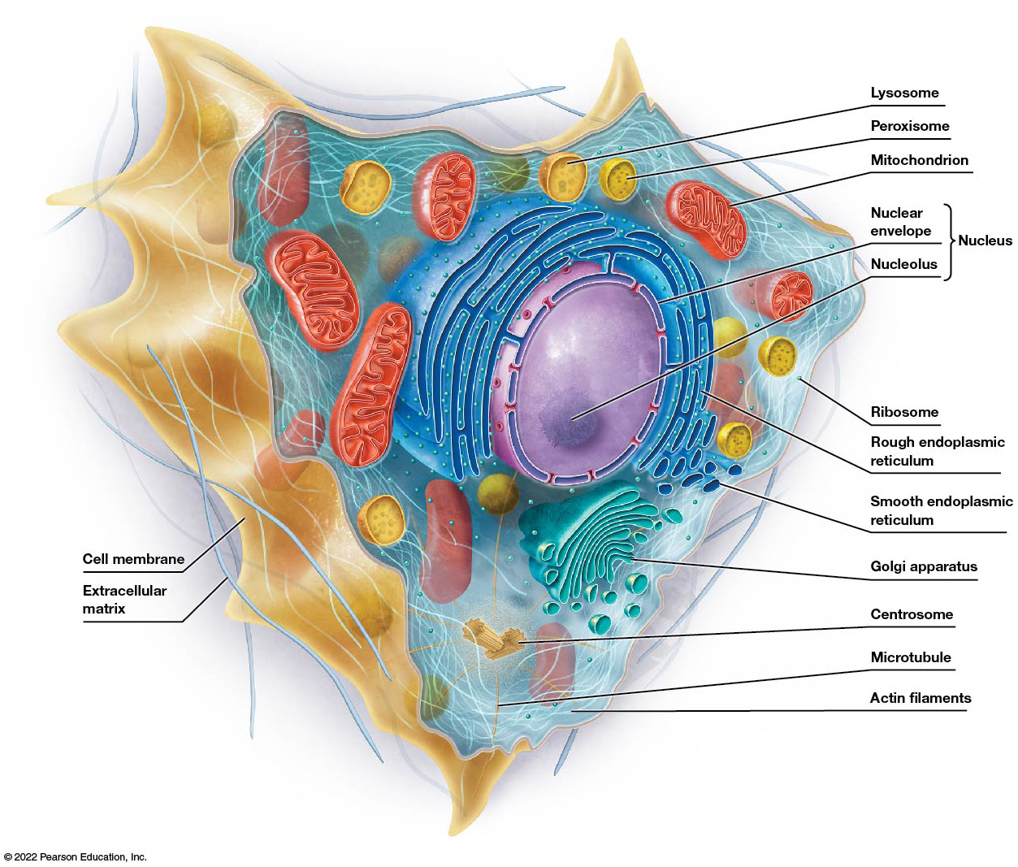
An Animal Cell
Figure 4.7 An Animal Cell.
Notes:
Long Description:
The parts of an animal cell are lysosome, peroxisome, mitochondrion, nucleus, ribosome, rough endoplasmic reticulum, smooth endoplasmic reticulum, Golgi apparatus, centrosome, microtubule, and actin filaments. The nucleus comprises of an inner nucleolus and an outer nuclear envelope.

Slide 42
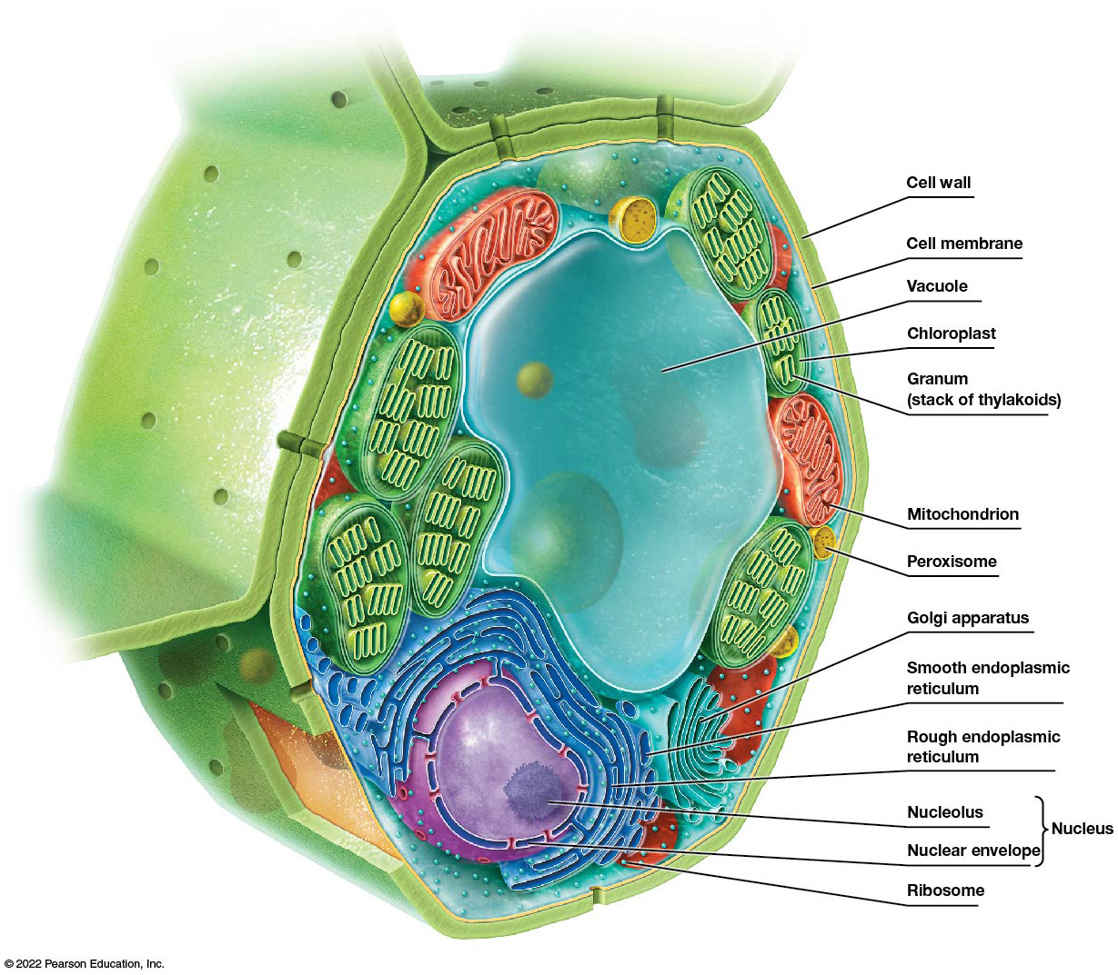
A Plant Cell
Figure 4.8 A Plant Cell.
Notes:
Long Description:
The different parts that are labeled are a large part of vacuole, chloroplast, granum or stack of thylakoids, mitochondrion, peroxisome, Golgi apparatus, smooth endoplasmic reticulum, rough endoplasmic reticulum, nucleus, and ribosome. The nucleus comprises of nucleolus and nuclear envelope.

Slide 43
Exocytosis and Endocytosis
Eukaryotic cells can exchange materials between compartments within the cell and the exterior of the cell.
This is possible through exocytosis and endocytosis, processes involving membrane fusion events unique to eukaryotic cells.

Slide 44
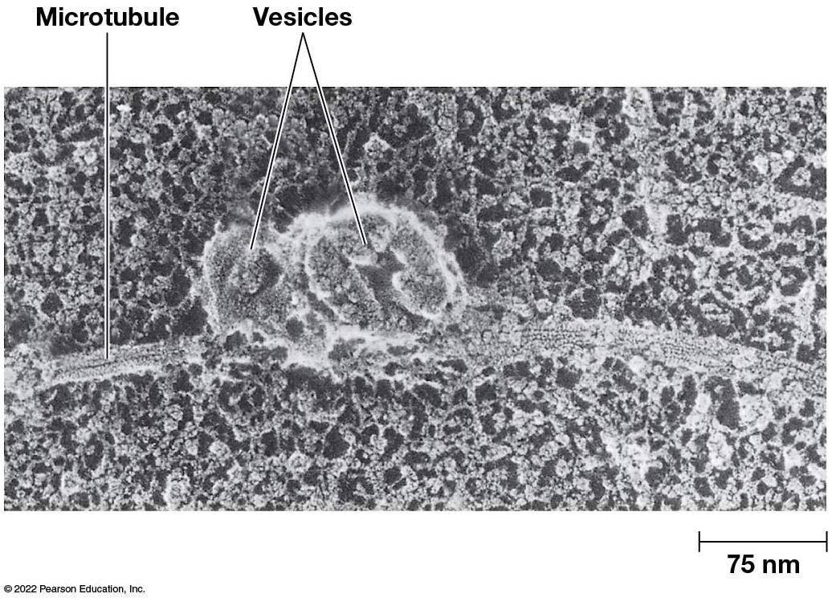
Vesicle Transport
Figure 4.9 Vesicle Transport.

Slide 45
Organization of D N A
Bacterial D N A is present in the cell as a circular molecule, called a chromosome, associated with few proteins.
Eukaryotic D N A is organized into linear molecules (chromosomes) complexed with large amounts of proteins called histones.
Archaeal D N A is circular and complexed with proteins similar to eukaryotic histone proteins.

Slide 46
D N A Packaging
The circular D N A of bacteria or archaea is much longer than the cell itself and so must be folded and packed tightly, equivalent to packing about 60 feet of thread into a thimble.
Eukaryotic cells have about 1000 times more D N A than bacteria.
The problem of D N A packaging is solved among eukaryotes by organizing the D N A into chromosomes.

Slide 47
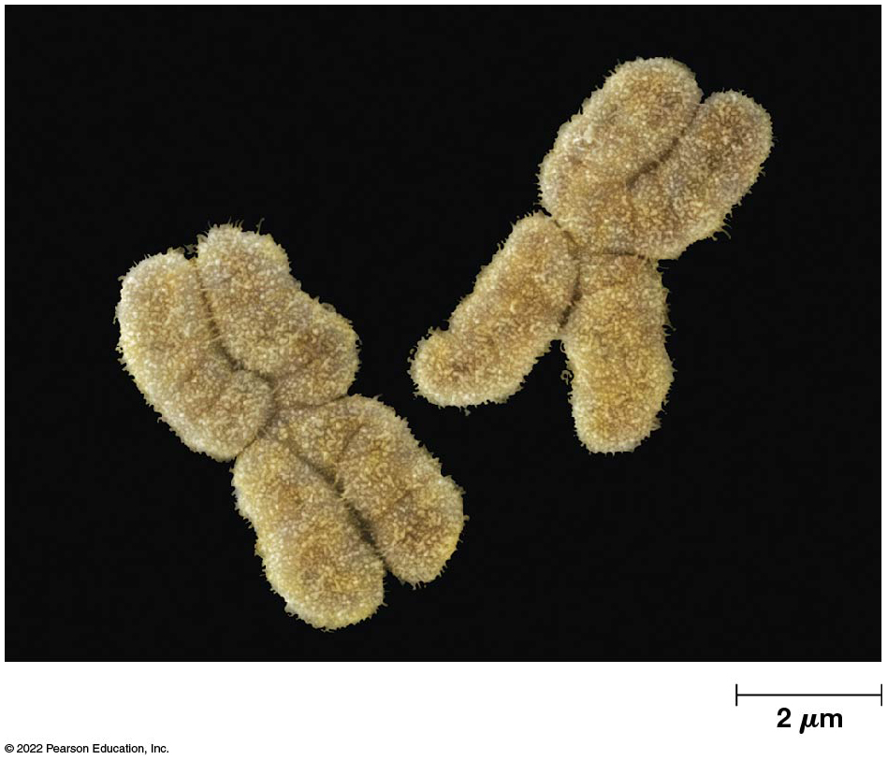
A Pair of Eukaryotic Chromosomes
Figure 4.10 A Pair of Eukaryotic Chromosomes.
Notes:
Long Description:
The measurement at the bottom left corner reads 2 micrometer.

Slide 48
Segregation of Genetic Information
Prokaryotes and eukaryotes differ in how genetic information is allocated to daughter cells upon division.
Bacterial and archaeal cells replicate their D N A and divide by binary fission, with one molecule of the replicated D N A and the cytoplasm going into each daughter cell.
Eukaryotic cells replicate D N A and then distribute their chromosomes into daughter cells by mitosis and meiosis, followed by cytokinesis, division of the cytoplasm.

Slide 49
Expression of D N A (1 of 2)
Eukaryotic cells transcribe genetic information in the nucleus into large R N A molecules that are processed and transported into the cytoplasm for protein synthesis.
Each mature R N A molecule typically encodes one polypeptide.
Bacteria transcribe genetic information into R N A, and the R N A molecules produced may contain information for several polypeptides.
There is very little R N A processing in bacteria.

Slide 50
Expression of D N A (2 of 2)
In archaea, there is a moderate amount of R N A processing.
In both bacteria and archaea, R N A molecules become involved in protein synthesis before transcription is complete.

Slide 51
4.3 The Eukaryotic Cell in Overview: Structure and Function
The structural complexity of eukaryotic cells is illustrated by the typical animal and plant cells.
A typical eukaryotic cell has a plasma membrane, a nucleus, membrane-bounded organelles, and the cytosol interlaced by a cytoskeleton.
In addition, plant and fungal cells have a rigid cell wall surrounded by an extracellular matrix.

Slide 52
The Plasma Membrane Defines Cell Boundaries and Retains Contents
The plasma membrane surrounds every cell.
It ensures that the cells contents are retained.
It consists of lipids, including phospholipids and membrane proteins, and is organized into two layers.

Slide 53
Amphipathic Membrane Components
Each phospholipid molecule consists of two hydrophobic “tails” and a hydrophilic “head” and is therefore an amphipathic molecule.
The lipid bilayer is formed when the hydrophilic heads face outward and the tails face inward.
Membrane proteins are also amphipathic; some, with polysaccharides attached to them, are called glycoproteins.

Slide 54
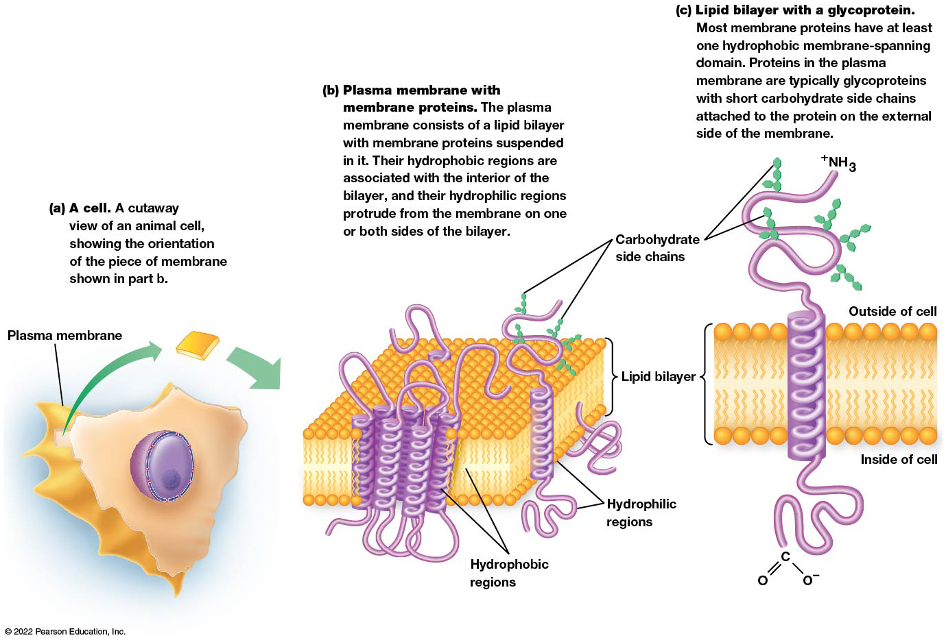
Organization of the Plasma Membrane
Figure 4.11 Organization of the Plasma Membrane.
Notes:
Long Description:
The details are as below:
Cutaway view of a cell: A cell. A cutaway view of an animal cell, showing the orientation of the piece of membrane shown in the next image, a close-up view. The cell is surrounded by a plasma membrane.
Close-up view of a section of plasma membrane: Plasma membrane with membrane proteins. The plasma membrane consists of a lipid bilayer with membrane proteins suspended in it. Their hydrophobic regions are associated with the interior of the bilayer and their hydrophilic regions protrude from the membrane on one or both sides of the bilayer. The parts labeled are: a lipid bilayer, carbohydrate side chains on the top of the lipid bilayer, and hydrophilic regions passing through the lipid bilayer.
Membrane section view: Lipid bilayer with a glycoprotein. Most membrane proteins have at least one hydrophobic membrane-spanning domain. Proteins in the plasma membrane are typically glycoproteins with short carbohydrate side chains attached to the protein on the external side of the membrane. The parts labeled on the outside of the cell are carbohydrate side chains and N H subscript 3 at one end of the hydrophobic region. The other end that passes through the lipid bilayer shows C double bond O and single bond O negative.

Slide 55
Proteins in the Plasma Membrane (1 of 2)
Proteins in the plasma membrane play a variety of roles.
Enzymes catalyze reactions associated with the membranes, such as cell wall synthesis.
Others serve as anchors for structural components of the cytoskeleton.
Transport proteins move substances across the membrane.

Slide 56
Proteins in the Plasma Membrane (2 of 2)
Receptors for external signals trigger processes within the cell.
The latter two are transmembrane proteins.

Slide 57
The Nucleus Is the Information Center of the Eukaryotic Cell
The most prominent structure in the eukaryotic cell is the nucleus.
It contains the D N A and is surrounded by the nuclear envelope, composed of inner and outer membranes.
The nuclear envelope has numerous openings called pores, each of which is a transport channel lined with a nuclear pore complex.

Slide 58
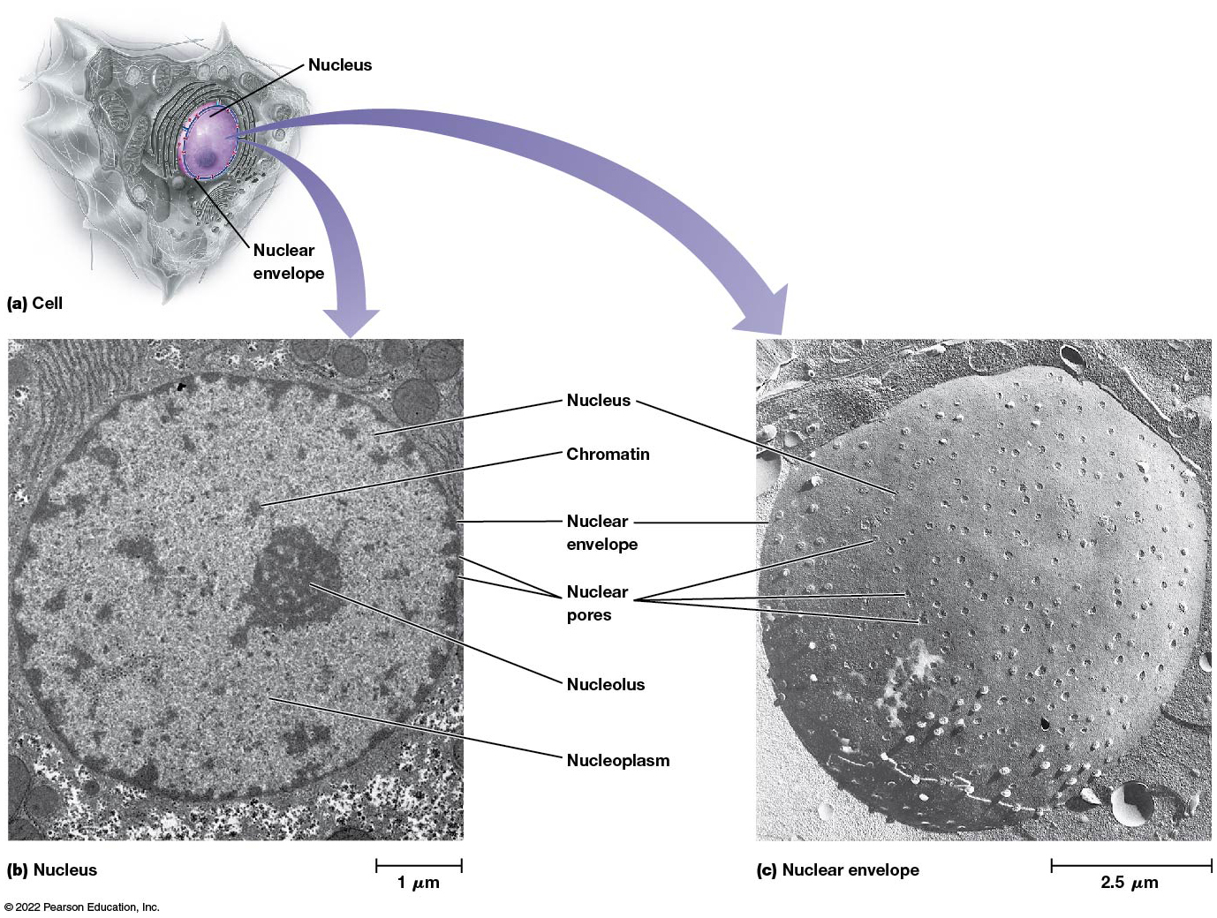
The Nucleus (1 of 2)
Figure 4.12 The Nucleus.
Notes:
Long Description:
The details are as below:
A cell: It shows a nucleus surrounded by a nuclear envelope at the center.
Nucleus of a rat liver and nucleus of the embryo of a fruit fly: Both the nuclei show the following parts in common: nucleus, nuclear envelope, and nuclear pores. The animal nucleus additionally shows chromatin and a central nucleolus surrounded by nucleoplasm. The animal nucleus shows a measurement of 1 micrometer at the left bottom corner and the plant nucleus shows 2.5 micro meter.

Slide 59
The Nucleus (2 of 2)
The number of chromosomes in the nucleus is a species-specific characteristic.
Chromosomes are most easily visualized during mitosis, whereas during interphase they are dispersed as chromatin and difficult to visualize.
Nucleoli (singular: nucleolus) are also present in the nucleus.
Nucleoli are responsible for synthesizing ribosomal R N A and beginning the assembly of proteins.

Slide 60
Mitochondria and Chloroplasts Provide Energy for the Cell
The mitochondrion and the chloroplast are organelles involved in energy production for cells.
The mitochondrion assists with the degradation of sugars.
The chloroplast harvests solar energy and converts it to chemical energy in the form of A T P.

Slide 61
The Mitochondrion (1 of 2)
Mitochondria, found in all eukaryotic cells, are the site of aerobic respiration.
They are comparable in size to bacteria.
Most eukaryotic cells contain hundreds of mitochondria, each of which is surrounded by an inner and outer mitochondrial membrane.

Slide 62
Mitochondrial Structure
The inner mitochondrial membrane encloses the matrix, a semifluid material filling the mitochondria.
The matrix includes small circular D N A molecules that encode some R N A s and proteins needed in the mitochondria.
It also contains ribosomes involved in protein synthesis.

Slide 63
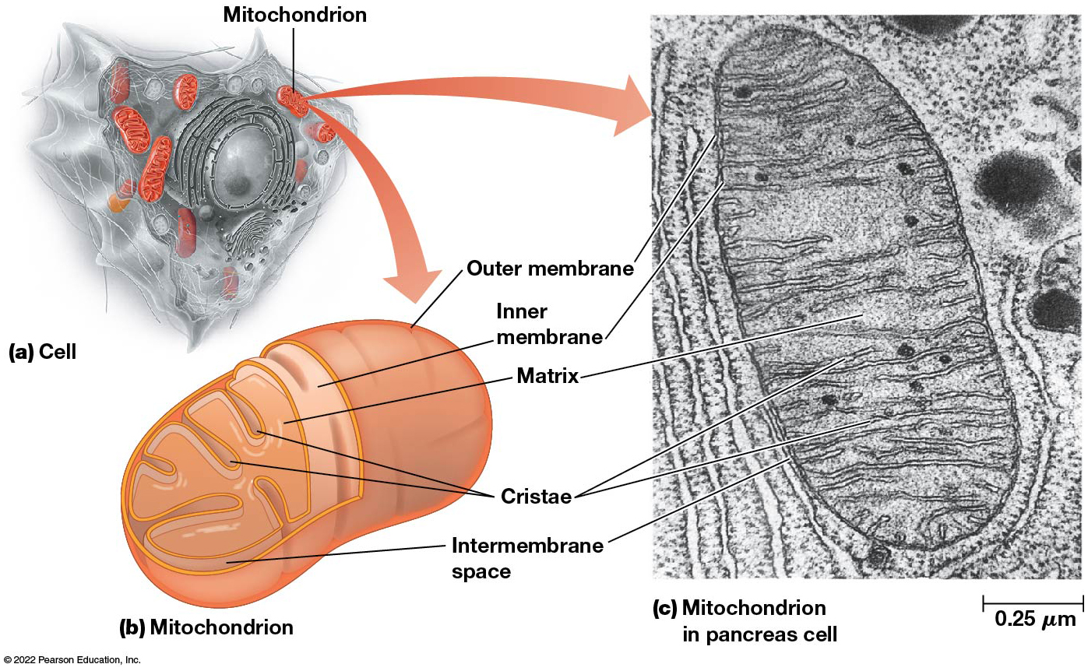
The Mitochondrion (2 of 2)
Figure 4.13 The Mitochondrion.
Notes:
Long Description:
The details are as below:
Cutaway view: The cutaway view of a cell shows multiple mitochondria surrounding the nucleus, suspended in the cytoplasm.
Schematic illustration: It shows an outer membrane, an inner membrane, matrix, cristae, and an intermembrane space.
Mitochondrion in pancreas cell: The electron microscopic view shows an outer membrane, an inner membrane, matrix, cristae, and an intermembrane space. The measurement at the left bottom corner reads 0.25 micrometer.

Slide 64
Mitochondrial Function
The mitochondrion contains enzymes and intermediates needed for oxidation of sugars and generation of adenosine triphosphate (A T P).
Many of these are found on cristae, infoldings of the mitochondrial membrane.
Cells with high energy needs have many mitochondria, located in the region of the cell where the need is greatest.
Such cells include sperm and muscle cells.

Slide 65
The Chloroplast (1 of 2)
The chloroplast is the site of photosynthesis in plants and algae.
They are large and can be quite numerous in the cells of green plants.
They are surrounded by both inner and outer membranes and contain a system of flattened membranous sacs called thylakoids (interconnected by stroma thylakoids), stacked into grana.

Slide 66
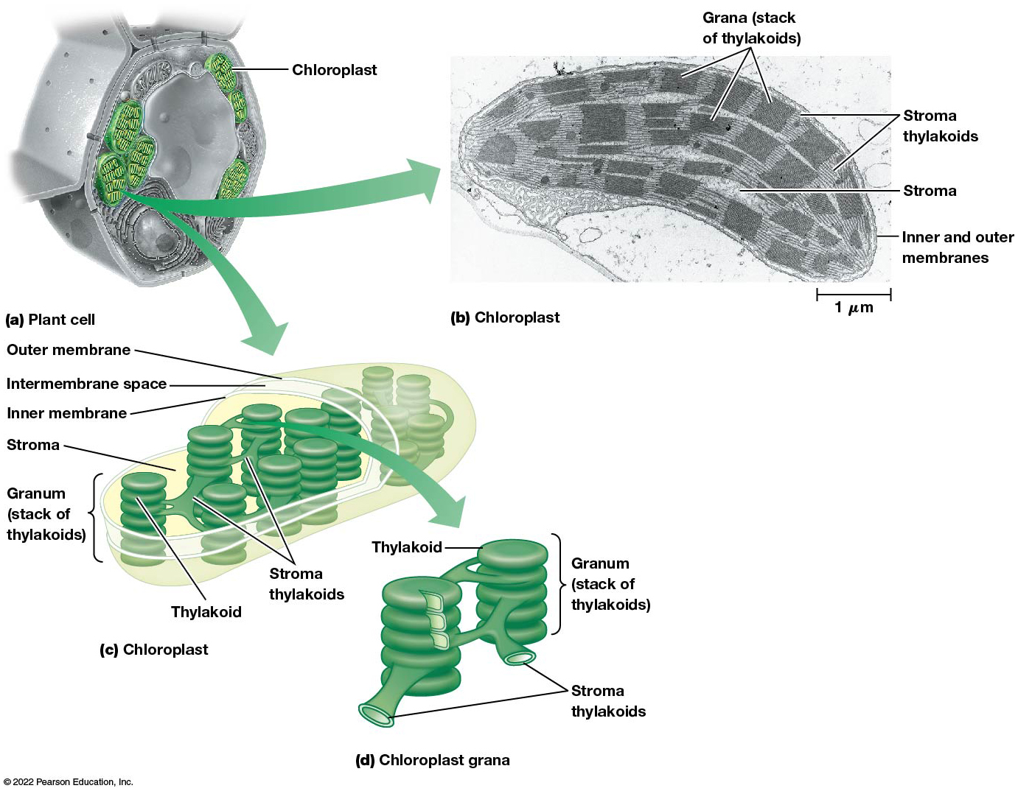
The Chloroplast (2 of 2)
Figure 4.14 The Chloroplast.
Notes:
Long Description:
The details are as below:
Cutaway view: The cutaway view of a cell shows the orientation of the chloroplast highlighted in green.
The electron microscopic view of chloroplast shows the grana which is the stack of thylakoids in rows and are joined by the stroma thylakoids. Stroma is found between the granum. The inner and the outer membranes are labeled. The measurements at the bottom right corner is 1 micrometer.
Schematic illustration: It shows an outer membrane, an inner membrane, the intermembrane space, the stroma, granum which is the stack of thylakoids, a thylakoid and the stroma thylakoids connecting the granum.
A cutaway view of the chloroplast grana shows two granum which is the stack of thylakoids connected by stroma thylakoid.

Slide 67
Chloroplast Function (1 of 2)
Chloroplasts are the site of photosynthesis, a process that uses solar energy and C O₂ to produce sugars and other organic compounds.
Chloroplasts are found in photosynthetic cells and contain most of the enzymes needed for photosynthesis.

Slide 68
Chloroplast Function (2 of 2)
Reactions that depend on solar energy take place in or on the thylakoid membranes.
Reactions involved in the reduction of C O₂ to sugar occur within the stroma, a semifluid in the interior of the chloroplast.
Chloroplasts contain their own ribosomes and a small, circular D N A molecule that encodes some R N A s and proteins needed in the chloroplast.

Slide 69
Plastids
Class of plant organelles
Chloroplasts are one of several types of plastids found in plant cells.
Chromoplasts are pigment-containing plastids responsible for the coloration of flowers, fruits, and other plant parts.
Amyloplasts are specialized for the storage of starches.

Slide 70
The Endosymbiont Theory Proposes That Mitochondria and Chloroplasts Were Derived from Bacteria
Mitochondria and chloroplasts are semiautonomous organelles, with many similarities to bacteria.
Semiautonomous organelles can divide on their own and contain their own D N A, m R N A, t R N A s, and ribosomes.

Slide 71
Other Similarities Between Mitochondria and Chloroplasts and Bacteria
Both resemble bacteria in size and shape and are surrounded by double membranes, the inner of which has bacterial-type lipids.
All have circular D N A molecules without associated histones.
r R N A sequences, ribosome size, sensitivities to inhibitors of R N A and protein synthesis, and type of protein factors used in protein synthesis are all similar.

Slide 72
The Endosymbiont Theory
The endosymbiont theory suggests that mitochondria and chloroplasts evolved from ancient bacteria that established a symbiotic relationship with primitive nucleated cells.
Evidence of this theory:
Mitochondria and chloroplasts have a double membrane (like bacteria).
The membranes have bacteria-like lipids and transmembrane proteins.

Slide 73
Outside-In Versus Inside-Out Theories of Eukaryotic Origins
Eukaryotic cells have a nuclear envelope and mitochondria.
Two classes of theories to account for these features: outside-in and inside-out theories.

Slide 74
Outside-In Theories
In the protoeukaryote (ancestor of eukaryotic cells) the nuclear envelop formed by an invagination of the cell’s plasma membrane and eventually surrounded the cell’s D N A.
These cells developed the ability to engulf nutrients and particles (phagocytosis), including bacteria and cyanobacteria.
Instead of digesting the smaller cells, they were surrounded by host cell membrane and evolved with the protoeukaryote.

Slide 75
Inside-out Theories
Some archaeal cells form protrusions.
The protoeukaryote cell could make these protrusions which led to the ability to interact with and engulf nearby bacteria. These enveloped bacteria could then evolve into mitochondria.
These protrusions also made it possible to form a primitive endoplasmic reticulum.
The nuclear membrane originated from the outer plasma membrane.

Slide 76
Three-Membrane Problem
In either the outside-in or inside-out theories, the mitochondria should have three membranes surrounding it—its own double membrane and one membrane from the host.
Mitochondria only have two membranes.

Slide 77
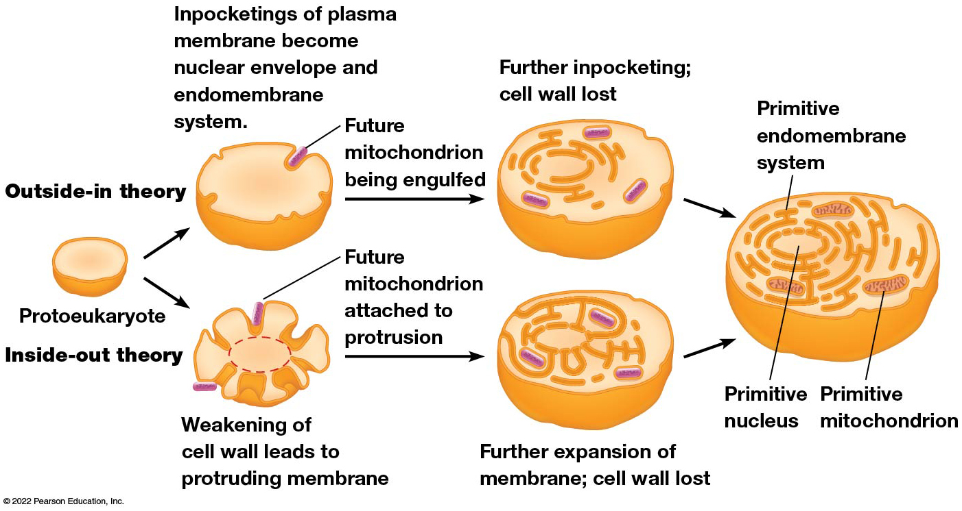
Theories of Endosymbiosis
Figure 4.15 Theories of Endosymbiosis.
Notes:
Long Description:
Outside-in theory: The process involves the following steps.
Protoeukaryote
Inpocketings of plasma membrane become nuclear envelope and endomembrane system.
Future mitochondrion is being engulfed.
Further inpocketing; cell wall lost.
Finally, there is a primitive endomembrane system, primitive nucleus, and primitive mitochondrion.
Inside-out theory: The process involves the following steps.
Protoeukaryote
Weakening of cell wall leads to protruding membrane
Future mitochondrion attached to protrusion
Further expansion of membrane; cell wall lost
Finally, there is a primitive endomembrane system, primitive nucleus, and primitive mitochondrion.

Slide 78
Mitochondria Evolution from Ancient Aerobic Bacteria
The first step toward evolution of mitochondria may have occurred when an anaerobic protoeukaryote ingested smaller aerobic bacteria by phagocytosis.
The aerobic bacteria were able to utilize glucose of the host cell efficiently in the presence of oxygen and could provide the anaerobic cell with additional energy.
This mutually beneficial relationship led to the gradual loss of independence of the bacterial cells.

Slide 79
Chloroplasts Evolution from Ancient Photosynthetic Bacteria
The first step toward evolution of chloroplasts may have occurred when an early eukaryotic cell (perhaps containing a primitive mitochondria) ingested primitive photosynthetic cells.
The ingested organism probably provided energy to the host cell in exchange for shelter and nutrients.
This mutually beneficial relationship led to the gradual loss of functions not needed in the photosynthetic cells’ new environment.

Slide 80
Endosymbiosis Is Still Occurring
Algae, dinoflagellates, diatoms, and photosynthetic bacteria live as endosymbionts in the cells of more than 150 existing protists and invertebrates.
Our ideas about how eukaryotic cells acquired their complex array of organelles must remain speculative because we can never test them directly.

Slide 81
The Endomembrane System Synthesizes Proteins for a Variety of Cellular Destinations
The endomembrane system synthesizes proteins destined for various organelles, cellular membranes, or secretion.
The proteins are packaged and then directed to various destinations around the cell in small membrane-bound vesicles.

Slide 82
The Endoplasmic Reticulum (1 of 2)
Almost every eukaryotic cell has a network of membranes in the cytoplasm, called the endoplasmic reticulum (E R).
It consists of tubular membranes and flattened sacs called cisternae.
The internal space of the E R is called the lumen.
The E R is continuous with the other membranes in the cell.

Slide 83
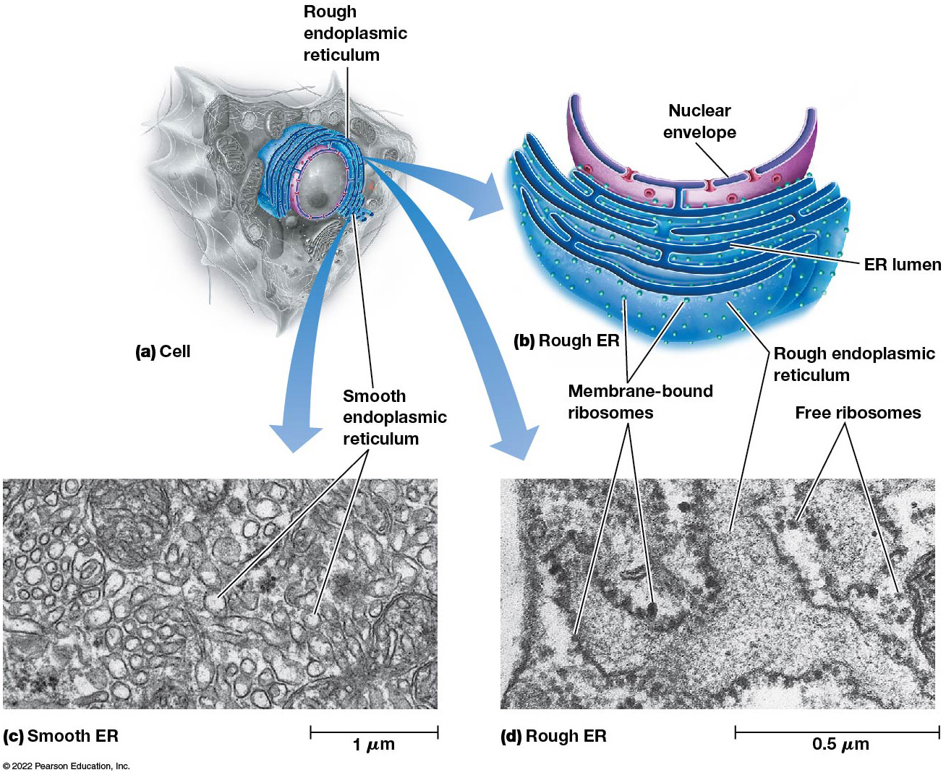
The Endoplasmic Reticulum (2 of 2)
Figure 4.16 The Endoplasmic Reticulum.
Notes:
Long Description:
The details are as below:
A cell: The nucleus in the center is surrounded by rough endoplasmic reticulum and smooth endoplasmic reticulum.
Rough E R: The nuclear envelope is at the center. It is surrounded by layers of E R membrane and the space inside the E R is the E R lumen. Many membrane-bound ribosomes are studded on the outer membrane of the E R and makes it appear rough.
Smooth E R: An electron micrograph shows multiple smooth E R in a cell. There are no membrane-bound ribosomes. The measurement at the bottom left corner reads 1 micro meter.
Rough E R: An electron micrograph shows multiple rough E R surrounding the nucleus in a cell. The membrane bound ribosomes and free ribosomes are seen. The measurement at the bottom left corner reads 0.5 micro meter.

Slide 84
Rough Endoplasmic Reticulum
E R can be rough or smooth in appearance.
Rough E R is studded with ribosomes on the cytoplasmic side of the membrane.
These ribosomes synthesize polypeptides that accumulate within the membrane or are transported across it to the lumen.
Free ribosomes are not associated with the E R.

Slide 85
Smooth Endoplasmic Reticulum
Smooth E R has no role in protein synthesis.
It is involved in the synthesis of lipids and steroids such as cholesterol and its derivatives.
Smooth E R is responsible for inactivating and detoxifying potentially harmful substances.
Sarcoplasmic reticulum has critical functions in contraction.

Slide 86
The Golgi Apparatus (1 of 2)
The Golgi apparatus, closely related to the E R in proximity and function, consists of a stack of flattened vesicles known as cisternae.
It plays an important role in processing and packaging secretory proteins, and in synthesis of complex polysaccharides.
It accepts transition vesicles that bud off the E R.

Slide 87
The Golgi Complex Is Like a Processing Station
The contents of vesicles from the E R are modified and processed in the Golgi complex.
For example, secretory and membrane proteins are mainly glycosylated (the addition of short-chain carbohydrates), a process that begins in the E R and is completed in the Golgi complex.
The processed substances then move to other locations in the cell through vesicles that bud off the Golgi complex.

Slide 88
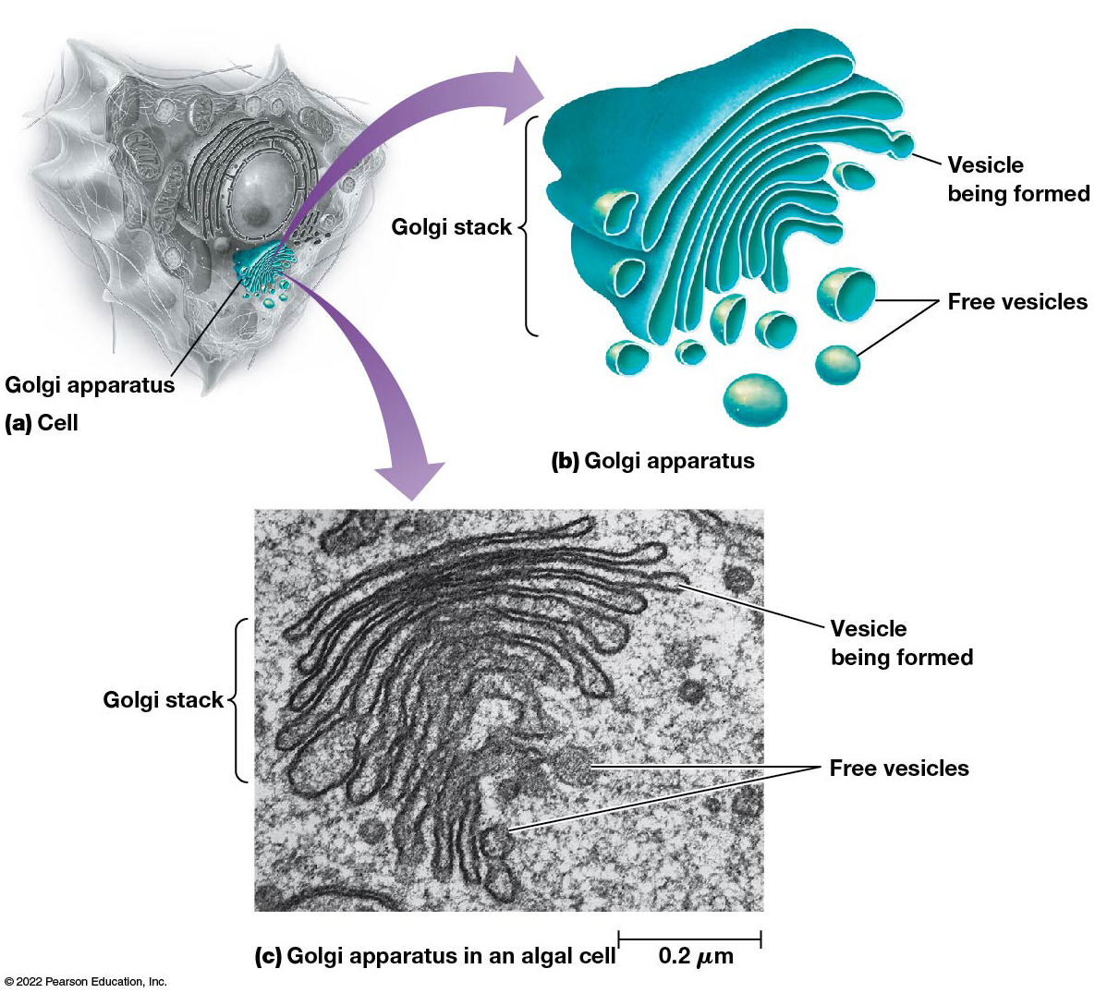
The Golgi Apparatus (2 of 2)
Figure 4.17 The Golgi Apparatus.
Notes:
Long Description:
The cell shows flattened vesicles in continuous layers termed as Golgi stack and free vesicles too. Together, this is termed Golgi apparatus.
The electron microscope shows vesicle being formed, free vesicles, and Golgi stack. The measurement at the bottom left corner is 0.2 micro meter.

Slide 89
Secretory Vesicles
Once processed by the Golgi complex, materials to be exported from the cell are packaged into secretory vesicles.
These move to the plasma membrane and fuse with it, releasing their contents outside the cell (exocytosis).
The E R, Golgi, secretory vesicles, and lysosomes make up the endomembrane system of the cell, responsible for trafficking substances through the cell.

Slide 90
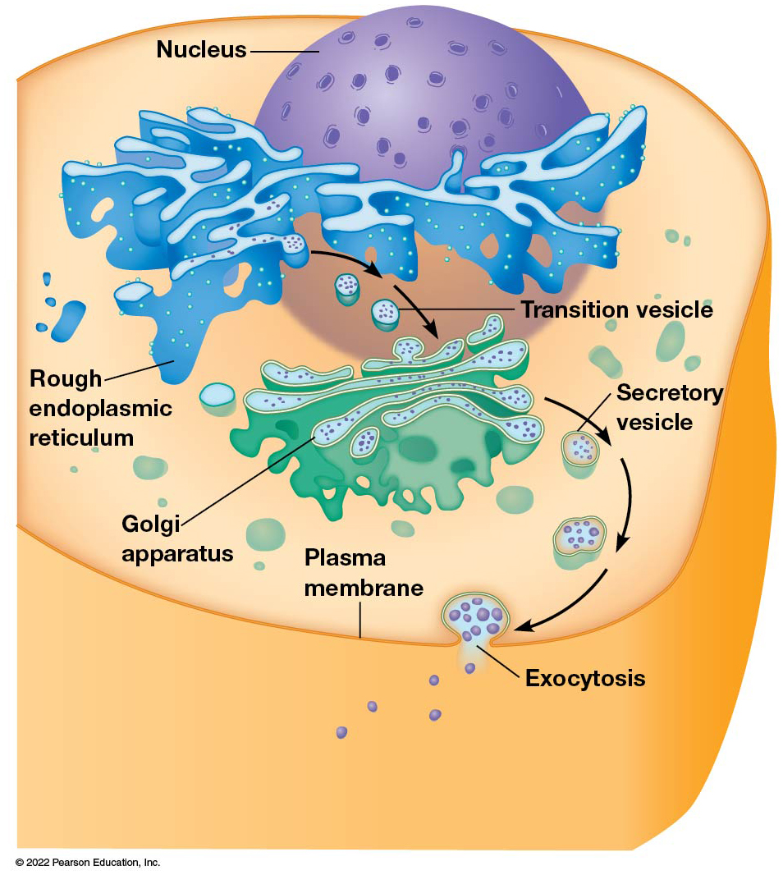
The Process of Secretion in Eukaryotic Cells
Figure 4.18 The Process of Secretion in Eukaryotic Cells.
Notes:
Long Description:
The plasma membrane is labeled as the outer layer of the cell. The nucleus is also labeled.

Slide 91
The Lysosome
Lysosomes are single-membrane organelles that store hydrolases, enzymes that can digest biological molecules.
Hydrolases are sequestered to prevent them from digesting the contents of the cell.
A special carbohydrate coating on the inner lysosome membrane protects it from digestion.

Slide 92
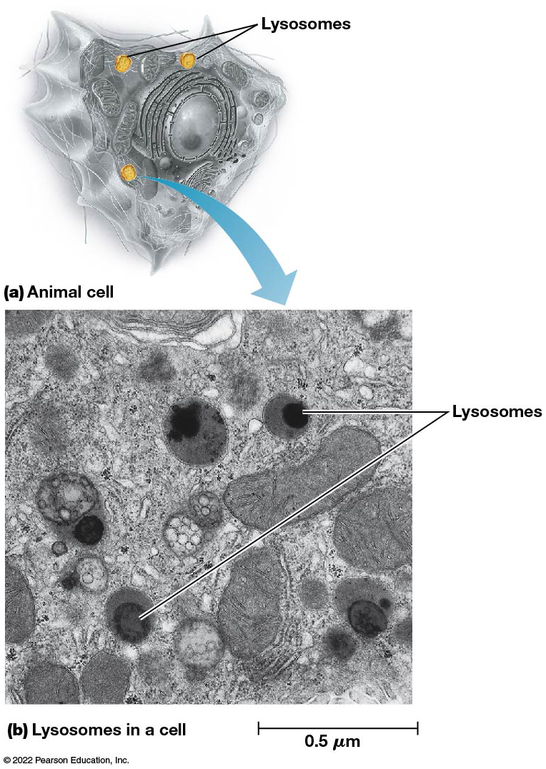
Lysosomes
Figure 4.19 Lysosomes.

Slide 93
Other Organelles Also Have Specific Functions
Peroxisomes and vacuoles are additional organelles with specialized cellular functions.

Slide 94
The Peroxisome
Peroxisomes resemble lysosomes in size and appearance.
They are surrounded by a single membrane and perform several functions depending on cell type.
Peroxisomes are especially prominent in the liver and kidney cells of animals.

Slide 95
Hydrogen Peroxide
H₂O₂ is highly toxic to cells but can be formed into water and oxygen by the enzyme catalase.
Eukaryotic cells have metabolic processes that produce H₂O₂.
These reactions are confined to peroxisomes that contain catalase, so that cells are protected from the harmful effects of peroxide.

Slide 96
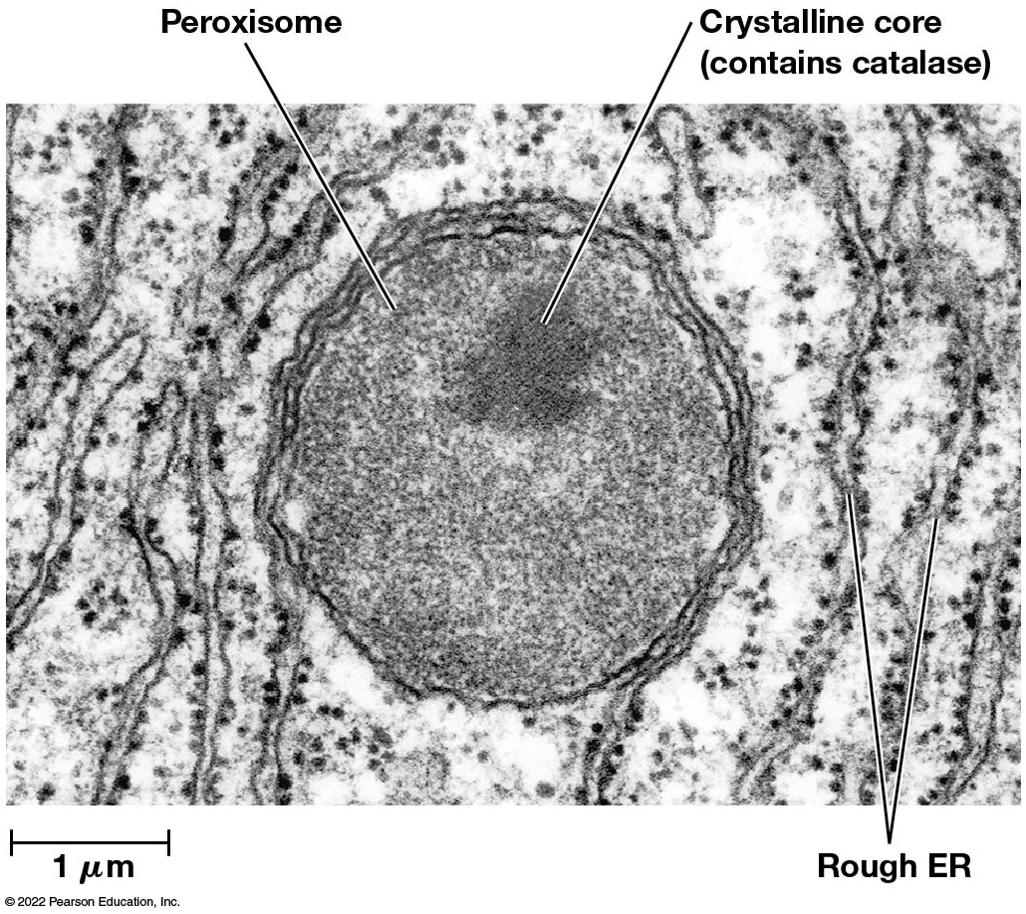
A Peroxisome in a Liver Cell
Figure 4.20 A Peroxisome in a Liver Cell.

Slide 97
Other Functions of Peroxisomes
Peroxisomes detoxify other harmful compounds and catabolize unusual substances.
In animals, they play roles in oxidative breakdown of fatty acids, especially longer-chain fatty acids (up to 22 carbon atoms).
Some serious human diseases result from defects in one or more peroxisomal enzymes, normally involved in degrading long-chain fatty acids.

Slide 98
Peroxisomes in Plants
During germination of fat-storing seeds, specialized peroxisomes called glyoxysomes play a role in converting the stored fat into carbohydrates.
Leaf peroxisomes are prominent in photosynthetic tissue because of their role in photorespiration, the light-dependent uptake of oxygen and release of carbon dioxide.

Slide 99
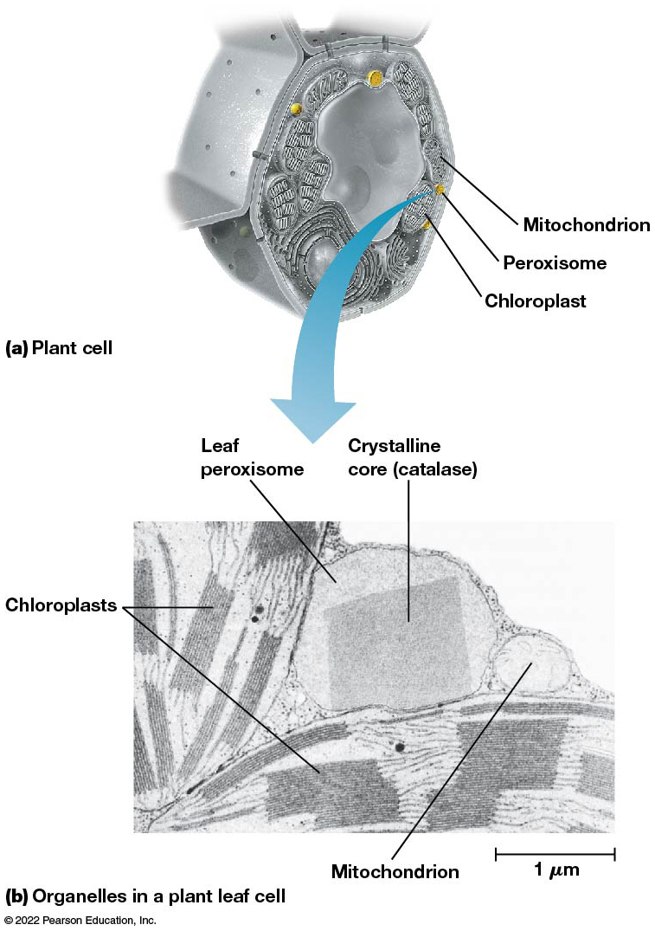
A Leaf Peroxisome and Its Relationship to Other Organelles in the Plant Cell
Figure 4.21 A Leaf Peroxisome and Its Relationship to Other Organelles in a Plant Cell.
Notes:
Long Description:
The cutaway view shows mitochondrion, peroxisome, and chloroplast surrounding the vacuole. An enlarged view of the peroxisome in a microscopic view shows crystalline core catalase in it. It lies closer to chloroplast and mitochondrion. The measurement at the bottom left corner reads 1 micro meter.

Slide 100
Vacuoles
Some cells contain a membrane-bounded vacuole.
In animal and yeast cells, vacuoles are used for temporary storage or transport.
Phagocytosis leads to the formation of a membrane-bounded particle called a phagosome.
When this type of vacuole fuses with a lysosome, the contents are hydrolyzed to provide nutrients to a cell.

Slide 101
Plant Vacuoles
Most mature plant cells contain a single large vacuole called a central vacuole.
The main function of the central vacuole is to maintain the turgor pressure that keeps the plant from wilting.
Tissues wilt when the central vacuole no longer presses against the cell contents (fails to provide adequate pressure).

Slide 102
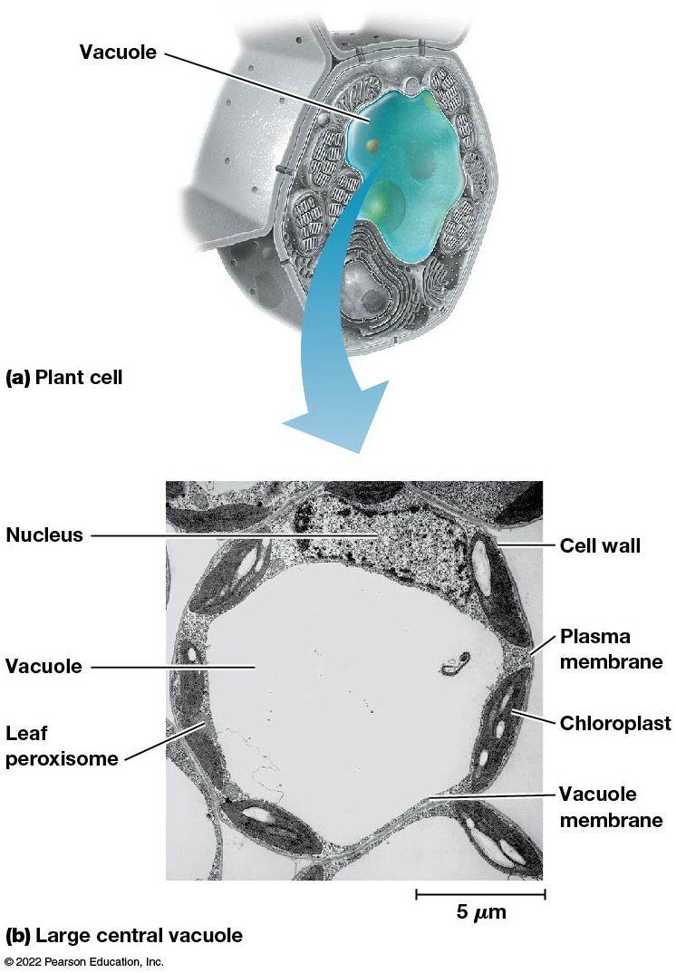
Normal and Sickled Red Blood Cells
Figure 4.22 The Vacuole in a Plant Cell.
Notes:
Long Description:
The micrograph shows an outer cell wall, then a plasma membrane surrounding a vacuole. The vacuole is surrounded by a vacuole membrane. The other parts labeled are nucleus, leaf peroxisome, and chloroplast. The measurement reads 5 micro meter at the bottom left corner.

Slide 103
Ribosomes Synthesize Proteins in the Cytoplasm
Ribosomes are the site of protein synthesis and are far more numerous than most other intracellular structures.
They are found in all cells but differ slightly in bacteria, archaea, and eukaryotes in their size and composition.
Each of these cell types has its own unique type of ribosomal R N A.

Slide 104
Ribosome Are Numerous and Ubiquitous
Ribosomes are much more numerous than most other cellular structures (prokaryote cells contain thousands; eukaryote cells may contain millions).
Ribosomes in mitochondria and chloroplasts are similar in size and composition to those of bacteria.
This is particularly true of the nucleotide sequences of their r R N A s.

Slide 105
Ribosomes Are Very Small
Ribosomes can be seen only under the electron microscope.
They have sedimentation coefficients in keeping with their small size.
Sedimentation coefficient: a measure of how rapidly a particle sediments in an ultracentrifuge, expressed in Svedberg units (S).
Ribosomes have values of 80S (eukaryotes) or 70S (bacteria and archaea).

Slide 106
Ribosome Subunits
Ribosomes have two subunits, the large and small subunits, with sedimentation coefficients of 60S and 40S, respectively.
Bacteria and archaea have large and small subunits of 50S and 30S, respectively.
The S values of large and small subunits do not add up to the value for the complete ribosome, because S values depend on both size and shape.

Slide 107
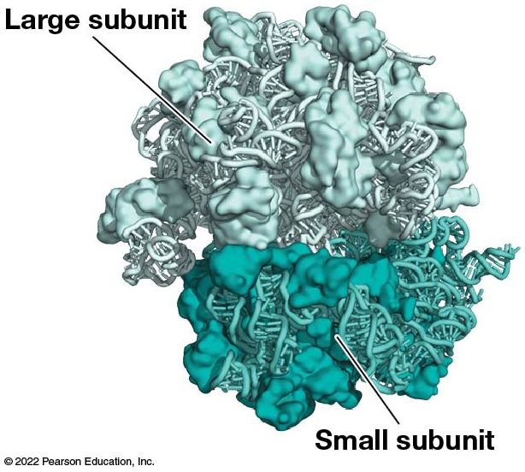
Structure of a Ribosome
Figure 4.23 Structure of a Ribosome.

Slide 108
The Cytoskeleton Provides Structure to the Cytoplasm
The cytoplasm of eukaryotic cells contains an intricate, organized, three-dimensional array of interconnected proteinaceous structures called the cytoskeleton.

Slide 109
The Cytoskeleton (1 of 2)
The cytoskeleton gives a cell its distinctive shape and internal organization.
It also plays a role in cell movement and cell division.
Proteins related to the eukaryotic cytoskeleton have recently been discovered in bacteria and archaea and appear to play a role in maintaining cell shape.

Slide 110
The Cytoskeleton (2 of 2)
The cytoskeleton serves as a framework for positioning and moving organelles and macromolecules within the cell.
It may do the same for ribosomes and enzymes.
Even some of the water within the cell (20–40%) may be bound to microfilaments and microtubules.

Slide 111
Components of the Cytoskeleton
There are three structural elements of the cytoskeleton:
Microtubules
Microfilaments
Intermediate filaments

Slide 112
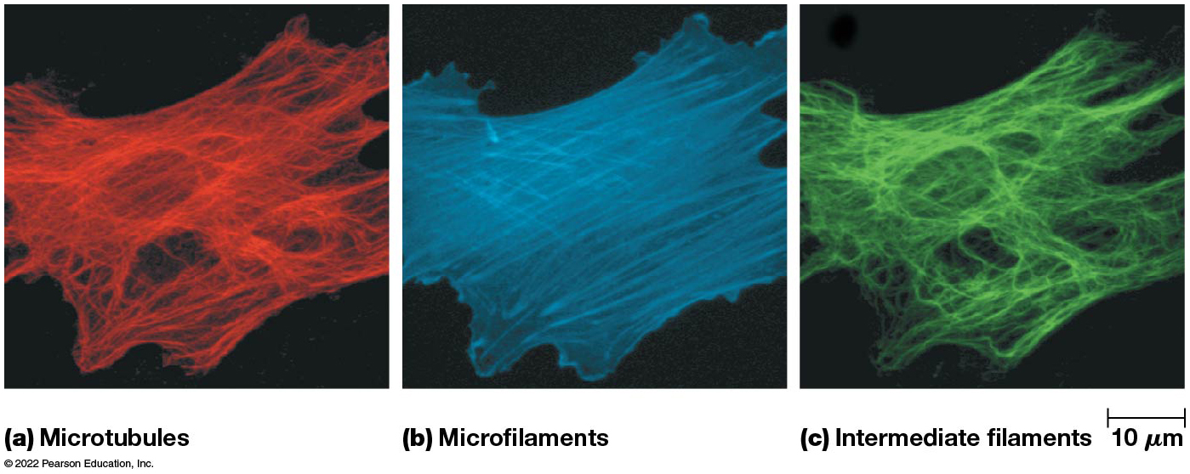
The Cytoskeleton
Figure 4.24 The Cytoskeleton.

Slide 113
The Extracellular Matrix and Cell Walls Are Outside the Plasma Membrane
Most cells are characterized by extracellular structures that give physical support to cells.
These structures often give physical support to the cell.

Slide 114
The ECM of Animal Cells
For many animal cells, these structures are called the extracellular matrix (E C M) and consist mainly of collagen fibrils and proteoglycans
The primary function of the E C M is support.
The types of materials and the patterns in which the E C M is deposited regulate a variety of processes.
In animal cells, the E C M compositions vary depending on the cell type.

Slide 115
The Plant and Fungal Cell Wall
For plant and fungal cells, the extracellular structures are cell walls.
They consist mainly of cellulose microfibrils in a matrix of polysaccharides and some proteins.

Slide 116
The Plant Cell Wall (1 of 2)
The primary cell wall is laid down during cell division and consists mainly of cellulose fibrils embedded in a polysaccharide matrix.
It is flexible and extensible.
The secondary cell wall forms when the plant cell reaches full size by deposition of additional cellulose and lignin on the inner surface of the primary cell wall.
It is rigid and inextensible.

Slide 117
Cell Communication
Plant cells are connected to neighboring cells by cytoplasmic bridges called plasmodesmata, which pass through the cell wall.
Plasmodesmata are large enough to allow the passage of water and small solutes from cell to cell.

Slide 118
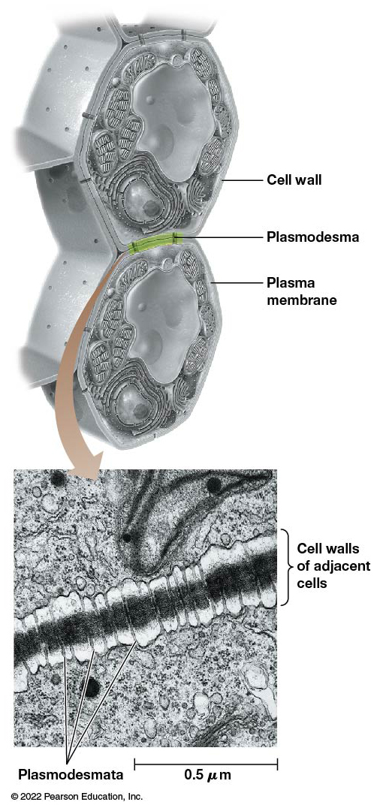
The Plant Cell Wall (2 of 2)
Figure 4.25 The Plant Cell Wall.

Slide 119
Bacterial Cell Walls
Bacterial cell walls are composed of peptidoglycans, long chains of G l c N A c and M u r N A c.
These are held together by peptide bonds between a small number of amino acids, forming a netlike structure.
There are additional substances specific to cell walls of major groups of bacteria.

Slide 120
Motility and the ECM
Plant cells are nonmotile and thus suited to the rigidity that cell walls confer on an organism.
Animal cells are motile and therefore are surrounded by a strong but elastic network of collagen fibers.
Bacteria and archaea may be motile or not; their cell walls provide protection from bursting due to osmotic differences between the cell and the surrounding environment.

Slide 121
4.4 Viruses, Viroids, and Prions: Agents That Invade Cells
There are several types of agents that invade cells, disrupt cell function, and even kill the host cell.
These include the viruses and the less well-understood viroids and prions.

Slide 122
A Virus Consists of a D N A or R N A Core Surrounded by a Protein Coat
Viruses are acellular parasitic particles incapable of a free-living existence.
They have no cytoplasm, organelles, or ribosomes and consist of only a few different molecules of nucleic acid and protein.
They invade and infect cells, using the host’s synthetic machinery to produce more virus particles.

Slide 123
Viruses
Viruses are responsible for many diseases in humans, animals, and plants.
They are significant research tools for cell and molecular biologists.
They are typically named after the disease they cause.
Viruses that infect bacteria are bacteriophages, or phages.

Slide 124
Structure of Viruses (1 of 2)
Viruses are small; the smallest are about the size of a ribosome, whereas the largest are about one-quarter the size of a bacterial cell.
Each virus has a characteristic shape, defined by its protein capsid.
Viruses are chemically quite simple, consisting of a coat (capsid) of protein surrounding a core containing D N A or R N A, depending on the type of virus.

Slide 125
Structure of Viruses (2 of 2)
Some viral capsids consist of a single type of protein, whereas more complex viruses have capsids with a number of different proteins.
Some viruses are surrounded by a membrane and are called enveloped viruses; H I V (human immunodeficiency virus) is an example.

Slide 126
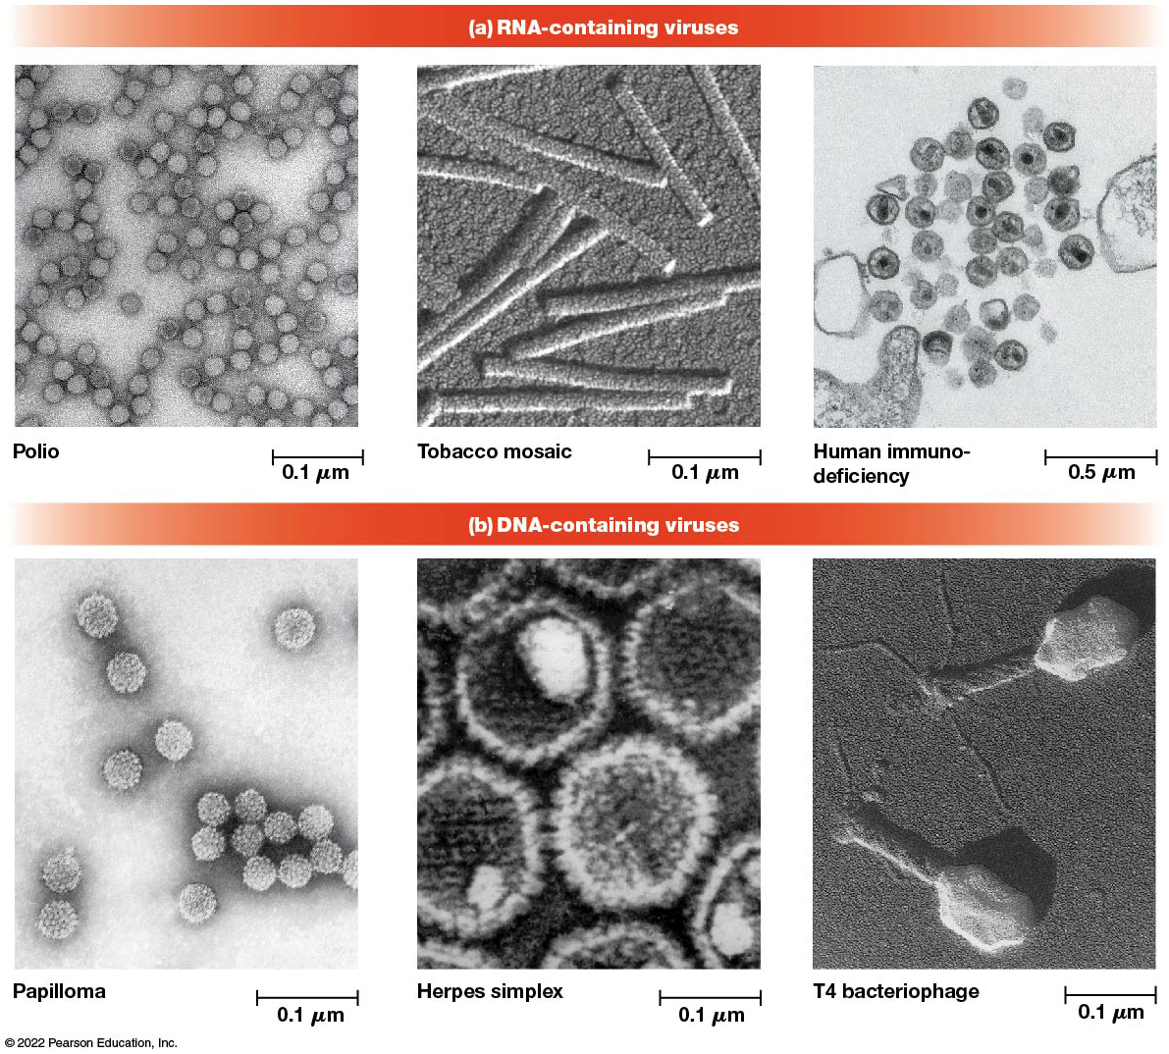
Sizes and Shapes of Viruses
Figure 4.26 Sizes and Shapes of Viruses.
Notes:
Long Description:
The three R N A hyphen containing viruses are circular polio, rod shaped tobacco mosaic, and irregularly spherical shaped human immuno-deficiency. The measurements at the left bottom corner for polio is 0.1 micro meter, tobacco mosaic is 0.1 micro meter, and human immune-deficiency is 0.5 micro meter.
The three D N A hyphen containing viruses are papilloma which are spherical and studded, herpes simplex, which is polygonal, and T 4 bacteriophage, which is T shaped. The measurements at the left bottom corner for all the three types is 0.1 micro meter.

Slide 127
Are Viruses Living?
Living things have the fundamental properties of
Metabolism (cellular reactions, in pathways)
Irritability (perception of and response to external stimuli)
Ability to reproduce
Viruses do not satisfy the first two, and though they reproduce, they can do so only via the machinery of a living cell.

Slide 128
Viroids Are Small, Circular R N A Molecules That Can Cause Plant Diseases
Viroids, found in some plant cells, are even simpler than viruses.
They are small, circular R N A molecules and are the smallest known infectious agents.
Viroids cause several diseases of crop plants such as cadang-cadang disease in coconut palms.
Viroids don’t exist freely and are transmitted when the surfaces of adjacent plant cells are damaged.

Slide 129
Prions Are Infectious Protein Molecules
Prions are proteinaceous infective particles that are responsible for neurological diseases such as scrapie, kuru, and mad cow disease.
Scrapie affects sheep and goats, causing infected animals to rub against trees or other objects, scraping their wool in the process.
Kuru is a progressive, degenerative disease of the central nervous system in humans.
Mad cow disease affects cattle.

Slide 130
Prions
Prions are abnormally folded versions of normal cellular proteins.
Prions cannot be destroyed by cooking or boiling.
In regions where the prion disease chronic wasting disease is found in deer and elk, hunters must have meat tested for the prion before eating it.

