Slide 1
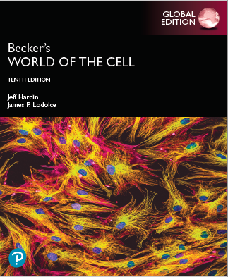
Becker’s World of the Cell
Tenth Edition, Global Edition
Chapter 24
The Cell Cycle and Mitosis
Lectures by Anna Hegsted, Simon Fraser University
Copyright © 2022 Pearson Education Ltd. All Rights Reserved.
Notes:
If this PowerPoint presentation contains mathematical equations, you may need to check that your computer has the following installed:
1) MathType Plugin
2) Math Player (free versions available)
3) NVDA Reader (free versions available)

Slide 2
The Cell Cycle and Mitosis
Cell growth is generally accompanied by cell division, whereby one cell gives rise to two new daughter cells.
The genetic information in the nucleus must be accurately duplicated (D N A replication) and carefully distributed to the daughter cells.
In doing this, a cell passes through a series of stages known as the cell cycle, which includes mitosis and cytokinesis.

Slide 3
24.1 Overview of the Cell Cycle
The cell cycle begins when two new cells are formed by division of a parent cell and ends when one of these cells divides again.
M phase is when the cells actually divide; the nucleus first, followed by the cytoplasm.
Nuclear division is mitosis, and division of the cytoplasm is cytokinesis.

Slide 4
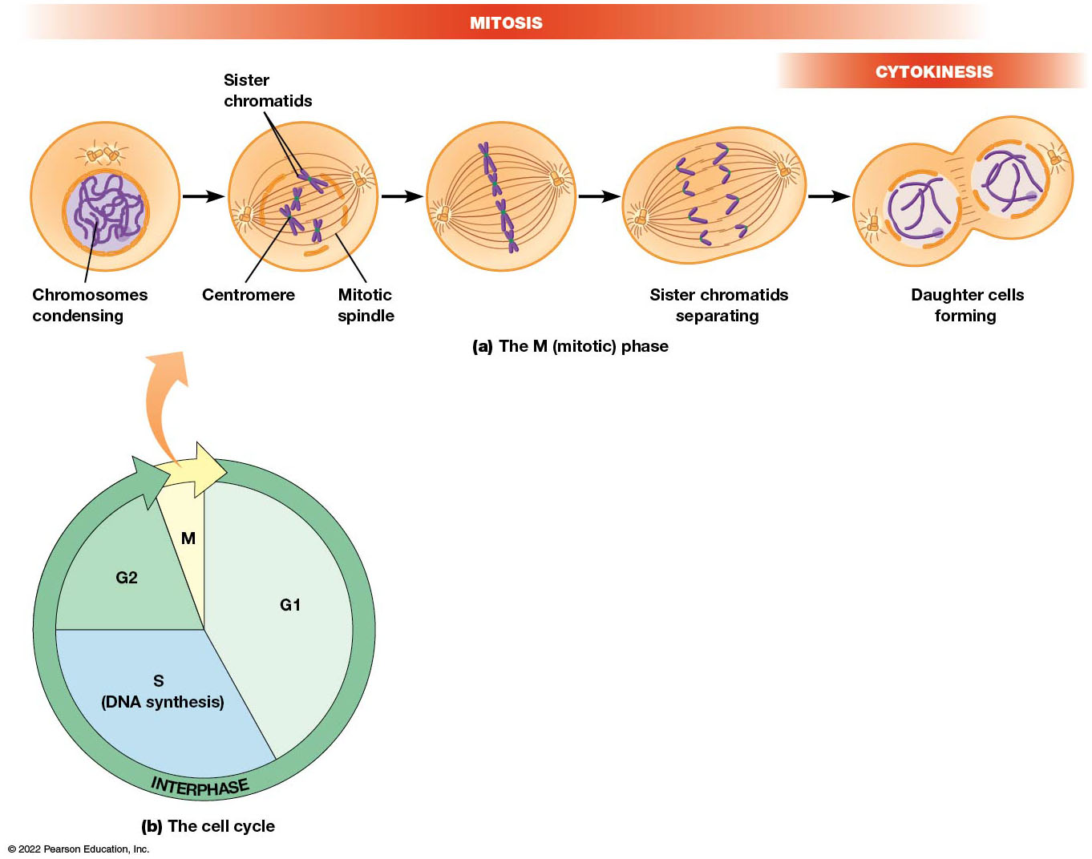
The Eukaryotic Cell Cycle
Figure 24.1 The Eukaryotic Cell Cycle.
Notes:
Long Description:
The mitotic phase:
The steps are as below:
Chromosomes condensing
Sister chromatids formation with centromere in the mitotic spindle.
The chromatids arrange in a perpendicular plane along a straight line.
Sister chromatids separate.
Cytokinesis: Formation of daughter cells.
The cell phase:
The cell phase consists of gap phase G1, DNA synthesis S phase, gap phase G 2, and M, which is the mitotic phase. The cell is in the intermediate phase between divisions.

Slide 5
Chromosomes in Mitosis
At the beginning of mitosis, chromatin folds and condenses to produce visible chromosomes.
D N A replicated during the S phase (before mitosis), so each chromosome is composed of two sister chromatids.
The microtubules of the mitotic spindle will distribute the chromatids to opposite ends of the cell.

Slide 6
Mitosis Is a Relatively Short Part of the Cell Cycle
Cells spend very little time in M phase.
Most of the time is spent in interphase, which is composed of G1 phase, S phase (when D N A is replicated), and G2 phase.
The overall length of the cell cycle is called the generation time; in cultured mammalian cells, this is about 18–24 hours.

Slide 7
Mitotic Index
The percentage of time in M phase is called the mitotic index.
It can be determined by examining a group of cells and determining the proportion that are in mitosis at any point in time multiplied by the generation time.
For cultured mammalian cells, it is 3–5% or 30–45 minutes.

Slide 8
The G Phases
G1 is quite variable depending on cell type; G2 is shorter and less variable.
During G1, a major decision is made whether a cell will divide again; cells that arrest in G1, waiting for a signal to divide, are said to be in G0 (G zero).
Cells that exit the cell cycle are said to undergo terminal differentiation.

Slide 9
Measuring the Length of the Stages
Classically, cells were exposed to radioactively labeled D N A precursors (usually ³H-thymidine) for a short period of time.
Cells are then examined by autoradiography.
Modern cell biologists use thymidine analogues, such as 5-bromodeoxyuridine (BrdU) or 5-ethynyl-2′-deoxyuridine (E d U).
The cells are then examined via fluorescence microscopy.

Slide 10
Techniques for Studying Cell Cycle
Flow cytometry is a technique that permits automated analysis of the chemical makeup of millions of individual cells.
The related technique, fluorescence-activated cell sorting (F A C S), allows physical sorting of cells.

Slide 11
24.2 Nuclear and Cell Division
The two copies of each chromosome made during S phase are distributed into daughter cells during M phase.
M phase includes nuclear division (mitosis) and cytoplasmic division (cytokinesis).

Slide 12
Mitosis Is Subdivided into Prophase, Prometaphase, Metaphase, Anaphase, and Telophase
Mitosis is divided into five stages based on changing appearance and behavior of chromosomes.
These are prophase, prometaphase, metaphase, anaphase, and telophase.

Slide 13
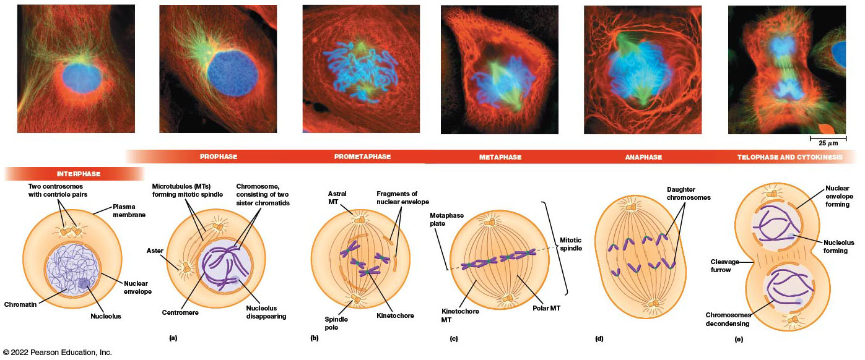
The Phases of Mitosis in an Animal Cell
Figure 24.2 The Phases of Mitosis in an Animal Cell.
Notes:
Long Description:
The details are as below:
Interphase:
The micrograph shows dense chromosomes surrounded by spindle of microtubule fibers, and intermediate filaments.
The illustration shows two centrosomes with centriole pairs in the cytosol within the plasma membrane. The nucleus has a nuclear envelope, a nucleolus, and chromatins within.
Prophase:
The chromosomes expand forming chromatids. The microtubules are in the process of splitting.
The illustration shows microtubules or MTs forming mitotic spindle and aster in the cytosol. Chromosome, consisting of two sister chromatids and centromeres is formed in the nucleus. The nucleolus starts disappearing.
Prometaphase:
There are two distinct microtubules and multiple chromatids in a network of intermediate filaments in the micrograph.
The illustration shows astral MT, spindle pole, fragments of nuclear envelope, and kinetochore.

Slide 14
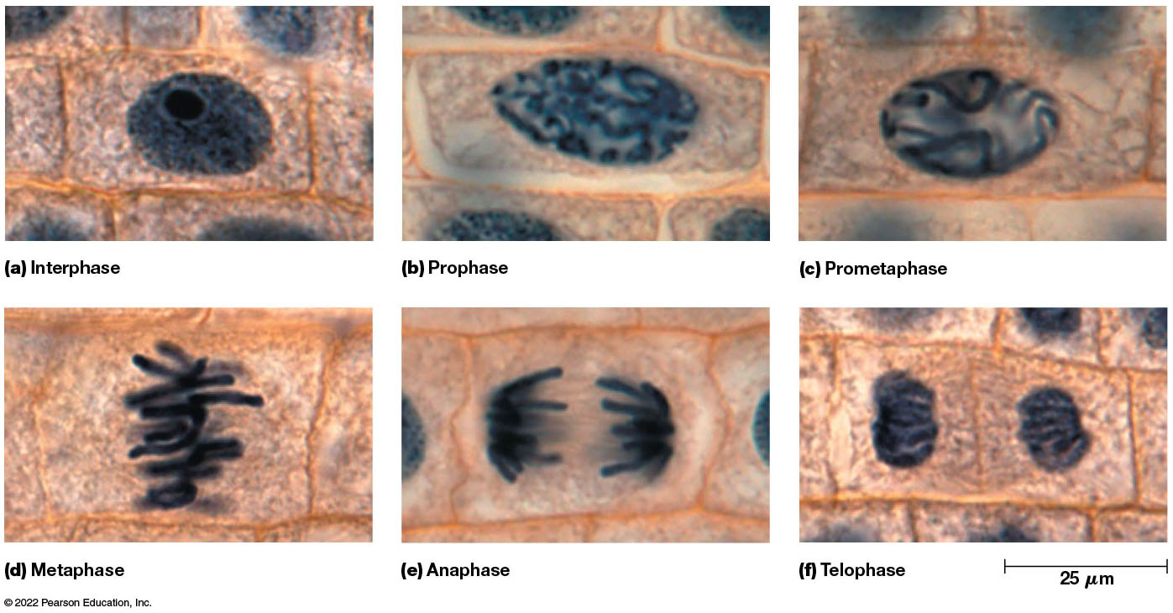
The Phases of Mitosis in a Plant Cell
Figure 24.3 The Phases of Mitosis in a Plant Cell.
Notes:
Long Description:
The details are as below:
Interphase: A dense nucleus with nucleolus.
Prophase: Formation of chromosomes.
Prometaphase: Distinct chromatids with centromeres.
Metaphase: Alignment of the chromatids along the metaphase plane.
Anaphase: Separation into two cells with spindles and daughter chromosomes.
Telophase: Two distinct cells with chromosomes and the measurement is 25 micrometers.

Slide 15
Prophase (1 of 3)
After D N A replication, cells exit S phase and enter G2 phase, where final preparations are made for entry into mitosis.
Toward the end of G2, chromosomes begin to condense into more compact, folded structures.
The G2 to prophase transition is not sharply defined, but cells are in prophase when individual chromosomes become visible.

Slide 16
Prophase (2 of 3)
Each prophase chromosome is composed of two sister chromatids, tightly attached to each other.
In animal cells, nucleoli disperse; but in plant cells, nucleoli may still be visible.
The centrosomes are a multiprotein complex that function as microtubule-organizing centers (M T O C). They are generally duplicated at S phase.
At the beginning of prophase, they migrate towards opposite ends of the nucleus.

Slide 17
Prophase (3 of 3)
Within the centrosomes are microtubule-containing structures called centrioles.
As centrosomes move, they act as nucleation sites for microtubules (M T s), destined to form the mitotic spindle.
A dense starburst of M T s called an aster forms near each centrosome.

Slide 18
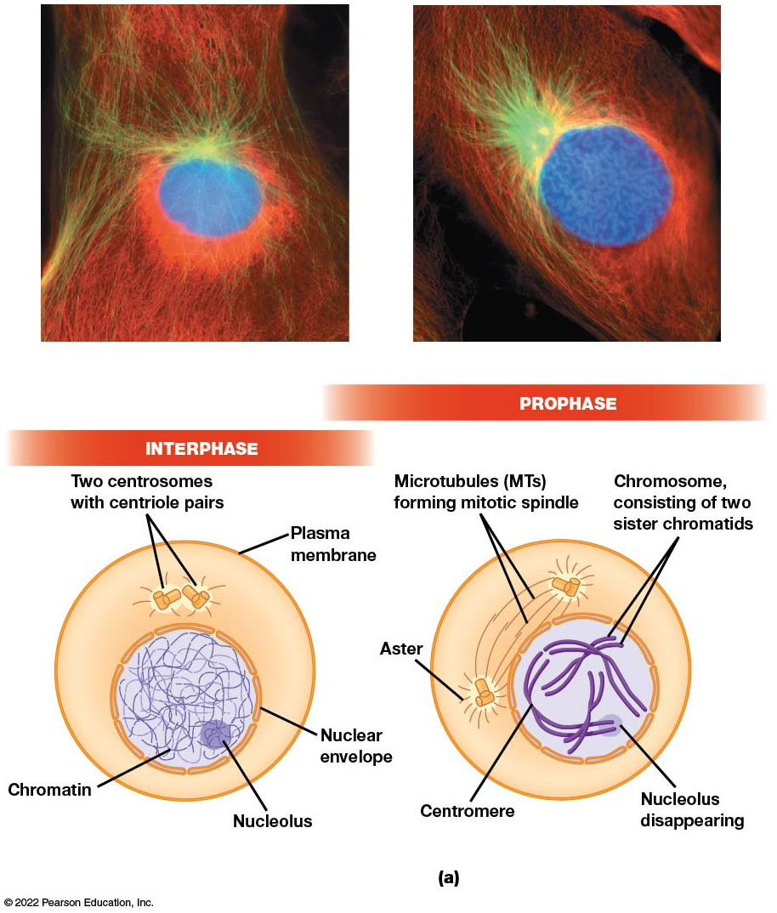
The Phases of Mitosis in an Animal Cell: Interphase and Prophase
Figure 24.2 The Phases of Mitosis in an Animal Cell.
Notes:
Long Description:
The two micrographs shows interphase and prophase of mitosis taking place in newt lungs cells. The blue coloured circle are chromosomes, green coloured branches are microtubules and red coloured portion represents intermediate filaments.
The illustration shows interphase of prophase with four chromosomes. In interphase, nucelolus and chromatin network can be seen enclosed in a nuclear envelope. Two centrosomes with centriole pairs are present. In prophase, nucleolus can be seen disappearing and chromosome with sister chromatids can be seen forming. Centromere is present in chromosomes. The microtubules can be seen forming a mitotic spindle with aster.

Slide 19
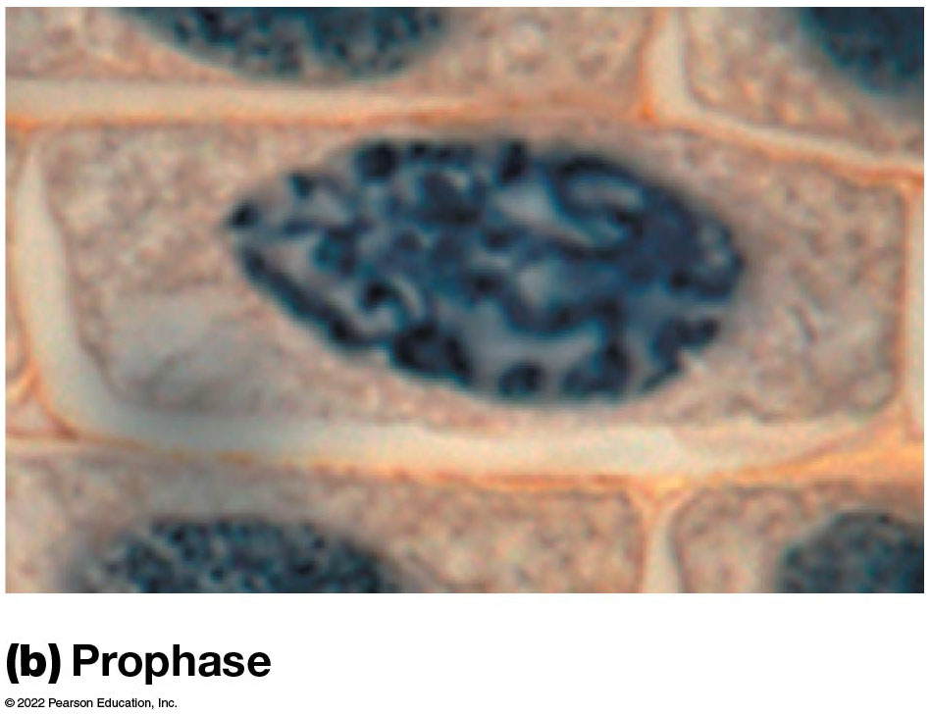
The Phases of Mitosis in a Plant Cell: Prophase
Figure 24.3 The Phases of Mitosis in a Plant Cell.

Slide 20
Prometaphase
The onset of prometaphase is marked by the fragmentation of the membranes of the nuclear envelope.
Centrosomes complete their movement to opposite sides of the nucleus, and the spindle M T s contact the condensed chromosomes.
M T s attach to chromosomes in the centromere region.

Slide 21
Prometaphase: Centromeres and Kinetochores
D N A in centromeres consists of simple, tandemly repeated C E N sequences, with considerable variation among species.
A common feature among species is the presence of a special histone H3 called C E N P-A in humans.
C E N P-A recruits additional proteins to the centromere to form the kinetochore, to which M T s attach.

Slide 22
Prometaphase: Kinetochores
Kinetochore proteins begin to assemble on centromeres shortly after S phase.
During prometaphase, spindle M Ts bind the kinetochores associated with each chromatid.
Forces exerted by these kinetochore microtubules (K-fibers) gradually move chromosomes toward the center of the cell.

Slide 23
Inner and Outer Kinetochore
The inner kinetochore contains proteins that bind to centromeric D N A.
The outer kinetochore contains proteins that attach to the plus ends of microtubules.
A specialized structure called the fibrous corona is visible when a kinetochore is not attached.

Slide 24
Prometaphase: Mature Kinetochores
Mature kinetochores have two main parts:
The constitutive centromere-associated network (C C A N) forms the centromere-associated inner part of a kinetochore. It contains C E N P and other proteins.
The K M N network forms the outer kinetochore.
The K M N network directly interacts with microtubules and the C C A N binds centromeric chromatin, bridging the M T and the chromosome.

Slide 25
Two Other Types of Microtubules
Polar microtubules interact with microtubules from the opposite pole of the cell.
Astral microtubules are shorter and form the asters at each pole.
Some of the astral microtubules interact with proteins lining the plasma membrane.

Slide 26
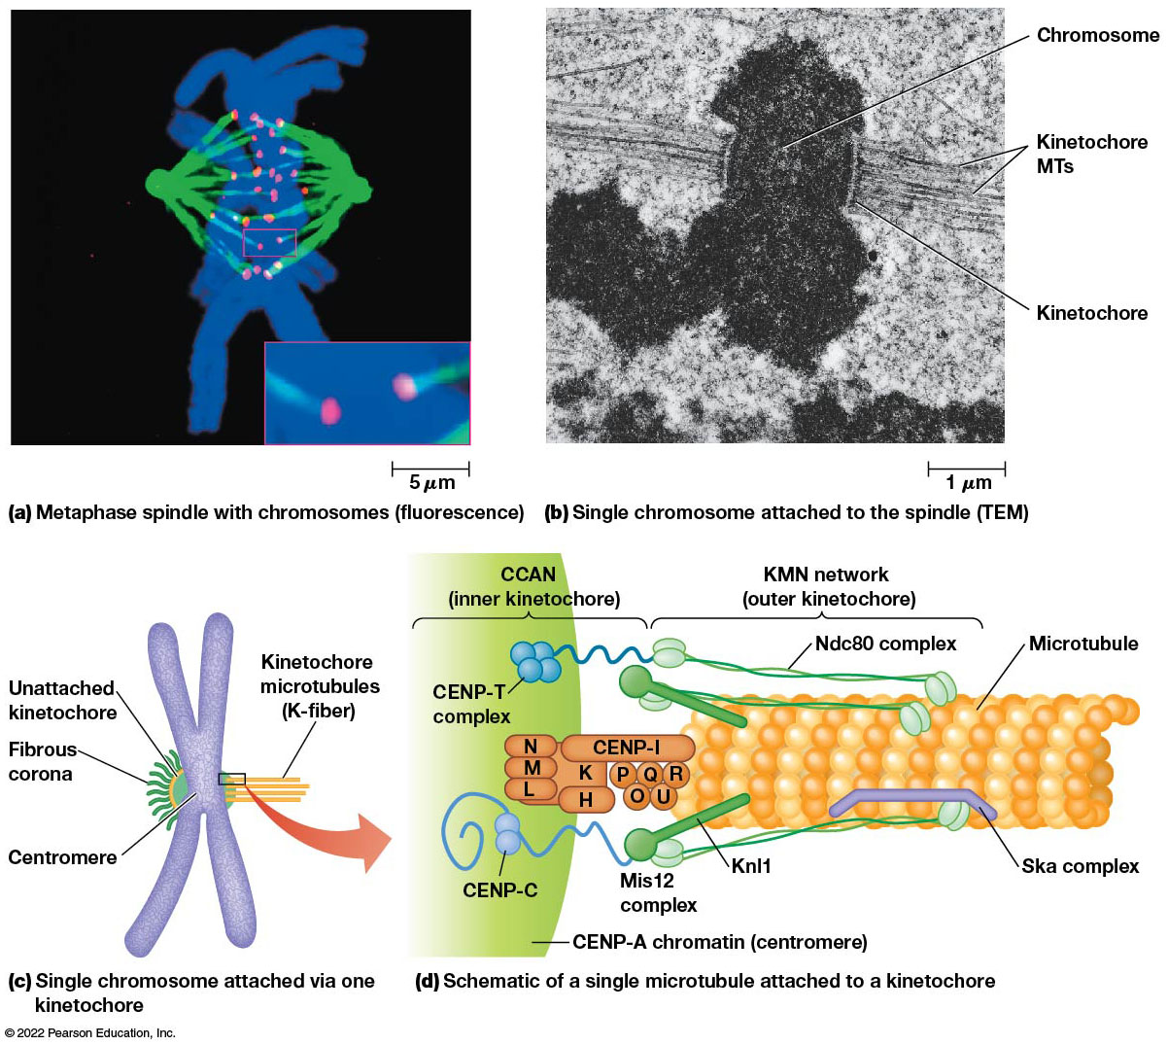
Attachment of Chromosomes to the Mitotic Spindle
Figure 24.4 Attachment of Chromosomes to the Mitotic Spindle.
Notes:
Long Description:
Metaphase spindle with chromosomes (fluorescence):
The measurement of the micrograph is 5 micrometers. It shows separation of two spindles and daughter chromosomes.
Single chromosome attached to the spindle (TEM):
The measurement is 1 micrometer. The parts labeled are chromosome, kinetochore MTs, and kinetochore.
Single chromosome attached via one kinetochore
The parts labeled are unattached kinetochore, kinetochore microtubules or K-fiber, fibrous corona, and centromere.
Schematic of a single microtubule attached to a kinetochore
The parts labeled are C CAN in inner kinetochore, KMN network in outer kinetochore, microtubule, Ska complex, Knl1, Mis12 complex, CENP-A chromatin or centromere, and CENP-C. The C CAN includes CENP-T complex and other cells. The KMN network includes Ndc80 complex.

Slide 27
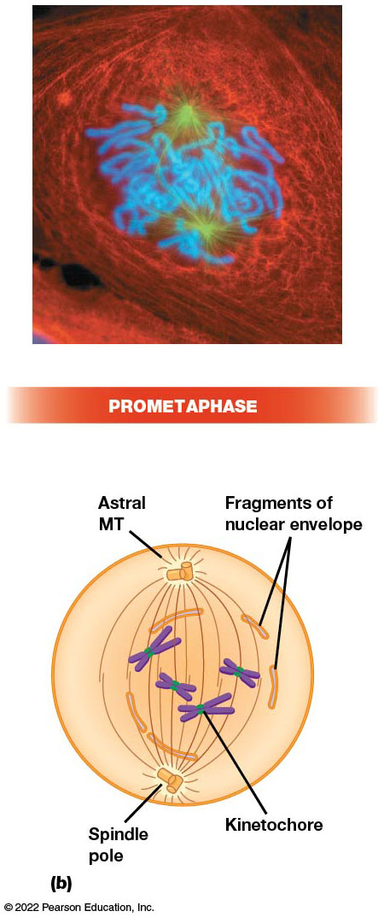
The Phases of Mitosis in Animal Cells: Prometaphase
Figure 24.2 The Phases of Mitosis in an Animal Cell.
Notes:
Long Description:
The newt lung cell when viewed under fluorescence microscope, the blue coloured parts are chromosomes, microtubules are green coloured parts and red coloured parts depict intermediate filaments.
The illustration shows fragmentation of nuclear envelope and formation of spindle poles. The kinetochore in chromosomes are depicted as green coloured dots in illustration.

Slide 28
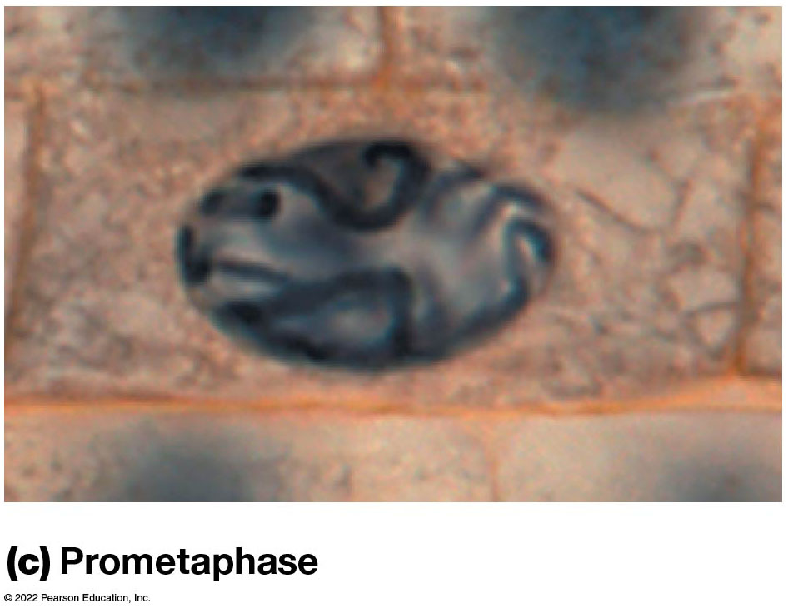
The Phases of Mitosis in Plant Cells: Prometaphase
Figure 24.3 The Phases of Mitosis in a Plant Cell.

Slide 29
Metaphase
In metaphase, the fully condensed chromosomes are all aligned at the metaphase plate (a plane equidistant between the two poles of the spindle).
Agents that interfere with spindle function (for example, colchicine) are used to arrest cells at metaphase.
During metaphase, the sister chromatids of each chromosome are being actively tugged toward opposite poles.

Slide 30
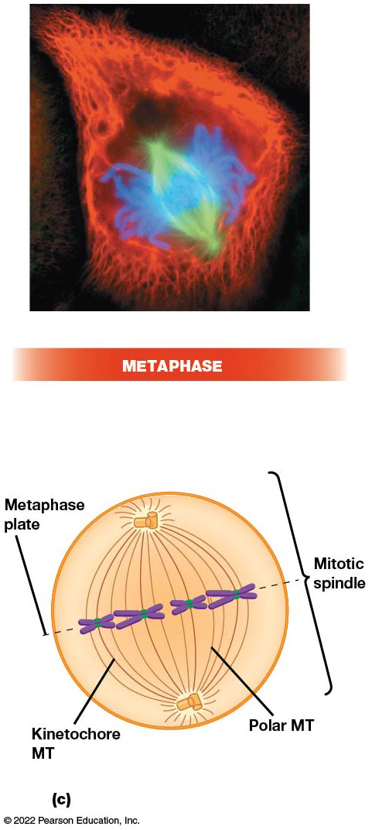
The Phases of Mitosis in Animal Cells: Metaphase
Figure 24.2 The Phases of Mitosis in an Animal Cell.
Notes:
Long Description:
In micrograph of metaphase, blue coloured parts are chromosomes, microtubules are green coloured parts and red coloured parts depict intermediate filaments.
In illustration of metaphase, the formation of metaplate can be seen along with mitotic spindle. The kinetochore MT and polar MT can be seen in the illustration.

Slide 31
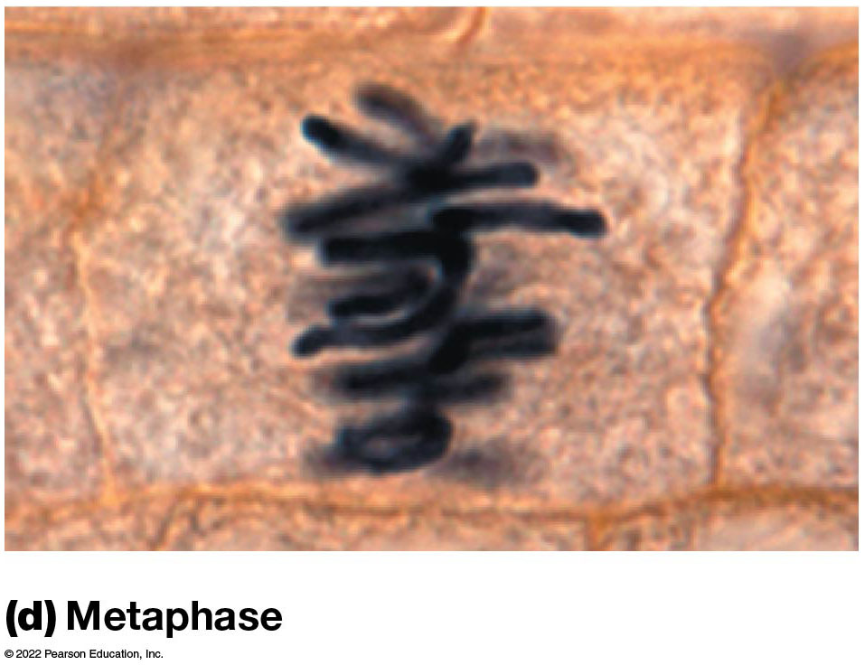
The Phases of Mitosis in Plant Cells: Metaphase
Figure 24.3 The Phases of Mitosis in a Plant Cell.

Slide 32
Anaphase (1 of 2)
Anaphase is the shortest phase of mitosis.
The two sister chromatids of each chromosome abruptly separate and move toward opposite poles.
In anaphase A, the chromosomes are pulled toward spindle poles as kinetochore M T s get shorter.

Slide 33
Anaphase (2 of 2)
In anaphase B, the spindle poles themselves move away from each other as polar M T s lengthen.
Depending on the cell type, anaphase A and B may take place at the same time, or anaphase B may follow anaphase A.

Slide 34
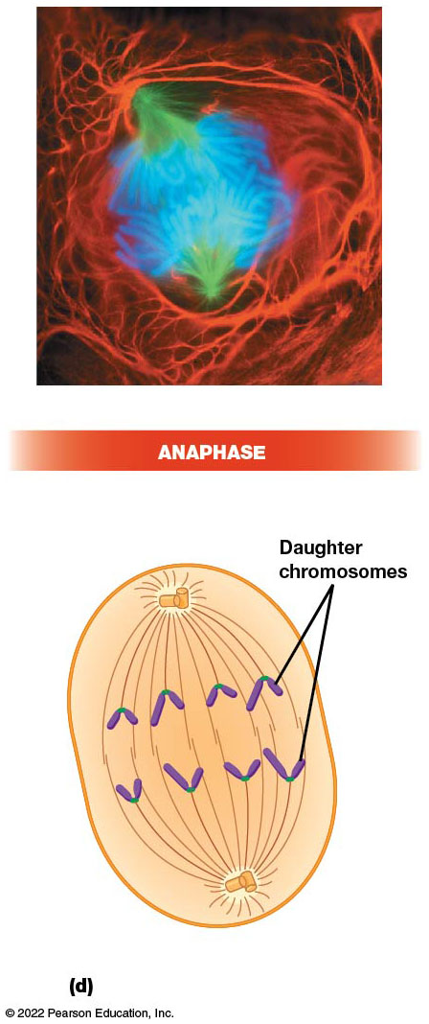
The Phases of Mitosis in Animal Cells: Anaphase
Figure 24.2 The Phases of Mitosis in an Animal Cell.
Notes:
Long Description:
In micrograph of anaphase, blue coloured parts are chromosomes, microtubules are green coloured parts and red coloured parts depict intermediate filaments.
In illustration of anaphase, the formation of daughter chromosomes can be seen.

Slide 35
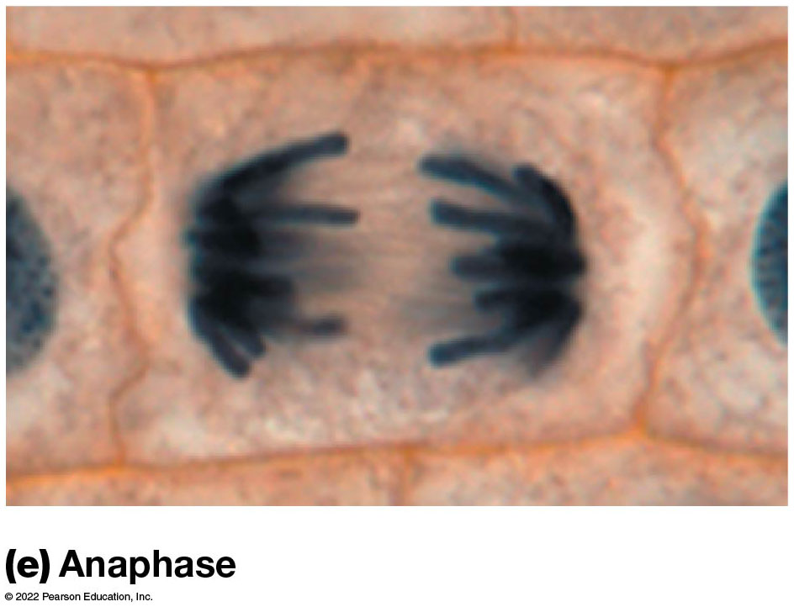
The Phases of Mitosis in Plant Cells: Anaphase
Figure 24.3 The Phases of Mitosis in a Plant Cell.

Slide 36
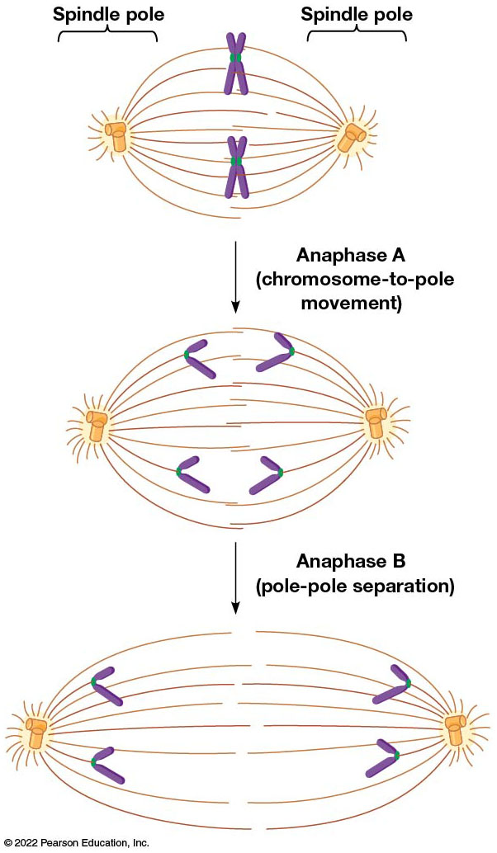
The Two Types of Movement Involved in Chromosomes Separation During Anaphase
Figure 24.5 The Two Types of Movement Involved in Chromosome Separation During Anaphase.

Slide 37
Telophase
At the beginning of telophase, the daughter chromosomes arrive at the poles of the spindle.
Chromosomes uncoil into interphase chromatin.
The mitotic spindle disassembles.
nuclear envelopes form around each group of chromosomes.
During this period, cytokinesis (generally) also takes place.

Slide 38
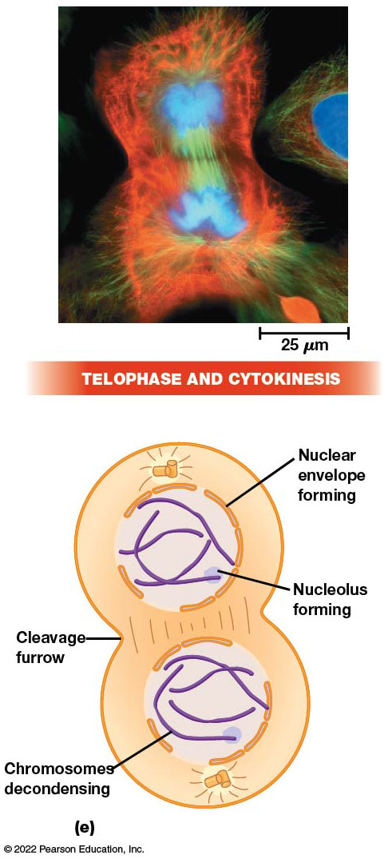
The Phases of Mitosis in Animal Cells: Telophase and Cytokinesis
Figure 24.2 The Phases of Mitosis in an Animal Cell.
Notes:
Long Description:
In micrograph of telophase and cytokinesis, blue coloured parts represents chromosomes, microtubules are shown by green colour and red coloured parts depict intermediate filaments.
In illustration of telophase, the formation of daughter cells can be seen forming with development of individual nuclear envelope and nucleolus. The chromosomal decondensing is also shown. The cleavage furrow is formed between two intact daughter cells.

Slide 39
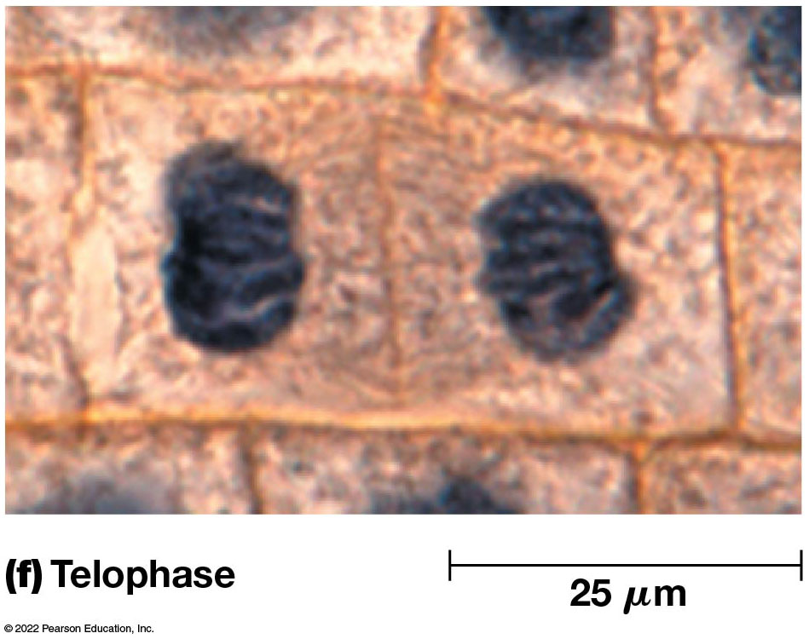
The Phases of Mitosis in Plant Cells: Telophase
Figure 24.3 The Phases of Mitosis in a Plant Cell.

Slide 40
The Mitotic Spindle Is Responsible for Chromosome Movements During Mitosis
The microtubule-containing apparatus responsible for separation of chromatids into daughter cells is the mitotic spindle.

Slide 41
Spindle Assembly and Chromosome Attachment
Microtubules have an inherent polarity (the two ends have different chemical properties).
The end where M T assembly is initiated (the centrosome in the case of the spindle) is the minus (−) end.
The end where most growth occurs is the plus (+) end.

Slide 42
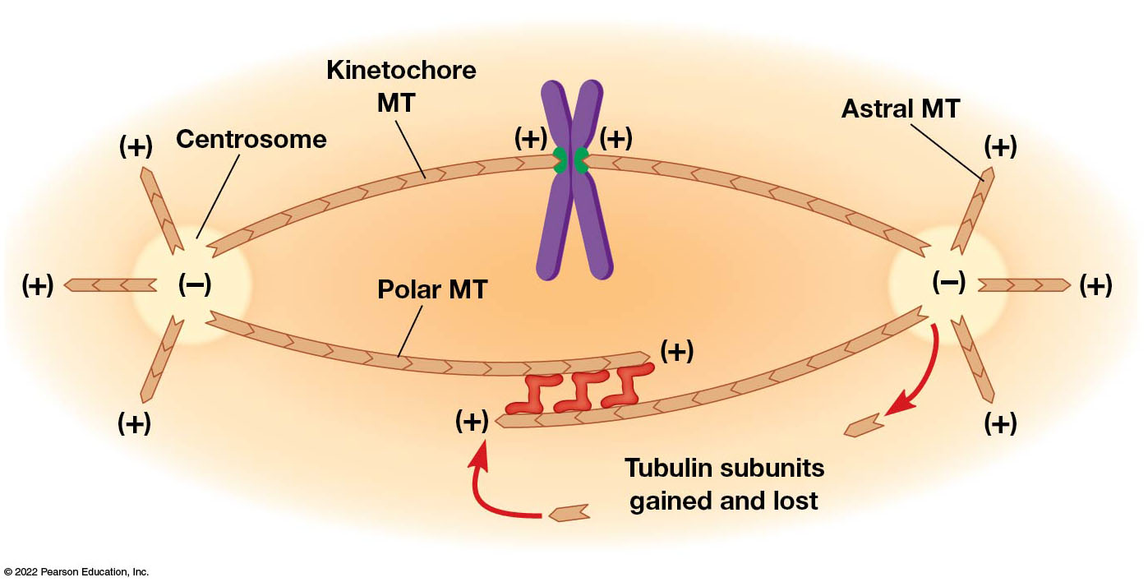
Microtubule Polarity in the Mitotic Spindle
Figure 24.6 Microtubule Polarity in the Mitotic Spindle.
Notes:
Long Description:
It shows positive polarity at astral MT end and negative polarity at the centrosome end on both ends of the spindle.
The kinetochore MT extends between the centrosomes of both the poles at upper side and at lower side polar MT can be seen extending from one centrosome to the middle of the spindle. Another polar MT extends from the Astral MT end but is separated from first polar MT by tubulin subunits gained and lost. The centromeres at the chromatids are positive in polarity. Tubulin subunits gained and lost show positive polarity.

Slide 43
Spindle Assembly
During late prophase, M T growth speeds up dramatically, and initiation of new M T s at centrosomes increases.
When the nuclear envelope disintegrates, kinetochores and M T s can come into contact.
When the plus end of M T s and the kinetochore bind, the M T becomes a kinetochore M T.

Slide 44
Kinetochores
The two kinetochores are located at opposite sides of a chromosome, so they usually attach to M T s from opposite spindle poles.
The polar M T s make direct contact with polar M T s from the opposite pole at the same time.
Where polar M T s of opposite polarity overlap, crosslinking proteins bind them to each other.

Slide 45
Cells Without Centrosomes
Cells without centrosomes can still form spindles using a different mechanism promoted by chromosomes.
This requires the involvement of Ran, the G T P-binding protein.
Ran binds to G T P because of a protein associated with mitotic chromosomes and then binds importin and releases proteins that promote M T assembly.

Slide 46
Chromosome Alignment and Separation (1 of 2)
Chromosomes migrate to the central region of the spindle through a series of movements called congression, which occurs via three mechanisms:
Kinetochore microtubules exert a pulling force towards the poles via cytoplasmic dynein.
Kinetochore microtubules push chromosomes away from the spindle poles via kinesin C E N P-E.
Polar microtubules push chromosomes mediated by chromokinesins, kinesin-4 and kinesin-10.

Slide 47
Chromosome Alignment and Separation (2 of 2)
Chromosomes reach the metaphase plate and stay there as a result of precisely balanced forces pulling them toward opposite poles.
At anaphase, chromatids separate and move towards opposite poles.
This process involves topoisomerase Ⅱ and changes in adhesive proteins that hold sister chromatids together.

Slide 48
Motor Proteins and Chromosome Movement
The movement of chromosomes to separate poles I mediated by several motor proteins that play active roles in mitosis.
They use energy from A T P to change shape and exert force that causes movement of attached structures.
Motor proteins play at least three distinct roles in movement of anaphase chromosomes.

Slide 49
Motor Proteins in Anaphase Chromosome Movement: Movement by Catastrophin (1 of 2)
Chromosomes are moved, kinetochores first, toward the spindle poles during anaphase A.
This is driven by kinesins associated with the kinetochore M Ts (kinesin-13 also called catastrophin).
One catastrophin is at the plus end of the M T, embedded in the kinetochore, and moves the chromosome as it “chews up” the M T.

Slide 50
Motor Proteins in Anaphase Chromosome Movement: Movement by Catastrophin (2 of 2)
The other catastrophin motor is located at the minus end of the kinetochore M T s.
It is embedded in the spindle pole and induces depolymerization there, “reeling in” the microtubules and the attached chromosomes.

Slide 51
Motor Proteins in Anaphase Chromosome Movement: Movement by Bipolar Kinesin
Motor proteins play a role in the movement of the spindle poles away from each other during anaphase B.
Bipolar kinesin motors bind to overlapping polar M T s from opposite spindle poles, sliding the spindle poles away from each other.

Slide 52
Motor Proteins in Anaphase Chromosome Movement: Movement by Cytoplasmic Dynein
Cytoplasmic dynein is associated with astral microtubules that are connected to the cell cortex.
The cell cortex is a layer of actin microfilaments lining the inner surface of the plasma membrane.
The dynein moves toward the minus ends of the microtubules and appears to move the spindle toward the cortex during anaphase B.

Slide 53
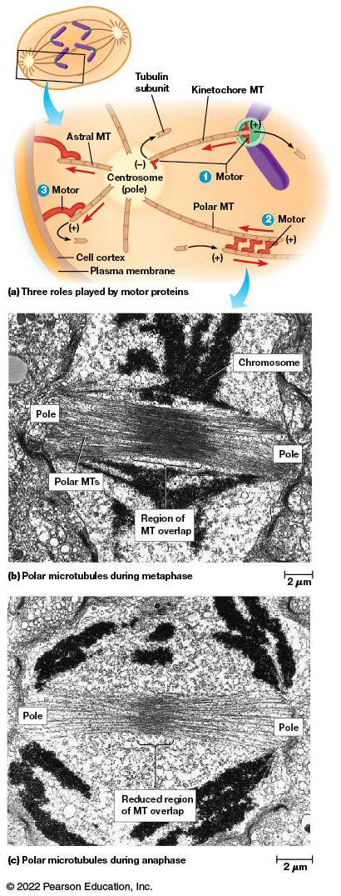
Mitotic Motors
Figure 24.7 Mitotic Motors.
Notes:
Long Description:
Three roles played by motor proteins:
Motor proteins of kinetochore MTs between the plus ends in chromosome and minus ends in centrosome poles of the spindles.
Motor proteins of the polar MTs force the spindle poles away from each other. The polar MTs are lengthened by tubulin subunits.
The astral MT motor proteins link the plus ends of astral MTs to the cell cortex surrounded by the plasma membrane.
Polar microtubules during metaphase
The micrograph shows chromosome, poles, dense region of MT overlap between the poles, and polar MTs. The measurement is 2 micrometers.
Polar microtubules during anaphase:
The micrograph shows reduced region of MT overlap between the poles. The measurement is 2 micrometers.

Slide 54
Cytokinesis Divides the Cytoplasm
After the chromosomes have separated, cytokinesis divides the cytoplasm in two.
It usually starts in late anaphase or early telophase.
Certain cell types undergo many rounds of nuclear division without cytokinesis, forming a syncytium (multinucleate cell). This syncytium can be permanent or temporary.

Slide 55
Cytokinesis in Animal Cells
Cytoplasmic division is called cleavage; it begins with a slight puckering of the cell surface that deepens into a cleavage furrow.
The furrow continues to deepen until opposite surfaces make contact and split the cell in two.
The furrow deepens along a plane passing through the spindle equator.

Slide 56
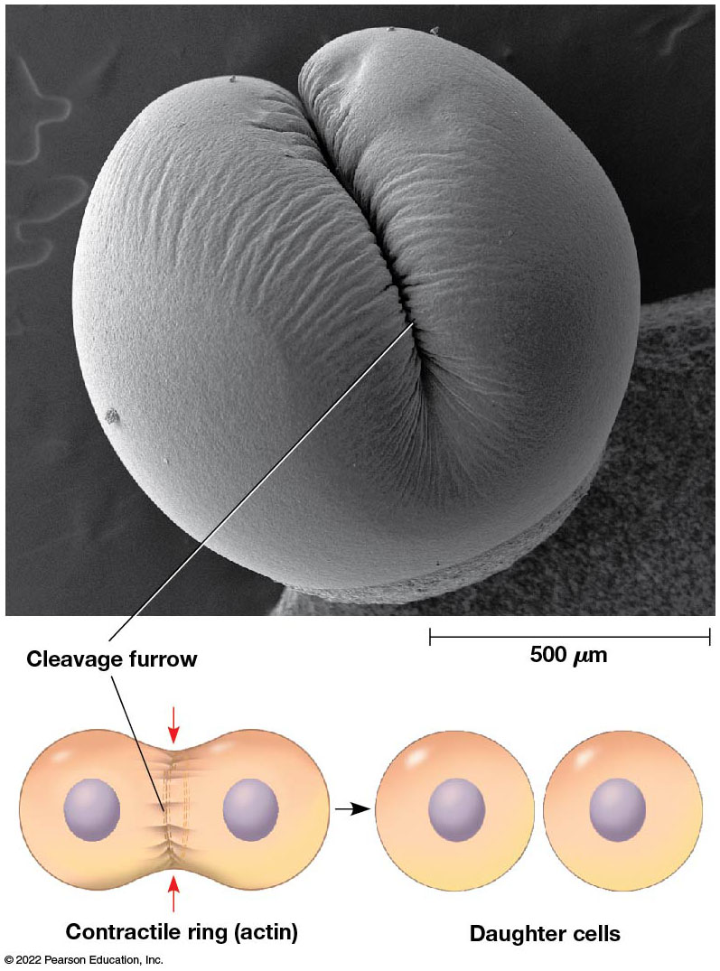
Cytokinesis in an Animal Cell
Figure 24.8 Cytokinesis in an Animal Cell.
Notes:
Long Description:
The illustrations show nuclei in each of the two daughter cells. The contractile ring or actin is the dividing line. Two separate daughter cells area formed.

Slide 57
Cytokinesis (1 of 2)
Signals emanating from the central part of the spindle, the spindle midzone, are important for completing cytokinesis.
For example, in nematodes and fruit flies, a multiprotein complex called centralspindlin is required to complete cytokinesis.

Slide 58
Cytokinesis (2 of 2)
Cleavage depends on a bundle of actin microfilaments (the contractile ring) that forms just below the plasma membrane in early anaphase.
As cleavage progresses, the ring tightens around the cytoplasm.

Slide 59
Myosin and Cleavage
Contraction of the ring is generated by interactions between actin filaments and nonmuscle myosin Ⅱ, a motor protein.
Members of Rho-G T P binding proteins regulate assembly and activation of the contractile ring.
RhoA is recruited to the cleavage furrow to activate proteins needed for actin polymerization and also stimulates activation of myosin.

Slide 60
End of Cytokinesis
As cytokinesis ends, the connection between the two cells narrows to a thin stalk.
At its center is the midbody, an electron-dense material with tightly packed microtubules, which are remnants from the spindle.
This midbody persists for some time until abscission, the final separation of the two daughter cells.

Slide 61
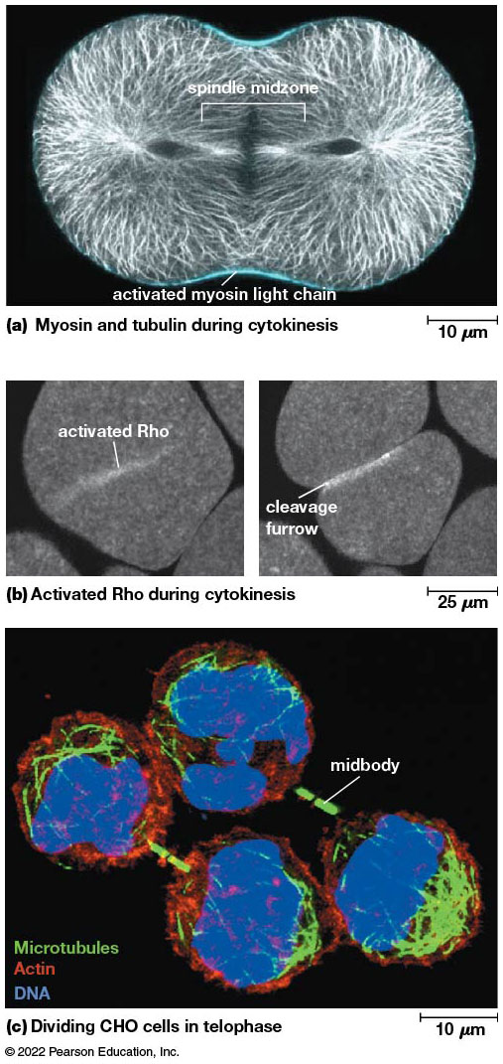
The Contractile Ring and Midbody During Cytokinesis
Figure 24.9 The Contractile Ring and Midbody During Cytokinesis.
Notes:
Long Description:
The details are as below:
Myosin and tubulin during cytokinesis:
The measurement is marked as 10 micrometers. The egg cell is dividing into two cells and the spindle midzone is seen. Activated myosin light chain forms an outer layer.
Activated Rho during cytokinesis
The measurement is 25 micrometers. An activated Rho is a single light streak and a cleavage furrow is formed.
Dividing CHO cells in telophase:
The measurement is shown as 10 micrometers. The colored micrograph shows mid body, inner DNA, surrounded by actin and microtubules.

Slide 62
Cytokinesis in Plant Cells (1 of 2)
Plant cells cannot form a contractile ring because of the rigid cell wall.
They assemble a plasma membrane and cell wall between the two daughter nuclei.
In late anaphase or early prophase, a group of small vesicles from the Golgi complex align themselves across the equatorial region of the spindle.

Slide 63
Cytokinesis in Plant Cells (2 of 2)
The vesicles contain polysaccharides and glycoproteins for cell wall formation and are guided to the spindle equator by the phragmoplast.
This is an array of M T s derived from polar M T s.
The vesicles fuse together to form a cell plate, which expands outward from the cell wall.

Slide 64
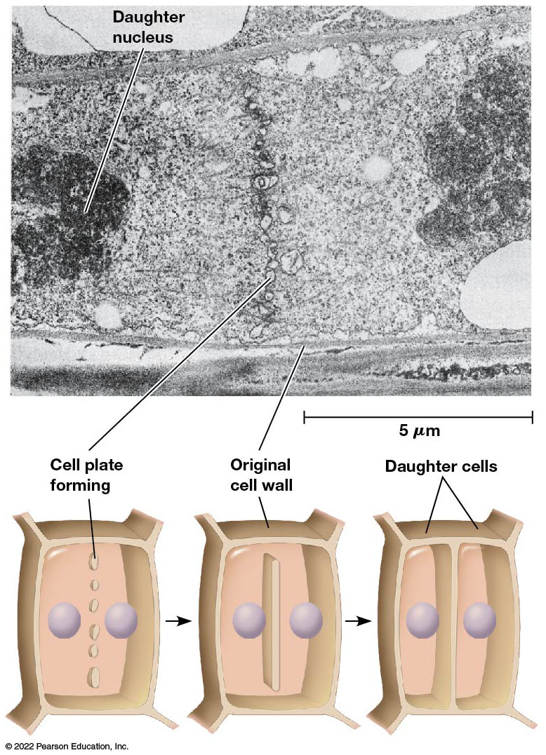
Cytokinesis and Cell Plate Formation in a Plant Cell
Figure 24.10 Cytokinesis and Cell Plate Formation in a Plant Cell.
Notes:
Long Description:
The micrograph shows daughter nucleus, cell plate forming, and original cell wall. The measurement is 5 micrometers.
The illustrations show cell plate formation at the center, original cell wall, and formation of two daughter cells.

Slide 65
Asymmetric Cell Division
Cytokinesis is not always symmetric; sometimes the spindle forms in asymmetric fashion.
This can result in one large and one small cell like in Saccharomyces cerevisiae.
These asymmetric divisions also occur frequently during embryonic development; sometimes cells formed in this way have differing developmental potentials.

Slide 66
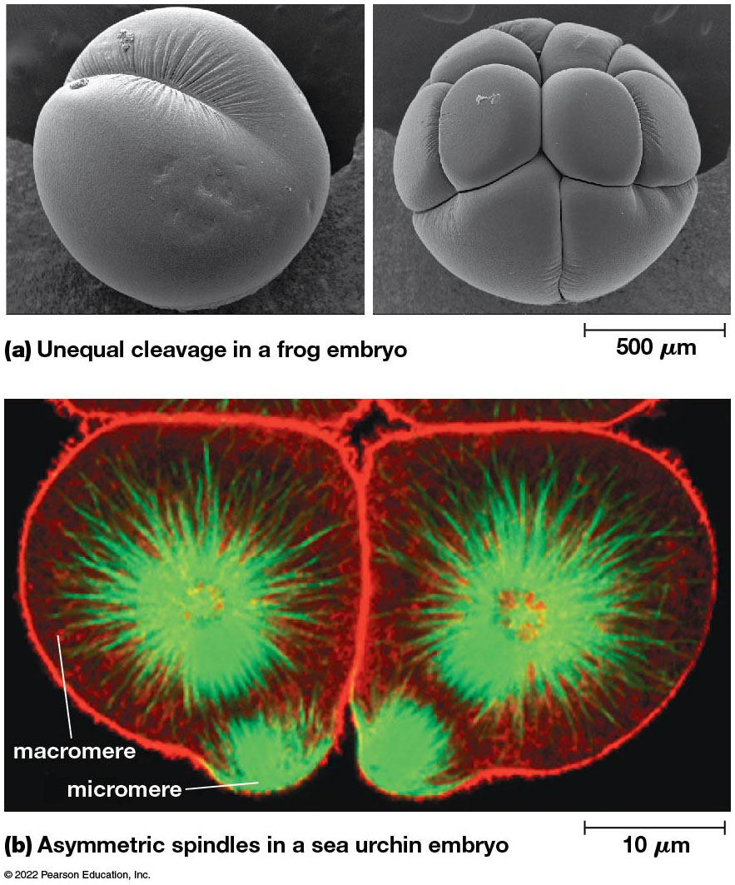
Asymmetric Cell Division in Animal Embryos
Figure 24.11 Asymmetric Cell Division in Animal Embryos.
Notes:
Long Description:
Unequal cleavage in a frog embryo: There are two micrographs on cell division in a frog embryo. The first shows a single cell division with a cleavage formation. The second shows multiple unequal divisions and multiple cleavages. Certain divisions area visibly larger than the others. The measurement is marked as 500 micrometers.
Asymmetric spindles in a sea urchin embryo: The micrograph shows multiple cells dividing with asymmetric spindles, microtubules, and actin in a sea urchin embryo. The larger cells are macromere and the smaller are the micromere. The measurement shows 10 micrometers.

Slide 67
Bacteria and Eukaryotic Organelles Divide in a Different Manner from Eukaryotic Cells
Cytokinesis in bacteria involves recruitment of a cytoskeletal protein, FtsZ, which is structurally similar to tubulin.
Fibers of FtsZ form a ring at the site where the two daughter cells will pinch off.
Some organelles, like chloroplasts, in eukaryotes have striking similarities to bacteria, including during cytokinesis.

Slide 68
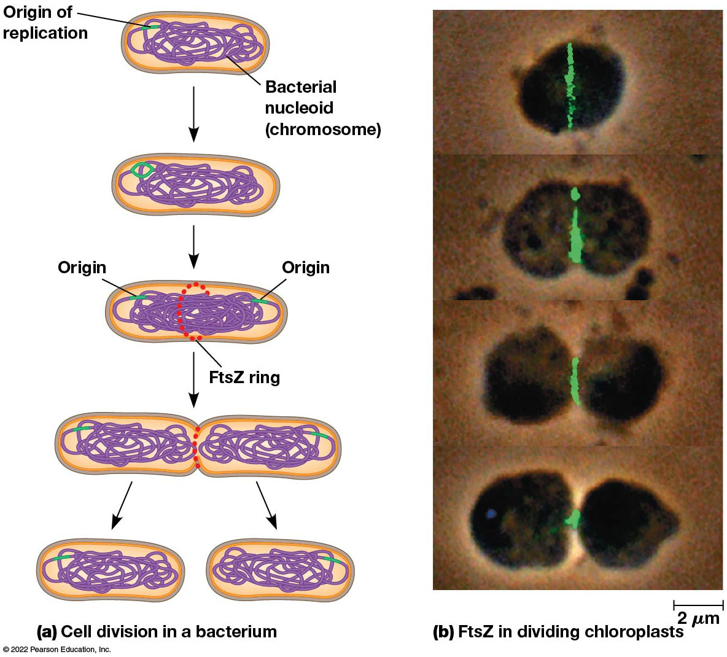
Cell Division in Bacteria and Organelles
Figure 24.12 Cell Division in Bacteria and Organelles.
Notes:
Long Description:
The details are as below:
Cell division in a bacterium: The origin of replication is the chromosome in the bacterial nucleoid.
The FtsZ ring is formed at the center of the chromosome.
A cleavage is formed at the site of the ring and the cell divides into two.
Two cells are formed.
FtsZ in dividing chloroplasts: Four micrographs show the formation of FtsZ ring and the embryo divides into two cells. The measurement is 2 micrometers.

Slide 69
24.3 Regulation of the Cell Cycle
Variations are observed in:
Overall length of the cell cycle
Relative length of time spent in various phases
How closely mitosis and cytokinesis are coupled
The cell cycle is regulated to meet the needs of each cell type and organism.

Slide 70
Cell Cycle Length Varies Among Different Cell Types
At one extreme are cells that divide continuously to replace cells that are constantly lost or destroyed.
For example, the cells of sperm formation and stem cells that produce blood, skin, and epithelial cells.
At the other extreme are extremely slow growing tissues or even some (mature nerve or muscle cells) that do not divide at all.
Some cells do not divide unless stimulated like liver cells or lymphocytes.

Slide 71
Variations in Generation Time
Most of the variations in generation time are based on differences in the length of G1, though S and G2 can also vary.
Cells that divide very slowly may spend days, months, or years in the offshoot of G1 called G0.
Cells that divide very rapidly have a short G1 or may skip it entirely.

Slide 72
Cell Growth and the Cell Cycle (1 of 2)
Although in some cases cell growth is not essential to the cell cycle, the two are generally linked.
A protein kinase called T O R (target of rapamycin) plays a role in the signaling network that controls cell size and coordinates it with cell cycle progression.
The network activates T O R in the presence of nutrients and growth factors.

Slide 73
Cell Growth and the Cell Cycle (2 of 2)
Activated T O R stimulates molecules that control the rate of protein synthesis, leading to increased cell mass.
Some of the molecules also facilitate entry into S phase.
T O R is therefore an important regulator of both cell size and cell cycle progression.

Slide 74
Cell Cycle Progression Is Controlled at Several Key Transition Points
Control of the cell cycle must:
Ensure that events of each phase are carried out in the correct order and at the appropriate time.
Ensure that each phase is completed before the next one begins.
Respond to external conditions.

Slide 75
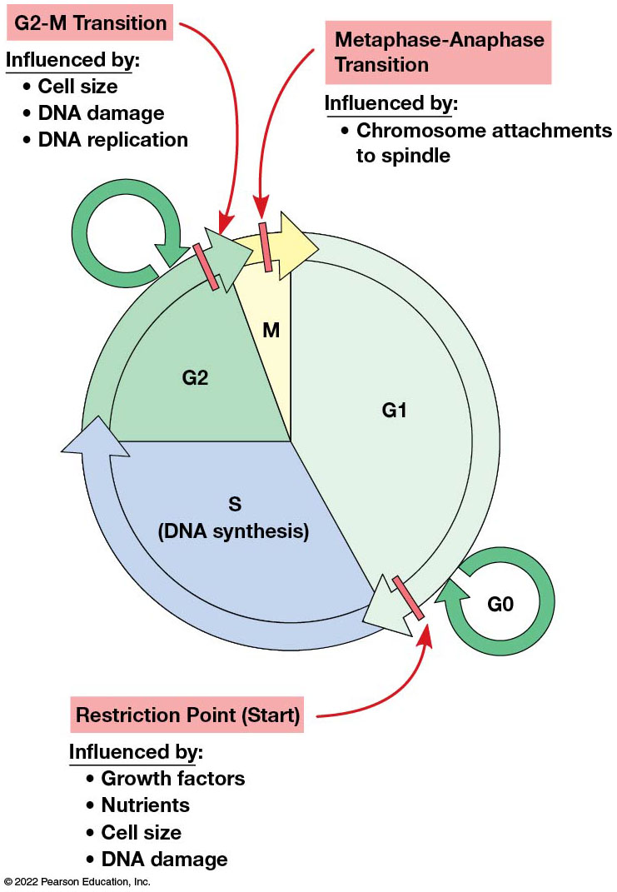
Key Transition Points in the Cell Cycle
Figure 24.13 Key Transition Points in the Cell Cycle.
Notes:
Long Description:
The cell cycle shows G1, S or DNA synthesis, G2, and M. The cycle shows the below key points:
Restriction point or the start that is influenced by growth factors, nutrients, cell size, and DNA damage. This is toward the end of cycle G 1, where a circular arrow G 0 is marked outside.
G2-M transition is at the end of G2. An outer circular arrow is shown outside the cell cycle illustration at G 2 end. This is influenced by cell size, DNA damage, and DNA replication.
Metaphase-anaphase transition is in the mitotic phase. This is influenced by chromosome attachments to spindle.

Slide 76
Restriction Point (G1-S Transition) (1 of 2)
At key transition points in the cell cycle, conditions in the cell determine whether or not it will proceed.
The first control point occurs in late G1; the G1 to S progression is called Start in yeast.
In animal cells, the comparable control point is called the restriction point; the ability to pass it is influenced by the presence of extracellular growth factors.

Slide 77
Restriction Point (G1-S Transition) (2 of 2)
Cells that successfully pass the restriction point are committed to S phase.
Those that do not, enter into G0 and reside there until a signal allows them to reenter G1 and pass through the restriction points.

Slide 78
G2-M Transition
At the G2 to M boundary, the commitment is made to enter mitosis.
In some cell types, the cell can be arrested in G2 indefinitely, and the cell enters a state analogous to G0.
In most cells, the G1 arrest is the more prevalent type of control, but in some, such as frog eggs, the G2 arrest is more important.

Slide 79
Metaphase-Anaphase Transition
A third key transition point is at the junction between metaphase and anaphase.
Here the commitment is made to move the two sets of chromosomes into the new cells.
Before cells can begin anaphase, all the chromosomes must be properly attached to the spindle.

Slide 80
Cell Fusion Experiments and Cell Cycle Mutants Identified Molecules That Control the Cell Cycle
Understanding of cell cycle control is based on several experimental approaches.

Slide 81
Heterokaryons (1 of 2)
Cell fusion experiments in the 1970s gave hints about the identity of molecules that drive the cell cycle.
Two cultured mammalian cells were fused to form a cell with two nuclei—a heterokaryon.
If one cell is in S phase and the other in G1, the G1 nucleus quickly begins D N A replication, suggesting that S phase cells contain molecules that trigger the G1 to S progression.

Slide 82
Heterokaryons (2 of 2)
Fusion of cells in M phase with cells in G1, S, or G2 causes the interphase nuclei to immediately begin mitosis.
These experiments suggest that molecules in the cytoplasm drive cells from G1 to S or G2 to M.

Slide 83
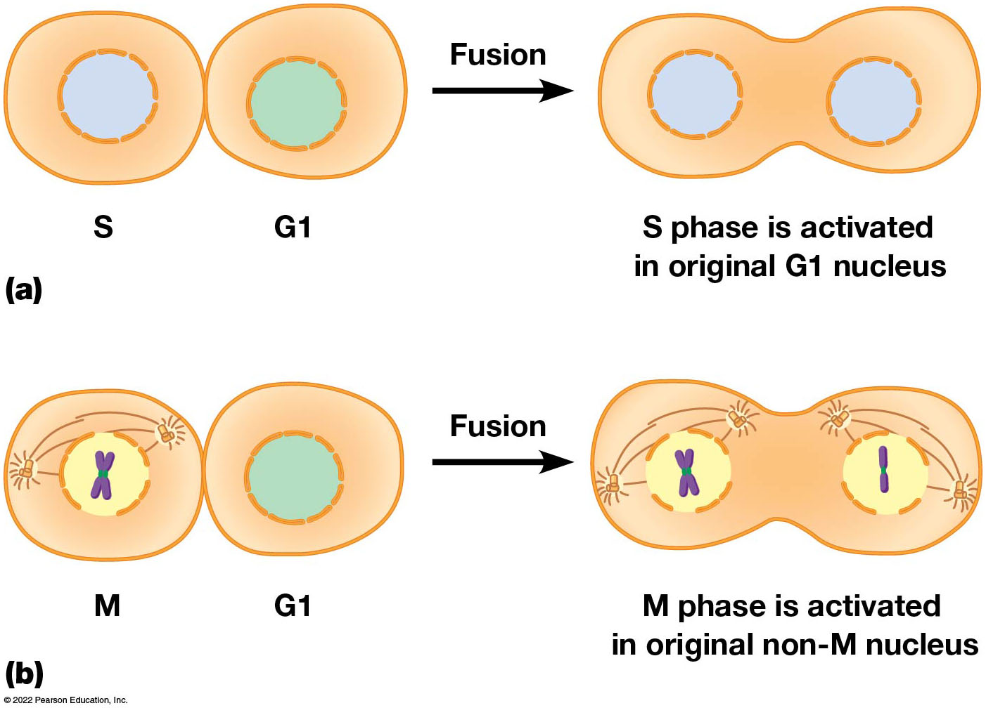
Evidence for the Role of Chemical Signals in Cell Cycle Regulation
Figure 24.14 Evidence for the Role of Chemical Signals in Cell Cycle Regulation.
Notes:
Long Description:
In the fusion of S and G1, S phase is activated in original G1 nucleus. The final fused structure shows two nuclei. In the fusion of M and G1, M phase is activated in original non-M nucleus. The fused structure shows two nuclei, one with sister chromatids and the other with a single strand of chromatid.

Slide 84
Cell Cycle Mutants in Yeast
Budding yeasts, Saccharomyces cerevisiae, carrying a temperature-sensitive mutation affecting the cell cycle can be grown at a lower (permissive) temperature.
Their cell cycles will be blocked at high temperatures.
Leland Hartwell and colleagues identified many genes involved in cell cycle regulation using this approach.

Slide 85
Similar Work in Fission Yeast
Paul Nurse carried out similar research with the fission yeast, Schizosaccharomyces pombe.
He identified a gene called cdc2, whose activity is needed for the G2 to M transition.
cdc2 was soon found to have counterparts in all eukaryotic cells studied; it was found to encode a protein kinase.

Slide 86
The Cell Cycle Is Controlled by Cyclin-Dependent Kinases (Cdks)
Phosphorylation of target proteins by protein kinases and dephosphorylation by protein phosphatases is a common mechanism for controlling the cell cycle.
Cell cycle progression is driven by protein kinases that are active only when bound to an activating protein called a cyclin.
These kinases are cyclin-dependent kinases (Cdks).

Slide 87
Cyclins
The concentration of cyclins varies with phases of the cell cycle.
Mitotic cyclins are required for the G2 to M transition and bind mitotic Cdks; this complex is called M P F (mitosis-promoting factor).
G1 cyclins are required for passage through the G1 restriction point (or Start), and the Cdks to which they bind are called G1 Cdks.
S cyclins are required for D N A replication.

Slide 88
Other Kinases
Polo-like kinases and Aurora B kinase are other kinases that play roles in cell cycle regulation.
Aurora B kinase is part of a complex of proteins that associate with chromosomes and then the mitotic spindle at the end of cell division.
Because they transiently “ride” along with chromosomes, they are called the chromosome passenger complex.

Slide 89
Cdk-Cyclin Complexes Are Tightly Regulated
One level of control on Cdk-cyclin activity is availability of cyclin molecules.
A second type of regulation involves phosphorylation of Cdks.

Slide 90
Cyclin Availability
Mitotic Cdk has constant concentration throughout the cell cycle.
However, it is active only when bound to mitotic cyclin, and mitotic cyclin is not always present in adequate amounts.
Concentration of mitotic cyclin increases during G1, S, and G2.

Slide 91
Mitotic Cyclin
Mitotic cyclin levels reach a critical threshold at the end of G2.
This permits it to activate mitotic Cdk and trigger the onset of mitosis.
Halfway through mitosis, the mitotic cyclins are abruptly destroyed.
The original mitotic cyclin is named cyclin B.

Slide 92
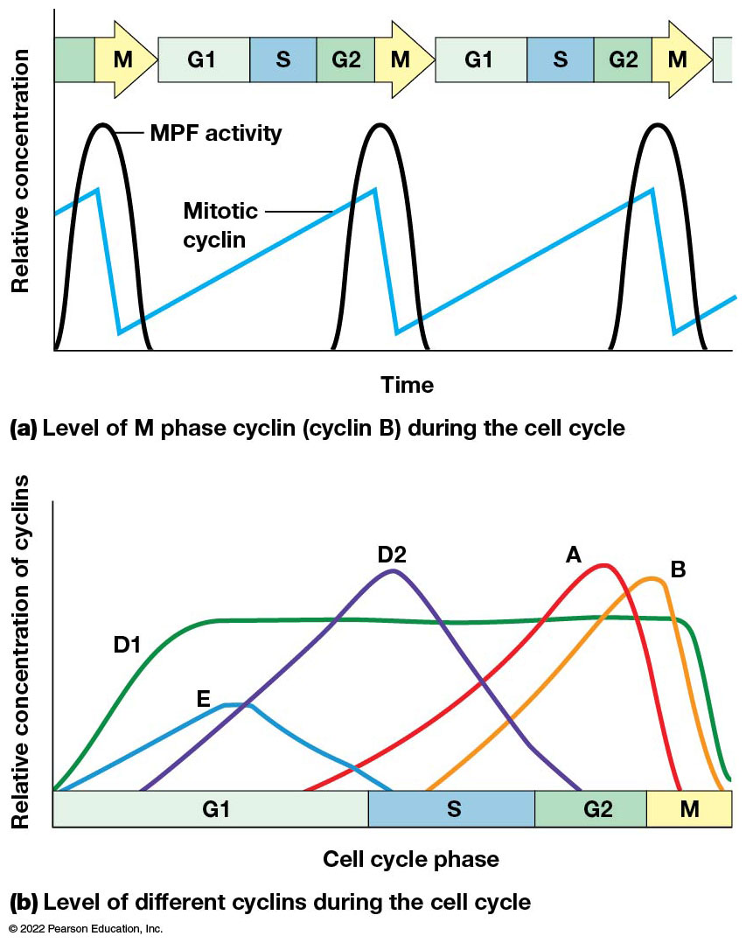
Fluctuating Levels of Cyclins and M P F Activity During the Cell Cycle
Figure 24.15 Fluctuating Levels of Cyclins and M P F Activity During the Cell Cycle.
Notes:
Long Description:
Level of M phase cyclin (cyclin B) during the cell cycle:
The X-axis shows time and Y-axis shows relative concentration. The cycle goes from G 1 to S to G 2 to M. The M P F activity occurs during the M phase and the mitotic cyclin shows a peak at the same time.
Level of different cyclins during the cell cycle:
The x axis shows cell cycle phase like G1, S, G2, and M. The Y axis shows relative concentration of cyclins. The G1 shows peaks of D1 and E, S shows D2, G2 shows A, and M shows B.

Slide 93
Cdk Phosphorylation: Steps 1 and 2
Activation of mitotic Cdk involves phosphorylation and dephosphorylation.
The binding of mitotic cyclin to mitotic Cdk forms a Cdk-cyclin complex that is initially inactive.
Inhibiting kinases phosphorylate two sites on the Cdk, blocking the active site.

Slide 94
Cdk Phosphorylation: Steps 3 and 4
An activating phosphate is then added by an activating kinase.
The final step is the removal of the inhibiting phosphates by a specific phosphatase enzyme.
Once the phosphatase begins removing the phosphates, activated Cdk stimulates the phosphatase, amplifying the activation.

Slide 95
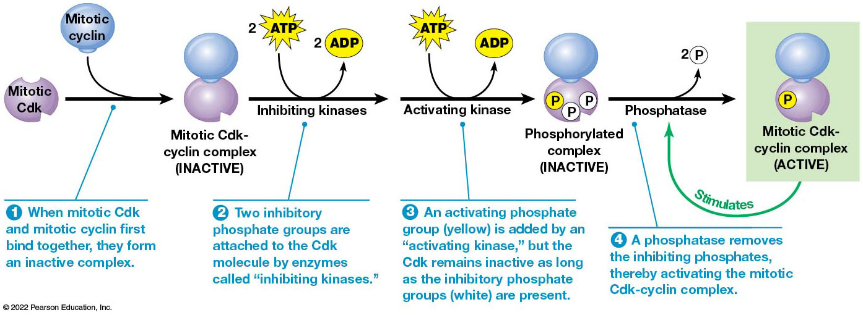
Regulation of Mitotic Cdk-Cyclin by Phosphorylation and Dephosphorylation
Figure 24.16 Regulation of Mitotic Cdk-Cyclin by Phosphorylation and Dephosphorylation.
Notes:
Long Description:
The steps are as below:
When mitotic Cdk and mitotic cyclin first bind together, they form an inactive complex.
Inhibiting kinases: 2 ATP to 2 ADP. Two inhibitory phosphate groups are attached to the Cdk molecule by enzymes called “inhibiting kinases.”
Activating kinase: ATP to ADP. An activating phosphate group (yellow) is added by an “activating kinase,” but the Cdk remains inactive as long as the inhibitory phosphate groups (white) are present.
A phosphatase removes the inhibiting phosphates, thereby activating the mitotic Cdk-cyclin complex, which is active.

Slide 96
Onset of Mitosis
Once activated, the Cdk-cyclin triggers mitosis by phosphorylating many proteins. Some examples are given as follows:
Phosphorylation Target | Result
Lamin | Lamina breakdown and destabilization of the nuclear envelope
Condensin | Chromosome condensation
Microtubule-associated proteins | Assembly of the mitotic spindle
Proteins in D N A repair pathways | Prevents D N A break repair during mitosis

Slide 97
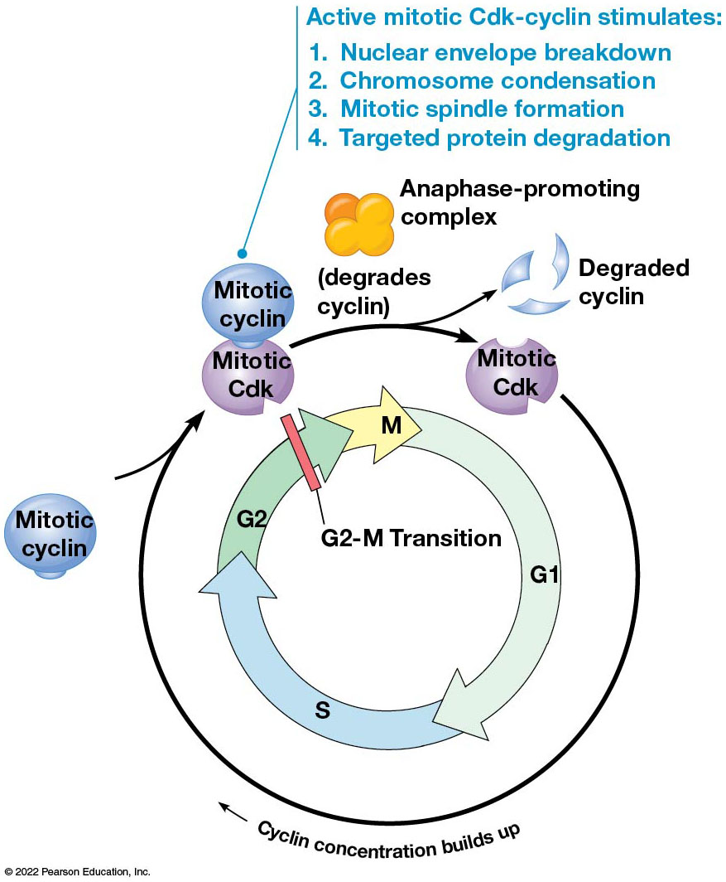
The Mitotic Cdk Cycle
Figure 24.17 The Mitotic Cdk Cycle.
Notes:
Long Description:
Active mitotic Cdk-cyclin stimulates:
Nuclear envelope breakdown
Chromosome condensation
Mitotic spindle formation
Targeted protein degradation

Slide 98
The Anaphase-Promoting Complex Allows Exit from Mitosis
Mitotic Cdk-cyclin phosphorylates and contributes to activation of the anaphase-promoting complex (A P C/C), which leads to anaphase and separating chromatids.
The anaphase-promoting complex functions as a ubiquitin ligase, which adds ubiquitin to proteins to target them for destruction.
One target is securin, an inhibitor of sister chromatid separation.

Slide 99
Function of Securin
Prior to anaphase, sister chromatids are held together by adhesive proteins called cohesins.
Securin maintains this attachment by inhibiting the separase protein that would otherwise degrade the cohesins.
When the anaphase-promoting complex triggers destruction of securin, separase cleaves cohesin, freeing the sister chromatids.

Slide 100
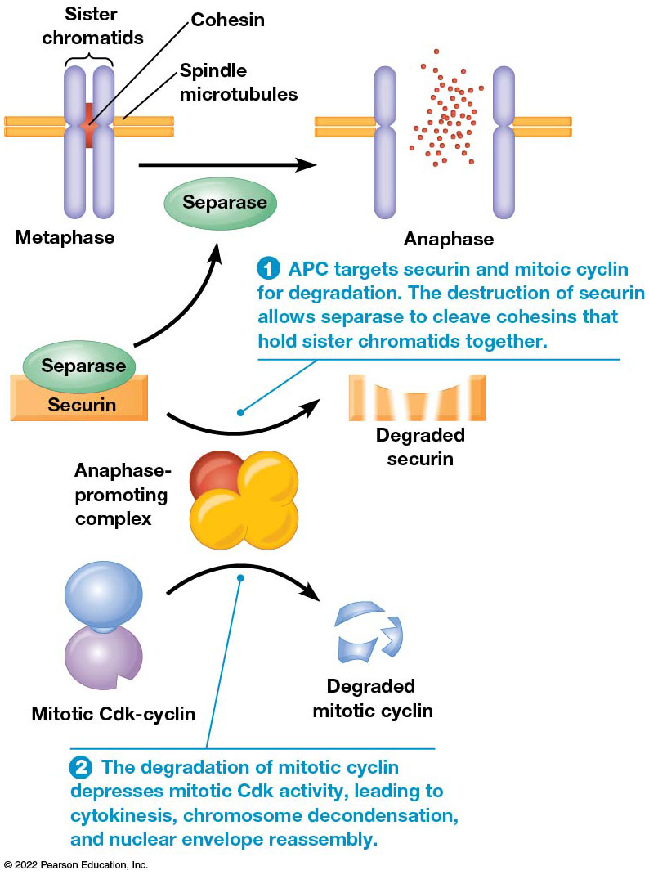
The Anaphase-Promoting Complex
Figure 24.18 The Anaphase-Promoting Complex.
Notes:
Long Description:
The details are as below:
APC targets securin and mitoic cyclin for degradation. The destruction of securing allows separase to cleave cohesins that hold sister chromatids together. The parts labeled are sister chromatids, cohesion, and spindle microtubules. Metaphase, on separase, gives anaphase. Securin becomes degraded securing. Mitotic Cdk-cyclin is degraded to mitotic cyclin in the presence of anaphase-promoting complex.
The degradation of mitotic cyclin depresses mitotic Cdk activity, leading to cytokinesis, chromosome decondensation, and nuclear envelope reassembly.

Slide 101
Other Activities of the Anaphase-Promoting Complex
The anaphase-promoting complex targets mitotic cyclin for destruction, causing the kinase activity of mitotic Cdk to fall.
Many changes associated with exit from mitosis— cytokinesis, chromosome decondensation, nuclear envelope reassembly—depend on degradation of mitotic cyclin.

Slide 102
Checkpoint Pathways Monitor Key Steps in the Cell Cycle
If cells proceeded from one phase of the cell cycle to the next without completing each step, daughter cells might be abnormal.
For example, aneuploidy (incorrect number of chromosomes) could result.
Cells use a series of checkpoint mechanisms that ensure each phase is completed properly before the next one begins.

Slide 103
G1-S: Cdk-Cyclin and the Rb Protein
G1 Cdk-cyclin phosphorylates the key target Rb protein.
Nonphosphorylated Rb binds the E 2 F transcription factor.
Unbound E 2 F activates transcription of genes coding for proteins that initiate D N A replication.

Slide 104
R b and E 2 F
While Rb remains bound to E 2 F, the E 2 F molecule is inactive, and the cell cannot enter S phase.
But when cells are stimulated to divide by growth factors, G1 Cdk-cyclin is activated and phosphorylates Rb.
Rb releases E 2 F, which initiates transcription of genes needed for entry of S phase.

Slide 105
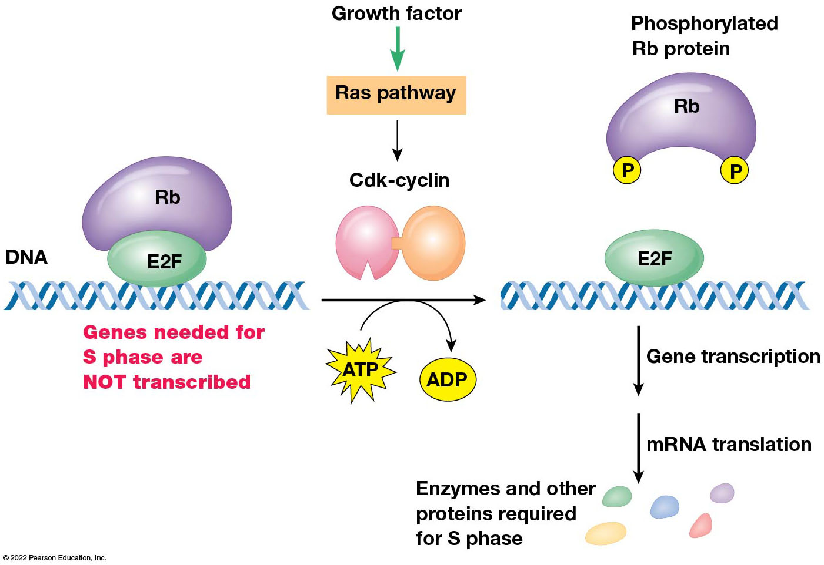
Roles of the Rb Protein in Cell Cycle Control
Figure 24.19 Role of the Rb Protein in Cell Cycle Control.
Notes:
Long Description:
The growth factor leads to Ras pathway to Cdk-cyclin. ATP to ADP conversion happens. The gene transcription after the process leads to mRNA translation resulting in enzymes and other proteins required for S phase.

Slide 106
S Phase: Replication Licensing
It is crucial that nuclear D N A molecules be replicated once, and only once, prior to cell division.
A process called licensing ensures this.
M C M proteins bind to origins of D N A replication.
This requires both O R C and helicase loaders.

Slide 107
M C M Proteins and Licensing
Once replication begins, the M C M proteins are displaced from the origins.
Re-replication from the same origins is prevented by mechanisms that stop M C M proteins from binding the origins again.

Slide 108
Prevention of Relicensing
A Cdk is a player in this mechanism; it blocks relicensing by inhibiting the function of proteins such as O R C and the helicase loaders.
Another inhibitor of relicensing is geminin, a protein made during S phase.
It blocks binding of M C M proteins to D N A.
Once mitosis is complete, geminin is degraded.

Slide 109
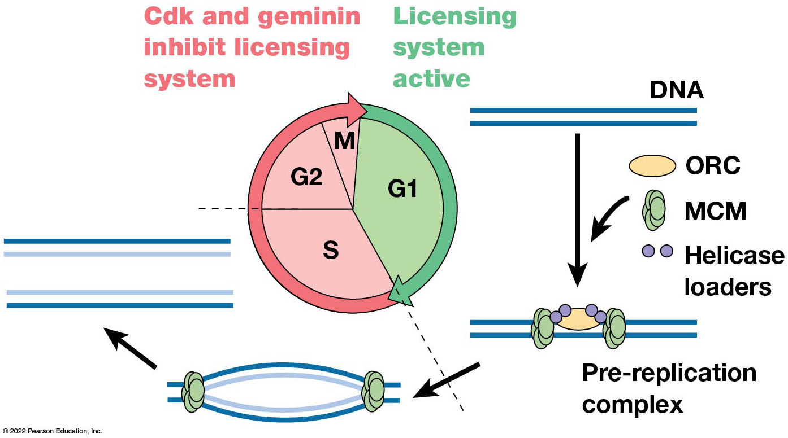
Licensing of D N A Replication During the Eukaryotic Cell Cycle
Figure 24.20 Licensing of D N A Replication During the Eukaryotic Cell Cycle.

Slide 110
G 2-M: The D N A Replication Checkpoint
The D N A replication checkpoint ensures that D N A synthesis is complete before the cell exits G2 and begins mitosis.
Cells that are prevented from completing D N A replication fail to undergo the final dephosphorylation step in the activation of mitotic Cdk-cyclin.

Slide 111
Spindle Assembly Checkpoint: Mad and Bub Proteins
The mitotic spindle checkpoint prevents anaphase from beginning before the chromosomes are all attached to the spindle.
Kinetochores that remain unattached to microtubules produce a “wait” signal that inhibits the anaphase-promoting complex.
Members of the Mad and Bub protein families are involved.

Slide 112
Mad and Bub
Mad and Bub proteins accumulate at unattached kinetochores.
They become part of a multiprotein complex that inhibits the anaphase-promoting complex by blocking the action of Cdc20 protein.
Once all the chromosomes are attached, Mad and Bud no longer persist at kinetochores, and the inhibition is lifted.

Slide 113
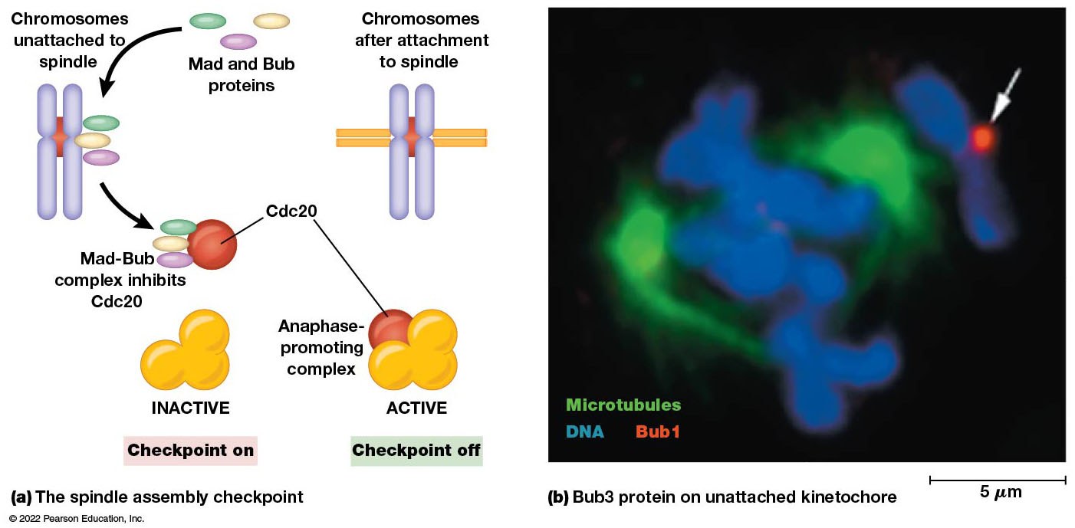
The Spindle Assembly Checkpoint
Figure 24.21 The Spindle Assembly Checkpoint.
Notes:
Long Description:
The flow is as below:
Mad and Bub proteins
Chromosomes unattached to spindles
Mad-Bub complex inhibits Cdc20.
Inactive when the checkpoint is “on” and active when the checkpoint is “off.”
Chromosomes are attached to the spindle.
The micrograph shows microtubules, DNA, and Bub1 attached to the DNA. The measurement is 5 micrometers.

Slide 114
D N A Damage: p53
A multiple series of D N A damage checkpoints monitor D N A for damage and halt the cell cycle at various points (late G1, S, and late G2) by inhibiting different Cdk-cyclin complexes.
p53 protein, the “guardian of the genome,” plays a central role in these checkpoint pathways.

Slide 115
D N A Damage: p53 Response to Double-Stranded D N A Breaks (1 of 2)
Breaks in D N A trigger activation of an enzyme called the A T M (ataxia telangiectasia mutated) protein kinase.
A T M phosphorylates checkpoint kinases, which then phosphorylate p53 (and other targets).
Phosphorylated p53 is unable to bind to Mdm2; Mdm2 marks p53 for destruction.

Slide 116
D N A Damage: p53 Response to Double-Stranded D N A Breaks (2 of 2)
Phosphorylated p53 is protected from degradation and activates two types of events: cell cycle arrest and cell death.
p53 activates the gene coding for p21, a protein that halts progression of the cell cycle by inhibiting activity of different Cdk-cyclins.
A T R (A T M-related) acts similarly in response to single-stranded D N A breaks.

Slide 117
Cell Death
p53 stimulates production of enzymes involved in D N A repair.
But if the damage cannot be repaired, p53 activates genes needed to trigger cell death by apoptosis.
A key protein in this pathway is called Puma (p53 upregulated modulator of apoptosis), which inactivates Bcl-2, an apoptosis inhibitor.

Slide 118
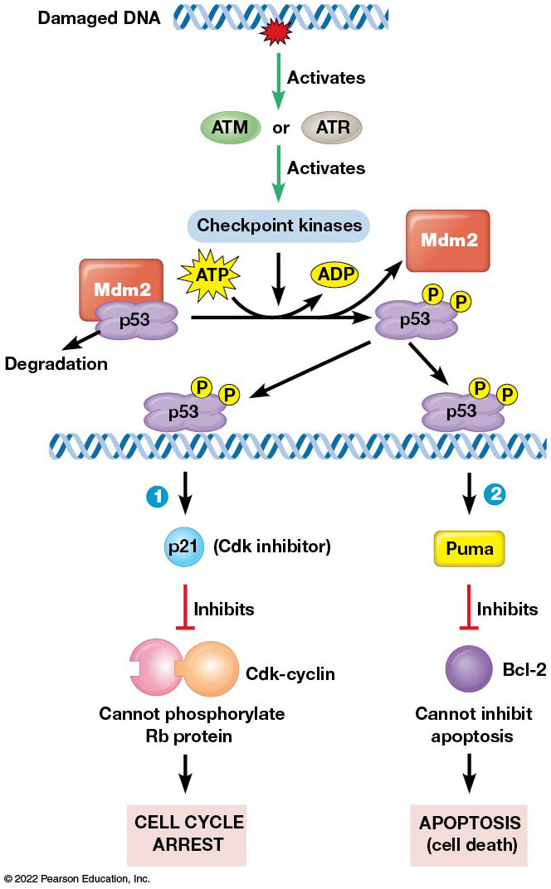
The Role of p53 Protein in Responding to D N A Damage
Figure 24.22 Role of the p53 Protein in Responding to D N A Damage.
Notes:
Long Description:
The process is as below:
The damaged DNA activates ATM or ATR.
This activates checkpoint kinases.
p53 causes degradation of Mdm2 and ATP to ADP occurs.
Mdm2 separates and p53 binds to DNA.
Upon binding to DNA, two processes can be triggered.
p53 and p21:
p53 binds to DNA and activates transcription for p21, which is a Cdk inhibitor.
This inhibits Cdk-cyclin and cannot phosphorylate Rb protein.
Cell cycle is arrested.
P53 and puma:
p53 reacts with a key protein puma that inhibits Bcl 2. This cannot inhibit and leads to apoptosis, which is cell death.

Slide 119
24.4 Growth Factors and Cell Proliferation
In simple unicellular organisms, presence of sufficient nutrients in the environment is the primary factor determining whether cells grow and divide.
In multicellular organisms, extracellular signaling proteins, growth factors, control the rate of cell proliferation.
Growth factors are called mitogens.

Slide 120
Stimulatory Growth Factors Activate the Ras Pathway
Mammalian cells with plenty of nutrients but no growth factors arrest in G1.
Growth and division can be triggered by adding blood serum, which contains several stimulatory growth factors, such as P D G F (platelet-derived growth factor).
Another is epidermal growth factor (E G F).

Slide 121
Action of Growth Factors
Growth factors such as P D G F and E G F act by binding receptors on the plasma membrane.
This activates the tyrosine kinase activity of the receptors, which triggers a complex cascade of events that ends with the cell passing the restriction point.
The Ras pathway plays a central role in these events.

Slide 122
The Ras Pathway in the Cell Cycle: Steps 1 and 2
Binding of a growth factor to its receptor leads to Ras activation.
Activated Ras leads to phosphorylation and activation of a protein kinase called Raf, which starts a phosphorylation cascade.
Raf phosphorylates a protein kinase called M E K, which phosphorylates a group of M A P kinases (mitogen-activated protein kinases).

Slide 123
The Ras Pathway in the Cell Cycle: Step 3
Activated M A P K s enter the nucleus and phosphorylate specific genes, including Jun and members of the Ets family of transcription factors.
These transcription factors turn on transcription of “early genes.” Early genes such as Myc, Fos, and Jun activate transcription of a family of “delayed genes”.
One of these encodes the E 2 F transcription factor, covered earlier.

Slide 124
The Ras Pathway in the Cell Cycle: Step 4
The delayed genes include several genes coding for Cdk or cyclin molecules that form Cdk-cyclin complexes that phosphorylate Rb and trigger G1 to S transition.

Slide 125
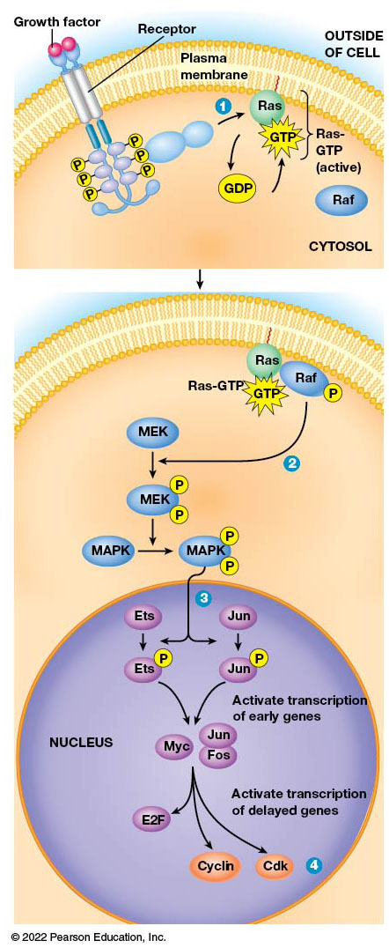
Regulation of the Cell Cycle via the Ras Pathway
Figure 24.23 Regulation of the Cell Cycle via the Ras Pathway.
Notes:
Long Description:
The parts labeled are six P molecules attached to the two receptors. This activates the Ras protein, then GDP to GTP.
The reactions inside the cytosol are as below:
Ras-GTP, G T P, P attached to Raf.
The P attached to M E K reacts with M A P K. Two P molecules attach to M A P K.
The reactions inside the nucleus are as follows:
The two P molecules attach to M A P K, where each P is attached to Ets and Jun.
The Ets and Jun activate transcription of early genes.
Ets and Jun react with Myc, Jun, Fos.
Activating transcription of delayed genes occurs.

Slide 126
Stimulatory Growth Factors Can Also Activate the P I 3-Kinase-Akt Pathway
Activated growth factor receptors may trigger other pathways besides Ras.
One is the P I 3-kinase–Akt pathway, which begins with receptor-induced activation of phosphatidyl-inositol 3-kinase (P I3K), which catalyzes formation of P I P₃ (phosphatidylinositol-3,4,5-trisphosphate).
It leads ultimately to Akt phosphorylation and activation and suppression of apoptosis by Akt.

Slide 127
Inhibition of Cell Cycle Arrest
Akt inhibits cell cycle arrest through activation of a monomeric G protein called Rheb.
This leads to activation of T O R, a key regulator of cell growth.
The net effect of the P I 3-kinase–Akt signaling pathway is to promote cell survival and proliferation.

Slide 128
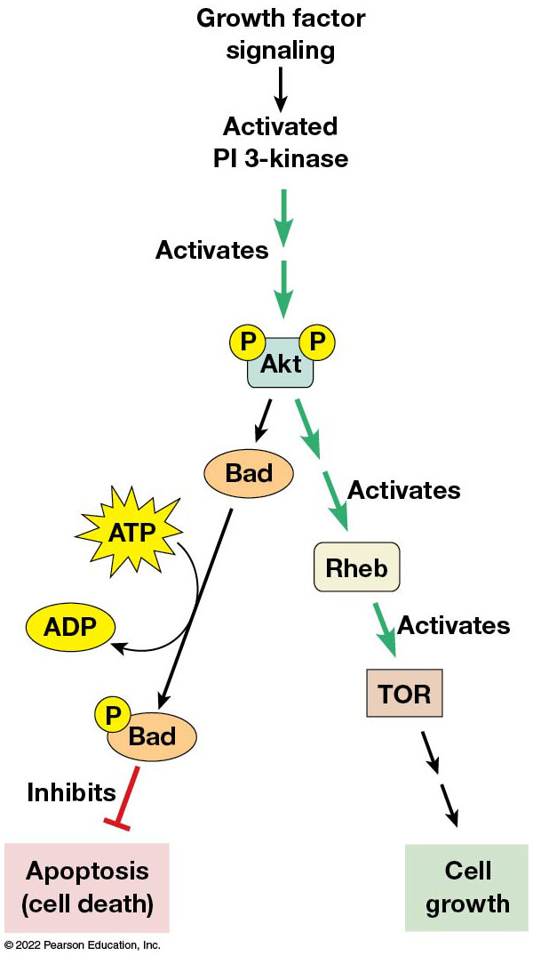
The P I 3-Kinase–Akt Signaling Pathway
Figure 24.24 The P I 3-Kinase–Akt Signaling Pathway.
Notes:
Long Description:
The flow is as below:
Growth factor signaling
Activated P I 3-kinase
Activates Akt with two P molecules
One pathway follows bad, ATP to ADP, P attached to Bad, inhibits, and leads to apoptosis or cell death.
The other pathway follows Akt activates Rheb that activates T O R and leads to cell growth.

Slide 129
Inhibitory Growth Factors Act Through Cdk Inhibitors
Some growth factors inhibit cell proliferation; one example is transforming growth factor β (T G F β).
Binding of T G F β to its receptor phosphorylates Smad proteins that move into the nucleus and activate expression of genes coding for proteins that inhibit proliferation.
Two Cdk inhibitors that block cell cycle progression are p15 and p21.

Slide 130
Putting It All Together: The Cell Cycle Regulation Machine
The “machine” that regulates the eukaryotic cell cycle involves two interacting mechanisms:
An autonomous clock goes through a fixed cycle over and over again via the synthesis and degradation of cyclins.
The clock is adjusted as needed by providing feedback from the cell’s internal and external environments often through kinases and phosphatases.

Slide 131
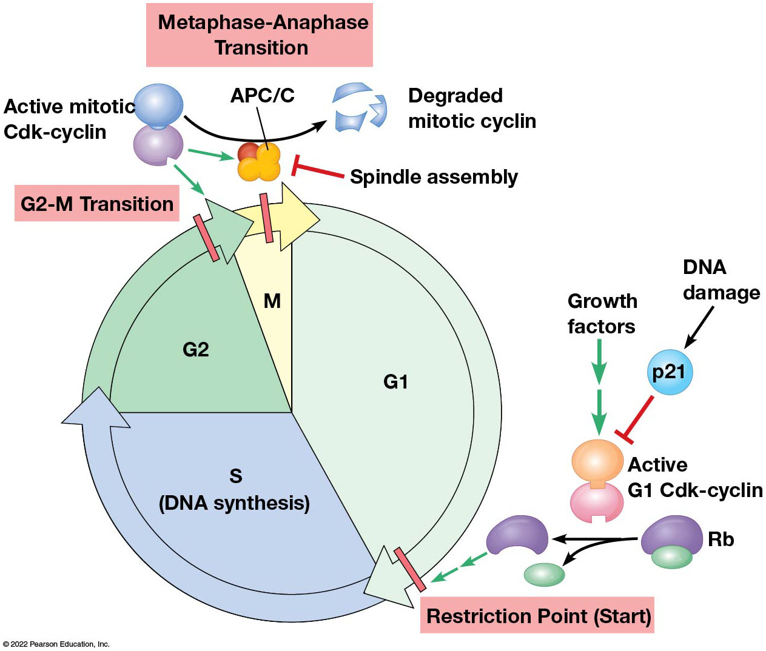
Summary of Cell Cycle Regulation by Checkpoints
Figure 24.25 Summary of Cell Cycle Regulation by Checkpoints.
Notes:
Long Description:
The details are as below:
Restriction point or start:
DNA damage to p21 activates G1 Cdk-cyclin along with growth factors. Rb protein splits (catalyzing phosphorylation) and one of it acts at the restriction point or start.
G2-M transition:
At the end of G2 phase, active mitotic Cdk-cyclin promotes G2 M transition.
Metaphase-Anaphase transition:
Active mitotic Cdk-cyclin to degraded mitotic cyclin in the presence of APC/ C. Chromosome attachment to spindle s marked as spindle assembly.

Slide 132
24.5 Apoptosis
Damaged or diseased cells need to be eliminated.
In such cases, the process must not damage surrounding cells.
Multicellular organisms accomplish this through a programmed cell death—apoptosis.

Slide 133
Apoptosis and Necrosis
Another type of cell death, called necrosis, sometimes follows tissue injury.
Necrosis involves swelling and rupture of injured cells, whereas apoptosis involves a specific series of events that lead to dismantling of the cell contents.

Slide 134
Steps of Apoptosis: Steps 1 and 2
The cell’s D N A segregates near the periphery of the nucleus, and the cytoplasm decreases.
The cell produces small cytoplasmic extensions, and the nucleus begins to fragment.
D N A is cleaved by an apoptosis-specific endonuclease (D Nase), which cuts the D N A into intervals of 200 bp.

Slide 135
Steps of Apoptosis: Step 3
The cell is dismantled into small pieces called apoptotic bodies.
Inactivation of a phospholipid translocator (flippase) causes accumulation of phosphatidylserine in the outer leaflet of the plasma membrane.
This serves as a signal for the remnants of the affected cell to be engulfed by nearby cells (usually macrophages) via phagocytosis.

Slide 136
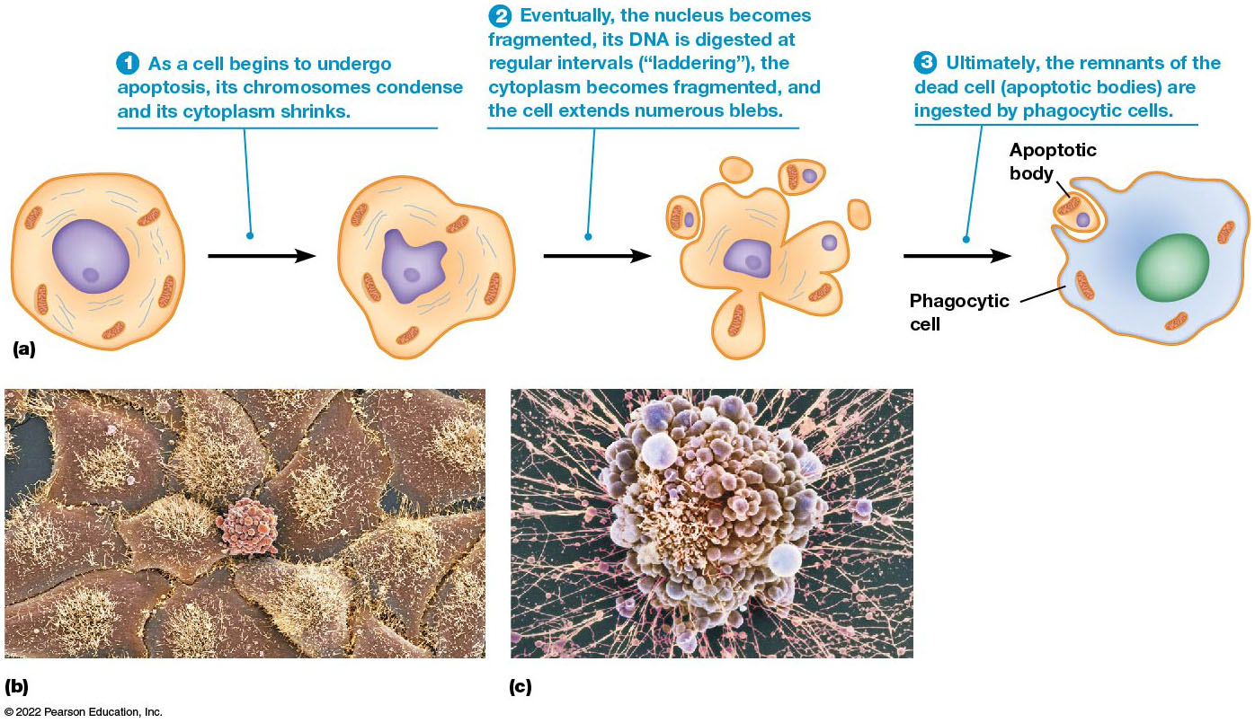
Major Steps of Apoptosis
Figure 24.26 Major Steps in Apoptosis.
Notes:
Long Description:
The steps in the process of apoptosis are as below:
As a cell begins to undergo apoptosis, its chromosomes condense and its cytoplasm shrinks.
Eventually, the nucleus becomes fragmented, its DNA is digested at regular intervals (“laddering”), the cytoplasm becomes fragmented, and the cell extends numerous blebs.
Ultimately, the remnants of the dead cell (apoptotic bodies) are ingested by phagocytic cells.
A micrograph shows continuous connected epithelial cells forming a flat sheet like structure. The second micrograph shows epithelial cells rounding up as groups without connections with one another. A third micrograph shows a single dead cell with many apoptotic bodies.

Slide 137
Apoptosis in Caenorhabditis elegans
Robert Horvitz and colleagues studied cell death in C. elegans.
These ced (cell death abnormal) mutants were defective for specific aspects of apoptosis.
ced-10 encodes a member of the Rac family, ced-3 encodes a caspase, and ced-9 encodes the C. elegans version of Bcl-2.

Slide 138
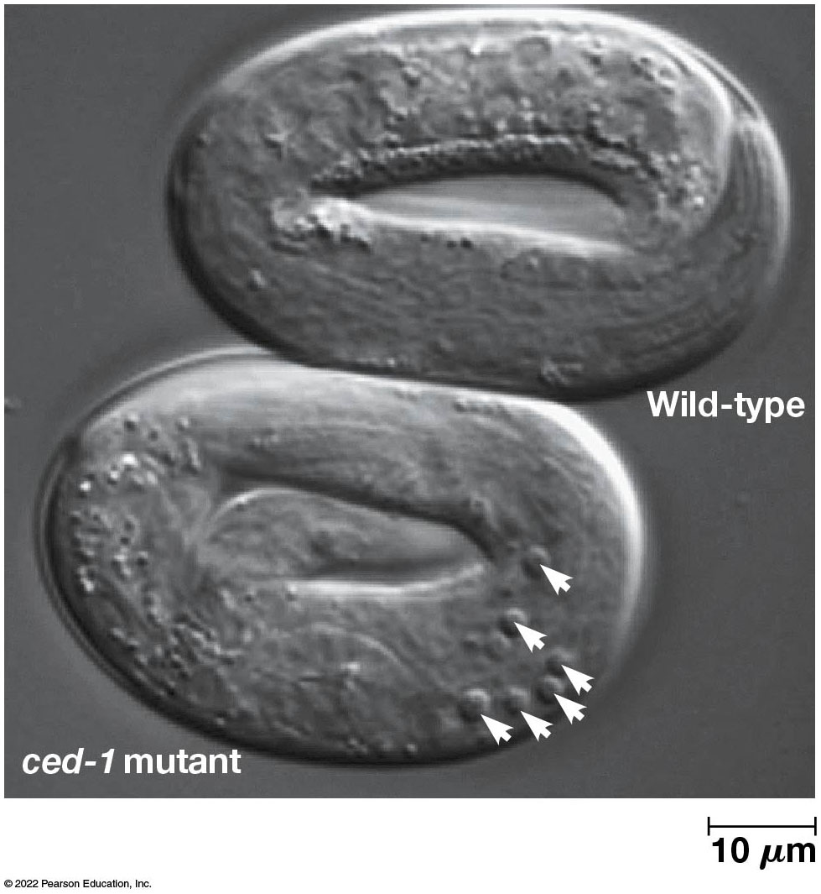
Cell Death in C. elegans
Figure 24.27 Cell Death in C. elegans.
Notes:
Long Description:
Cell death is seen in both the types of embryos as small buttons. The dead cell bodies accumulate in the ced-1 embryo and are visible. The measurement is marked as 10 micrometers.

Slide 139
Caspases
Apoptosis proceeds through the activation of a series of enzymes called caspases.
They are produced as inactive precursors called procaspases and are cleaved to create active enzymes.

Slide 140
Apoptosis Is Triggered by Death Signals or Withdrawal of Survival Factors
There are two main routes by which cells can activate caspases and enter apoptosis: directly or indirectly.
Activation can occur directly; for example, when human cells are infected by viruses, cytotoxic T lymphocytes are activated and induce apoptosis.
This is triggered when cells receive cell death signals.

Slide 141
Cell Death Signal: Apoptosis in Cells Infected by Viruses
Two death signals are tumor necrosis factor and C D95/Fas.
C D95 is a protein on the surface of infected cells; lymphocytes have a protein on their surfaces that binds C D95, causing it to aggregate.
When cells are infected by certain viruses, cytotoxic T lymphocytes are activated and induce the infected cells to undergo apoptosis.

Slide 142
Cell Death Signal: Initiator and Executioner Caspases
Adaptor proteins attach to the clustered C D95, which recruits procaspase-8 to the sites of clustering.
When the procaspase is activated, it acts as an initiator caspase, initiating the caspase cascade.
Initiator caspases also activate an executioner caspase, caspase-3, which is important for activating many steps in apoptosis.

Slide 143
The Second Type of Apoptosis Is Indirect and Involves Survival Factors (1 of 2)
One of the best-studied cases of the second type of apoptosis involves survival factors.
When survival factors are withdrawn, a cell may enter apoptosis.
The site of action is the mitochondrion.
Healthy cells have several anti-apoptotic proteins in the outer mitochondrial membrane.

Slide 144
The Second Type of Apoptosis Is Indirect and Involves Survival Factors (2 of 2)
The proteins are structurally related to a protein called Bcl-2, which, together with other proteins, counteracts proteins that promote apoptosis (pro-apoptotic proteins).
When cellular signals shift in balance toward pro-apoptotic proteins, the cell is more likely to undergo apoptosis.
One pro-apoptotic protein is called Bad (Bcl-2-associated death promoter).

Slide 145
Indirect Apoptosis by Survival Factors: Mitochondria Trigger Apoptosis (1 of 2)
Mitochondria trigger apoptosis by releasing cytochrome c into the cytosol after accumulation of pro-apoptotic proteins leads to formation of channels in the outer mitochondrial membrane.
Cytochrome c stimulates calcium release from mitochondria and E R, where it binds I P₃ receptors.
It also activates an initiator procaspase, procaspase-9, by recruiting a cytosolic adaptor protein, Apaf-1.

Slide 146
Indirect Apoptosis by Survival Factors: Mitochondria Trigger Apoptosis (2 of 2)
Apaf-1 assembles procaspase-9 into a complex called an apoptosome.
The apoptosome promotes production of active caspase-9.
Caspase-9 activates the executioner caspase, caspase-3.
Both mechanisms lead to activation of a common caspase that sets apoptosis in motion.

Slide 147
Damaged Cells Can Trigger Their Own Apoptosis
If a cell suffers such damage that it can’t repair itself, it may trigger its own demise.
It can enter apoptosis through the activity of p53, which acts through the protein Puma, which binds and inhibits Bcl-2.

Slide 148
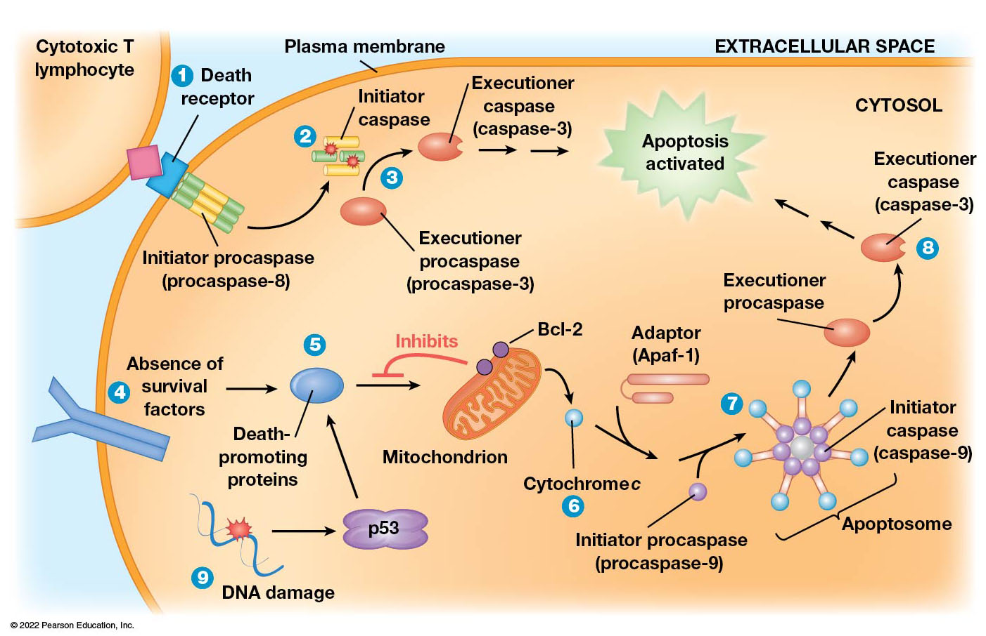
Induction of Apoptosis by Cell Death Signals or by Withdrawal of Survival Factor
Figure 24.28 Induction of Apoptosis by Cell Death Signals or by Withdrawal of Survival Factors.
Notes:
Long Description:
The processes are as below:
Death receptor on the plasma membrane with initiator procaspase or procaspase-8.
Initiator caspase
Executioner casphase or casphase-3.
Apoptosis activated
Absence of survival factors
Death promoting proteins p53. Inhibits Bcl 2. Release of cytochrome c. Activation of initiator procaspase or procaspase-9
Activation of initiator caspase or caspase-9. Apoptosome is labeled.
Executioner procaspase
Activation of executioner caspase or caspase-3.
Apoptosis activated.

