Slide 1
Magnetizing Water
GMX International
https://www.youtube.com/watch?v=LZj4pSZj8Q4

Slide 2
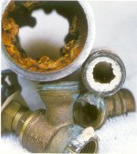
The Problem: Scale and Calcium Build up

Slide 3
Problems from Scale Build up
Scale build-up from hard water can cause the following problems:
Clogged water pipes & reduced water pressure
“Frozen" valves on faucets
Poor lathering of soaps, detergents, and shampoos
Hard-to-remove film on shower tiles and doors
Spots and milky clouds on glassware and silverware
Performance decrease in appliances that use water

Slide 4
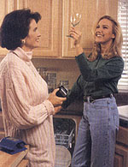
Film on your glasses?
Scale build up on your glasses & silverware, (as well as inside coffee makers and household pipes) can be reduced by installing GMX water conditioners.

Slide 5
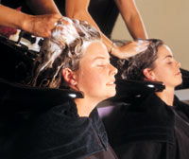
Want Nicer Hair and Skin?
Softer skin is reported after installing a magnetic water treatment system
Use smaller quantities of soaps and shampoos and produce a better lather
Using less soap and shampoo rinses cleaner & is better for your skin & hair

Slide 6
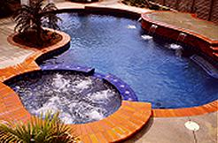
Tired of Buying Pool Chemicals?
Magnetic Water Conditioners reduce the need for pool chemicals up to 75%.
“We used to spend almost $100 per month on chemicals for our pool, since installing the magnets, our chemical bill averages $17 per month,” says a pool and spa owner in New Mexico.

Slide 7
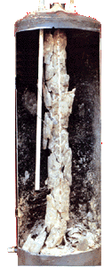
Water Heating
According to the U.S. Bureau of Standards, a 1/4-inch layer of scale results in a whopping 40 percent increase in energy costs. By making these appliances more efficient, you save energy dollars.
GMX conditioners reduce the scale build-ups that can drastically effect the efficiency of water heaters.

Slide 8
Costs of Scale Build Up
The estimated energy cost for running a 40-gallon electric hot water heater is $450 each year.
A scale build up of just 3/8" gobbles up 55 percent more energy, according to the U.S. Bureau of Standards.
That's an additional $247 more each year to produce the same amount of hot water, for a total of $697.

Slide 9
No Ongoing Costs
Water softeners consume over 800 pounds of salt each year. GMX conditioners use no salt.
Water softeners also require significant amounts of electricity, as well as extra water for backwashing (up to 10,000 gallons a year.) GMX conditioners use no electricity.
With GMX conditioners you can save money by reducing the amount of soaps and detergents you use for clothing, dishes and bathing including shampoos.

Slide 10
The Solution:
GMX Magnetics!

Slide 11
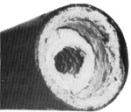
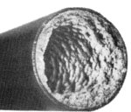
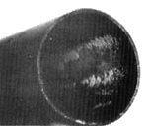
Magnetically Treated Water
Typical scale and calcium build-up caused by untreated water has almost closed this pipe.
This photo shows the effect of magnetically treated water on the same section of pipe a short time after the installation.
After continual treatment, most scale is removed and will be prevented as long as the system is in operation.

Slide 12
Here are just some of the ways in which GMX conditioners are being used:
Plumbing systems
Pools, spas, and fountains
Evaporative (swamp) coolers
Water-cooled equipment
Irrigation systems
R.V. water systems
Car and truck fuel systems
Car and truck cooling systems
Coffee machines
Laundry machines
Commercial dishwashers
Car washes

Slide 13
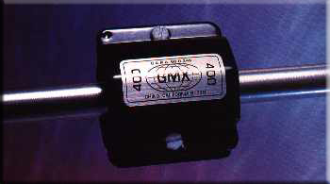
Model 400 GMX
Model 400 GMX
Magnetic Fluid Conditioner For 1/4" to 1/2" Tubing or Pipe.
Primary Applications:
Residential and commercial applications wherever hard water is present (swamp coolers, commercial ice machines, fountains, printing equipment, commercial dishwashers).

Slide 14
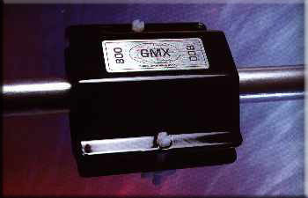
Model 800 GMX
Model 800
Magnetic Fluid Conditioner For 1/2" to 1" Tubing or Pipe.
Primary Applications:
Residential, commercial, and light industrial applications wherever hard water is present (plumbing systems, water heaters, commercial ice machines, fountains, laundries, printing equipment, commercial dishwashers).
Other applications: car and truck cooling systems and irrigation systems.

Slide 15
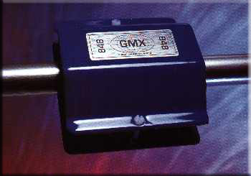
Model 848
Model 848
For 1 1/4" to 2" Tubing or Pipe.
Primary Applications:
Residential, commercial and industrial applications wherever hard water is present (plumbing systems, appliances, pools, and spas).
Other applications: systems for apartment, condominiums, water-cooled equipment, laundries, car washes, and irrigation systems.

Slide 16
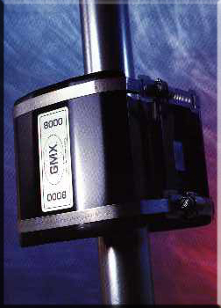
Model 8000
Model 8000
Magnetic Fluid Conditioner For 2" to 8" Tubing or Pipe.
Primary Applications:
Residential, Commercial, Industrial,and agricultural applications wherever hard water is present.

Slide 17
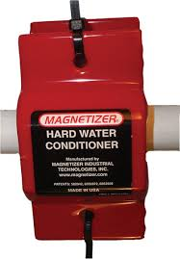
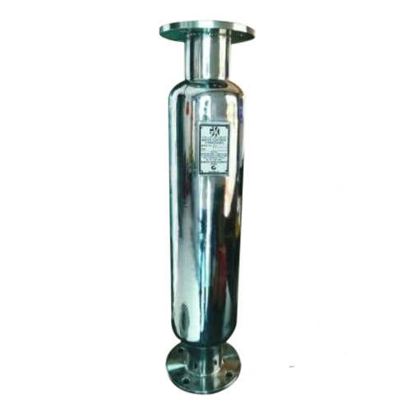
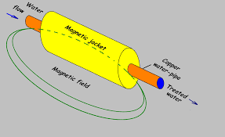

Slide 18
Plants & Irrigation
Surface tension plays a key role in the effective irrigation of plants.
Magnets reduce the surface tension of fluids.
Water with low surface tension, enables plants to quickly receive nutrients and re-hydrate.
The benefits:
A savings of water
Healthier more productive plants
Reduction of scale build up on irrigation equipment
Cost saving from the above items

Slide 19
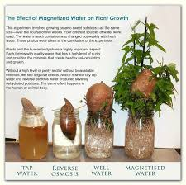
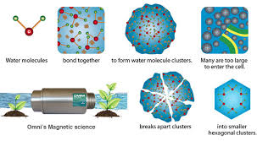
https://www.youtube.com/watch?v=rObJQWy8xa8
https://www.youtube.com/watch?v=pVPo1GylfG8
https://www.youtube.com/watch?v=DO34hjCdV9M

Slide 20
INDUSTRIAL/COMMERCIAL RESULTS
Alaska Pipeline: The Alaska Pipeline has 40,000 five pound Magnets attached to it. Oil Companies use magnets to prevent wax and sludge build-ups in pipes.*
California Wineries: Over 90% of the large Wineries in California are using Magnetic Systems in tasting rooms, winery and grape fields.*
U.S. Dept. of Coast Guard, Engineer's Digest: Scale deposit had restricted the plumbing to a point where only 40% of the needed flow rate was available. After the Magnetic System had cleared the tubes, the oil consumption in a 2 week period dropped to 40, from 60 gallons, providing an approximate 30% savings in fuel, which will pay for the System in a short period of time and prolong the life of the boiler and heat exchanger. This equipment has been maintenance free and has continued to provide energy savings and improved equipment life.*
*source: http://www.safe2use.com/safe-products/agua-soft/articles/industrial-uses.htm

Slide 21
Time to give it a try?
GMX magnets are sized to fit your pipes
Affordable and maintenance free
No risk - 90 day Satisfaction Guarantee
Lifetime Manufacturer’s Warranty

Slide 22
Contact GMX International
Toll Free: 800-373-4469
gmxinternational.com
Or your local GMX distributor

Slide 23
