Slide 1
BT233 – General Microbiology Laboratory
Dilution
{{Isolation, Purification and Identification of Bacteria}}
Lab#6 (Final Exam Materials Start from this lab

Slide 2
How can we isolate certain types of bacteria and study them from different sources: Today we will use soil as a bacterial source
By using isolation technique: Serial dilution with either:
1. Pour-plate method OR
2. Surface-spreading method
Followed by purification techniques:
Surface-streaking method
In conclusion : first isolation, then Purification.

Slide 3
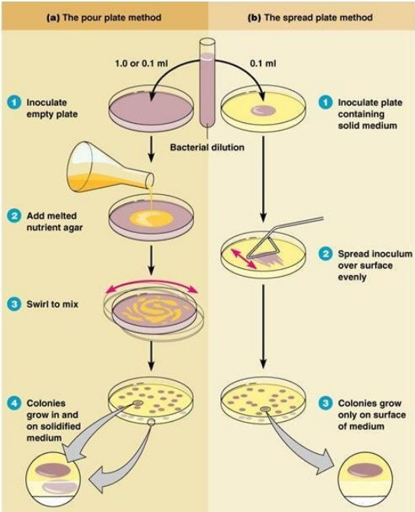

Slide 4
Serial dilution is used to decrease the number of bacteria in the sample
Surface-spreading method used for seeding of bacteria and converting it into visible form
We can use both 1 & 2 to get non contaminated cultures which contains different bacterial colonies from the same source
Surface-streaking method used to convert non contaminated cultures into pure cultures that contains only one type of bacteria

Slide 5
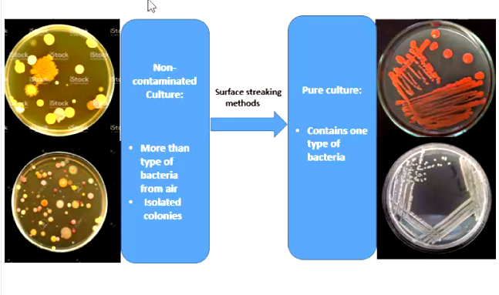

Slide 6
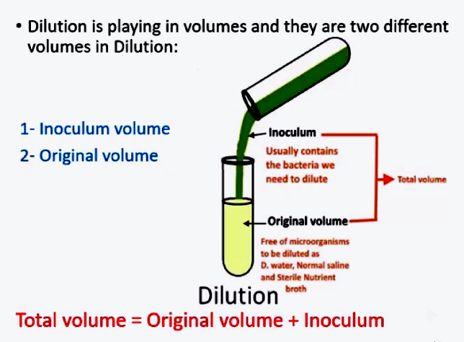

Slide 7
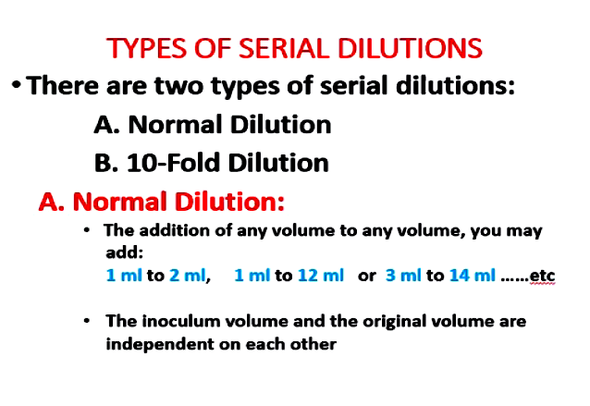

Slide 8
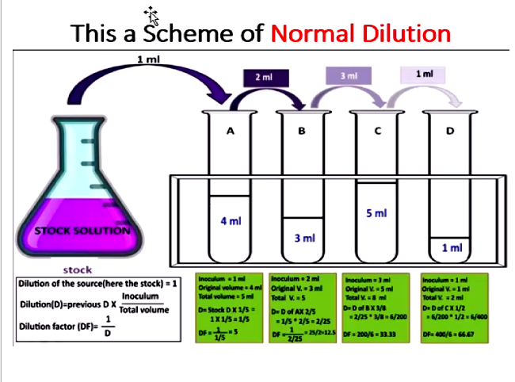

Slide 9
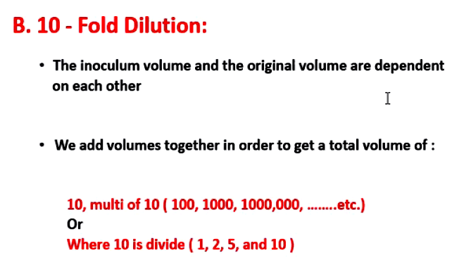

Slide 10
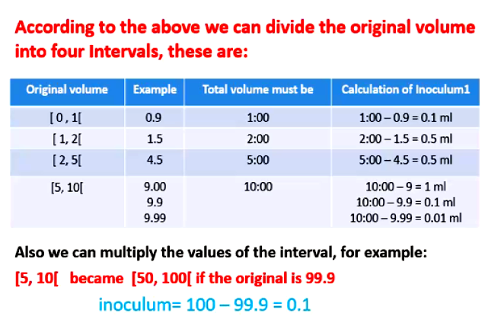

Slide 11
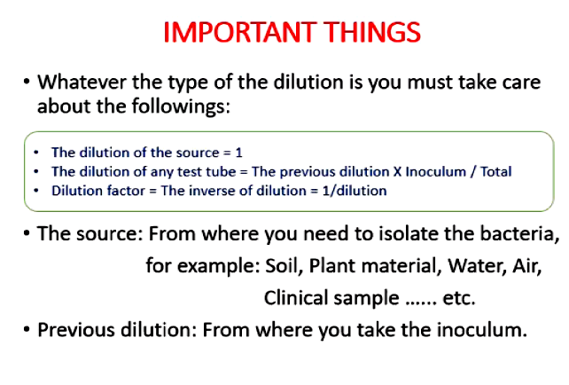

Slide 12
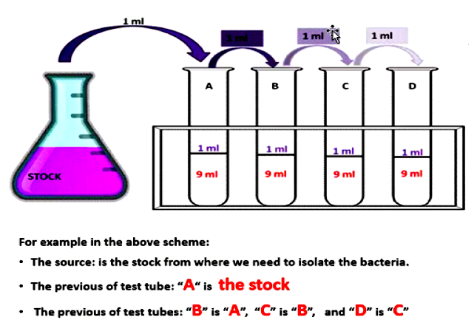

Slide 13
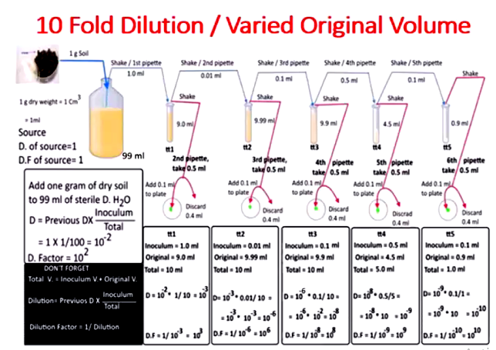

Slide 14
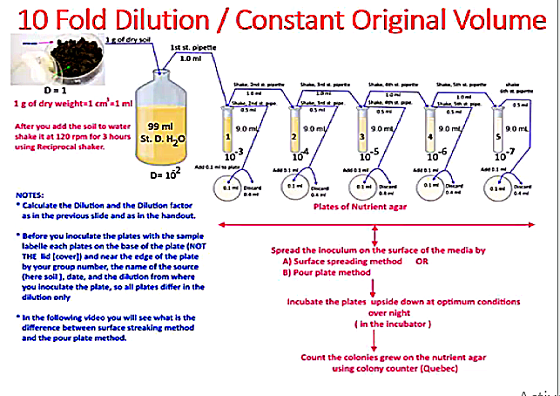

Slide 15
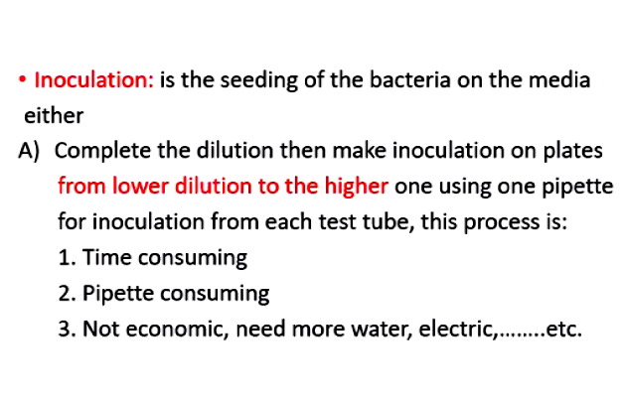

Slide 16
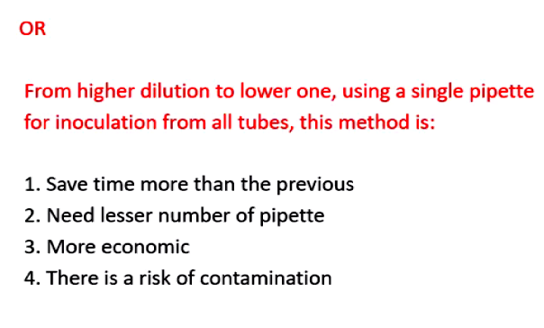

Slide 17
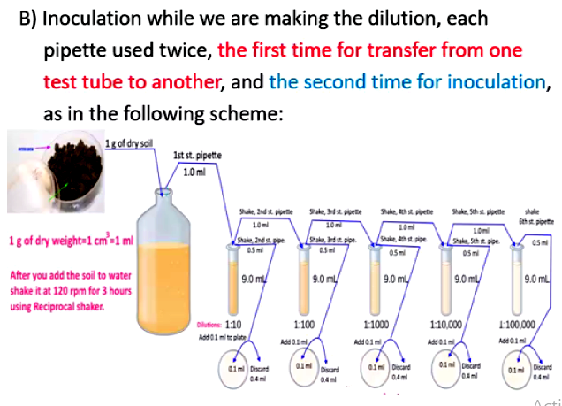

Slide 18
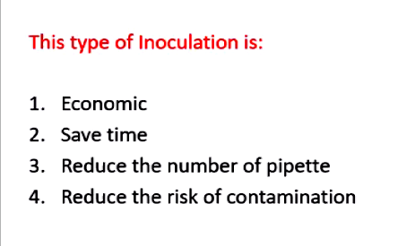

Slide 19
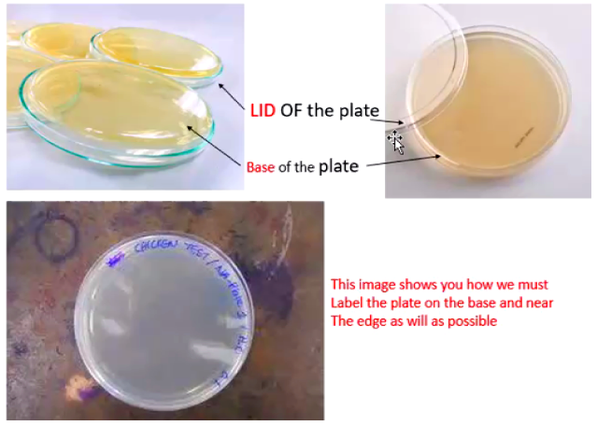
You need to make smart labelling for your plates: write using a thin permanent marker on the edge of the plate Base (Day, session number, date, group number and the first letters of the group member names).

Slide 20
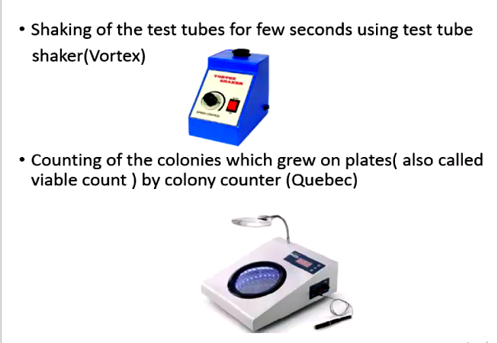

Slide 21
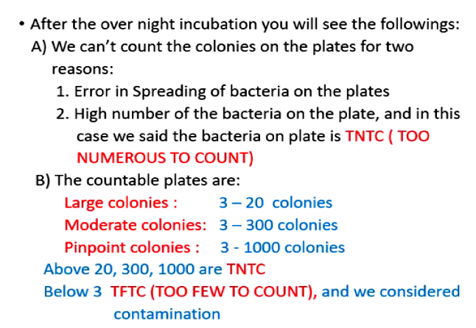

Slide 22
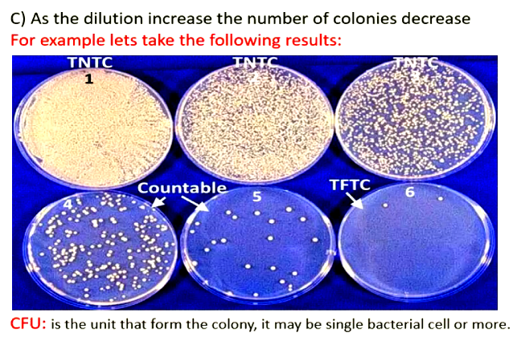

Slide 23
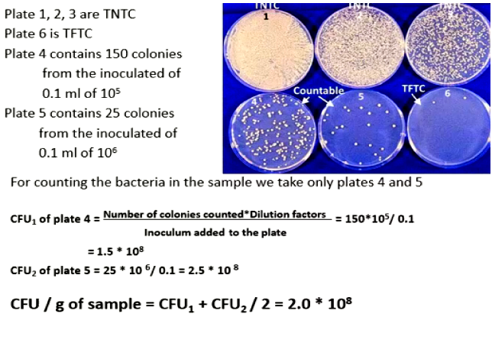

Slide 24
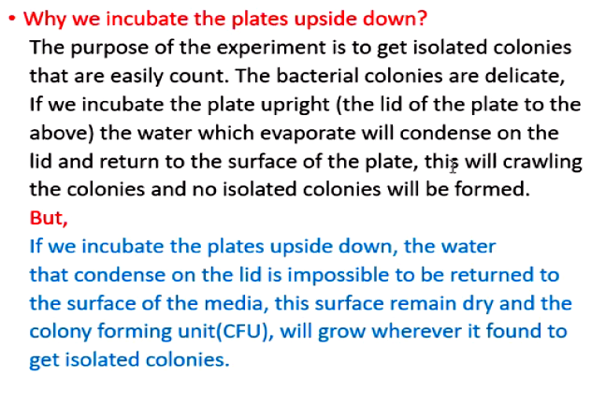

Slide 25

Important Points
Smart labelling is of great importance:
Student: I don’t find my plates. ooooooh
Instructor: Welcome to the Zero Club
Wash your test tubes after finishing your work and put them in the identified basket on the instructor bench
Coming to the lab after 24 hours of incubation is named open lab You can enter to the open lab as follows:
Sunday-Wednesday: 09:30-02:30 p.m
Thursday: 09:30 -02:00 p.m
Do your work carefully, no time and space to repeat the work at all.
Do your open lab work quietly since there will be a lab session while you're working.

Slide 26
THE END

