Slide 1

Hotel Booking Cancellation Analysis
By: Hemang Gala, Soham Nanavati, Nidhee Patil, Ryan Song, Akash Malde

Slide 2

Problem statement and solution
The dataset contains real-life hotel stay data with 20 different features including whether the booking was cancelled or not.
The main business questions are:
”Why are the customers cancelling their bookings at the hotel?”
”What solutions should be applied to reduce cancellations?”
“Can the cancellations be predicted?”
The project aims at providing practical insights using exploratory data analysis to find relation between different trends and using machine learning techniques to find out reasons for cancellations and predict the same.

Slide 3
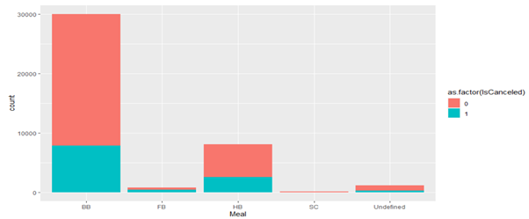
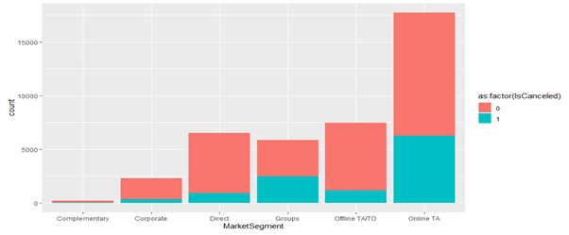
Exploratory data analysis: Bar plot

Slide 4
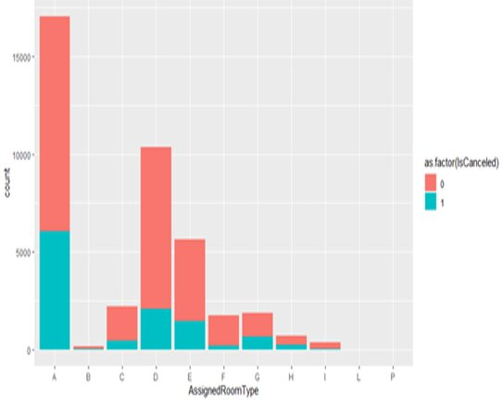
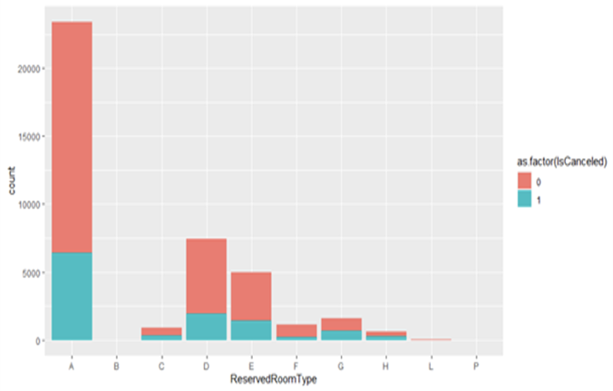
Exploratory data analysis: Bar plot

Slide 5
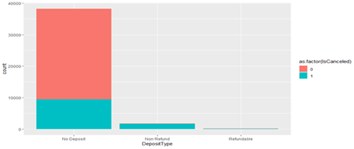
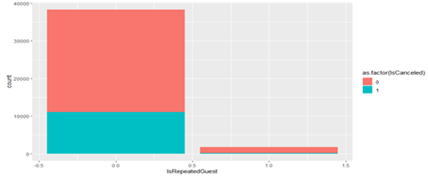
Exploratory analysis: Bar plot

Slide 6
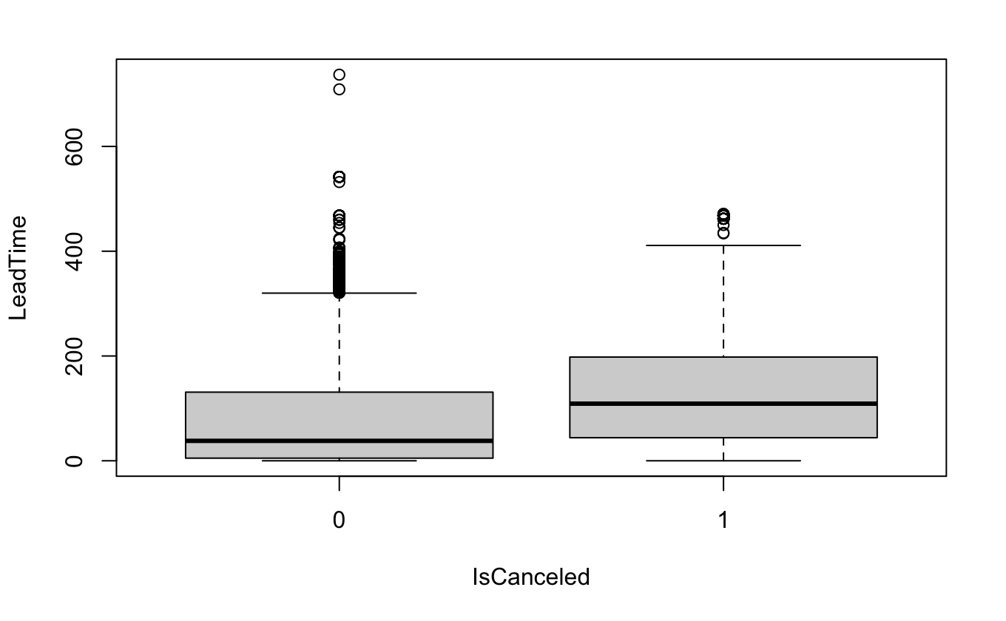
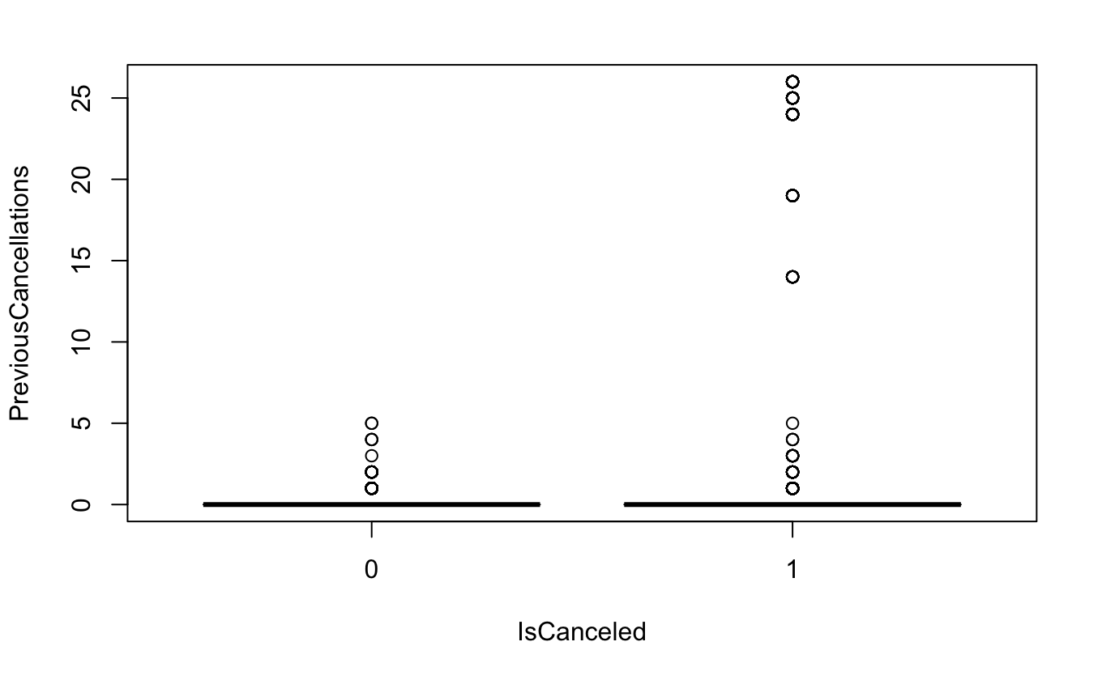
Boxplots

Slide 7
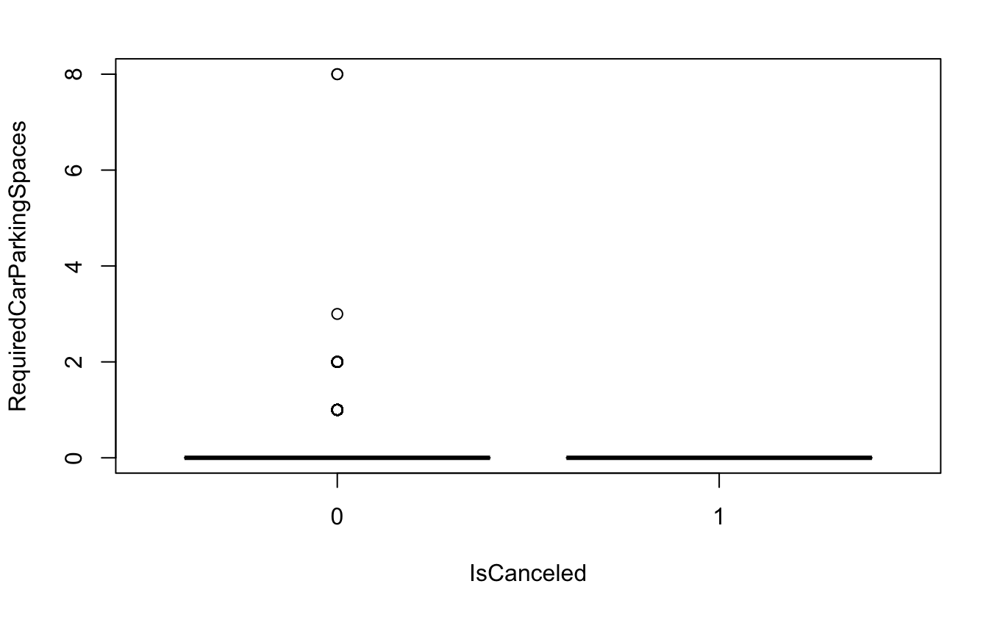
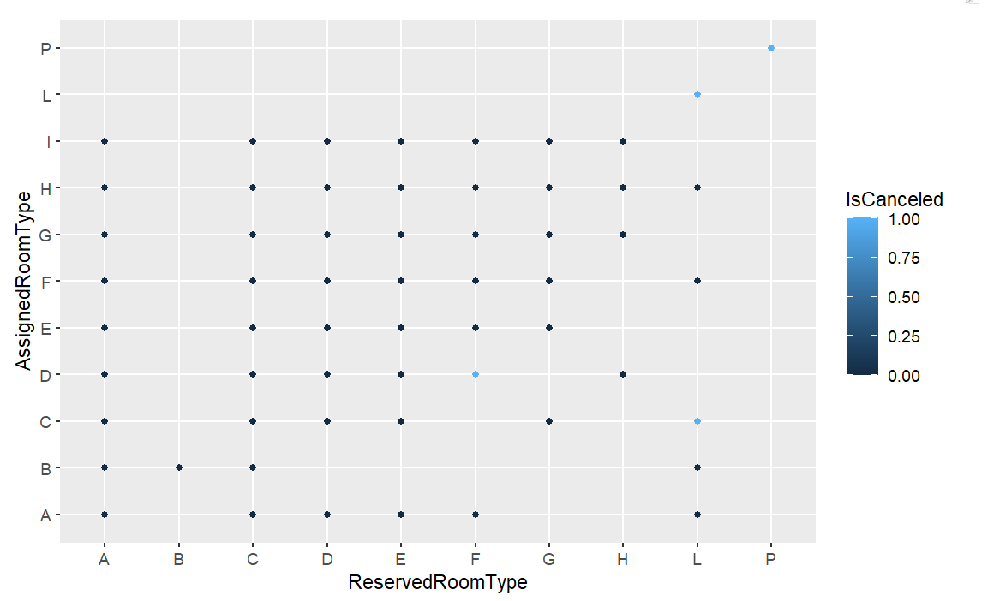
Boxplot and scatterplot

Slide 8
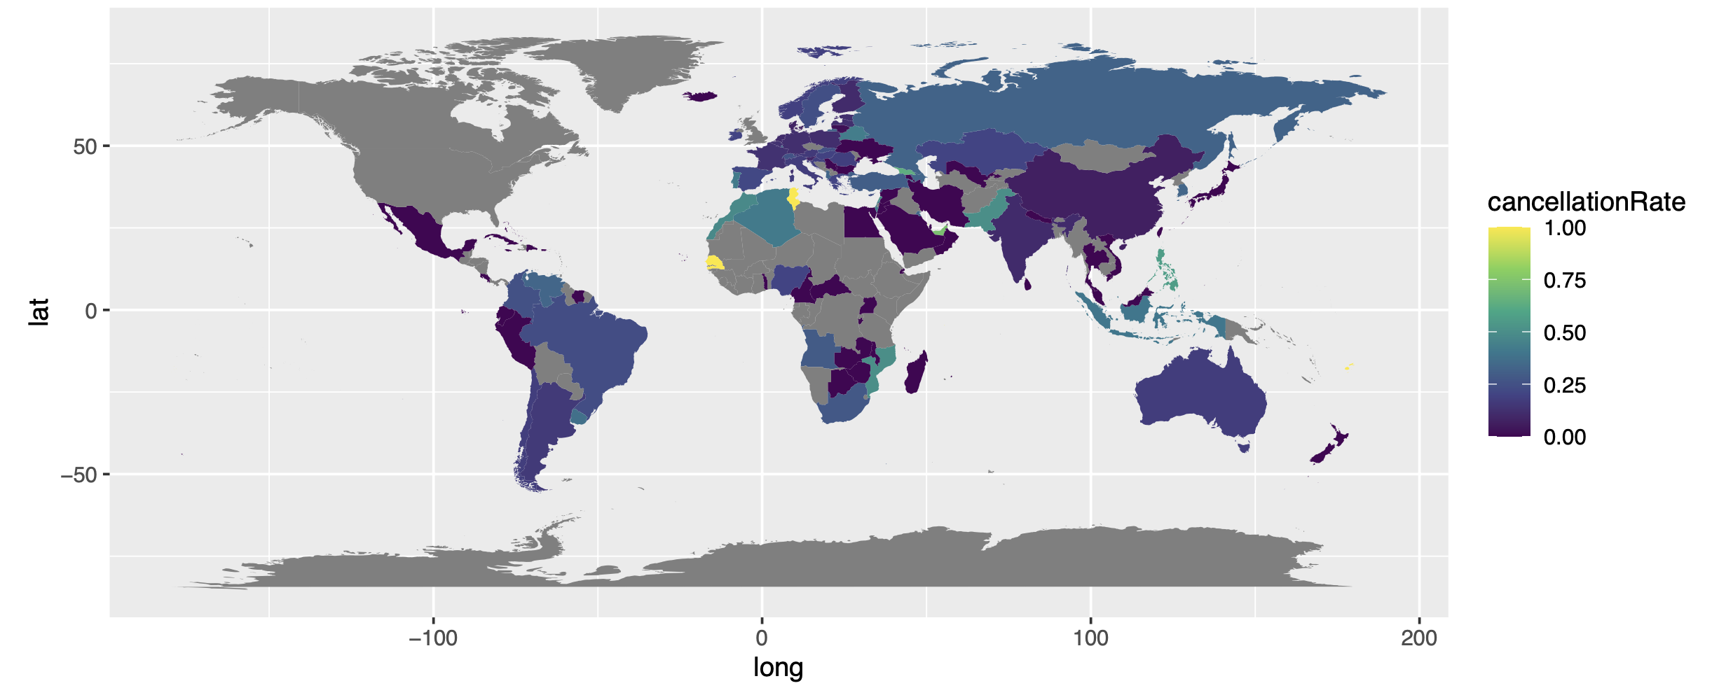
Worldwide cancellations

Slide 9

MODELS IMPLEMENTED and their results
Associate Rule Mining gives a total 22 combination of reasons why a customer tends to cancel their booking with a confidence of 80-96% that the said combination is likely to cancel.
The SVM model gives us an 81% accurate prediction of cancellations when we consider the most relevant aspects of the booking.
The Decision Tree model gives us cancellation prediction accuracy of 81.3% when we consider the most relevant aspects of the booking.
The aspects of bookings we considered for the latter 2 models are LeadTime, PreviousCancellations, BookingChanges, SpecialRequests, RequiredCarParkingSpace, MarketSegment, AssignedRoom and the DepositType. These factors are the most relevant ones to booking cancellations.

Slide 10


Business solution
Implement a loyalty program as there aren’t many customers that come back to the hotel.

Slide 11

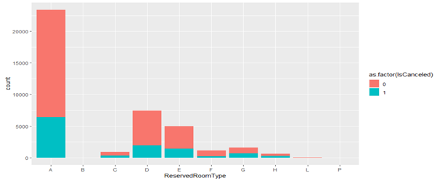
Business solution
Check the condition of room B, L and P and renovate the rooms to increase availability.

Slide 12

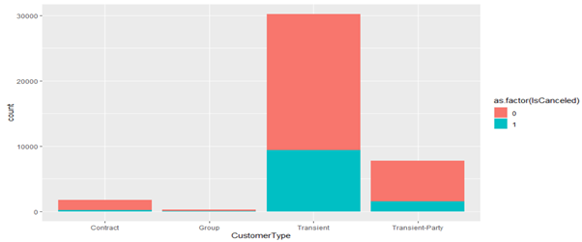
Business solution
Increase contract benefits to attract recurring income.

Slide 13

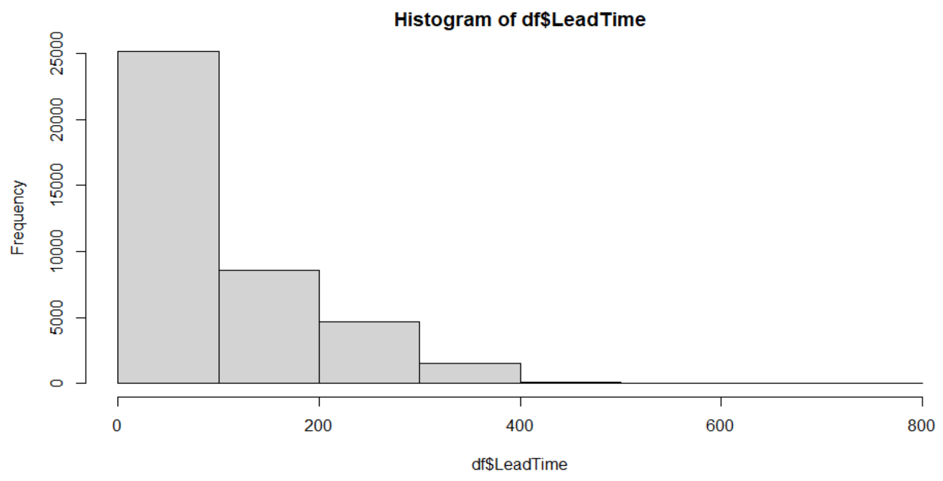
Business solution
To reduce the cancelations, we can engage with the customers by sending regular mil and keeping our guests on upcoming events.

Slide 14

Business solution
Use the decision tree model that was discussed earlier for the prediction of cancellations as it has the highest accuracy of 81.3% and has a much faster speed than the other models.

