Slide 1
Milestone 1
Team SPAM, Feb 1, 2023

Slide 2

Team SPAM
The name is an acronym made out of our first names’ first letters:
Sammy D.
Pavel D.
Andrey Y.
Musab M.

Slide 3
Personal Expense Consultant
Vision
We realize there is serious competition in this industry
We are creating something that would be completely our own, with the potential to do some things better than the competition does
Secret ingredient: PASSION! ❤️‍🔥
Very good learning project
System Overview: The Consultant will be both an immediate and an ongoing analyst and advisor in your personal monetary matters. It will help you determine whether you’re doing fine in your financial life, or you need a little guidance. It will help you plan for and achieve financial health.

Slide 4
Personal Expense Consultant
Story Map
Initial customer feature set:
Secure Login
Load History via Parsing Engine
Manual Transaction Entry
Display Transactions (sortable columns)
Display Summary
Display Suggestions
Change Settings (password, close account, etc.)

Slide 5


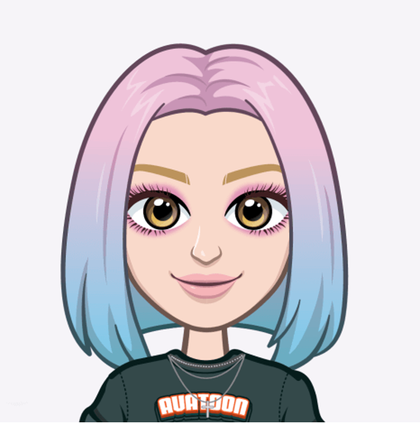


Personal Expense Consultant
Personas
Amanda's values:
Efficiency
Security
Accurate invoicing
Expenses tracking
Convenience
User-friendly
Ben’s values:
Speed
Ease of use
Security
App dependability
At-a-glance reports
Chloe’s values:
Expense tracking
Budgeting
Financial control
User-friendly interface
Easy-to-read summaries

Slide 6
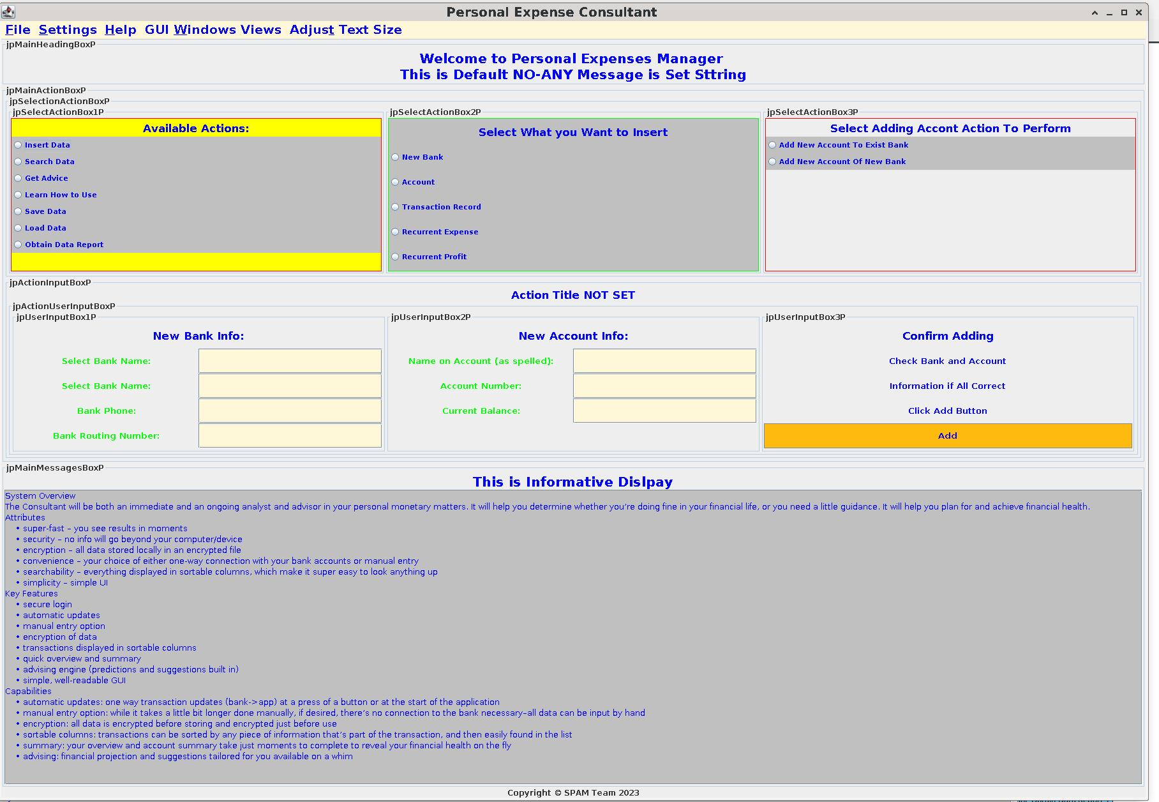
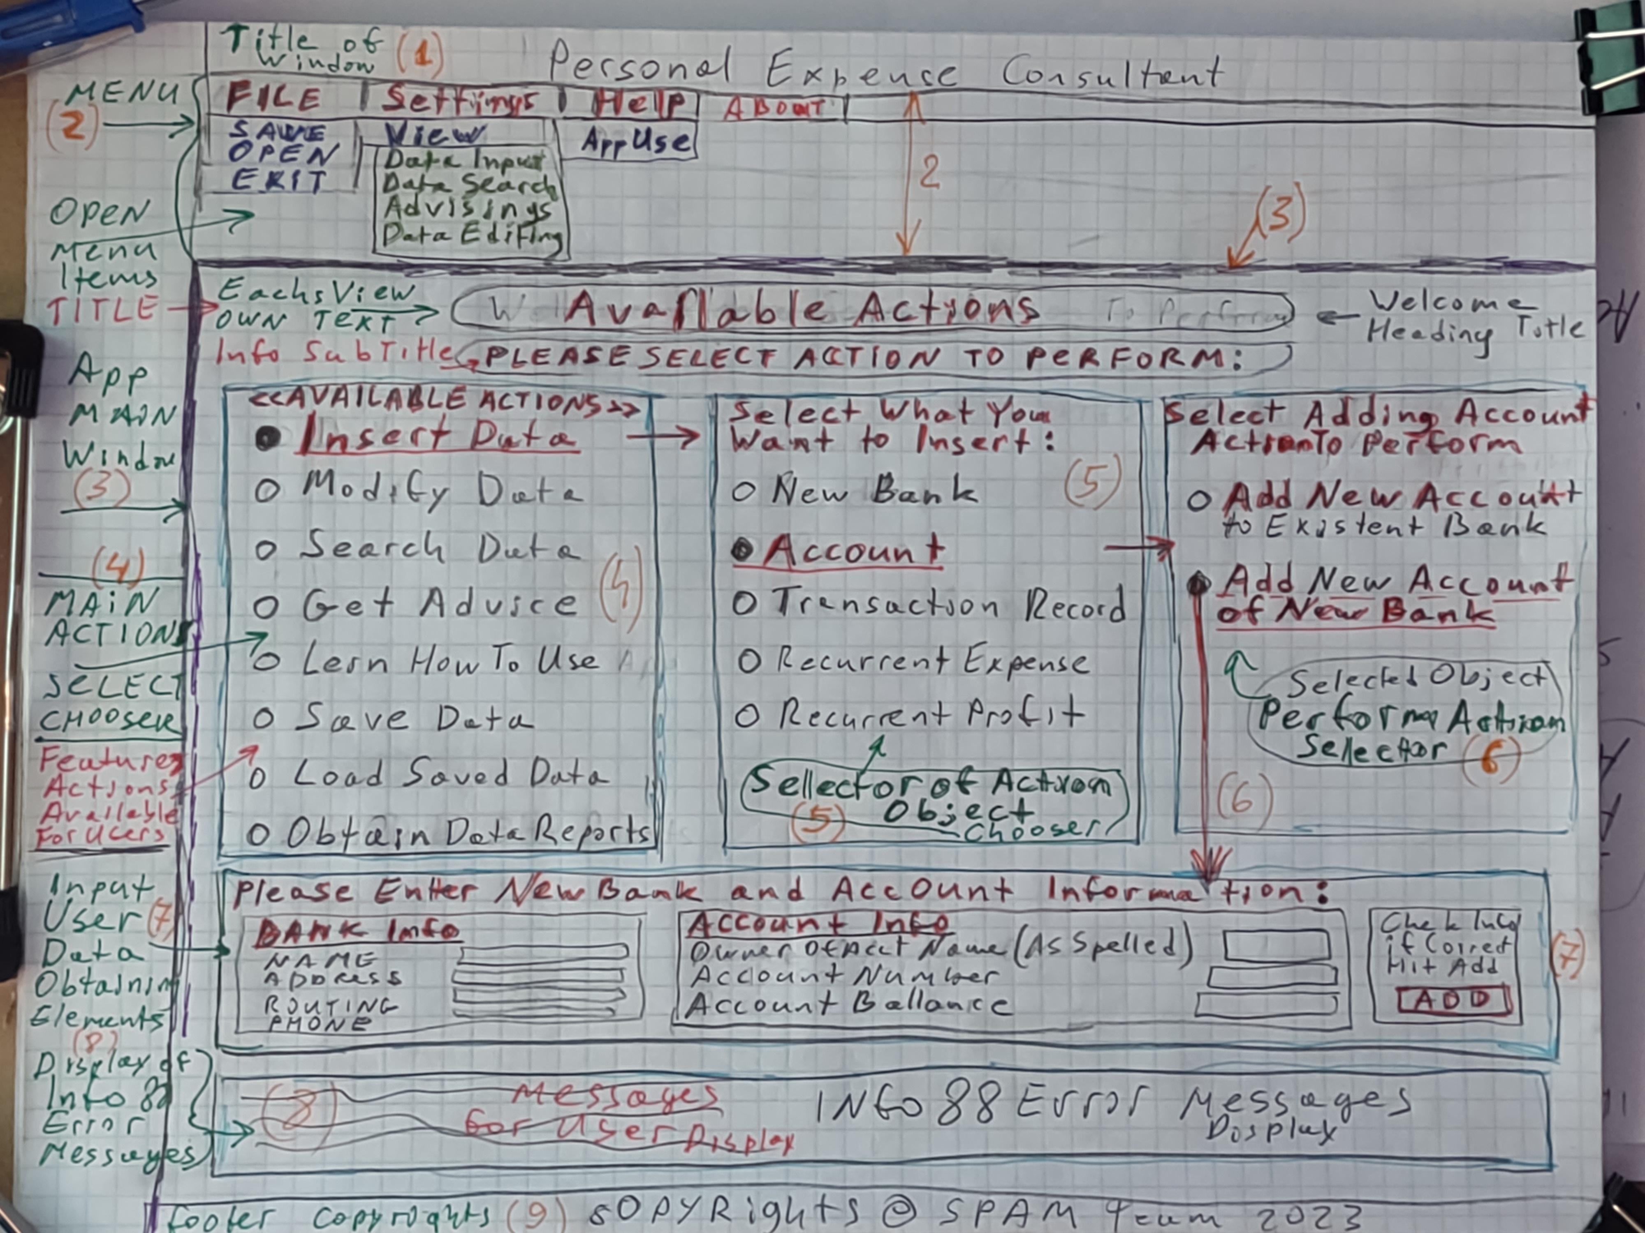
Personal Expense Consultant
GUI Examples
Paper version of the prototype versus the computer version.

Slide 7
Personal Expense Consultant
Non-Functional Requirements
Data Security and Privacy
User-friendly Interface
Accurate and Up-to-Date Information
Quick and Efficient Analysis
Responsiveness and Reliability
Performance
Scalability

Slide 8
Personal Expense Consultant
Summary of Challenges
Choosing the right project
A member leaving the team
GitHub setup
Bank APIs

Slide 9
Personal Expense Consultant
Q & A

