Slide 1
Convolution neural network on CIFAR10 dataset with improvement
CSYE7380 Week 4 assignment
Shen Wang
002697074
wang.shen3@northeastern.edu

Slide 2
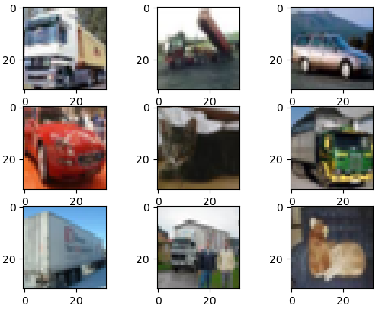
CNN and CIFAR10 Dataset
1.1 CIFAR-10 Photo Classification Dataset
baseline model: test harness
1. convolutional layer with 3*3*32 filters
2.pooling layer with 2*2 filter
3. flatten layer and fully connected layer with 128 neurons
4. output layer with 4 neurons
5. backpropagation with SGD
For our study, we will use only 4 classes
A quick glance at sample images
Improvements to implement
1) Batch Normalization
2) Dropout
3) Number of convolution and pooling layers
4) Activation functions
5) A combination of 1-4
1: automobile
3: cat
5: dog
9: truck

Slide 3
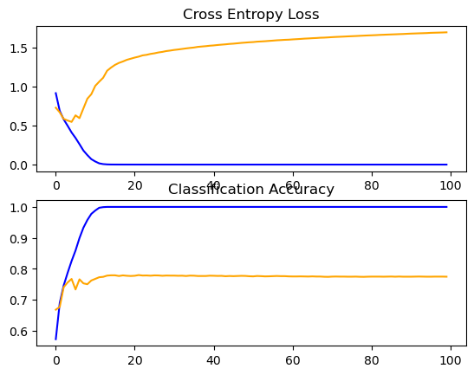
Baseline model
Accuracy: 77.475%
overfitting on train dataset around 15th epoch
cross entropy loss on test set keeps on increasing
need improvements
---test dataset
---train dataset

Slide 4
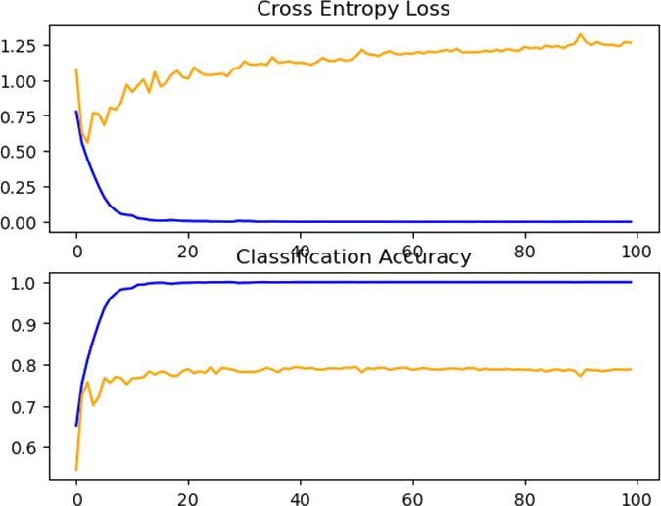
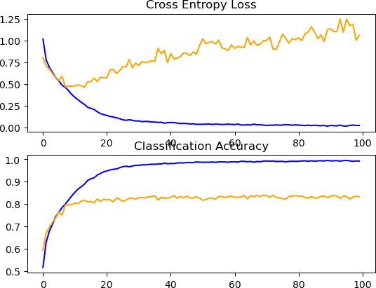
Batch Normalization
Dropout
---test dataset
---train dataset
---test dataset
---train dataset
Accuracy raised to 78.875%, (+1.4%)
The testing on the test data is not stalled
Accuracy raised to 83.3%, (+5.825%)
Convergence is slowing down

Slide 5
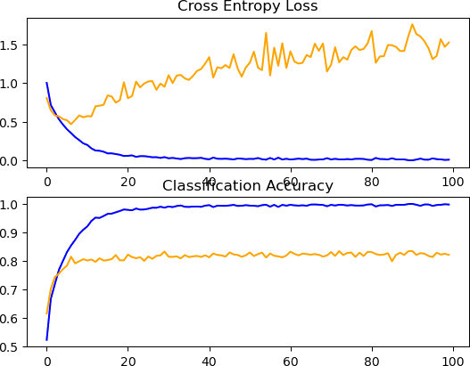
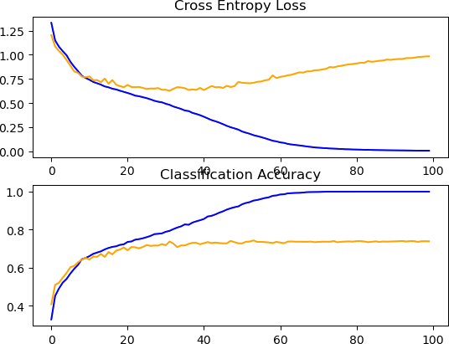
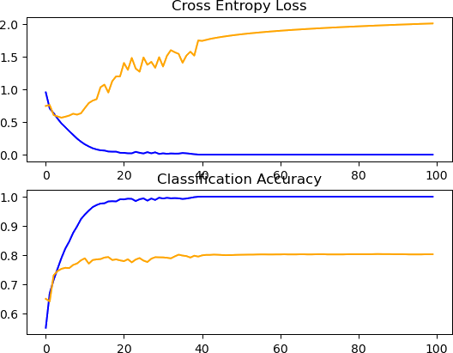
Number of convolution and pooling layers
Activation function: sigmoid
3 blocks
2 blocks
---test dataset
---train dataset
---test dataset
---train dataset
Accuracy :80.3%, (+2.825%) with 2 blocks
Accuracy :82.1%, (+4.625%) with 3 blocks
convergence is significantly suppressed
Accuracy dropped to 73.9%, (-3.575%)
Convergence is slowing down

Slide 6
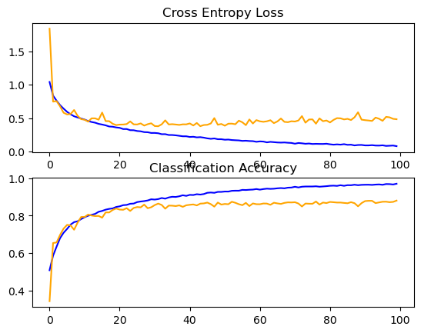
One shot to apply them all
method | accuracy (%) | improvement (%)
Baseline | 77.475 | 0
BatchNormalization | 78.875 | 1.4
Dropout | 83.3 | 5.825
2blocks | 80.3 | 2.825
3blocks | 82.1 | 4.625
Activation Function | 73.9 | -3.575
Combined | 88.025 | 10.55
---test dataset
---train dataset
Accuracy raised to 88.025%, (+10.55%)
Could still improve with more epochs

