Slide 1
kubernetes
siva@way2learnonline.com

Slide 2
What is Kubernetes ?
Kubernetes is opensource orchestration system for docker containers
  It lets you schedule containers on a cluster of machines
  You can run multiple containers on one machine
Kubernetes will manage the state of these containers
  Kubernetes can start the container on specific nodes
  Will restart the container if killed
  Can move containers from one node to another node
siva@way2learnonline.com

Slide 3
Other popular Docker Orchestrators
Docker Swarm
Mesos
siva@way2learnonline.com

Slide 4
Minikube
Minikube is a tool that makes it easy to run kubernetes locally
Minikube runs a single node kubernetes cluster inside a linux VM
minikube start
Kubectl is a tool to manage kubernetes cluster
siva@way2learnonline.com

Slide 5
LAB – STARTING SINGLE NODE CLUSTER USING MINIKUBE
siva@way2learnonline.com

Slide 6
AWS Setup
To set up kubernetes on AWS, you can use a tool called kops
  KOPS stands for Kubernetes operations
Kops only works on Mac or Linux
If you are on Windows You can set up a VM in virtual box using vagrant,etc
siva@way2learnonline.com

Slide 7
POD
Group of one or more containers that are always co-located, co-scheduled and run ina shared context
Containers in same pod have the same hostname
Each pod is isolated by
  PID namespace
  Network namespace
  IPC namespace
Alternate to a VM with multiple processes
siva@way2learnonline.com

Slide 8
POD
Can we run multiple processes in same Docker container ?
POD allows us to group multiple related containers which can run in a shared context eg. WebApp and redis may have to be packaged together . Both of them can use localhost to communicate with each other
siva@way2learnonline.com

Slide 9
Labels and Selectors
How do we group or identify all related pods belonging to same application ?
How do we schedule a pod to be executed on a particular type of node ? E.g I want to schedule a pod running mysql db in a node which has SSD drive
Give a label to Node and in pod descriptor, you can specify a selector which selects a Node with particular label value
Labels are the essential glue to associated one API object with other
  Replication Controller → Pods
  Service →Pods
  Pods → nodes
siva@way2learnonline.com

Slide 10
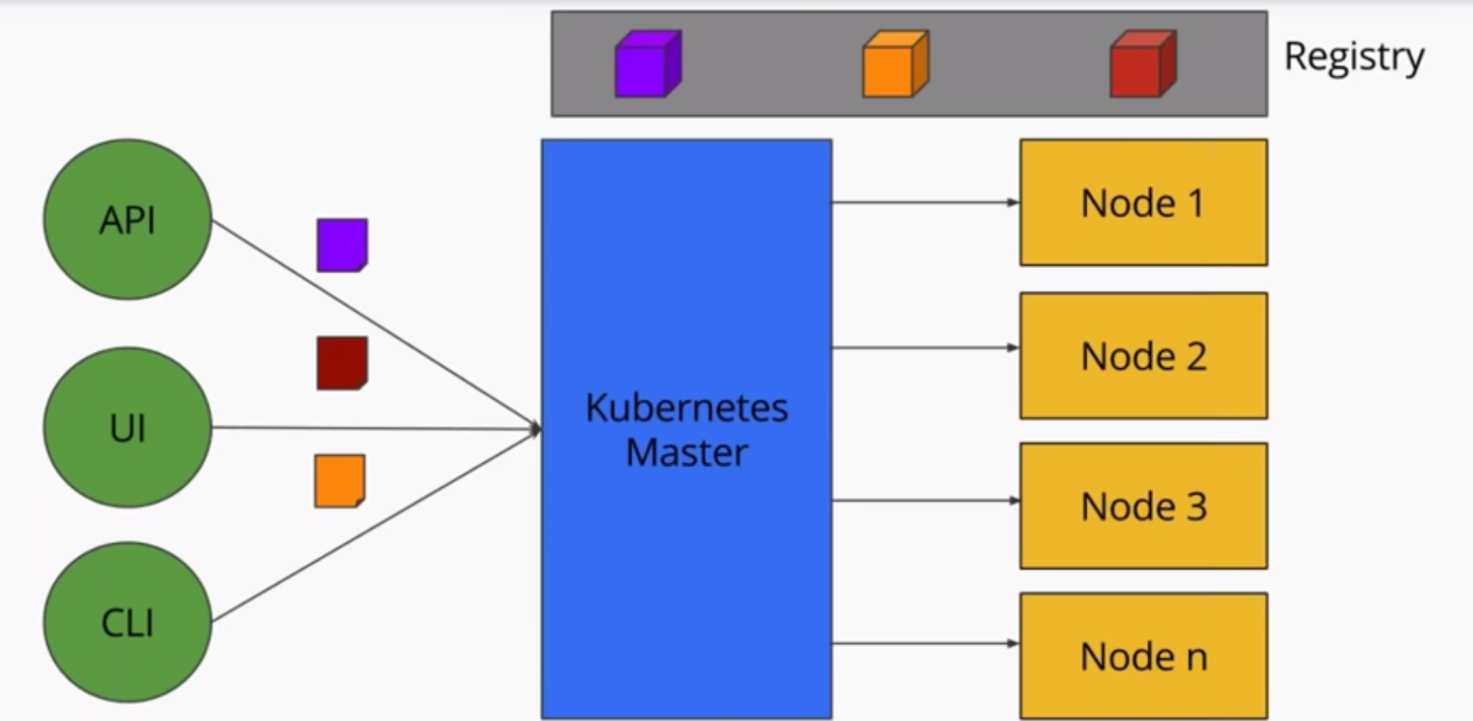
Kubernetes Architecture
siva@way2learnonline.com

Slide 11
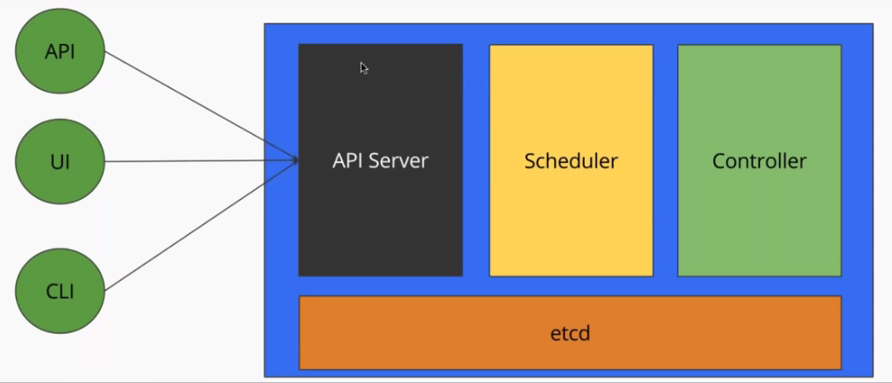
Kubernetes Master
siva@way2learnonline.com

Slide 12
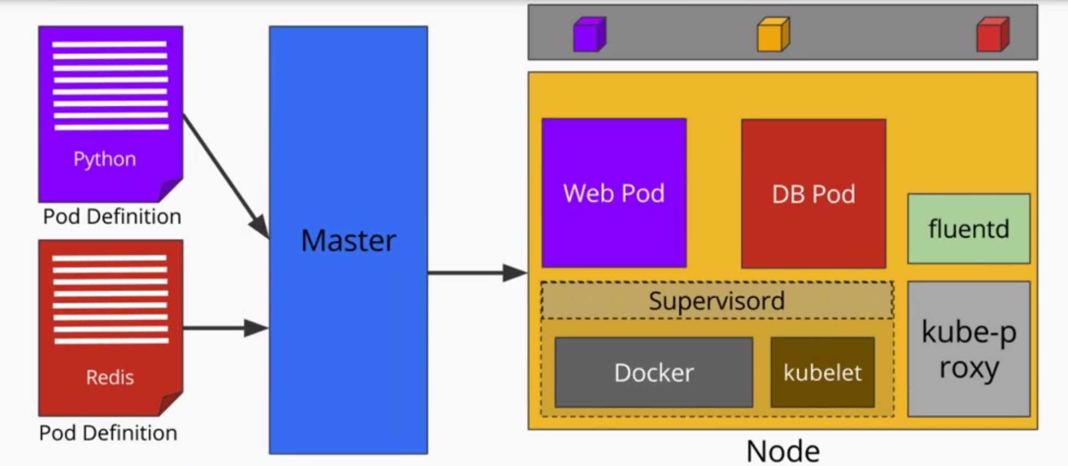
Deploying Pods
siva@way2learnonline.com

Slide 13
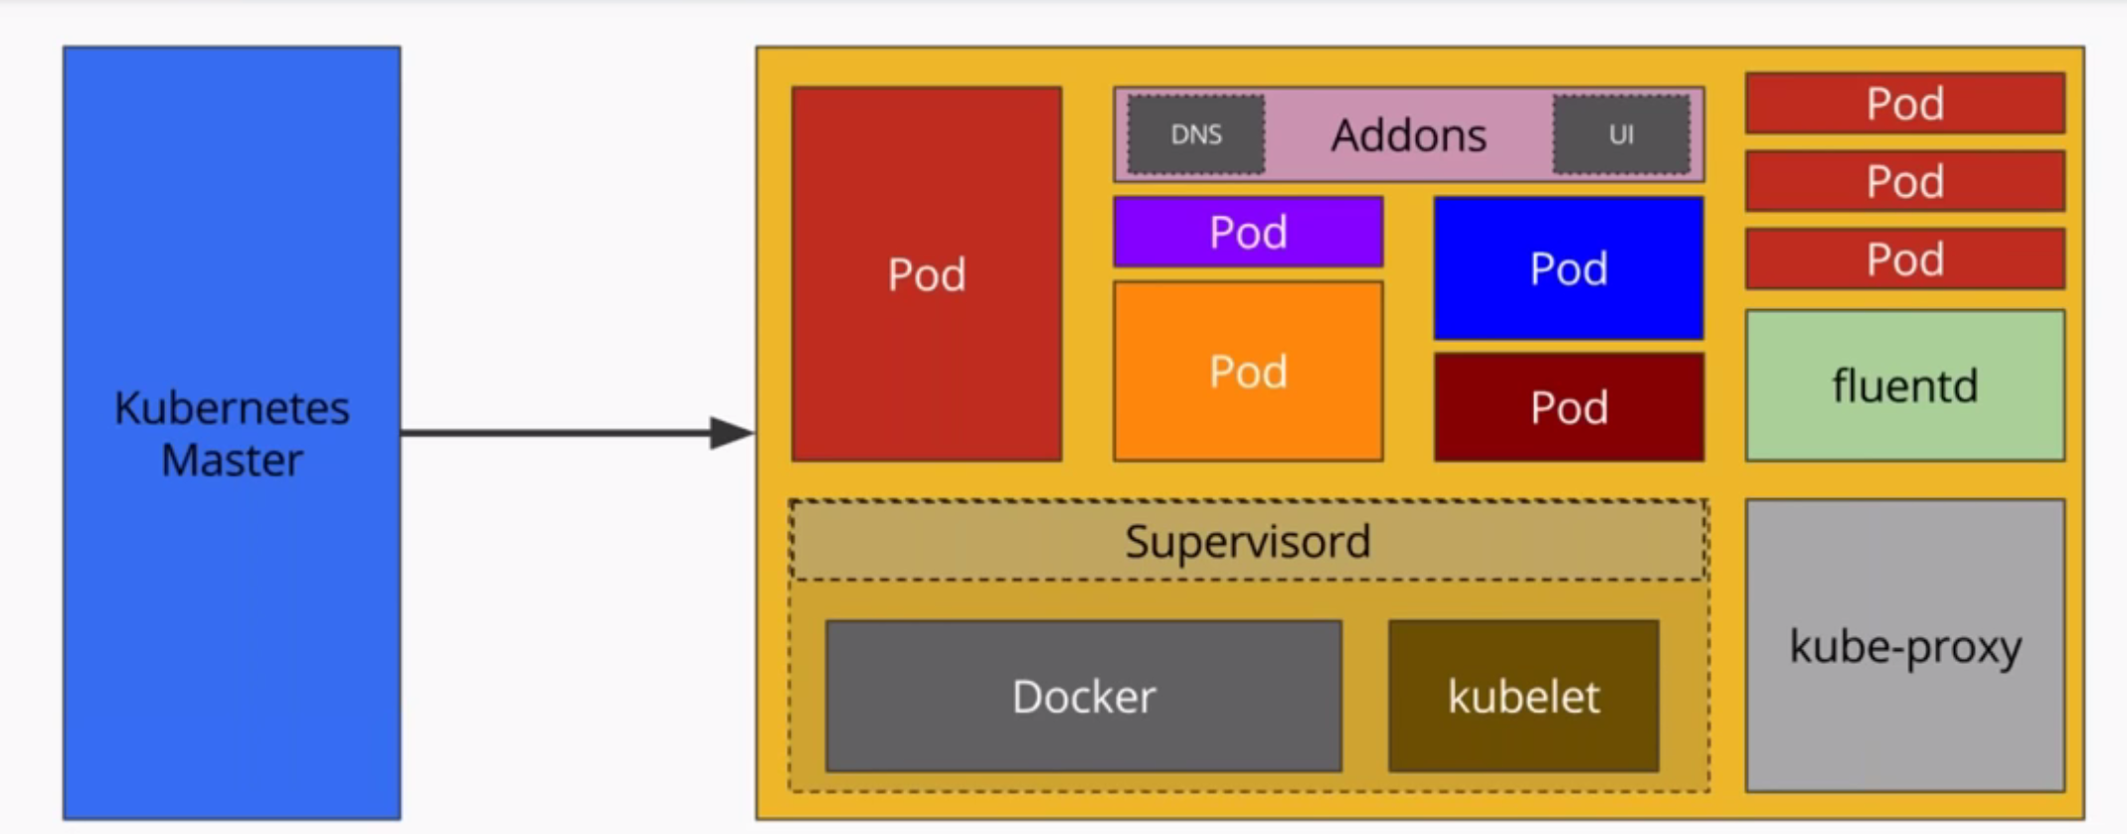
Kubernetes Node
siva@way2learnonline.com

Slide 14
What is Kube proxy ?
Kube proxy is responsible for maintaining the entire network configuration.
It maintains distributed network across all the nodes
It maipulates the iptables on each node so that one pod can talk to another pod ,one node can talk to another node and once container can talk to another container
It also exposes services
siva@way2learnonline.com

Slide 15
What is Kubelet?
Kubelet is an agent to which API server talks to.
Kubelet is also responsible for reporting the health of pods in this node to controller inside the master
Docker and Kubelet are packaged into supervisord .
Supervisord is a process manager which can run multiple processes under one parent process. It will ensure that docker and kubelet are running all the time
siva@way2learnonline.com

Slide 16
What is fluentd ?
Fluentd is the log manager
siva@way2learnonline.com

Slide 17
What are Services?
We want to expose set of pods both internally and externally.
Services are essentially endpoints which allow pods to be exposed internally and externally
I want to expose a db pod and that should be accessible with in the cluster and not to external world.
I can create a service of type ClusterIP
I want to expose a webserver pod to external world . So, i can created a service of type NodePort
siva@way2learnonline.com

Slide 18
Services
Creating a service will create an endoint for your pod(s)
  ClusterIP : a virtual ip address reachable only within the cluster’
  NodePort : A port that is same on each node that is also reachable externally
siva@way2learnonline.com

Slide 19
Services
An Abstraction to define alogical set of pods bound by a policy to access them
Services are exposed through internal and external endpoints
Interfaces with kubeproxy to maintain iptables
siva@way2learnonline.com

Slide 20
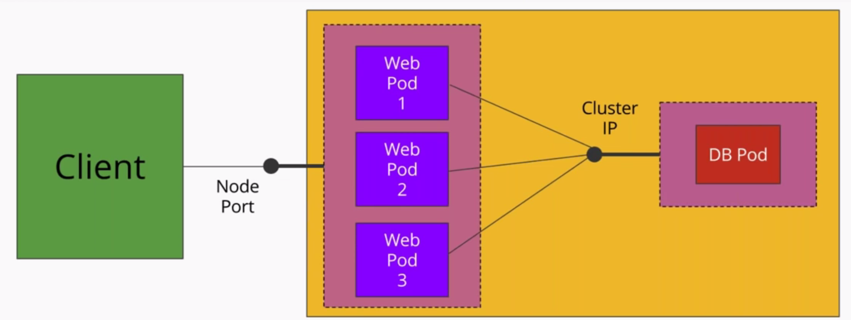
Exposing Services
siva@way2learnonline.com

Slide 21
Replication Set
Replication Set is next genertion Replication Controller
It supports a new selector that can do selection based on filtering according to set of values
  E.g environment either dev or prod’
  Not only based on equality like ReplicationController
    i.e environment==dev
Replication Set is used by deployment object
siva@way2learnonline.com

Slide 22
Deployments
A deployment is a declaration in kubernates that allows you to do app deployments and updates
When using deployment object you define the state of your application
  Kubernetes will make sure that cluster matches your desired state
Just using Replication Controller or Replication set might be cumbersome to deploy your applications
siva@way2learnonline.com

Slide 23
Deployments
With Deployment you can
  Create a deployment (e.g deploying your app)
  Update a deployment(e.g deploying a new version)
  Rolling Updates (with Zero downtime)
  Rollback to a previous version
siva@way2learnonline.com

Slide 24
Useful commands
Kubectl get deployments
Kubectl get rs
Kubectl get pods –show-labels
Kubectl rollout status deployment/helloworld-deployment
Kubectl set image deployment/helloworld-deployment k8s-demo=k8s-demo:2
Kubectl edit deployment/helloworld-deployment
Kubectl rollout history deployment/helloworld-deployment
Kubectl rollout undo deployment/helloworld-deployment
Kubectl rollout undo deployment/helloworld-deployment --to-verion=n
siva@way2learnonline.com

