Slide 1
OAUTH2
siva@way2learnonline.com

Slide 2
OAuth Actors
Resource Owner
Resource Server
Client Application
Authorization Server
siva@way2learnonline.com

Slide 3
oAuth Grant Types
Authorization Code Grant
Implicit Grant
Resource Owner Credentials Grant (Password Grant)
Cleint Credentials Grant
siva@way2learnonline.com

Slide 4
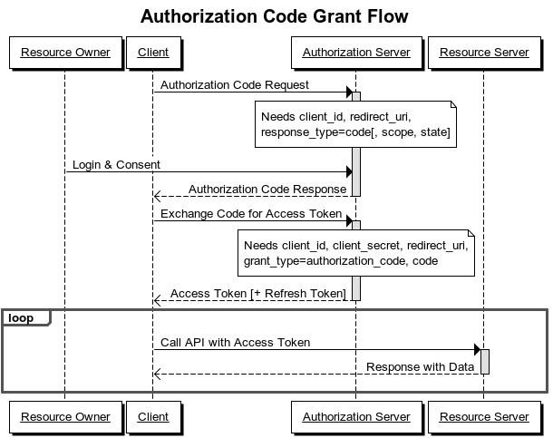
AUTHORIZATION CODE GRANT FLOW
siva@way2learnonline.com

Slide 5
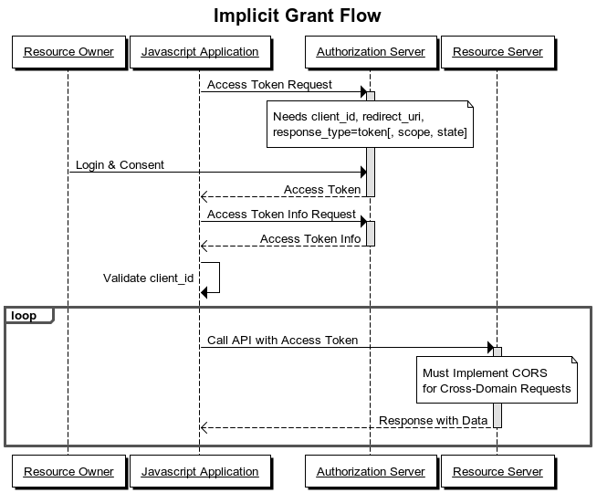
siva@way2learnonline.com

Slide 6
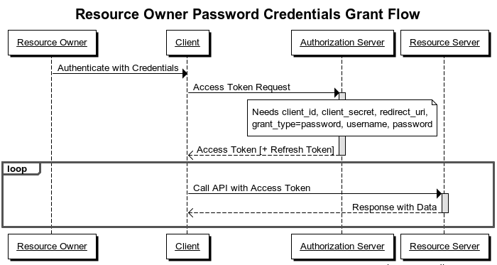
siva@way2learnonline.com

Slide 7
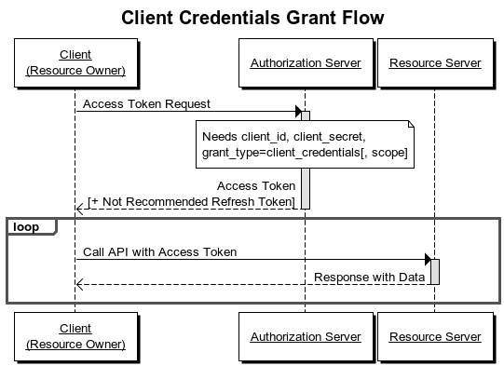
siva@way2learnonline.com

Slide 8
siva@way2learnonline.com

Slide 9
JSON WEB TOKEN (JWT)
siva@way2learnonline.com

Slide 10
What is JWT?
JWT is open standard for passing claims (security information) between 2 parties
JWT is self contained . It carries all information required with in itself
Can be passed as part of URL, form body parameter, cookie ot Http Header(x-access-token)
siva@way2learnonline.com

Slide 11
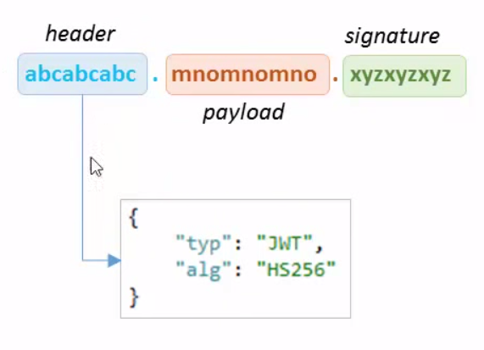
Structure of JWT
3 sections seperated with dots
  Header, payload and signature
  All are Base64Encoded
Header contains 2 parts :
  Typ – should be JWT
  alg -- Hashing Alogorithm
siva@way2learnonline.com

Slide 12
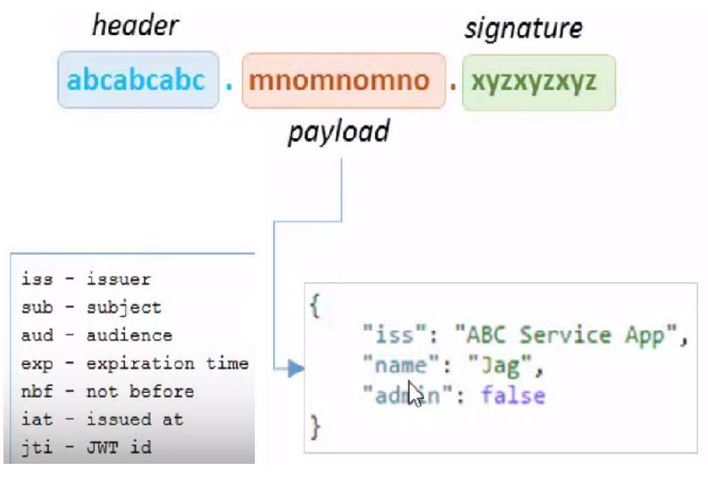
Payload
Payload contains
  Information which needs to be transmitted
  Information is Json representation of claims(key: value)
siva@way2learnonline.com

Slide 13
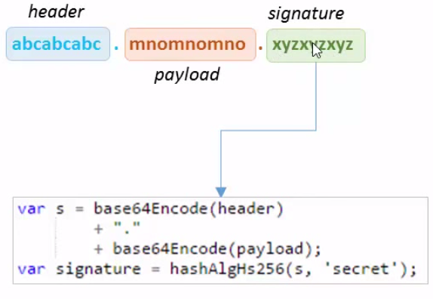
Signature
Signature is a Hash of header and payload using a secret
siva@way2learnonline.com

Slide 14
Create JWT
  http://jwtbuilder.jamiekurtz.com
Verify JWT
  http:// jwt.io
Base 64 encoding/decoding
  https://www.base64encode.org/
siva@way2learnonline.com

Slide 15
siva@way2learnonline.com

