Slide 1
Transactions In MicroServices
siva@way2learnonline.com

Slide 2
Use Case
“credit card bill payment" is a composite operation across two services. The debit and credit operations should happen together or not happen at all.
siva@way2learnonline.com
Notes:
Good Article
https://dzone.com/articles/transactions-in-microservices

Slide 3

Compensating Transactions
If the composite service detects a failure in credit operation after executing debit operation, it will have to reverse the debit operation by posting an equivalent credit entry. This credit entry is a compensating transaction.
siva@way2learnonline.com

Slide 4
There are scenarios that can affect the transaction integrity with the compensation strategy.
One of the scenarios is when composite service fails after executing a debit operation before it can execute credit operation.
Multiple patterns can be used to handle failure during the transaction.
  State Store.
  Routing Slip.
  Process Manager.
siva@way2learnonline.com

Slide 5
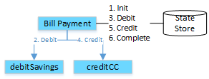
State Store
Composite service records all the state changes in a state store.
In case of failure, state store can be used to find and recover incomplete transactions.
siva@way2learnonline.com

Slide 6
Routing Slip
Composite service creates a message with two request commands (a debit and a credit instruction) in a routing slip.
This message is given to the debitSavings service from the routing slip.
The debitSavings service executes the first command and enriches the routing slip before handing message to credit service that completes the credit operation.
If there is a failure, the message is sent to an error queue, where the composite service can look at state and error status and compensate if required.
siva@way2learnonline.com

Slide 7
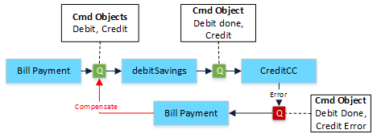
siva@way2learnonline.com

Slide 8
Process Manager
An alternative to routing slip approach is the Process Manager, which listens to events generated by Debit and Credit Operations and decides on compensating or completing the transaction
siva@way2learnonline.com

Slide 9
SAGAS
A saga is a sequence of local transactions.
Each local transaction updates the database and publishes a message or event to trigger the next local transaction in the saga.
If a local transaction fails because it violates a business rule then the saga executes a series of compensating transactions that undo the changes that were made by the preceding local transactions.
siva@way2learnonline.com
Notes:
https://microservices.io/patterns/data/saga.html

Slide 10
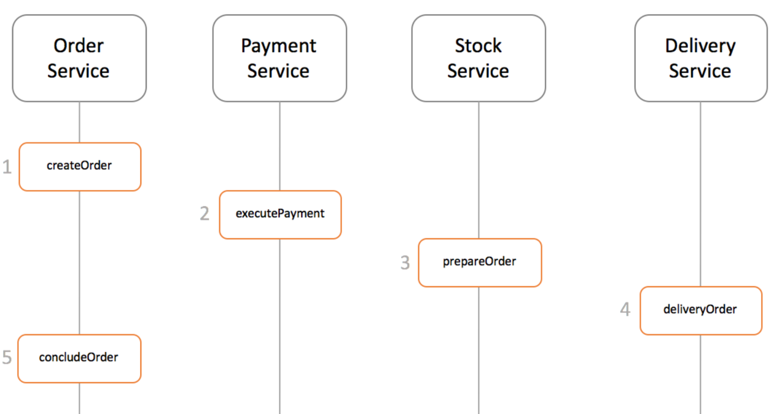
siva@way2learnonline.com

Slide 11
Ways to implement Coordination Sagas
There are two ways of coordination sagas:
  Choreography - each local transaction publishes domain events that trigger local transactions in other services
  Orchestration - an orchestrator (object) tells the participants what local transactions to execute
siva@way2learnonline.com

Slide 12
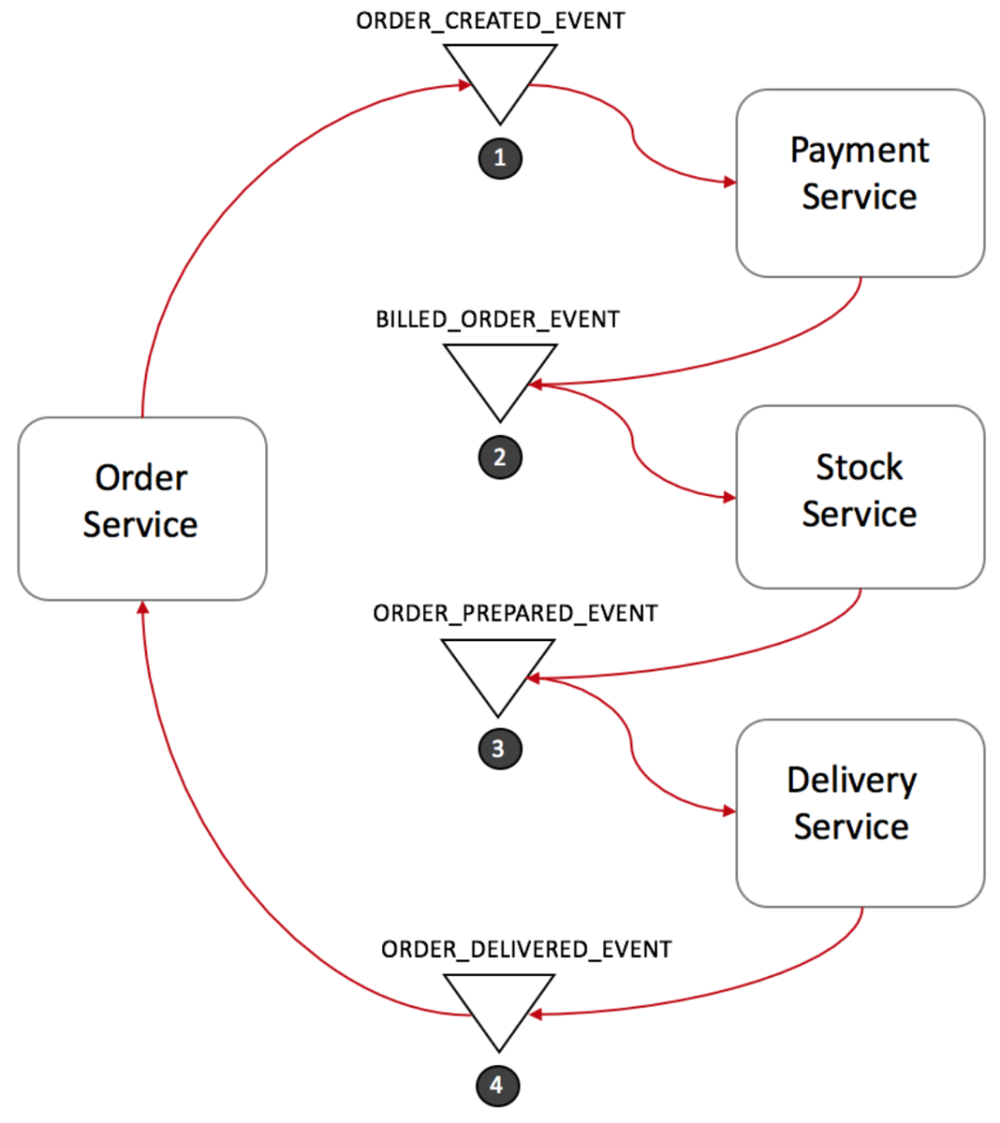
Choreography based saga
siva@way2learnonline.com

Slide 13
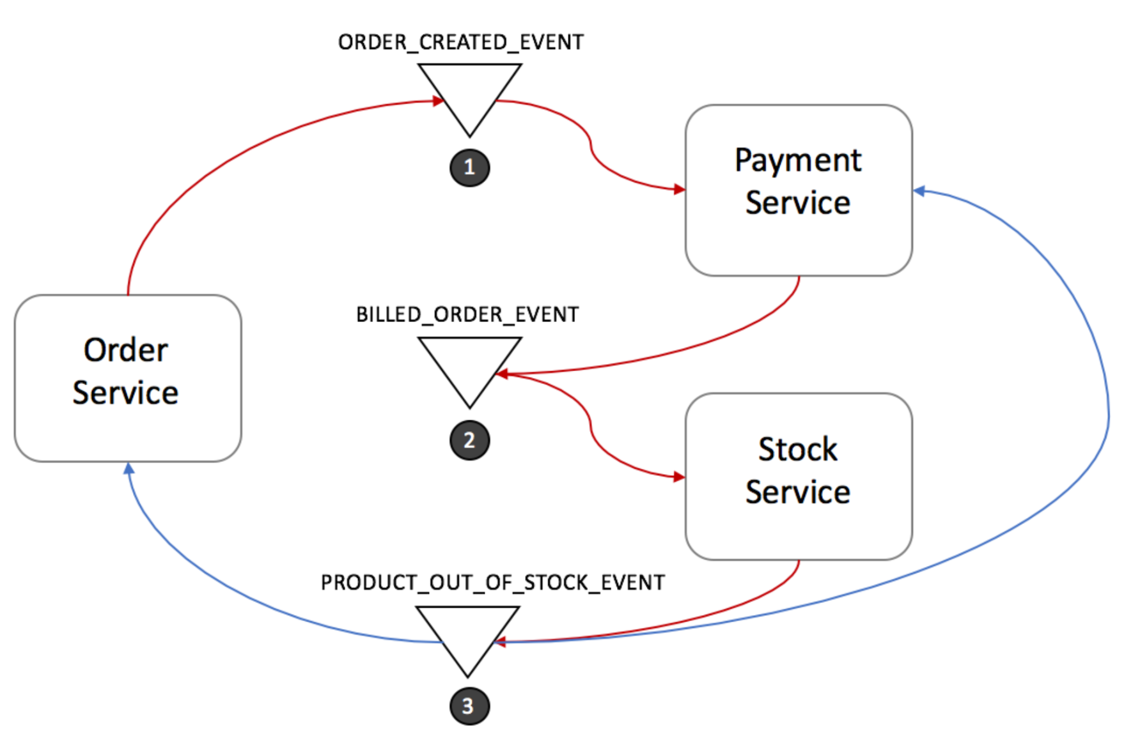
siva@way2learnonline.com

Slide 14
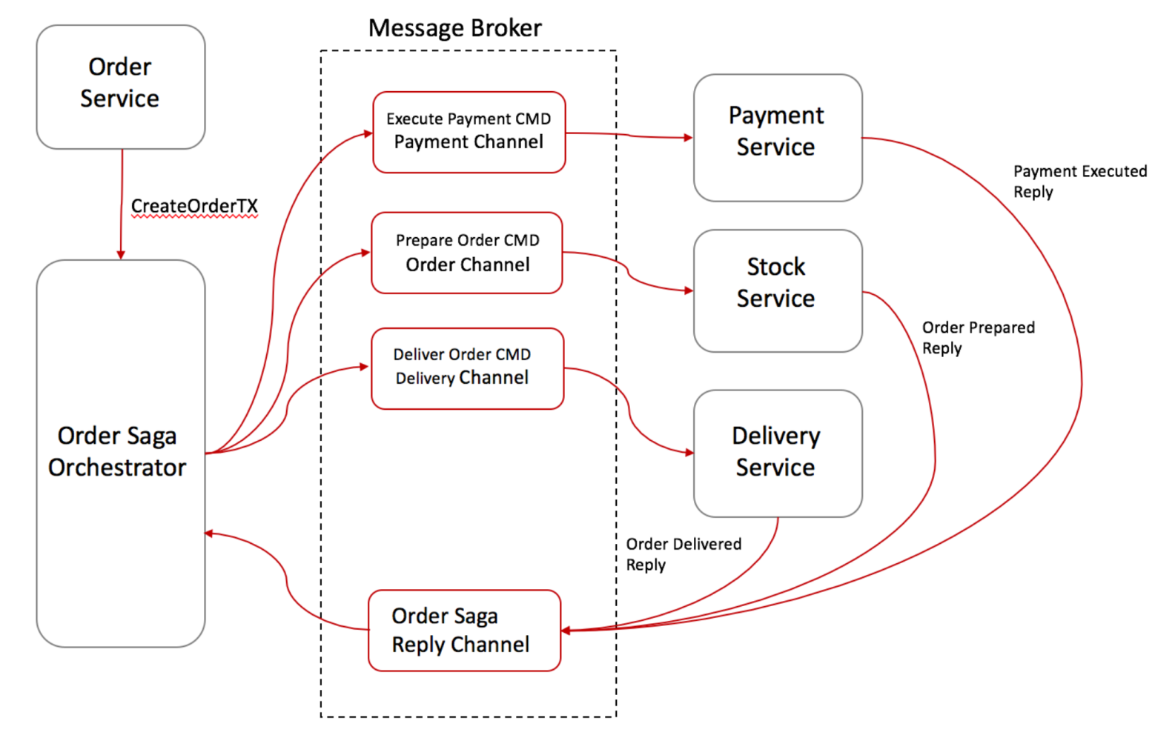
Orchestration-based saga
siva@way2learnonline.com

Slide 15
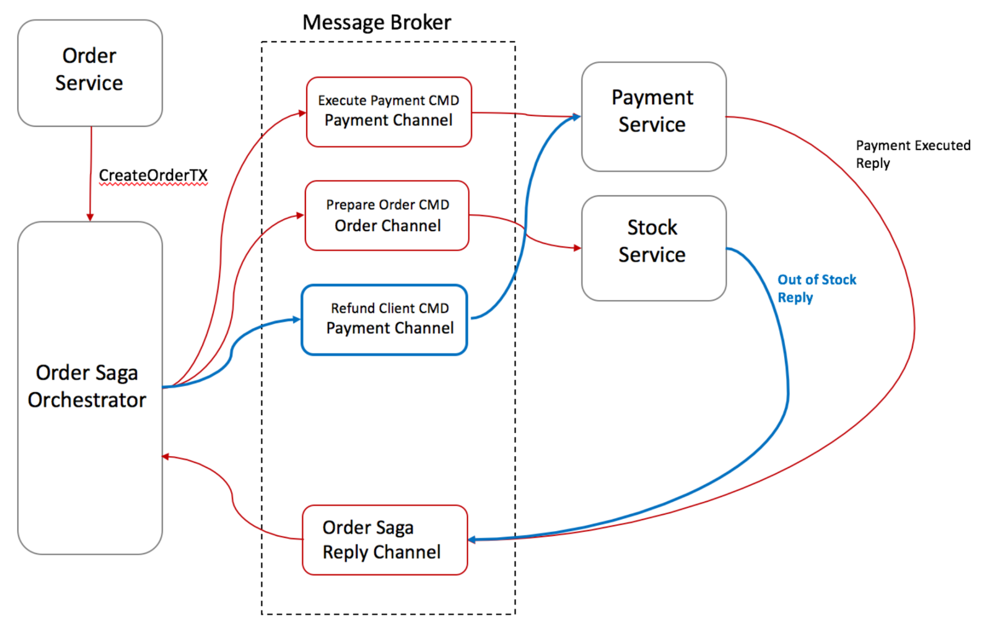
Rolling back in Saga’s Command/Orchestration
siva@way2learnonline.com

Slide 16
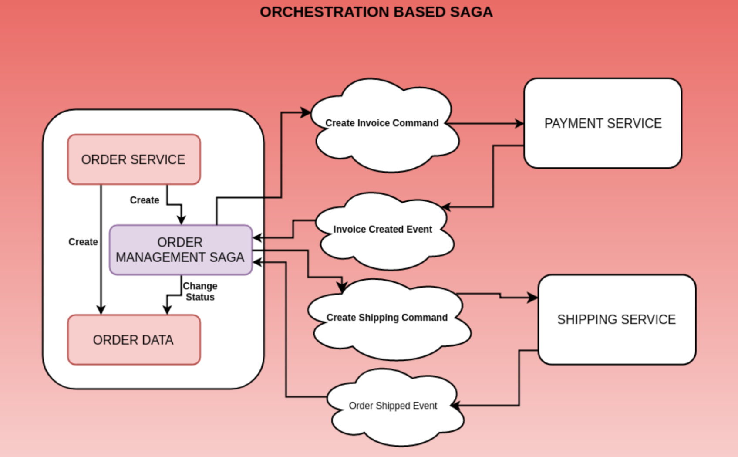
siva@way2learnonline.com

