Slide 1
CQRS
siva@way2learnonline.com

Slide 2
What is Event Sourcing?
The concept behind event sourcing is that every change to the state of the application should be captured.
In other words, every action performed on an application entity should be persisted.
Then, we can query those events.
We can also use the list of events to reconstruct the current state of the object.
siva@way2learnonline.com

Slide 3
Accounting application example
let’s assume the following transactions occur on a particular account:
Creation of account with initial balance of 100 USD.
Account set to ACTIVE status.
A friend paid some money back for sharing a meal. Deposit of 55 USD in the account.
You bought an ice-cream for your girl-friend. Withdrawal of 20 USD.
The girl-friend didn’t like the ice-cream. And so, you had to buy another one. Withdrawal of 50 USD.
siva@way2learnonline.com

Slide 4
You forgot to pay the rent. Landlord imposed a penalty. Withdrawal of 100 USD.
Account set to HOLD status because of negative balance.
Deposit 100 USD to the account.
Account set to ACTIVE status.
siva@way2learnonline.com

Slide 5
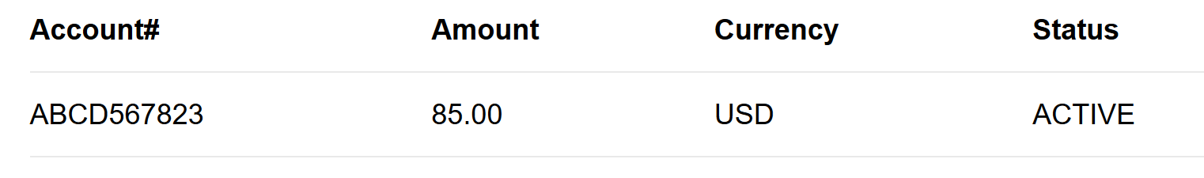
In a typical data store, the account details, after all the above transactions have occurred, will be as follows:
siva@way2learnonline.com

Slide 6
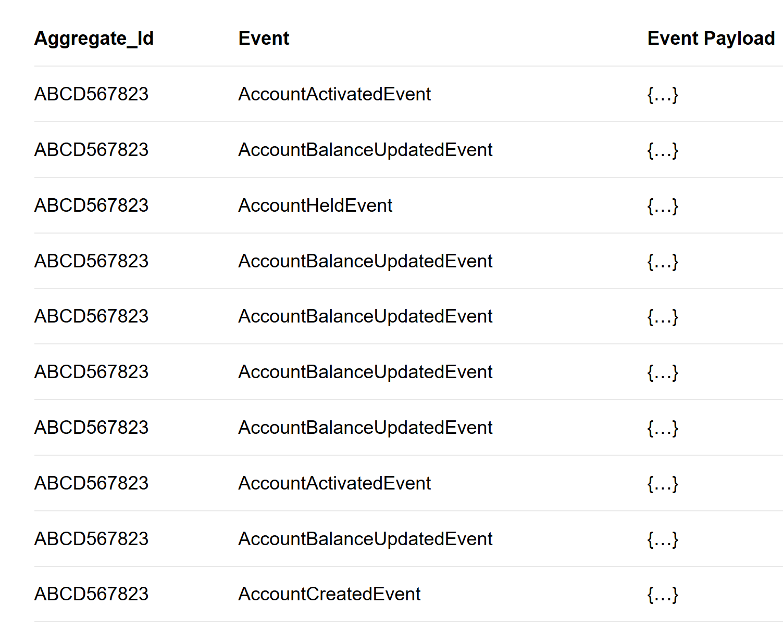
Data in Event Store
siva@way2learnonline.com

Slide 7
Why Event Sourcing?
Event Sourcing is one of the best ways to atomically update state and publish an event.
The traditional way is to persist the current state of the aggregate.
However, in Event Sourcing the aggregate is stored as a sequence of events.
Basically, for every state change a new event is created and added to the event store. Such an operation is inherently atomic.
siva@way2learnonline.com

Slide 8
Event Store maintains a complete history of the aggregate. This makes it extremely easy to reconstruct the historical state of the object.
In case of any production issues, you can reconstruct the state of the object at the time of issue to investigate.
siva@way2learnonline.com

Slide 9
IMPLEMENTING CQRS AND EVENT SOURCING
siva@way2learnonline.com

Slide 10
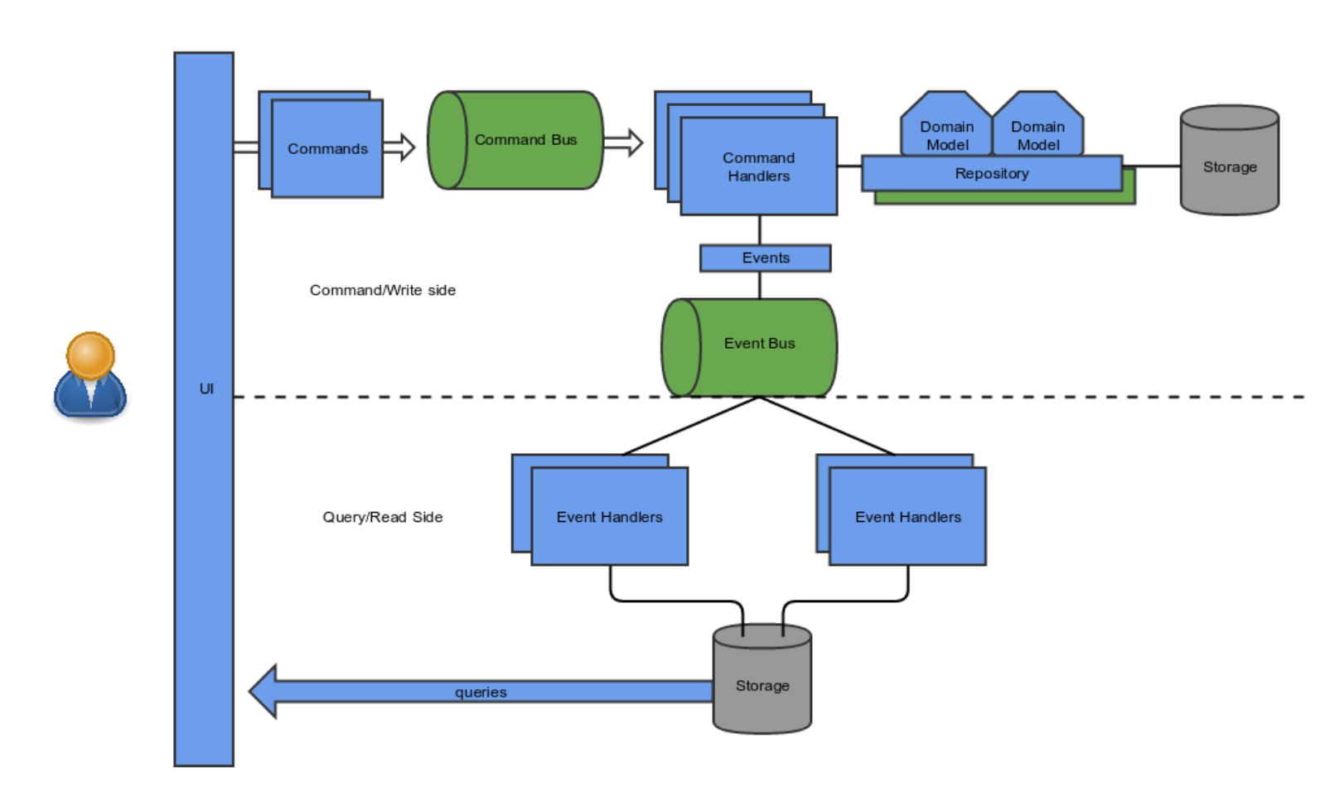
siva@way2learnonline.com

Slide 11
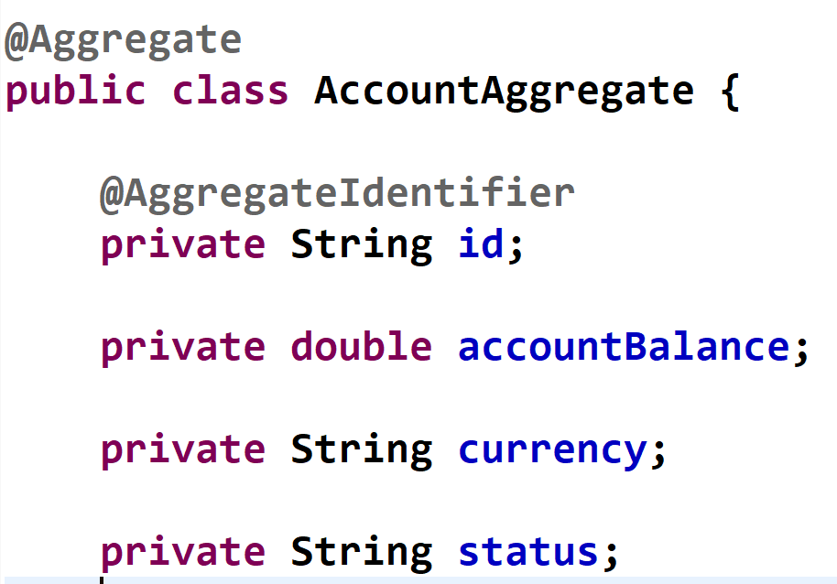
Account Aggregate
@Aggregate annotation tells Axon that this entity will be managed by Axon
siva@way2learnonline.com

Slide 12
Modelling the Commands and Events
Axon works on the concept of commands and events. To elaborate, Commands are user-initiated actions that can change the state of your aggregate.
However, Events are the actual changing of that state.
Eg: Create Account Command, Credit Money Command and Debit Money Command.
and
Account Created Event, Money Credited Event and Money Debited Event.
siva@way2learnonline.com

Slide 13
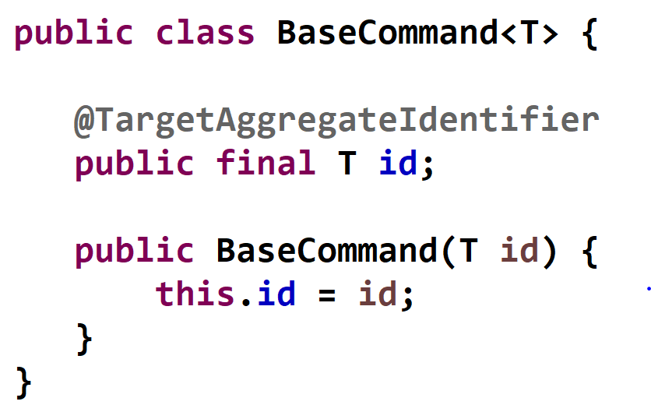
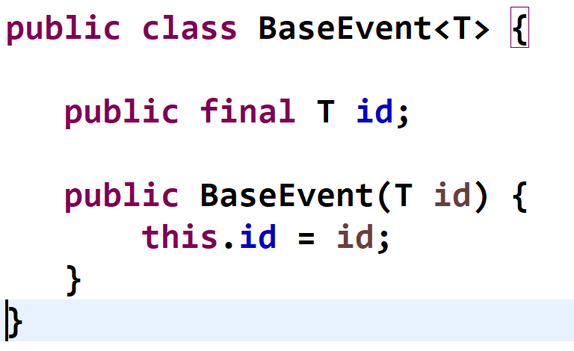
siva@way2learnonline.com

Slide 14
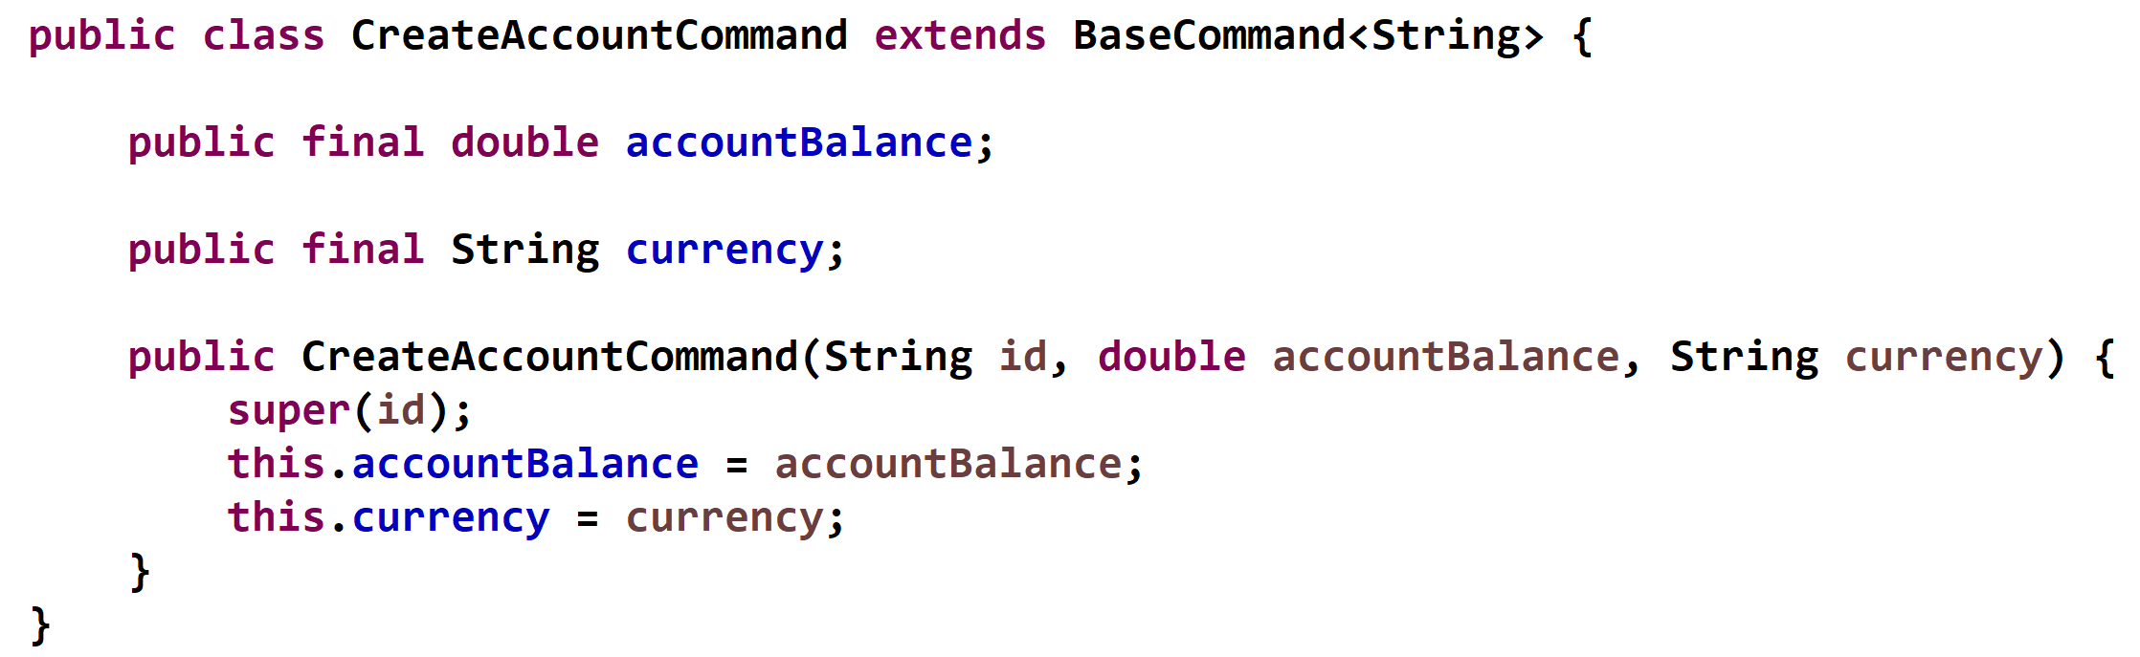
siva@way2learnonline.com

Slide 15
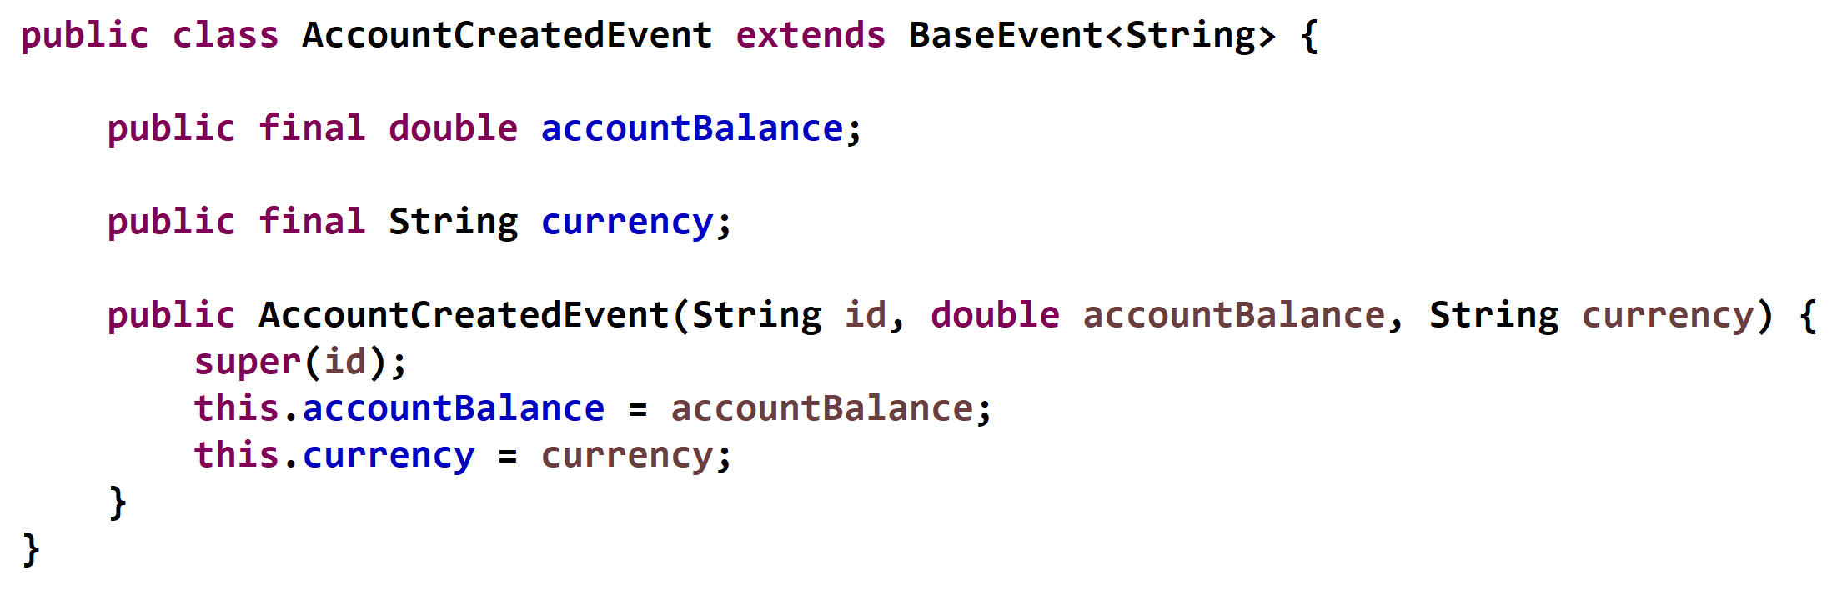
siva@way2learnonline.com

Slide 16
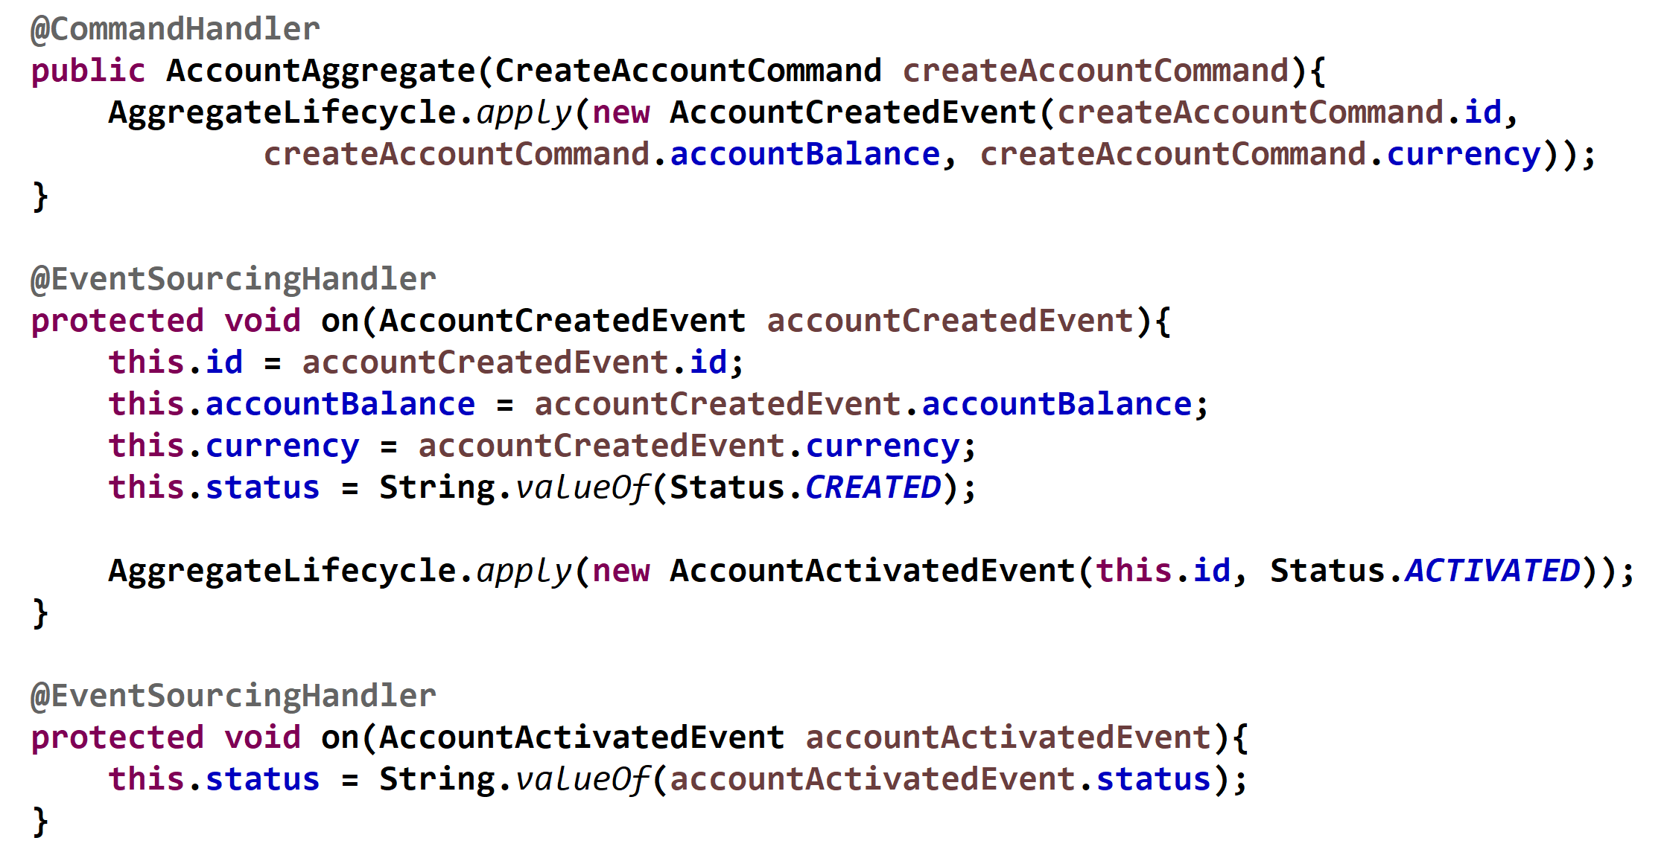
Command Handlers and Event Handlers
Handlers are methods on the Aggregate that should be invoked for a particular command or an event.
siva@way2learnonline.com

Slide 17
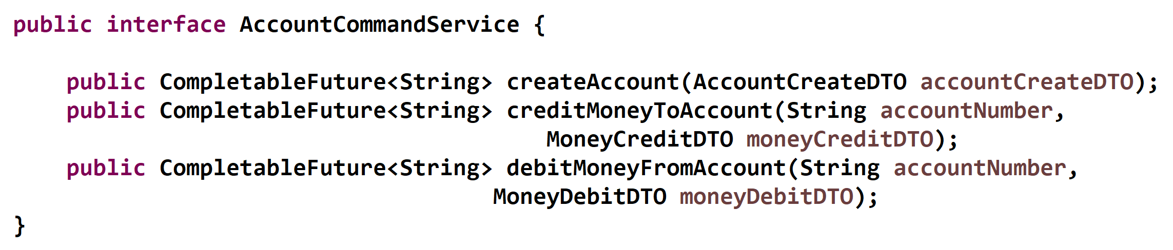
Implementing Command Service
siva@way2learnonline.com

Slide 18
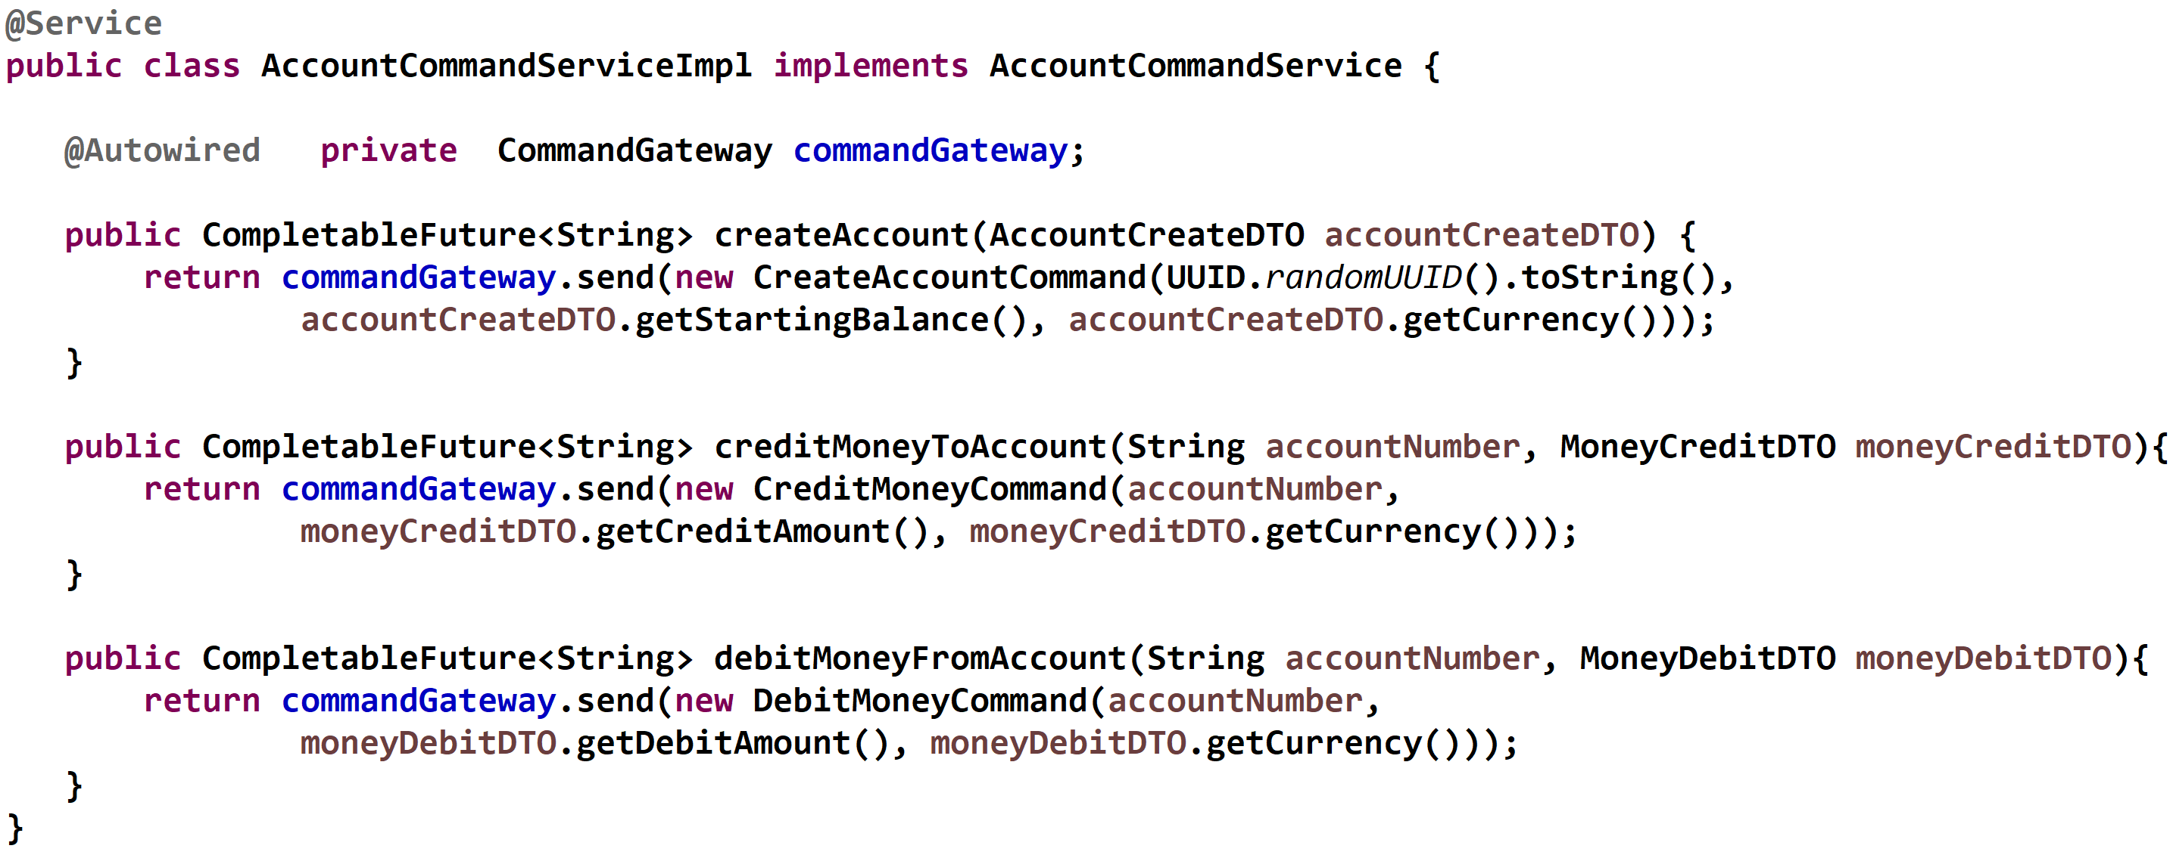
siva@way2learnonline.com

Slide 19
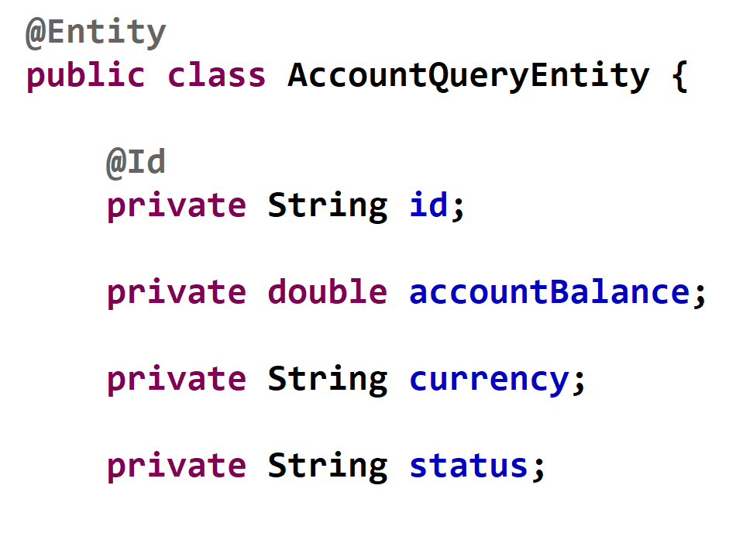
Entity on Query Side
siva@way2learnonline.com

Slide 20
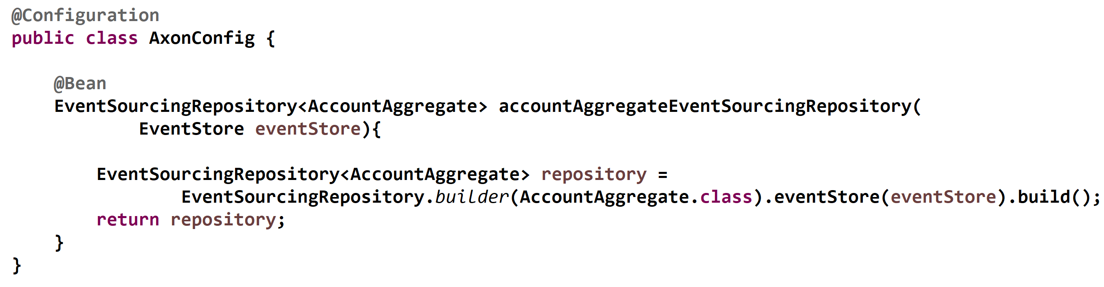
siva@way2learnonline.com

Slide 21
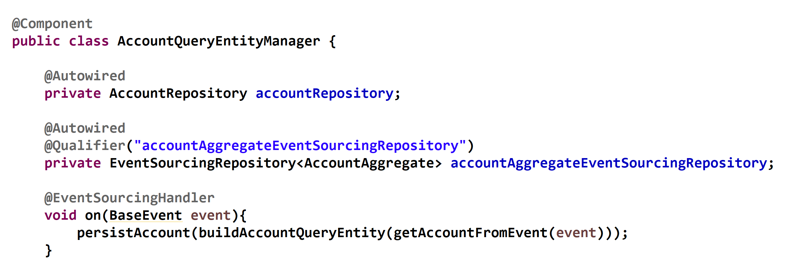
siva@way2learnonline.com

Slide 22
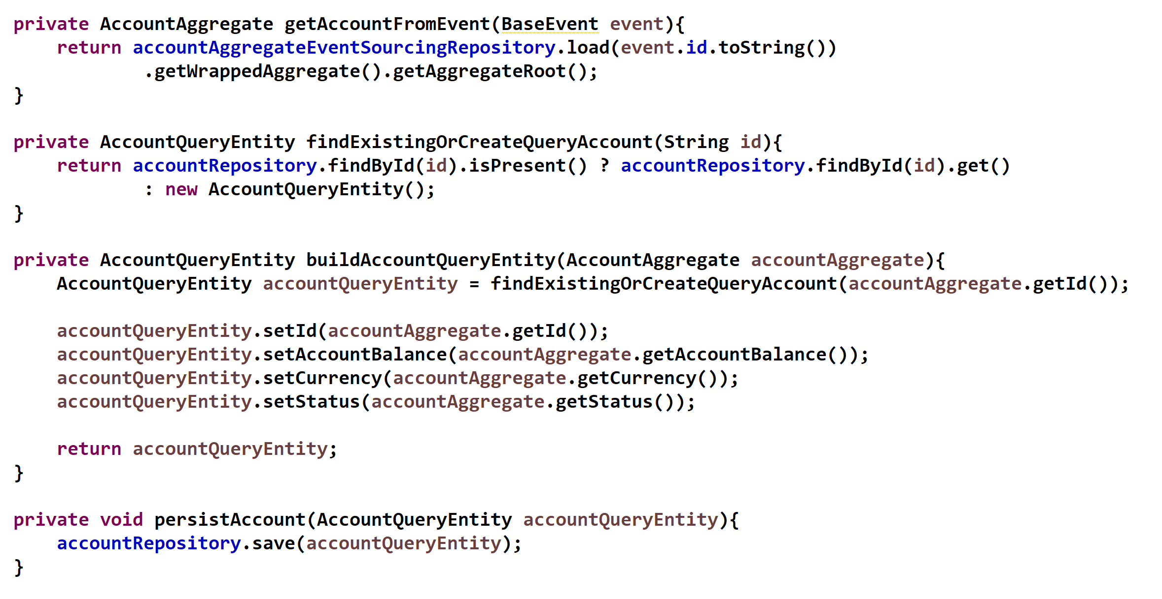
siva@way2learnonline.com

Slide 23
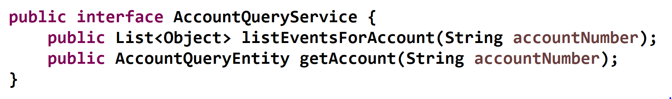
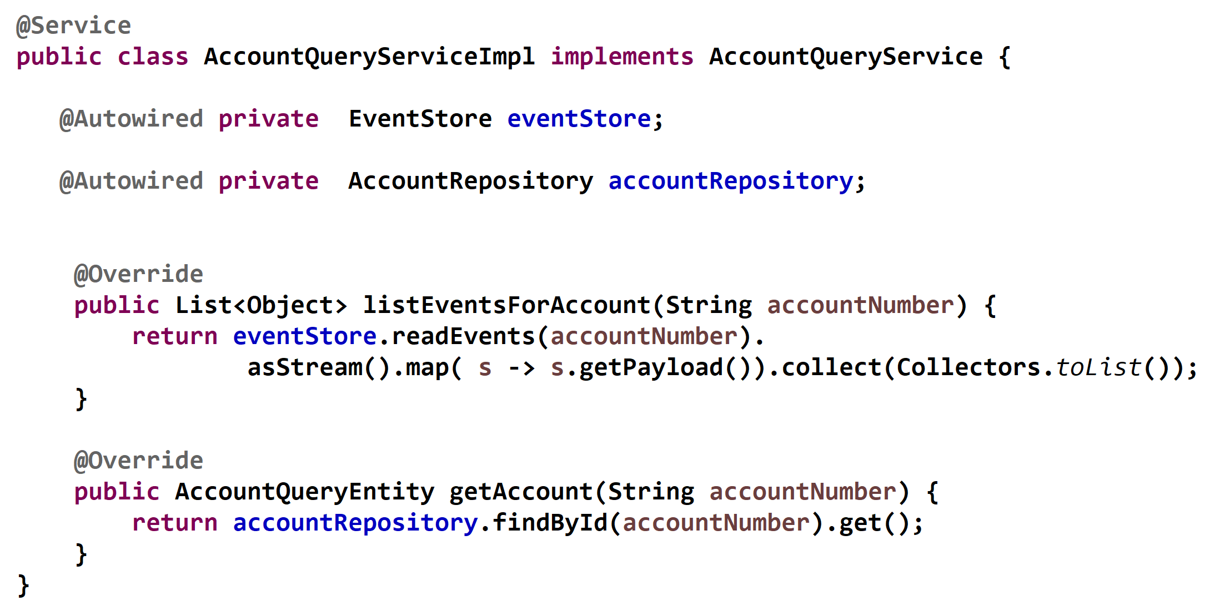
siva@way2learnonline.com

Slide 24
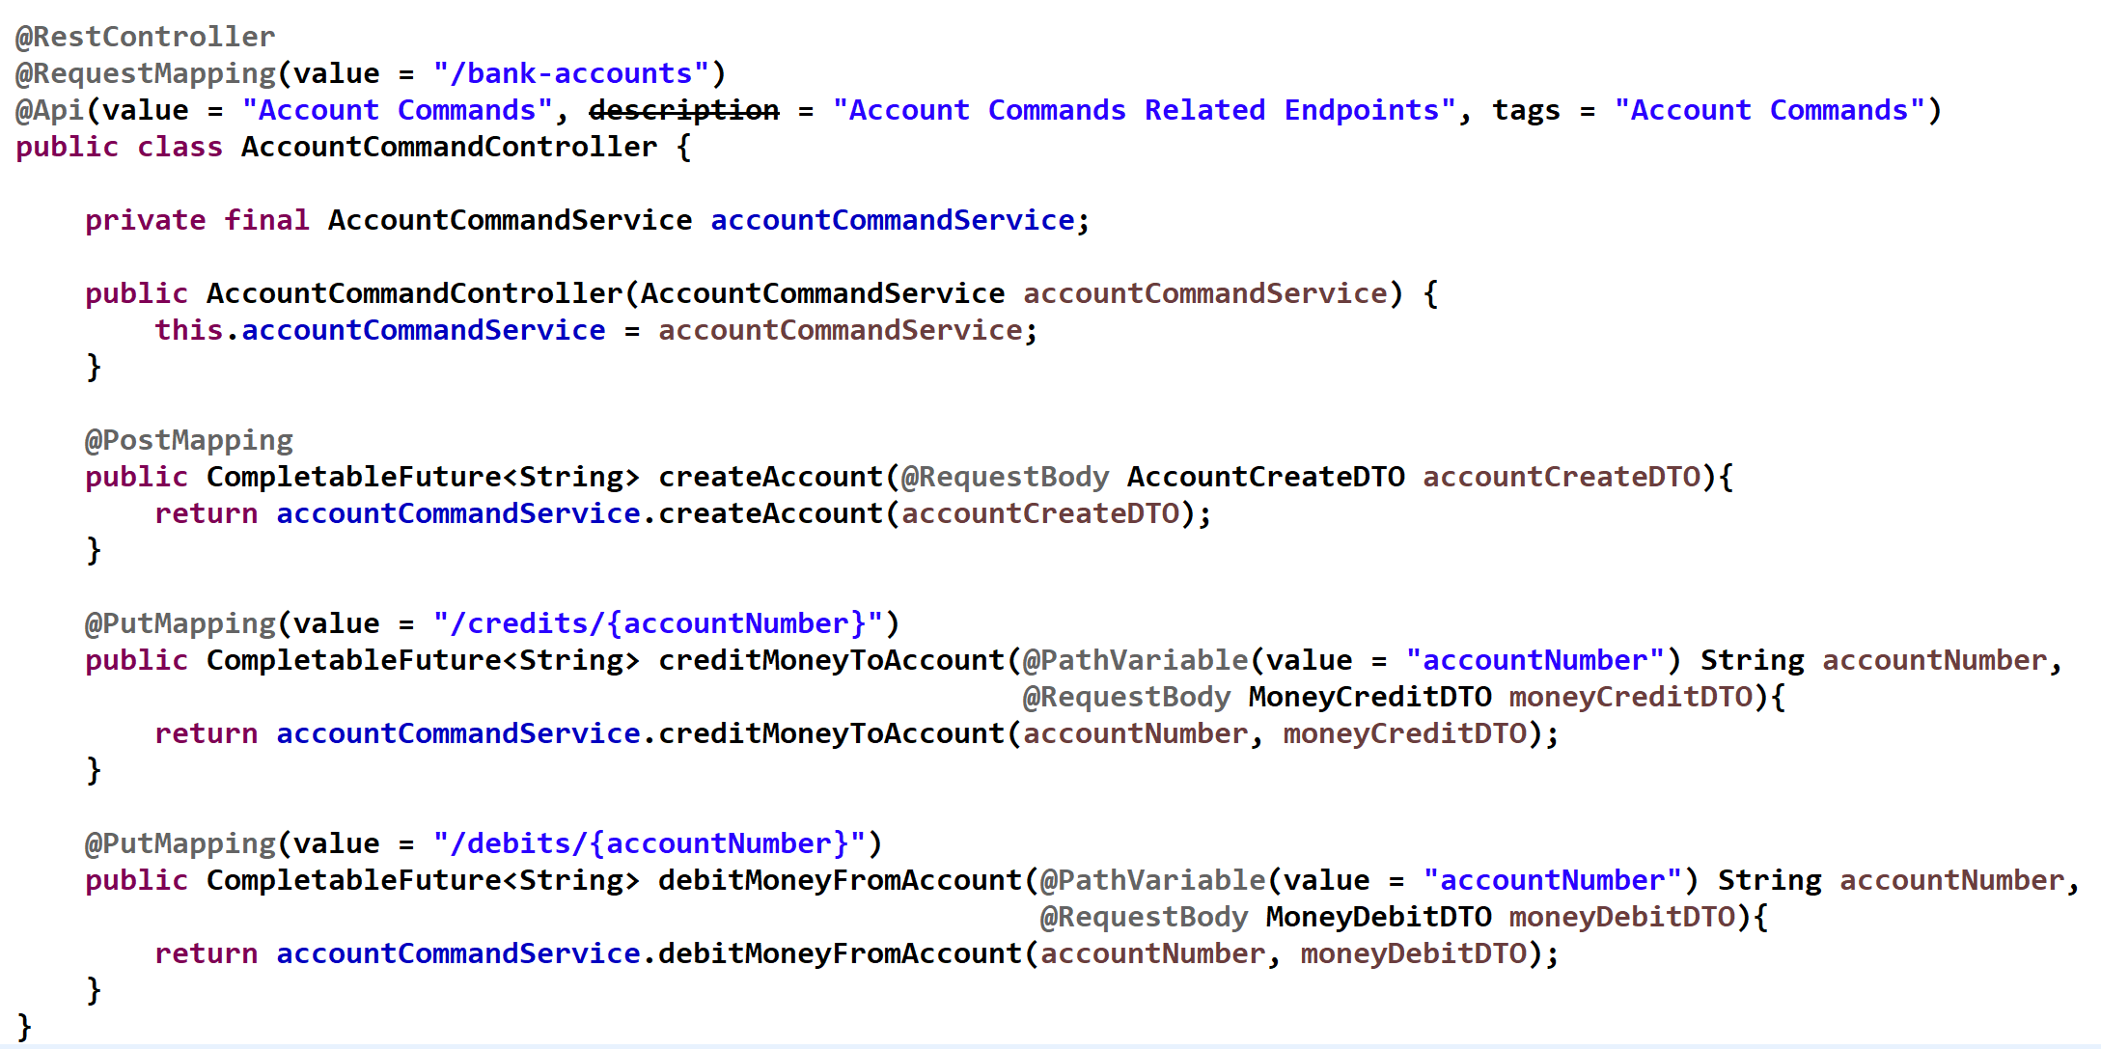
Controllers
siva@way2learnonline.com

Slide 25
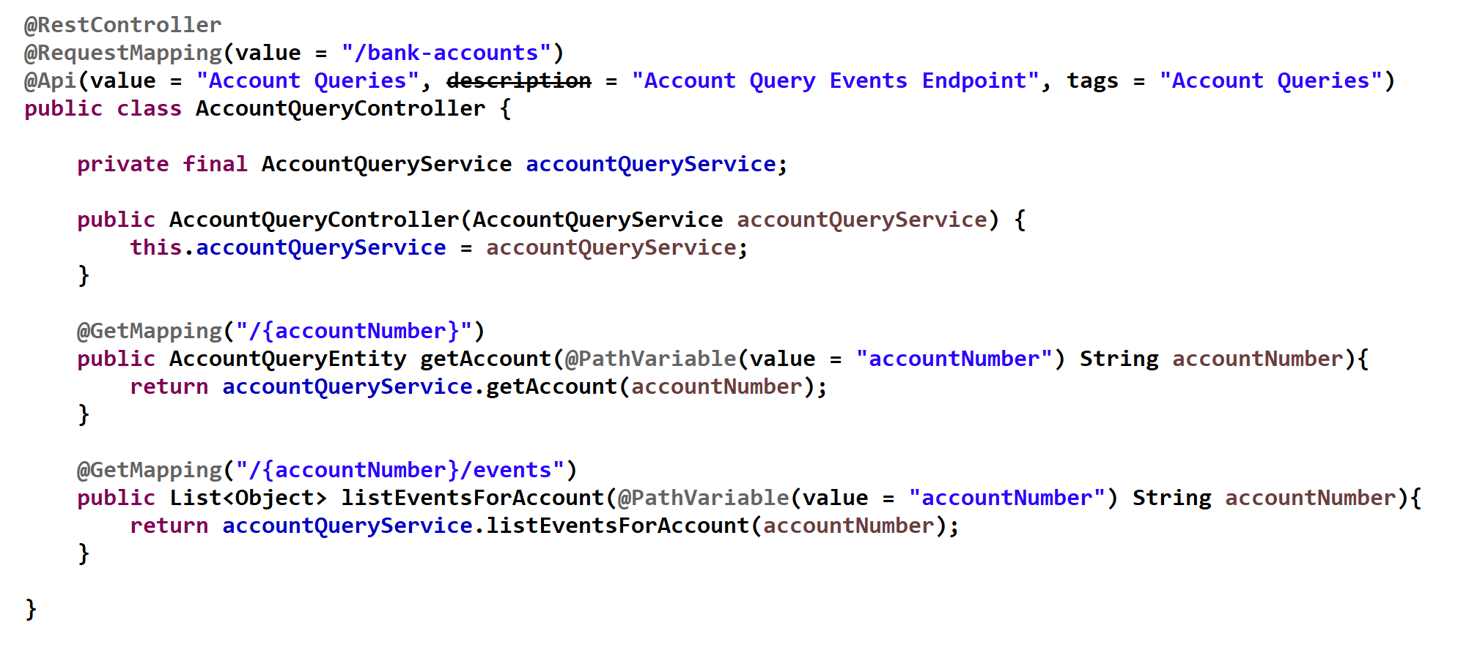
siva@way2learnonline.com

Slide 26
http://localhost:8080/swagger-ui.html.
siva@way2learnonline.com

